Slide 1


A Closer Look at the
CIW Community Wellbeing Survey Results for Orillia and Area
Prepared for:
Information Orillia
May 2019
Notes:
A Closer Look: A Report of the Canadian Index of Wellbeing
When referring to this report, please use this citation:
Smale, B., & Gao, M. (2019). A Closer Look at the CIW Community Wellbeing Survey Results for Orillia and Area. A report prepared for Information Orillia. Waterloo, ON: Canadian Index of Wellbeing and University of Waterloo.

Slide 2
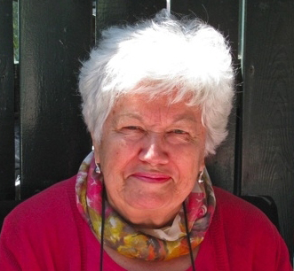
Wellbeing as a basic human right
“People are much more than the goods and services they produce! Their health and quality of life come from the conditions of their daily living – the circumstances in which they are born, grow, live, work, and age.”
The Honourable Monique Bégin
Former CIW Advisory Board Co-Chair
Former Canadian Commissioner
WHO Commission on Social Determinants of Health
Notes:
The Canadian Index of Wellbeing
This quotation by the Honourable Monique Bégin nicely summarises the essence of the CIW. We strive to move away from economic measures and to focus on those aspects of people’s lives that matter most to them and enable them to flourish.

Slide 3
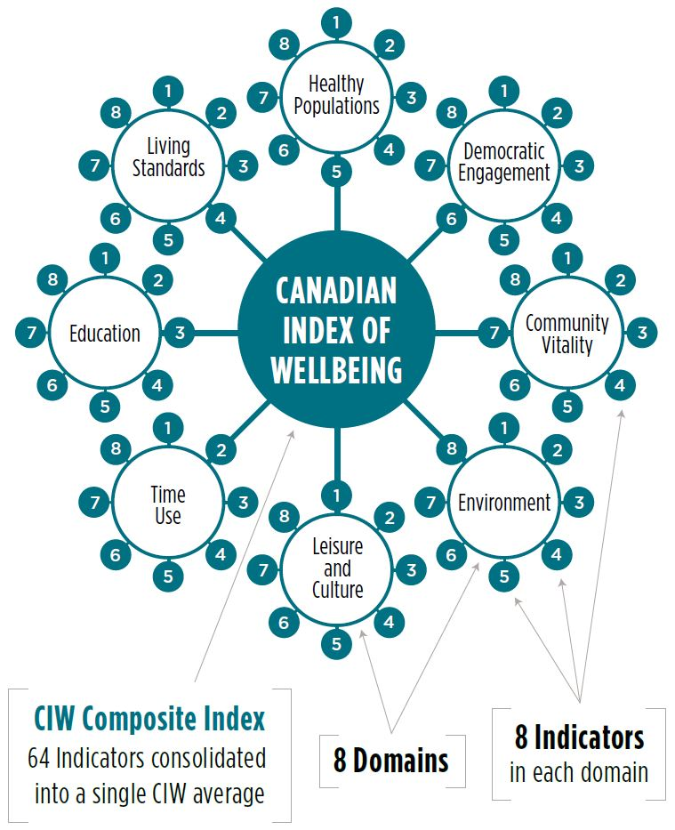

Slide 4

2018 CIW Community Wellbeing Survey

Slide 5
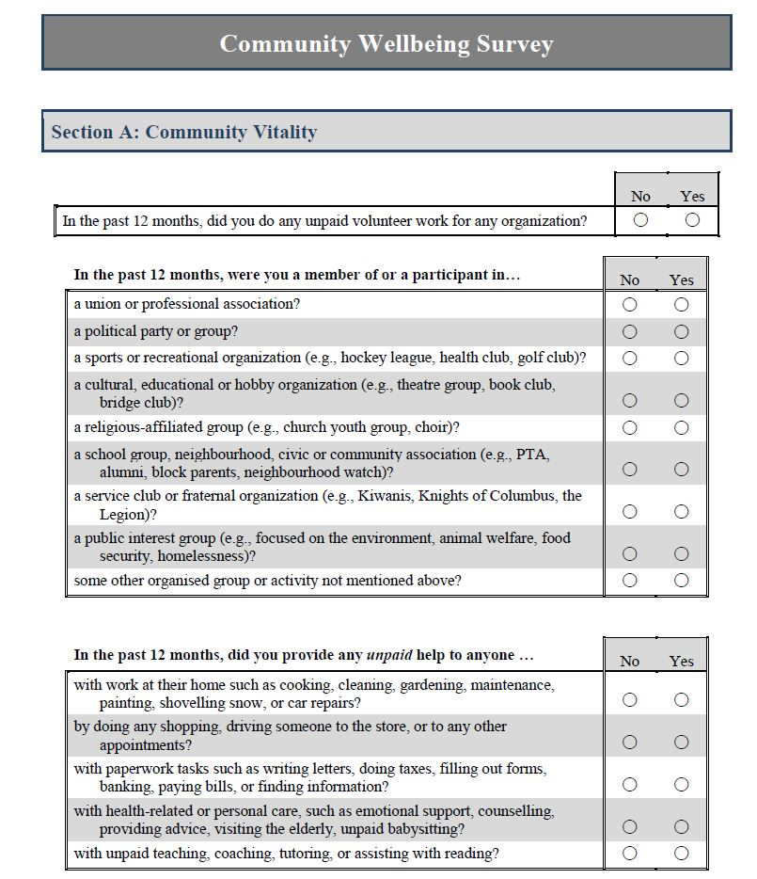
CIW Community Wellbeing Survey
Sample
Random sample of households, stratified by four municipalities in the Orillia and Area
Questionnaire
Behaviours and perceptions directly related to each of the CIW’s domains
Aspects of and overall wellbeing
Comprehensive demographics
Analysis
Technical report summarising all measures in the questionnaire
Targetted analyses on issues of local concern

Slide 6
Reliability of Sample and Results
Sample
A representative sample of almost 9,500 households from Orillia, Oro-Medonte, Ramara, and Severn were invited to participate in the survey, with additional efforts to reach the three smaller municipalities
Estimated response rate of 10.7% – above expectation for a general population survey
Weighting of data by municipality, age, and sex ensures balanced representation of voices from across Orillia and Area
Results
Careful assessment of all respondents to ensure reliable and valid responses to majority of questions on survey.
A total of 856 usable questionnaires comprised the final sample.
The margin of error is ± 3.3% (19 times out of 20) – similar to most national polls

Slide 7
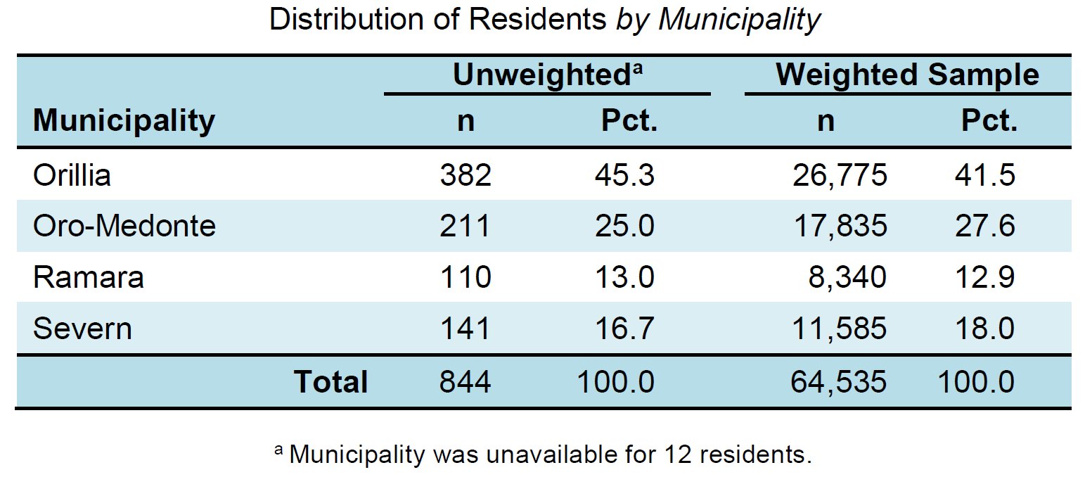
Orillia and Area Final Sample

Slide 8
Overall Wellbeing in Orillia and Area

Slide 9
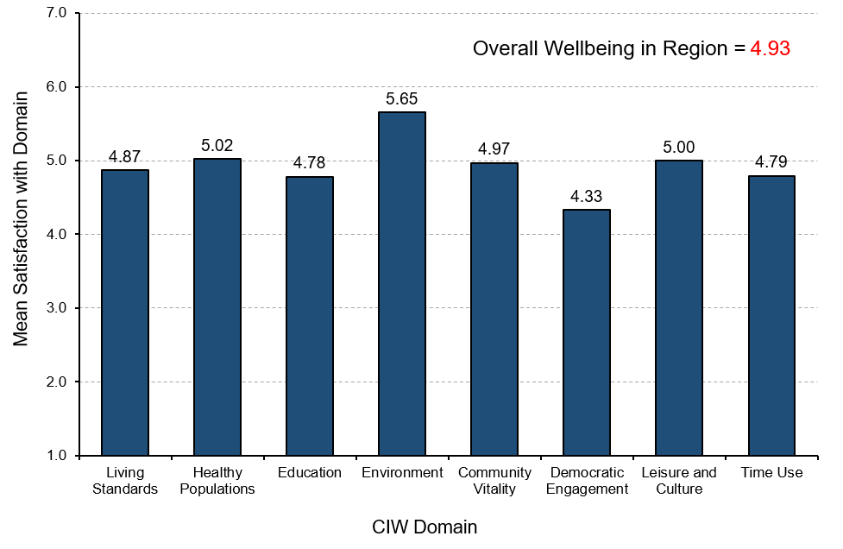
Wellbeing by Domain: Orillia and Area
Notes:
Overall Wellbeing
“How do residents report their satisfaction with different domains of wellbeing in Orillia and Area?”
Orillia and Area residents report relatively high levels of satisfaction with domains of environment, healthy populations, leisure and culture, and community vitality.
Orillia and Area residents are most satisfied with the environment domain and report the lowest satisfaction with the democratic engagement domain, which is typical of most communities where political viewpoints are most diverse.

Slide 10
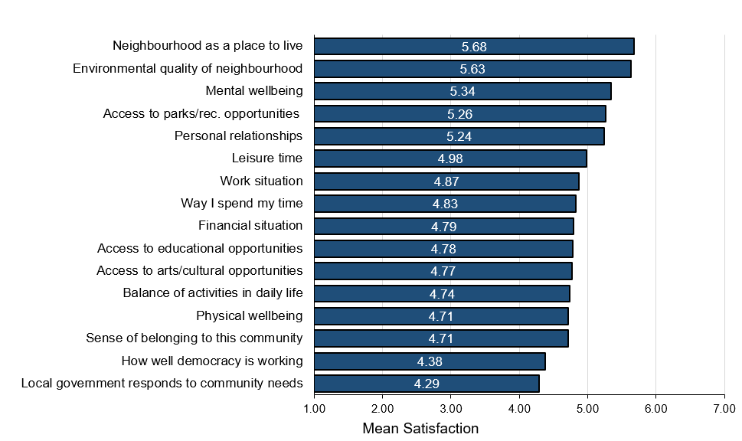
Satisfaction with Aspects of Wellbeing: Orillia and Area
Notes:
Overall Wellbeing
“How satisfied are residents with different aspects of wellbeing in Orillia and Area?”
Orillia and Area residents report high levels of satisfaction with their neighbourhood both as a place to live, with environmental quality, and in terms of mental wellbeing. Given the percentages of residents who express satisfaction with these areas, not surprisingly many also express satisfaction with access to parks and recreation opportunities and their personal relationships, which are important contributors to overall wellbeing.
Levels of satisfaction among Orillia and Area residents are comparatively lowest for how well the local government is responding to community needs, how well democracy is working in the community, and sense of belonging to the community; however, residents do still indicate satisfaction with these aspects (i.e., the lowest average score is 4.29 based on 7-point scales).

Slide 11
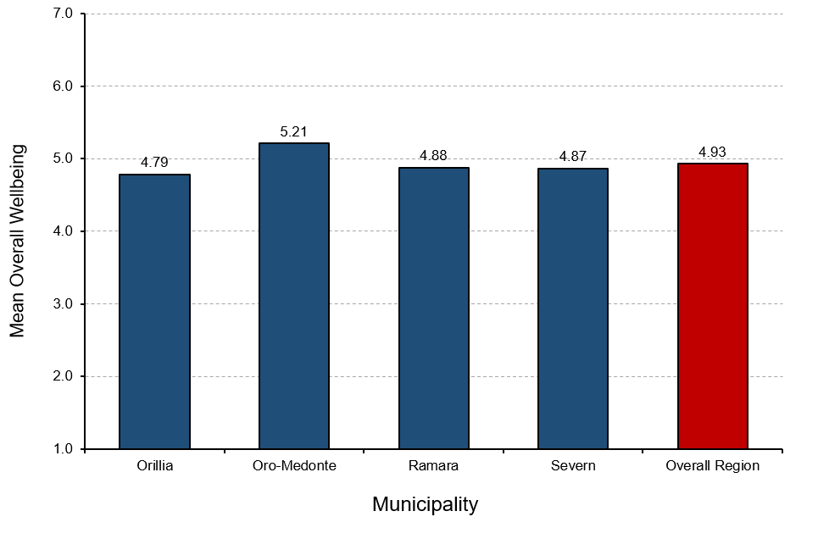
Wellbeing by Municipality: Orillia and Area
Overall Wellbeing by Municipality
Notes:
Overall Wellbeing
“How do residents living in different municipalities report their overall wellbeing?”
Overall, Orillia and Area residents report a relatively high level of wellbeing (average score is 4.93 based on a 7-point scale).
Comparatively, residents living in the townships report higher levels of wellbeing than residents living in the city. In particular, the self-rated wellbeing of residents living in Oro-Medonte is the highest, followed by Ramara and Severn. In contrast, Orillia residents report the lowest level of wellbeing, but it is still above the mid-point on the scale.

Slide 12
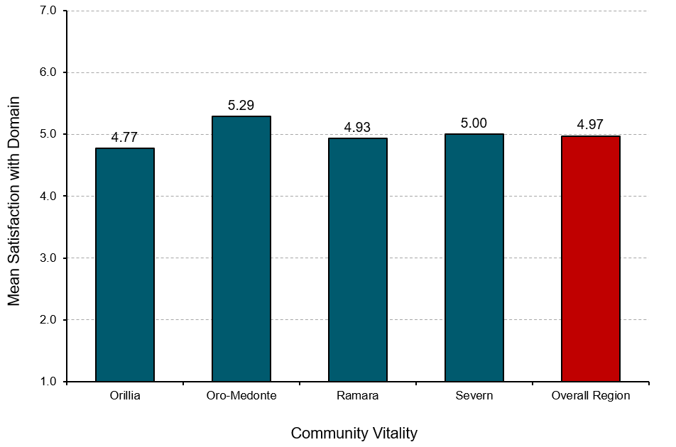
Wellbeing by Municipality: Community Vitality
Community Vitality by Municipality
Notes:
Community Vitality
“How satisfied are residents in the different municipalities with Community Vitality?”
Overall, Orillia and Area residents report a relatively high level of satisfaction with the Community Vitality domain (average score is 4.97 based on a 7-point scale).
Comparatively, residents living in the townships report higher levels of satisfaction with the Community Vitality domain than residents living in the city. In particular, people residing in Oro-Medonte report the highest level of satisfaction with this domain, followed by Severn and Ramara. In contrast, Orillia residents report the lowest level of satisfaction with this domain.

Slide 13
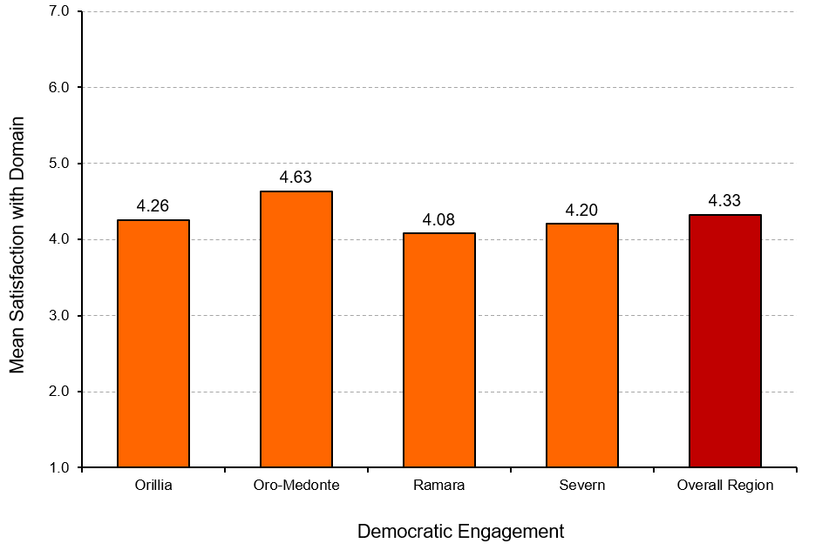
Wellbeing by Municipality: Democratic Engagement
Democratic Engagement by Municipality
Notes:
Democratic Engagement
“How satisfied are residents in the different municipalities with Democratic Engagement?”
Overall, Orillia and Area residents report somewhat high satisfaction with the Democratic Engagement domain (average score is 4.33 based on a 7-point scale).
Residents living in the townships and city have no substantial differences regarding levels of satisfaction with the Democratic Engagement domain. Residents living in Oro-Medonte report the highest satisfaction with this domain, whereas Ramara residents report the lowest satisfaction.

Slide 14
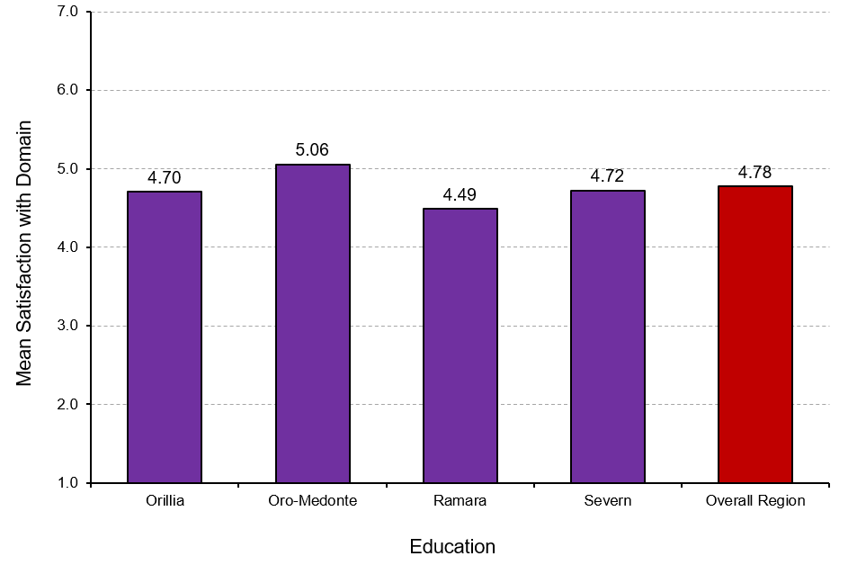
Wellbeing by Municipality: Education
Education by Municipality
Notes:
Education
“How satisfied are residents in the different municipalities with Education?”
Overall, Orillia and Area residents report a relatively high level of satisfaction with the Education domain (average score is 4.78 based on a 7-point scale).
In particular, residents living in Oro-Medonte report the highest satisfaction with the Education domain, followed by Severn and Orillia. In contrast, residents living in Ramara report the lowest level of satisfaction with this domain.

Slide 15
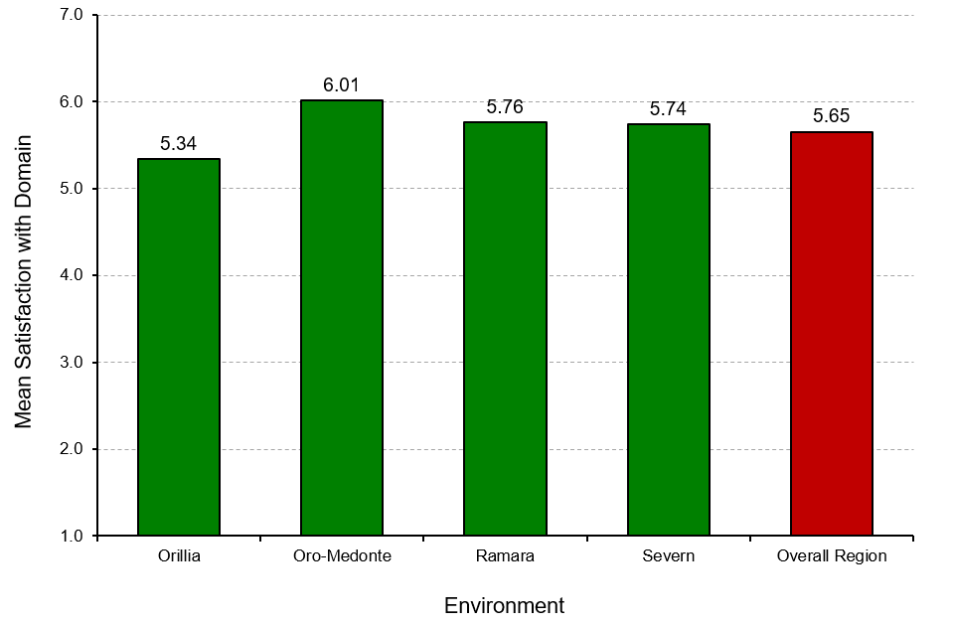
Wellbeing by Municipality: Environment
Environment by Municipality
Notes:
Environment
“How satisfied are residents in the different municipalities with the Environment?”
Overall, Orillia and Area residents report a high level of satisfaction the Environment domain (average score is 5.65 based on a 7-point scale).
Comparatively, residents living in the townships report higher levels of satisfaction with the Environment domain than residents living in the city. In particular, residents living in Oro-Medonte report the highest level of satisfaction with the Environment domain, followed by Ramara and Severn. In contrast, Orillia residents report the lowest level of satisfaction with this domain.

Slide 16
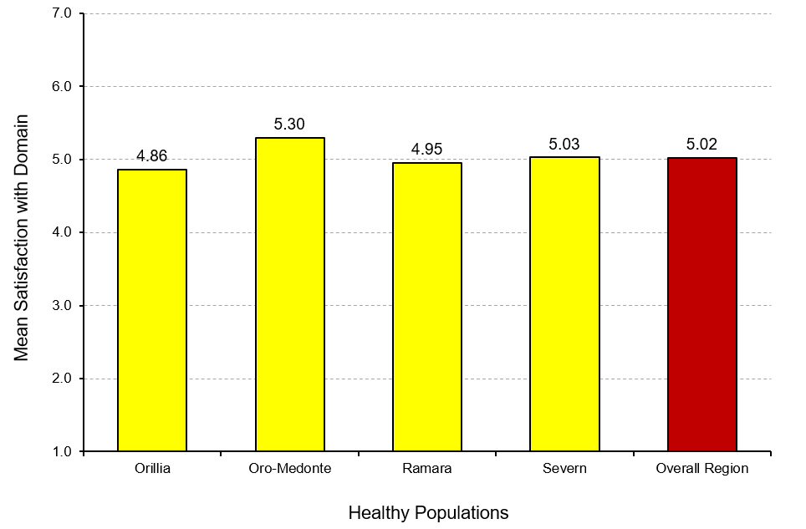
Wellbeing by Municipality: Healthy Populations
Healthy Populations by Municipality
Notes:
Healthy Populations
“How satisfied are residents in the different municipalities with Healthy Populations?”
Overall, Orillia and Area residents report a relatively high level of satisfaction with the Healthy Populations domain (average score is 5.02 based on a 7-point scale).
Comparatively, people residing in the townships report slightly higher levels of satisfaction with the Healthy Populations domain than residents living in the city. In particular, residents living in Oro-Medonte report the highest satisfaction with the Healthy Populations domain, followed by Severn. In contrast, Orillia residents report the lowest satisfaction with this domain.

Slide 17
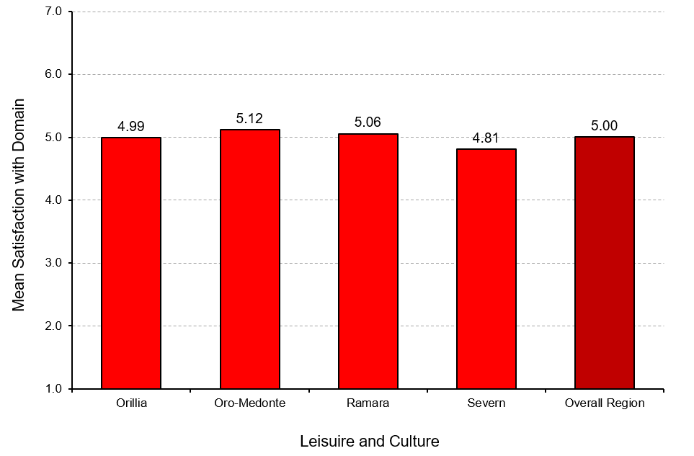
Wellbeing by Municipality: Leisure and Culture
Leisure and Culture by Municipality
Notes:
Leisure and Culture
“How satisfied are residents in the different municipalities with Leisure and Culture?”
Overall, Orillia and Area residents report a relatively high level of satisfaction with the Leisure and Culture domain (average score is 5.00 based on a 7-point scale).
Residents living in Oro-Medonte report the highest satisfaction with the Leisure and Culture domain, followed by Ramara and Orillia. In contrast, residents living in Severn report the lowest satisfaction with this domain.

Slide 18
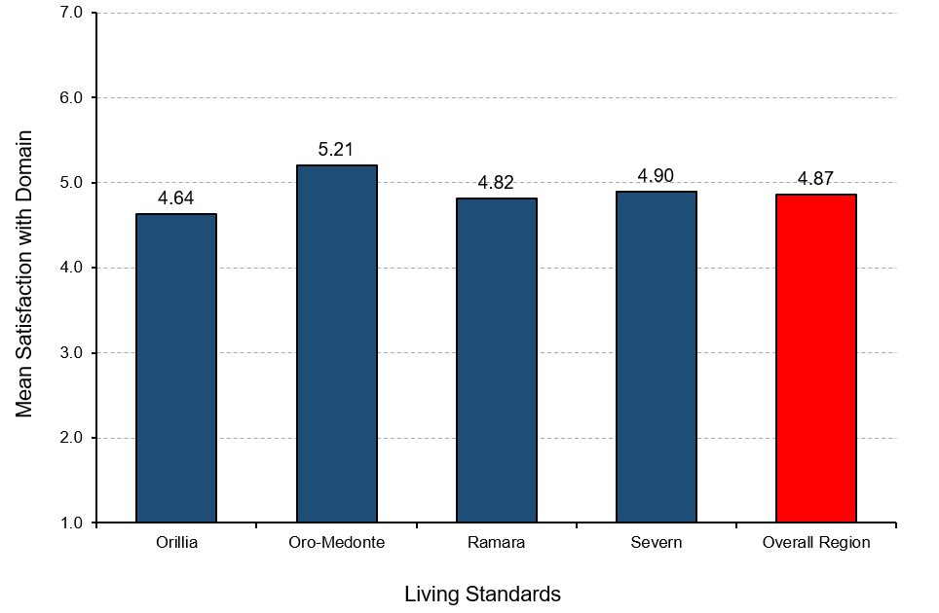
Wellbeing by Municipality: Living Standards
Living Standards by Municipality
Notes:
Living Standards
“How satisfied are residents in the different municipalities with Living Standards?”
Overall, Orillia and Area residents report a relatively high level of satisfaction with the Living Standards domain (average score is 4.87 based on a 7-point scale).
Comparatively, residents living in townships report notably higher levels of satisfaction with their living standards than residents living in cities. In particular, Oro-Medonte residents report the highest satisfaction with the Living Standards domain, followed by Severn and Ramara. In contrast, Orillia residents report the lowest level of satisfaction with this domain.

Slide 19
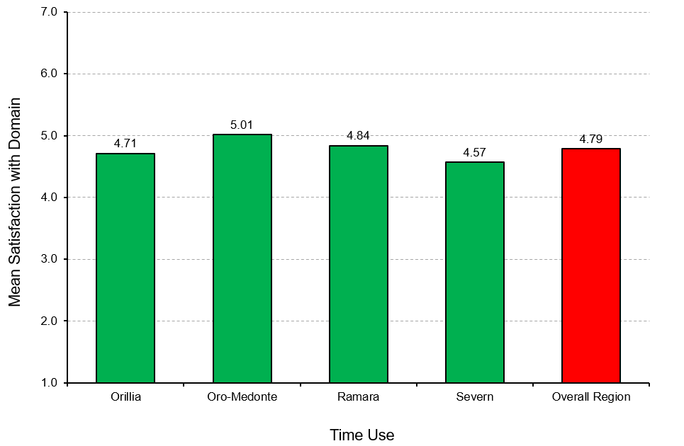
Wellbeing by Municipality: Time Use
Time Use by Municipality
Notes:
Time Use
“How satisfied are residents in the different municipalities with Time Use?”
Overall, Orillia and Area residents report a somewhat high level of satisfaction with the Time Use domain (average score is 4.79 based on a 7-point scale).
There are no substantial differences between rural residents and urban residents regarding their satisfaction with the Time Use domain. Oro-Medonte residents report a comparatively higher satisfaction with the Time Use domain. In contrast, Severn residents report the lowest level of satisfaction with this domain.

Slide 20
Demographics and Wellbeing
Notes:
Demographics and Wellbeing
Recognizing the unique socio-demographic profile of a region is an important first step in understanding the needs and circumstances of its residents. How many people live here? Are the residents generally younger or older? What do their families look like? How diverse is the population? Answers to these questions allow us to make more informed decisions about the types of programs and services that will best contribute to the wellbeing of residents in Orillia and Area.

Slide 21

What characterises residents with higher or lower wellbeing?
Characteristics of wellbeing in Orillia and Area
Below average wellbeing
Above average wellbeing
Women
Younger
Single, never married
More spend over 30% of income on housing
Living with a disability or chronic illness
Couple with children at home
Men
Tend to be older
Married
More likely to have a graduate degree
More likely to be retired
Couple with no children at home (i.e., “empty nester”)
Notes:
Characteristics of wellbeing in Orillia and Area
Above average wellbeing
52.4% are men
38.7% are older adults
63.1% are married
41.4% have a university or graduate degree
45.7% are retired
40.8% are households of couples with no children at home
Below average wellbeing
57.4% are women
28.8% are under 35 years of age
19.9% are single, never married
54.2% spend more than 30% of monthly income on housing AND 13.9% spend more than 50% of monthly income on housing
35.1% are living with a disability (mental or physical) or chronic illness that limits activity
39.2% are households of couples living with children at home

Slide 22
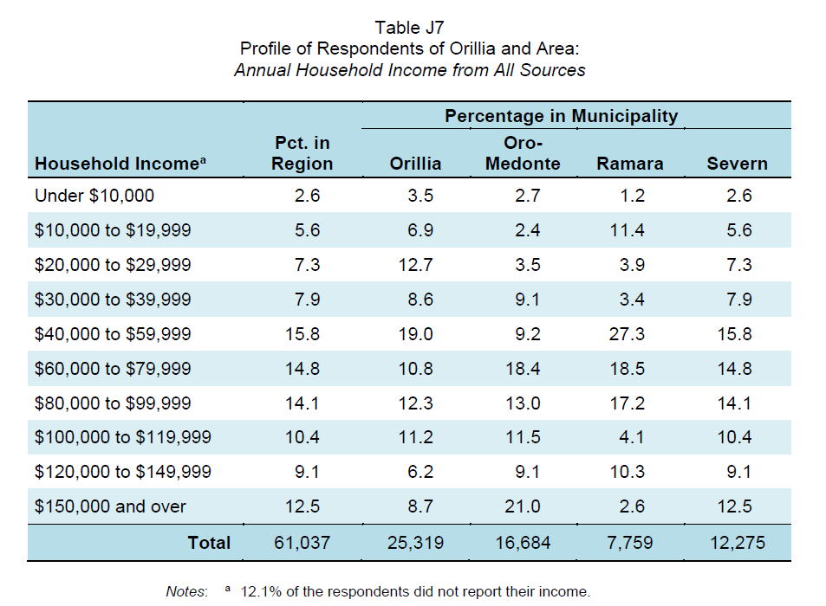
Low Income Residents and Wellbeing
Low income: Total household income before taxes from all sources was under $30,000 per year
Notes:
Selected characteristics of low income residents:
20.4% are under 35 years of age
60.7% are women
56.9% are on their own (single, divorced, or widowed)
62.1% are residing in Orillia
Work
17.5% do not work (unemployed, or on leave due to long-term disability)
Housing
64.7% spend more than 30% of monthly income on housing AND 34.6% spend more than 50% of monthly income on housing
44.9% are living alone or sharing accommodation
51.1% rent their current residence
Health
54.6% are living with a disability (mental or physical) or chronic illness that limits their activity

Slide 23
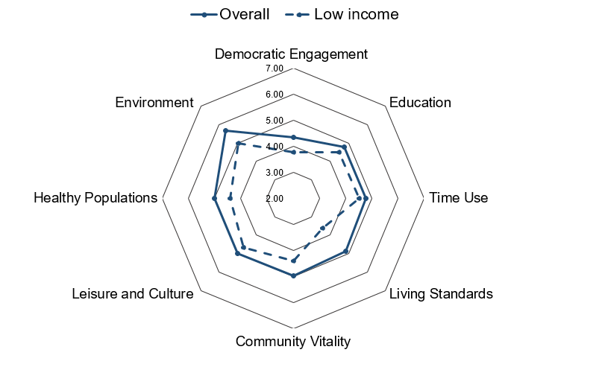
Low Income Residents and Wellbeing
Low income resident satisfaction with domains of wellbeing
Notes:
Low Income
“How do low income residents and the overall general population compare on satisfaction with the domains of wellbeing?”
Low income residents are less satisfied with ALL 8 domains compared to the general population of Orillia and Area.
Low income residents are least satisfied with the Living Standards and Democratic Engagement domains.

Slide 24
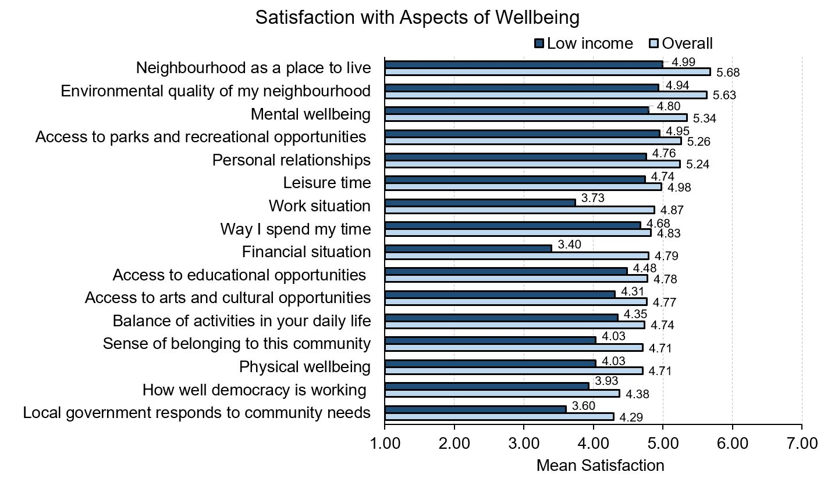
Low Income Residents and Wellbeing
Notes:
Low Income
“How do low income residents and the overall general population compare on satisfaction with aspects of wellbeing?”
Low income residents are less satisfied with ALL aspects of wellbeing compared to the general population.
Low income residents are least satisfied with their financial situation, work situation, how well democracy is working, and the way their local government responds to community needs.

Slide 25
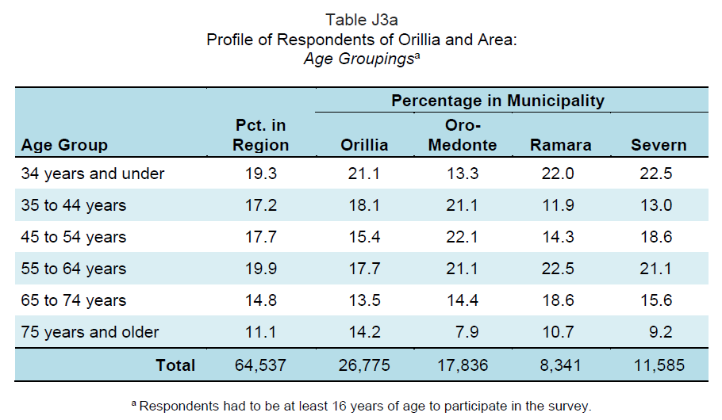
Older Adults and Wellbeing
Older adults: Residents aged 65 to 74 years and those 75 years and older
Notes:
Selected characteristics of older adults:
83.2% were born in Canada
63.6% are married AND 21.2% are widowed
27.9% are living alone
Income and Work
18.3% have a total household income before taxes from all sources under $30,000 per year
88.7% are retired OR 9.5% are working
Housing
80.2% spend less than 30% of monthly income on housing
Health
29.8% are living with a disability (mental or physical) or chronic illness

Slide 26
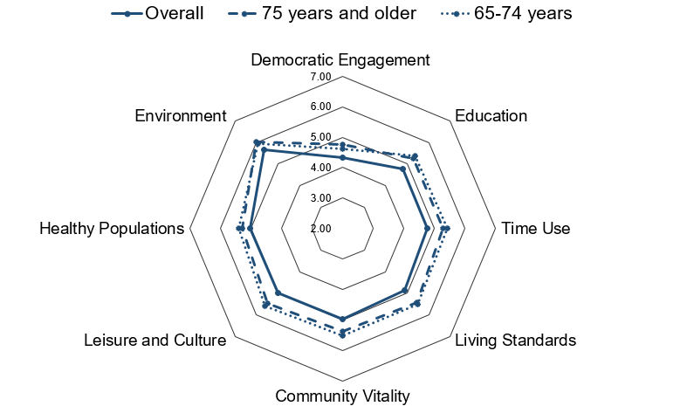
Older adults satisfaction with domains of wellbeing
Older Adults and Wellbeing
Notes:
Older Adults
“How do older adults and the overall general population compare on satisfaction with the domains of wellbeing?”
Older adults are more satisfied in ALL 8 domains compared to the general population but are least satisfied with the Democratic Engagement domain.

Slide 27
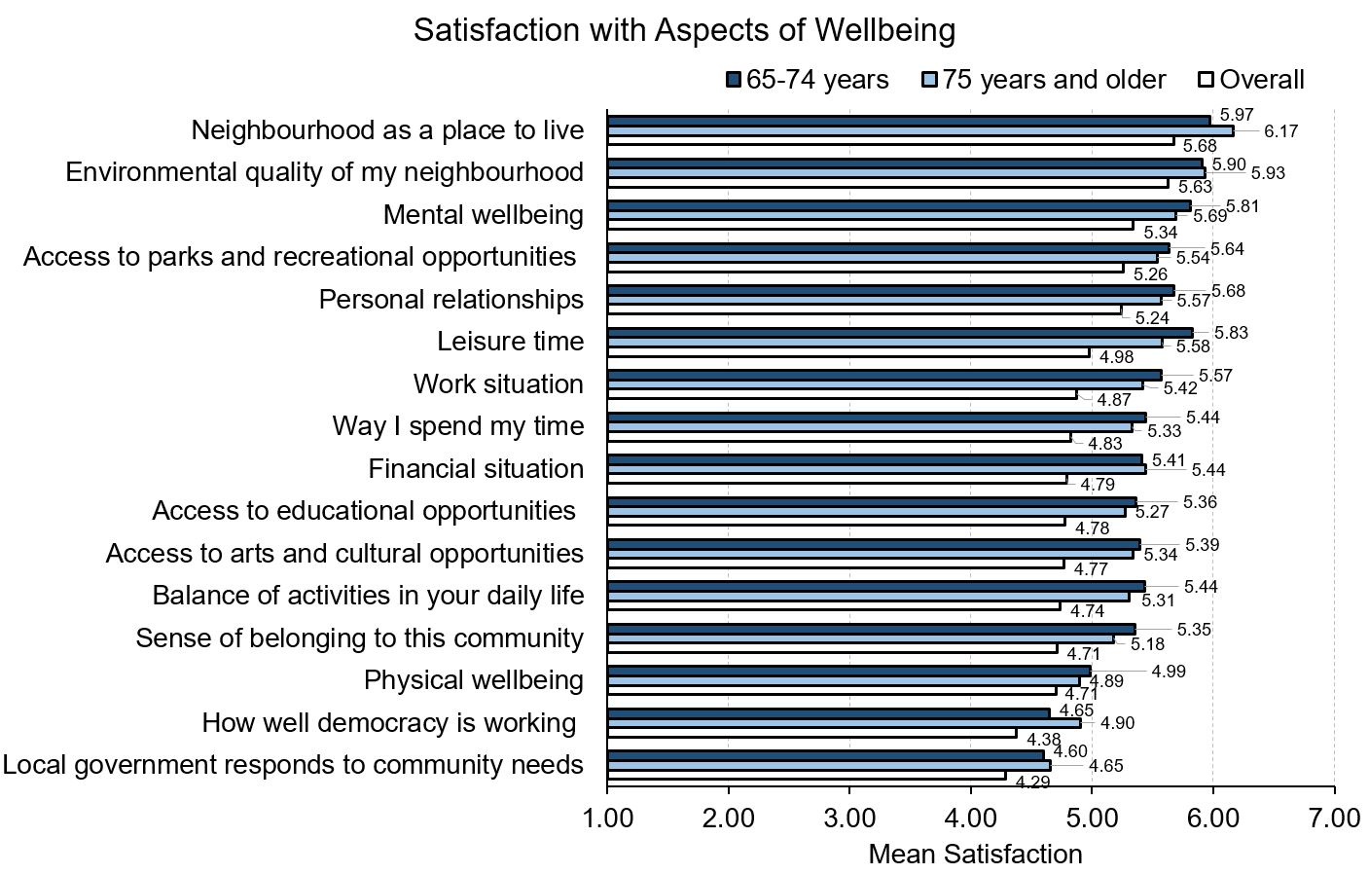
Older Adults and Wellbeing
Notes:
Older Adults
“How do older adults and the overall general population compare on satisfaction with aspects of wellbeing?”
Older adults are more satisfied with ALL aspects of wellbeing compared to the general population.
Older adults who are 65 to 74 years of age have higher satisfaction with almost all aspect of wellbeing except neighbourhood as a place to live, environmental quality, how well democracy is working, and the way their local government responds to community needs compared to those who are 75 years and older.

Slide 28
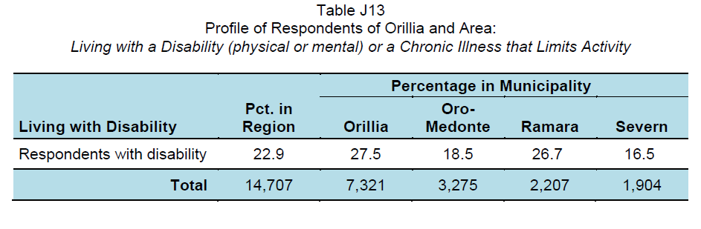
Disabilities and Wellbeing
Living with a disability or chronic illness:
Residents who are living with a physical or mental disability or a chronic illness that limits their activity
Notes:
Selected characteristics of residents living with a disability:
33.3% are 65 years and older
41.1% are on their own (single, divorced, or widowed)
50.9% are women
Income and Work
15.7% do not work (unemployed, or on leave due to long-term disability)
36.5% have a total annual household income before taxes from all sources lower than $30,000
Housing
27.9% are either living alone or sharing accommodation
26.2% rent their current residence
50.3% spend more than 30% of monthly income on housing

Slide 29
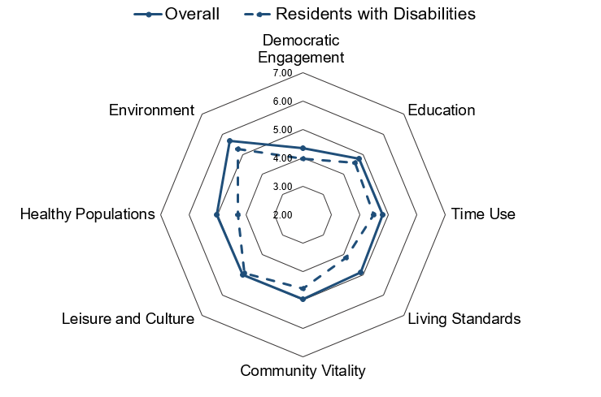
Satisfaction with domains of wellbeing for those residents living with a disability or chronic illness
Disabilities and Wellbeing
Notes:
Residents with Disabilities
“How do residents with disabilities and the overall general population compare on satisfaction with the domains of wellbeing?”
Residents living with a disability are less satisfied in ALL 8 domains compared to the general population.
Residents living with a disability are least satisfied with the Healthy Populations and Living Standards domains.

Slide 30
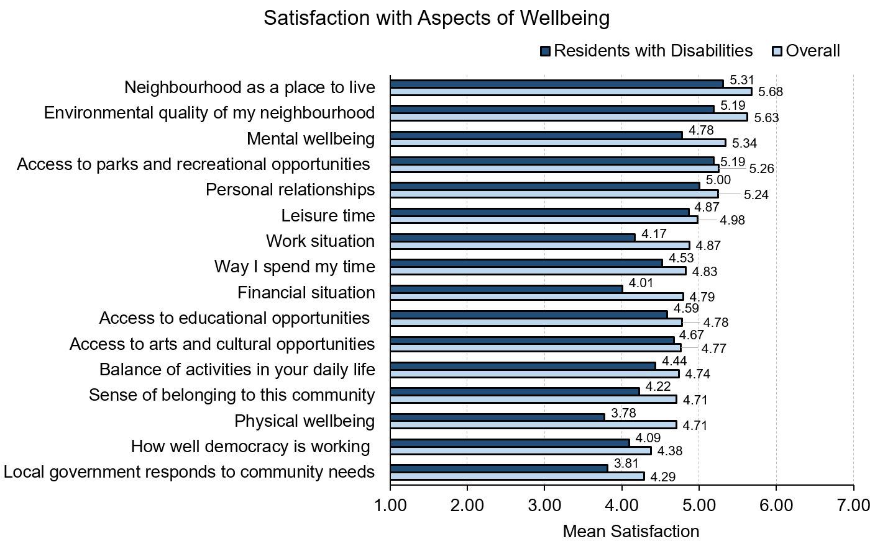
Disabilities and Wellbeing
Notes:
Residents living with a disability or chronic illness
“How do residents with disabilities and the overall general population compare on satisfaction with aspects of wellbeing?”
Residents living with a disability are less satisfied with ALL aspects of wellbeing compared to the general population.
Residents living with a disability have lower satisfaction regarding their work situation, financial situation, physical wellbeing, how well democracy is working, and the way their local government responds to community needs.

Slide 31
Wellbeing by CIW Domains

Slide 32

Living Standards
Notes:
Living Standards
Living Standards examines Canadians’ average and median income and wealth, distribution of income and wealth including poverty rates, income fluctuations and volatility. It considers economic security, including labour market security, and housing and food security.
Our living standards should reflect our capacity to transform economic growth into stable current and future income streams for everyone. Economic growth does not automatically translate into better living standards. A higher average income, for example, may be achieved at the cost of increased social inequality or greater economic insecurity. In contrast, achieving greater job quality, reducing poverty, and providing affordable housing and food security to individuals and families will raise wellbeing for everyone.

Slide 33
How do residents with higher or lower wellbeing compare?
LIVING STANDARDS and Wellbeing
Below average wellbeing
Above average wellbeing
Lower job security
Less work flexibility
Greater work interference with personal life
More people could not pay their bills and mortgage or rent on time
More people ate less due to lack of money for food
More likely to have a regular weekday schedule
Better job fit and more opportunities for job promotion
Shorter commute times
Have enough money to buy things they needed and wanted
Notes:
Living Standards
“How do residents with higher or lower wellbeing compare on living standards?”
Above average wellbeing group:
68.6% have a regular weekday schedule compared to 57.5% of people below average in wellbeing.
Have better job fit (average=4.97) compared to people below average in wellbeing (average=3.97); higher perceived opportunities for job promotion (average=4.75) than people below average in wellbeing (average=3.91).
Spend less time to commute (average=16.81 minutes) compared to those below average in wellbeing (average=20.73 minutes).
27.5% report having no money to buy things they wanted at least once in past year (60.6% for below average group); 6.8% report having no money to buy things they needed at least once in past year (39.8% for below average group).
Below average wellbeing group:
Have lower job security (average=4.03) compared to above average wellbeing group (average=5.18).
26.9% work on a flexible schedule (64.5% for above average group).
Report greater work interference with personal life (average=4.18) than above average wellbeing group (average=2.94).
39.9% could not pay bills on time at least once in past year compared to 6.9% for people with above average wellbeing; 21.3% could not pay mortgage or rent on time at least once in past year compared to 10% for those with above average wellbeing; 26.5% ate less at least once in past year because there was not enough food or money for food compared to 4.3% for those with above average wellbeing.

Slide 34
How do women and men compare on living standards?
LIVING STANDARDS and Wellbeing by sex
Women
Men
Greater work interference with personal life
More women could not pay their bills on time
Have enough money to buy things they needed and wanted
Work at multiple jobs
More likely to have a flexible work schedule
More likely to have a regular weekday schedule
More likely to work long hours
Notes:
Living Standards
“How do women and men compare on living standards?”
Women:
Women report greater work interference with personal life than men do (average as 3.74 for women and 3.63 for men).
21.4% of women report could not pay bills on time at least once in past year (15.8% for men).
41.3% of women report having no money to buy things they wanted at least once in past year (38.2% for men), and 21.9% of women report having no money to buy things they needed (14.3% for men).
Men:
29.6% of men report working multiple jobs. In contrast, 25% of women report working multiple jobs.
More men report having a regular weekday schedule compared to women (71.5% and 65.2%, respectively).
More men report having a flexible work schedule than women do (45.4% and 30.6%, respectively).
The percentage of men who report working more than 55 hours at their main job per week (11.5%) is greater than the percentage for women (3.6%).

Slide 35
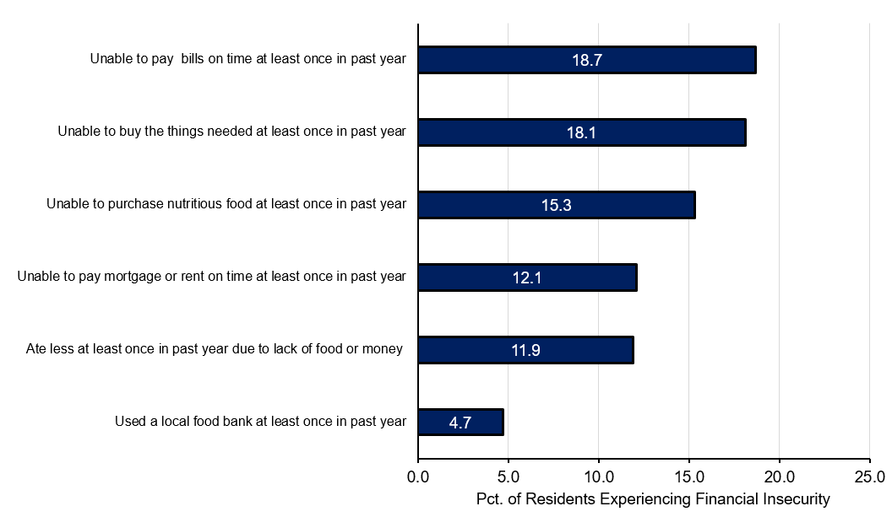
Overall Financial Insecurity
Notes:
Living Standards
“How do residents in Orillia and Area report their financial situation?”
Residents living in Orillia and Area experience the highest financial insecurity related to not having enough money to pay their bills on time, followed by not having enough money to buy things that are needed and purchasing nutritious food. Interestingly, Orillia and Area residents rarely use a local food bank.
Financial insecurity means that people may have difficulty meeting their basic subsistence needs including food, shelter, and clothing. Without these essentials, access to other important areas of life such as transportation, leisure, and many social activities can be severely curtailed.

Slide 36
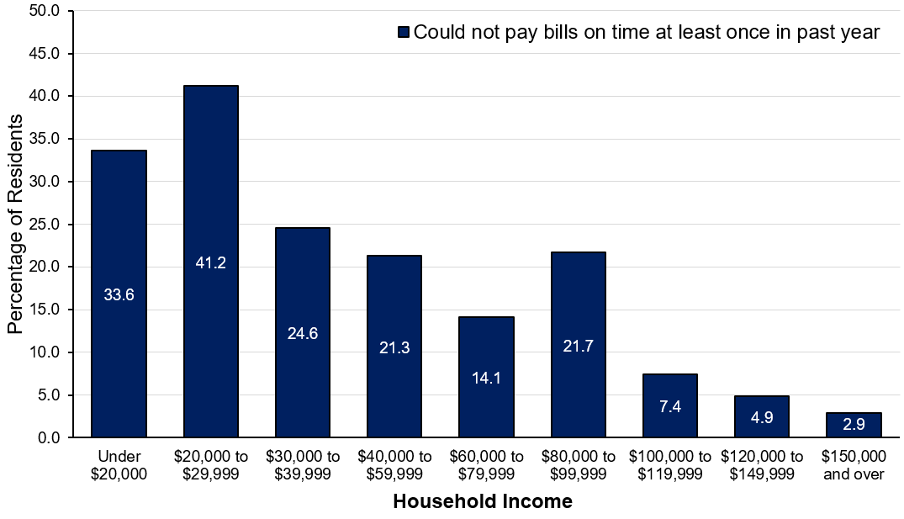
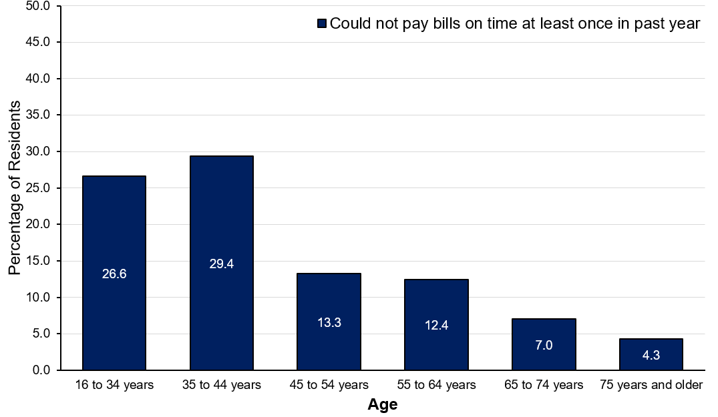
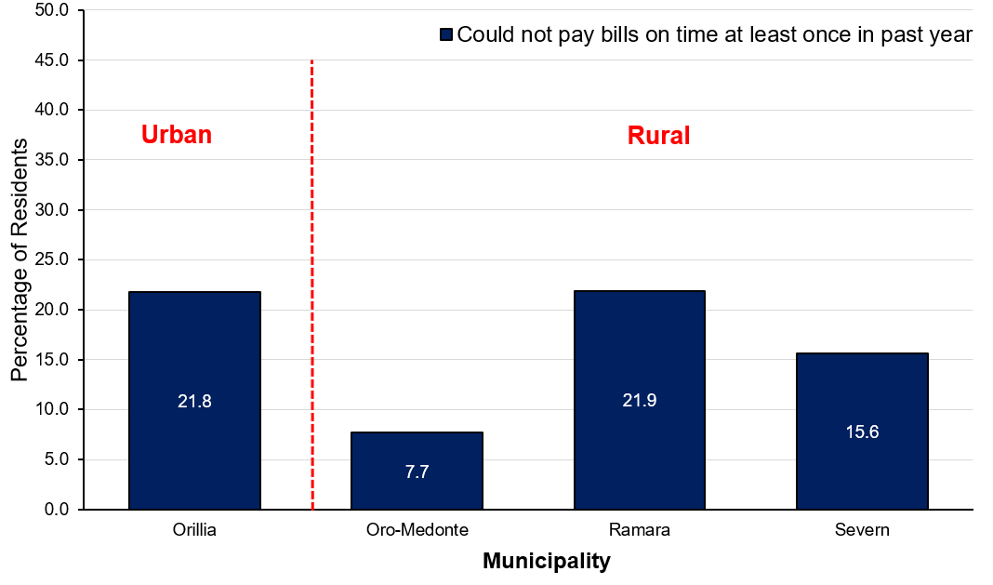
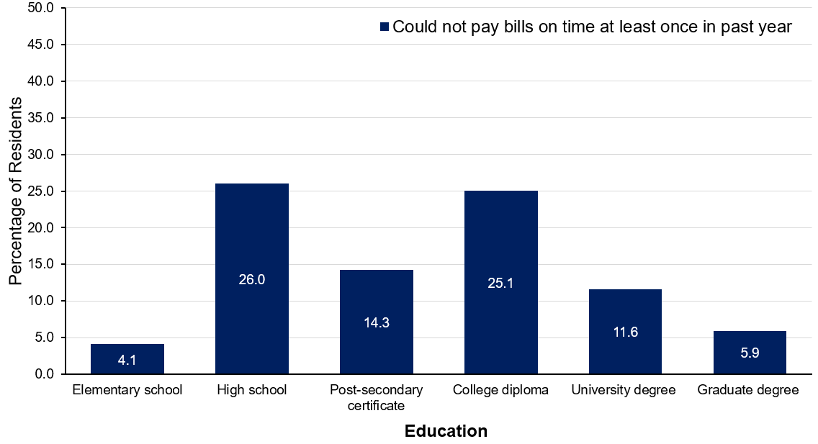
Financial Insecurity: Inability to pay bills on time
INCOME
AGE
MUNICIPALITY
EDUCATION
Notes:
Living Standards
“How do residents report their financial situation in terms of paying bills?”
As anticipated, income is directly related to the inability to pay bills on time. As income increases, inability to pay bills decreases. In particular, the low income group experience the greatest difficulty in paying their bills on time. About one-third of the residents with annual household incomes lower than $20,000 report that they could not pay bills on time (33.6%), and this number is even higher for those with annual household incomes between $20,000 to $29,999 (41.2%).
Age is also related to the inability to pay bills. Older adults are the least likely to experience difficulty paying their bills on time. Young people (under 35 years) and middle age adults (35 to 44 years) report higher financial insecurity.
Where you live also affects financial insecurity. Ramara has the highest percentage of residents who could not pay bills on time at least once in past year (21.9%), followed by Orillia (21.8%). In contrast, Oro-Medonte has the lowest percentage of residents reporting having difficulties to pay bills on time (7.7%).
Residents with a college diploma report the highest financial insecurity related to paying bills on time, followed by those holding a high school diploma. However, residents with only elementary school and those with a graduate degree report the lowest financial insecurity in terms of paying their bills on time.

Slide 37
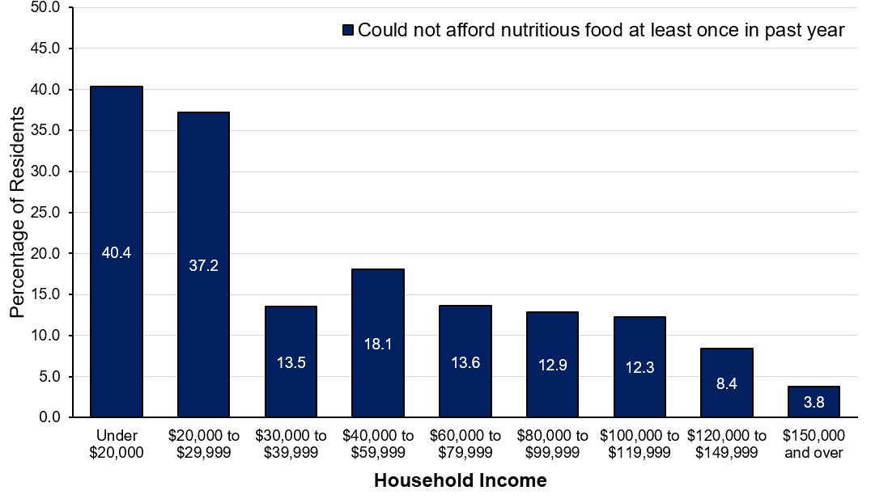
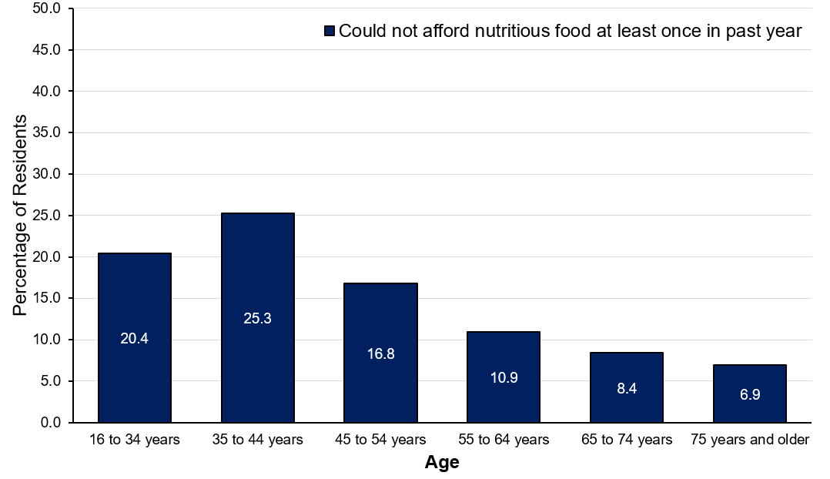
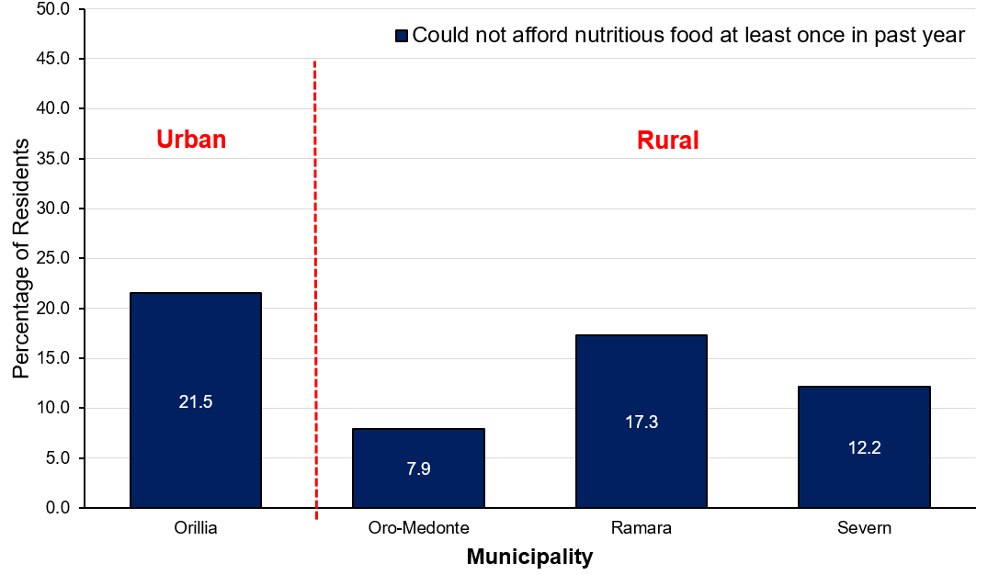
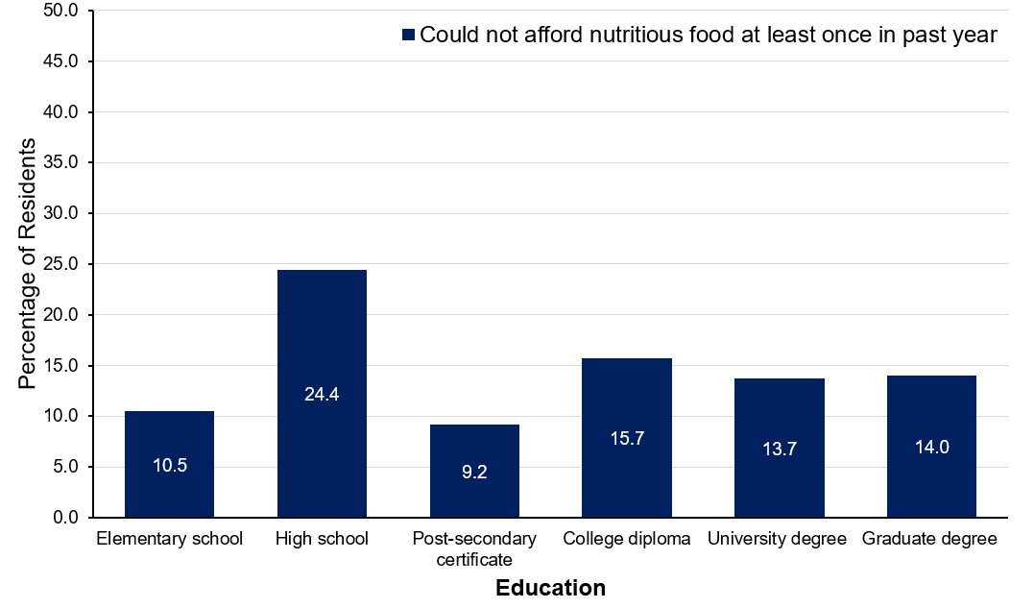
Financial Insecurity: Inability to purchase food
INCOME
AGE
MUNICIPALITY
EDUCATION
Notes:
Living Standards
“How do residents report their financial situation in terms of buying food?”
As anticipated, income is directly related to inability to pay for food with lower income groups (under $30,000) experiencing the greatest difficulty in meeting their basic needs.
Age is also related to the inability to meet basic financial needs. Older adults are the least likely to experience difficulty in affording nutritious food. People in the age group of 35 to 44 years are the most likely to experience difficulty in buying nutritious food (25.3%), followed by young people (under 35 years).
Fewer residents living in Oro-Medonte report experiencing difficulties buying nutritious food (7.9%), whereas Orillia has the highest percentage of residents who could not afford nutritious food at least once in the past year (21.5%).
Residents who have a high school diploma are the most likely to experience difficulties in buying nutritious food (24.4%). However, people having a post-secondary certificate or who have completed elementary school report the lowest level of food insecurity.

Slide 38
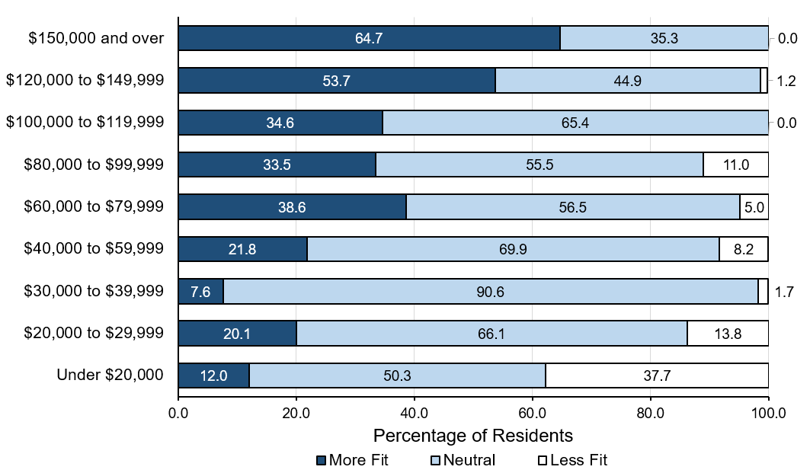
Job Fit by income
Notes:
Living Standards
“Is job fit related to household income?”
Income is strongly associated with perceived job fit. As income increases, so does the percentage of people who agree that opportunities at work and income match their education and training.
Fewer people with an income under $40,000 per year agree that their opportunities at work match their education and training.

Slide 39
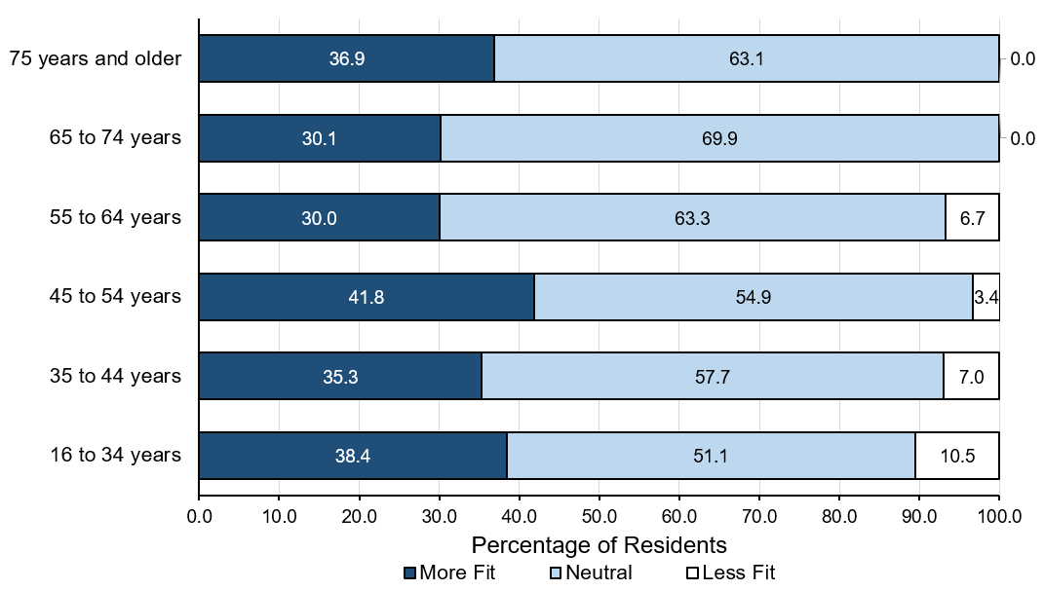
Job Fit by age
Notes:
Living Standards
“Is job fit related to age?”
Comparatively, young people (under 35 years) and middle age people (35 to 54 years) are more likely to perceive a better job fit.
About one-third of middle age workers and young workers feel that their job adequately reflects their efforts and achievements, while a slightly greater percentage of workers 45 to 54 years of age agreed (41.8%).

Slide 40
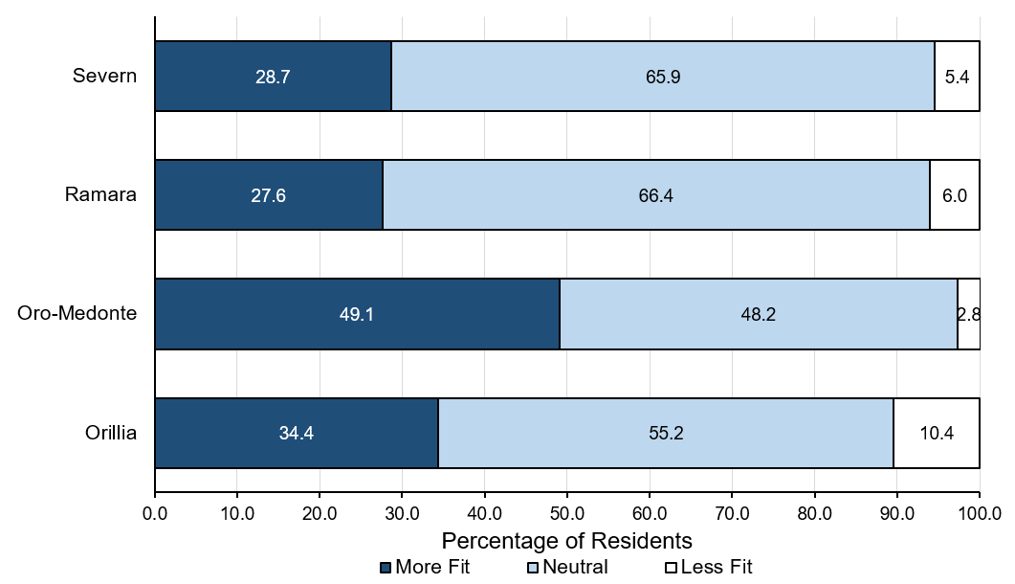
Job Fit by municipality
Notes:
Living Standards
“Is job fit related to where you live?”
In terms of whether the job opportunities and income match with personal education and efforts, a higher percentage of Oro-Medonte residents agree (49.1%), while the lowest percentage of residents who agreed live in Ramara (27.6%).
About one-third of residents living in Orillia perceive a better job fit (34.4%). However, Orillia also has the highest percentage of people who think their job opportunities and income do not match with personal education and efforts (10.4%).

Slide 41
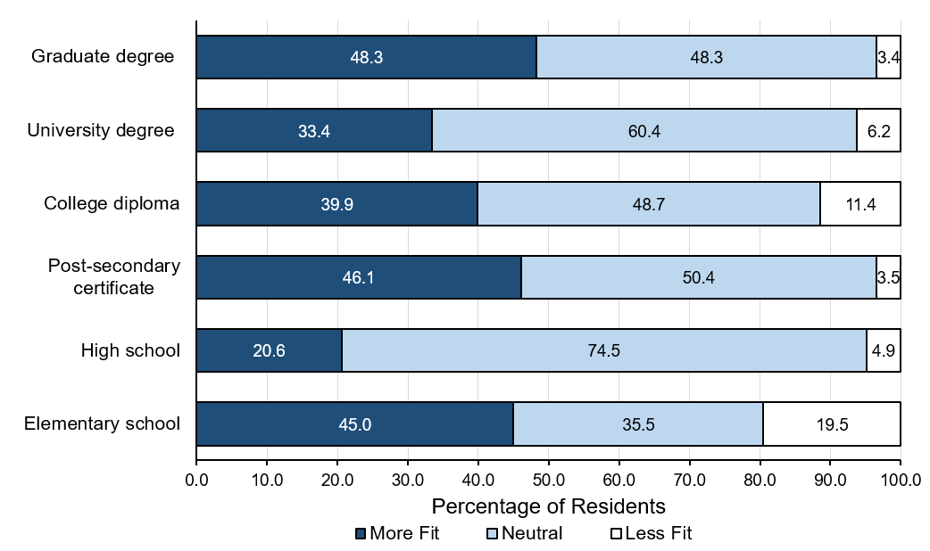
Job Fit by education
Notes:
Living Standards
“Is job fit related to education level?”
There is a higher percentage of agreement among people who have a graduate degree that their job is a good fit (48.3%).
A lower percentage of people with a high school diploma agree that opportunities at work are adequate and that their income adequately reflects their education and training (20.6%).
A higher percentage of people who completed elementary school agree that their job adequately reflects their efforts and achievements (45.0%), however this group also has the highest percentage of people who think their job does not reflect their efforts and achievements (19.5%).

Slide 42
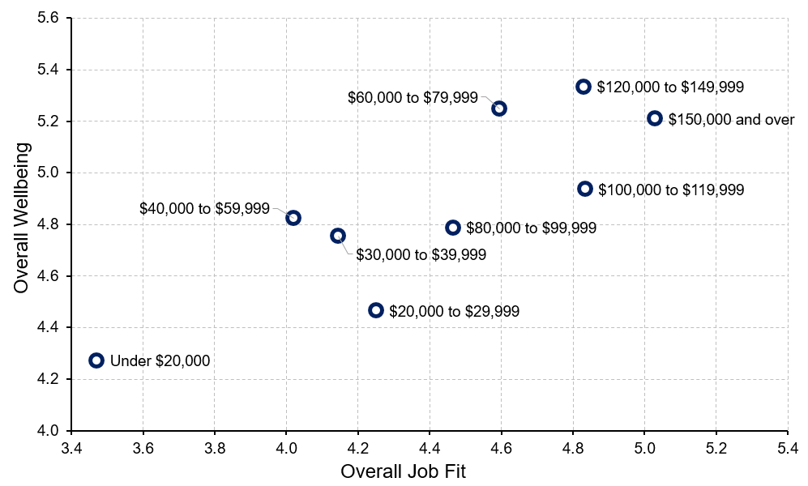
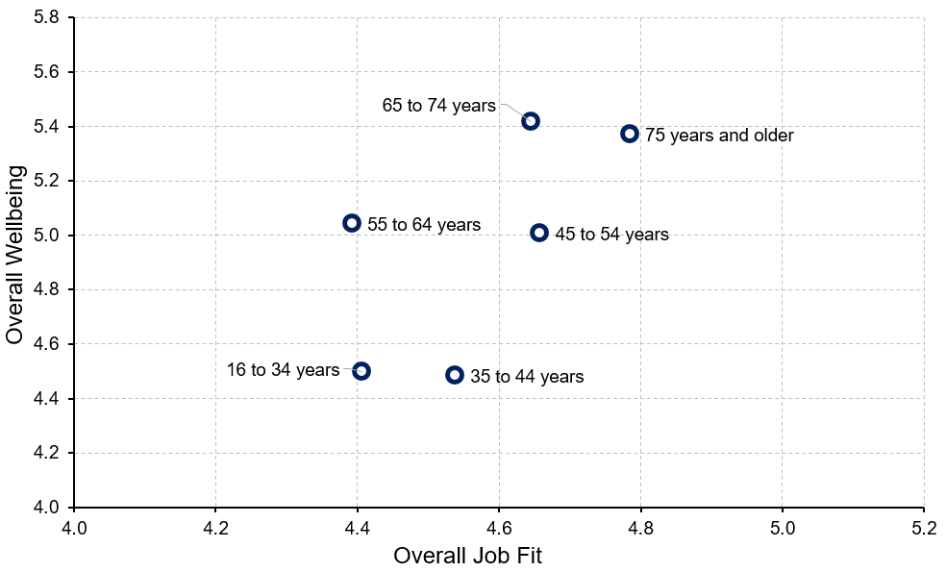
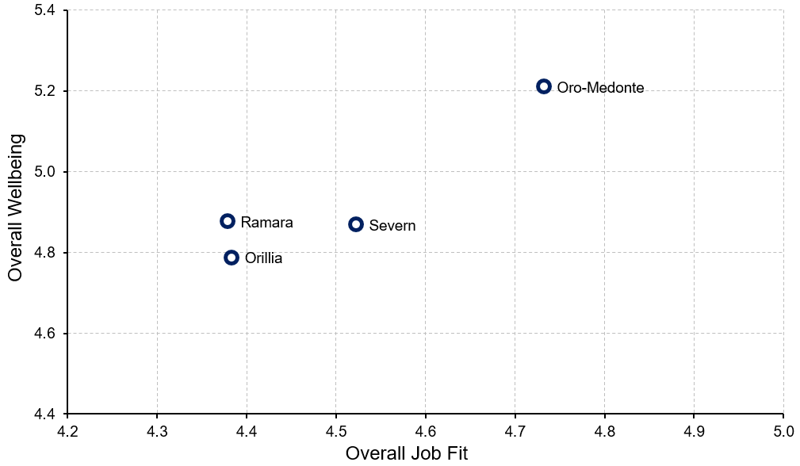
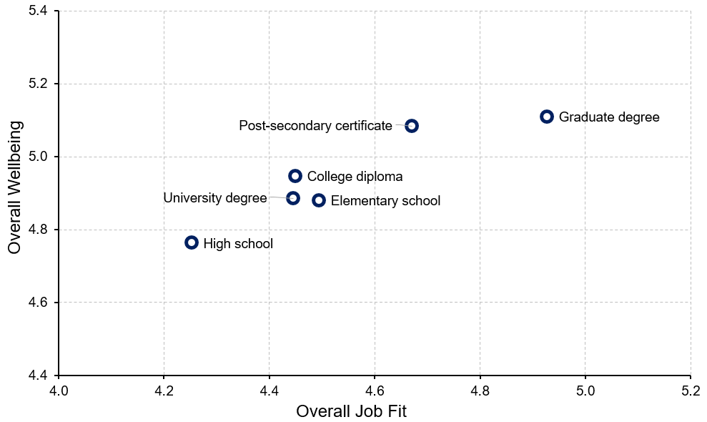
Job Fit and Overall Wellbeing
INCOME
AGE
MUNICIPALITY
EDUCATION
Notes:
Living Standards
“Is job fit related to overall wellbeing?”
A higher perceived job fit is related to higher overall wellbeing.
And is linked to:
Higher incomes; however, people with annual household incomes of $80,000 to $99,999 report relatively low job fit and overall wellbeing and interestingly, people with annual household incomes of $60,000 to $79,999 report somewhat higher job fit and significantly higher wellbeing.
No clear patterns regarding age.
Residents living in Oro-Medonte.
People with a graduate degree.

Slide 43
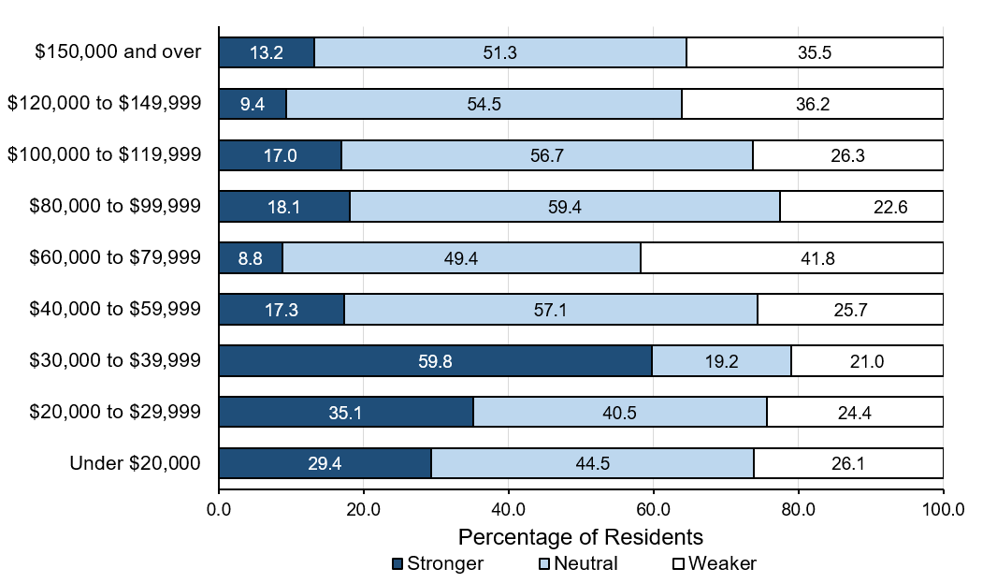
Work-Life Imbalance by income
Notes:
Living Standards
“Is work-life imbalance related to household income?”
Work-life imbalance is more prevalent among residents with lower incomes in Orillia and Area.
Residents with annual household incomes between $30,000 to $39,999 are especially at risk of experiencing work-life imbalance.

Slide 44
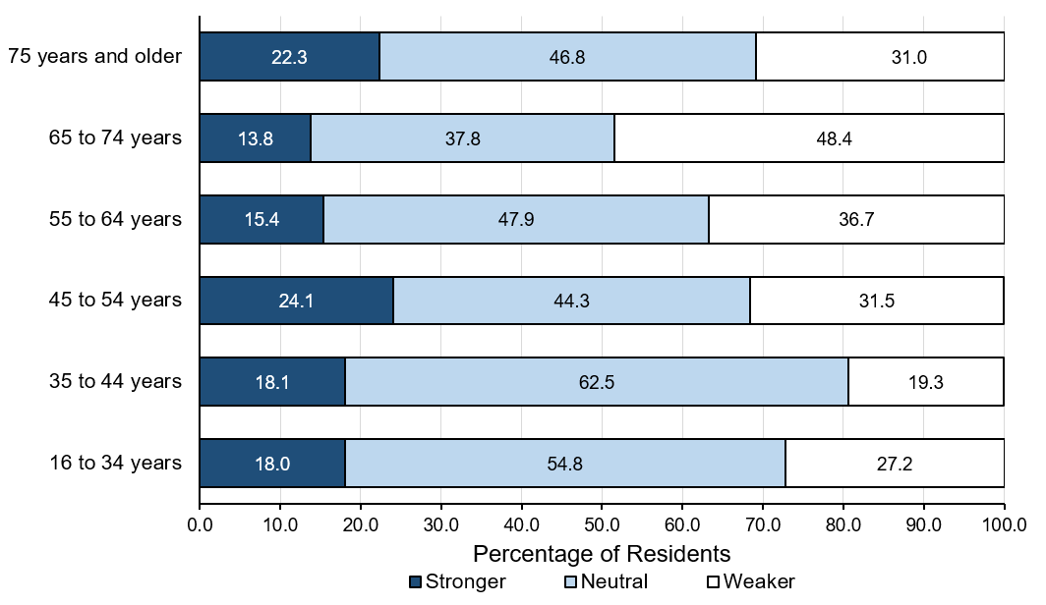
Work-Life Imbalance by age
Notes:
Living Standards
“Is work-life imbalance related to age?”
Work-life imbalance is most common among workers in the middle age range (45 to 54 years), followed closely by older adults (75 years and older).
Young workers (under 35 years) and those between 35 to 44 years of age also experience higher levels of work-life imbalance.

Slide 45
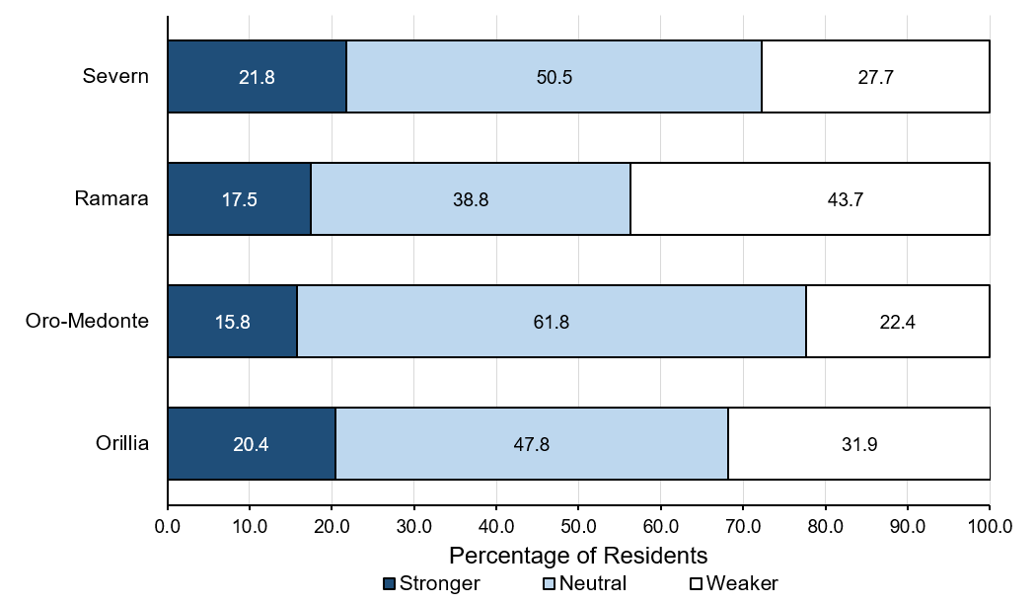
Work-Life Imbalance by municipality
Notes:
Living Standards
“Is work-life imbalance related to where you live?”
Residents living in Severn are especially at risk of experiencing stronger work-life imbalance (21.8%), followed closely by people residing in Orillia (20.4%).
In contrast, work-life imbalance is less prevalent among residents living in Oro-Medonte and Ramara.

Slide 46
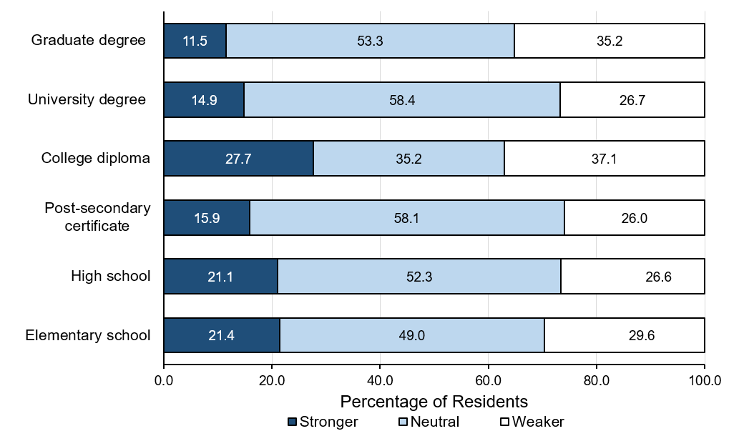
Work-Life Imbalance by education
Notes:
Living Standards
“Is work-life imbalance related to education level?”
Work-life imbalance is the most severe among people who hold a college diploma.
People with more advanced degrees (i.e., university degree, graduate degree) are less likely to experience work-life imbalance compared to people in other groups.

Slide 47
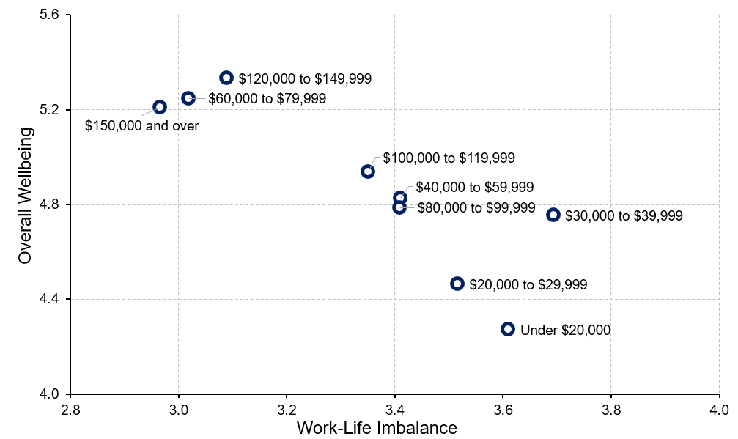
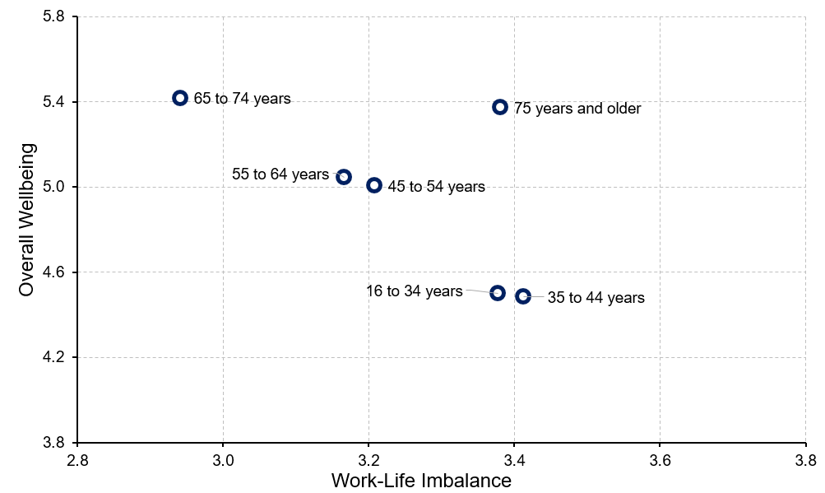
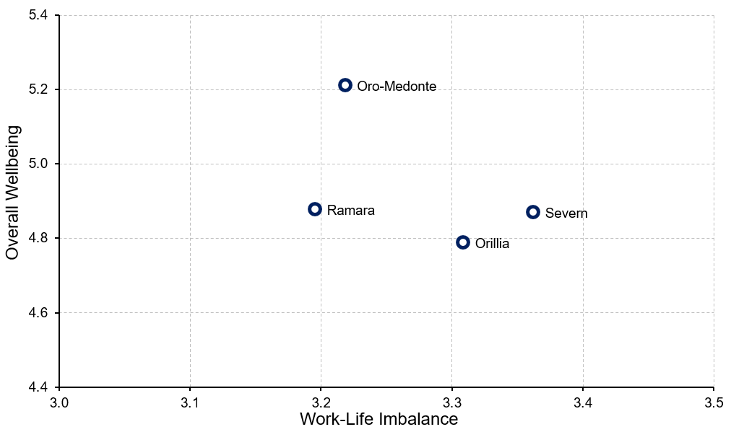
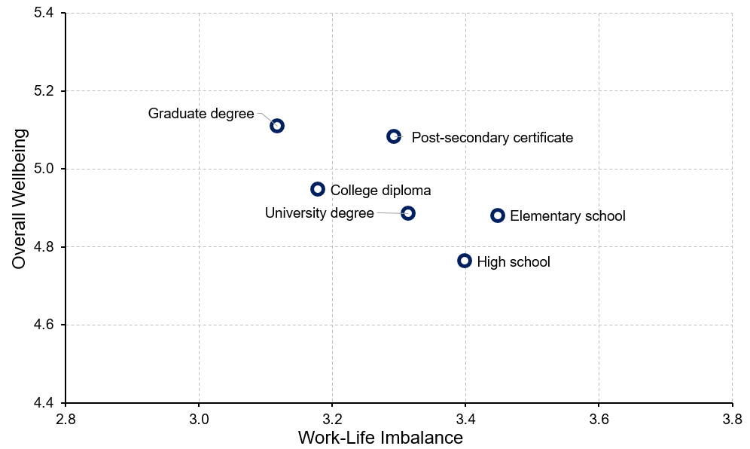
Work-Life Imbalance and Overall Wellbeing
INCOME
AGE
MUNICIPALITY
EDUCATION
Notes:
Living Standards
“Is work-life imbalance related to overall wellbeing?”
A higher perceived work-life imbalance is related to lower overall wellbeing.
And is linked to:
Lower incomes; however, people with annual household incomes of $80,000 to $99,999 report comparatively higher work-life imbalance and considerably lower wellbeing. In contrast, people with annual household incomes of $60,000 to $79,999 report comparatively lower work-life imbalance and considerably higher wellbeing.
Younger residents (under 44 years)
Residents living in Severn and Orillia
No clear pattern with education level; however, people with a high school diploma report lowest wellbeing and considerably higher work-life imbalance than those with higher educational achievement.

Slide 48

Healthy Populations
Notes:
Healthy Populations
The Healthy Populations domain considers the physical, mental, and social wellbeing of the population. It examines life expectancy, lifestyle and behaviours, and the circumstances that influence health such as access to health care.
Healthy populations captures both the overall health of the population (“health status”) as well as factors that influence health (“health determinants”). This broad perspective is used because peoples’ lifestyles and behaviours are constrained and shaped by broader social factors such as how food is distributed and priced, how houses are constructed and located, how urban transportation is designed, how easily people can access health care and recreational services, and how we interact with the natural environment.

Slide 49
How do residents with higher or lower wellbeing compare?
HEALTHY POPULATIONS and Wellbeing
Below average wellbeing
Above average wellbeing
More likely to experience negative impacts due to their own or a family member’s mental health issues
Eat healthy meals less often
Participate less in vigorous and light exercise
Better self-rated physical health
Better self-rated mental health
Perceive both quality and accessibility of the health care services to be better
Got more good quality exercise
Notes:
Healthy Populations
“How do residents with higher or lower wellbeing compare on healthy populations?”
Above average wellbeing group:
70% rate physical health as very good or excellent compared to 33.3% of people below average in wellbeing.
86% rate mental health as very good or excellent compared to 35.8% of people below average in wellbeing.
65.2% rate quality of health care services as very good or excellent compared to 22.7% of people below average in wellbeing.
53.1% rate access of health care services as very good or excellent.
More likely to get good quality exercise compared to people below average in wellbeing (88% and 52.7%, respectively)
Below average wellbeing group:
38.1% experience negative impacts due to their own mental health issues (4.3% for above average group).
45.6% experience negative impacts due to a family member’s mental health issues (20.3% for people above average in wellbeing).
65.3% eat healthy meals more often (96.2 % for above average group).
Less participation in vigorous exercise (average= 4.70) than those above average in wellbeing (average=7.02).
Less participation in light exercise (average=12.54) than those above average in wellbeing (average=16.02).

Slide 50
How do women and men compare on healthy populations?
HEALTHY POPULATIONS and Wellbeing by sex
Women
Men
More likely to experience negative impacts due to mental health issues
More likely to experience negative impacts from a family member’s substance use
Better self-rated mental health
Higher perceived quality of health care services
Higher perceived access to health care services
Got more good quality exercise
On average, both women and men rate their physical health as good or better
Notes:
Healthy Populations
“How do women and men compare on healthy populations?”
Women:
22.8% of women experience negative impacts due to their own mental health issues, while 17.7% of men report negative impacts from their own mental health issues.
More women report experiencing negative impacts from a family member’s mental health issues than men do (36.2% and 30.5%, respectively).
Men:
More men rate mental health as very good or excellent than women do (66.2% and 47.7%, respectively).
The percentage of men who rate quality of health care services as very good or excellent (46.5%) is greater than the percentage for women (43.6%).
38.2% of men rate the access to health care services as very good or excellent, whereas only 30.2% of women rate access to health care services at the same level.
43.8% of men get more good quality exercise (32.4% for women).

Slide 51
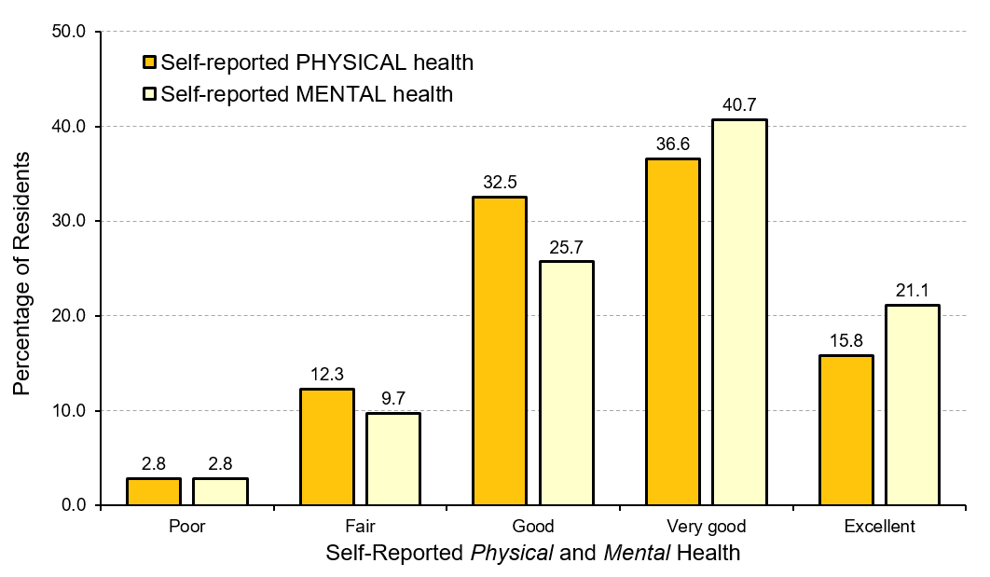
Physical and Mental Health in Orillia and Area
Notes:
Healthy Populations
“How do residents perceive their physical and mental health?”
More than 60% of Orillia and Area residents rate their mental health as very good or excellent (61.8%), while 12.5% of them rate their mental health as poor or fair. In contrast, over half of residents rate their physical health as very good or excellent (52.4%), whereas 15.1% of residents rate their physical health either as poor or as fair. In general, more residents rate their mental health as better than their physical health.
Self-assessed health indicates how people themselves feel about their health rather than having a physician or other health care professional provide an objective measure. Yet, self-assessed health generally corresponds well to objective assessments of health and wellbeing. The physical and mental health of people in the community is important to consider because healthier people enjoy a better quality of life and are more capable of participating in and contributing to family, community, economic, and other activities. Overall, a higher percentage of residents consistently rate mental health as very good or excellent more often than physical health, regardless of the demographic characteristic being considered.

Slide 52

Health Care Services in Orillia and Area
Notes:
Healthy Populations
“How do residents perceive the quality and accessibility of health care services in Orillia and Area?”
45.1% of Orillia and Area residents rate the quality of health care services as very good or excellent, while 22.1% of residents rate it as either poor or fair. Conversely, 34% of residents feel that the access to health care services is very good or excellent, while 34.5% of residents rate it as either poor or fair. In general, most residents feel the overall quality of health care services is better than their access to them.
Canadians place a high value on a universal, publicly funded and administered health care system. An important part of that system is providing high quality services so that people can feel confident they will receive the best possible care from health care professionals in their community.
Access to health care services in the community is an essential component of quality of life because it allows people to address their health needs locally. These needs can range from regular check-ups, to ongoing care of chronic or episodic illness, to supporting maternal and infant health, and to emergency services and palliative care.

Slide 53




Quality of Health Care Services
INCOME
AGE
MUNICIPALITY
EDUCATION
Urban
Rural
Notes:
Healthy Populations
“How do residents report the quality of health care services?”
Low income residents believe that the quality of health care services is notably lower when compared to the middle and upper income groups. People with annual household incomes under $30,000 report especially low levels of quality of health care services.
Perceived quality of health care services increases with age. Younger people rate the quality of health care services much lower than older adults (mean of people under 35 years = 2.90, mean of people 75 years and older = 3.51).
Perceived quality of health care services does vary by geographic location. People residing in rural areas rate the quality of health care services at higher levels than people residing in cities do. In particular, Oro-Medonte residents rate the quality of health care services as the highest, whereas Orillia residents rate the quality of health care services as the lowest.
Perceived quality of health care services generally inclines with education level. People who have a graduate degree perceive the quality of health care services as the highest (mean=3.61).
Note: The mean is based on a 5-point scale where 1 = poor and 5 = excellent.

Slide 54




Accessibility of Health Care Services
INCOME
AGE
MUNICIPALITY
EDUCATION
Urban
Rural
Notes:
Healthy Populations
“How do residents report the accessibility of health care services?”
The perceived access to health care services is lower among people in lower income groups, especially those with an income between $20,000 to $29,999 per year. Upper income groups rate the access to health care services notably higher than lower and middle income groups.
As residents age, the perceived access to health care services increases. Older adults (65 years and older) report the highest ratings of access to health care services.
Generally, residents living in cities rate the access to health care services lower than residents living in rural areas. People residing in Orillia report the lowest rating of access to health care services. Conversely, Oro-Medonte residents rate the access to health care services as the highest compared to people residing in other municipalities.
There is no significant association between perceived access to health care services and education level. The highest rating of access to health care services is reported by people holding a post-secondary certificate (mean=3.12), followed people holding a graduate degree (mean=3.09). People with a high school diploma rate the access to health care services as the lowest (mean=2.81).
Note: The mean is based on a 5-point scale where 1 = poor and 5 = excellent.

Slide 55




Physical Health in Orillia and Area
INCOME
AGE
MUNICIPALITY
EDUCATION
Urban
Rural
Notes:
Healthy Populations
“How do residents report their physical health?”
Income level is associated with self-assessed physical health. As household income increases, so do ratings of self-assessed physical health. However, people with household incomes under $20,000 per year do not follow the pattern.
Levels of self-assessed physical health are lower amongst older adults (65 years and older). Physical health is reported highest by people who are in the age group of 45 to 54 years, followed by young people who are under 35 years of age.
Physical health varies according to where people live. In particular, the self-assessed physical health of Oro-Medonte residents is the highest while Ramara is the lowest.
Self-assessed physical health generally inclines with education level.
Note: The mean is based on a 5-point scale where 1 = poor and 5 = excellent.

Slide 56




Physical Health and Overall Wellbeing
INCOME
AGE
MUNICIPALITY
EDUCATION
Notes:
Healthy Populations
“Is physical health related to overall wellbeing?”
Overall, lower self-reported physical health is related to lower overall wellbeing.
And is linked to:
Lower incomes (under $30,000); however, people with annual household incomes of $80,000 to $99,999 and $100,000 to $119,999 also report relatively low overall wellbeing despite better self-reported physical health. In contrast, people with annual household incomes of $60,000 to $79,999 report comparatively higher physical health and significantly higher wellbeing.
Younger people (under 35 years) and early mid-age adults (35 to 44 years) report better physical health, but lower overall wellbeing than any other age group. Older adults (65 years and over) report much higher overall wellbeing despite lower self-rated physical health.
Residents living in Oro-Medonte report higher physical health and overall wellbeing than any other municipality.
Lower education levels are associated with lower of both physical health and overall wellbeing.

Slide 57




Mental Health in Orillia and Area
INCOME
AGE
MUNICIPALITY
EDUCATION
Urban
Rural
Notes:
Healthy Populations
“How do residents report their mental health?”
Income level is slightly associated with self-assessed mental health. People with an annual household income higher than $120,000 report the highest mental health, whereas people with a household income lower than $30,000 per year report lower mental health.
Middle age adults (45 to 54 years) report the highest self-assessed mental health, followed by people between 55 to 64 years of age. In contrast, young people and older adults rate their mental health as lower.
Self-assessed mental health does vary by geographic location. Residents of rural areas rate their mental health slightly higher than people living in cities. People residing in Oro-Medonte report the highest self-assessed mental health (mean=3.92), while Orillia residents report the lowest (mean=3.46).
People with a post-secondary certificate and people who have a graduate degree report the highest level of mental health (mean=3.85). In contrast, people who have completed elementary school report the lowest level of mental health (mean= 3.25). Comparatively, self-assessed mental health is higher among people holding more advanced degrees compared to people with lower levels of educational achievement.
Note: The mean is based on a 5-point scale where 1 = poor and 5 = excellent.

Slide 58




Mental Health and Overall Wellbeing
INCOME
AGE
MUNICIPALITY
EDUCATION
Notes:
Healthy Populations
“Is mental health related to overall wellbeing?”
Lower self-reported mental health is related to lower overall wellbeing.
And is linked to:
Lower incomes (under $30,000); however, people with annual household incomes of $80,000 to $99,999 and $100,000 to $119,999 also report relatively low mental health and overall wellbeing. In contrast, people with annual household incomes of $60,000 to $79,999 report comparatively higher mental health and significantly higher wellbeing.
Younger people (under 35 years)
Residents living in Orillia
Lower education levels

Slide 59




Accessibility of Health Care and Overall Wellbeing
INCOME
AGE
MUNICIPALITY
EDUCATION
Notes:
Healthy Populations
“Is accessibility of health care services related to overall wellbeing?”
A higher perceived accessibility of health care services is related to higher overall wellbeing.
And is linked to:
Higher income; however, people with annual household incomes of $60,000 to $79,999 and of $80,000 to $99,999 rate the access to health care services identically but the former group reports significantly higher wellbeing.
Older residents
Residents living in Oro-Medonte
No clear patterns with education level; however, people with a post-secondary certificate or a graduate degree rate the access to health care services and overall wellbeing highest.

Slide 60

EDUCATION
Notes:
Education
Education is the systematic instruction, schooling, or training given to the young in preparation for the work of life, and by extension, similar instruction or training obtained in adulthood.
Societies that thrive encourage a thirst for knowledge – at every age and stage of life. Education is a process that begins before school age and is reflected in pre-school arrangements such as child care and early childhood education. Children are born ready to learn – the experiences and relationships in the years leading up to school age influence the capacity for learning. It also continues beyond elementary and high school, to college, university, and professional training through apprenticeships. Education continues as lifelong learning. As the world changes, education helps Canadians adapt to new challenges.

Slide 61
How do residents with higher or lower wellbeing compare?
EDUCATION and Wellbeing
Below average wellbeing
Above average wellbeing
Lower perceived availability of formal education opportunities
Courses seen as too expensive
Courses seen as offered at inconvenient times
More likely to have taken courses to improve skills or qualifications for current job
More likely to have taken courses for interest in community or online
Higher perceived availability of courses for interest
Notes:
Education
“How do residents with higher or lower wellbeing compare on education?”
Above average wellbeing group:
28.8% take courses to improve skills for current job (21.1% for below average group).
24.9% take courses to lead directly to a qualification for current job (17.2% for below average group).
21.7% have taken courses for interest in community or online in the past year (13.4% for below average group).
83.7% agree that there are plenty of opportunities to take courses for interest (40.8% for below average group).
Below average wellbeing group:
39.2% think opportunities are adequate for formal education (79.8% for above average group).
49.2% agree courses are too expensive (12.1% for above average group).
26.5% think courses are offered at inconvenient times (8.5% for above average group).

Slide 62
How do women and men compare on education domain?
EDUCATION and Wellbeing by sex
Women
Men
More likely to have taken courses to prepare for job
Higher perceived availability of formal education opportunities
Courses seen as offered at inconvenient times
Courses seen as too expensive
Less likely to take courses for interest in community or online
Less likely to have taken courses to get started in their new job
Lower perceived availability of courses for interest
Notes:
Education
“How do women and men compare on education?”
Women:
16.8% of women report having taken courses to prepare them for a job in the future compared to 13.5% for men.
More women agree that there are plenty of opportunities to take formal education courses than men do (67.5% and 55.9%, respectively).
More women agree that there are places nearby to upgrade educational qualifications than men do (66.6% and 58.9%, respectively).
23.8% of women report that courses are offered at inconvenient times compared to 10.7% for men.
More women (36.2%) agree courses are too expensive than men do (22%).
Men:
Fewer men report having taken courses to help them get started in their new job than women do (6.5% and 13.3%, respectively).
The percentage of men taking courses for interest in community or online is lower than that for women (15% and 20.3%, respectively).
Fewer men agree that there are places nearby to take courses for interest than women do (55.4% and 68.5%, respectively).
Fewer men agree that there are plenty of opportunities to take courses for interest than women do (60.3% and 70.1%, respectively).

Slide 63

Taking Courses in Orillia and Area
Notes:
Education
“How do residents report their participation in formal education and in courses for interest in Orillia and Area?”
Overall, there is slight difference with respect to the purpose of taking courses for interest and formal education. Residents living in Orillia and Area are more likely to take courses to improve skills for their current job, followed by taking courses for a qualification related to current job.

Slide 64




Taking Courses for Interest
INCOME
AGE
MUNICIPALITY
EDUCATION
Notes:
Education
“Who are those people taking courses for interest?”
People with annual household incomes $150,000 and over and people with annual household incomes between $20,000 to $29,999 are more likely to take courses for interest.
Middle age adults (45 to 64 years) are more likely to take courses for interest. However, young people (under 35 years) and older adults (75 years and older) are less likely to take courses for interest.
Residents living in Oro-Medonte report the highest participation (20.9%). Conversely, residents living in Ramara are the least likely to take courses for interest (15.4%).
Taking courses for interest generally inclines with education level. People with higher educational achievement are more likely to take courses for interest. However, people who have a graduate degree do not follow this pattern. Only 15.4% of them report having taken courses for interest in past year.

Slide 65

Educational Opportunity in Orillia and Area
Notes:
Education
“How do residents perceive educational opportunities in Orillia and Area?”
Residents living in Orillia and Area agree that there are plenty of opportunities to take formal courses and upgrade their educational qualifications. Residents also report a somewhat high agreement that courses are too expensive as well as courses are offered at inconvenient times.
Having access to educational opportunities, like formal courses, allows people to improve existing, or acquire new job skills that can lead directly to qualifications enabling career opportunities. Interest courses are an important component of lifelong learning that can enhance leisure experiences and contribute to ongoing intellectual development and knowledge acquisition.
Note: The mean is based on a 7-point scale.

Slide 66

Educational Opportunity by income
Notes:
Education
“How do residents with different household incomes perceive the educational opportunities in Orillia and Area?”
The relationship is evident between income and perceived barrier of educational opportunity due to cost – low income residents find that cost prevents their participation more than middle or upper income residents.
There is little connection between income and educational opportunities with respect to places nearby for interest courses. The highest percentage of agreement is among people with household incomes between $60,000 to $79,999 per year (75.4%), followed by those with annual household incomes between $120,000 to $149,999 (74.6%).
Note: The mean is based on a 7-point scale.

Slide 67

Educational Opportunity by age
Notes:
Education
“How do residents at different ages perceive the educational opportunities in Orillia and Area?”
Agreement of cost as a barrier of educational opportunities declines with age. Older adults report lower levels of agreement that cost prevents their participation; in contrast, young people agree that the cost of programs limits their participation.
There is somewhat of an association between age and the agreement that there are places nearby to take courses for interest. Older adults are more likely to agree that there are places nearby for interest courses than young people and middle age adults.
Note: The mean is based on a 7-point scale.

Slide 68

Educational Opportunity by municipality
Urban
Rural
Notes:
Education
“How do residents living in different municipalities perceive the educational opportunities in Orillia and Area?”
Agreement that courses are too expensive is slightly higher amongst residents living in the city. In contrast, people residing in townships believe that courses are not less accessible due to their cost, especially those living in Oro-Medonte.
Ramara residents have the highest level of agreement about the availability of places nearby to take courses of interest, followed by residents living in Oro-Medonte. In contrast, residents living in Severn report lower accessibility to places nearby to take courses of interest.
Note: The mean is based on a 7-point scale.

Slide 69

Educational Opportunity by education
Notes:
Education
“How do residents with different education levels perceive the educational opportunities in Orillia and Area?”
The perception of courses being too expensive generally declines with education level. However, people with a college diploma are more likely to agree that courses are too expensive.
People who hold a graduate degree are the most likely to agree that there are places nearby to take courses for interest (70.9%), followed by people with a post-secondary certificate (67.5%) and people with a university degree (67.3%). In contrast, people who have a college diploma are the least likely to agree that places nearby are available to take courses in the community.
Note: The mean is based on a 7-point scale.

Slide 70




Educational Opportunity and Overall Wellbeing
INCOME
AGE
MUNICIPALITY
EDUCATION
Notes:
Education
“Is perception of educational opportunity related to overall wellbeing?”
Higher perceived educational opportunity is related to higher overall wellbeing.
And is linked to:
No clear patterns with income
Older residents
Residents living in Oro-Medonte
No clear patterns regarding education level

Slide 71

ENVIRONMENT
Notes:
Environment
The environment is the foundation upon which human societies are built and the source of our sustained wellbeing. On a broader level, environmental protection involves the prevention of waste and damage while revitalizing our ecosystems and working towards the sustainability of all of our natural resources.
The environment is the basis for our health, our communities, and our economy. Despite its fundamental importance to human existence and the natural resource wealth it provides to Canada, we often fail to appreciate the various ecosystem services provided by nature that sustain human wellbeing. Indeed, our wellbeing is influenced directly by the quality of our air, soil, and water.

Slide 72
How do residents with higher or lower wellbeing compare?
ENVIRONMENT and Wellbeing
Below average wellbeing
Above average wellbeing
Perceive traffic congestion as worse
Perceive air quality and water quality as lower
Less likely to conserve energy or conserve water
Less likely to purchase local food
Perceive quality of natural environment as higher
See more opportunities to enjoy nature in community and in neighbourhood
More likely to reuse and recycle materials, and to reduce and separate waste
Both groups do not take public transit, or walk or bike very often.
Notes:
Environment
“How do residents with higher or lower wellbeing compare on the environment?”
Above average wellbeing group:
94.8% agree that the quality of the natural environment in their neighbourhood is very high (62.3% for below group); 93.5% agree that the quality of the natural environment in their community is very high (67.2% for below group).
98.4% agree there are plenty of opportunities to enjoy nature in their community (87.5% for below group); 96.5% agree there are plenty of opportunities to enjoy nature in their neighbourhood (76.0% for below group).
72.7% reuse materials (65.6% for below group), 91.5% recycle materials (85% for below group), 83.5% reduce waste (71.7% for below group), 86.5% separate waste (67.2% for below group) very often or all of the time.
Below average wellbeing group:
39.7% feel traffic congestion is a problem in their community (20.5% for above group).
64.9% are satisfied with air quality in their community (91.0% for above group); 51.6% are satisfied with water quality in their community (88.8% for above group).
77.3% conserve energy (90.3% for above group), 66.7% conserve water (80.3% for above group) very often or all of the time.
35.5% purchase foods locally very often or all of the time (58.7% for above group).
Neither group walk or bike very often (27% for above group, 25.7% for below group) or take public transit very often (5.9% for above group, 8.6% for below group).

Slide 73
How do women and men compare on environment domain?
ENVIRONMENT and Wellbeing by sex
Women
Men
Perceive air quality and water quality as lower
More likely to reuse materials
More likely to use carpool or car share
More likely to purchase local food
Perceive quality of nature environment as higher
More likely to conserve energy or water
More likely to separate waste
Both women and men report a similarly lower use of public transit.
Notes:
Environment
“How do women and men compare on the environment?”
Women:
77.3% feel the air quality in their community is very good (85.9% for men).
69.4% feel the water quality in their community is very good (75.9% for men).
71.5 % reuse materials (65.3 % for men).
12.8% use carpool or use care share (7.8% for men).
48.5% purchase food produced locally (45.9% for men).
Men:
87.1% agree that the quality of the natural environment in their community is very high (80.5% for women).
86.1% conserve energy (84.3% for women), 75.7% conserve water (74.1% for women) very often or all of the time.
81.1% separate waste very often or all of the time (77.5% for women).
Neither women nor men walk or bike very often (23.4% for women, 23.6% for men), or take public transit very often (6.5% for women, 5.4% for men).

Slide 74

Active Transportation by income
Notes:
Environment
“Is using active transportation related to household income?”
People with an annual household income under $20,000 report the highest percentage of walking or biking more often or all of the time (35.1%), followed by people who have a household income between $30,000 to $39,999 per year (32.1%).
People with lower incomes, especially those who have an annual household income lower than $20,000, are more likely to take public transit.

Slide 75

Active Transportation by age
Notes:
Environment
“Is using active transportation related to age?”
Residents in the middle age groups (35 to 64 years) are more likely to walk or bike when compared to people in other age groups.
There is little difference between age groups in the percentage of people who take public transit quite often or all of the time. People in the 35 to 44 year and 55 to 64 year age groups report the lowest percentage (4.1% and 4.2%, respectively) taking public transit quite often or all of the time.

Slide 76

Active Transportation by municipality
Urban
Rural
Notes:
Environment
“Is using active transportation related to geographic location?”
People residing in rural areas report notably lower percentages of walking or biking compared to residents living in Orillia. Oro-Medonte residents are least likely to walk or bike compared to residents living in other municipalities.
People residing in Orillia are more likely to take public transit quite often or all of the time compared to people residing in rural areas (Oro-Medonte, Ramara, Severn).

Slide 77

Active Transportation by education
Notes:
Environment
“Is using active transportation related to education level?”
Using active transportation–walk or bike rather than use a car–is related to education level. A higher percentage of people holding a university or graduate degree walk or bike more often than people with other educational levels. People who have completed elementary school are the least likely to walk or bike compared to people in other groups.
There is no clear association between taking public transit and education level. Overall, people do not take public transit very often. The highest percentage of residents taking public transit quite often or all of the time are amongst those who have completed elementary school (8.9%) or a college diploma (8.9%). In contrast, those with a graduate degree have the lowest percentage of people taking public transit quite often or all of the time (1.4%).

Slide 78

Perceived Environmental Quality by income
Notes:
Environment
“How do residents with different household incomes perceive the quality of the environment in their community?”
There is no clear pattern in terms of income and perception of traffic congestion in Orillia and Area. Nevertheless, people with annual household incomes between $20,000 to $ 29,999 report the highest level of agreement that traffic congestion is a problem.
Income is related to perceptions of the quality of the natural environment. As income increases, so does the perceived quality of the natural environment in their community. People living on less than $30,000 per year have a lower level of agreement that the quality of the natural environment in their community is very good.
There is also a link between income and perceived opportunities to enjoy nature. Residents with annual household incomes under $30,000 report lower levels of agreement regarding opportunities to enjoy nature.
Note: The mean is based on a 7-point scale.

Slide 79

Perceived Environmental Quality by age
Notes:
Environment
“How do residents at different ages perceive the quality of the environment in their community?”
Older adults (65 and older) agree less often that the natural environment is very good in their community.
There is little difference in terms of perceived opportunities to enjoy nature by age group. Comparatively, people who are under 35 years of age report the highest level of agreement that there are plenty of opportunities to enjoy nature in their community.
More young people (under 35 years) agree that traffic congestion is a problem compared to those in the middle or older age groups.
Note: The mean is based on a 7-point scale.

Slide 80

Perceived Environmental Quality by municipality
Urban
Rural
Notes:
Environment
“How do residents living in different municipalities perceive the quality of the environment in their community?”
There are considerable variations by geographic location. People residing in rural areas (Oro-Medonte, Ramara, Severn) perceive the quality of the natural environment as better than residents living in Orillia.
A similar geographic pattern holds for opportunities to enjoy nature. People residing in rural areas (Oro-Medonte, Ramara, Severn) have higher levels of agreement that there are plenty of opportunities to enjoy nature in their community compared to residents living in Orillia.
Residents living Orillia and Severn are more likely to agree that traffic congestion is a problem in their community. In contrast, Oro-Medonte residents have the lowest level of agreement of traffic congestion being a problem.
Note: The mean is based on a 7-point scale.

Slide 81

Perceived Environmental Quality by education
Notes:
Environment
“How do residents with different education levels perceive the quality of the environment in their community?”
There is no significant relationship between levels of agreement of traffic congestion being a problem in the community and educational level. Comparatively, people holding a university degree and those with a graduate degree have slightly lower levels of agreement that traffic congestion is a problem in the community.
Perceived quality of the natural environment generally inclines with education level. In particular, people with more advanced degrees agree more often that the quality of natural environment in their community is very good. Comparably, lower levels of agreement are reported by people with lower educational levels.
There is no significant relationship between perceived opportunities to enjoy nature and education level. People with a graduate degree report the highest level of agreement that there are plenty of opportunities to enjoy nature in their community (mean = 6.02), followed by people with a post-secondary certificate (mean = 5.90).
Note: The mean is based on a 7-point scale.

Slide 82




Environmental Quality and Overall Wellbeing
INCOME
AGE
MUNICIPALITY
EDUCATION
Notes:
Environment
“Is perceived quality of the environment related to overall wellbeing?”
Higher perceived environmental quality is related to higher overall wellbeing.
And is linked to:
Higher incomes; however, people with annual household incomes of $60,000 to $79,999 perceive environmental quality to be relatively high compared to their income. In contrast, people with annual household incomes of $80,000 to $99,999 perceive environmental quality and their overall wellbeing to be significantly lower.
No clear patterns regarding age; however, young people (16 to 34 and 35 to 44 years of age) perceive environmental quality to be quite high but their overall wellbeing is significantly lower.
Residents living in rural areas, especially residing in Oro-Medonte.
People with higher education levels; however, people with a university degree report the environmental quality and overall wellbeing notably lower.

Slide 83

DEMOCRATIC ENGAGEMENT
Notes:
Democratic Engagement
Democratic Engagement means being involved in advancing democracy through political institutions, organizations, and activities.
A society that enjoys a high degree of democratic engagement is one where citizens participate in political activities, express political views, and foster political knowledge; where governments build relationships, trust, shared responsibility, and participation opportunities with citizens; and where citizens, governments, and civil society uphold democratic values at local, provincial, and national levels. A healthy democracy needs citizens who feel their votes count, are informed, participate, debate, and advocate. It needs governments at all levels to be transparent, inclusive, consultative, and trustworthy. In essence, political leadership, citizen participation, and communication demonstrate the level of democratic engagement.

Slide 84
How do residents with higher or lower wellbeing compare?
DEMOCRATIC ENGAGEMENT and Wellbeing
Below average wellbeing
Above average wellbeing
More likely to participate in public demonstration or protest
More likely to join social media on local issues
Feel they have less say in what government does
Feel public officials do not care what they think
More interest in federal, provincial, and local politics
More likely to agree programs/services have made community better off
More likely to attend local or regional council meetings
Feel well informed and have better understanding of issues facing the region
Notes:
Democratic Engagement
“How do residents with higher or lower wellbeing compare on democratic engagement?”
Above average wellbeing group:
More interest in federal politics (70.5%, 49.5% for below group), provincial politics (71.9%, 50.2% for below group), local politics (65.8%, 39.5% for below group).
More likely to agree programs/services of the local government have made community better off than the below average group (65.8% and 26.8%, respectively).
20.7% attend a local or regional council meeting (8.6% for below average group).
24.3% attend a neighbourhood meeting (12.7% for below average group).
70.4% feel they have good understanding of important issues in Orillia and Area (53% for below average group).
74.5% feel they are well informed about politics and government (50.2% for below average group).
Below average wellbeing group:
4% participate in a public demonstrations or protests (1.1% above average group).
19.1% join social media on local issues (14.5% for above average group).
48.8% feel they don’t have any say in what government does (14.2% for above average group).
47% feel public officials do not care what they think (18.2% for above average group).

Slide 85
How do women and men compare on democratic engagement?
DEMOCRATIC ENGAGEMENT and Wellbeing by sex
Women
Men
More likely to participate in a public demonstration or protest
More likely to join social media on local issues
Feel they have a say in what government does
Feel public officials care what they think
Feel they are less informed about politics/government
More interest in federal, provincial, and local politics
More likely to attend a neighbourhood meeting
Feel they are well qualified to participate in politics and have better understanding of issues facing the region
Feel they could do as good a job in public office as most people
Notes:
Democratic Engagement
“How do women and men compare on democratic engagement?”
Women:
4.4% participate in a public demonstration or protest (2.4% for men).
21.7% join social media on local issues (15.4% for men).
27.8% feel they don’t have any say in what government does (29.4% for men).
31.9% feel public officials do not care what they think (33.2% for men).
22.1% feel they are not well informed about politics and government (12.1% for men).
Men:
73.9% of men have greater interest in federal politics (51.4% for women); 74.1% in provincial politics (54.2% for women); 58.2% in local politics (47.1% for women).
15.9% of men attend a municipal or regional council meeting (11.4% for women).
22.5% of men attend a neighbourhood meeting (15.5% for women).
67.9% feel they have good understanding of important issues in Orillia and Area (56.5% for women).
55.5% feel they are well qualified to participate in politics (36.4% for women).
49.6% feel they could do as good a job in public office as most people (28.8% for women).

Slide 86

Overall Interest in Politics
Notes:
Democratic Engagement
“How do residents living in Orillia and Area report their interest in different levels of politics?”
More residents living in Orillia and Area show a lot of interest in federal politics and provincial politics than in local politics.
Over 60% of residents of Orillia and Area express a lot of interest in federal (62.3%) and provincial (63.9%) politics.
Comparatively, only 24.9% of residents of Orillia and Area show a lot of interest in local politics.

Slide 87

Interest in Local Politics by income
Notes:
Democratic Engagement
“Is interest in local politics related to household income?”
People with annual household incomes of $100,000 and over and incomes between $30,000 to $39,999 have more interest in local politics.
Fewer low income residents (under $20,000) express a lot of interest in politics, however, more of them express little or no interest in local politics.

Slide 88

Interest in Local Politics by age
Notes:
Democratic Engagement
“Is interest in local politics related to age?”
There is a relationship between interest in local politics and residents’ age. As residents age, the interest in local politics increases.
Residents under 35 years of age are the least likely to have interest in local politics with the lowest percentage of people having a lot of interest in local politics.
Although residents in the 35 to 44 years of age group have a higher percentage of people showing more interest in local politics, there is also a higher percentage of people having little or no interest in local politics.

Slide 89

Interest in Local Politics by municipality
Notes:
Democratic Engagement
“Is interest in local politics related to geographic location?”
There is no major difference with respect to interest in local politics by geographic location.
Comparatively, Severn has the highest percentage of people reporting a lot of interest in local politics (59.2%).

Slide 90

Interest in Local Politics by education
Notes:
Democratic Engagement
“Is interest in local politics related to education level?”
People with a graduate or university degrees are more likely to have greater interest in local politics (57.9% and 61.7%, respectively).
The highest percentage of people reporting less interest in local politics are amongst those completing elementary school (33.6%) and high school (32.1%) .

Slide 91

Political Capital by income
Notes:
Democratic Engagement
“To what extent do residents with different household incomes feel their voices are heard by politicians (referred to as political capital/political efficacy) in Orillia and Area?”
Low income people, especially those with annual household incomes under $30,000, agree at higher levels that they do not have a say in what government does.
Low income residents have a stronger feeling that public officials do not care what they think than middle or upper income residents.
Low income people agree more often that they are not as well-informed about politics and government as others.
Note: The mean is based on a 7-point scale.

Slide 92

Political Capital by age
Notes:
Democratic Engagement
“To what extent do residents at different ages feel their voices are heard by politicians in Orillia and Area?”
Young people (under 35 years) and people in the middle age range (34 to 44 years) have a slightly higher level of agreement that they do not have any say about what government does.
Young people (under 35 years) and people in the middle age range (34 to 44 years) report a marginally higher agreement that public officials do not care much what they think.
Young people (under 35 years) and people in the middle age range (34 to 44 years) express the lowest level of agreement that they are as well-informed about politics and government as most people.
Note: The mean is based on a 7-point scale.

Slide 93

Political Capital by municipality
Urban
Rural
Notes:
Democratic Engagement
“To what extent do residents living in different municipalities feel their voices are heard by politicians in Orillia and Area?”
People residing in Ramara and Severn are more likely to believe that they do not have any say about what government does compared to residents living in other municipalities.
Residents living in Severn report the highest level of agreement that public officials do not care much what they think, followed by people residing in Ramara.
There is no significant difference in terms of where people live and agreement of being as well-informed about politics and government as most people.
Note: The mean is based on a 7-point scale.

Slide 94

Political Capital by education
Notes:
Democratic Engagement
“To what extent do residents with different education levels feel their voices are heard by politicians in Orillia and Area?”
Agreement of having no say about what government does is generally associated with education level. In particular, people with less education agree at higher levels that they do not have any say about what government does.
Agreement that public officials do not care much what people think declines with education level.
People who have achieved higher educational levels agree more often that they are as well-informed about politics and government as most people.
Note: The mean is based on a 7-point scale.

Slide 95




Political Capital and Overall Wellbeing
INCOME
AGE
MUNICIPALITY
EDUCATION
Notes:
Democratic Engagement
“Is perception of political capital related to overall wellbeing?”
Lower perceived political capital is related to lower overall wellbeing.
And is linked to:
Lower incomes; however people with annual household incomes of $60,000 to $79,999 and of $80,000 to $99,999 report identically moderate political capital but the formal group of people report notably higher overall wellbeing.
No clear patterns with age; however, younger people (16 to 34 and 35 to 44 years of age) report the lowest political capital and overall wellbeing.
No clear patterns regarding geographic location.
Lower education level.

Slide 96

COMMUNITY VITALITY
Notes:
Community Vitality
Vital communities are those that have strong, active, and inclusive relationships among people, private, public, and non-governmental organizations that foster individual and collective wellbeing.
Vital communities are able to cultivate and marshal rich and diverse relationships in order to create, adapt, and thrive in the changing world. They do so by focusing on social relationships and support, including community safety and social engagement, and on social norms and values, including feelings towards others and residents’ sense of belonging to their communities.

Slide 97
How do residents with higher or lower wellbeing compare?
COMMUNITY VITALITY and Wellbeing
Below average wellbeing
Above average wellbeing
More socially isolated
Lower needs fulfillment
Experience discrimination more often (i.e., ethnicity, age)
Feel less safe walking alone after dark
Volunteer more
Stronger sense of belonging
Stronger social bonds
Feel help is available if needed
Greater trust in others
More confidence in institutions
Notes:
Community Vitality
“How do residents with higher or lower wellbeing compare on community vitality?”
Above average wellbeing group:
61.9% volunteered (42.4% for below average group).
88.4% have a strong sense of belonging to community (26.0% for below group)
Have stronger social bonds (average = 5.54) compared to people below average in wellbeing (average = 4.29).
Believe at higher level that help is available if needed (average = 5.32) compared to people below average in wellbeing (average = 4.34).
93.2% have a greater trust in people in neighbourhood (65.4% for below group).
80.2% have more confidence in justice system and courts (50.8% for below group).
84.1% have more confidence in the police (64% for below group).
Below average wellbeing group:
39.9% feel more socially isolated (1.9% for above group).
Feel lower needs fulfillment (average = 4.07) than those above average in wellbeing (average = 5.50).
8.6% experience discrimination due to ethnicity more often (1.4% for above group)
15.7% experience discrimination due to age more often (1.5% for above group).
27% feel unsafe walking alone after dark in neighbourhood (6.3% for above group).

Slide 98
How do women and men compare on community vitality?
COMMUNITY VITALITY and Wellbeing by sex
Women
Men
Provide more unpaid help for personal support
Volunteer more
Experience age and gender discrimination more often
More confidence in the police
Provide more unpaid help for home maintenance
Stronger sense of belonging
Greater trust in others
Feel safer walking alone after dark
Notes:
Community Vitality
“How do women and men compare on community vitality?”
Women:
50.6% provide unpaid help for personal support (46% for men).
50.3% volunteered (47.7% for men).
5.4% experience discrimination due to gender (1.7% for men).
Women have more confidence in the police than men do (80.4% and 70.2%, respectively).
Men:
55% of men provide unpaid help with work at their home such as cooking, cleaning, maintenance, car repairs (42.1% for women).
66.8% have stronger sense of belonging to community (59.6% for women).
Men have a greater trust in people in their neighbourhood than women do (82.8% and 78.1%, respectively).
6.2% feel unsafe walking alone after dark in (21.2 % for women).

Slide 99

Social Isolation by income
Notes:
Community Vitality
“Is social isolation related to household income?”
Social isolation is more prevalent among residents with lower incomes in Orillia and Area.
Residents with annual household incomes under $30,000 are especially at risk of being socially isolated.
People living on incomes between $60,000 to $79,999 per year feel as less social isolation than people with higher incomes ($120,000 to $149,999).

Slide 100

Social Isolation by age
Notes:
Community Vitality
“Is social isolation related to age?”
Social isolation is more prevalent among younger residents (under 44 years) compared to middle age and older adults.
More than three-quarters of older residents feel less socially isolated in the community. The percentage for younger residents, especially those residents under 35 years of age, was substantially lower (60.1%).

Slide 101

Social Isolation by municipality
Notes:
Community Vitality
“Is social isolation related to geographic location?”
People residing in Orillia report feeling more social isolation than people residing in rural areas (Oro-Medonte, Ramara, Severn).
Orillia has the lowest percentage of residents who feel less socially isolated (67.4%) and the highest proportion of people feeling more socially isolated (22.5%).
In contrast, Ramara has the highest percentage of residents who feel less socially isolated (89.7%) and the lowest percentage of people feeling more socially isolated (2.8%).

Slide 102

Social Isolation by living arrangement
Notes:
Community Vitality
“Is social isolation related to living arrangement?”
Households of one adult living with children at home (single parents) are the most likely to feel intense social isolation (26,2%).
Couples living with no children at home have the highest percentage of people who report feeling less social isolation (84.2%), which is not substantially different from couples living with children at home (82.4%).
Adults living alone and adults sharing accommodation with others also report intense feelings of being socially isolated.

Slide 103

Social Isolation by education
Notes:
Community Vitality
“Is social isolation related to education level?”
People who completed elementary school are the most likely to feel social isolation. This group of people also report more intense feelings of being socially isolated.
People who have a graduate degree are less likely to feel socially isolated. This group has the highest percentage of people feeling less social isolation (82.4%), which is significantly higher than other groups.
Although people with a university degree and a college diploma are more likely to feel less socially isolated (71.9% and 76.2%, respectively), there is also a higher percentage of those people feeling more socially isolated (18.7% and 18.2%, respectively).

Slide 104




Social Isolation and Overall Wellbeing
INCOME
AGE
MUNICIPALITY
EDUCATION
Notes:
Community Vitality
“Is social isolation related to overall wellbeing?”
A higher feeling of social isolation is related to lower overall wellbeing.
And is linked to:
Lower incomes (under $30,000); however, people with annual household incomes of $80,000 to $99,999 report notably higher feelings of social isolation and lower overall wellbeing compared to their income. In contrast, people living on annual household incomes of $60,000 to 79,999 report significantly lower feelings of social isolation and higher overall wellbeing.
Younger residents (under 35 years and 35 to 44 years).
Residents living in Orillia and Severn.
Lower education levels (elementary school and high school).

Slide 105

Safety in Community by income
Notes:
Community Vitality
“How do residents with different household incomes perceive the safety of walking around their neighbourhood after dark and at home?”
Feeling unsafe is more prevalent among residents with lower incomes.
Residents with annual household incomes under $40,000 are especially at risk of feeling unsafe walking around their neighbourhood after dark.
People with annual household incomes under $20,000 and those with annual household incomes between $30,000 to $39,999 are more likely feel unsafe at home.

Slide 106

Safety in Community by age
Notes:
Community Vitality
“How do residents of different ages perceive the safety of walking around their neighbourhood after dark and at home?”
Young people (under 35 years) are most likely to report feeling unsafe walking around their neighbourhood after dark.
There are no substantial differences regarding feelings of safety at home among different age groups.

Slide 107

Safety in Community by education
Notes:
Community Vitality
“How do residents with different education perceive the safety of walking around their neighbourhood after dark and at home?”
The highest percentage of people who feel unsafe walking around their neighbourhood after dark are amongst those who completed elementary school (23.8%), followed by people with a high school diploma (20.4%) and people with a college diploma (18.0%).
People who completed elementary school also report the highest percentage feeling unsafe at home (20.5%), which is significantly higher than people in other groups.

Slide 108

Safety in Community by municipality
Notes:
Community Vitality
“How do residents living in different municipalities perceive the safety of walking around their neighbourhood after dark and at home?”
Overall, people feel safer at home than walking around their neighbourhood after dark.
Residents’ feelings of safety vary by geographic location. More people residing in Orillia feel unsafe walking around their neighbourhood compared to people residing in rural areas (Oro-Medonte, Ramara, Severn).
Residents living in Orillia are also especially at risk of feeling unsafe at home (2.9%) compared to people living in rural areas.

Slide 109

LEISURE and CULTURE
Notes:
Leisure and Culture
By participating in leisure and cultural activities, whether arts, culture, or recreation, we contribute to our wellbeing as individuals, to our communities, and to society as a whole. The myriad of activities and opportunities we pursue and enjoy benefit our overall life satisfaction and quality of life.
As forms of human expression, leisure and cultural activities help to more fully define our lives, the meaning we derive from them, and ultimately, our wellbeing. This remains true throughout our lives regardless of age, gender, or social group. The impact of participation in leisure and cultural activities is even greater for people in marginalized groups, such as those living with disabilities, living in poverty, and as members of a minority population.

Slide 110
How do residents with higher or lower wellbeing compare?
LEISURE and CULTURE and Wellbeing
Below average wellbeing
Above average wellbeing
Watch television more regularly
Participate more in computer-based leisure activities
Perceive recreation and culture facilities as less accessible (i.e., costly programs, not convenient, no child care available)
Use community recreation centres and arts facilities more often
Participate more in arts and cultural activities, and in social leisure activities
Perceive better access to recreation and cultural facilities (i.e., easy to get to, facilities are welcoming)
Notes:
Leisure and Culture
“How do residents with higher or lower wellbeing compare on leisure and culture?”
Above average wellbeing group:
11.8% use community recreation centres more often (4.2% for below group)
10.8% use performing arts facilities more often (5.6% for below group)
73.5% participate in arts and cultural activities (e.g., attend music concerts) (58.8% for below group)
96.5% attend social leisure activities (84.5% for below group)
88.3% agree recreation and cultural facilities being easy to get to (56.9% for below group)
70.8% agree recreation and cultural facilities being very welcoming (38% for below group)
Below average wellbeing group:
78.7% participate more in computer-based leisure activities (e.g., socialize online) (69.9% for above group)
2.3% use outdoor sports facilities (11.9% for above group).
39% agree that recreation and cultural programs are less accessible with respect to cost (10.5% for above group )
32.9% agree that recreation and cultural facilities are less accessible with respect to convenience of schedule (9.4% for above group )
19% agree that recreation and cultural facilities are less accessible with respect to availability of child care (2.9% for above group )

Slide 111
How do women and men compare on leisure and culture?
LEISURE and CULTURE and Wellbeing by sex
Women
Men
Participate more in home-based leisure activities, and in arts and cultural activities
Use community recreation centres and public libraries more often
Perceive recreation facilities more expensive
Participate more in sports-related social leisure activities
Use sports and outdoor facilities more often
Perceive recreation and culture facilities less welcoming, and programs offered at inconvenient times
Notes:
Leisure and Culture
“How do women and men compare on leisure and culture?”
Women:
94.7% participate in home-based leisure activities (e.g., reading for fun) (89.6% for men)
69.6% participate in arts and cultural activities (e.g., attend music concerts) (60.5% for men)
9.5% of women use community recreation centres quite often or all of the time (6.8% for men)
23% of women use public libraries quite often or all of the time (14.8% for men)
31% agree that the cost of recreation and culture programs prevents them from participating (15.4% for men)
70.7% agree that there are places nearby to take classes for interest (63.4% for men)
Men:
30.1% participate in sports-related social leisure activities (e.g., going to sports events) (22.4% for women)
8% of men use sports and outdoor facilities quite often or all of the time (4.2% for women)
46.4% agree that programs are offered at convenient times (49.3% for women)
51.2% agree that recreation and cultural facilities are very welcoming (59.7% for women)

Slide 112

Facility Use in Orillia and Area
Notes:
Leisure and Culture
“What type of recreation and cultural facilities are used most often in Orillia and Area?”
The most frequently used recreation and cultural facilities are local parks, playgrounds, and trails. About 90% of people residing in Orillia and Area report using local parks, playgrounds, and trails (89.3%). The percentage of residents who use performing arts facilities and public libraries are also relatively high (69.7% and 62.9%, respectively).
In contrast, the least frequently used type of facilities is reported as curling rink, followed by outdoor skating rink and arena.

Slide 113

Facility Use by income
Notes:
Leisure and Culture
“Is recreation and cultural facility use related to household income?”
The use of community complex/recreation centres is less used amongst residents with annual household incomes under $20,000 (30.5%). People who have annual household incomes between $80,000 to $99,999 report a similarly low level of use (31.8%).
People with different levels of incomes are ALL using local parks, playgrounds, and trails in Orillia and Area. Comparatively, people with annual household incomes under $20,000 report a considerably lower percentage of use (75.5%).

Slide 114

Facility Use by age
Notes:
Leisure and Culture
“Is recreation and cultural facility use related to age?”
Using community complex/recreation centres is more prevalent among middle age residents (35 to 44 years and 45 to 54 years).
The percentage of residents who use local parks, playgrounds, and trails declines with age.

Slide 115

Facility Use by municipality
Notes:
Leisure and Culture
“Is recreation and cultural facility use related to geographic location?”
Residents living in Ramara report the highest percentage of people using community complex/recreation centres (45.8%), followed by people residing in Orillia (45.6%). Conversely, residents living in Severn are the least likely to use community complex/recreation centres (31.6%).
Regardless of which municipality residents are living in, they are ALL using local parks, playgrounds, and trails at similar and high levels in Orillia and Area.

Slide 116

Facility Use by education
Notes:
Leisure and Culture
“Is recreation and cultural facility use related to education level?”
A similar pattern found that as education level increases, so does the use of community complex/recreation centres. People who have completed elementary school report a significantly lower usage of community complex/recreation centres compared to people in other groups.
Use of local parks, playgrounds, and trails generally increases with education level in Orillia and Area.

Slide 117

Accessibility of Facilities in Orillia and Area
Notes:
Leisure and Culture
“How do residents perceive the accessibility of recreation and culture facilities in Orillia and Area?”
Residents living in Orillia and Area feel the recreation and cultural facility more accessible in terms of childcare being available at recreation facilities as well as local parks nearby being easy to get to. In contrast, residents of Orillia and Area have lower levels of agreement of cost prevents participation, or programs being offered at convenient times.
Recreation and cultural facilities can enhance quality of life in the community by providing opportunities to improve physical and mental health, relax and unwind, connect with other people, and learn new things. Despite these benefits, there are some reasons why people might choose not to participate in programs or visit recreation and cultural facilities. These reasons may include unaffordable fees or related expenses, the programs could be offered at an inconvenient time of day, and feelings of not being welcome at the facility or event.
Note: The mean is based on a 7-point scale.

Slide 118

Accessibility of Facilities by income
Notes:
Leisure and Culture
“How do residents with different household incomes perceive the accessibility of recreation and cultural facilities in Orillia and Area?”
There is no clear relationship between income and level of agreement that recreation and cultural facilities in the community are easy to get to.
There is little connection between income and the ability to access recreation opportunities based on the convenience of schedule.
The relationship is evident between income and less participation in recreation and cultural programs due to cost – low income residents find that cost prevents their participation more than people with higher incomes.
Note: The mean is based on a 7-point scale.

Slide 119

Accessibility of Facilities by age
Notes:
Leisure and Culture
“How do residents at different ages perceive the accessibility of recreation and cultural facilities in Orillia and Area?”
There are almost no major differences amongst different age groups in the extent to which people feel that recreation and cultural facilities are easy to get to.
When compared to other age groups, older adults (65 years and older) agree at higher levels that programs are offered at convenient times probably because of having greater freedom to allocate their time.
Middle age adults and older adults report lower levels of agreement that cost prevents their participation; in contrast, young people agree at higher levels that the cost of programs limits their access.
Note: The mean is based on a 7-point scale.

Slide 120

Accessibility of Facilities by municipality
Urban
Rural
Notes:
Leisure and Culture
“How do residents living in different municipalities perceive the accessibility of recreation and cultural facilities in Orillia and Area?”
People residing in urban areas have higher levels of agreement that recreation and cultural facilities are easy to get to compared to residents living in rural areas.
People residing in Oro-Medonte report a slightly higher level of agreement that recreation and cultural facilities are accessible during convenient times, followed by residents living in Ramara.
Agreement that cost prevents participation is slightly lower amongst residents in rural areas, especially for those residing in Oro-Medonte.
Note: The mean is based on a 7-point scale.

Slide 121

Accessibility of Facilities by education
Notes:
Leisure and Culture
“How do residents with different education levels perceive the accessibility of recreation and cultural facilities in Orillia and Area?”
Agreement that recreation and cultural facilities are easy to get to is clearly related to education level - as education level increases, so does agreement.
There is little association between perceived convenience of recreation and cultural facilities and education level. However, people with a more advanced degree (i.e., graduate degree) find the schedules of recreation and cultural facilities are less convenient.
People with a high school diploma or a post-secondary certificate agree at notably high levels that cost prevents their access to recreation and cultural facilities.
Note: The mean is based on a 7-point scale.

Slide 122




Accessibility of Facilities and Overall Wellbeing
INCOME
AGE
MUNICIPALITY
EDUCATION
Notes:
Leisure and Culture
“Is accessibility of recreation and cultural facilities related to overall wellbeing?”
Higher perceived accessibility of recreation and cultural facilities is related to higher overall wellbeing.
And is linked to:
No clear patterns with income.
Older residents; however, people 35 to 44 years of age perceive the accessibility of recreation and cultural facilities to be notably higher but report significantly lower overall wellbeing.
People living in the city (Orillia) report the highest accessibility of recreation and cultural facilities but their overall wellbeing is the lowest.
No clear patterns regarding education level.

Slide 123

TIME USE
Notes:
Time Use
Time use measures how people experience and spend their time. It means how the use of our time affects physical and mental wellbeing, individual and family wellbeing, and present and future wellbeing. It examines the length of our workweek, our work arrangements, our levels of time pressure, and the time we spend with friends and in other free-time activities.
The implicit assumption with Time Use is the notion of balance. Most activities are beneficial to wellbeing when done in moderation, but are detrimental when done excessively or not at all. There are only 24 hours in a day, so too much time directed towards one activity can mean not enough or no time at all allocated for other activities that are also critical for our wellbeing. Not only does the amount of time matter, but the pace of and relative control over timing of activities throughout the day can affect overall quality of life.

Slide 124
How do residents with higher or lower wellbeing compare?
TIME USE and Wellbeing
Below average wellbeing
Above average wellbeing
More often feel rushed
Less time to:
Get enough sleep
Prepare healthy meals
Be with partner
Be together with family
Socialize
More like to provide unpaid care to children and older adults
More vacation days
More time to:
Keep in shape
Nurture spiritual side
Be with children
Form/sustain relationships
Participate in community
Lower work-life imbalance
Notes:
Time Use
“How do residents with higher or lower wellbeing compare on time use?”
Above average wellbeing group:
Have more vacation days (average = 18.89) compared to people below average in wellbeing (average = 9.14).
Pct. reported having enough time to:
Keep in shape (84.4%) – (36.2% for below group).
Nurture spiritual side (82.9%) – (31.3% for below group).
Be with children (83.3%) – (52.9% for below group).
Form or sustain relationships (86.7%) – (34.4% for below group).
Participate in community (78.3%) – (25.2% for below group).
Feel a lower imbalance between work and life (average = 2.70) compared to people below average in wellbeing (average = 3.79).
Below average wellbeing group:
56.6% feel rushed a few times per week - (28.4% for above group).
Pct. reported having enough time to:
Sleep (44%) - (84.1% for above group)
Prepare healthy meals (45.8%) - (84.5% for above group)
Be with partner(46.3%) - (91.6% for above group)
Be together with family (44.9%) - (80.3% for above group)
Socialize (37.8%) - (87.2% for above group)
23.7% provide unpaid care to children (17.1% for above group); 14.9% provide unpaid care to an dependent older adult (9.6% for above group).

Slide 125
How do women and men compare on time use?
TIME USE and Wellbeing by sex
Women
Men
Devote more time taking care of children
More often feel rushed
Less time to:
Get enough sleep
Be with partner
Be with children
To socialize
Work interferes more with personal life
More often feel that they have free time on their hands
More time to:
Keep in shape
Nurture spiritual side
Form/sustain relationships
Be active in community
Higher perceived work-life balance
Notes:
Time Use
“How do women and men compare on time use?”
Women:
22.8% devote more time taking care of children (17% for men).
47.9% feel rushed a few times per week (42.4% for men).
Pct. reported having enough time to:
Sleep (68.6%) – (71.3% for men)
Be with partner (67.2%) – (77.4% for men)
Be with children (60.4%) – (74.4% for men)
To socialize (63.3%) – (69.7% for men)
Women feel more interference of work with personal life than men do (average = 3.71, 3.43 for men).
Men:
30.3% have free time on their hands more than once a week (24.4% for women).
Pct. reported having enough time to:
Keep in shape (68.3%) – (58.2% for women)
Nurture spiritual side (62.6%) – (55.3% for women)
Form or sustain relationships (64.2%) – (58.5% for women)
Be active in community (56.5%) – (45.5% for women)
Men feel less imbalance between work and life than women do (average = 3.21, 3.35 for women).

Slide 126

Providing Unpaid Care by income
Notes:
Time Use
“Is providing unpaid care related to household income?”
A higher percentage of people who have annual household incomes between $100,000 to $119,999 report providing unpaid care to children (27.7%).
Residents with annual household incomes under $40,000 are more likely to provide unpaid care to older adults (17% to 19.4%).

Slide 127

Providing Unpaid Care by age
Notes:
Time Use
“Is providing unpaid care related to age?”
Residents in the 35 to 44 years of age group report the highest percentage of unpaid care to children (38.7%).
Middle age and older adults are more likely to provide unpaid care to older dependent adults than young people. People in the 55 to 64 years of age group report the highest percentage of unpaid care to older adults (19.1%), followed by people in the 45 to 54 years of age group (16.3%).

Slide 128

Providing Unpaid Care by municipality
Notes:
Time Use
“Is providing unpaid care related to geographic location?”
Providing unpaid care to children does vary by geographic location. More people residing in Orillia provide unpaid care to children compared to people residing in rural areas.
Residents living in Ramara (16.4%) and those living in Severn (14.4%) are more likely to take care of dependent adults than residents living in other municipalities.

Slide 129

Providing Unpaid Care by education
Notes:
Time Use
“Is providing unpaid care related to education level?”
The percentage of people providing unpaid care to children is the highest amongst those holding a graduate degree (36.4%), and is the lowest amongst those with who completed elementary school (3.0%).
The percentage of people providing unpaid care to dependent older adults is the highest amongst those completing elementary school (22.5%), followed by those with a high school diploma (17.7%).

Slide 130

Time Adequacy in Orillia and Area
Notes:
Time Use
“How do residents in Orillia and Area perceive different aspects of time adequacy?”
Having adequate time for daily activities that contribute to quality of life is an important component of wellbeing. Overall, Orillia and Area residents feel they have enough time for activities related to mental and physical health including being themselves, sleep and preparing and eating healthy meals.
With respect to personal relationships, Orillia and Area residents report somewhat high levels of agreement of having adequate time for their partner or spouse, their children, and to socialize with others.
Perceptions of having adequate time to be active in the community, to nurture their spiritual or creative side, and to be together with their family are the lowest. These results suggest that people may be more likely to sacrifice time in these areas in order to have enough time for other responsibilities, commitments, and personal priorities.

Slide 131

Time Adequacy by income
Notes:
Time Use
“Is perceived time adequacy related to household income?”
Fewer residents with lower incomes report high levels of time adequacy, and more residents with lower incomes report low levels of time adequacy.
Residents with annual household incomes under $30,000 are especially at risk of having lower levels of time adequacy.
In addition, residents with annual household incomes between $80,000 to $119,999 also report lower levels of time adequacy.

Slide 132

Time Adequacy by age
Notes:
Time Use
“Is perceived time adequacy related to age?”
Middle age residents (45 to 54 years) have the most time adequacy in Orillia and Area.
The percentage of young people and older adults who report having more time adequacy is substantially lower.
People in the 35 to 44 years of age group have the lowest percentage having more time adequacy and highest percentage of people having less time adequacy.

Slide 133

Time Adequacy by municipality
Notes:
Time Use
“Is perceived time adequacy related to geographic location?”
There is little difference of perceived time adequacy in relation to where people live.
Orillia and Severn have slightly higher percentages of people who feel they don’t have enough time to do a lot of things (10.9% and 10.8%, respectively).

Slide 134

Time Adequacy by education
Notes:
Time Use
“Is perceived time adequacy related to education level?”
Education level makes little difference in terms of perceived time adequacy.
More people who have a college diploma or a university degree report having less time adequacy (13.6% and 8.9%, respectively).

Slide 135




Time Adequacy and Overall Wellbeing
INCOME
AGE
MUNICIPALITY
EDUCATION
Notes:
Time Use
“Is perception of time adequacy related to overall wellbeing?”
Lower perceived time adequacy is related to lower overall wellbeing.
And is linked to:
No clear patterns with income; however, residents with annual incomes under $20,000 are at greater risk of not having enough time to enhance their wellbeing.
Younger residents (under 35 years and 35 to 44 years).
Residents living in Orillia.
No clear patterns with education level.

Slide 136
Which domains are most critical to the quality of community life?
Notes:
Relative importance of Domains
“Which domains are the most critical to community wellbeing?”
After examining all eight domains and the various factors to which each one is related, a question that inevitably arises is, “which domain is most important to overall wellbeing?”

Slide 137









Community Vitality
Living Standards
Healthy Populations
Democratic Engagement
Education
Leisure and Culture
Time Use
Environment
Notes:
Relative importance of Domains
“Which domains are the most critical to community wellbeing?”
There are three answers to this question:
First, all eight domains make a significant contribution to wellbeing. In other words, every domain enhances the wellbeing of residents in its own way and works in conjunction with all other domains in further enhancing wellbeing.
Second, when the relative contribution of each domain to overall wellbeing is compared, three domains emerge as having the greatest impact: Leisure and Culture, Community Vitality, and Time Use. In other words, as progress is made in areas linked to these domains, the impact on wellbeing is greater than it would be by similar progress made on other domains.
Three, the domains not only all contribute to overall wellbeing, they interact in meaningful ways to collectively have an impact. All of the domains are also highly related to one another. Consequently, all explorations of the various indicators that affect wellbeing should be considered in conjunction with indicators from domains to understand the intersection of the domains.

Slide 138
Comparisons to Other Communities

Slide 139

Community Vitality: Sense of belonging to community
Notes:
Comparisons to other communities
“Are there any differences in terms of sense of belonging compared to other communities in Ontario?”
There are slight variations in terms of sense of belonging to community across all five communities.
The residents with the strongest sense of belonging to community live in Orillia (mean = 4.82), and the lowest live in Waterloo Region (mean = 4.35).
The sense of belonging for residents living in Bruce-Grey Counties, Kingston, and Oxford County are almost identical (mean = 4.79, 4.77, 4.76, respectively).
Note: The mean is based on a 7-point scale.

Slide 140

Healthy Populations: Ratings of health care services
Notes:
Comparisons to other communities
“Are there any differences in terms of perceptions of health care services compared to other communities in Ontario?”
Across all five communities, the quality of health care services is rated higher than the perceived access to health care services.
Ratings of both quality of health care and access to health care services are highest amongst Kingston residents, followed by Orillia and Area and Bruce-Grey Counties. The ratings are lowest and almost identical for residents of Waterloo Region and Oxford County.
Note: The mean is based on a 5-point scale where 1 = poor and 5 = excellent.

Slide 141

Living Standards: Experiences of financial insecurity
Notes:
Comparisons to other communities
“Are there any differences in terms of financial insecurity compared to other communities in Ontario?”
Residents of all five communities experience more difficulties in paying bills on time than purchasing food.
Residents of Waterloo Region and Kingston have the highest and almost identical percentage of people who could not pay their bills on time (22.4% and 22.3%, respectively). Bruce-Grey Counties have the lowest percentage of people experiencing financial insecurity (17.8%). Orillia and Area also has a lower percentage of people having difficulties in paying bills on time (18.7%).
Waterloo Region has the highest percentage of people who ate less due to lack of food or money for food (19.1%), while Bruce-Grey Counties have the fewest people who experience food insecurity in past year (9.4%). Orillia and Area also has a lower percentage of people who ate less because having no enough food in past year (11.9%).

Slide 142

Environment: Active transportation
Notes:
Comparisons to other communities
“Are there any differences in terms of active transportation use compared to other communities in Ontario?”
In general, a higher percentage of residents walk or bike more often than take public transit, with the exception of Oxford County.
The highest percentage of residents who walk or bike quite often or all of the time live in Waterloo Region (28.4%), followed by people residing in Orillia and Area (23.5%) and Bruce-Grey (23.0%), while the lowest percentage is in Oxford County (18.5%).
By contrast, the lowest percentage of residents taking public transit is in Bruce-Grey Counties and Orillia and Area (4.5% and 5.7%, respectively), whereas 42.3% of residents in Oxford County report taking public transit as quite often or all of the time.

Slide 143

Education: Educational opportunities
Notes:
Comparisons to other communities
“Are there any differences in terms of educational opportunities compared to other communities in Ontario?”
Residents living in Kingston and Waterloo Region report a higher agreement that, when considering educational opportunities, courses are too expensive (mean = 4.17 and 4.15, respectively).
In contrast, Bruce-Grey County residents have the lowest agreement that the cost of courses is a barrier to education (mean = 3.72).
People residing in Orillia and Area report a somewhat low agreement that courses are too expensive in the community (mean = 3.95).
Note: The mean is based on a 7-point scale.

Slide 144

Time Use: Perceived time adequacy
Notes:
Comparisons to other communities
“Are there any differences in terms of time adequacy compared to other communities in Ontario?”
Across all five communities, more people provide unpaid care to children than provide unpaid care to dependent older adults.
Oxford County has the highest percentage of people who provide unpaid care to children (23.2%), followed by residents living in Bruce-Grey Counties and Waterloo Region identically (20.8% and 20.6%, respectively). Kingston has the fewest people who provide unpaid care to children (17.3%).
By contrast, residents living in Orillia and Area and Oxford County have the same highest percentage of people providing unpaid care to older adults (12.9%). The percentage of people in Kingston who provide unpaid care to older adults is the lowest (10.1%).

Slide 145

Democratic Engagement: Political capital
Notes:
Comparisons to other communities
“Are there any differences in terms of perceived political capital compared to other communities in Ontario?”
People report a somewhat high level of agreement that they are not heard by government across different communities.
In particular, residents living in Bruce-Grey Counties have the highest agreement that they do not have a say and public officials do not care, followed by Waterloo Region. Agreement is the lowest amongst residents living in Orillia and Area.
Note: The mean is based on a 7-point scale.

Slide 146

Leisure and Culture: Accessibility to facilities
Notes:
Comparisons to other communities
“Are there any differences in terms of accessibility to recreation and cultural facilities compared to other communities in Ontario?”
Residents living in Orillia and Area agree at the highest level that recreation and cultural programs are offered at convenient times (mean = 4.54).
However, residents of Orillia and Area also report the highest agreement that the cost of recreation and cultural facilities is too expensive and prevents participation (mean = 3.89).
Note: The mean is based on a 7-point scale.

Slide 147
Social Issues Concerning Residents

Slide 148

Top Five Social Issues Perceived to Affect Wellbeing
Summary by Municipality
Social connectivity replaced addictions as a top-5 issue in Oro-Medonte
Food insecurity replaced employment opportunities as a top-5 issue in Orillia
Notes:
Social issues perceived to affect wellbeing
“What are the top ranked social issues perceived to affect wellbeing?”
Across all four municipalities, access to affordable housing is ranked as the most critical social issue that affects residents’ wellbeing.
Mental health is also perceived to be an important issue that affects residents’ wellbeing in both urban and rural areas.
Employment opportunities are perceived more critical by residents who live in rural areas (Oro-Medonte, Ramara, Severn).
Other social issues that rose to the top include poverty, addictions, food insecurity, and social connectivity.

Slide 149
Connectivity between Domains

Slide 150
AFFORDABLE HOUSING
MENTAL HEALTH
SOCIAL CONNECTIVITY
EMPLOYMENT OPPORTUNITIES

Slide 151

Affordable Housing as a problem in community
Income
Notes:
Affordable Housing
“How do residents with different household incomes perceive affordable housing as a problem that affects wellbeing in Orillia and Area?”
People with a total household income before taxes from all sources of $30,000 to $39,999 per year are more likely to agree affordable housing is a problem that affects wellbeing (92.3%).
There are also considerably high percentages of residents living on household incomes of $120,000 to $149,999 per year who believe affordable housing is a problem that affects wellbeing (91.2%).
Over half of people with annual household incomes lower than $20,000 think affordable housing is a more severe problem that affects wellbeing (55.6%), followed by people with annual household incomes of $30,000 to $39,999 (47.8%) and with annual household incomes of $20,000 to $29,999 (43.5%).

Slide 152

Affordable Housing as a problem in community
Age
Notes:
Affordable Housing
“How do residents at different ages perceive affordable housing as a problem that affects wellbeing in Orillia and Area?”
Young people (under 35 years) are the most likely to agree that affordable housing is a problem that affects wellbeing.
The highest percentage of people who think affordable housing is a more severe social issue that affects wellbeing are in the 55 to 64 years of age group (39.2%).
Although people in the 45 to 54 years of age group report the lowest percentage of agreement that affordable housing is an issue that affects wellbeing, a higher percentage of them report affordable housing is a more severe social issue that affects wellbeing (36.8%).

Slide 153

Affordable Housing as a problem in community
Living Arrangement
Notes:
Affordable Housing
“How do residents living in different household types perceive affordable housing as a problem that affects wellbeing in Orillia and Area?”
Households of adults living alone are the most likely to agree that affordable housing is a problem that affects wellbeing (90.6%).
In addition, household of adults sharing accommodation with others are the most likely to believe affordable housing is a more severe problem that affects wellbeing (47.5%), followed by households of adults living alone (44.9%) and households of one adult living with children at home (single parents, 34.7%).
Households of couples are less likely to be affected by issues related to affordable housing.

Slide 154

Affordable Housing and Sense of Belonging
Notes:
Affordable Housing
“Is perception of affordable housing related to sense of belonging to community?”
A higher percentage of people with strong sense of belonging agree that affordable housing is a problem that affects wellbeing only sometimes (26.8%).
A higher percentage of people with weak sense of belonging agree that affordable housing is a problem that affects wellbeing all of the time (25%).

Slide 155

Affordable Housing and Political Capital
Notes:
Affordable Housing
“Is perception of affordable housing related to political capital?”
A higher percentage of people with higher perceived political capital feel that affordable housing is not a problem in their community (19.6%).
A higher percentage of people with lower perceived political capital agree that affordable housing is a problem in their community quite often (17.7%) or all of the time (17.6%).

Slide 156

Affordable Housing and Overall Wellbeing
Notes:
Affordable Housing
“Is perception of affordable housing related to overall wellbeing?”
People reporting lower levels of wellbeing more often agree that affordable housing is a problem in the community.
A higher percentage of people with below average wellbeing agree that affordable housing is a problem quite often (21.7%) or all of the time (21.6%).
A higher percentage of people with above average wellbeing feel that affordable housing is not a problem in their community (21.5%).

Slide 157
Affordable Housing and Overall Wellbeing
People who agree affordable housing is a social issue that affects wellbeing in Orillia and Area:
  younger people
  live alone or share accommodation with others
  live on lower annual household incomes
  have a weak sense of belonging to community
  have less political capital
  have lower wellbeing

Slide 158
AFFORDABLE HOUSING
MENTAL HEALTH
SOCIAL CONNECTIVITY
EMPLOYMENT OPPORTUNITIES

Slide 159

Mental Health as a problem in community
Income
Notes:
Mental Health
“How do residents with different household incomes perceive mental health as a problem that affects wellbeing in Orillia and Area?”
People with a total household income before taxes from all sources of $30,000 to $39,999 per year are more likely to feel mental health is a problem that affects wellbeing, followed by people with annual household incomes of $100,000 to $119,999.
More people with annual household incomes lower than $20,000 agree mental health is a more severe problem that affects wellbeing.
There are also considerably high percentages of residents living on household incomes of $30,000 to $59,999 per year who believe mental health is a more severe problem that affects wellbeing.

Slide 160

Mental Health as a problem in community
Age
Notes:
Mental Health
“How do residents at different ages perceive mental health as a problem that affects wellbeing in Orillia and Area?”
Young people (under 35 years) are the most likely to agree mental health is a problem that affects wellbeing.
More people in the 45 to 54 years of age group report mental health as a more severe problem that affects wellbeing (38.2%), followed by people in the 55 to 64 years of age group (30.5%).

Slide 161

Mental Health as a problem in community
Living Arrangement
Notes:
Mental Health
“How do residents living in different household types perceive mental health as a problem that affects wellbeing in Orillia and Area?”
Households of adults living alone are the most likely to agree that mental health is a problem that affects wellbeing (88.5%).
In addition, households of adults living alone are the most likely to think mental health is a more severe (42.2%), followed by households of one adult living with children at home (single parents, 37.8%) and households of adults sharing accommodation with others (35.1%).
Households of couples, especially couples with no children at home, are more likely to agree that mental health is not an issue that affects wellbeing.

Slide 162




Mental Health and Social Isolation
INCOME
AGE
MUNICIPALITY
LIVING ARRANGEMENT
Notes:
Mental Health
“Is mental health related to social isolation?”
A higher level of social isolation is related to lower mental health.
And is linked to:
Lower incomes; however, people with annual household incomes of $60,000 to $79,999 report being less socially isolated and have a relatively high level of mental health compared to their income, whereas people living on annual household incomes of $80,000 to $99,999 report being more socially isolated and have a lower level of mental health.
No clear patterns with age, but young people (under 35 years) report the strongest feelings of social isolation and the lowest level of mental health.
Residents living in Orillia.
Adults living alone or sharing accommodation with others.

Slide 163

Mental Health and Work-Life Imbalance
Notes:
Mental Health
“Is mental health related to work-life imbalance?”
Generally, people who experience higher work-life imbalance also suffer from negative impacts due to mental health issues.
A higher percentage of people with higher work-life imbalance agree that mental health is a problem that affects wellbeing quite often (20.8%) or all of the time (17.2%).
A higher percentage of people with lower work-life imbalance agree that mental health is not a problem that affects wellbeing (21.2%).

Slide 164

Mental Health and Overall Wellbeing
Notes:
Mental Health
“Is mental health related to overall wellbeing?”
A higher percentage of people with below average wellbeing agree that mental health is a problem that affects wellbeing quite often (24.6%) or all of the time (12.2%).
Conversely, a higher percentage of people with above average wellbeing agree that mental health is not a problem that affects wellbeing (19%).

Slide 165
Mental Health and Overall Wellbeing
People who agree mental health is a social issue that affects wellbeing in Orillia and Area:
  younger people
  live alone, share accommodation with others, or are single parents
  live on lower annual household incomes (under $20,000)
  have higher work-life imbalance
  have lower wellbeing

Slide 166
AFFORDABLE HOUSING
MENTAL HEALTH
SOCIAL CONNECTIVITY
EMPLOYMENT OPPORTUNITIES

Slide 167

Social Connectivity as a problem in community
Income
Notes:
Social Connectivity
“How do residents with different household incomes perceive social connectivity as a problem that affects wellbeing in Orillia and Area?”
People with a total household income before taxes from all sources of $30,000 to $39,999 per year are more likely to think social connectivity is a problem that affects wellbeing, followed by people with annual household incomes under $20,000.
There are also considerably higher percentages of residents in upper income groups (i.e., $150,000 and over, $80,000 to $99,999) who believe social connectivity is a problem that affects wellbeing.

Slide 168

Social Connectivity as a problem in community
Age
Notes:
Social Connectivity
“How do residents at different ages perceive social connectivity as a problem that affects wellbeing in Orillia and Area?”
More people in the younger age groups (under 35 years and 35 to 44 years of age) believe social connectivity is a problem that affects wellbeing.
More middle age adults (45 to 54 and 55 to 64 years of age) report social connectivity as a more severe problem compared to other age groups.

Slide 169

Social Connectivity as a problem in community
Living Arrangement
Notes:
Social Connectivity
“How do residents living in different household types perceive social connectivity as a problem that affects wellbeing in Orillia and Area?”
Households of adults living alone and adults sharing accommodation with others are more likely to agree that social connectivity is a more severe problem that affects wellbeing (24.8% and 24.1%, respectively).
Households of couples, especially couples with no children at home, are more likely to agree that social connectivity is not an issue that affects wellbeing.
There is no major difference in terms of perceptions of social connectivity being as a problem between households of couples living children at home and households of one adult living with children at home (single parents).

Slide 170




Social Isolation and Sense of Belonging to Community
INCOME
AGE
MUNICIPALITY
LIVING ARRANGEMENT
Notes:
Social Connectivity
“Is social isolation related to sense of belonging to community?”
A higher level of social isolation is related to a lower sense of belonging to community.
And is linked to:
Lower incomes; however, people with annual household incomes of $80,000 to $99,999 also report strong feelings of social isolation and a weaker sense of belonging to community, whereas people living on annual household incomes of $60,000 to $79,999 report feeling less socially isolated and a stronger sense of belonging to community.
Younger residents (under 35 years and 35 to 44 years of age).
Living in Orillia.
Adults sharing accommodation with others.

Slide 171

Social Connectivity and Community Centres Use
Notes:
Social Connectivity
“Is social connectivity related to use of community centres?”
People who believe social connectivity affects their wellbeing are more likely to use community centres.

Slide 172

Social Connectivity and Overall Wellbeing
Notes:
Social Connectivity
“Is social connectivity related to overall wellbeing?”
A higher percentage of people below average in wellbeing feel that social connectivity is a problem that affects wellbeing quite often (14.7%) or all of the time (3.4%).
In contrast, a higher percentage of people above average in wellbeing believe that social connectivity is not a problem that affects wellbeing (25.0%).

Slide 173
Social Connectivity and Overall Wellbeing
People who agree social connectivity is a social issue that affects wellbeing in Orillia and Area:
  younger people
  live alone or share accommodation with others
  more likely live on lower annual household incomes
  more likely to use community centres
  have lower wellbeing

Slide 174
AFFORDABLE HOUSING
MENTAL HEALTH
SOCIAL CONNECTIVITY
EMPLOYMENT OPPORTUNITIES

Slide 175

Employment Opportunity as a problem in community
Income
Notes:
Employment Opportunity
“How do residents with different household incomes perceive employment opportunity as a problem that affects wellbeing in Orillia and Area?”
People with a total household income before taxes from all sources of $80,000 to $99,999 per year are the most likely to agree that employment opportunity is a problem that affects wellbeing (93.6%).
There are also considerably high percentages of residents living on household incomes of $30,000 to $39,999 per year who believe employment opportunity is a problem that affects wellbeing (91.5%).
About 40% of people with annual household incomes of $20,000 to $29,999 agree that employment opportunity is a more severe problem that affects wellbeing (39.1%), followed by people with annual household incomes lower than $20,000 (34.1%).

Slide 176

Employment Opportunity as a problem in community
Age
Notes:
Employment Opportunity
“How do residents at different ages perceive employment opportunity as a problem that affects wellbeing in Orillia and Area?”
Young people (under 35 years) are the most likely to believe employment opportunity is a problem that affects wellbeing.
More people in the 55 to 64 years of age group agree that employment opportunity is a severe problem that affects wellbeing (28.9%), followed by people 75 and older (26.4%).

Slide 177

Employment Opportunity as a problem in community
Living Arrangement
Notes:
Employment Opportunity
“How do residents living in different household types perceive employment opportunity as a problem that affects wellbeing in Orillia and Area?”
Households of couples living with children at home are the most likely to agree that employment opportunity is a problem that affects wellbeing (92%), followed by households of adults living alone (89.9%).
There is little difference in agreement that employment opportunity is a problem that affects wellbeing, with the exception that households of one adult living with children at home (single parents) are more likely to agree that employment opportunity is not a problem.

Slide 178




Work Situation and Sense of Belonging to Community
INCOME
AGE
MUNICIPALITY
LIVING ARRANGEMENT
Notes:
Employment Opportunity
“Is work situation related to sense of belonging to community?”
A lower level of satisfaction with work situation is related to a lower sense of belonging to community.
And is linked to:
Lower incomes; however, people with annual household incomes of $80,000 to $99,999 also have relatively low satisfaction with work situation and weak sense of belonging to community, while people living on annual household incomes of $60,000 to $79,999 have relatively high satisfaction with work situation and a strong sense of belonging to community.
Younger residents (35 to 44 years)
Residents living in Orillia
Adults sharing accommodation with others

Slide 179

Employment Opportunity and Job Fit
Notes:
Employment Opportunity
“Is employment opportunity related to job fit?”
A higher percentage of people with more job fit believe that employment opportunity is not a problem that affects wellbeing (16.2%).
A higher percentage of people with less job fit agree that employment opportunity is a problem that affects wellbeing quite often (19.8%) or all of the time (9.8%).

Slide 180

Employment Opportunity and Overall Wellbeing
Notes:
Employment Opportunity
“Is employment opportunity related to overall wellbeing?”
People reporting lower levels of wellbeing more often agree that employment opportunity is a problem in their community.
A higher percentage of people with below average wellbeing agree that employment opportunity is a problem that affects wellbeing quite often (15.9%) or all of the time (13.1%).
In contrast, a higher percentage of people with above average wellbeing agree that employment opportunity is not a problem that affects wellbeing (18.5%).

Slide 181
Employment Opportunity and Overall Wellbeing
People who agree employment opportunity is a social issue that affects wellbeing in Orillia and Area:
  younger people
  live alone
  live on lower annual household incomes (under $30,000)
  have a weak sense of belonging to community
  have less job fit
  have lower wellbeing

Slide 182

SUMMARY

Slide 183
We have tried to
measure what matters…
Now we must
make the measures matter

Slide 184
A pathway forward to wellbeing…
Which are some of the groups that appear to be falling behind in their wellbeing?
Women
Lower income
Younger adults
What might be done to raise wellbeing?
Greater access to opportunities in community
Strengthen connections to community
Build trust in institutions, especially government
Ensure all voices are heard in policy development

Slide 185




For positive social change…
“… place wellbeing at the centre
of policy development.”
Canadian Index of Wellbeing
University of Waterloo
@ciwnetwork #wellbeing
www.ciw.ca

