Slide 1
How to make cover letters less painful
Nimish Sardana, Career Leader Centre for Career Development

Slide 2
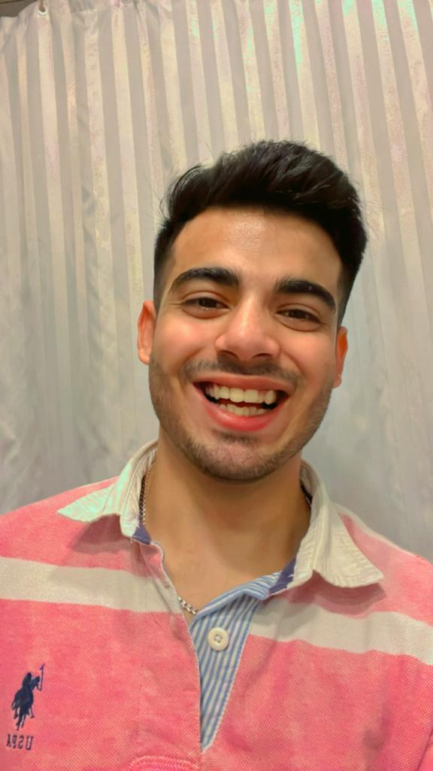
NIMISH SARDANA (He/Him)
Career Leader, Workshop Facilitator @ Centre for Career Action
Meng , ECE
https://www.linkedin.com/in/nimish-sardana-8381021a6/
Fun fact: I love swimming and Field hockey
Notes:
This presentation will be presented through my own lens and guided through my own experiences. Although I will share my own anecdotes alongside the content, I would like to emphasize that all of the material I present today is well-researched and backed up by the CCA. We get primary information from employers, recruiters, and more!

Slide 3
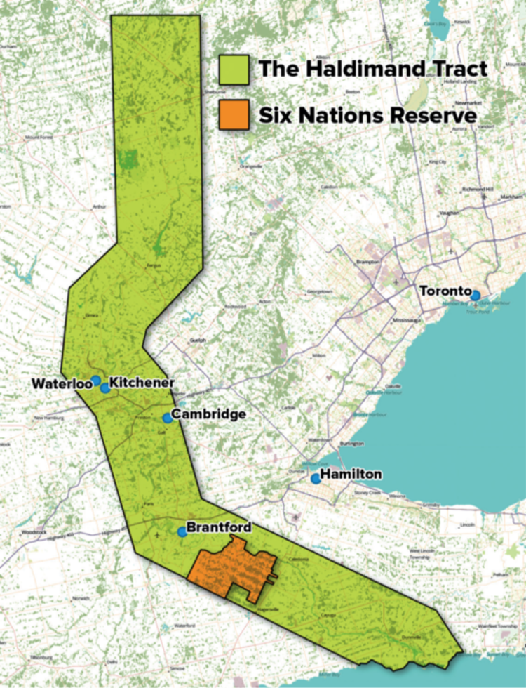
WHOSE LAND ARE WE ON?
The University of Waterloo acknowledges that much of our work takes place on the traditional territory of the Neutral, Anishinaabeg and Haudenosaunee peoples. Our main campus is situated on the Haldimand Tract, the land granted to the Six Nations that includes six miles on each side of the Grand River. Our active work toward reconciliation takes place across our campuses through research, learning, teaching, and community building, and is coordinated within the Office of Indigenous Relations.
June is Indigenous history month!
Upcoming presentation: June 20
On Land and Territorial Acknowledgements
Notes:
Nimish
I like to start all our workshops with our Territorial Acknowledgement – recognizing that this is just one very small step we can take towards honouring the original occupants of the land.
The University of Waterloo acknowledges that much of our work takes place on the traditional territory of the Neutral, Anishinaabeg and Haudenosaunee peoples. Our main campus is situated on the Haldimand Tract, the land granted to the Six Nations that includes six miles on each side of the Grand River. Our active work toward reconciliation takes place across our campuses through research, learning, teaching, and community building, and is coordinated within the Office of Indigenous Relations.
June is National Indigenous History Month and the Office of Indigenous Relation is organizing a series of really interesting events. An upcoming event is an hour long workshop on how to give territorial acknowledgements. Too often these acknowledgements can be a box ticking exercise, so this is a great opportunity to learn how to craft one that is culturally respectful and meaningful. Many of you will have to give territorial acknowledgements at some point in your career like presenting at a conference. I just registered myself last week and you can do the same here: https://uwaterloo.ca/indigenous/events/dr-kayla-murphy-and-robin-stadelbauer-land-and-territorial

Slide 4
What to Expect
Principles of curiosity, care and respect
Take things at your own pace and participate in a way that works for you: everything is optional
Ask questions throughout! Via the chat or direct message
Q & A at the end
Take what works for you, leave what doesn’t
Notes:
Today, we hope to create a generative space for learning during our time together here today. Talking about cover letters can be hard because it’s about putting yourself out there and telling your story. So, we invite you all to show up with curiosity, care and respect for your self as well as for each other.
We also invite you to take things at your own pace and participate in a way that works for you
Please feel free to use the chat to ask questions as they come up. We’ll also leave time for questions at the end where folks are invited to ask more questions as well. If you want to ask a question privately, please feel free to direct message either Nimish or myself.
As always, take what works for you, leave what doesn’t
​

Slide 5
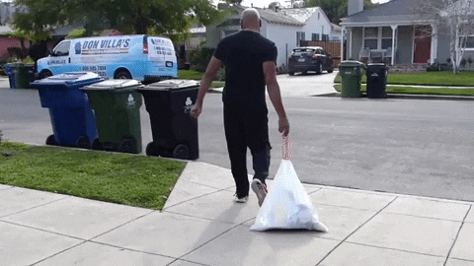
CHECKING IN!
Share in the chat, if you’re comfortable!
Your academic program, year
A GIF that captures how you feel about cover letters!
Sending off my cover letter!
Notes:
Today we’ll be talking about one of the most dreaded parts of the job search process: COVER LETTERS. Take a moment to find a gif that captures how you feel about the topic, as well as your academic program and year.
If you’re like me, you can sometimes feel like this when you’re submitting a cover letter. You spend all this time writing them and then just never hear back – it can feel like you might as well have thrown it in the trash. With that being said, we’re here today to make a case for the value of cover letters and how you can make writing them a whole lot less painful.

Slide 6
Today’s Agenda
Cover letter myth-busting
(Why) do I need a cover letter?
How to write a cover letter
What are the skills employers are looking for?
Going from skills identification to articulation
Q&A
Notes:
Nimish

Slide 7
Cover Letter Myth-Busting
Notes:
Nimish

Slide 8
Common Cover Letter Misconceptions
Cover Letters are replicas of resumes
Employers don’t read cover letters
Cover letters are time consuming
Cover letters are a waste of my time
Stock photo from npr.org
Notes:
Nimish:
Cover Letters are replicas of resumes
Resumes summarise qualifications, shows skills, educational history etc., which are all important facts about you. But just because you tell me those facts does that mean that I now somehow know who you are as a person? You're so much more than that and when you show up to work, you bring all of who you are to it.
The cover letter allows you to tell the story of who you are and what value you could bring to the employer.
Employers don’t read cover letters
If you google this question, you’ll come out more confused than earlier. Totally understandable because there is a lot of contradicting statistics out there. MSNBC says that 75% of recruiters don’t read the cover letter. That it has become obsolete in the current day and age. But other statistics show that it is not that simple: whether you need a cover letter or not and whether employers will read your cover letter depends on the company, the job you’re applying for etc. ​ Some say that even if a company doesn’t specify whether or not they want a cover letter, if you do attach one and they are using an ATS tracking system and you have tailored your cover letter for a specific job description, then the system will rank you’re application higher. ​
End of the day, there is no way to 100% be sure about whether or not you should write a cover letter for a job or not. ​ That is why, let is pause on this and approach it with a different question. Reframe it into- what is my motivation and commitment to this job that drives/impels me to write a cover letter?
Many people feel like cover letters are time consuming, but as we’ll get into later – there are smart and efficient ways you can approach tailoring your cover letter, where you don’t have to start from scratch every time. Plus, the more you write them, the easier they get to write
Steph
The final myth we often hear at the career centre is that cover letters are simply a waste of your time. Why devote so much time into writing one if employers may never even end up reading them?
This is a GREAT question! And it leads us to our next section….

Slide 9
(Why) Do I Need A Cover Letter?
Notes:
Nimish

Slide 10
The function of a cover letter
Cover letter = bridge between resume and interview
A place to…
Demonstrate your interest in the role
Go into detail! (Skills, experiences, etc.)
Explain things – if you want to
Show you’ve done your research
Notes:
Nimish
The cover letter serves many functions! Many people assume that cover letters are just a regurgitation or a summary of your resume. But it’s so much more than that! I want to invite you to think about it as a bridge between your resume and interview. While your resume provides highlights from your work and academic experience, your cover letter is an opportunity to make the case for why that experience would be an asset to the employer, thereby preparing you for a potential interview.
It’s really a place to…
demonstrate your interest in the role – why are you applying? What excites you most about this role? How does it fit within your career goals?
It’s also an awesome opportunity to go into detail about your experience and elaborate on what’s in your resume by telling the story of who you are
If you’d like you can also explain things – for instance, when I made the transition from communications to advising in my career, I took the opportunity to explain my decision to make the shift in my cover letter.
And last but not least, it’s a great opportunity to show the employer you’ve done your homework. By explaining how your experience is a great fit for the role and that it will help advance their mission – you’re showing them that you’ve closely read through the job description and done background research on what the company is all about.

Slide 11
Prioritizing job applications
Job Applications
High priority
Jobs that align very well with my interests/career goals
Mid-priority
Jobs that are appealing but not in complete alignment with my interests/career goals
Low priority
Jobs in minimal alignment with my interests/career goals
When should I submit a cover letter?
How much time should I invest tailoring my cover letter?
Is it OK to submit a generic cover letter?
Notes:
Nimish
But the question still remains: do you ALWAYS need a cover letter? Because the fact is some job postings require one while others don’t! At the centre for career action we often get questions like:
When should I submit a cover letter?
How much time should I invest in tailoring my cover letter?
Is it OK to submit a generic cover letter?
To all of these questions, we often ask students to reflect and prioritize their job applications. Is this a low priority job that only has minimal alignment with your interest and career goals? If so, you might not want to invest too much time customizing a cover letter! But if the job is a high priority job, meaning that is aligns very well with your interests and career goals then it’s probably worth taking the time to really research the company, study the job description closely and tailor your cover letter accordingly.

Slide 12
How does a cover letter benefit YOU?
Ensures job fit
If you can’t make your cover letter sound enthusiastic, should you be applying?
Articulates your career story
Helps us self-reflect & articulate our story across contexts (e.g. interviews, LinkedIn)
Creates future opportunities
Deepen your understanding of the sector
Notes:
Nimish
As we discussed earlier, a common myth we hear is that students aren’t’ motivated to write custom cover letters because they assume that no one will ever read them. How do you get motivated to write one then? Well, I think it’s a worthwhile exercise even if it doesn’t lead to an interview because the process of writing one benefits you in many ways.
First it ensure job fit – As I just mentioned, the cover letter is a great place to express your excitement for the role. If you find yourself struggling to articulate why you’re interested in the role, this is a red flag! It most likely means you shouldn’t be apply for the job in the first place.
Secondly, it also helps to articulate your career story. What do I mean by that? Well, when you write a cover letter you’re forced to reflect on your motivations, your values and the skills you’ve developed through your academic and professional experience. This exercise in self-reflection is GREAT practice for networking and interviews, so that next time someone asks you “Tell me about yourself” you’ll be better prepared.
And finally, writing cover letters can help create future opportunities. Because if you’re doing research ahead of time, you’re deepening your understanding of the company and the sector.
So, far from a waste of time, taking the time to write a cover letter – or update an old one – really benefits you in the long run when it comes to your personal professional development.
At this point, I may just pause for a moment to see if we have any questions. Feel free to pop it into the chat or just come off mute. I’ll pause for about 20 seconds to give folks some time.

Slide 13
How to write a cover letter
Notes:
Wonderful! So, when it comes to writing cover letters, the MOST important thing to remember is our audience. And who is that? They’re busy hiring managers, who are probably processing dozens of applications on top of working their full time job.
What that means is that in most cases they’re probably just skimming our cover letters.

Slide 14
Eye-catching cover letters
What are some things we can do to make our cover letters stand out?
Please use the chat or unmute to SHARE.
P.S. there are no right or wrong answers!
Notes:
So the question is: What are some things we can do to make our cover letters stand out?

Slide 15
Let’s talk strategy…
STEP 1: Review the job description
Reflect on 2-3 reasons you want the job
Highlight key words / skills
Pay attention to tone
STEP 2: Research!
Learn more about company: values, mission, etc.
Consider scheduling an informational interview (informal chat with someone in the industry)
STEP 3: Start writing!
Tailor the cover letter based on priority and capacity
Notes:
Nimish
When writing a cover letter, you always want to carefully study the job description and reflect on WHY it is that you want the job! What’s your motivation for writing the cover letter?
If you’re having a hard time coming up with reasons to apply, maybe this is one of those low priority jobs – and you might want to consider not applying or not spending too much time on your cover letter
- But if it is a mid to high priority job, you’ll want to examine the job description carefully and highlight key words and skills
And also pay attention to the tone. If the job posting is written in a casual, friendly voice, then you may want to consider mirroring that voice in your cover letter
Another helpful tip to strategic cover letter writing is doing your homework ahead of time. So, for those mid- to high- priority jobs, you might want to approach it as an opportunity to conduct research and to network. Before starting to write a cover letter, I always advise students to do as much background research on the organization and the team as possible. If it’s your dream job, you may want to go the extra mile and reach out to the hiring manager or a team member to see if they may be open to chatting with you and discussing the role in further detail. Take it from me, you’ll be surprised by how open and generous people are with their time!
And then last, but not least, you’ve gotta get writing!

Slide 16
Cover Letter Structure
Opening
Summarize how values/experience align with the company’s requirements/mission
Show enthusiasm by highlighting your reasons for applying
Name the job you’re applying to and how you found out about it
Body
2-3 specific examples of why you’re a good fit for the job
Use key words from job posting
Closing
Reiterate your reason for applying
Refer to your enclosed resume and provide contact information to follow-up
Notes:
Opening paragraph is a great way to set the stage, show that alignment. Ask yourself: How do my values or skills align with the company’s or position’s requirements/mission? This is where you can discuss that. By saying, hey! Here is a common space where we both meet. This gets them interested in your profile and wanting to know more.
You also want to convey your enthusiasm for the role. Remember employers are BUSY and they may be reviewing 100s of applications. So you want to make sure your cover letter stands out by hooking them in with a lively first paragraph.
Name the job you are applying to and where you saw or heard the advertisement
If applicable, include a reference to the person(s) you spoke to about the organization
Briefly sum up your value to the employer by stating what interests you in the organization and position
Middle paragraph:
You’ll want to provide just a couple of specific examples of why you’re a good fit for the job. Examples are a great way to group your skills!
Organize your points carefully and place the most important ones first
When discussing your qualifications, use (occasionally) words from the job description
Last paragraph: -you’ll definitely want to reiterate your reason for applying
-Refer to your enclosed résumé (optional)
-Mention that you would like to provide more information in an interview
-Include your phone number with the best times to reach you, and your email address (except in co-op process)
Space to discuss misc items: Flexible schedule. Remote work. Can work in any of the library branches, can be available on call when needed.

Slide 17
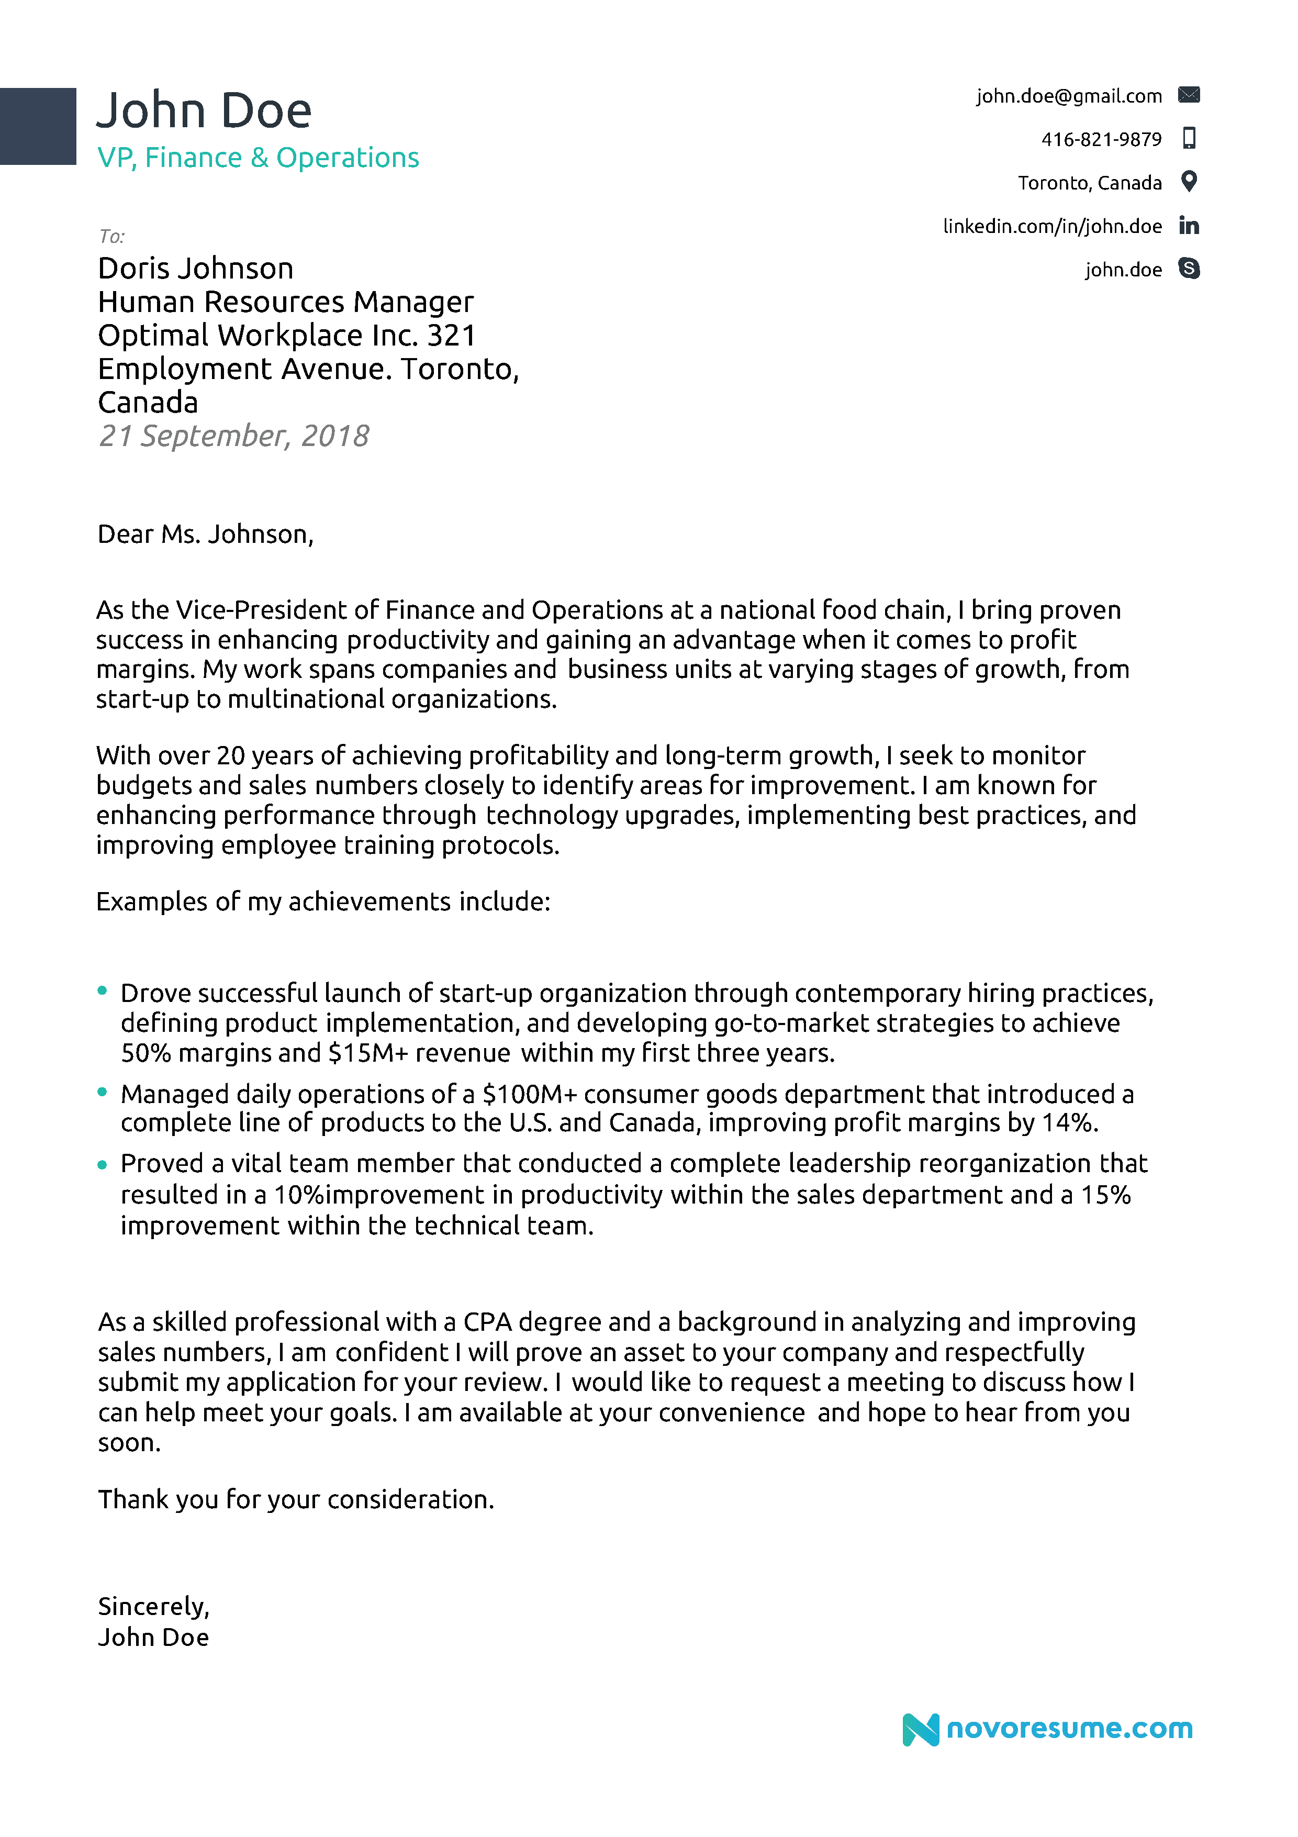
Cover Letter Structure
Your Name & Contact Information
Name & Address of Recipient
Date
Salutation
Opening
Body
Closing
Respects & Your Name
Notes:
Nimish
Now let’s take a look at this general outline of what a cover letter might look like. I’ll ask you to take a moment to reflect on what stands out here.
The first things that might stand out are:
Lots of white space
It’s one page: No hard and fast rule – but often people choose to keep it down to one
The name and contact information is easy to find
Don’t forget to add your name and contact information.
Followed by the organisation you are sending it to. If you know the name of the HR manager you are sending it to, fine. Otherwise no problem. Just the name of the organisation and their address will do.
Salutation Dear recruiting manager or hiring manager. Avoid using Mr/Ms if possible (unless you know how the recruiting manager identifies themselves)

Slide 18
Smart tailoring
Don’t write every cover letter from scratch!
Look for patterns and recurring key works in job postings
Try out the Lego approach:
Paragraphs = building blocks
Swap out the opening and closing paragraphs
Prepare multiple middle paragraphs to pick and choose from
Notes:
Nimish
So in a perfect world, we’d tailor our cover letter to every job we’re applying for. But the world isn’t perfect. You’re all juggling school and bunch of other responsibilities!
So here are a few tips to be smart and efficient in how you approach cover letters:
So, the first tip is that when we say tailor your cover letter, we don’t necessarily mean writing it from scratch every time! We mean making a few changes here and there to speak to the specifics of the job postings
Chances are you’re probably applying to similar types of positions. For me, I remember applying to dozens of communications jobs straight out of university. After a while, I noticed that most of the job postings kind of looked the same. So, that’s the second tip: Look for patterns while job searching like what kinds of skills and qualifications are they looking for? Take note of the key words seen across postings and make sure to include those.
Another tip is thinking about your cover letter like blocks of lego, where you can think about each paragraph of your cover letter like a building block you can switch out for another block to better suit the requirements of the job you’re applying for
In this approach, you might create one master version of your cover letter that you simply copy and rework for each application.
By reworking the first and final paragraphs, for instance, you can easily reframe your experience to make it more tailored to a specific job.
Alternatively, you may want to create a doc where you create multiple versions of your middle paragraph, where each one is tailored to a specific kind of job. Then you can pick and choose with one you need. I personally have used this approach before, where I had a version of middle paragraph tailored to communications jobs in different contexts like: universities, governments and corporate settings.
Next I’ll be handing it off to Nimish, who will be going through how we can tackle that body paragraph by identifying the skills we want to highlight in our cover letter

Slide 19
What are the skills employers are looking for?
Notes:
Nimish

Slide 20
Making Your Case
Why are you a match for the job?
Identify the employer’s “wish list”
Identify your skills & experiences
Create a table if it helps!
Notes:
Nimish
While preparing to write your cover letter these are a few questions one should ask themselves.
Why are you a match for this job?
Go through the job description and identify what out of the job description do u bring to the table.
A Good way is to make a table to make examples for all sections of the Job description.

Slide 21
Identify Required Skills
Library Shelver – Job Posting
We’re looking for individuals with exceptional eyes for detail to step into the inner workings of our library system. At WPL, Shelvers play an important role in our day-to-day operations with their knack for process, friendly faces, and their ability to keep things impeccably neat and tidy allow our customers have a superb library experience.
What required skills can you identify?
Notes:
Nimish
Now, let’s put our learning into action!
Note down some of the skills that stands out for you as I read through the slides.
Here are some from us.

Slide 22
Identify Required skills
What you’ll do:
Use automated sorter to check in and sort materials
Shelve materials in the library according to the Dewey Decimal System
Maintain a tidy library space
Be a friendly face to customers by responding to basic questions and referring them to our staff
What we’re looking for:
Highly detail-oriented individuals with a flair for neatness and organization
Warm and friendly personalities who keep the customer always in mind
Responsible and dependable individuals that can work with minimal supervision
People who enjoy a job with both physical and mental demands
Notes:
Nimish
Note down some of the skills that stands out for you.

Slide 23
Match your experience with required skills
Job requirement | Evidence that I meet them
Attention to detail | Citing research
Warm and friendly | Teaching assistant
Physical and mental demands | UWaterloo swim team member
Minimal supervision / dependable | Independent research
Neat and tidy | Organizing books and journals
Notes:
Make your own if you want to

Slide 24
How can we improve this middle paragraph?
“As a graduate student, I have the interpersonal skills necessary for this job. As a member of the swim team, I also have the abilities needed to physically carry and shelve materials. Having worked as a content writer with marketing experience, a major portion of my work involved writing articles and reports as well as managing meetings with clients situated in Australia, Europe, UK and the US, so I have the communication skills needed for this position as well.”
Key words: attention to detail, neat and tidy, physical and mental demands, responsible and dependable, minimal supervision, warm and friendly personality
Notes:
Now that we’ve read through the job description carefully and identified examples from our lives that show we have the required skills, now we can start writing our cover letter for the shelver position.
Here’s one example of a middle paragraph. Read through slide. Ask: How can we improve this middle paragraph?
Wait 20 seconds.
Reads like a long list of skills without real evidence that the person has those skills.
Does not include key words
Does not use specific examples that show how the person’s experience meets the job requirements
Some of the experience seems irrelevant to the job posting

Slide 25
Improved version
“My experience as a graduate student at the University of Waterloo has equipped me with the skills needed to be a dependable member of the shelving team. In my independent research, I need to stay organized with all the books and journals I reference and pay detailed attention to the current research in my field – all with minimal supervision. As a teaching assistant, I also support 25+ students every term with their coursework. My teaching evaluations indicate that my warm and friendly personality makes students feel comfortable approaching me with questions and concerns. I believe these interpersonal skills will be an asset in this customer-facing role.”
Key words: attention to detail, neat and tidy, physical and mental demands, responsible and dependable, minimal supervision, warm and friendly personality
Notes:
Now, let’s take a look at an improved version of the paragraph. Read slide. Ask: What do you notice is different?
Uses key words found in the job description
Provides specific examples their experience of how they’ve demonstrated the required skills
Shows how the person’s experience will add value to the job

Slide 26
Going from Identification to articulation
How can you prove that you have these skills?
Notes:
Nimish
Now that we know how to identify the skills that employers are looking for, how can we prove that we have these skills?

Slide 27
The Body Paragraph
Show don’t tell
Use specific examples!
Use S.T.A.R. approach to structure examples
Situation (What, when who, why, where?)
Task (what action did you take?)
Action (What skills did you use?)
Result (What was the outcome?)
Notes:
Nimish
Cover letters are our chance to make the case for why we’re the right candidate for the job in the body of our cover letter. But how do we do that? The #1 piece of advice I can give you is SHOW DON’T TELL! That is don’t just TELL me you’re the right person for the job, show me you’re the right person for the job through illustrative examples. It’s important to be specific!
And for this, I invite students to consider using the STAR approach. How many people have heard of the STAR approach? Let’s see some thumbs up!
STAR is an acronym for Situation: So, first you want to set the stage: what happened? Task: What action did you take? Action: What skills did you use and, finally, result, what was the final outcome?
This is a versatile model, which can be used to structure not just the examples in your cover letter, but also in crafting your answers to questions in the interview. So, it’s definitely worth your time to get to know it well!

Slide 28
What’S Missing?
“I am able to work effectively as part of a team.”
Please use the chat or unmute to SHARE.
P.S. there are no right or wrong answers!
Notes:
Keeping in mind, the STAR approach, what’s missing here?
Situation, Task, Action, Result.
Making a claim – but hasn’t provided any evidence to prove it
Sounds like ChatGPT wrote it!

Slide 29
Show Don’t Tell!
Telling
“I am able to work effectively as part of a team.”
Showing
Situation | In my mechanical engineering class this year,
Task | I was required to collaborate with my peers on building a functional robot.
Action | As team lead, I leveraged my project management skills to delegate tasks as well as my communication skills to resolve inter-personal conflicts.
Result | We received top marks and our prototype will be used as an example for future classes.
Notes:
Nimish
So, this is a good example of someone telling rather than showing.
If we wanted to rework this via the STAR method, it could look something like this:
In my mechanical engineering class this year,
I was required to collaborate with my peers on building a functional robot.
I leveraged my skills in project management to delegate tasks and my communication skills to troubleshoot design issues to complete the project, for which we received top marks.
As we can see, this answer is showing us how this candidate is good with teamwork rather than just telling us! It provides a very specific example, which details the situation, what I did and the result of my actions.
Like the skills identification chart that Nimish introduced earlier, we invite you to use this table to help structure the examples you use in your cover letter! It can be a helpful guide to creating a powerfully convincing middle paragraph.

Slide 30
TAKEAWAYS

Slide 31
Key Takeaways
Employers are busy – make your cover letter stand out!
The process of writing cover letters benefits YOU
Tailor your cover letters – efficiently!
Study the job description carefully
Match your skills/experience with what they’re looking for!
Show don’t tell
Use the S.T.A.R. model

Slide 32
Supports & Resources

Slide 33
A note on safety and disclosure in cover letters
Social safety: you can share, but you don’t have to share
Emotional safety: what is coming up for you when writing this cover letter?
Accommodations: can be requested through the company’s Human Resources department
Protected grounds from the Ontario Human Rights Code:
“Age, Ancestry, Colour, Race, Citizenship, Ethnic Origin, Place of Origin, Creed, Disability, Family Status, Marital Status, Gender Identity, Gender Expression, Receipt of public Assistance, Record of Offences, Sex, Sexual Orientation” The Ontario Human Rights Code | Ontario Human Rights Commission (ohrc.on.ca)
Notes:
Nimish
Social safety: ex. Pronouns
Emotional safety: if you don’t feel safe disclosing certain information, maybe ask yourself it this is the right opportunity for you?
Accommodations: contact information for the company’s resources department is usually included in the job posting
Ontario human rights code:
Just remember that it is a provincial law that gives everybody equal rights and opportunities without discrimination in areas such as jobs, housing and services. The Ontario Human Rights Code protects people from discrimination in these areas. If you think your rights under the Code have been violated, you can file a complaint .

Slide 34
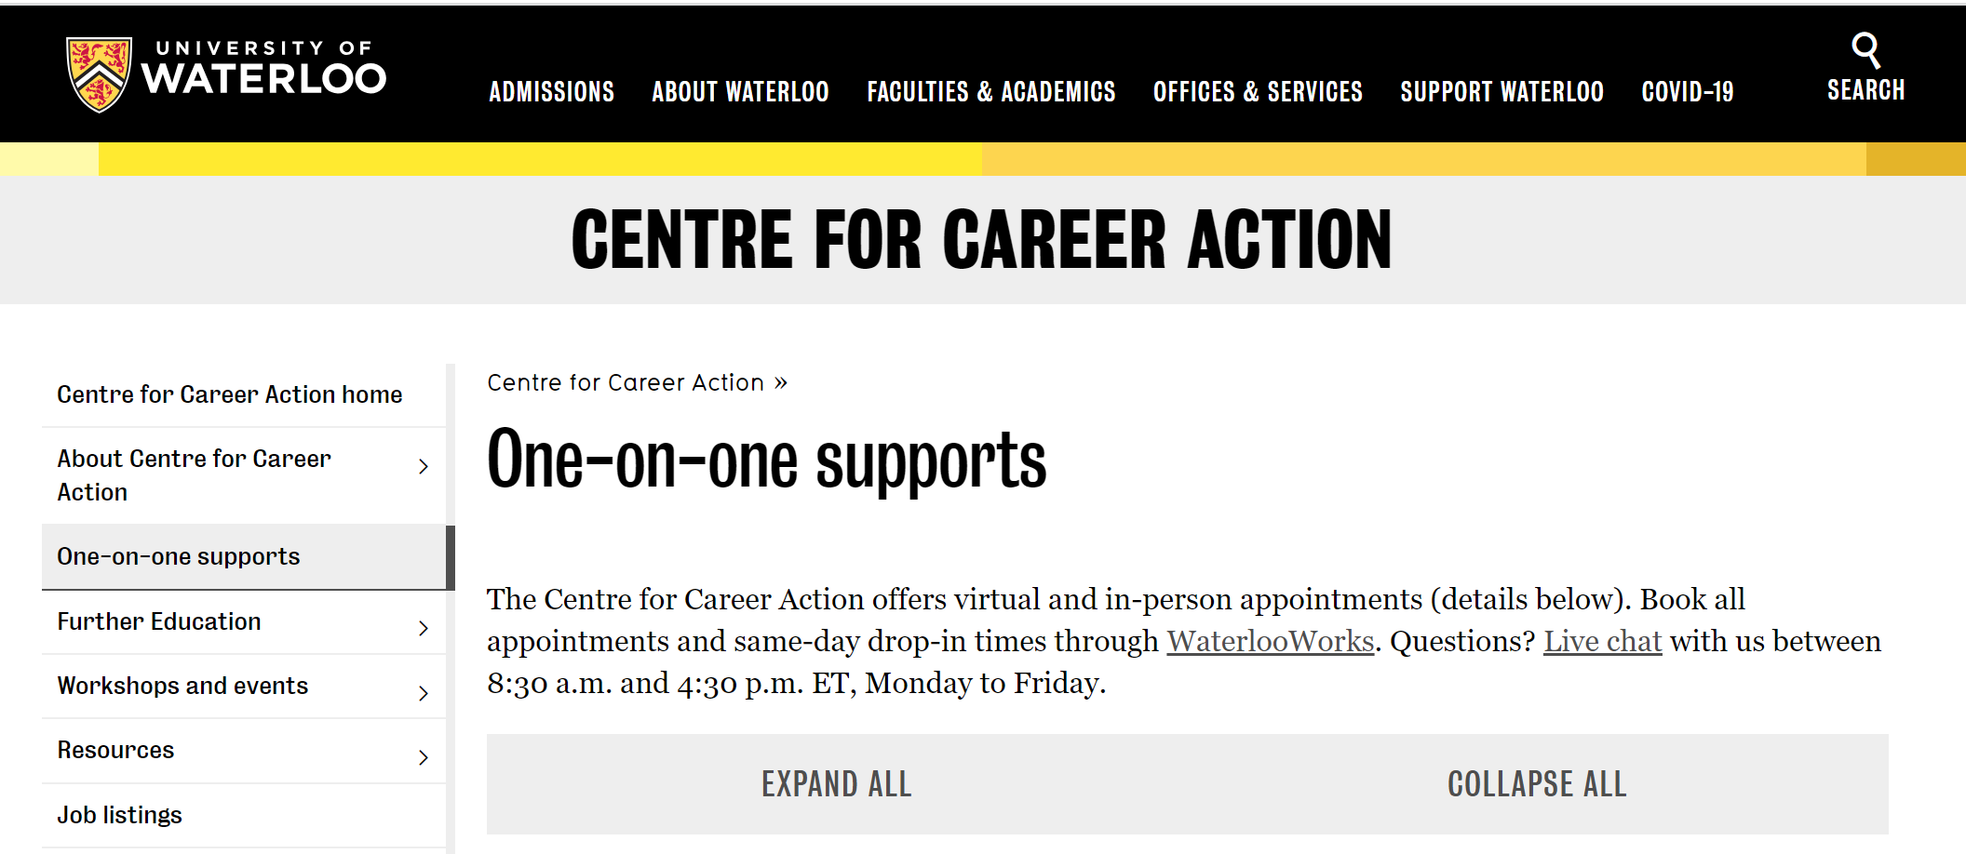
Additional Support
Visit the Centre for Career Action (virtually or in-person) for one-on-one support with your job search and application documents, including cover letters
Same day 20-minute drop-ins
30-minute cover letter appointments
https://uwaterloo.ca/career-action/one-one-supports
Notes:
Nimish
IMPORTANT: don’t have to figure it out by yourself. Reach out to people who are here to support you.

Slide 35
Questions?
Notes:
Nimish

Slide 36
Thank you! Any questions or comments?
What has come up for you during this workshop?
Feel free to go mic on to ask questions, or use the chat feature in Zoom
Please don’t hesitate to reach out!

