Slide 1
Question Facilitation Tools
Dr. Mark Morton
Centre for Teaching Excellence
University of Waterloo
mmorton@uwaterloo.ca
www.markmorton.ca

Slide 2
Learning Outcomes for this Workshop
After this workshop you will be able….
to explain the basic functionality of each of these tools
to identify which technologies are most relevant to your teaching practice
to describe how you might use a given technology to enhance your students’ learning experience
to locate additional resources for those technologies that you want to learn more about.

Slide 3
What this workshop won’t do
Get into the specifics of how to use these tools (e.g. how to set up a clicker receiver, how to adjust audio in Camtasia, etc., how to install CmapTools, etc.)
CTE has other resources to learn those details

Slide 4
What you’ll be doing in this workshop
Listening (to learn about the functionality of the tools)
Thinking (about how those tools can be used effectively)
Sharing (your ideas)

Slide 5
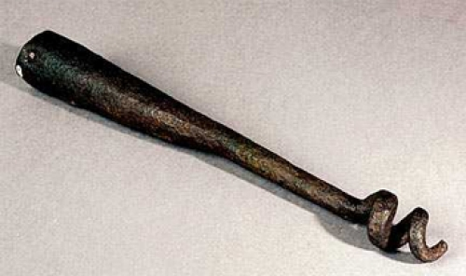
A Warm-Up Exercise

Slide 6
Google Moderator
What does it do?
It’s an online space where students can post questions
Other students can see the questions that are posted and vote them up or down
Everyone is able to see how many students like a question and how many students don’t like it
The instructor and students can respond, in Google Moderator, to questions that are posted
A Google Moderator session can have many sub sessions
The instructor chooses whether questions can be posted anonymously

Slide 7
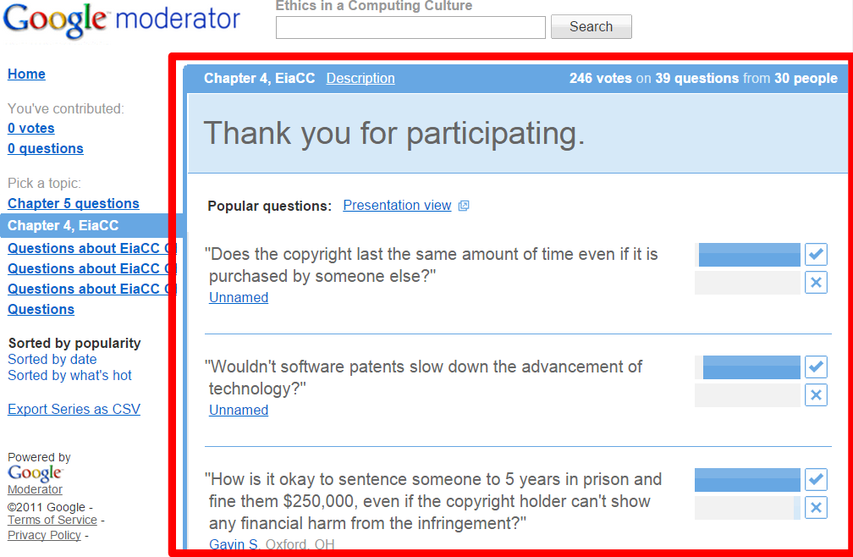
Google Moderator
What does it do?
It’s an online space where students can post questions

Slide 8
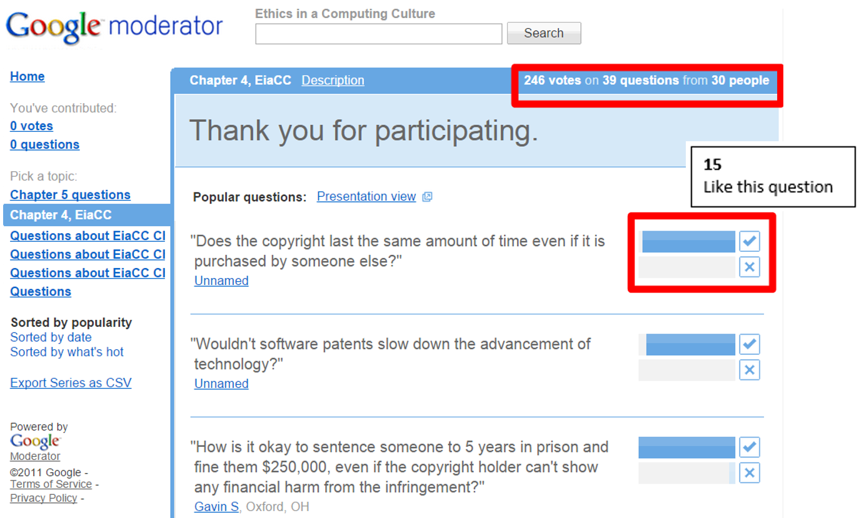
Google Moderator
What does it do?
Other students can see the questions that are posted and vote them up or down
Everyone is able to see how many students like a question and how many students don’t like it

Slide 9
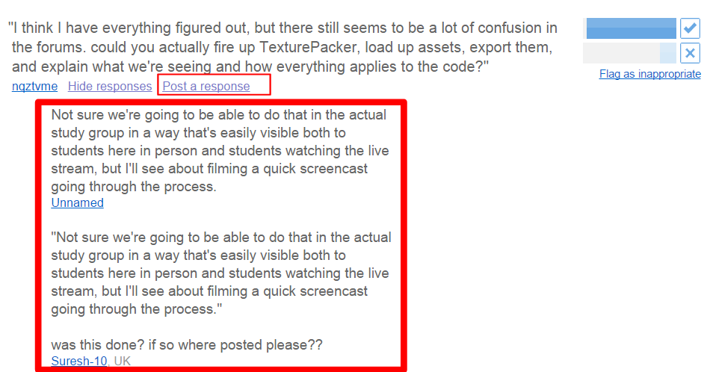
Google Moderator
What does it do?
The instructor and students can respond, in Google Moderator, to questions that are posted

Slide 10
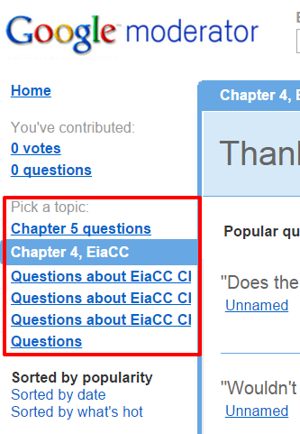
Google Moderator
What does it do?
A Google Moderator session can have many sub sessions or “topics”

Slide 11
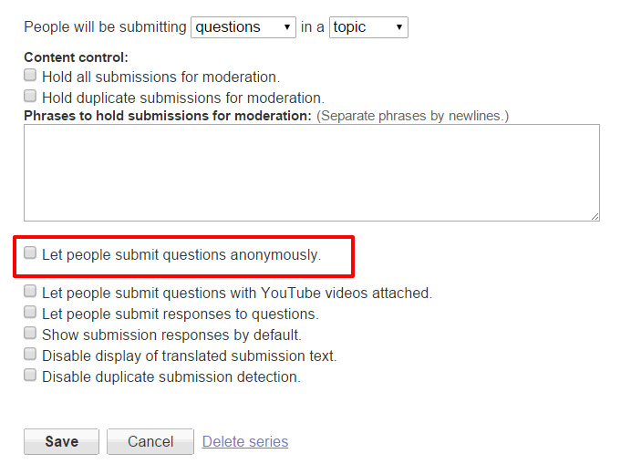
Google Moderator
What does it do?
The instructor chooses whether questions can be posted anonymously

Slide 12
Brainstorming: How could Google Moderator enhance your students’ learning experience?
Google Moderator
Encourages “shy” students to ask questions in class
You can see which questions are of most interest to the greatest number of students
You can “vet” the questions before responding to them
You have a record of students question which, if you want, you can respond to outside of class time (e.g. in the Learning Management System)

Slide 13
Piazza
What does it do?
Piazza is an online space that is blends the functionality of an online discussion forum with the functionality of a wiki.
Students or the instructor post questions to Piazza. The questions appear in a sequence (like posts in a discussion forum).
Students collaboratively solve the question in a single online space (like a wiki).
The instructor can “endorse” the students’ solution when appropriate.
The instructor can respond to the question.
Follow-up questions or discussion can be posted.

Slide 14
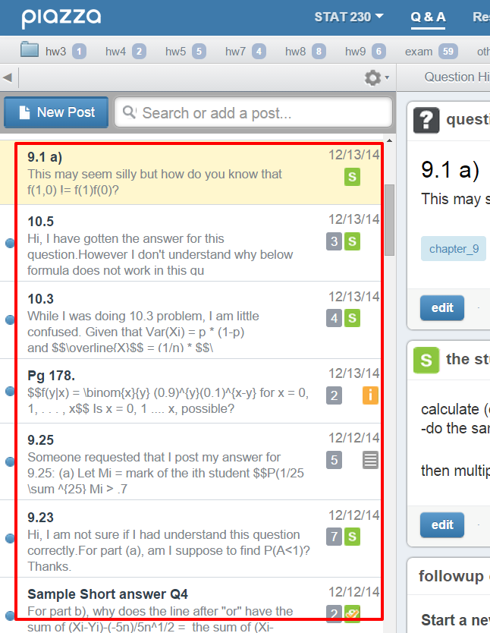
Piazza
What does it do?
Students or the instructor post questions to Piazza. The questions appear in a sequence (like posts in a discussion forum).

Slide 15
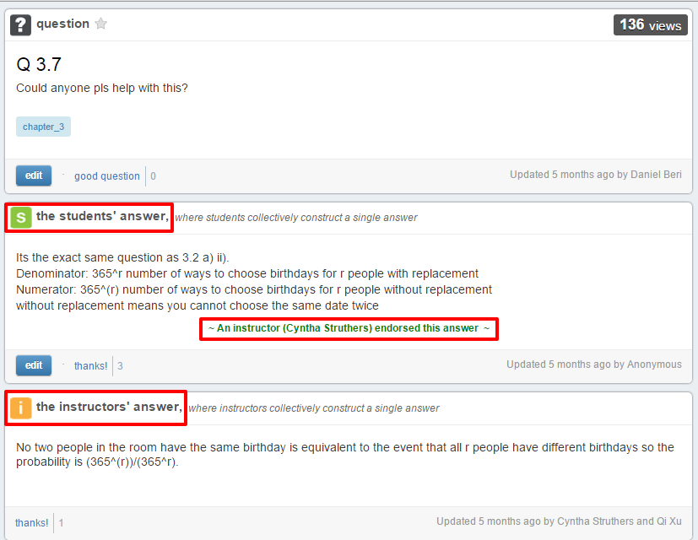
Piazza
What does it do?
Students collaboratively solve the question in a single online space (like a wiki).
The instructor can “endorse” the students’ solution when appropriate.
The instructor can respond to the question.

Slide 16
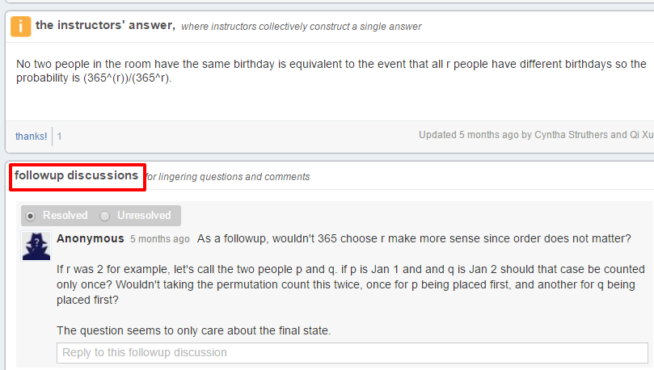
Piazza
What does it do?
Follow-up questions and discussion can be posted.

Slide 17
Brainstorming: How could Piazza enhance your students learning experience?
Piazza
It empowers students: they collaborate on developing their own answers to their own questions.
It leverages peer instruction:
The best way to learn something is to teach someone else
Overcomes “expertise bias”
Students get just-in-time responses to their questions, usually within a few minutes.

Slide 18
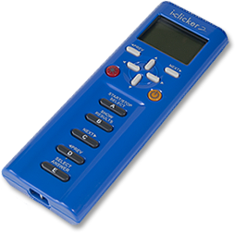
Clickers
What does it do?
The instructor projects a question on the classroom screen
Students use their clickers to respond to the question
The clicker base unit collects the responses and displays them as a bar chart

Slide 19
Clickers
What does it do?
The instructor projects a question on the classroom screen

Slide 20
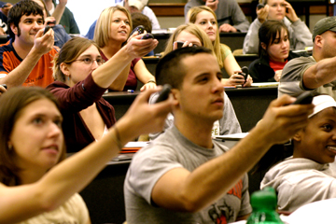
Clickers
What does it do?
Students use their clickers to respond to the question
The clicker base unit collects the responses and displays them as a bar chart

Slide 21
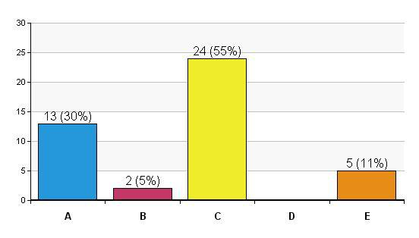
Clickers
What does it do?
The clicker base unit collects the responses and displays them as a bar chart

Slide 22
Brainstorming: How can Clickers enhance your students’ learning experience?
Clickers
Clickers can make your class time more engaging: sustains student interest
Use clickers to get a sense of whether students are “getting it”
Use them to ensure that students come to class fully prepared.
Leverages Peer Instruction
The best way to learn something is to teach someone else
Overcomes “expertise bias”

Slide 23
Example of Peer Instruction using clickers
Clickers
Grab an iClicker and get read to use it!

Slide 24
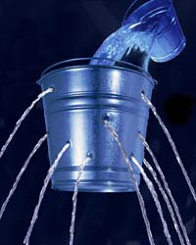
Example of Peer Instruction using clickers
Clickers
If holes are made in the side of a suspended bucket, water will flow out in a downward parabolic trajectory.
What happens to the flow of liquid if you drop the bucket, that is, while it is falling?
The flow out of the holes diminishes
The flow out of the holes completely stops
The water flows out of the holes in straight lines
The water flows out of the holes and curves upward

Slide 25
An Example of Peer Instruction using clickers
Clickers
What happens to the flow of liquid if you drop the bucket, that is, while it is falling?
The flow out of the holes diminishes
The flow out of the holes completely stops
The water flows out of the holes in straight lines
The water flows out of the holes and curves upward
Water flows out of the holes because the water pressure inside is higher than the air pressure outside. The water pressure is due to the weight of the water. When the bucket is in free fall, the water is weightless, so the water pressure is zero. Therefore, no water flows out of the holes.

Slide 26
Learning Catalytics
What does it do?
Learning Catalytics is an online platform with clicker-like functionality.
The instructor creates the questions in the online platform; various kinds of questions are supported.
The instructor displays the questions one at a time on the classroom screen; alternatively, students can view the questions on their laptops, smart phones, or other mobile devices.
Students use their laptops, smart phones, or other mobile devices to respond to the questions.
Learning Catalytics collects the students’ responses and displays them as a bar chart (or in other graphical forms)

Slide 27
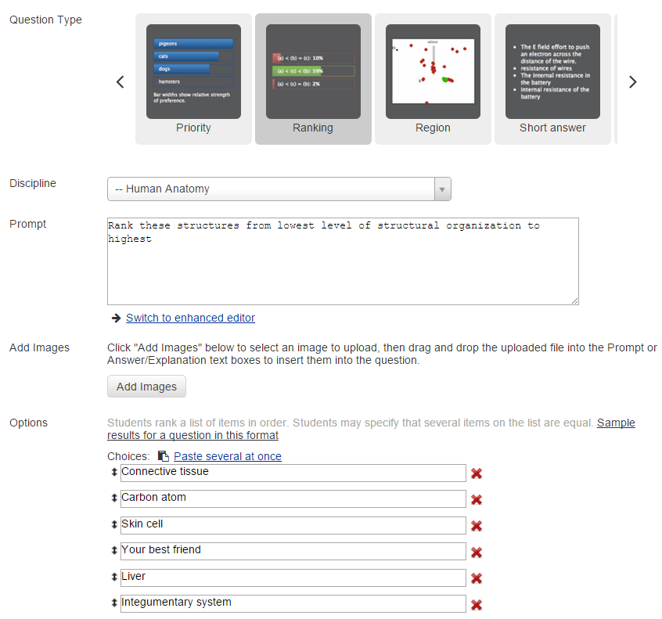
Learning Catalytics
What does it do?
The instructor creates the questions in the online platform; various kinds of questions are supported.

Slide 28
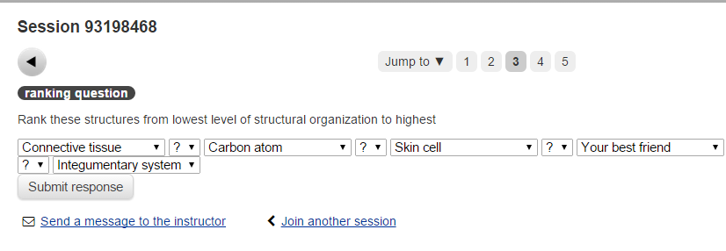
Learning Catalytics
What does it do?
The instructor displays the questions one at a time on the classroom screen; alternatively, students can view the questions on their laptops, smart phones, or other mobile devices.

Slide 29
Learning Catalytics
What does it do?
Students use their laptops, smart phones, or other mobile devices to respond to the questions.

Slide 30
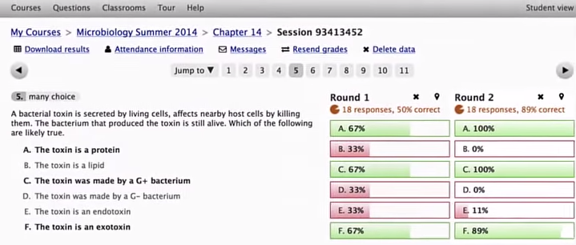
Learning Catalytics
What does it do?
Learning Catalytics collects the students’ responses and displays them as a bar chart (or in other graphical forms)

Slide 31
Top Hat
What does it do?
Similar functionality to Learning Catalytics:
Top Hat is an online platform with clicker-like functionality.
The instructor creates the questions in the online platform; various kinds of questions are supported.
The instructor displays the questions one at a time on the classroom screen; alternatively, students can view the questions on their laptops, smart phones, or other mobile devices.
Students use their laptops, smart phones, or other mobile devices to respond to the questions.
Top Hat collects the students’ responses and displays them as a bar chart (or in other graphical forms)
Differences between the two platforms are listed here

Slide 32
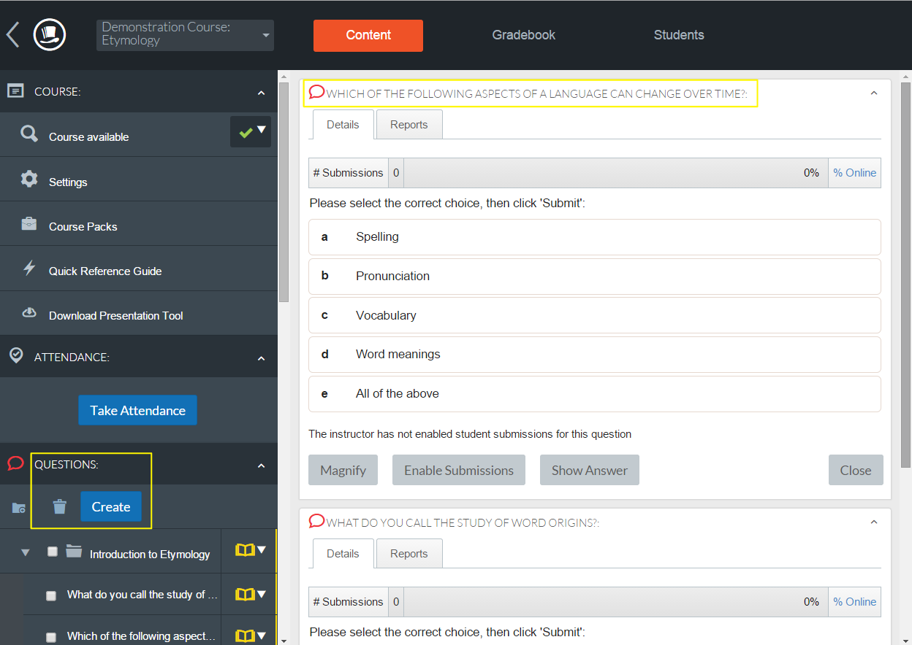
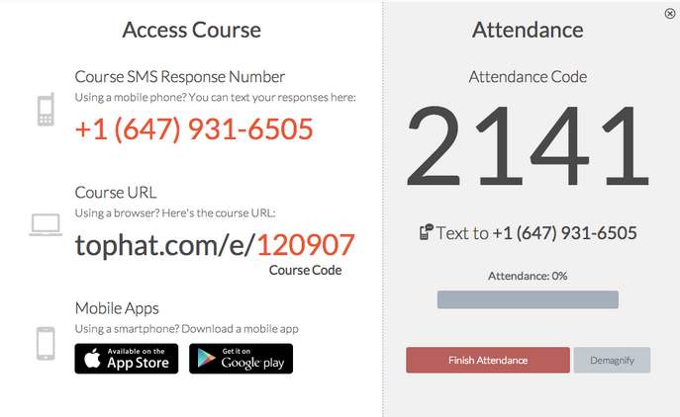
Top Hat

Slide 33
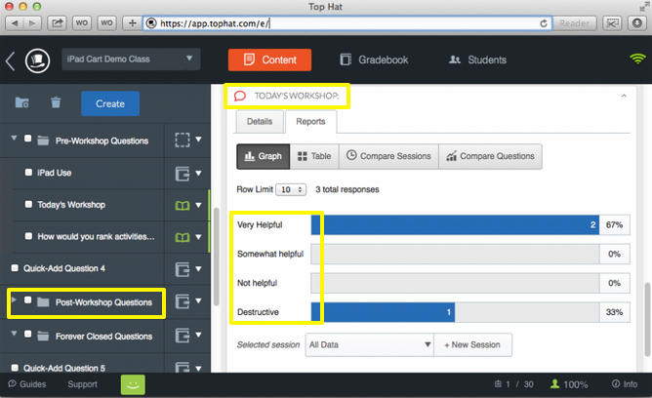
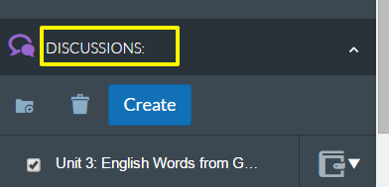
Top Hat

Slide 34
Brainstorming: What are the relative merits of Top Hat and Learning Catalytics (on the one hand) versus Clickers (on the other hand)?
Clickers
Clickers have one purpose: to collect responses (they don’t have other “distractions” built into them)
Clickers are cheap (not all students can afford a mobile device, which is needed to use Piazza)
Top Hat and Learning Catalytics
Students never forget their smartphones but they might forget to bring their clickers
Top Hat allows you to ask a wider variety of questions
Top Hat seems more “hip” than clickers
With Top Hat, each student can interact with simulations and animations
Top Hat facilitates students asking their own questions

Slide 35
Questions and Discussion

