Slide 1

Preparing for
Difficult Conversations
Conflict Management and Human Rights Office
Matt Erickson, Director

Slide 2

reinforce the importance of early response
recognize barriers to an early response
provide structure with which to
    assess
    plan
    actively participate
  in a difficult conversation.

Slide 3
Conflict Management & Human Rights Office
Conflict Management
Facilitation
Mediation
Support
Coaching
Education and Training
Human Rights
Information
Consultation
  Preventative
  Responsive
  Education and Training

Slide 4


Slide 5


Slide 6


Slide 7


Slide 8


Slide 9
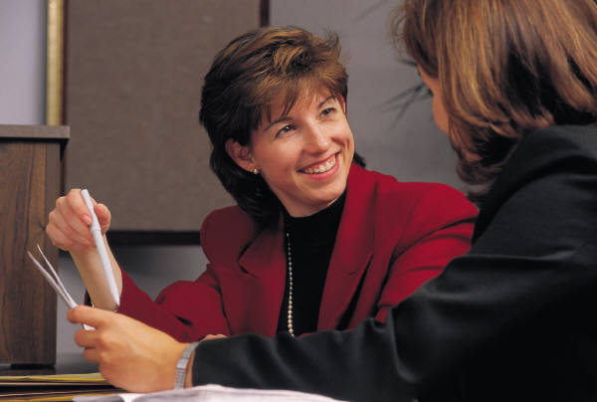

Slide 10
How do I know that I am going into, involved in or have just left a difficult conversation?
I can’t trust them
I feel tension
I don’t understand
I ‘m physically ill
I want to quit
I’m afraid
I don’t enjoy good relations
I’m worried
I found it to be non-productive
they didn’t care
they were evasive
I don’t feel listened to
I ‘m de-motivated
I’m distracted
I’m upset
I’m exhausted
they didn’t listen
they were defensive
I can’t communicate

Slide 12
Solid Relationship
Spiralling consequences
Troubled relationship

Slide 13
Continuum of Conflict Management Processes
No assistance,
direct
communication
Informal 3rd party
assistance with...
Formal 3rd party
assistance:
no direct
communication
Relationship Process Substantive
Negotiation
Meetings
Conversations
Conciliation
Coaching
Team
Building
Coaching
Training
Facilitation
Mediation
Advisory
mediation
Fact finding
Settlement
conferences
Grievances
Arbitration
Investigation
Adjudication
Informal: despite the intervention, the party retains control over, and input into, the final outcome.
Formal: the party gives up control
over, and has limited input into, the final
outcome.
Adapted from: Moore, Christopher et. al. Effective Mediation. Boulder: CDR Associates, 1989.

Slide 14

Perceived Barriers Can Impede Effective Early & Effective Resolution Attempts

Slide 15
Perceived Barriers Can Impede Effective Early & Effective Resolution Attempts
ASSESSING
PLANNING
ACTIVELY PARTICIPATING

Slide 16


Slide 17

Two Things:
There will be an ongoing need to share or hear information that we believe to be negative or critical and where there is a real possibility for a negative impact.
If this is to be the case, then we need to consider that there is more that contributes to a difficult conversation that negative content of the message.

Slide 18
P R O C E S S
G O O D
P O O R
SUBSTANCE
POS
Positive Substance
Good Process
Positive Substance
Poor Process
Good Relationship
Poor Relationship
NEG
Negative Substance
Good Process
Negative Substance
Poor Process
Good Relationship
Poor Relationship
RELATIONSHIP
G O O D P O O R

Slide 19
Characteristics of a
Damaged Relationship
Desire to understand another’s perspective is low
Presence of high negative emotions
Distrust is high
Effective communication is low
  Questions that promote understanding diminish and are replaced by statements
  The quality of listening diminishes
Presence of active negative filters contributing to misperception, pre-judgements
Notes:
When concerns of harassment arise, it is important to document what is happening as proper documentation is very important to case resolution.
Documentation of a complaint should be clear and detailed, and events noted in a chronological order.
The contents of the complaint should answer the following questions:
When did the incident(s) occur?
provide date(s) of the incident(s)
provide time(s) of occurrence including duration
Where did the incident(s) occur?
location of incident(s) (e.g., office, cafeteria, parking lot, social function)
medium of communication of harassment: verbal, non-verbal (e.g., gestures and physical contact), written (including e-mail), etc.
What exactly happened during the incident(s)?
provide details of the incident(s): specify the actions taken by the harasser (e.g., sent e-mail or a letter, touched complainant, made harassing comments, etc.)
Were there any witnesses?
who, if anyone, saw the harasser's actions
is anyone else aware of the incident(s) taking place
Did the complainant tell anyone about the incident(s)?
who else was told about the incident(s) (e.g., supervisor, co-worker, human resources, counselor, friend, etc.)
What attempts, if any, have been made to remedy the situation?
have there been any steps taken to stop the harassment
if action has been taken, specify the steps taken to rectify the situation (e.g., complainant told the harasser that his/her actions were unacceptable, complainant approached personnel about the situation, warning was issued to the harasser, etc.)
How did the complainant feel when the incident took place?
specify how the harasser's actions emotionally affected the complainant (e.g., angry, fearful, feelings of inferiority, etc.)

Slide 20

SUCCESSFUL OUTCOME UNSUCCESSFUL
influences
P R O C E S S
G O O D
P O O R
SUBSTANCE
POS
1
2
Positive Substance
Good Process
Positive Substance
Poor Process
Good Relationship
Poor Relationship
3
4
NEG
Negative Substance
Good Process
Negative Substance
Poor Process
Good Relationship
Poor Relationship
G O O D CONCERNS EMERGING P O O R
RELATIONSHIP

Slide 21
What Barriers Can Impede the Effectiveness of a Difficult Conversation?
Low confidence
Lack knowledge “how to …”
Lack requisite skills
Lack support … “I’m all alone”
Uncertainty
Carelessly framed problems and solutions
Perceived lack of caring/sensitivity
Fear
Lack of understanding

Slide 22
Case Study C
Peter is the manager of a large academic support unit.
No problems in the past but lately tension between Olivia and Ben.
Olivia has always been pleasant to work with.
Recently, she seems grumpy and works night and day.
Some suggest problems at home.
Ben has had no issues with Olivia until recently.
She has started calling Ben at home late in the evening
This has been going on for six weeks now
Ben’s wife is becoming very annoyed.
Ben has come to Peter for help.
Ben assured Peter that he had tried to talk to Olivia but she refused to listen. Peter approached Olivia in the coffee room
Olivia became angry and said, “Why didn’t Ben talk to me himself?”
Peter wonders, “Why can’t these two figure this out on their own?”

Slide 23
Questions
Look for the missed opportunity that Ben had in which he could have had an earlier difficult conversation with Olivia and identify this opportunity.
What made this earlier opportunity a “prime time” to deal with the situation?
What behaviors do you believe interfered with effective communication between Ben and Olivia?

Slide 24
If Ben had taken advantage of this early opportunity, use the following questions to form a context statement that he could have presented to Olivia..
    Why does Ben need to have this conversation?
    Has something kept Ben from having this conversation earlier? What is that?
    What will Ben and Olivia gain from having the conversation? (e.g. greater clarity)
    Is it best for Ben to have this conversation now or should it be delayed? Why?
    What will be the likely outcome if Ben doesn’t have the conversation?
    Refer to the scenario … what costs can you identify?

Slide 25
Perceived Barriers Can Impede Effective Early Resolution Attempts
ASSESS
PLAN
PARTICIPATE ACTIVELY

