Slide 1
Maintaining Relations with Your Student for Graduate Supervisors
Matt Erickson
Lynn Long
CTE Sept. 25, 2015

Slide 2

CONFLICT MANAGEMENT AND HUMAN RIGHTS OFFICE
Notes:
To add a photo to this slide, click the Picture icon in the content area (first column of icons, second row). Navigate to the photo you would like to insert. PowerPoint will auto-resize the photo to fit the area. If you are unhappy with the results, you can either:
Manually resize your photo to 6.4” high x 10” wide using an image editor. Then, insert it via Home>Insert>Picture.
Insert your picture as-is via Home>Insert>Picture. Then, select your photo and choose Format. Resize and crop your photo using the editing tools in PowerPoint.

Slide 3
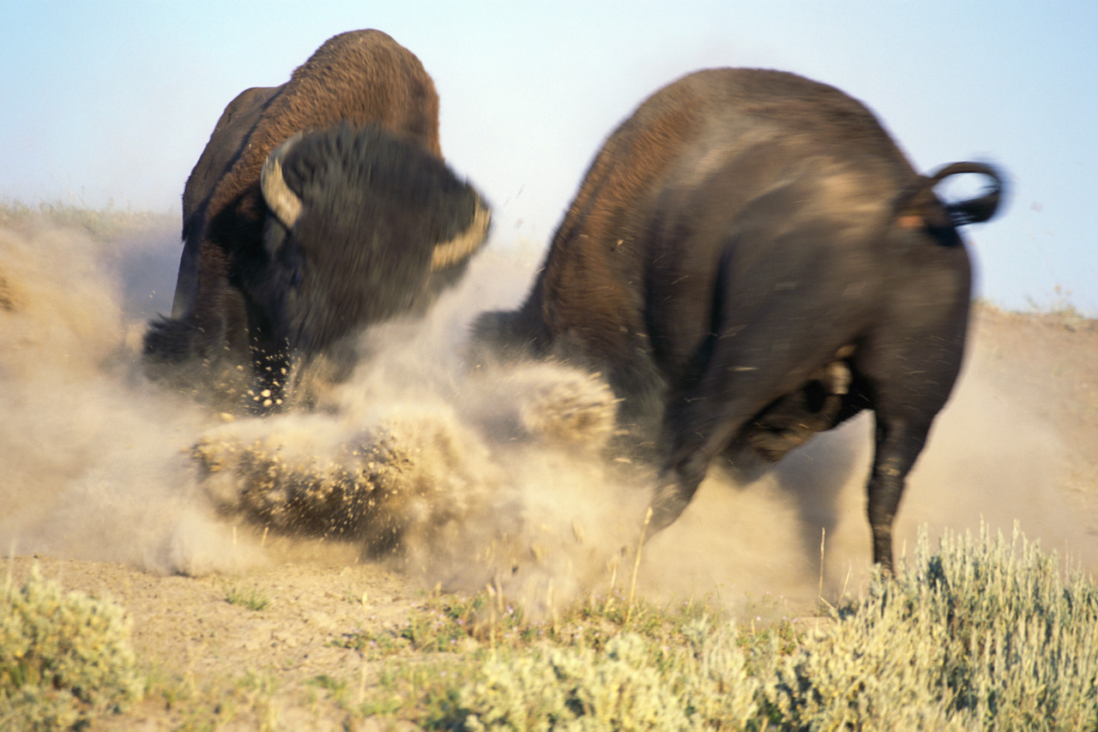
CONFLICT MANAGEMENT AND HUMAN RIGHTS OFFICE
Notes:
To add a photo to this slide, click the Picture icon in the content area (first column of icons, second row). Navigate to the photo you would like to insert. PowerPoint will auto-resize the photo to fit the area. If you are unhappy with the results, you can either:
Manually resize your photo to 6.4” high x 10” wide using an image editor. Then, insert it via Home>Insert>Picture.
Insert your picture as-is via Home>Insert>Picture. Then, select your photo and choose Format. Resize and crop your photo using the editing tools in PowerPoint.

Slide 4

CONFLICT MANAGEMENT AND HUMAN RIGHTS OFFICE
Notes:
To add a photo to this slide, click the Picture icon in the content area (first column of icons, second row). Navigate to the photo you would like to insert. PowerPoint will auto-resize the photo to fit the area. If you are unhappy with the results, you can either:
Manually resize your photo to 6.4” high x 10” wide using an image editor. Then, insert it via Home>Insert>Picture.
Insert your picture as-is via Home>Insert>Picture. Then, select your photo and choose Format. Resize and crop your photo using the editing tools in PowerPoint.

Slide 5

CONFLICT MANAGEMENT AND HUMAN RIGHTS OFFICE
Notes:
To add a photo to this slide, click the Picture icon in the content area (first column of icons, second row). Navigate to the photo you would like to insert. PowerPoint will auto-resize the photo to fit the area. If you are unhappy with the results, you can either:
Manually resize your photo to 6.4” high x 10” wide using an image editor. Then, insert it via Home>Insert>Picture.
Insert your picture as-is via Home>Insert>Picture. Then, select your photo and choose Format. Resize and crop your photo using the editing tools in PowerPoint.

Slide 6
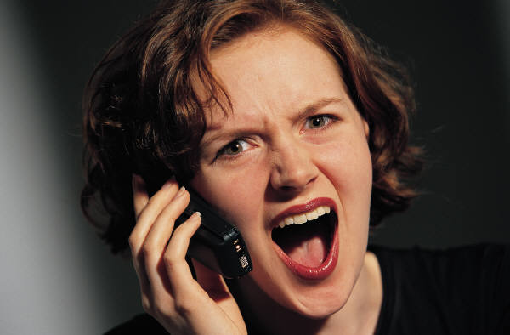
CONFLICT MANAGEMENT AND HUMAN RIGHTS OFFICE
Notes:
To add a photo to this slide, click the Picture icon in the content area (first column of icons, second row). Navigate to the photo you would like to insert. PowerPoint will auto-resize the photo to fit the area. If you are unhappy with the results, you can either:
Manually resize your photo to 6.4” high x 10” wide using an image editor. Then, insert it via Home>Insert>Picture.
Insert your picture as-is via Home>Insert>Picture. Then, select your photo and choose Format. Resize and crop your photo using the editing tools in PowerPoint.

Slide 7

CONFLICT MANAGEMENT AND HUMAN RIGHTS OFFICE
Notes:
To add a photo to this slide, click the Picture icon in the content area (first column of icons, second row). Navigate to the photo you would like to insert. PowerPoint will auto-resize the photo to fit the area. If you are unhappy with the results, you can either:
Manually resize your photo to 6.4” high x 10” wide using an image editor. Then, insert it via Home>Insert>Picture.
Insert your picture as-is via Home>Insert>Picture. Then, select your photo and choose Format. Resize and crop your photo using the editing tools in PowerPoint.

Slide 8
“While it is important to acknowledge that graduate students are partners in the University enterprise, it is equally important to recognize their differential power status, especially as it relates to their supervisors. Some students may feel at risk if they complain or disagree with their supervisors.”
http://www.grad.uwaterloo.ca/students/current/supervisory_guide_2011.pdf
CONFLICT MANAGEMENT AND HUMAN RIGHTS OFFICE

Slide 9
“While it is important to acknowledge that graduate students are partners in the University enterprise, it is equally important to recognize their differential power status, especially as it relates to their supervisors. Some students may feel at risk if they complain or disagree with their supervisors.”
http://www.grad.uwaterloo.ca/students/current/supervisory_guide_2011.pdf
CONFLICT MANAGEMENT AND HUMAN RIGHTS OFFICE

Slide 10
Continuum of Conflict Management Processes
No assistance,
direct
communication
Informal 3rd party
assistance with...
Formal 3rd party
assistance:
no direct
communication
Relationship Process Substantive
Negotiation
Meetings
Conversations
Conciliation
Coaching
Team
Building
Coaching
Training
Facilitation
Mediation
Advisory
mediation
Fact finding
Settlement
conferences
Grievances
Arbitration
Investigation
Adjudication
Informal: despite the intervention, the party retains control over, and input into, the final outcome.
Formal: the party gives up control over, and has limited input into, the final outcome.
Adapted from: Moore, Christopher et. al. Effective Mediation.
Boulder: CDR Associates, 1989.
CONFLICT MANAGEMENT AND HUMAN RIGHTS OFFICE
Notes:
To add a photo to this slide, click the Picture icon in the content area (first column of icons, second row). Navigate to the photo you would like to insert. PowerPoint will auto-resize the photo to fit the area. If you are unhappy with the results, you can either:
Manually resize your photo to 6.4” high x 10” wide using an image editor. Then, insert it via Home>Insert>Picture.
Insert your picture as-is via Home>Insert>Picture. Then, select your photo and choose Format. Resize and crop your photo using the editing tools in PowerPoint.

Slide 11
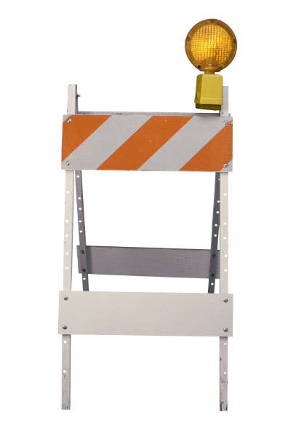

Perceived Barriers Can Impede Effective Early Resolution Attempts
CONFLICT MANAGEMENT AND HUMAN RIGHTS OFFICE
Notes:
To add a photo to this slide, click the Picture icon in the content area (first column of icons, second row). Navigate to the photo you would like to insert. PowerPoint will auto-resize the photo to fit the area. If you are unhappy with the results, you can either:
Manually resize your photo to 6.4” high x 10” wide using an image editor. Then, insert it via Home>Insert>Picture.
Insert your picture as-is via Home>Insert>Picture. Then, select your photo and choose Format. Resize and crop your photo using the editing tools in PowerPoint.

Slide 12
Perceived Barriers Can Impede Effective Early Resolution Attempts
ACTIVELY PARTICIPATING
PLANNING
ASSESSING
CONFLICT MANAGEMENT AND HUMAN RIGHTS OFFICE
Notes:
To add a photo to this slide, click the Picture icon in the content area (first column of icons, second row). Navigate to the photo you would like to insert. PowerPoint will auto-resize the photo to fit the area. If you are unhappy with the results, you can either:
Manually resize your photo to 6.4” high x 10” wide using an image editor. Then, insert it via Home>Insert>Picture.
Insert your picture as-is via Home>Insert>Picture. Then, select your photo and choose Format. Resize and crop your photo using the editing tools in PowerPoint.

Slide 13
CONFLICT MANAGEMENT AND HUMAN RIGHTS OFFICE
Notes:
To add a photo to this slide, click the Picture icon in the content area (first column of icons, second row). Navigate to the photo you would like to insert. PowerPoint will auto-resize the photo to fit the area. If you are unhappy with the results, you can either:
Manually resize your photo to 6.4” high x 10” wide using an image editor. Then, insert it via Home>Insert>Picture.
Insert your picture as-is via Home>Insert>Picture. Then, select your photo and choose Format. Resize and crop your photo using the editing tools in PowerPoint.

Slide 14

Two Things:
There will be an ongoing need to share or hear information that we believe to be negative or critical and where there is a real possibility for a negative impact.
If this is to be the case, then we need to consider that there is more that contributes to a difficult conversation that negative content of the message.
CONFLICT MANAGEMENT AND HUMAN RIGHTS OFFICE

Slide 15
P R O C E S S
G O O D
P O O R
SUBSTANCE
POS
Positive Substance
Good Process
Positive Substance
Poor Process
Good Relationship
Poor Relationship
NEG
Negative Substance
Good Process
Negative Substance
Poor Process
Good Relationship
Poor Relationship
RELATIONSHIP
G O O D P O O R
CONFLICT MANAGEMENT AND HUMAN RIGHTS OFFICE
Notes:
To add a photo to this slide, click the Picture icon in the content area (first column of icons, second row). Navigate to the photo you would like to insert. PowerPoint will auto-resize the photo to fit the area. If you are unhappy with the results, you can either:
Manually resize your photo to 6.4” high x 10” wide using an image editor. Then, insert it via Home>Insert>Picture.
Insert your picture as-is via Home>Insert>Picture. Then, select your photo and choose Format. Resize and crop your photo using the editing tools in PowerPoint.

Slide 16
Characteristics of a Damaged Relationship
Presence of high negative emotions
Desire to understand another’s perspective is low
Distrust is high
Effective communication is low
  Questions that promote understanding diminish and are replaced by statements
  The quality of listening diminishes
Presence of active negative filters contributing to misperception, pre-judgements
CONFLICT MANAGEMENT AND HUMAN RIGHTS OFFICE
Notes:
To add a photo to this slide, click the Picture icon in the content area (first column of icons, second row). Navigate to the photo you would like to insert. PowerPoint will auto-resize the photo to fit the area. If you are unhappy with the results, you can either:
Manually resize your photo to 6.4” high x 10” wide using an image editor. Then, insert it via Home>Insert>Picture.
Insert your picture as-is via Home>Insert>Picture. Then, select your photo and choose Format. Resize and crop your photo using the editing tools in PowerPoint.

Slide 17
SUCCESSFUL OUTCOME UNSUCCESSFUL
influences
P R O C E S S
SUBSTANCE
G O O D
P O O R
POS
Positive Substance
Good Process
Positive Substance
Poor Process
Good Relationship
Poor Relationship
NEG
Negative Substance
Good Process
Negative Substance
Poor Process
Good Relationship
Poor Relationship
G O O D CONCERNS EMERGING P O O R
RELATIONSHIP
CONFLICT MANAGEMENT AND HUMAN RIGHTS OFFICE
Notes:
To add a photo to this slide, click the Picture icon in the content area (first column of icons, second row). Navigate to the photo you would like to insert. PowerPoint will auto-resize the photo to fit the area. If you are unhappy with the results, you can either:
Manually resize your photo to 6.4” high x 10” wide using an image editor. Then, insert it via Home>Insert>Picture.
Insert your picture as-is via Home>Insert>Picture. Then, select your photo and choose Format. Resize and crop your photo using the editing tools in PowerPoint.

Slide 18
Barriers That Can Impede Effective Early Resolution Attempts:
Low confidence
Lack knowledge “how to …”
Lack requisite skills
Lack support … “I’m all alone”
Uncertainty
Carelessly framed problems and solutions
Perceived lack of caring/sensitivity
Fear
Lack of understanding
CONFLICT MANAGEMENT AND HUMAN RIGHTS OFFICE

Slide 19
FERD andJOHN:
Ferd has been waiting in for John, his first PhD student.
John was an excellent undergraduate and Masters student.
John is now in his second term of the PhD.
He has failed to deliver on any of the milestones.
He doesn’t appear to be coming into the lab to work.
After another no-show meeting,Ferd decides to fire him.
Ferd sends him an e-mail dismissing him.
Ferd CC’s the Department Chair, Graduate Officer, Faculty’s Associate Dean for Graduate Studies, Computing staff and campus Police.
CONFLICT MANAGEMENT AND HUMAN RIGHTS OFFICE

Slide 20
Questions:
Consider the state that things are currently in between Ferd and John. Now, look for the missed opportunity that Ferd had when he could have had an earlier “difficult conversation” with John. Identify this opportunity.
What made this earlier opportunity a “prime time” to deal with the situation?
CONFLICT MANAGEMENT AND HUMAN RIGHTS OFFICE

Slide 21
The Context Statement:
Sometimes those receiving messages spend time wondering about the motive and reasons for the message at the expense of listening to and understanding the message.
The potential for a critical message to have a negative impact can be minimized when the sender of a message takes the time to generate a common understanding of why the message is important even before sharing.
CONFLICT MANAGEMENT AND HUMAN RIGHTS OFFICE

Slide 22
Questions:
If Ferd had taken advantage of this early opportunity, he would need to consider how to set the context for his conversation. Use the following questions to prepare a context statement with which Ferd can begin his conversation with John.
  Why does Ferd need to have this conversation?
  Is it best to have this conversation now or should it be delayed? Why?
  Has something kept Ferd from having this conversation earlier? What is that?
  What will Ferd and John gain from having the conversation?
  What will be the likely outcome if Ferd and John do not have the conversation? (Refer to the scenario … what costs can you identify?)
CONFLICT MANAGEMENT AND HUMAN RIGHTS OFFICE

Slide 23
FERD’s Context Statement: A sample
John, I’d like to take some time to speak with you sometime soon. I’m concerned that you missed your first milestone and did so without any communication with me. Given your excellent past performance, this seems out of character for you and I’m concerned. I’d like to talk with you about this so I can better understand the circumstances from your perspective. I believe it’s important to discuss this matter now because I’m concerned about how these missed expectations will impact our ability to work effectively together. In addition, I don’t want anything to get in the way of your success as a doctoral student. My sense is that our working relationship will benefit with some clarity around this particular situation and how it is we can communicate when concerns or difficulties arise in the future. Are you okay to have a conversation with me about this today?
CONFLICT MANAGEMENT AND HUMAN RIGHTS OFFICE

Slide 24
What Ferd would learn:
When Ferd spoke to John, he learned that early in the academic year, John's partner had begun to struggle with depression. This had left John with many responsibilities at home as he was caring for his family and his ill partner. These responsibilities left John exhausted. Because John and his partner come from backgrounds where mental health issues are not discussed, they have not sought any help for the depression. For this same reason, John was ashamed to admit the problem to Ferd.
CONFLICT MANAGEMENT AND HUMAN RIGHTS OFFICE

Slide 25
Questions:
What behaviors does your group believe prevented with effective communication between Ferd and John?
CONFLICT MANAGEMENT AND HUMAN RIGHTS OFFICE

Slide 26

group work
CONFLICT MANAGEMENT AND HUMAN RIGHTS OFFICE

Slide 27
Pat and devika
Pat, a newly-tenured Associate Professor, is going on sabbatical.
Pat will be in Spain for a term and Mexico for a term.
Devika, one of Pat’s two doctoral students, is hoping to go along.
She will join Pat for one month of each term in each country.
Both are excited about the idea and it takes them past sites important to their work.
CONFLICT MANAGEMENT AND HUMAN RIGHTS OFFICE

Slide 28
Pat and devika: continued
Pat and Devika have been in Spain for almost a month.
At first, Devika seemed to fully engage in the work.
After a hotel stay, Devika has become distant and unmotivated.
Pat assumed that Delvika was struggling with culture shock.
Devika has retreated further, staying in her room for days at a time.
As she was going home, Pat told Devika that, not to come to Mexico.
Delvika went home in tears and withdrew from her program.
CONFLICT MANAGEMENT AND HUMAN RIGHTS OFFICE

Slide 29
Questions:
Consider the current situation with Pat and Devika. Now, look for the missed opportunity that Pat had to have had an earlier “difficult conversation” with Devika. Identify this opportunity.
What made this earlier opportunity a “prime time” to deal with the situation?
CONFLICT MANAGEMENT AND HUMAN RIGHTS OFFICE

Slide 30
Questions:
Use the following questions to gather the information needed for the context statement with which Pat can begin a conversation with Devika.
  Why does Pat need to have this conversation?
  Is it best to have this conversation now or should it be delayed? Why?
  Has something kept Pat from having this conversation earlier? What is that?
  What will Pat and Devika gain from having the conversation?
  What will be the likely outcome if Pat and Devika do not have the conversation? (Refer to the scenario … what costs can you identify?)
CONFLICT MANAGEMENT AND HUMAN RIGHTS OFFICE

Slide 31
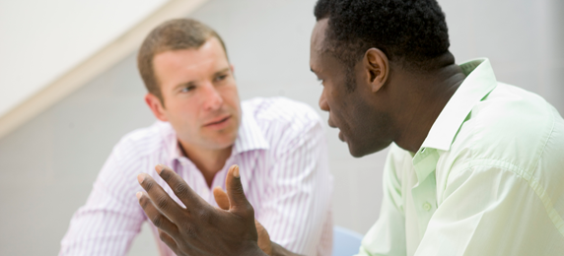
Context statements …
http://www.extendgrace.org/personal-impact.html
CONFLICT MANAGEMENT AND HUMAN RIGHTS OFFICE

Slide 32
Questions:
What behaviors does your group believe prevented with effective communication between Pat and Devika?
CONFLICT MANAGEMENT AND HUMAN RIGHTS OFFICE

Slide 33
What pat would learn:
Upon returning home at the end of the sabbatical, Pat learned that a staff person at the hotel had been sexually harassing Devika.
Devika was scared to confide in Pat for fear Pat might think that she had done something wrong.
CONFLICT MANAGEMENT AND HUMAN RIGHTS OFFICE

Slide 34
Perceived Barriers Can Impede Effective Early Resolution Attempts
PLAN
PARTICIPATE ACTIVELY
ASSESS
CONFLICT MANAGEMENT AND HUMAN RIGHTS OFFICE
Notes:
To add a photo to this slide, click the Picture icon in the content area (first column of icons, second row). Navigate to the photo you would like to insert. PowerPoint will auto-resize the photo to fit the area. If you are unhappy with the results, you can either:
Manually resize your photo to 6.4” high x 10” wide using an image editor. Then, insert it via Home>Insert>Picture.
Insert your picture as-is via Home>Insert>Picture. Then, select your photo and choose Format. Resize and crop your photo using the editing tools in PowerPoint.

Slide 35

  Contact:
  Matt Erickson
  519-888-4567 x 33765
  erickson@uwaterloo.ca
  Jeremy de Boer
  519-888-4567 x 39526
  jdeboer@uwaterloo.ca
CONFLICT MANAGEMENT AND HUMAN RIGHTS
Notes:
To add a photo to this slide, click the Picture icon in the content area (first column of icons, second row). Navigate to the photo you would like to insert. PowerPoint will auto-resize the photo to fit the area. If you are unhappy with the results, you can either:
Manually resize your photo to 6.4” high x 10” wide using an image editor. Then, insert it via Home>Insert>Picture.
Insert your picture as-is via Home>Insert>Picture. Then, select your photo and choose Format. Resize and crop your photo using the editing tools in PowerPoint.

