Slide 1
Developing an Anti-Oppressive Practice in Student Services
f
Fauxels via Pexel

Slide 2
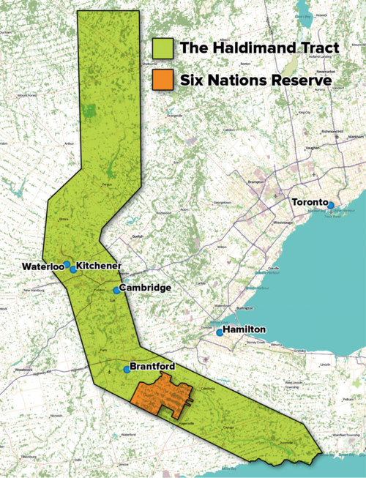
Territorial Acknowledgement
The Office of EDI-R acknowledges that we live and work on the traditional territory of ‎ the Neutral, Anishinaabeg and Haudenosaunee peoples. The University of Waterloo is situated on the Haldimand Tract, the land granted to the Six Nations that includes six miles on each side of the Grand River.
Adam Lewis "Living on Stolen Land,”
Alternatives Journal December 2015
www.native-land.ca/

Slide 3
LEARNING OUTCOMES:
Understand the necessity of operating from an anti-oppressive framework
Internalize knowledge/skills around current issues in student services in higher education relevant to their own positionality and abilities to effect change
Credit: Shih-wei via iStock

Slide 4
WORKSHOP AGREEMENTS
Be respectful
Engage mindfully
Speak from your personal experience
Maintain confidentiality
Take care of yourself

Slide 5
Let’s Activate our Prior Learning!
What do we learn about systemic oppression?
Karolina Grabowska via Pexel

Slide 6
SYSTEMIC OPPRESSION
Lens of Systemic Oppression
Individual
Systemic
The intentional disadvantaging of
groups of people based on ones
identity while advantaging members
of the dominant group
(gender, race, class, sexual orientation, language, etc.).
Individual
Institutional
An individual's beliefs and actions that perpetuate oppression:
Conscious and unconscious
Externalized and internalized
Interpersonal
Organizational policies and practices at the
The interactions between people, both within and across different identities.
Structural
How these impacts interact and accumulate across institutions and across history
Glasses icons created by Smashicons - Flaticon
Diagram adapted from National Equity Project's "The Lens of Systemic Oppression"

Slide 7
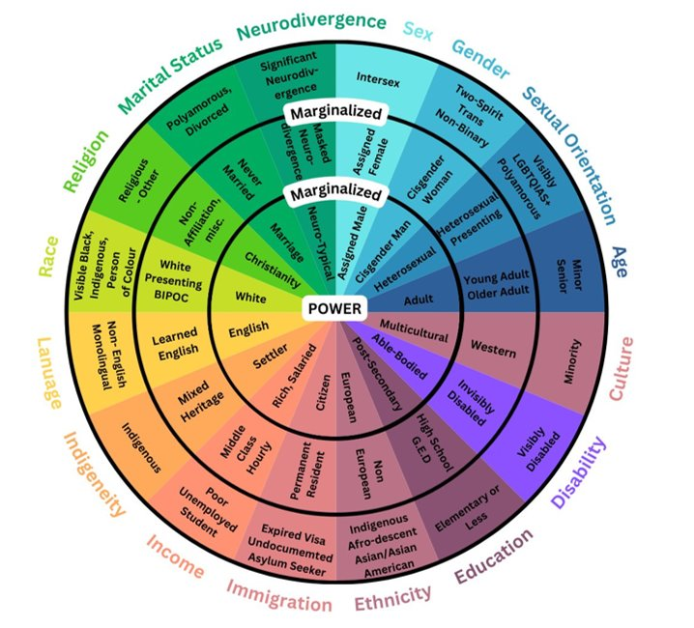
Power and Privilege
Power: the ability to influence and make decisions that impact others
Privilege: a group of cultural, social, legal, and institutional rights extended to a group based on being members of a social group. Individuals with privilege are positioned as the “normative” group, which renders those without access to these privileges marginalized, invisible, and/or classed as ‘abnormal’.
Image adapted from Sylvia Duckworth's Wheel of Power/Privilege

Slide 8
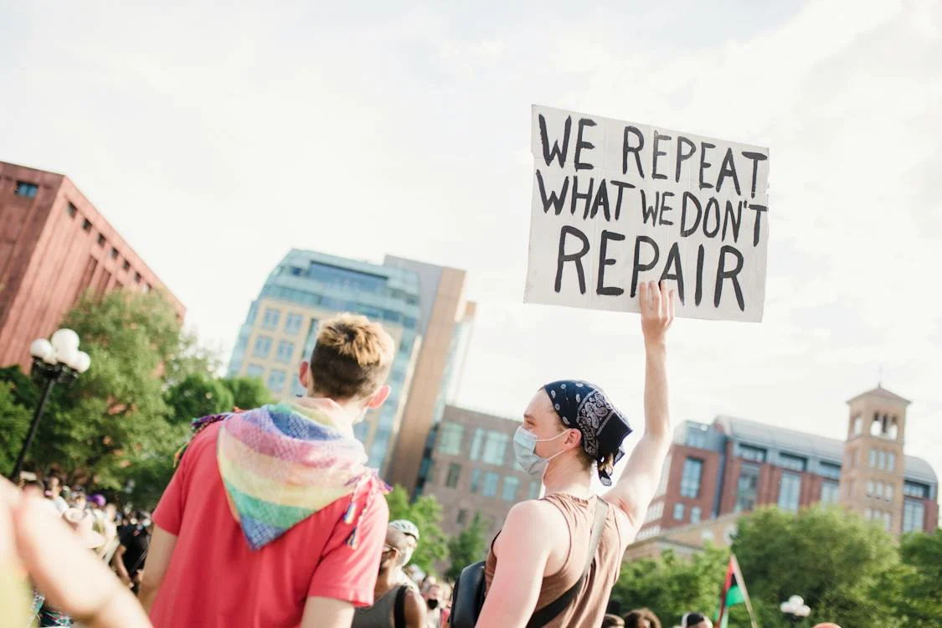
An Anti-Oppressive Framework
the method and process in which we understand how systems of oppression such as colonialism, racism, sexism, homophobia, transphobia, classism and ableism can result in individual discriminatory actions and structural/ systemic inequities for certain groups in society.
Anti-oppressive practices and goals seek to recognize and dismantle such discriminatory actions and power imbalances.
Life Matters via Pexels

Slide 9
An Anti-Oppressive Framework
AOP shares commonalities with Critical Race Theory, anti-racism, anti-homophobia, intersectional feminism, decolonizing education etc. as they all seek to disrupt ideologies and assumptions, discriminatory behaviours and structural barriers.
AOP is a participatory approach.
AOP shares commonalities with Critical Race Theory, anti-racism, anti-homophobia, intersectional feminism, decolonizing education etc. as they all seek to disrupt ideologies and assumptions, discriminatory behaviours and structural barriers.
AOP is a participatory approach
Promotes deep reflection and development of a ‘critical consciousness’ to analyze the ways the service being offered can be complicit in recreating and reinforcing structures of oppression
Fauxels via Pexels

Slide 10
Critical Consciousness
Tara Winstead via Pexels
The ability to recognize and analyze systems of inequality and the commitment to take action against these systems

Slide 11
Anti-oppression in action
The Method and The Process

Slide 12
Have a Reflective Practice
How does my social location create positions of privilege?
“How may social divisions impact my ability to best meet this service user’s needs?
What’s working from what’s not working? Who is seen vs. who is unseen?
Who is accessing our supports and who is not? Why or Why not?
What is preventing them from accessing the supports they need? Whose voice is silenced?
How can I work collaboratively with students or with student organizations/clubs to intentionally bring supports that meet their unique needs?
Polina Tankilevitch via Pexels

Slide 13
Engage in Active Listening
Lean in- allow students to share their point of view
Gather Feedback- what are their needs?
Listen with intention- commit to doing something with the information

Slide 14
Identify the Bigger Problem
Affordability
Access to Education
Mental Health
Student Engagement
Accessibility
Employment Opportunities
Campus Safety
Institutional Funding

Slide 15
Work Collaboratively
Roman Odintsov via Pexels
Why are you embarking on this relationship? How do you plan to nourish this relationship? Are you just checking a box? How are you willing to support the initiative?

Slide 16
Challenge Power and Privilege through Solidarity:
Allyship can be loud, vocal, visual and very performative to show others of your awareness of oppression. But unless policies and processes (the way we do things) change, all the noise does little good. Consequently, allyship does little to rebalance the uneven distribution of resources and power.
Solidarity on the other hand, actively and intentionally works to redistribute the unfair gains of systemic oppression. Solidarity calls for a deeper commitment to the work without relying on equity-deserving communities to provide education and affirmation.
What is one tangible way you and/or your team can move towards a deeper commitment to anti-oppressive work and solidarity?

Slide 17
CASE STUDY: COUNSELLING SERVICES
Jordyn recently lost a very close loved one to a car accident. While they have been trying to navigate the trauma, unfortunately, the emotional pain seems to be seeping into their academics. Jordyn has moved from being a high achieving student with top marks to barely attending classes and handing in assignments. Since this is out of character, more than one professor has expressed their concerns, urging them to seek supports through the school’s counselling department. Jordyn is reluctant, as they say, “those people won’t understand. They don’t even look like me.”
If Jordyn was to access the counselling services at the institution, how might you as a practitioner incorporate an AOP lens?

Slide 18
What new learning are you walking away with today?
Or
What new learning is being reinforced after today's session?
Notes:
Feel free to type in the chat

Slide 19
education and outreach unit equity, diversity, inclusion, anti-racism ediro.trainings@uwaterloo.ca

