Slide 1

Economic Evaluation of Damage Accrual in a Nationwide Canadian SLE Cohort
FACULTY OF MEDICINE І Division of Rheumatology
May Y. Choi, Y. St. Pierre, M.B. Urowitz, D. D. Gladman, S. Bernatsky, E. Vinet, C. Pineau, J.G. Hanly, C.A. Peschken, P.R. Fortin, M. Jung, C. Barber, S. Elliott, J. Dixon, A.E. Clarke
Webinar, April 30, 2019

Slide 2
Disclosures
Canadian Initiatives for Outcomes in Rheumatology Care (CIORA)
Canadian Institutes for Health Research (CIHR)
Lupus Canada
Lupus Society of Alberta
The Arthritis Society
Notes:
This project received funding from CIORA

Slide 3
Evidence-Based Medicine
Barber, Megan RW, and Ann E. Clarke. ”Economic Evaluation of Lupus Nephritis in the Systemic Lupus International Collaborating Clinics Inception Cohort Using a Multistate Model Approach." Arthritis Care and Research (2018);70:1294-1302.
Bruce, Ian N., et al. "Factors associated with damage accrual in patients with systemic lupus erythematosus: results from the Systemic Lupus International Collaborating Clinics (SLICC) Inception Cohort." Annals of the Rheumatic Diseases 74.9 (2015): 1706-1713.
Carter, Erin E., Susan G. Barr, and Ann E. Clarke. "The global burden of SLE: prevalence, health disparities and socioeconomic impact." Nature Reviews Rheumatology 12.10 (2016): 605-620.
Notes:
These are my references

Slide 4
SLE Cost-of-Illness Studies
Disease phenotype | Annual direct cost estimate (2015 USD $) | References
All patients | 4,271 - 33,223 | Clarke, Rheum 2004 Narayanan, J OE Med 2013
Severe flare | 13,494 - 55,344 | Clarke, AC&R 2015 Kan, Biomed Res Int 2013
Lupus nephritis | 10,017 - 71,334 | Jonsen, Lupus 2015 Carls, J OE Med 2009
Neuropsychiatric lupus | 33,750 | Furst, J Med Econ 2013
Notes:
And these are some of the studies that have looked at the cost of SLE
Listed here are the direct costs and as you can see the cost varies with disease phenotype, for example, LN has been shown to be up to 71000
As SLE is a relatively rare and complex disease, it has been challenging to accurately study the economic burden of SLE.
By gaining a greater appreciation of the cost of SLE, we can determine how to improve allocate health care resources to optimize patient outcomes.

Slide 5
Damage State and 10-Year Cumulative Costs
Baseline Damage State (SDI) | 10-Year Cumulative Cost 2015 CDN $ | Relative Cost
0 | 21,525 | 1
1 | 55,014 | 3
2 | 86,243 | 4
3 | 128,510 | 6
4 | 173,657 | 8
≥5 | 198,010 | 9
Barber M et al. Arthritis Rheumatol. 2016; 68 (suppl 10).
Notes:
Last year Barber et al showed that the cost of SLE is associated with disease damage.
Using the SLICC/ACR damage index, they found that SLE patients with more damage incurs more cost compared to patients with low damage by about 19 fold in terms of 10 year cumulative cost

Slide 6
Study Rationale
No study assessing total costs (including indirect costs) associated with damage accrual
Little data from Canada on the costs incurred by patients with SLE
  Existing studies involved small number of patients
  Many conducted almost 15 years prior
  They did not assess presenteeism costs
Therefore, a better understanding of indirect costs in SLE is needed
Notes:
But so far, no studies have looked at the total cost, i.e. including indirect costs, and whether or not it is associated with damage accrual
The last study was likely underestimating the true cost associated with damage accrual
Overall, there is still not a lot of data from Canada on costs in SLE.
Thus far, we have small studies, some of which >15 years ago
We have not looked at presenteeism costs yet which is a type of indirect cost I will later define
So we need better understanding and certainly also because many of the studies were using claims based data - – limited information on disease phenotype and on indirect costs

Slide 7




Study Aims
DIRECT
INDIRECT
To compare direct and indirect costs associated with damage state (SDI)
  Annual and long-term costs (Multi-State Markov model)
  Using a nationwide Canadian cohort of patients with SLE
Notes:
The purpose of our study was therefore to examine the annual and cumulative direct and indirect costs in a nationwide Canadian cohort of patients with SLE
We will use a multistate Markov model to estimate time during each damage state and taking into account patients transitioning states
We will also use this on another nationwide Canadian cohort

Slide 8
Definition of Direct Costs
DIRECT
Health resources used by patient
Travel costs and assistance required to attend health care visits
Notes:
Direct costs are…

Slide 9
Definition of Indirect Costs
INDIRECT
EMPLOYED/NOT EMPLOYED
PAID/UNPAID LABOUR (Housework, volunteering)
Opportunity Costs
Additional value of potential productivity
if the person was not ill
Absenteeism
Cost due to time missed from paid work
Presenteeism
Value of decreased productivity while working
Notes:
There are three different types of indirect costs that we examined
And they can vary based on whether they are employed or unemployed
And they can be paid of unpaid work
PAID LABOR:
ABSENTEEISM
annual value of time taken off current work due to health problems. (Days missed from work over 1 year times average hours worked per day times age-sex specific hourly wage)
PRESENTEEISM
annual value of productivity losses due to health status, of current workers while at work. (Self-assessment of the effect of health status on productivity at work as a proportion between 0 (no effect of health on work) and 1 (unable to perform any work), times annual hours currently worked for pay, times age-sex specific hourly wage)
UNPAID LABOR
NO ABSENTEESIM
OPPORTUNITY COST
annual value of potential productivity from paid labour, that did not materialize due to the respondents' health status. (Additional hours over 1 year that respondents estimate they would work for pay if they had no health problems, over and above their current paid work hours (which are zero for non-workers), times age-sex specific hourly wage)

Slide 10
Participants
6 centres across Canada
June 2015 – present
1361 patients fulfilled the revised SLE ACR/SLICC Classification Criteria
Quebec 60
Calgary
153
Winnipeg
157
Montreal
326
Halifax
202
Toronto
463
Notes:
1361 patients were recruited from 6 centres in Canada from 2015- present

Slide 11
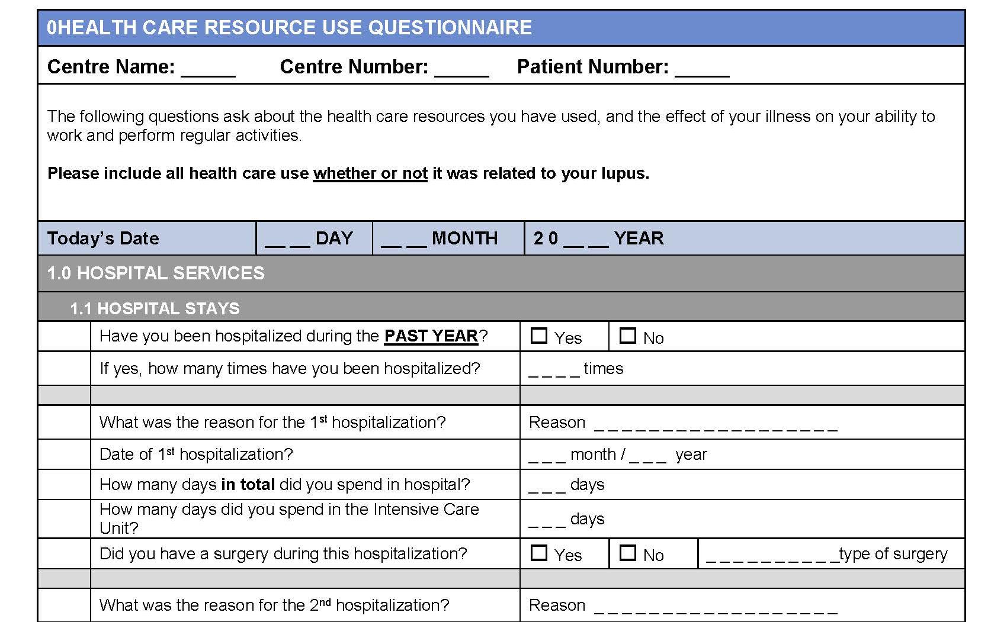
Healthcare Resource Use (Direct Costs) Questionnaire
Notes:
Patients filled out a validated health resource questionnaire annually
This assessed their frequency of hospitalizations, medications, MD visits, ER visits, labs, xrays and other imaging
Travel costs to health care visits

Slide 12
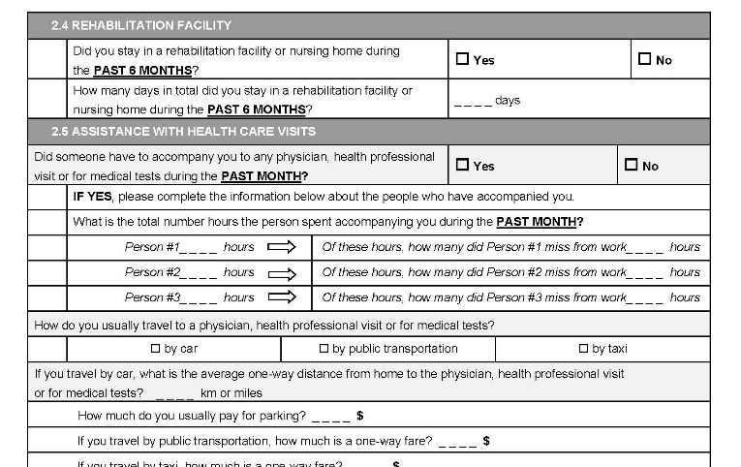
Lost Productivity (Indirect Costs) Questionnaire
Notes:
Assessed annually
Validated
Time loss & impaired productivity in paid & unpaid work
Valued using age & sex-specific wages from Stats Canada

Slide 13
Costs per damage states
Stratify by SLICC/ACR Damage Index (SDI)
SDI = 0
SDI = 1
SDI = 2
SDI = 3
SDI = 4
SDI = >5
Regressions to estimate average annual costs per SDI
Adjusted for age, race/ethnicity, disease duration
Canadian national prices and future costs discounted at a yearly rate of 3%
Notes:
Patients assigned into damage states based on the SLICC/ACR Damage Index (SDI)
Regressions were done to estimate cost per SDI per year

Slide 14
Costs per damage states
Stratify by SLICC/ACR Damage Index (SDI)
SDI = 0
SDI = 1
SDI = 2
SDI = 3
SDI = 4
SDI = >5
Multi-State Markov Model
Expected Duration Per Damage State
Bruce IN. Ann Rheum Dis 2015;74:1706-13
Notes:
Predict patient’s disease course and expected time in each disease damage state using Multi-state Markov Model
Transition rates between states and expected state duration were estimated

Slide 15
Predicted Duration of Damage States over 5 Years
 | Estimated Duration in SDI State over 5 Yrs
Baseline SDI State | 0 | 1 | 2 | 3 | 4 | ≥5
0 | 4.12 | 0.64 | 0.18 | 0.05 | 0.01 | 0.002
1 | 0 | 3.17 | 1.28 | 0.43 | 0.09 | 0.03
2 | 0 | 0 | 3.05 | 1.42 | 0.37 | 0.17
3 | 0 | 0 | 0 | 3.22 | 1.11 | 0.67
4 | 0 | 0 | 0 | 0 | 2.61 | 2.39
≥5 | 0 | 0 | 0 | 0 | 0 | 5
Bruce IN. Ann Rheum Dis 2015;74:1706-13
Notes:
Based on this model, we can predict how long a patient would spend in each damage state depending on what SDI they had at baseline
So someone who started out with SDI of 1 at baseline, would remain in the same SDI for 3.17 years out of 5 years but could lose damage

Slide 16
Costs per damage states
Average annual costs per SDI
Expected duration
per SDI
X
Cumulative Costs
Notes:
Estimated yearly costs per damage state
Cumulative costs = Yearly costs per damage state x expected duration per damage state

Slide 17
Patient Demographics at Baseline
Baseline Demographics (n=1361)
Disease Duration, yrs, Mean (range) | 16.8 (0-62.5)
Age at Diagnosis, yrs, Mean (range) | 33.1 (18-91)
Gender, % Female | 90.4
Ethnicity, % Caucasian | 71.0
SLEDAI-2K, Mean (SD) | 2.71 (3.21)
SDI, Mean (SD) | 1.54 (1.87)
Employed, % | 49.2%
Notes:
So what did our cohort look like at baseline?
Established disease, predom female and Caucasian and ½ were employed
Ethnicity and disease duration (0.5 year) in SLICC

Slide 18
Predicted Annual Health Costs (2017 CND $)
Damage State (SDI) | Direct Costs | Indirect Costs | Total Costs
0 | 4,379 | 24,768 | 29,147
1 | 5,846 | 26,625 | 32,474
2 | 6,743 | 31,285 | 38,028
3 | 10,885 | 23,786 | 34,671
4 | 9,427 | 30,272 | 39,699
≥5 | 18,620 | 27,903 | 46,523
≥5 vs. 0 | 4.3-fold | 1.1-fold | 1.6-fold
Notes:
So how much did each lupus patient cost per year according to their damage state?
First column we have damage state 0-5
Then broken down into direct costs, indirect costs and total costs
Several observations here:
As damage increase so did the cost
Comparing high to low damage, there was a 4.3 fold difference in direct cost, 1.6 in total, and not much change for indirect cost
Indirect cost exceed direct cost, which we will later on, was about 4-fold
Compared to Megan’s paper we had fewer people on dialysis…that’s why see only a 4.3 fold increase

Slide 19
Predicted 10-Year Cumulative Costs (2017 CND $)
0 1 2 3 4 >=5
Direct Indirect Total
Notes:
What does the 10-year cumulative cost look like?
Similar to annual cost, indirect cost did not change very much with different damage state
Cost more than direct costs
Overall total cost still increasing with damage, driven by direct costs
At the peak, SDI >=5 cumulative cost for 10 years, it’s about $400,000

Slide 20
Unadjusted Annual Costs By Components
DIRECT
20%
INDIRECT
80%
Notes:
Direct costs was 20% of total cost entire cohort vs 80% for indirect

Slide 21
Unadjusted Annual Costs By Components
DIRECT
20%
INDIRECT
80%
Notes:
Mostly from hospitals and meds
Other direct costs:
Rehab 1%
Outpatient Sx: 3%
Other HP 6%
Help 3%

Slide 22
Direct Cost Components
Notes:
SD1 0-2 hospitalization and meds
SDI 3 or higher, dialysis accounted for x of cost

Slide 23
Direct Cost Components
HOSPITALIZATIONS AND MEDICATIONS
HOSPITALIZATIONS AND DIALYSIS
Notes:
SD1 0-2 hospitalization and meds
SDI 3 or higher, dialysis accounted for x of cost

Slide 24
Unadjusted Annual Costs By Components
DIRECT
20%
INDIRECT
80%
Notes:
Most indirect costs were secondary to opportunity cost
Absenteeism was small portion

Slide 25
Baseline Percentage of Patients Working Based on SDI Level
Notes:
And the thing to remember here is that fewer patients are working with increasing damage

Slide 26
Indirect Cost Components for Paid Labour
BASELINE DAMAGE STATE (SDI)
Absenteeism Presenteeism Opportunity
Notes:
And if we look at the employed, absenteeism, i.e. missing work, is a very small component of the cost in paid labor
Much of it is due to impaired productivity while work and work anticipated if not ill

Slide 27
Indirect Cost Components for Paid Labour
BASELINE DAMAGE STATE (SDI)
Absenteeism Presenteeism Opportunity
Notes:
For unemployed can only consider opportunity cost, you can see it is still quite substantial
For non-workers, the opportunity cost for paid work decreases due to the increase of retirees as a proportion of patients with more damage. More patients older than 65 means less expected paid work.
This highlights the importance of evaluating the costs of both employed and not employed

Slide 28
Indirect Cost Components for Unpaid Labour
BASELINE DAMAGE STATE (SDI)
Presenteeism Opportunity
Notes:
For unpaid labor such as housework, volunteering, people who are employed lose productivity and opportunities as well
So don’t forget that

Slide 29
Indirect Cost Components for Unpaid Labour
BASELINE DAMAGE STATE (SDI)
Presenteeism Opportunity
Notes:
Not employed patients have more presenteeism and opportunity costs likely because they do not have a job and therefore have more potential to be doing unpaid labor
This highlights the importance of looking at paid and unpaid labor for SLE patients

Slide 30
Employed vs. Not Employed Total Indirect Costs
0 1 2 3 4 >=5
BASELINE DAMAGE STATE (SDI)
Employed Not Employed
Notes:
UNEMPLOYED COST MORE THAN EMPLOYED
DRIVEN BY HIGHER UNPAID OPPORTUNITY COST AND PRESENTEEISM
IF YOU ONLY LOOIK AT THE PEOPLE WHO ARE WORKING, UNDERAPPRECIATING THE TRUE COST OF EVERYONE AFFECTED

Slide 31
Limitations
The Multi-State Markov model has not been validated in this cohort
  Original model based on SLICC inception cohort
Estimates based on Canadian prices
  Concepts are still somewhat generalizable across countries
Notes:
We are not able to capture or get a good sense of what is their disease cost in the first 10 years.
We had few people with short disease duration so it limits our ability to adjust the regression for these people

Slide 32
Discussion – Direct Costs
SLE patients with the highest SDI incurred a 4-fold higher cumulative direct costs than those with lowest SDI
Majority of direct costs were due to hospitalizations and medications at lower SDIs
At higher SDIs, majority of the direct costs were due to hospitalizations and dialysis

Slide 33
Discussion – Indirect Costs
Indirect costs exceeded direct costs by 4-fold
Indirect costs did not vary with level of damage overall
  Substantial lost and diminished productivity even with low damage
  Indirect costs influenced by factors other than SDI (activity, QoL, fatigue, plateauing of expectations with damage accrual)
Presenteeism and opportunity costs were the main drivers of indirect costs for employed and not employed patients
Notes:
Indirect costs exceeded direct, on average, by 3.7-fold, underscoring the importance of lost workforce productivity and the need for actionable workplace and systems-level (i.e., government, policies, and society) interventions to improve the employment outcomes of those living with SLE.

Slide 34
Summary
Future economic analysis considering these indirect costs are needed to fully appreciate the economic burden of SLE
Lost productivity and opportunity are major concerns for patients living with SLE regardless of disease damage
  Need for tools to better measure functional impairment in SLE, e.g. frailty index, and identify those who are at high risk
Urgent need for actionable workplace and systems-level interventions to improve the employment outcomes of those living with SLE
Notes:
Indirect costs exceeded direct, on average, by 3.7-fold, underscoring the importance of lost workforce productivity and the need for actionable workplace and systems-level (i.e., government, policies, and society) interventions to improve the employment outcomes of those living with SLE.

Slide 35




Acknowledgements
Yvan St. Pierre
CaNIOS / SLICC Patients and Investigators
CIORA
The Arthritis Society
Lupus Society of Alberta
Lupus Canada
CIHR

