Slide 1
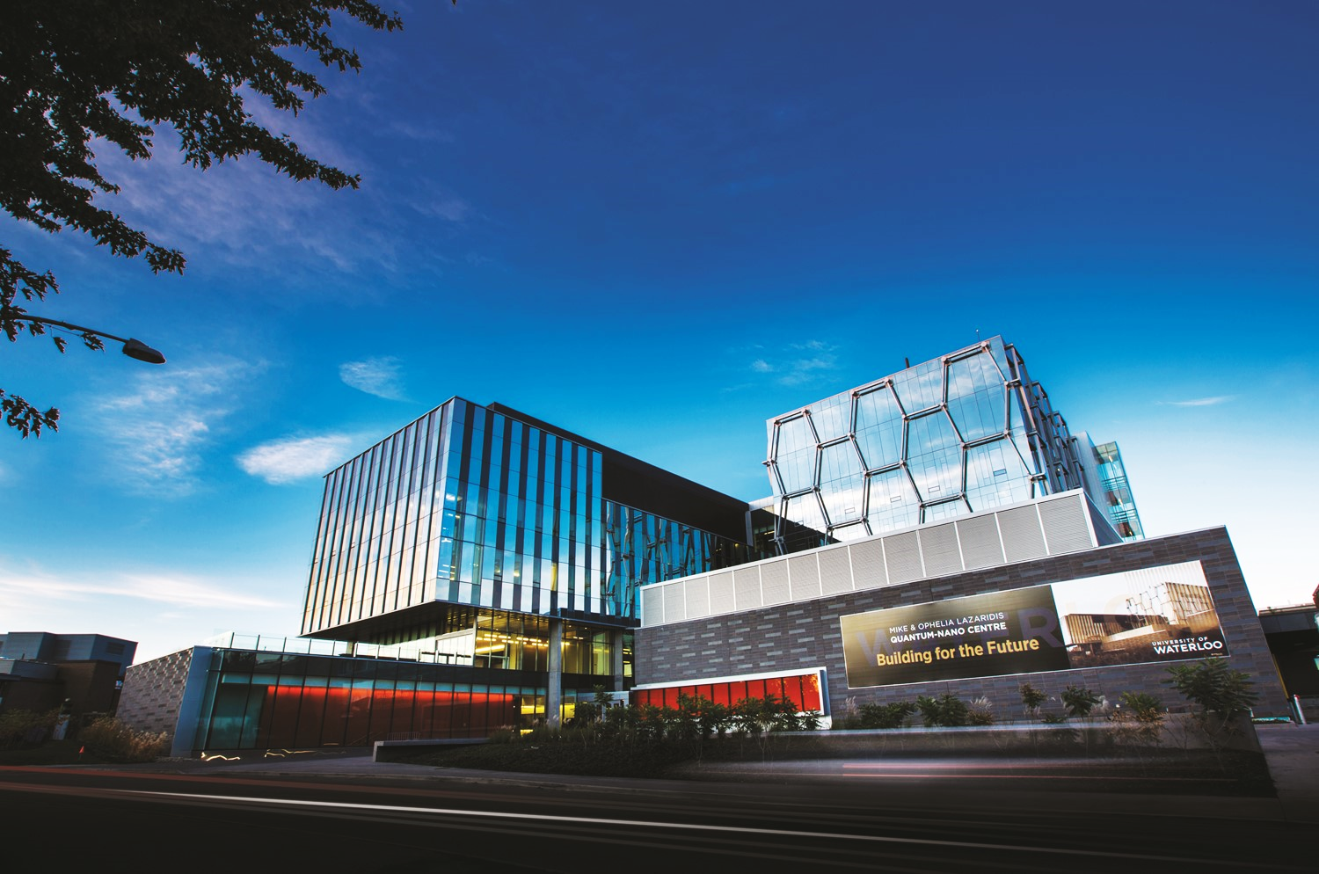
Waterloo Institute for Nanotechnology
Mike & Ophelia Lazaridis Quantum-Nano Centre

Slide 2
New application – now online
WIN NANOFELLOWSHIPS
Online Application Form – through Microsoft Forms
Prospective Student (students who have applied to graduate studies at the University of Waterloo and not yet started their graduate program, not yet taking courses or started research, and tuition fees have not been arranged for that term)
Existing Student (students who have already been accepted to UWaterloo Graduate Studies, made tuition arrangements and started their program with courses and/or conducting research）

Slide 3
Eligibility and Guidelines
WIN NANOFELLOWSHIPS
Amount: $10,000 CAD in cash, above guaranteed stipend from supervisor
Citizenship: Open to all Canadian and international grad students registered at UW
Conditions: Applicants must pursue Nanotechnology research
Other Awards: Nanofellowships can be held with other scholarships (depending on regulations of other awards)
Degree Program: UWstudents can win award twice during graduate studies at UW

Slide 4
Important Notes
WIN NANOFELLOWSHIPS
High Success Rate: usually 1 in 3 chances of winning
Collab Nano Grad Program – student does not have to be enrolled
Supervisor does not need to be WIN member to apply
Student needs to show how project contributes to:
Nanotechnology
United Nations Sustainable Development Goals (UNSDG)
Hope to increase recruitment of new students, increase applications
from under-represented students

Slide 5
Hints on writing an effective Research Proposal
WIN NANOFELLOWSHIPS
Explain:
1. The current problem you are trying to solve - why is it important?
2. Experimental design, already conducted and proposed
3. How does your project contribute to the field of nanotechnology? How is it ‘nano?’
4. Results and findings (if applicable)
5. References are not mandatory; if absolutely necessary try to fit into field on form
Make sure this is well-written.
Ensure your grammar usage is correct and the text is free from typos.
Have someone proof-read before submitting.
**You must include how your research aligns with at least one of the 4 key themes of
Nanotechnology AND one or more of the United Nations Sustainable Development
Goals (UNSDG) – see details on next slide

Slide 6
Alignment with Themes and United Nations Sustainable Development Goals (UNSDG)
WIN NANOFELLOWSHIPS
Explain:
In your research proposal, explain how your project contribute to the advancement of basic
understanding of one or more of the key thematic areas of nanotechnology
– as well as how your project aligns with one
or more of the following UNSDGs
Smart & Functional Materials
Connected Devices
Next Generation Energy Systems
Therapeutics & Theranostics
Nanotechnology themes:
https://uwaterloo.ca/institute-nanotechnology/research-waterloo-institute-nanotechnology
UNSDG descriptions: https://sdgs.un.org/goals
*You must include #10 – Reduced Inequalities in your proposal

Slide 7
ReferencES
WIN NANOFELLOWSHIPS
Whom should you ask to provide a reference for you?
Best:
Someone who has acted as your direct supervisor in a science/technical role
Has known you for at least 1 work term or summer placement (4 months minimum)
Can evaluate your technical abilities and problem-solving skills
Someone you know who likes you, and will provide a good reference for you
Lecturer or teacher whose class you aced, and you pursued research in that field
Committee member who knows you for over 1 year and has seen your progress
Good:
Lecturer or teacher whose class you did well in, and can comment on your class
performance
Will NOT be considered:
TA supervisors
Post-doctoral colleagues with whom you shared research responsibilities
Family members (regardless of stature or employment relationship)
High-school teachers or group leaders
Friends

Slide 8
Education history
WIN NANOFELLOWSHIPS
National Rankings for Universities
If you did not earn your Bachelors or Masters degree from a
Canadian university, find online ranking websites for the
country of interest
Centre for World University Rankings (CWUR) provides national
& worldwide rankings for most universities
Otherwise, search your university name within national
university ranking of country name and provide URL in form

Slide 9
Evaluation/marking scheme
WIN NANOFELLOWSHIPS
For Prospective and 1st year MASc/MSc students:
Academic: 35%
Research Potential: 45%
References 20%
For existing UW students with 1+ years in graduate studies and
Prospective students who have already completed MASc/MSc:
Academic: 25%
Research Potential: 55%
References 20%

Slide 10
WINNERS MUST give Presentations
WIN NANOFELLOWSHIPS
All Nanofellowship Recipients *MUST* give a presentation on their
research projects at annual celebration
If fail to attend or give presentation of some kind, remainder of
Nanofellowship payout will be withheld (or student may forfeit
Award entirely)
Seminar attendance: you must also attend 9 WIN Seminars,
3 Distinguished Lectures and 1 Pitches & Demos event

Slide 11
Questions?
WIN NANOFELLOWSHIPS
Contact:
Dr Lisa Pokrajac, PhD
lisa.Pokrajac@uwaterloo.ca
Assistant Director, Research Programs
Waterloo Institute for Nanotechnology

Slide 12
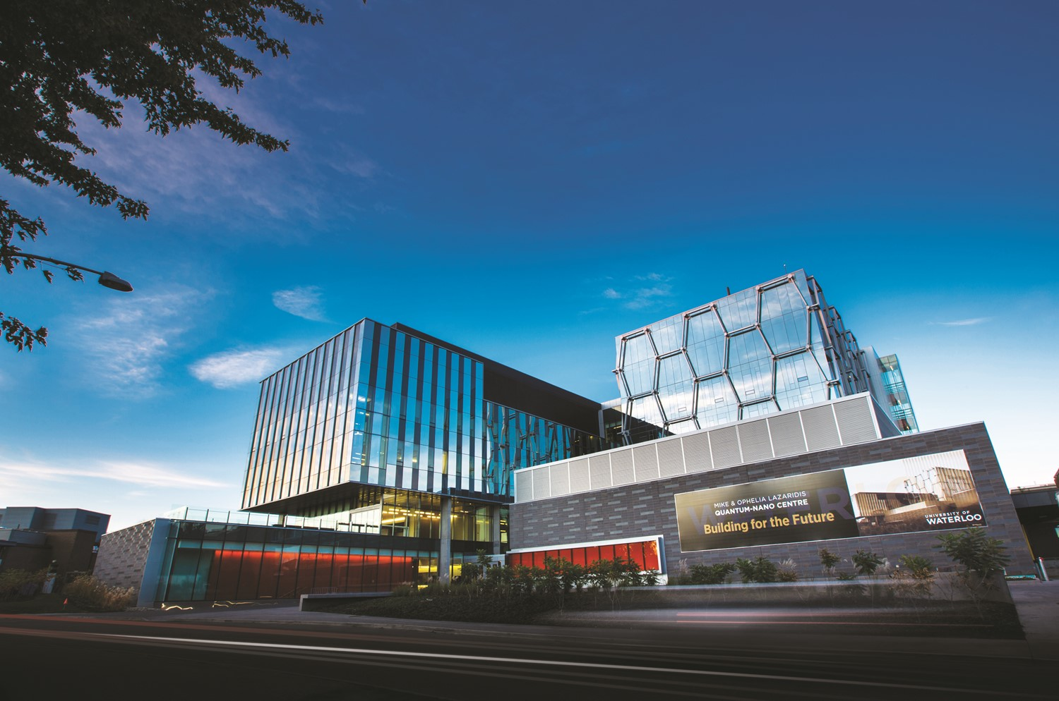
www.nano.uwaterloo.ca
Win-office@uwaterloo.ca
Mike & Ophelia Lazaridis Quantum-Nano Centre

