Slide 1
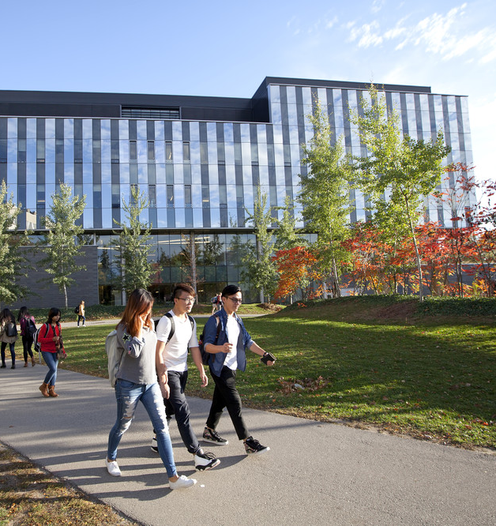
Math IT Lunch and Learn
May 16, 2018
Presented by: Debbie Brown, Lisa Tomalty
Math Faculty Computing Facility (MFCF), Information Systems and Technology (IST)

Slide 2
Agenda
Visibull digital displays
Lynda.com for undergraduate students
Qualtrics survey tool
WatVote voting system
Skype for Business
UWaterloo Scholar for faculty and graduate students
Event registration options
OneDrive and S: drive file storage
Updates
WatIAM 2.0 upgrade
SharePoint 2016 upgrade and re-organization
New Outlook Tips course and link to sew notes

Slide 3
Visibull digital displays
Display locations: MC 3rd, M3 atrium, MC 4th-MUO use, DC
Math Faculty related information – important dates, announcements, sessions
Campaigns exist for AM, C&O, PM, SAS - event & news pulled from Drupal
Target audience – Math undergrads, grads, faculty and staff
Math email: mathdisplay@uwaterloo.ca, CS email: jpetrik@uwaterloo.ca
Request in format: .png, .jpg - NO Word, .pdf
include removal date
PAGE 3

Slide 4
Lynda.com for undergraduate students
Lynda.com is available to all on campus (faculty, staff, grads and undergrads)
Web based training from Lynda.com using WatIAM credentials
Over 3000 online courses to assist your learning of software, creative, IT and business skills
LOGIN
Go to Lynda.com
Click Sign in link in top right corner.
Click Sign in with your organization.
Enter www.uwaterloo.ca and click Continue.
You will be redirected to the University of Waterloo sign in page. Enter your WatIAM ID and password and click Log in.
More information: https://uwaterloo.ca/information-systems-technology/services/lyndacom-courses

Slide 5
Qualtrics survey tool
Easy to use tool to create and distribute surveys, gather and organize information, do data analysis and create reports.
Campus license open to all University of Waterloo employees, including co-op students
uWaterloo URL and template/brand
Data stored in Canada
Add-ins: File Upload, Offline App
Extensive Qualtrics online documentation and support (online chat/phone)
More information about Qualtics survey tool

Slide 6
Qualtrics programming service
The Survey Research Centre provides Qualtrics programming services
Available to internal UW faculty, staff and grad students, using the University’s Qualtrics license
Charges are based on a daily per diem rate
Payment is typically done internally through funds transfer requests (UW account numbers)
For more information
Visit the Survey Research Centre’s services web page
Contact the Survey Research Centre
Or contact Janice Lam, j95lam@uwaterloo.ca, ext. 35071

Slide 7
WatVote voting system
Drupal-based electronic voting system (recently updated)
Supports the official online voting needs of faculty and staff on campus
Referendum (yes/no) votes
Election ‘first-past-the-post’ style votes (i.e. vote for 'x' of 'n' candidates)
WatVote provides counting and access control for:
Official online voting
Votes requiring authentication, security and anonymity
Qualtrics Online Surveys and WCMS Web forms are alternative tools
More information about WatVote

Slide 8
Skype for Business
Recently deployed to all of Math (lite version = without the phone feature)
Instant messaging (IM)
Quick, can see who is available and share files
Broadcast a presentation and share voice (via speaker) and PowerPoint, etc.
Integrates with connect/Exchange (Settings/Personal to change settings)
Creating a Skype for Business meeting
Skype for Business Uwaterloo online community/help
More information about using Skype for Business

Slide 9
Skype for Business on campus
Some departments are using Skype for Business for phones
Extension starts with 4 (e.g. 45873)
Calls to all continue to work the same
Other info/features ….
Skype Meeting
Chat
Share screen/files/specific programs/attachments
Audio/voice optional

Slide 10
UWaterloo Scholar for faculty and graduate students
Dynamic and customizable websites for scholars (UWaterloo faculty, graduate students and researchers)
Based on OpenScholar, used by Harvard and many other higher education institutions
Self-serve, authentication using WatIAM userid and password
Easy to create and maintain websites - no training required
UWaterloo Scholar presentation (2018) for Math Graduate students
More about UWaterloo Scholar
Notes:
Add link to ppt/pdf
Quick demo if time

Slide 11
UWaterloo Scholar benefits
Improved Google search results
Accessible web site by default
Secure, professional environment
Edit from anywhere through a web browser (no special software required)
Publications can be imported
Embed third party content (e.g. twitter)
Can grant site edit access to others
Developed by scholars for scholars
Blog
Class (es)
Events
Publications
Software projects
And more!
Online documentation and support from IST

Slide 12
Event registration options
Email (can be time consuming)
WCMS form
Qualtrics
Ticketfi
Eventbrite (used on campus but not officially supported by IST; there were some concerns about their terms of service but its seems OK for now)
New event registration system coming to UWaterloo Portal (~Fall term)
Aimed at free events open to the university community (anyone with WatIAM credentials)

Slide 13
OneDrive and S: drive file storage
S: drive is still preferred for most work files
Accessing S: drive from home:
Connect to campus VPN
Map to S: drive
Math: \\files.math.uwaterloo.ca\[UWUserid max 8 chars]
Computer Science: \\smb-files.cs.uwaterloo.ca\[UWUserid max 8 chars] – use CS-GENERAL password – not WatIam - see https://uwaterloo.ca/math-faculty-computing-facility/resources/accessing-graduate-file-storage)
Notes:
Confer with MFCF for details for this slide

Slide 14
OneDrive
OneDrive is a good option when travelling, working from home, etc. for any files that are not highly confidential
Microsoft data retention policy
Data stored in this service are subject to Microsoft data retention policies which may change from time to time. There is no capability to restore deleted data beyond the user-accessible facilities (e.g. versions and recycle bin) provided by Microsoft. Currently, Microsoft maintains a file history for 30 days.
Can share with off campus colleagues who have Microsoft or Gmail email accounts
5 T of storage
MFCF still recommends using S: drive for work files
Documentation: Office 365 for staff documentation , OneDrive documentation
Notes:
Confer with MFCF for details for this slide

Slide 15
Updates
WatIAM 2.0 upgrade
SharePoint 2016 upgrade (May 26) and re-organization (May 14)
New Outlook Tips course
Office 365 pop-up booth – MFCF Helpdesk – June 19, 2018, from 2-4pm
Faculty, staff, grad students
Bring your Office 365 questions
Ensure your Office 365 account is activated beforehand, if possible
Can also send Lisa/Lori your Office 365 questions ahead of time

Slide 16
Thank you and Q/A
Thank you!
Questions?
Debbie Brown, dabrown@uwaterloo.ca
Lisa Tomalty, ltomalty@uwaterloo.ca

