Slide 1
Psych 499 Undergraduate Thesis
September, 2021
Tim Ireland
Liaison librarian Psychology

Slide 2
Overview
Who am I and why am I here?
Session objectives
Access resources from off campus
Library catalogue –getting material from catalogue
Research tools (databases)
PsycINFO
Scopus
RefWorks
Contact info

Slide 3
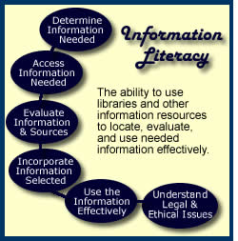
Information Literacy…
The information literate student shall…

Slide 4
Tim’s translation
Students should be able to find relevant
items
Students should be able to get relevant material
Students should be able to evaluate relevant material
Students should be able to cite material properly & avoid plagiarism

Slide 5
ASK QUESTIONS!!!
Tell me and I forget
Teach me and I remember
Involve me and I learn

Slide 6
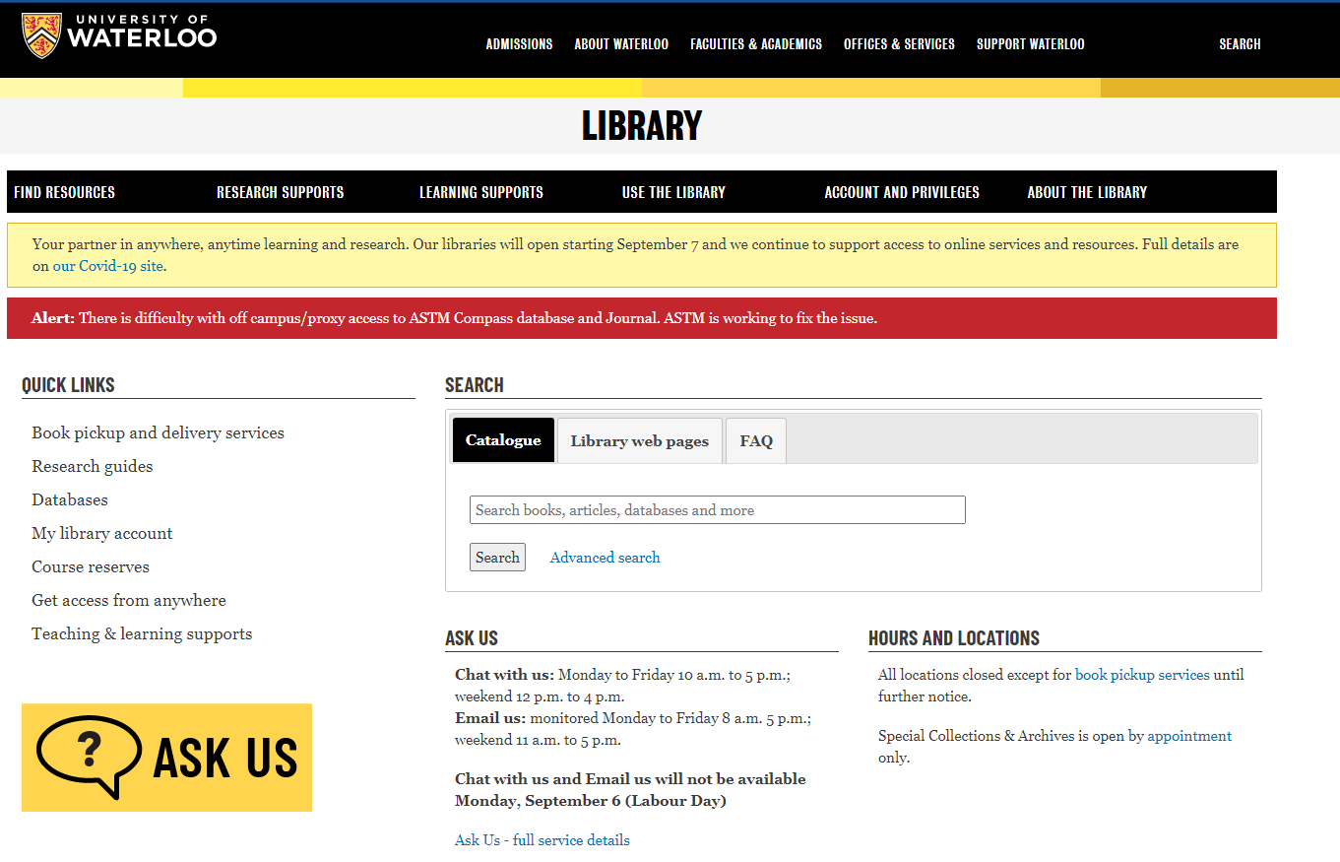
The virtual library

Slide 7
Any questions on getting updated information about library services? Any questions about getting access from off campus?

Slide 8
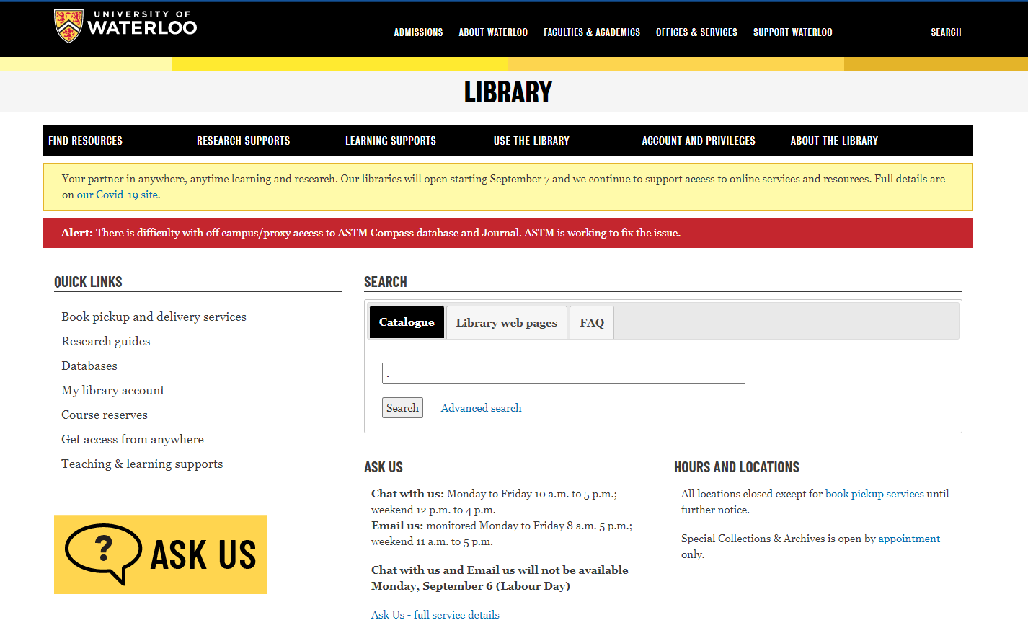
The Library Catalogue
Undergraduate Writing Psychology

Slide 10
“New” Catalogue -Omni
Loan period for books –Increased
may borrow up to 500 item in total with loan periods of 120 days for books and two weeks for journals.
have access to licensed electronic resources.
borrow two course reserves items at a time for one hour, three hours, one day, or three days.
use interlibrary loans (ILL) to request materials from another library free of charge.

Slide 11
Inter Library Loan
Circulating books from anywhere in the world
Journal articles from anywhere in the world
5-10 Business days
Journal articles will appear as e-mail links from your e-mail

Slide 12
NEW!!!

Slide 14
Select Get it –from a Waterloo Library

Slide 15
Select Books by Mail!

Slide 16
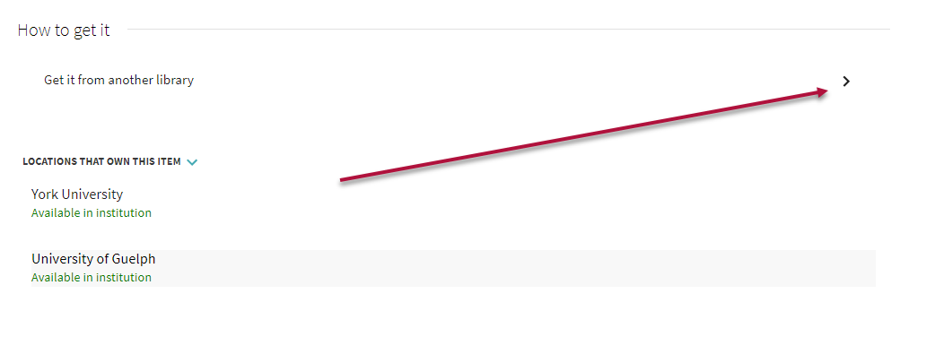
Not at Waterloo in Omni

Slide 18
If the book is not in the system

Slide 19
Any questions about the Library Catalogue or Inter-library loan system?

Slide 20
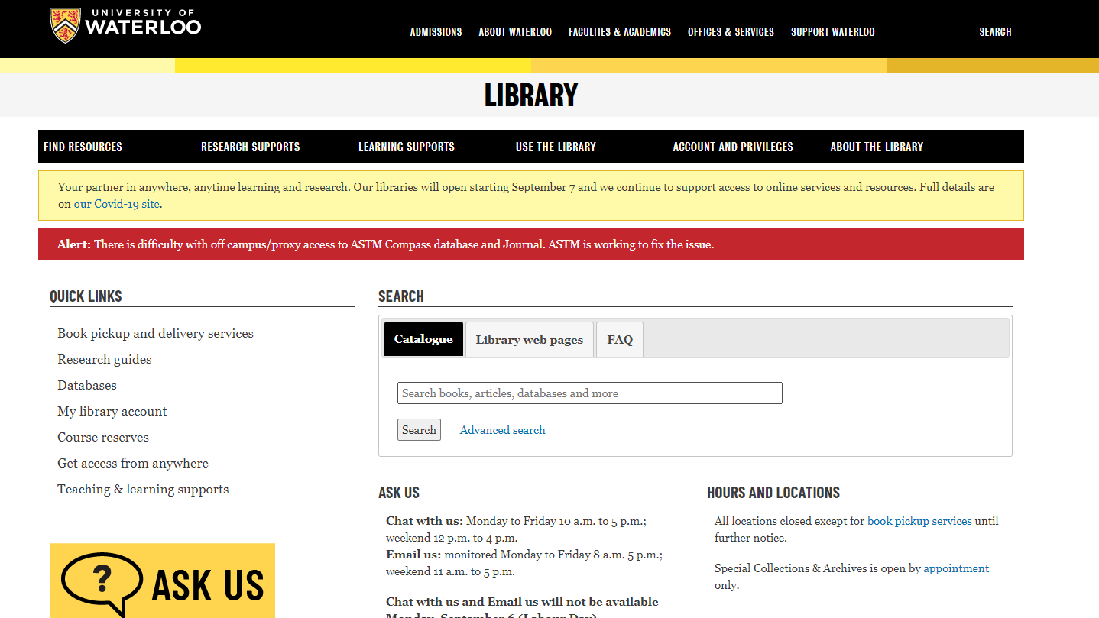
Databases

Slide 21
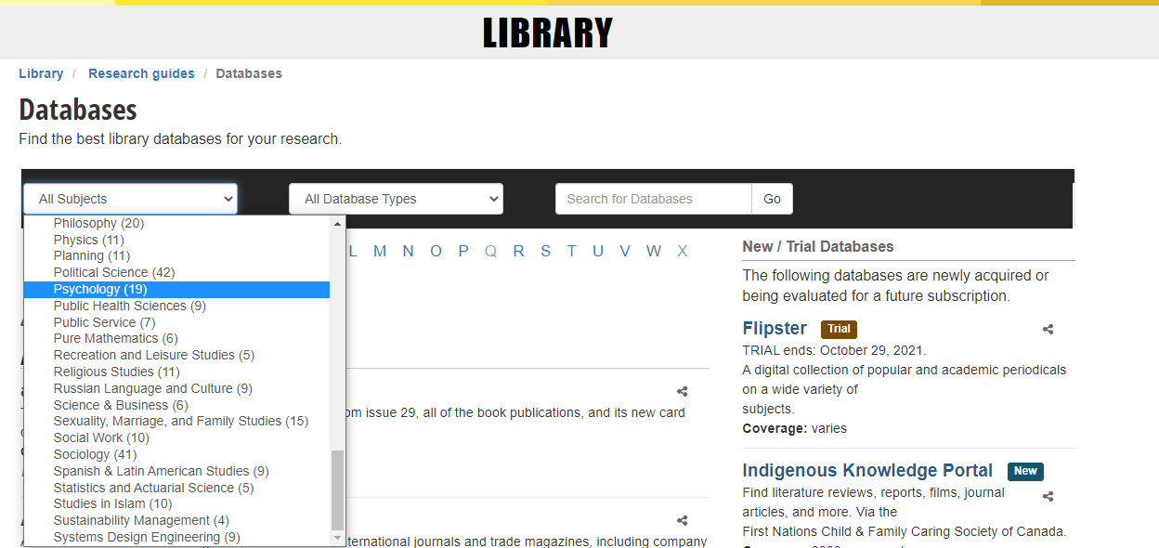

Slide 22
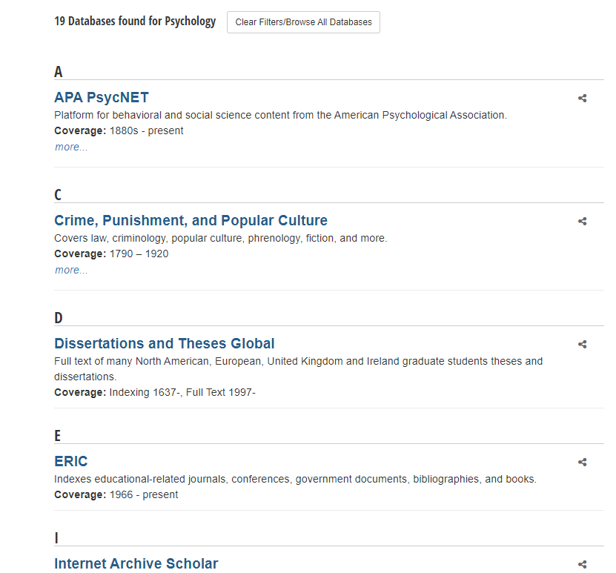

Slide 23
Research Guides

Slide 25
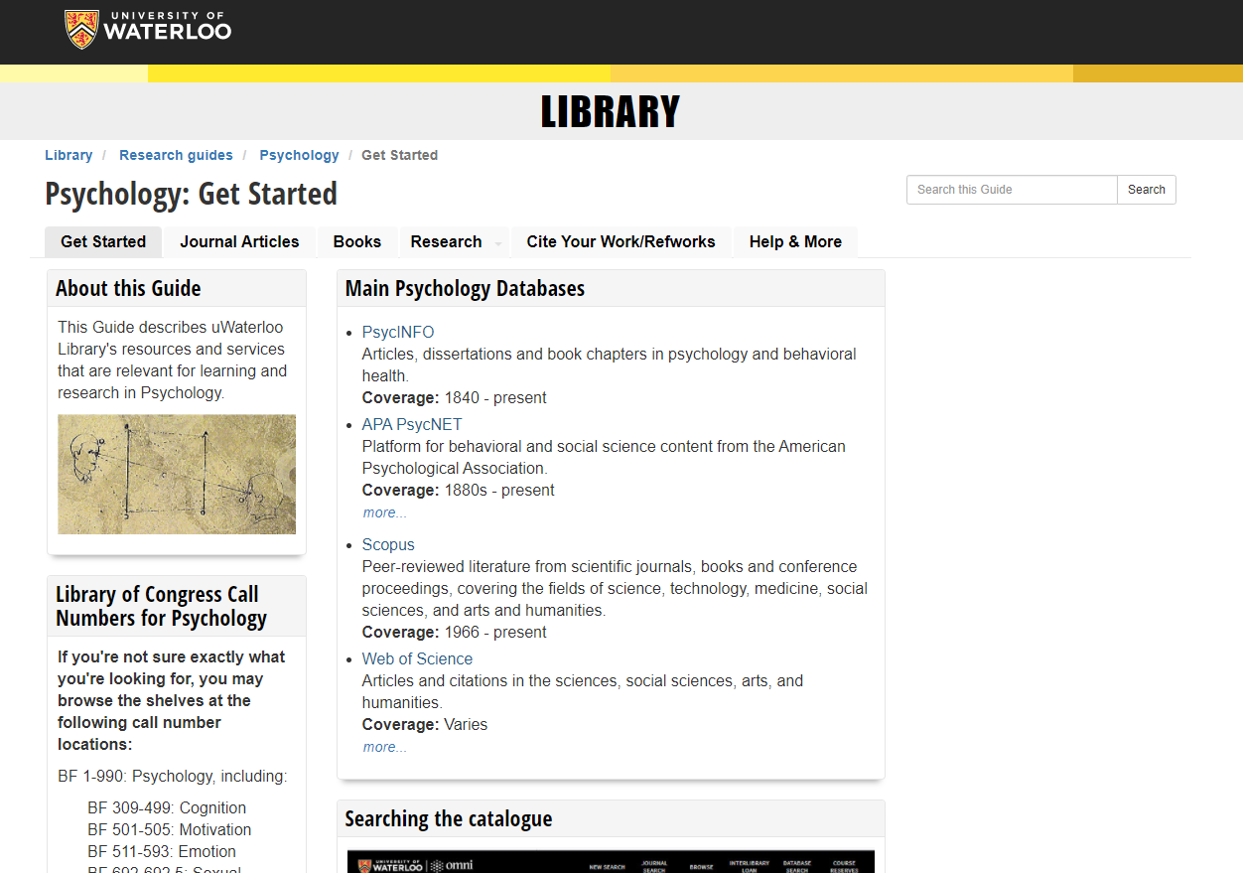

Slide 26
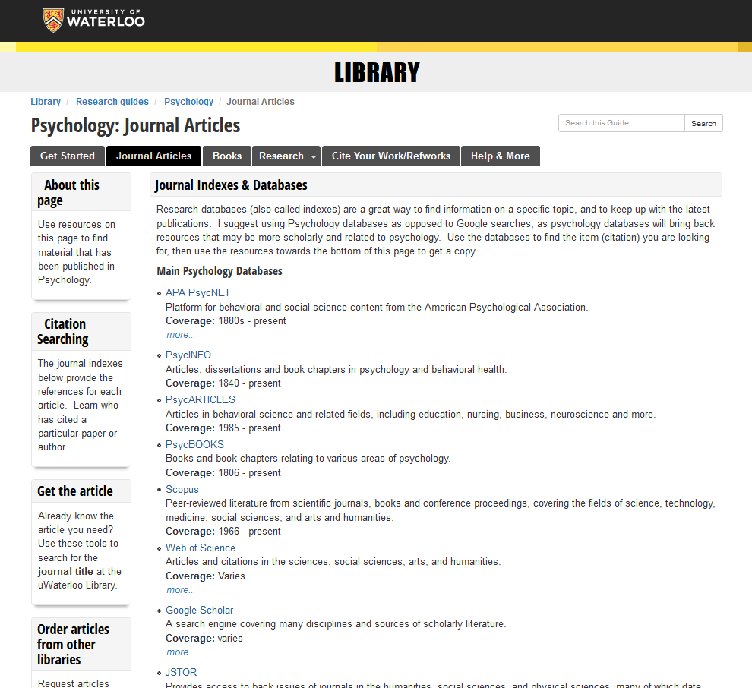

Slide 27
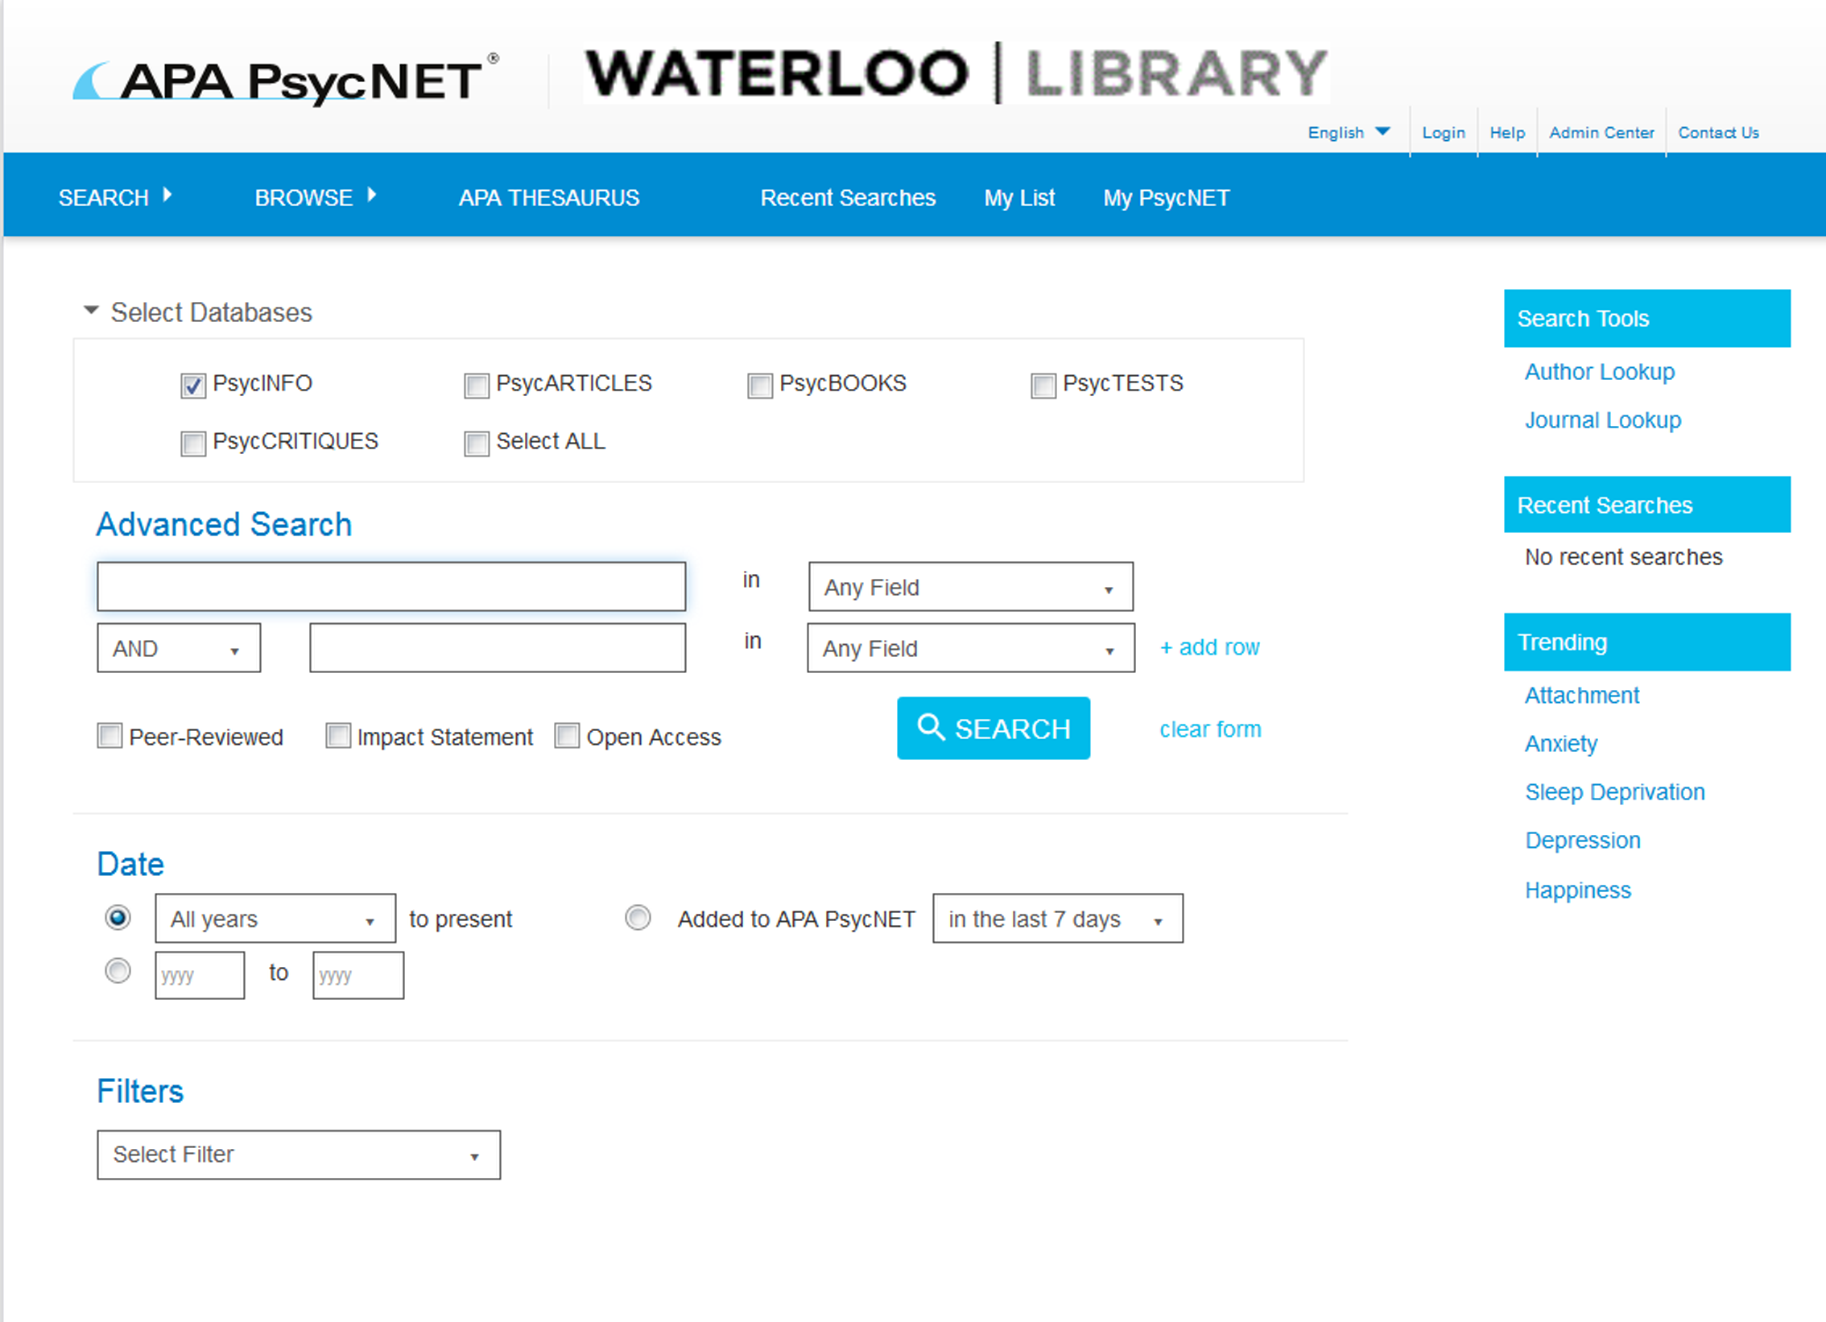
Writing a journal article

Slide 28
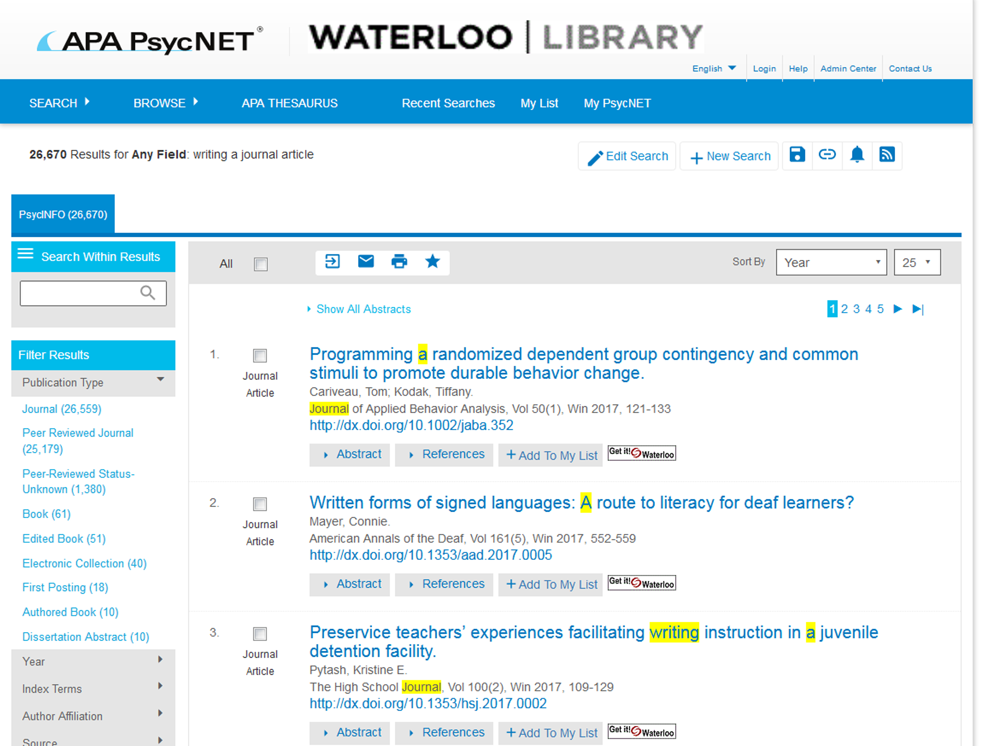

Slide 29
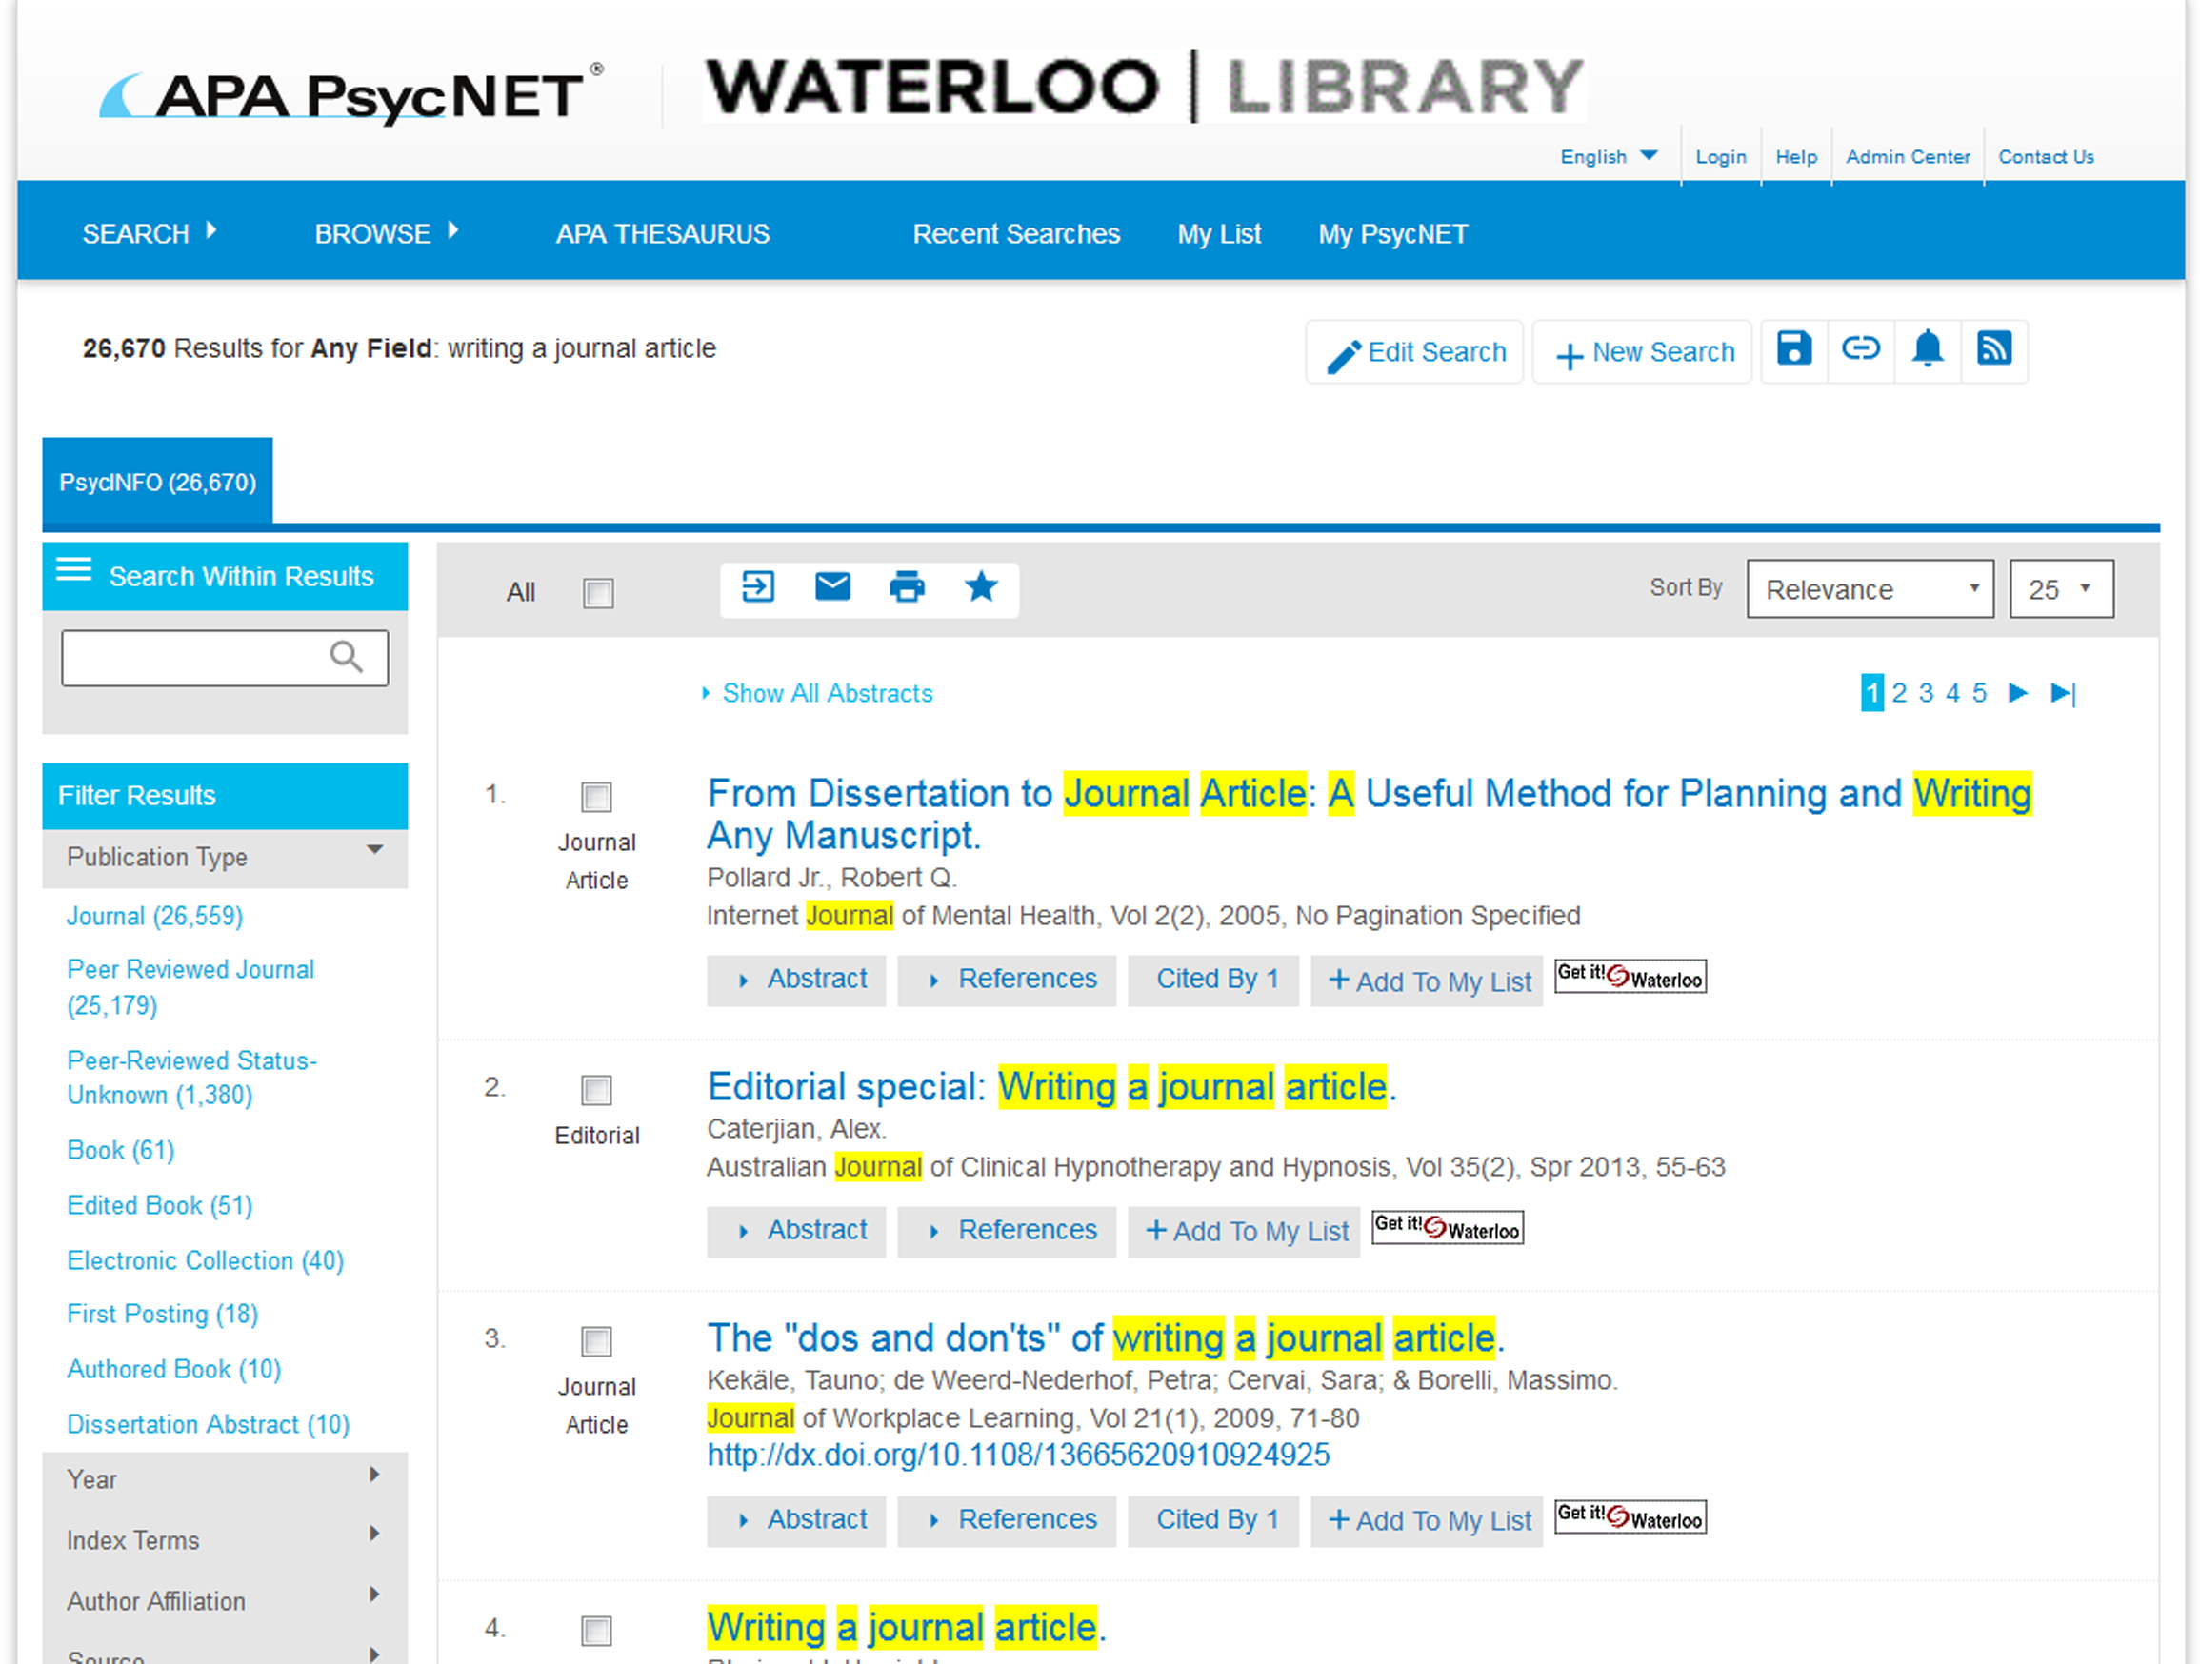

Slide 30
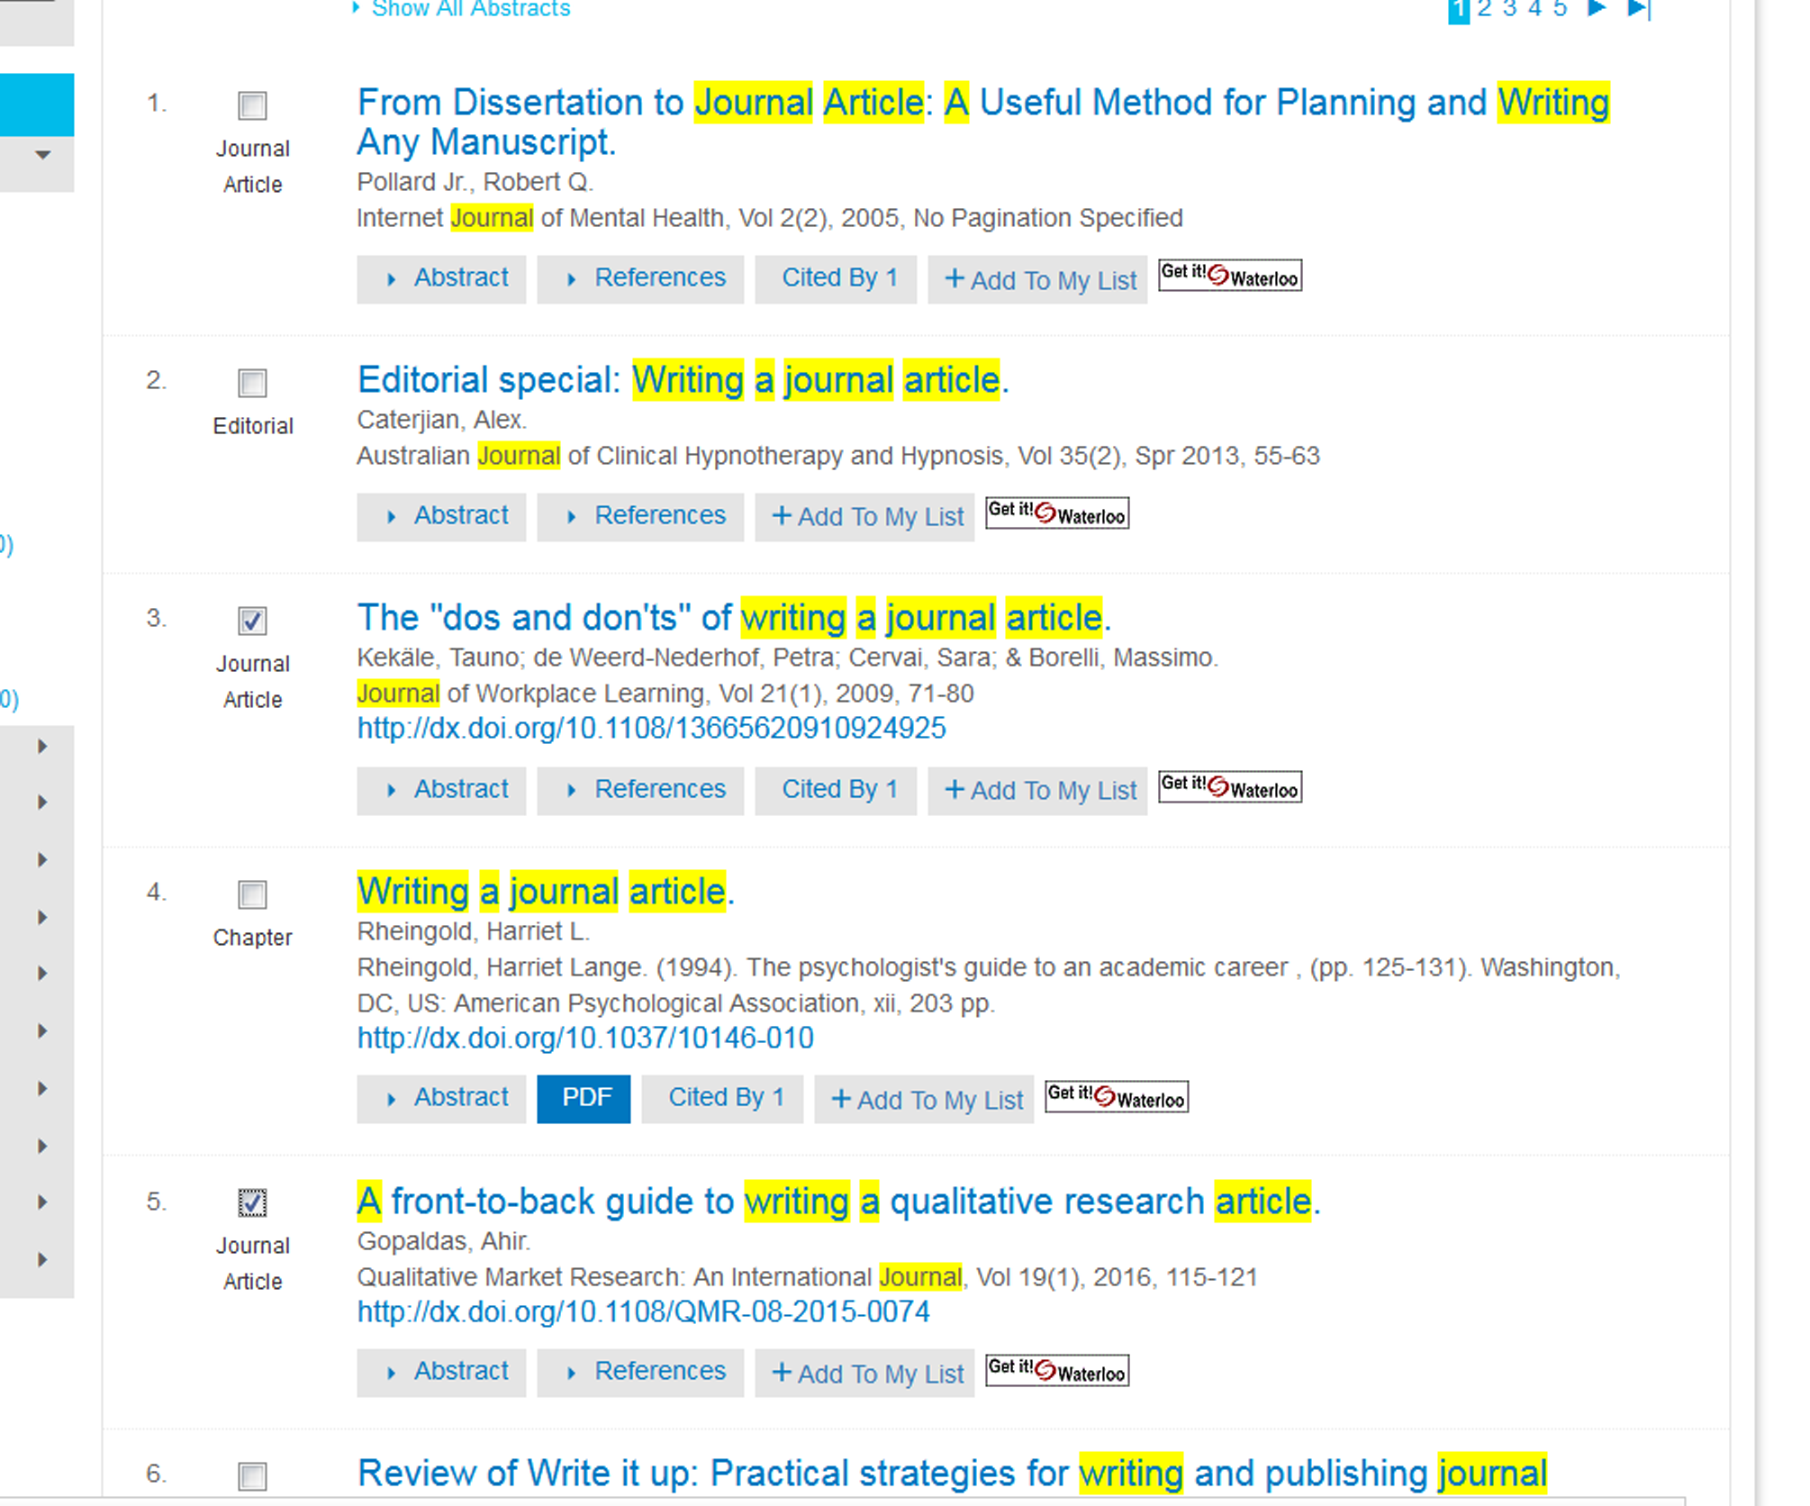

Slide 31
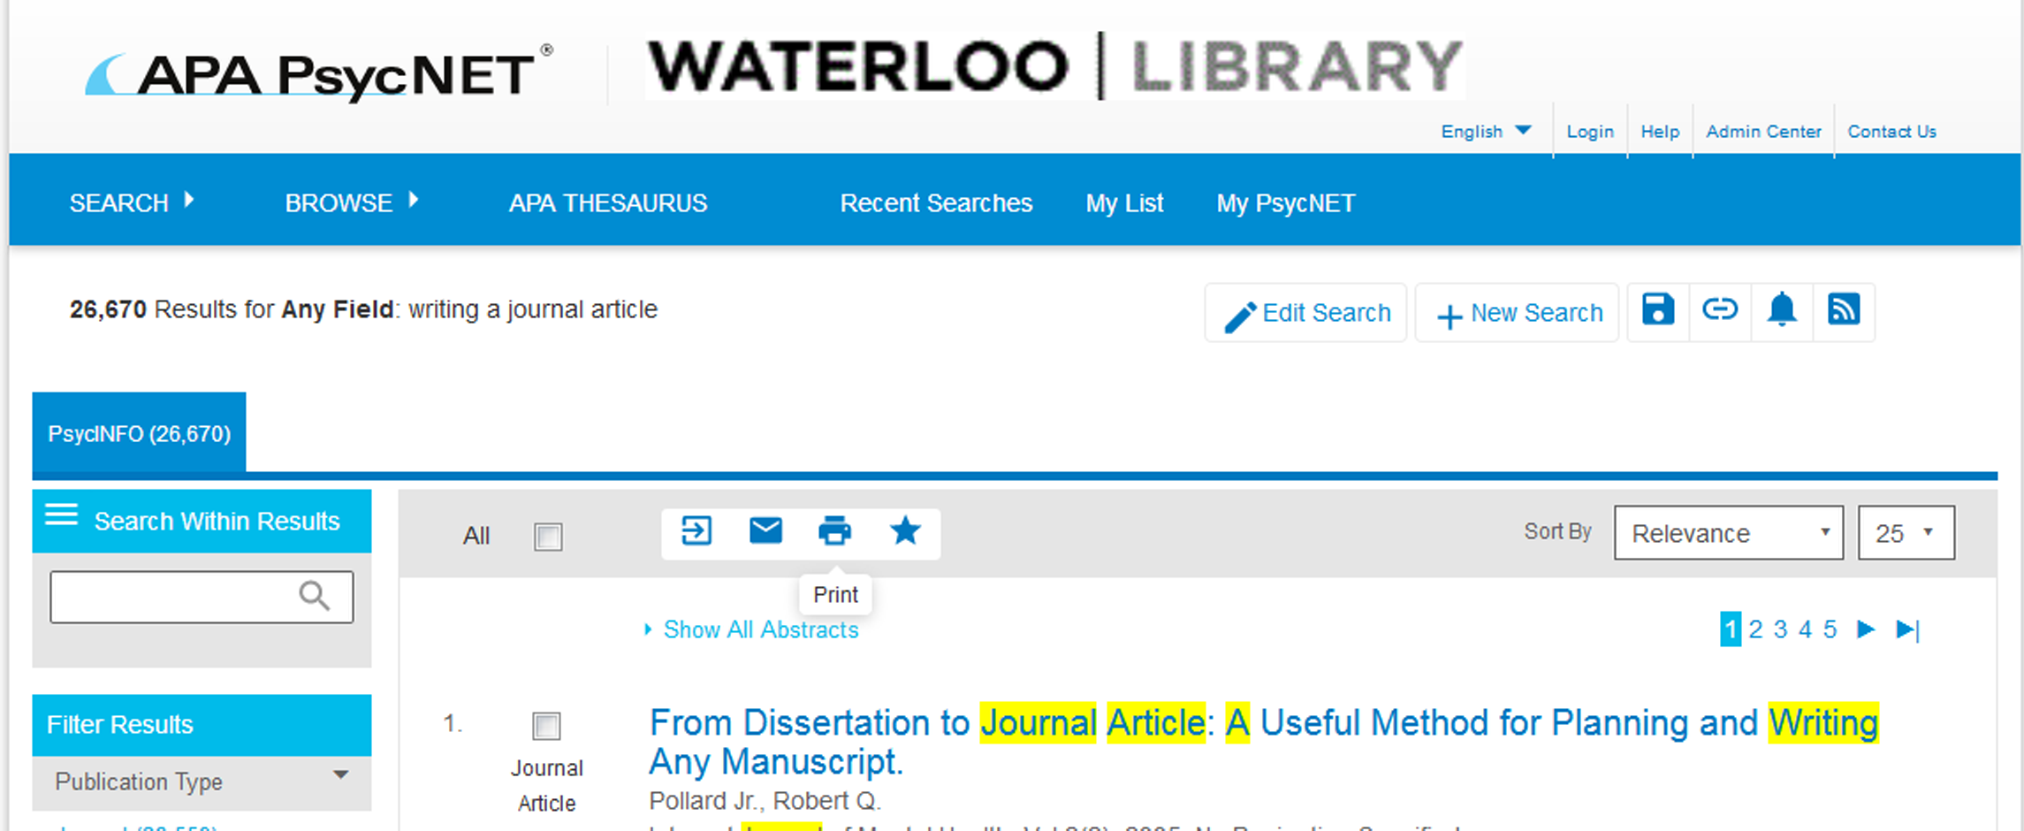
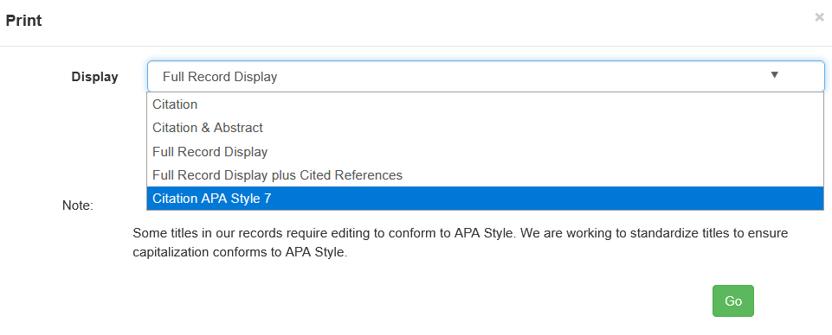

Slide 32
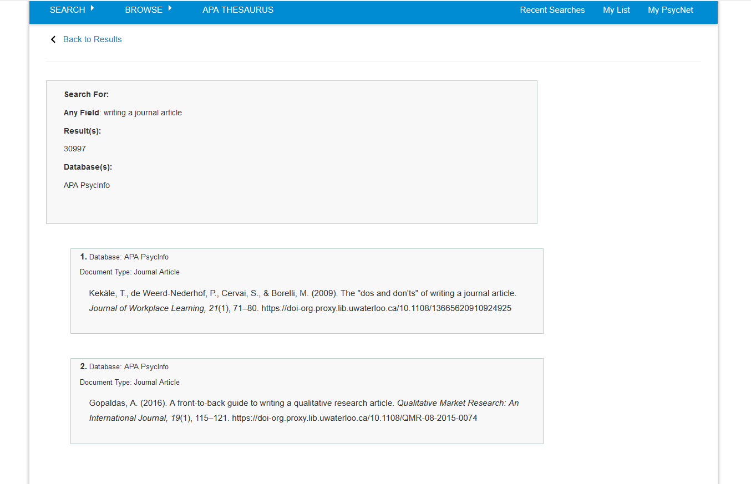

Slide 34
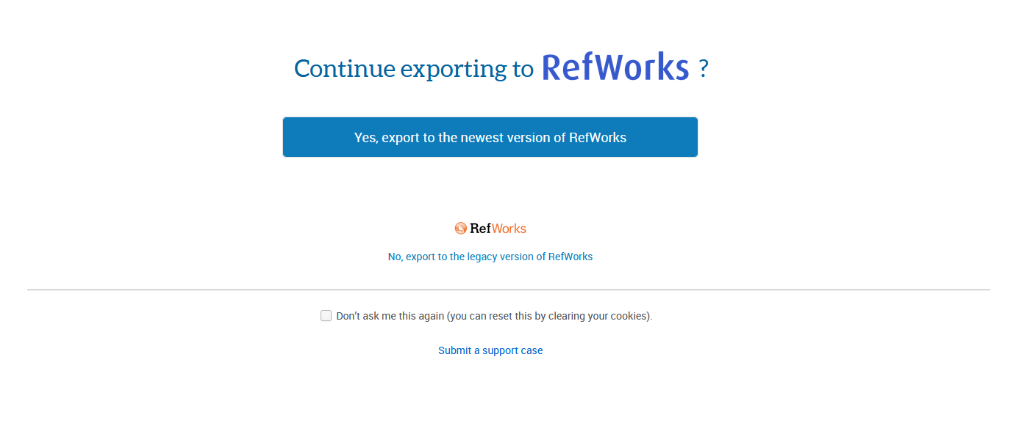
Select the version you are interested in using

Slide 35
Psych
ooooo

Slide 36
Online Citation manager
Free to current students and faculty
Keeps track of citations
Helps you “get” the article
Helps you in the writing process

Slide 37
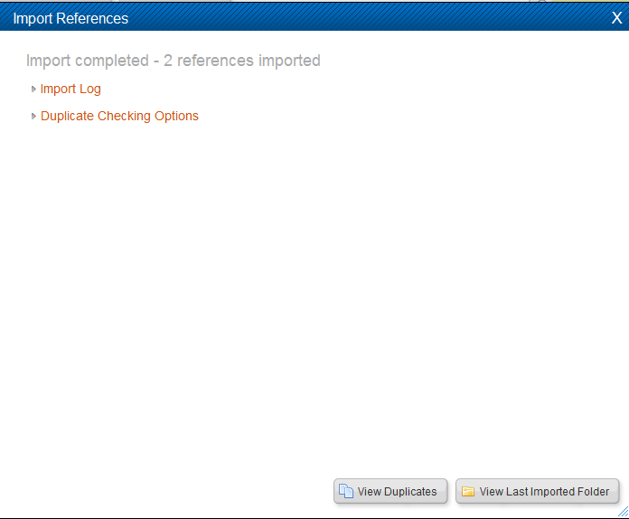

Slide 38
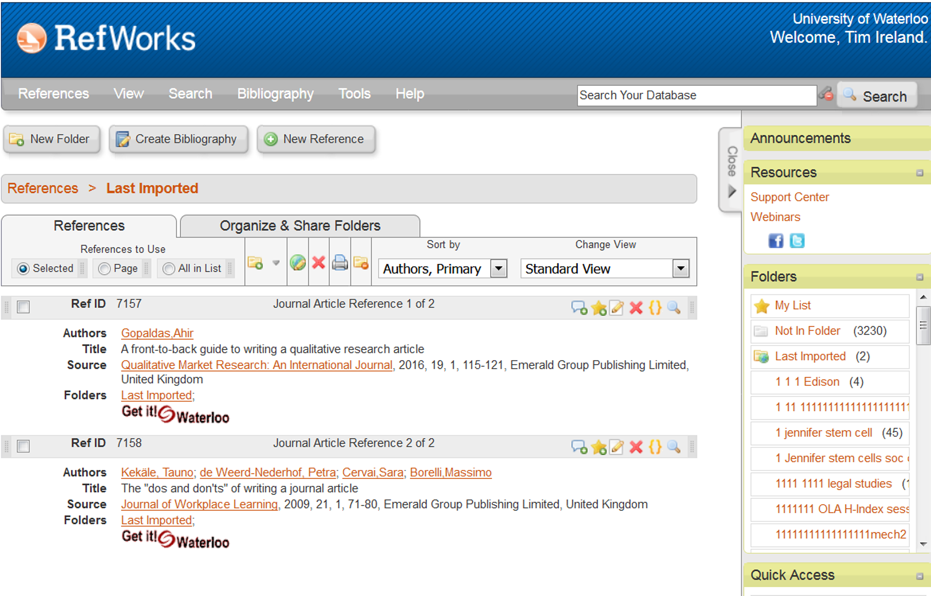

Slide 39
Lets see what we can do…
WARNING-TEASER

Slide 42
You then type your paper and when you get to a location where you are including an idea or thought that is not yours, you insert a citation.

Slide 43
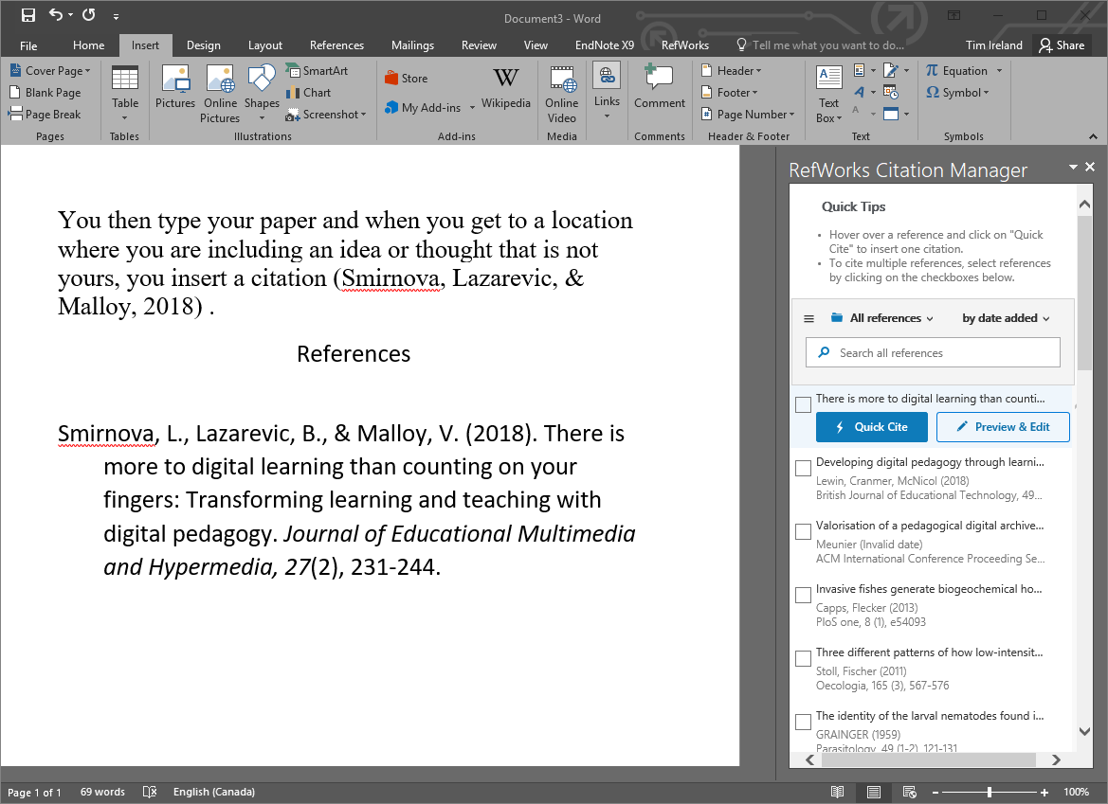

Slide 44
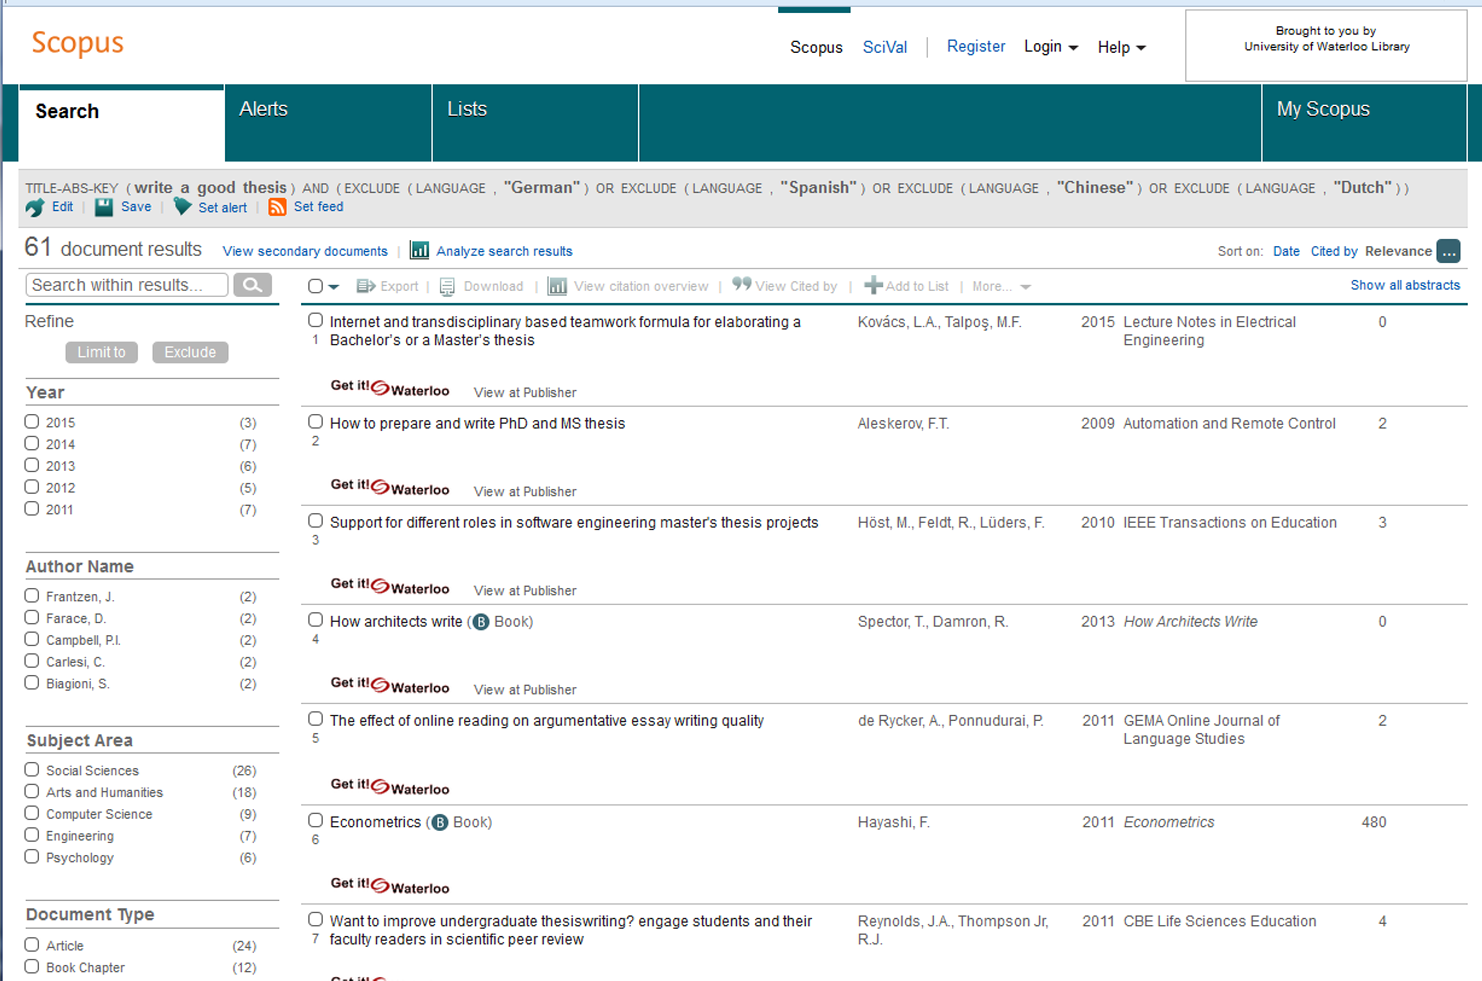
Scopus

Slide 45
PsycINFO vs Scopus
PsycINFO | Scopus
2395 Journals | 24008 Journals
Search Methodology | Times Cited
Focus on Psychology | Multidisciplinary
APA | Elsevier
Excellent controlled vocabulary | Inherited controlled vocabulary
Can specify peer review | All journals peer reviewed

Slide 46
Contact me!
Let me know if you would like to book an appointment with me for an hour (or more)!
Online tutorial
https://lib.uwaterloo.ca/online_learning/sites/default/files/learnings/Psych_499_final/#/
Tim Ireland
tireland@uwaterloo.ca
519-888-4567 X 35061

