Slide 1
Psych 499 Undergraduate Thesis
May, 2022
Tim Ireland
Liaison librarian Psychology

Slide 2
Overview
Who am I and why am I here?
Session objectives
Access resources from off campus
Library catalogue –getting material from catalogue
Research tools (databases)
PsycInfo NEW PsycTests
Scopus
RefWorks
Contact info

Slide 3
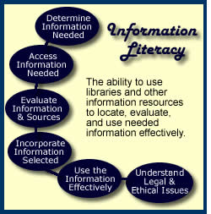
Information Literacy…
The information literate student shall…

Slide 4
Tim’s translation
Students should be able to find relevant
items
Students should be able to get relevant material
Students should be able to evaluate relevant material
Students should be able to cite material properly & avoid plagiarism

Slide 5
ASK QUESTIONS!!!
Tell me and I forget
Teach me and I remember
Involve me and I learn

Slide 6
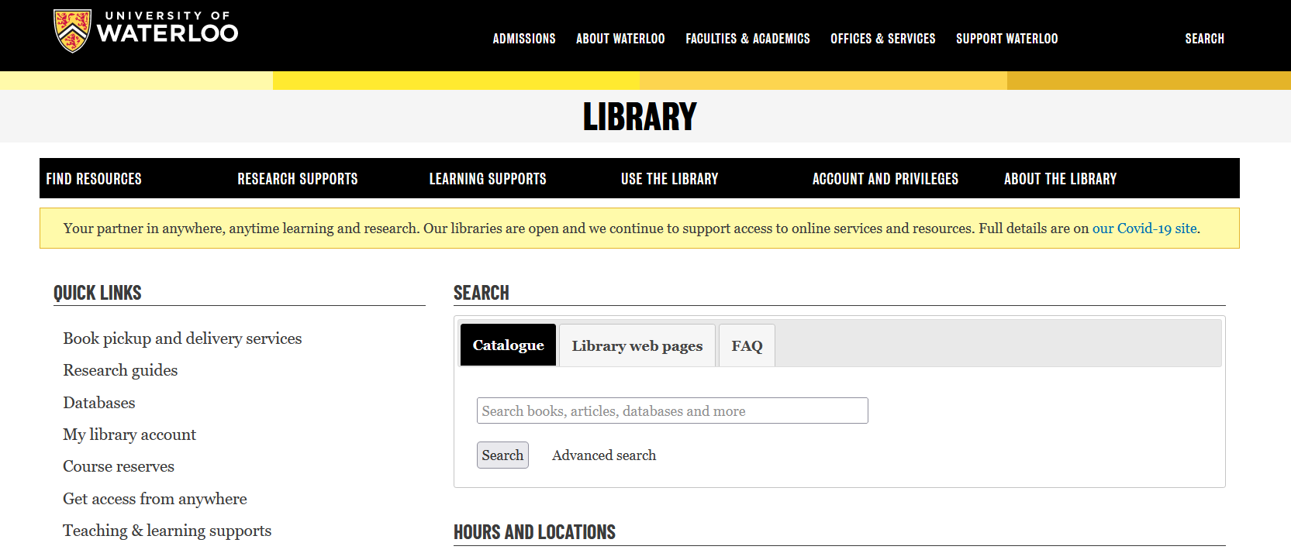
The virtual library

Slide 7
Any questions on getting updated information about library services? Any questions about getting access from off campus?

Slide 8
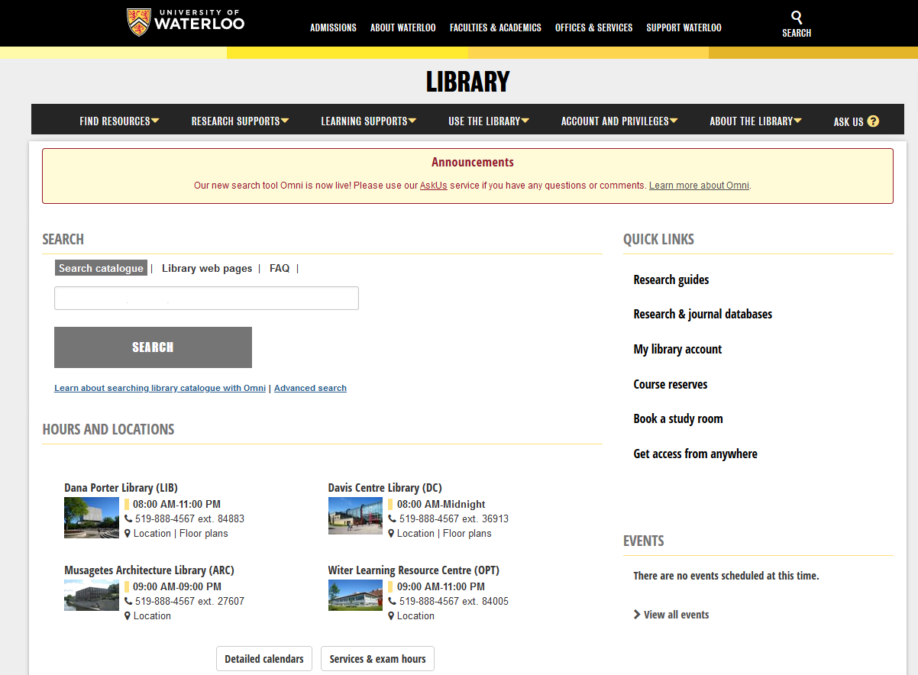
The Library Catalogue
Undergraduate Writing Psychology

Slide 9
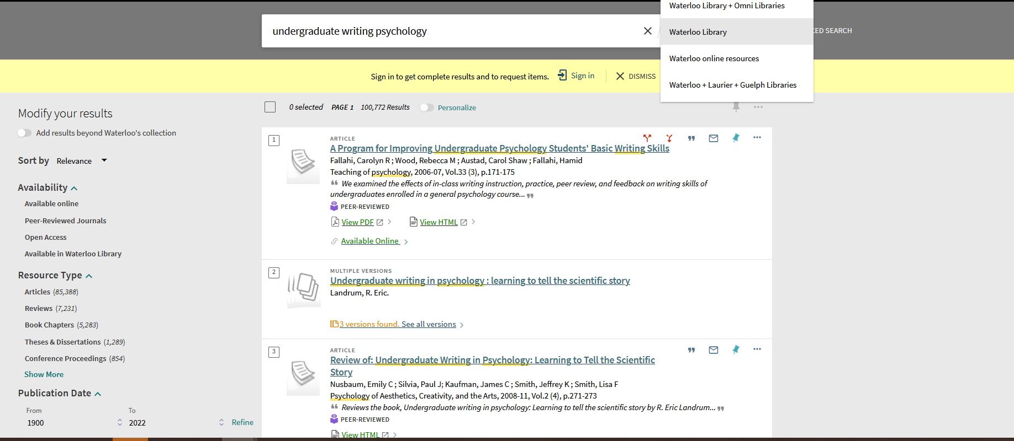

Slide 10
Catalogue -Omni
Loan period for books –Increased may borrow up to 500 item in total with loan periods of 120 days for books and two weeks for journals.
have access to licensed electronic resources.
use interlibrary loans (ILL) to request materials from another library free of charge.
Can have a portion of a book scanned/digitalized 10%
Can have any of the circulating items mailed to you with free return postage.
Can have your item sent to any library location (including non-UW).

Slide 11
If the book is not in the system

Slide 12
Inter Library Loan
Circulating books from anywhere in the world
Journal articles from anywhere in the world
5-10 Business days
Journal articles will appear as e-mail links from your e-mail

Slide 13
Any questions about the Library Catalogue or Inter-library loan system?

Slide 14
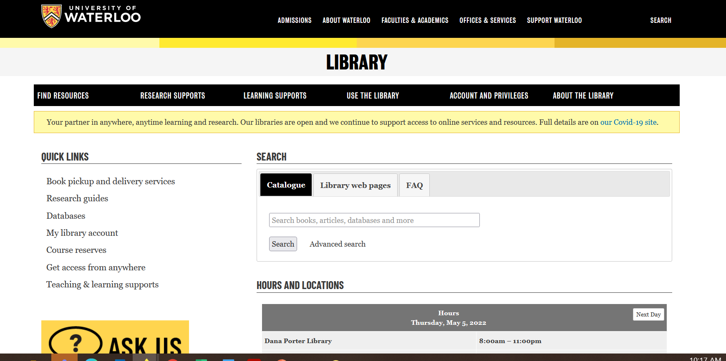
Databases

Slide 15
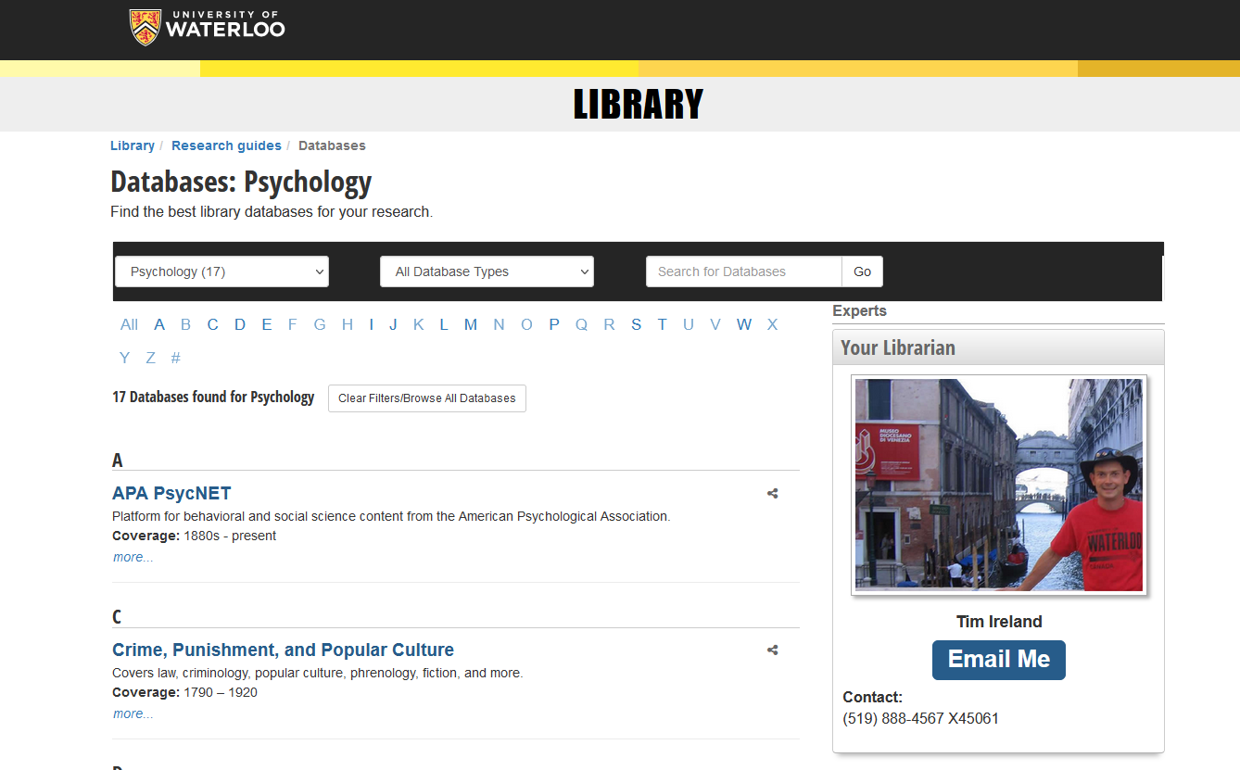

Slide 16
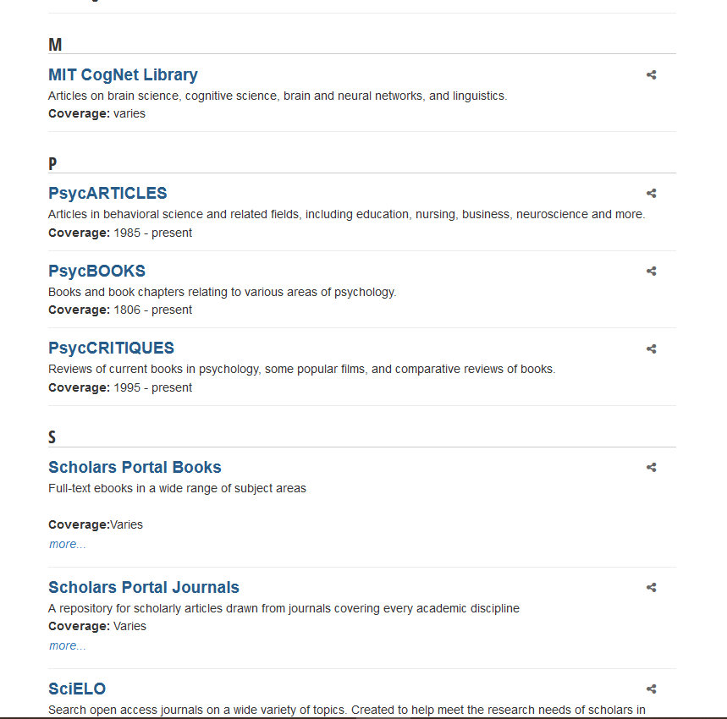

Slide 17
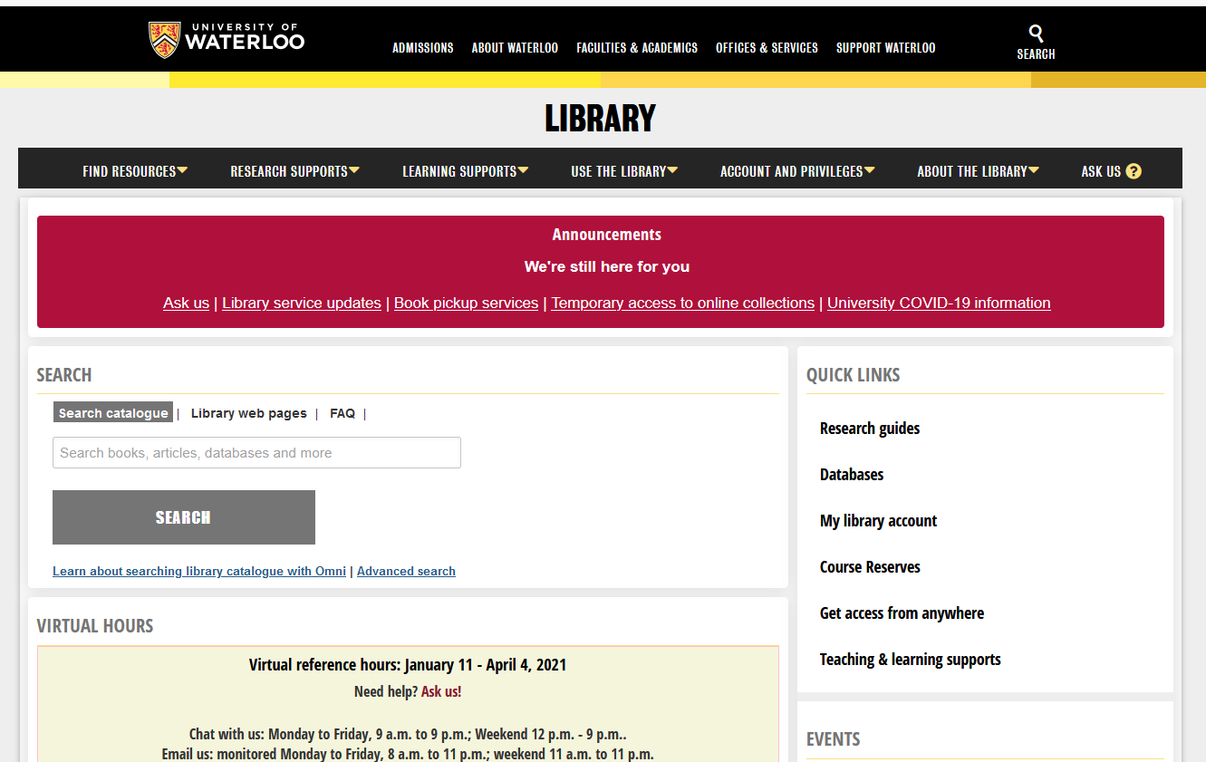
Research Guides

Slide 20
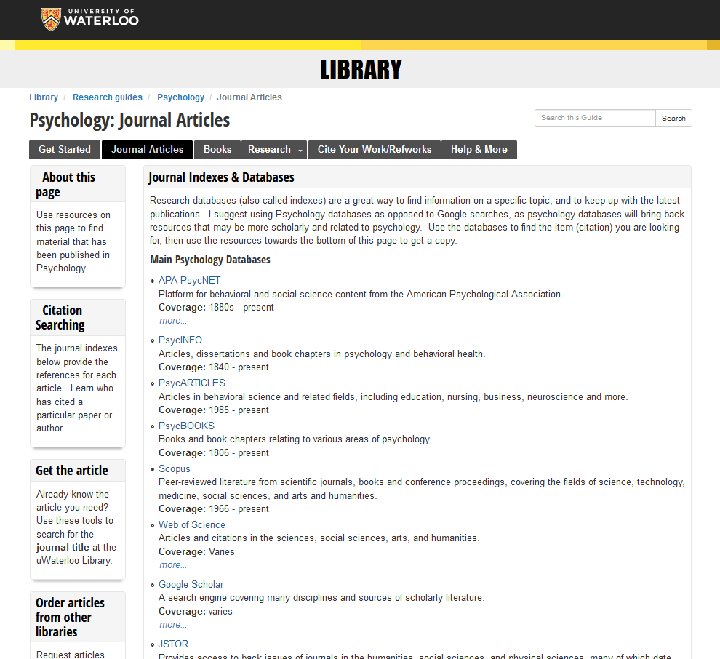

Slide 21
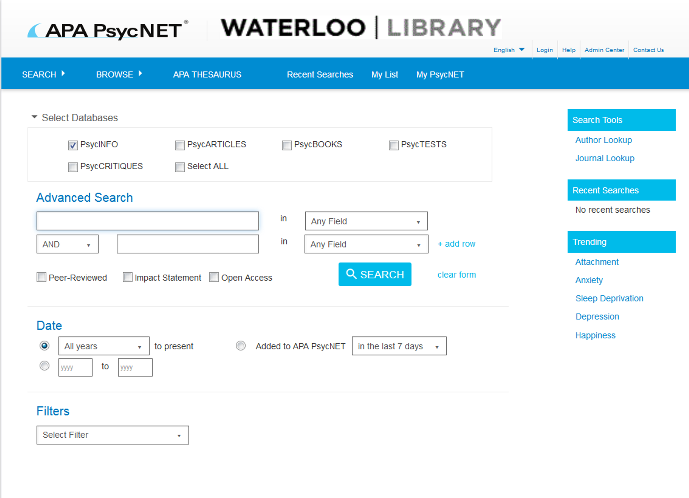
Writing a journal article

Slide 22
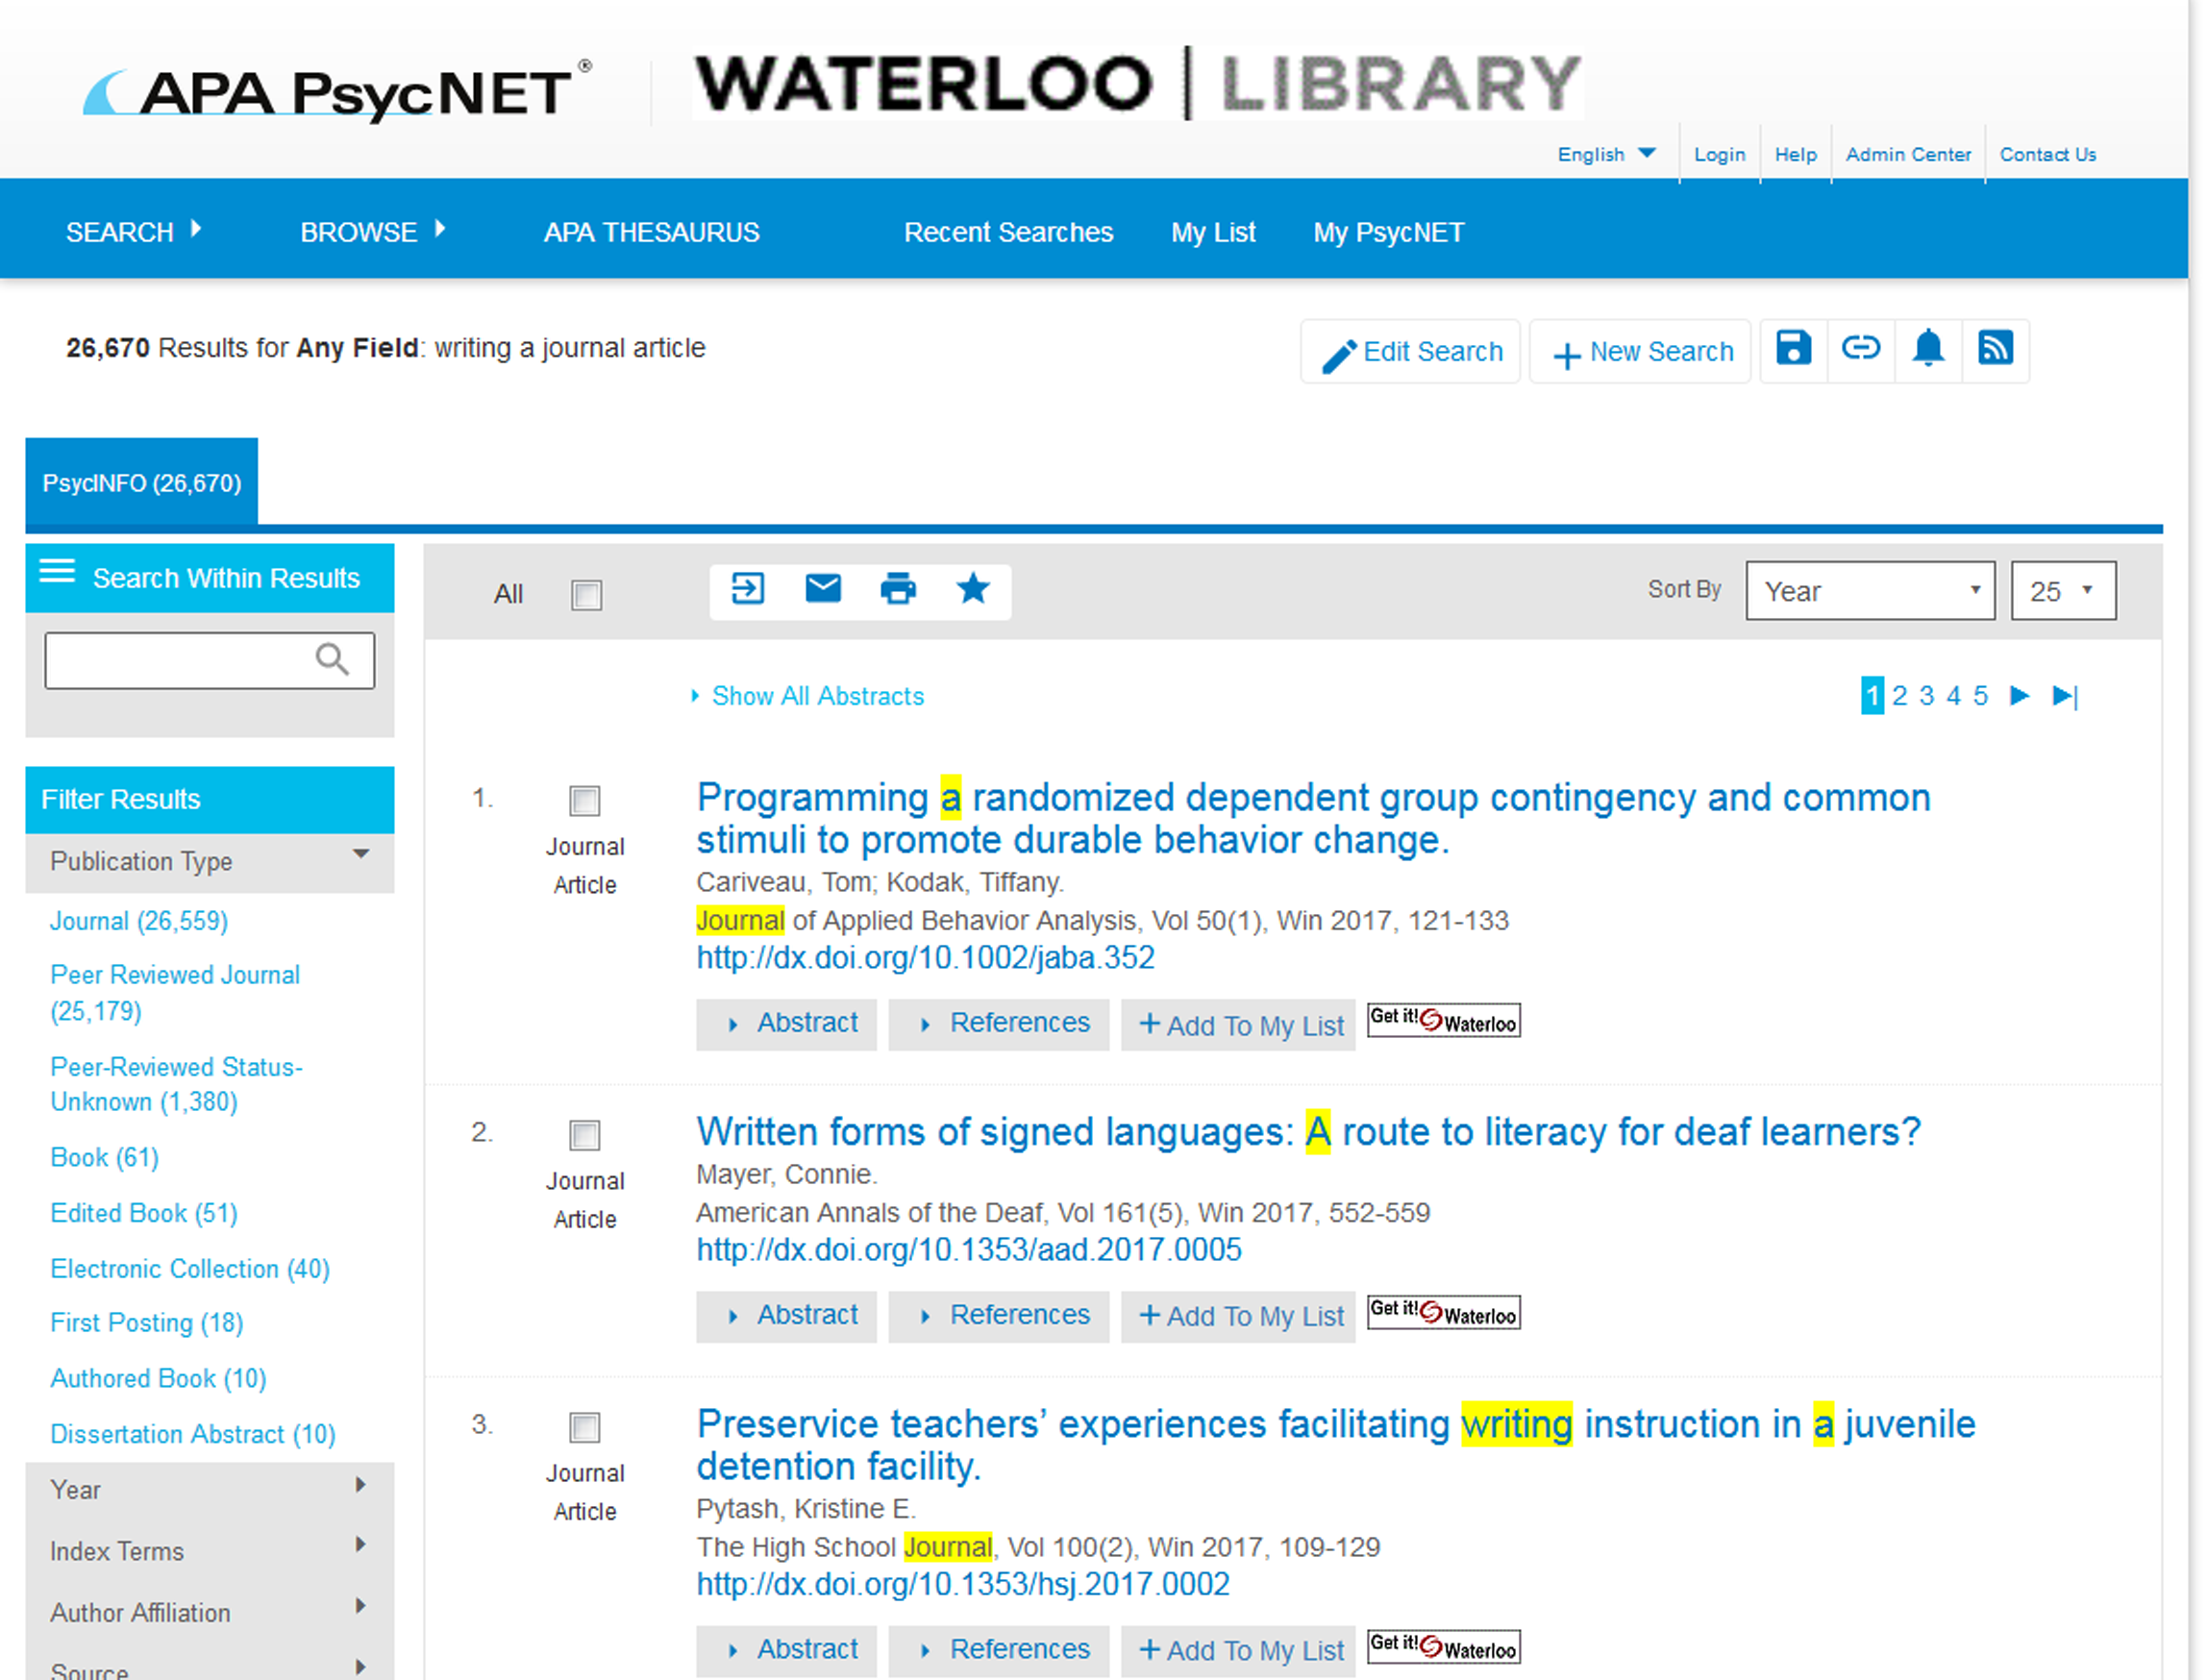

Slide 23
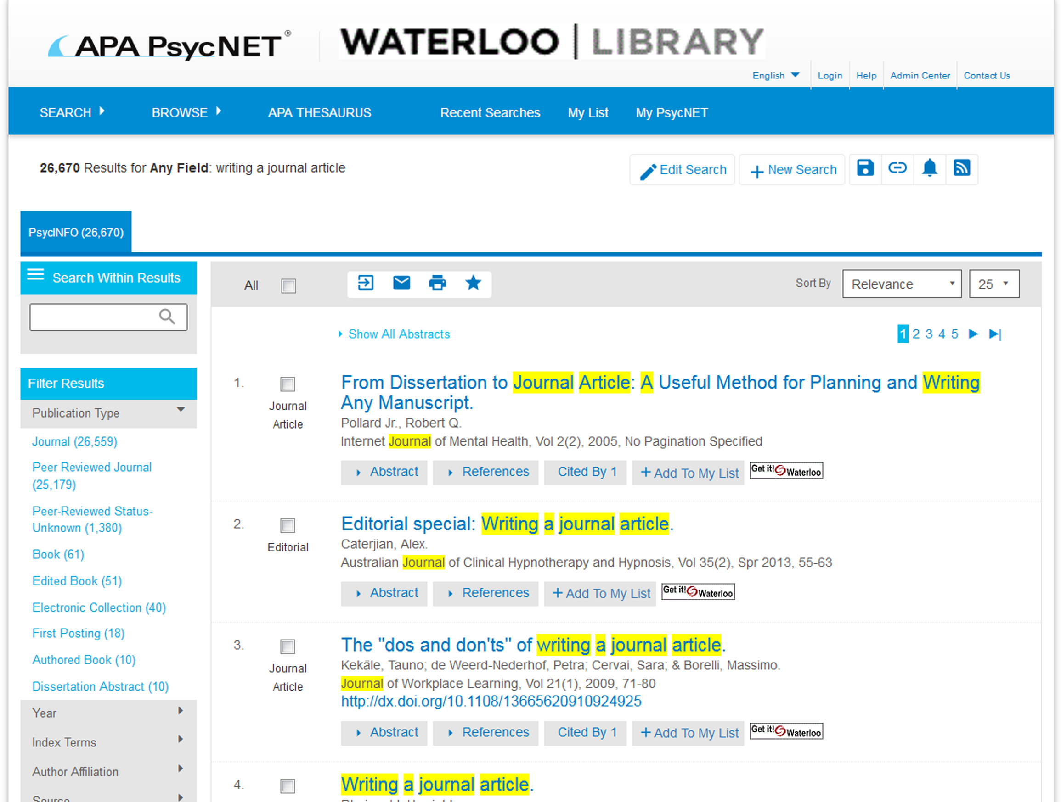

Slide 24
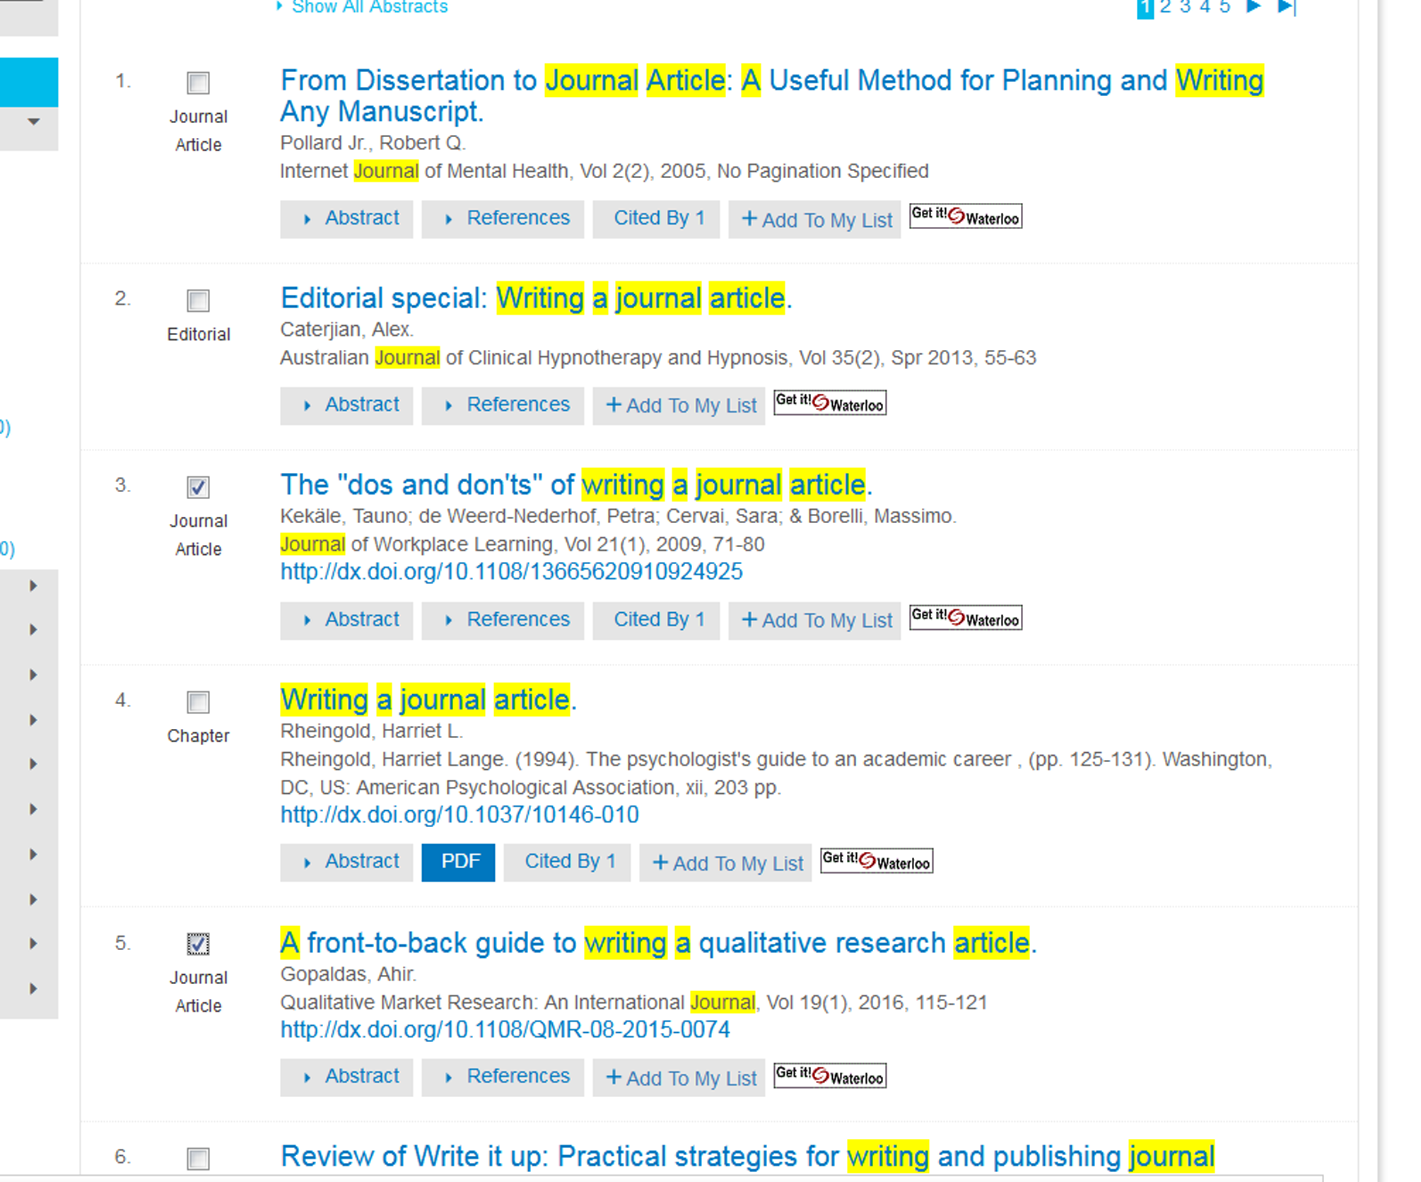

Slide 25
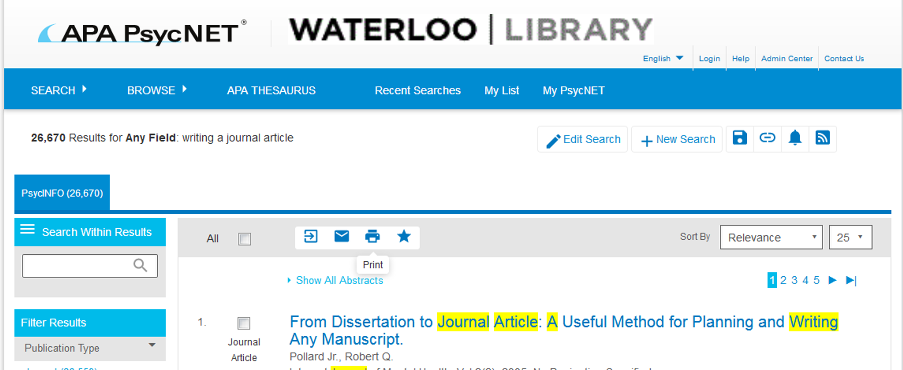
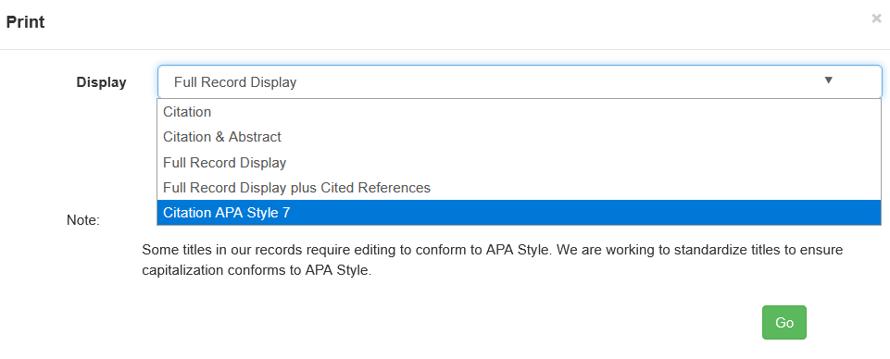

Slide 26
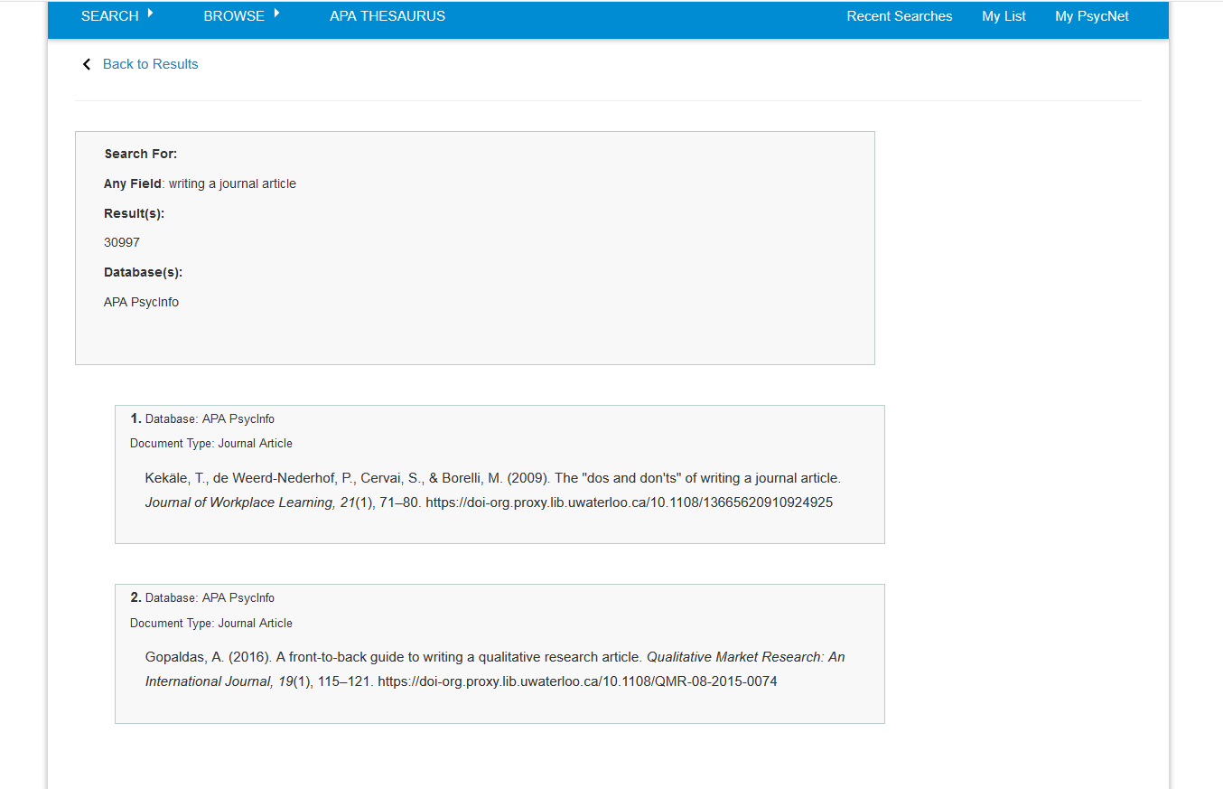

Slide 28
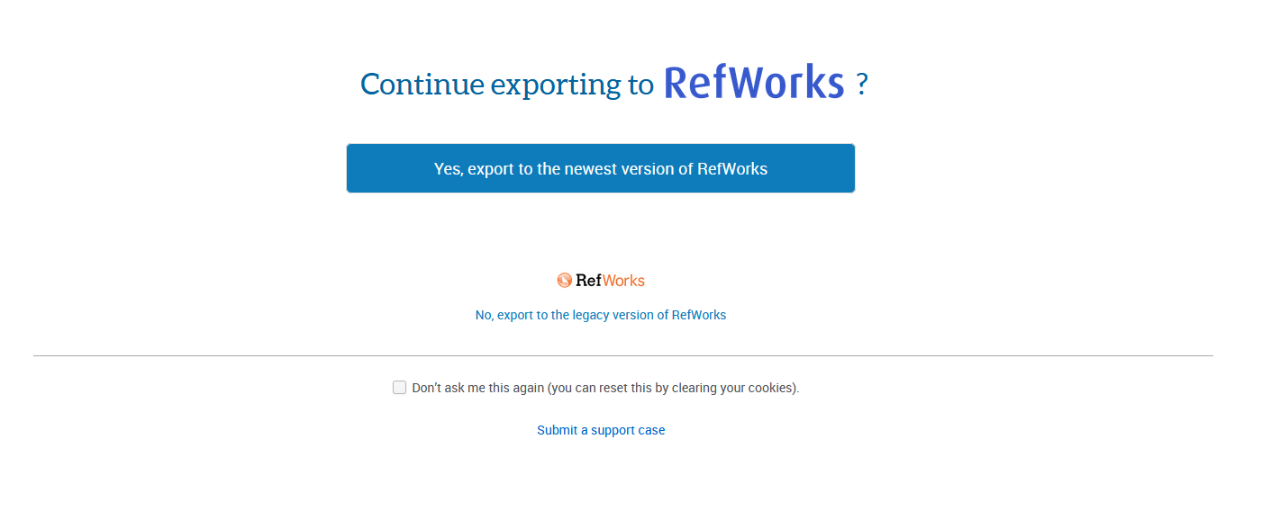
Select the version you are interested in using

Slide 29
Psych
ooooo

Slide 30
Online Citation manager
Free to current students and faculty
Keeps track of citations
Helps you “get” the article
Helps you in the writing process

Slide 31
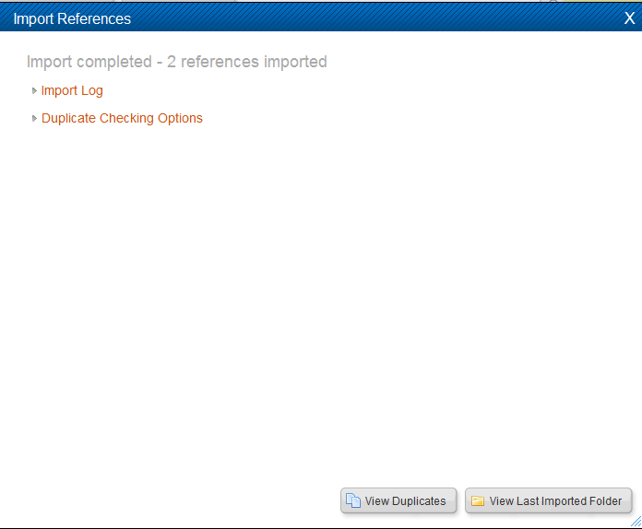

Slide 32
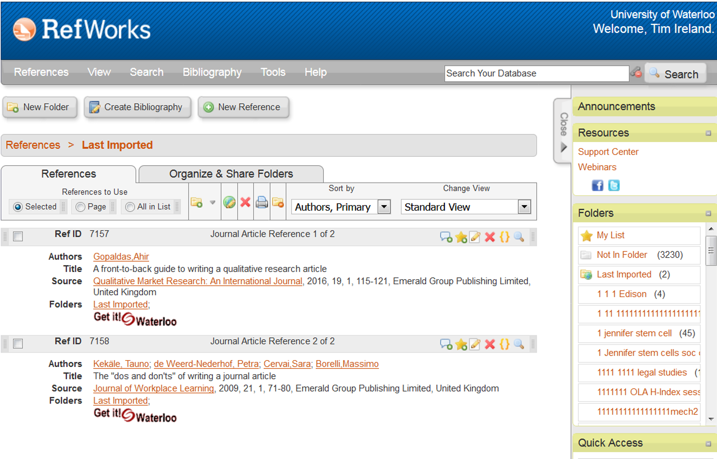

Slide 33
Lets see what we can do…
WARNING-TEASER

Slide 36
You then type your paper and when you get to a location where you are including an idea or thought that is not yours, you insert a citation.

Slide 37
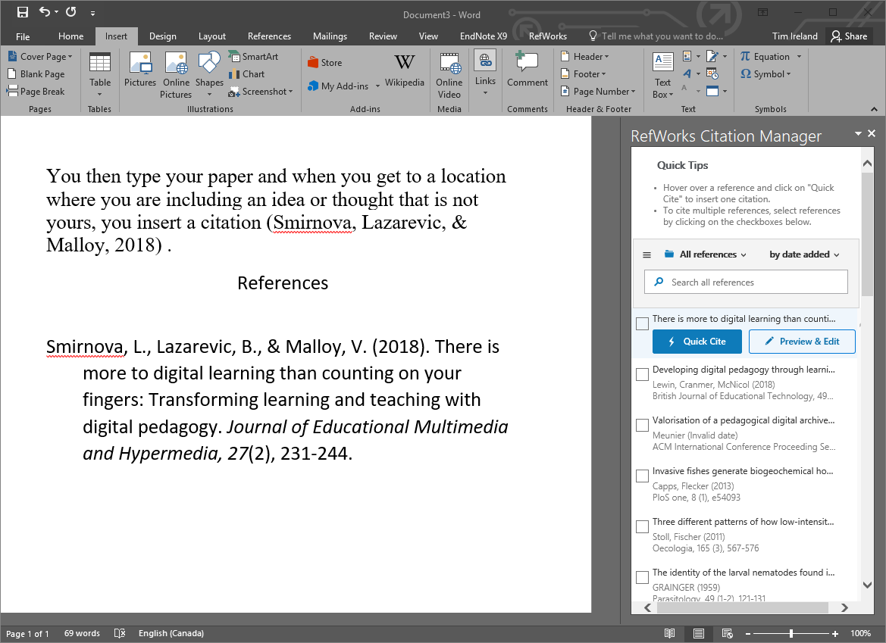

Slide 38
Zotero
Seems easier to pick up and use
Contact me if you would like me to help you get set up.

Slide 39
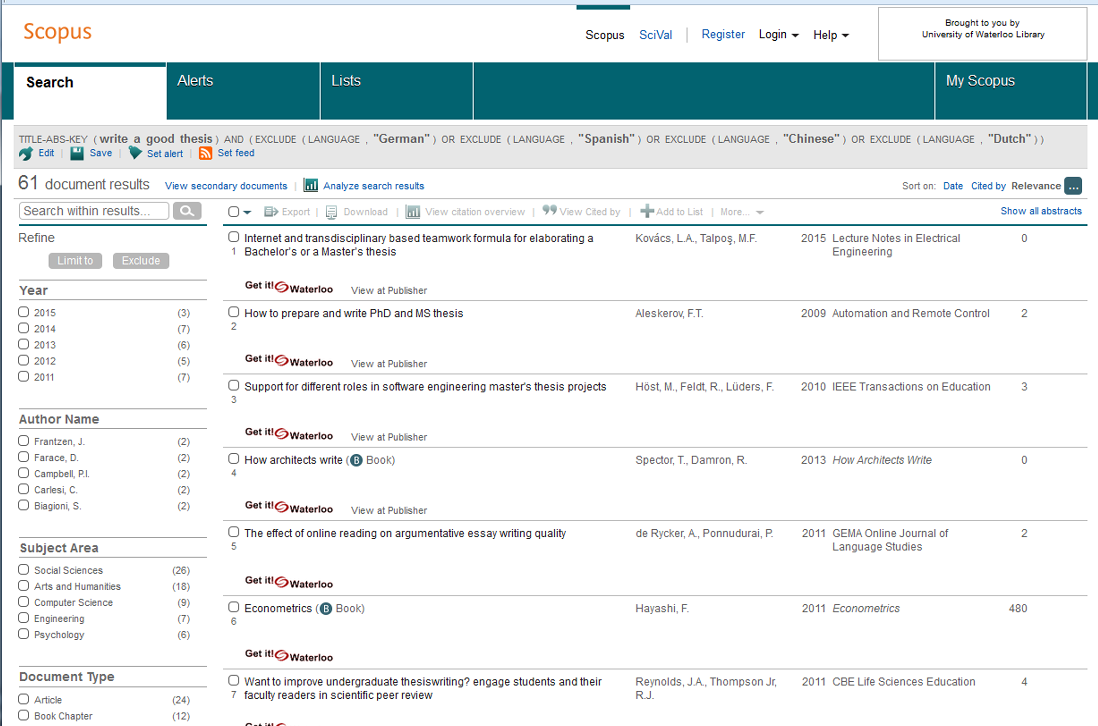
Scopus

Slide 40
PsycINFO vs Scopus
PsycINFO | Scopus
2395 Journals | 24008 Journals
Search Methodology | Times Cited
Focus on Psychology | Multidisciplinary
APA | Elsevier
Excellent controlled vocabulary | Inherited controlled vocabulary
Can specify peer review | All journals peer reviewed

Slide 41
Contact me!
Let me know if you would like to book an appointment with me for an hour (or more)!
Online tutorial
https://lib.uwaterloo.ca/online_learning/sites/default/files/learnings/Psych_499_final/#/
Tim Ireland
tireland@uwaterloo.ca
519-888-4567 X 35061

