Slide 1
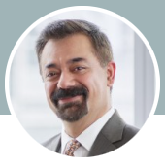
Week two panel
Behram Faroogh (https://www.linkedin.com/in/behram/)
Behram is a retired partner from PwC Canada, where he most recently led their Emerging Tech practice across the country.
He is currently a professor at the University of Toronto, teaching Accounting Information Systems, Risk & Controls, and Emerging Tech subjects including Blockchain, AI, Quantum Computing, etc. He also serves as the Vice President on the Board of Directors for the Toronto Chapter of ISACA.
Behram is an innovator who excels at defining ‘the art of the possible’ by challenging the norm, envisioning revolutionary solutions to complex business problems, and surpassing client expectations by helping them chart a course for rapid growth in today’s highly disruptive and often volatile technology landscape.
His unique blend of business and technology skill set, coupled with his entrepreneurial background, allows Behram to study any given problem from a balanced scorecard perspective that aligns technology needs to core business objectives and challenges the norm to envision revolutionary yet simple solutions to complex business issues, thereby turning ambiguity into concrete action.

Slide 2
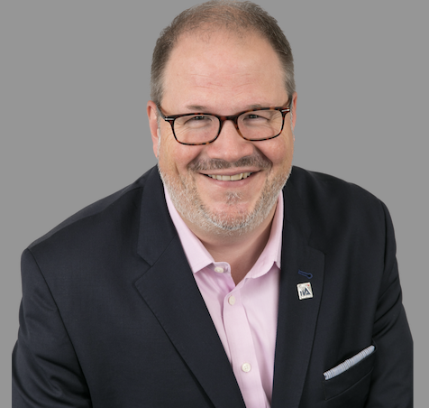
Week two panel
Jeff McIlravey https://www.linkedin.com/in/jeffmcilravey/?originalSubdomain=ca
Director, Member Service Delivery – Canada The Institute of Internal Auditors (IIA)
Jeff McIlravey, CRMA, CFSA, Director, Member Service Delivery, Canada. Jeff provides strategic leadership to advance and grow the internal audit profession in Canada. He leads and spearheads efforts towards IIA member satisfaction by ensuring an enhanced level of service for IIA members in Canada. Working together with the Global IIA – Advocacy, MC&L, Membership, and Marketing teams, Jeff ensures there is alignment of efforts and service delivery in collaboration with the 12 IIA Canada Chapters, including growth in memberships, training, and certifications.
Jeff’s over 25 years’ experience and expertise in the Internal Audit profession having worked for reputed organizations across different industries, such as aerospace, university sector and asset management. With a focus on enterprise governance and risk management. In addition, he has been an active volunteer for the IIA, Past President and Chair of the Board IIA Toronto Chapter, serving as the Co-Chair of several IIA Canada National Conferences, Finance Chair 2015- IIA International Conference, speaker and mentor. In 2019, Jeff received the Arthur Child Distinguished Service Award from the IIA.

Slide 3
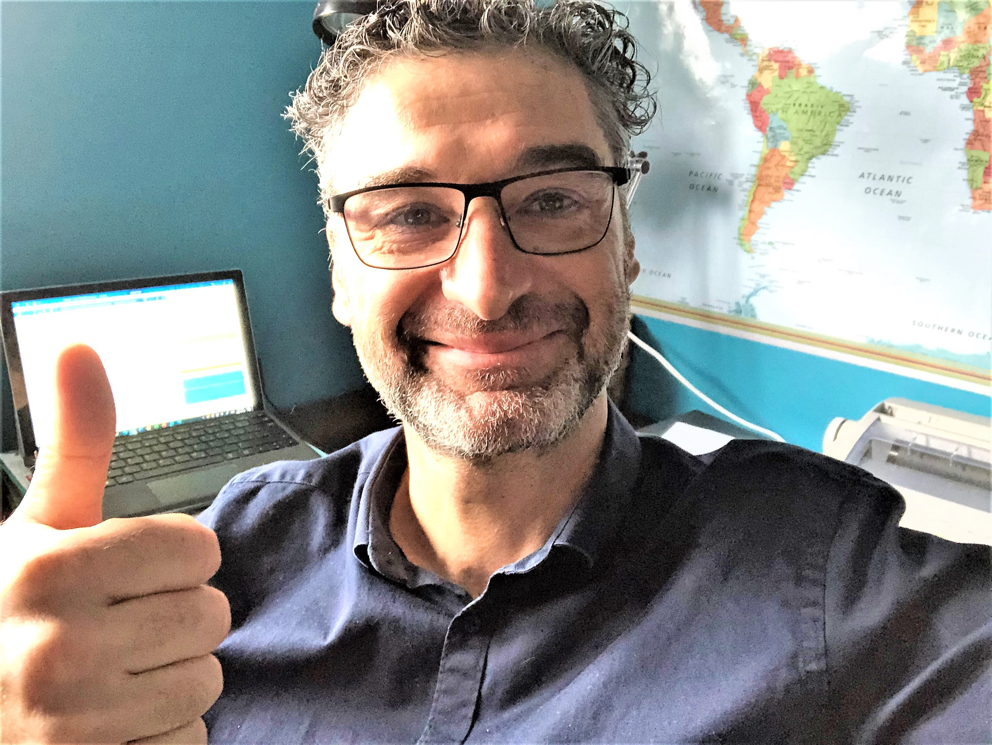
Week two panel
Mike Milito
Mike is the Assistant Comptroller General, Internal Audit Sector, Treasury Board of Canada Secretariat
Mike Milito has been Assistant Comptroller General, Internal Audit Sector (IAS) since December 11, 2017. In this role, Mike is responsible for conducting government-wide audits and audits of small departments; leading and championing the internal audit function in the Federal Public Service, which includes monitoring and assessing policy implementation; providing oversight and support; and developing policy advice and standards.
He is also responsible for the recruitment, appointment, and tenure of qualified and diverse departmental audit committee members.
Prior to his appointment as Assistant Comptroller General of IAS, Mike was the Director General of the Internal Audit and Evaluation Bureau at the Treasury Board Secretariat (TBS). Before joining TBS, Mike occupied various roles in the fields of Audit and Evaluation in Public Works and Government Services Canada, Health Canada, Privy Council Office, and Finance Canada.
Since 2014, he has been TBS’ Champion for the Public Service Employee Survey, where he collaborates with others to develop new approaches to continually improve the wellness and workplace of employees.
Mike holds a Bachelor of Commerce from Carleton University, and a Master of Business Administration from Dalhousie University. He is also a Certified Internal Auditor.

Slide 4
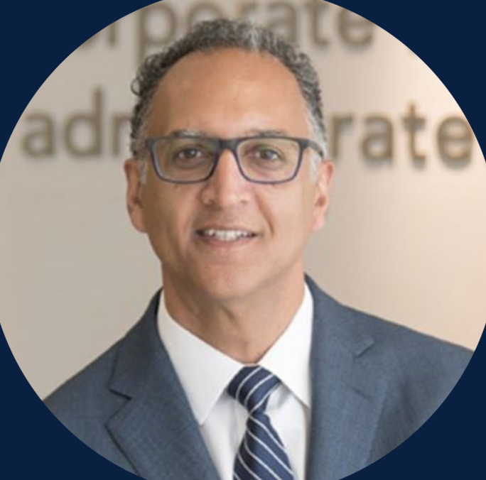
Week three (governance) presenter
Rahul Bhardwaj, LL.B, ICD.D
President and Chief Executive Officer, Institute of Corporate Directors
As President and CEO of the Institute of Corporate Directors, Rahul Bhardwaj leads a Canadian not-for-profit association of more than 17,300 members committed to improving national outcomes by growing the board leadership and governance capacities within Canadian businesses, agencies and not-for-profits.
Mr. Bhardwaj currently serves on the boards of Waterfront Toronto, the Institute of Corporate Directors, the Canadian Foundation for Governance Research, the Leader Council at the Ian O. Ihnatowycz Institute for Leadership at Ivey Business School, and as Director Emeritus at the Rideau Hall Foundation.
His corporate governance vision has made Mr. Bhardwaj a sought-after presenter, speaker and media commentator in Canada and across the globe.

Slide 5
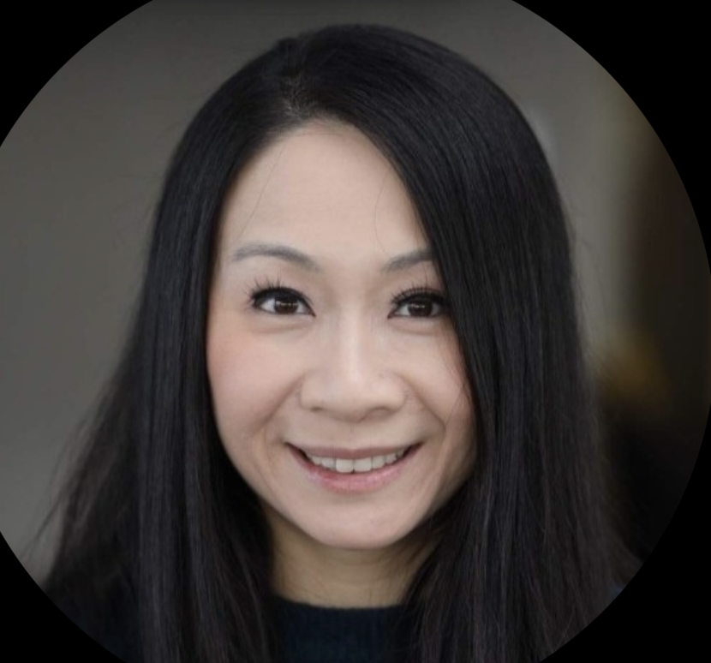
Week three (governance) presenter
Tiffany Wong https://www.linkedin.com/in/tiffany-wong-cpa-ca-5614021b/?originalSubdomain=ca
Senior Director, Head of Internal Audit, Pet Valu.
Tiffany has over 15 years in Internal Audit experience serving a variety of industries including retail, manufacturing and insurance. Tiffany currently leads the Internal Audit function at Pet Valu, developing the Company’s risk management framework and leading the ERM function on behalf of management.
Prior to Pet Valu, Tiffany spent five years at Walmart, including relocating to its head office in Bentonville, Arkansas to take on the position of Lead Trainer and Developer to teach the Company’s global team of approximately 250 auditors on the foundations and best practices of internal audit, including overhauling and redesigning the department’s audit methodology and leading the Quality Assurance Improvement Program (QAIP).
Tiffany is an alumnus from PwC and holds a Master of Accounting Degree from the University of Waterloo.

Slide 6
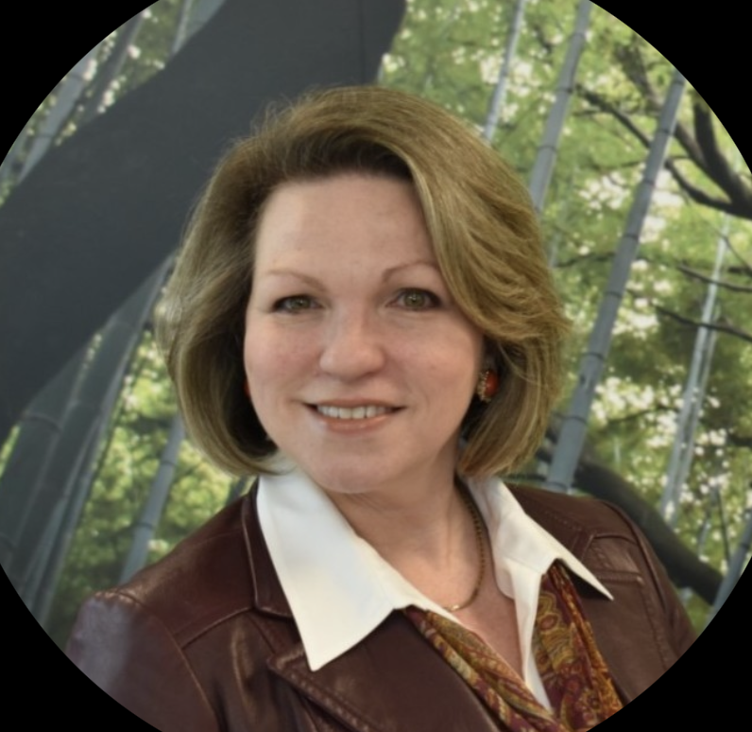
Week four (risk management) presenter
Nadine Petsche https://www.linkedin.com/in/nadinepetsche/?originalSubdomain=ca
Chief Audit Executive and Enterprise Risk Management Lead at Technical Standards and Safety Authority
Nadine is a CA, CPA, and MBA (Finance and Entrepreneurial Studies). She is a 30-year veteran of Ontario’s public sector, including Ontario’s electric utility industry and the Ontario government in various governance-related leadership positions including Enterprise Risk Management, Internal Audit, mergers and acquisitions, controllership and outsourcing.
As Director of Accounting Policy and Financial Reporting with the Ontario government, Nadine was responsible for establishing the government’s accounting policies, providing support to inform fiscal policy decisions and also oversaw the preparation of the Province’s consolidated financial report.

Slide 7
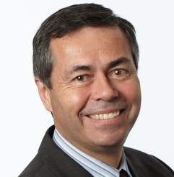
Week five (internal controls) presenter
Doug Johnson https://www.linkedin.com/in/douglasjmjohnson/
Doug is the Chief Risk Officer at Haventree Bank and formerly their VP, Internal Audit.
Doug Johnson is Haventree Bank’s Chief Risk Officer. He has been part of Haventree’s Executive Management Team since joining the Bank in 2014. Previous to roles at Haventree include Chief Compliance Officer, Chief Privacy Officer, and VP Internal Audit.
Doug has also held senior roles in the areas of Governance, Risk, Audit, Compliance, and IT Infrastructure Service Management with several large Financial Institutions including CIBC, RBC, TD Bank and AVIVA. Doug has led teams of various sizes and has a passion for developing people. He is an alumnus from EY and hold a Master of Accounting degree from the University of Waterloo. Doug is a CPA/CA, a Certified Internal Auditor, and a Certified Information Systems Auditor.
Doug has served on the Board of the Institute of Internal Auditors (IIA) Canada, on the Toronto IIA Academic Committee, and is a past president of ISACA, Toronto.
Doug also is a Board member of the University of Waterloo Center for Information Integrity and Information Systems Assurance (UW/CISA).

Slide 8
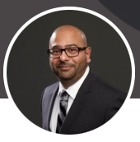
Week six (IT) presenter
Asif Mohammed https://www.linkedin.com/in/asifalimohammed/
Asif is a Partner at Richter LLP in the Risk Performance and Technology Advisory practice, responsible for practice strategy, and accountable for successful delivery of engagements and services.
Asif has spent 19 years between industry and consulting, managing risk and advising clients across a variety of sectors. Asif joined the Toronto chapter in 2005, and now serves as the ISACA Toronto Chapter Immediate Past-President. In his role, Asif is responsible for providing advice and guidance to the President and the Board of Directors, and he continues to serve as a voting member of the board. In doing so, Asif takes a member-centric approach to implementing initiatives and programs with an emphasis on continuous learning, workforce development, and building the professional community in the region.
Asif is a Certified Information Systems Auditor (CISA), Certified in Risk and Information Systems Control (CRISC), Certified Data Privacy Solution Engineer (CDPSE), and received his Master of Business Administration (MBA) from the Queen’s University, Smith School of Business.

Slide 9
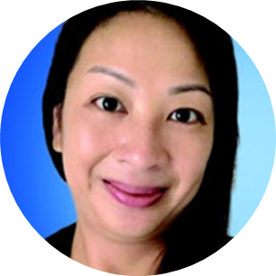
Week seven (fraud) presenter
Rebecca Ip https://www.linkedin.com/in/iprebecca/
Partner at KPMG Canada
Rebecca is a Partner in KPMG’s Risk Consulting and Forensic Practice and is currently the leader of the GVA Forensic Practice. She began her career with KPMG’s Audit practice in 2005 as Senior Accountant. In June 2007, she joined the Risk Consulting Forensic practice and has worked from KPMG’s London, England, Amstelveen, the Netherlands and Toronto and Vancouver offices.
Rebecca has led and assisted a wide range of forensic and internal audit assignments across different industries, mostly financial services, since 2007. These projects include assignments to assist clients in investigating employee misconduct, asset misappropriation, third party collusion, assessing and enhancing fraud and AML-related processes and controls.
Rebecca is currently the Co-Chair of the Association of Certified Ant-Money Laundering Specialist Toronto Chapter. She has also developed and delivered training in the AML Examination Preparedness Master Class Workshop for the Canadian Institute AML Conferences. She is also a frequent speaker at industry conferences, including the Cullen Commission in June 2022.

Slide 10
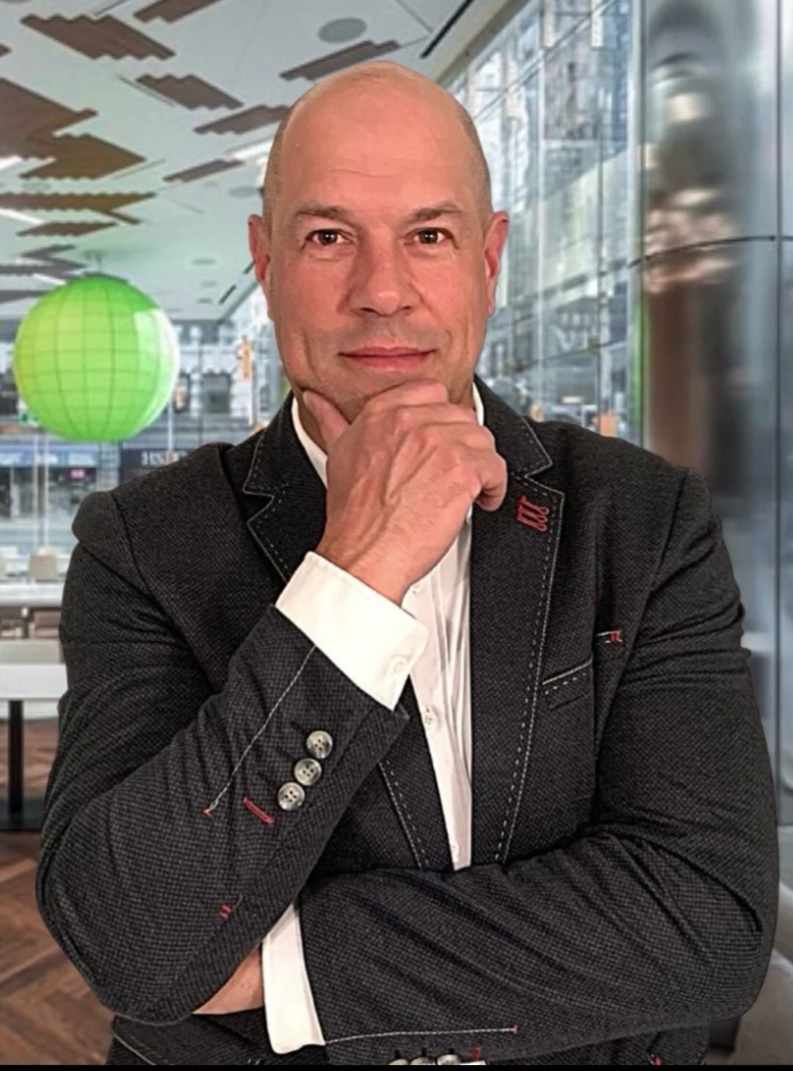
Week eight (ESG) presenter
Tim Scott Tim Scott | LinkedIn
National Managing Partner, Internal Audit Services, Risk Advisory
Tim is a partner in Deloitte’s Risk Advisory Services practice based in Toronto and is the leader of Deloitte’s Canadian Internal Audit offering. He has over 30 years of experience working in both professional services firms and industry, and specializes in internal audit, CEO/CFO certification, enterprise risk management and third-party risk management.
Prior to joining Deloitte, Tim’s extensive industry experience includes terms as the Senior Vice President, Asset Protection with Loblaw Companies Limited and SVP, Internal Audit and Enterprise Risk Management with Loblaw, in addition to Internal Audit, ERM and CFO roles within Maple Leaf Foods.
Tim is a graduate of the University of Western Ontario and has a Diploma in Accounting from Wilfrid Laurier University. He is a Chartered Professional Accountant, Chartered Accountant, Certified Internal Auditor and is a member of the Chartered Professional Accountants of Ontario and the Institute of Internal Auditors.

Slide 11
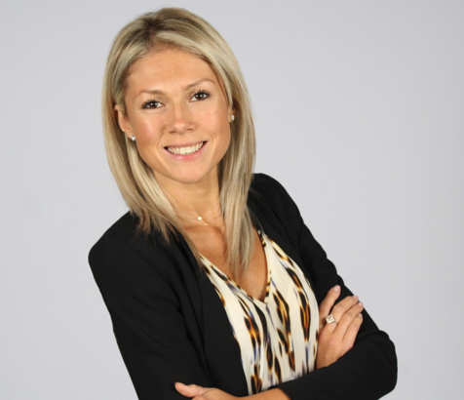
Week eight (ESG) presenter
Aleksandra Lazzari Aleksandra Lazzari | LinkedIn
Senior Manager, Deloitte Risk Advisory
Aleksandra is a Chartered Professional Accountant (CPA, CA) and a member of the Institute of Internal Auditors with over 10 years of professional services experience within the Deloitte Risk Advisory practice. Her work experience spans across multiple service offerings, internal controls and CEO/CFO certification /SOX, internal audit, business process and compliance reviews.
Aleksandra has worked extensively with clients across various industries including Technology, Media and Telecommunications, Energy and Resources, Consumer Business/Products, Public Sector, Financial Services, and. Serving as a trusted advisor, she provides clients with practical recommendations to assist organizations in evaluating and improving the effectiveness of their risk management, control, and governance practices.
Aleksandra leads projects varying in size and complexity and is motivated by helping organizations solve their most complex issues by bringing together an integrated team of professions from across our organization.

Slide 12
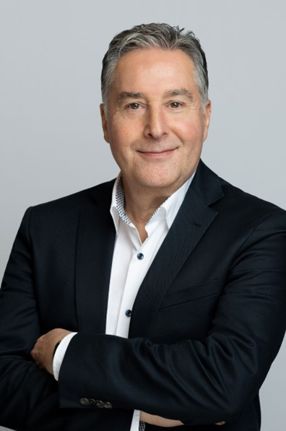
Week nine (managing) presenter
Paul Stathopoulos https://www.linkedin.com/in/paul-stathopoulos-18360620/
Internal Audit Executive
Paul was the Chief Auditor of Manulife for 10 years leading and managing the global Audit Services team.
Paul’s career in Financial Institutions spans over 35 years, including extensive experience in Internal Audit supplemented by roles in Risk Management, Corporate Banking, Compliance, and Treasury.
He joined Manulife from RBC where he was most recently responsible for enterprise regulatory risk governance practices and compliance policies. Prior to this, Paul led the audit groups responsible for personal and commercial banking, insurance, and finance. Before joining RBC in 1994, Paul worked for CIBC in the Investment and Corporate Banking Audit team. He began his career as an auditor at Deloitte.
Paul holds a Bachelor in Commerce from the University of Toronto. He is a Chartered Accountant, as well as a Certified Public Accountant from the American Institute of Public Accountants.

Slide 13
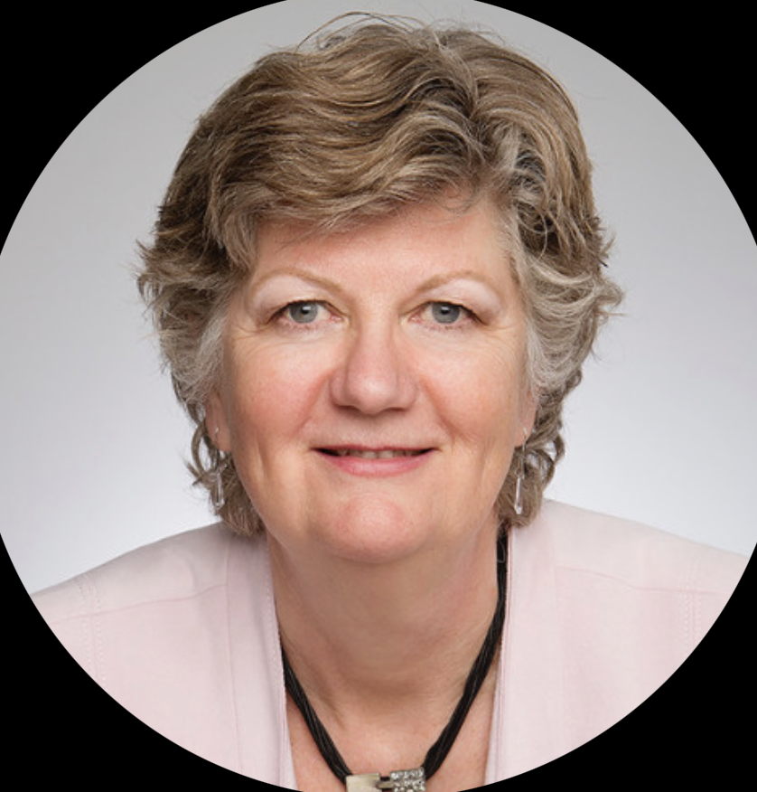
Week ten (planning) presenter
Ella Kila https://www.linkedin.com/in/ellakila/
Vice President, Audit and Risk, CAE at LCBO
Ella is a CPA, CA and started her career with PwC in Toronto. After 7 years she left PwC to work as a senior manager in standard setting at the then CICA (now CPA Canada). After having worked for both the Accounting Standards Board and the Criteria of Control Board for 5 years, she spent the next 2 decades working for big banks, private sector and public sector organizations.
She collected a few more credentials (CRMA, Master Integral Coach) and a lot of experience along the way as she worked in SOX, ERM, BCM, FRM, and of course Internal Audit. In her current role she oversees Internal Audit, the LCBO’s EthicsMatter program, ERM, and BCM. Her view of internal audit (and ERM and BCM) is that is must be focused on helping the organization succeed and auditors should understand the drivers of an organization’s success. Data analytics are an important aspect of her team’s work. She held a similar role for 9 years with the Ontario Lottery & Gaming Corporation.
She is a member-at-large of the UW CISA Board. She was previously a board member of GREO.

Slide 14
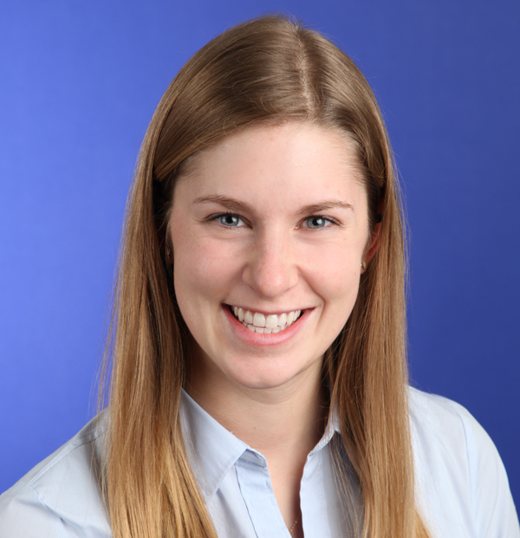
Week eleven (business process) presenter
Libby Duckworth https://www.linkedin.com/in/libbyduckworth/?originalSubdomain=ca
Senior Manager in KPMG’s Governance, Risk and Compliance Services (GRCS) group
Libby started with the firm as a co-op student from the University of Waterloo, directly into the IARCS team, where she completed her CPA, CA designation.
Over her 10+ years of experience, she has specialized in delivering internal audit, risk and governance services mainly to healthcare and other public sector clients.
One of her ongoing passions is around promoting internal audit to students – something she has been heavily involved in over the course of her career, and in particular through her role as a member of the IIA’s Academic Relations Committee.

Slide 15
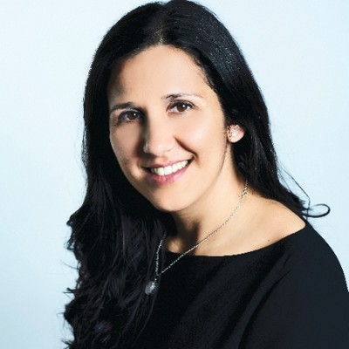
Week twelve (project) presenter
Margaret Pacheco https://www.linkedin.com/in/margaret-pacheco-b3465616/
President at Baywall Consulting Inc.
Margaret is a seasoned executive and recognized leader in Audit, Governance, Risk, Compliance, and Project Management with over 20 years of experience focused on Financial Institutions, Banking, Insurance, and Wealth Management.
Margaret has led various Internal Audit teams within TD Audit group including Insurance, Project Management, and Governance, Risk, Compliance and Corporate Functions.
Before joining TD, Margaret led various Banking, Insurance and Wealth Management audits at KPMG.
Margaret is currently proving Internal Audit consulting services and her clients include TD and Scotiabank.
Margaret is a past-president of the IIA Toronto Chapter and is the current Chair of the Board. She is also the chair of the IIA’s Academic Relations Committee and a member of the IIA Global Professional Certifications Board.

