Slide 1
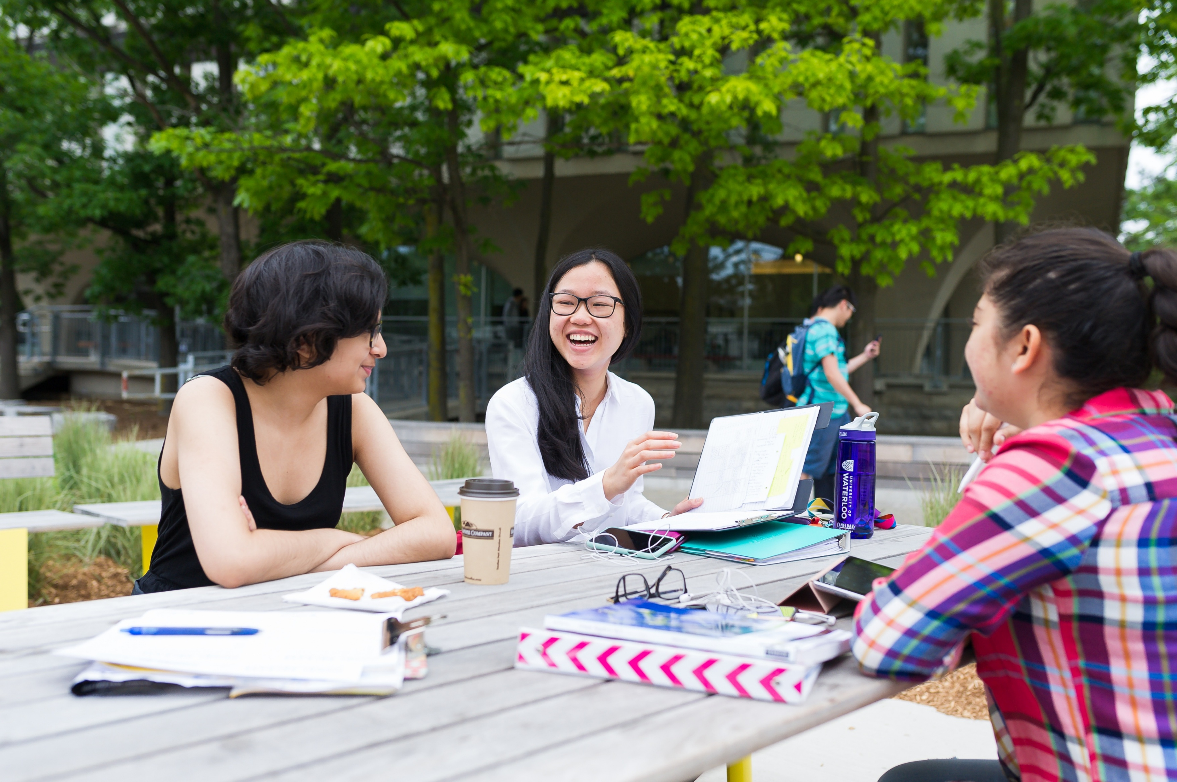
FROM BEING HERE
TO BELONGING
How academic leaders build
connected communities
Troy D. Glover, Ph.D.
Professor, Recreation and Leisure Studies
ACADEMIC LEADERSHIP PROGRAM

Slide 2
TWO PERSPECTIVES ON ACADEMIC COMMUNITY
RESEARCHER
FORMER CHAIR
How do proximity, interaction, recognition, contribution, and trust develop into connection and belonging?
What can leaders realistically influence when they lead peers within complex structures and inherited relationships?
The research gave me language for dynamics I experienced as a chair.
ACADEMIC LEADERSHIP PROGRAM | 02
UNIVERSITY OF WATERLOO

Slide 3
A CONNECTED ACADEMIC COMMUNITY
OPENING REFLECTION
Think of an academic community in which you genuinely felt part of something.
01
What happened that contributed to that feeling?
02
What did other people do?
03
What made your participation matter?
4 MINUTES
ACADEMIC LEADERSHIP PROGRAM | 03
UNIVERSITY OF WATERLOO

Slide 4
WHAT HELPED BELONGING DEVELOP?
Belonging develops through relational experiences.
ACADEMIC LEADERSHIP PROGRAM | 04
UNIVERSITY OF WATERLOO

Slide 5
THE PROXIMITY FALLACY
How can people work alongside one another
and still feel disconnected?
Departments assemble people through appointments, meetings, committees, programs, and shared space. None guarantees relationship.
ACADEMIC LEADERSHIP PROGRAM | 05
UNIVERSITY OF WATERLOO

Slide 6
BELONGING AS A CREDIBLE EXPECTATION
I can reasonably expect…
RECOGNITION
WELCOME
CONTRIBUTION
MEMBERSHIP
People know who I am
My presence is wanted
What I offer matters
I have a place within a shared ‘we’
A statement of inclusion becomes credible through repeated evidence.
ACADEMIC LEADERSHIP PROGRAM | 07
UNIVERSITY OF WATERLOO

Slide 7
THE MISSING MIDDLE
CO-PRESENCE
BELONGING
LEGITIMATE
OPENING
INTERACTION
REPEATED
ENCOUNTER
RECOGNITION
CONTRIBUTION
Permission to connect
Engagement
Repetition
Identity, contribution, and absence register
Having something to offer
THE MISSING MIDDLE
Stages may overlap, recur, or unfold differently across relationships.
ACADEMIC LEADERSHIP PROGRAM | 08
UNIVERSITY OF WATERLOO

Slide 8
CONDITIONS THAT SUPPORT CONNECTION
01
02
03
REPEATED CONTACT
LEGITIMATE OPENINGS
RECOGNITION
Realistic chances to encounter one another again
A reason to interact without forcing intimacy
Names, contributions, and absences register
ACADEMIC LEADERSHIP PROGRAM | 09
UNIVERSITY OF WATERLOO

Slide 9
BELONGING IN ORDINARY ACADEMIC LIFE
WE OFTEN LOOK TO
BELONGING ALSO DEVELOPS THROUGH
Retreats
Meetings and onboarding
Receptions
Work and service allocation
Celebrations
Decisions and explanations
Team-building activities
Recognition and follow-up
Ordinary structures accumulate into a relational climate.
ACADEMIC LEADERSHIP PROGRAM | 10
UNIVERSITY OF WATERLOO

Slide 10
THE RELATIONAL QUESTIONS INSIDE EVERY STRUCTURE
WHO ENCOUNTERS WHOM?
WHO CAN SPEAK?
WHO BECOMES KNOWN?
WHOSE CONTRIBUTION COUNTS?
ACADEMIC LEADERSHIP PROGRAM | 11
UNIVERSITY OF WATERLOO

Slide 11
THE LEADER’S SPHERE OF INFLUENCE
CONTROL
INFLUENCE
CONCERN
Meeting design
Invitations
Communication
Recognition
Norms
Relationships
Participation
Cross-role contact
Institutional pressures
Inherited histories
Personalities
Decisions made elsewhere
Relational leadership begins with an honest account of agency.
ACADEMIC LEADERSHIP PROGRAM | 12
UNIVERSITY OF WATERLOO

Slide 12
FOUR RELATIONAL LEADERSHIP TASKS
CREATE
Support openings and new relationships
BRIDGE
Connect roles, cohorts, and groups
MAINTAIN
Sustain recognition, reciprocity, and trust
REPAIR
Respond to rupture, harm, or accumulated distrust
A unit may need more than one response at the same time.
ACADEMIC LEADERSHIP PROGRAM | 13
UNIVERSITY OF WATERLOO

Slide 13
THE SOCIAL RISK OF PARTICIPATION
The cost of participation changes with…
Role and status
Seniority and security
Knowledge of unwritten norms
Existing relationships
Previous experiences of welcome or exclusion
Race, gender, disability, and language
The same invitation can ask different people to take very different risks.
ACADEMIC LEADERSHIP PROGRAM | 14
UNIVERSITY OF WATERLOO

Slide 14
Different relational conditions require different responses.
UNFAMILIARITY
Create openings and repeated contact
SEPARATION
Build bridges through meaningful shared work
WEAKENING TRUST
Restore communication, fairness, and recognition
HARM OR RUPTURE
Acknowledge, address, and support repair
ACADEMIC LEADERSHIP PROGRAM | 15
UNIVERSITY OF WATERLOO

Slide 15
BELONGING WITHOUT ENFORCED HARMONY
People should be able to disagree, dissent, and experience discomfort without their membership in the community becoming precarious.
Belonging does not require
compulsory sociability • universal friendship • agreement with the leader • silence about conflict
ACADEMIC LEADERSHIP PROGRAM | 16
UNIVERSITY OF WATERLOO

Slide 16
Academic leaders cannot
manufacture belonging.
They can make its development
more or less likely.
Belonging becomes more than a buzzword when we can identify and shape the conditions that support it.
ACADEMIC LEADERSHIP PROGRAM | 18
UNIVERSITY OF WATERLOO

