Slide 1
Arts digital screen template
How to use
Decide which slide layout you’d like to use, right click it, and select “Duplicate Slide” to start creating. (If you have dynamic, high-quality images, consider using the full image layout.)
To change the image in the slide, right click the photo, select “Change Picture,” and select the one you’d like to replace it with. To adjust the photo within the frame, right click the photo and select “Crop.”
Please keep text and additional info as short as possible! Think of these slides like an article headline – you want to grab people’s interest, not tell them the whole story.
When finished, select the slide(s) you want to save and go to File>Export. Choose your location, change the file format to jpg or png, ensure the dimensions are 1920 x 1080, and select “Export.”

Slide 2
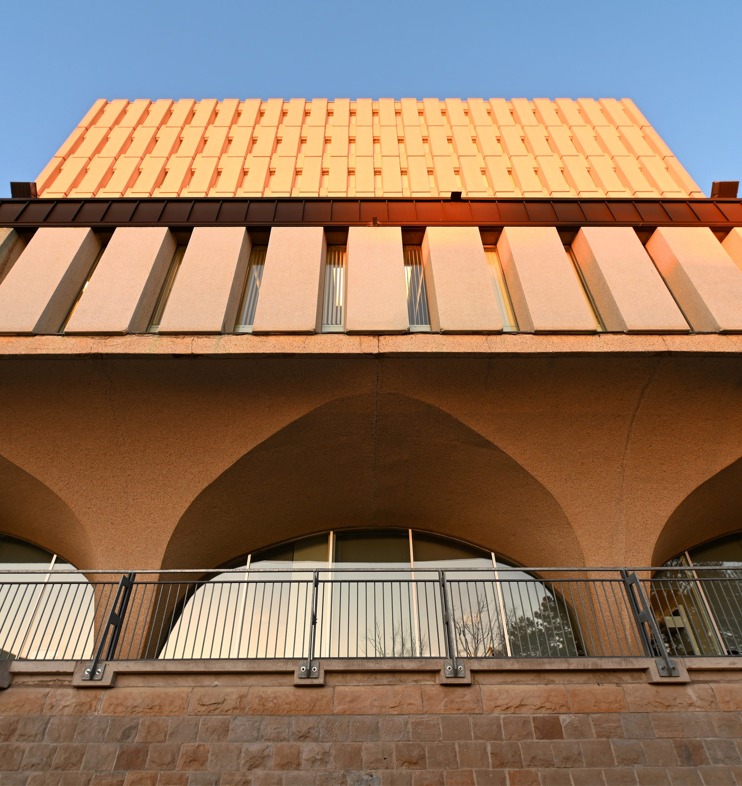
Main course title
Additional Info

Slide 3
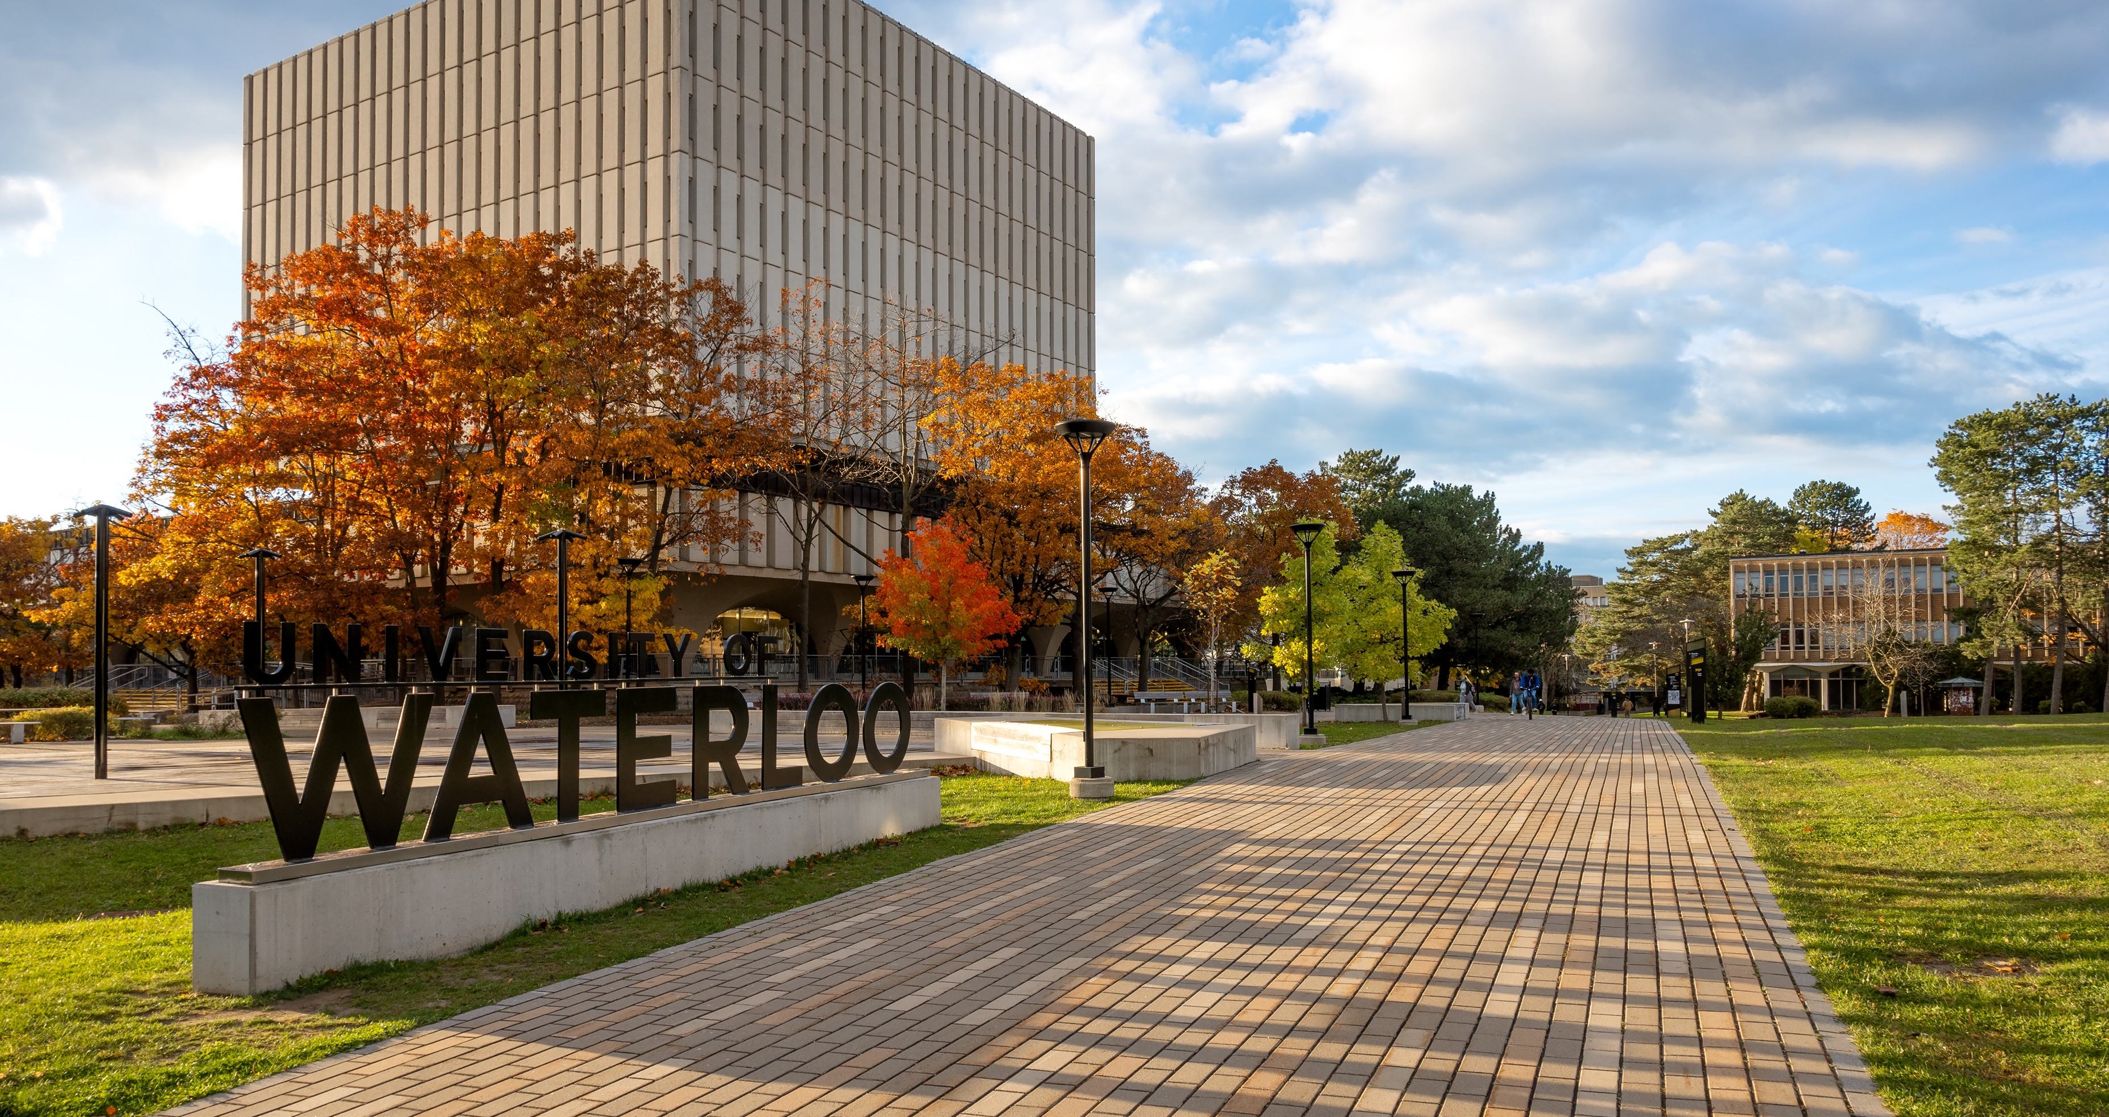
Main course title
Additional Info

Slide 4
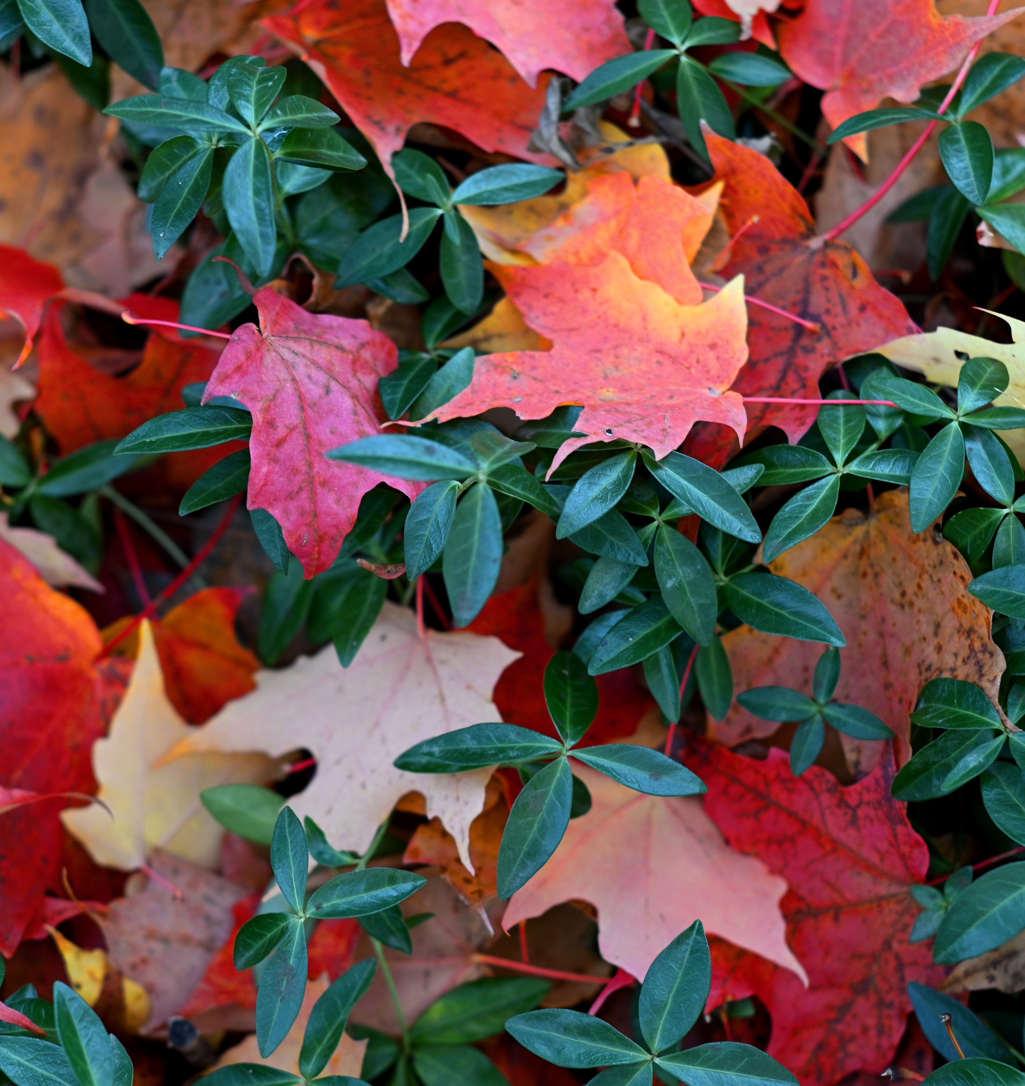
Main course title
Additional Info

Slide 5
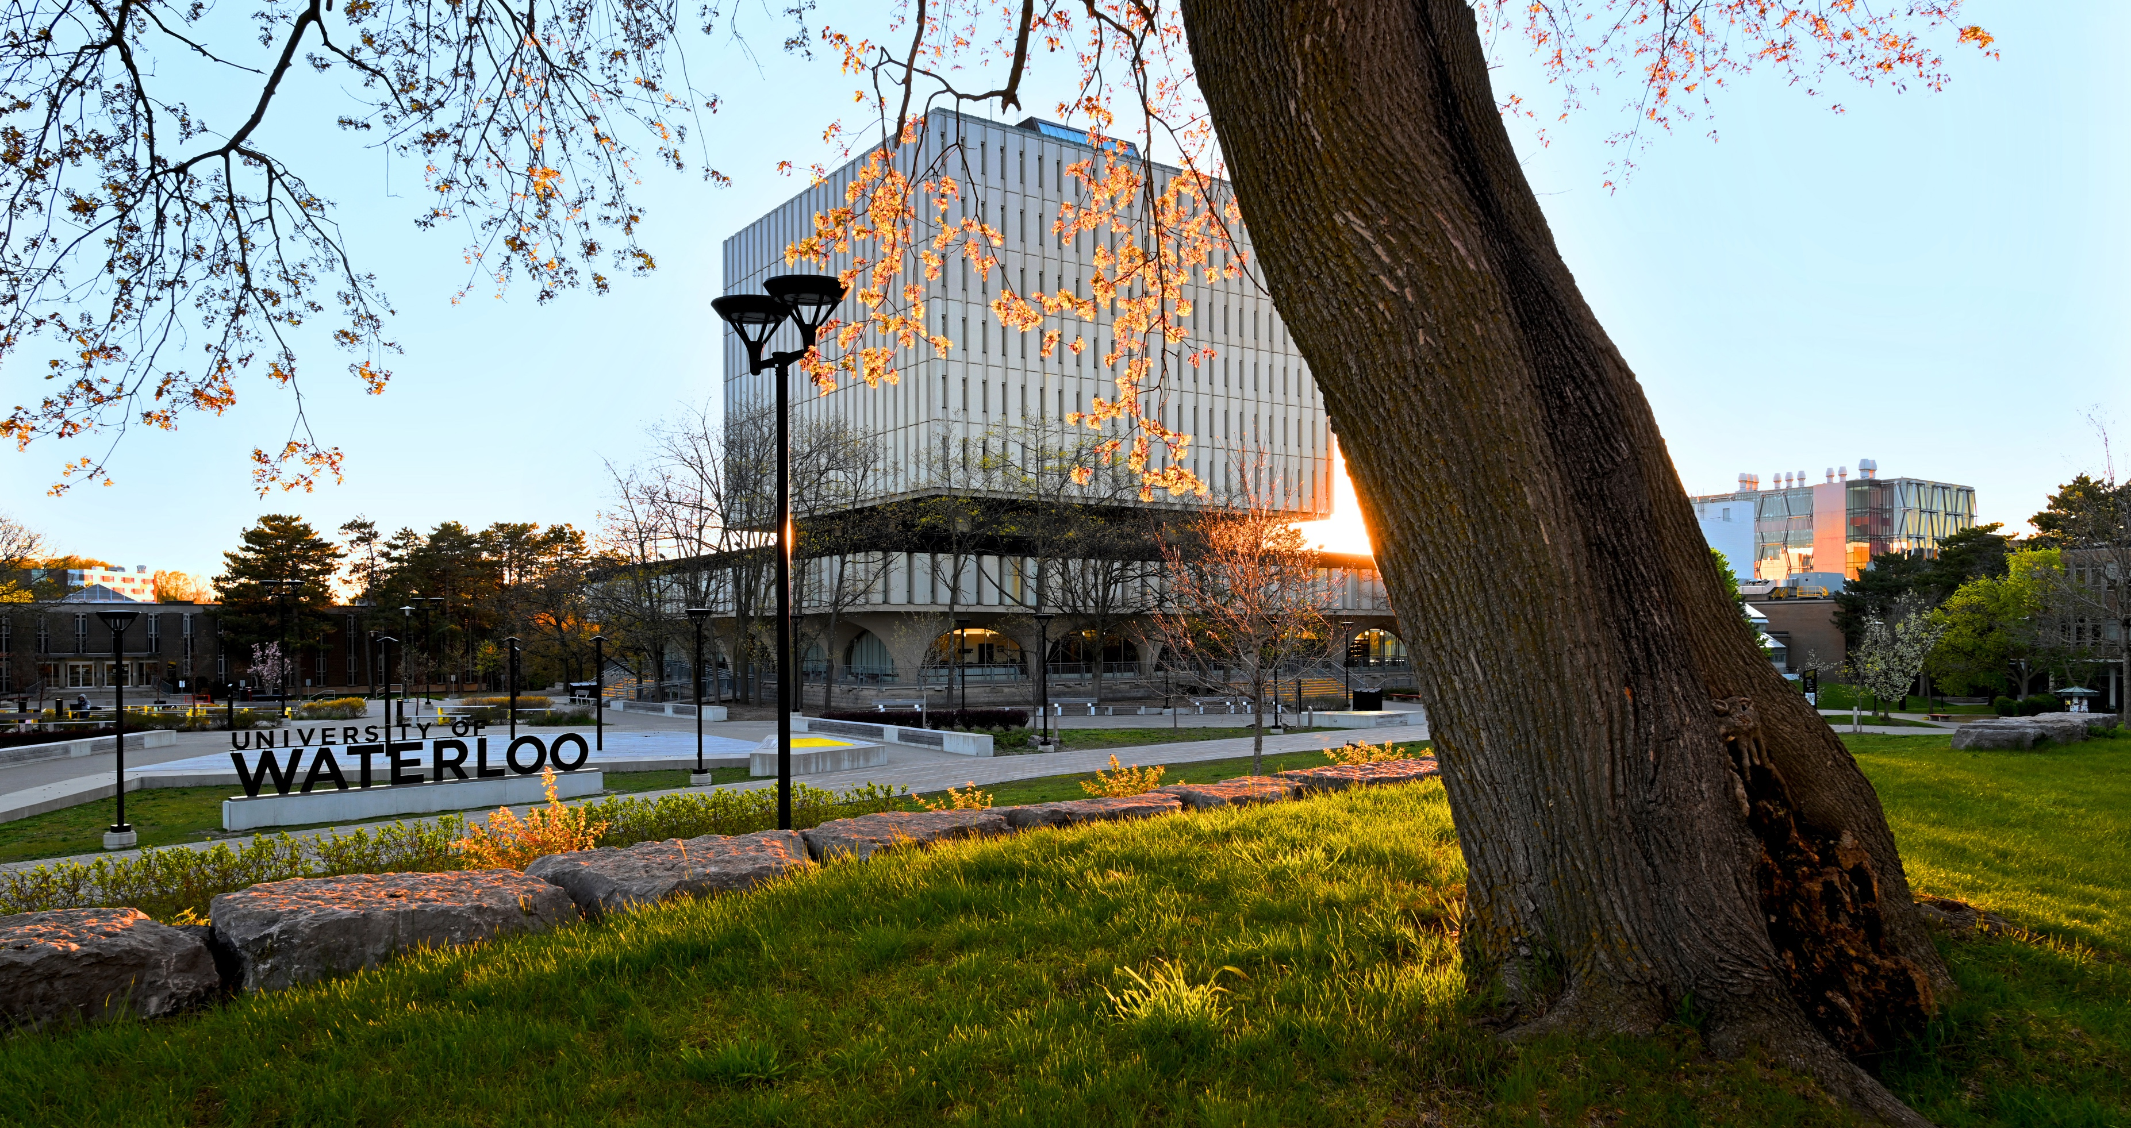
Main course title
Additional Info

Slide 6
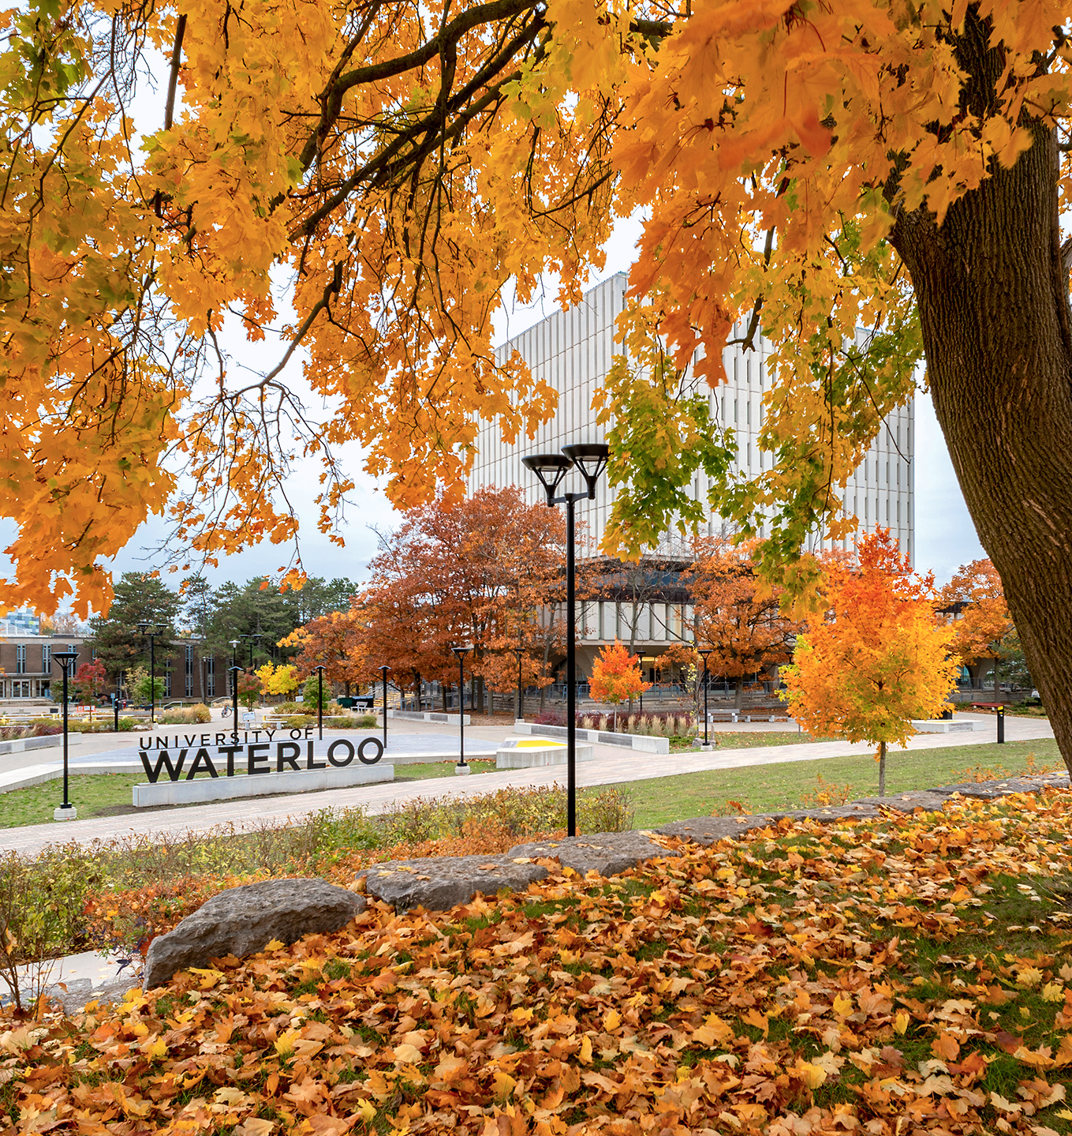
Event title
Additional Info

Slide 7
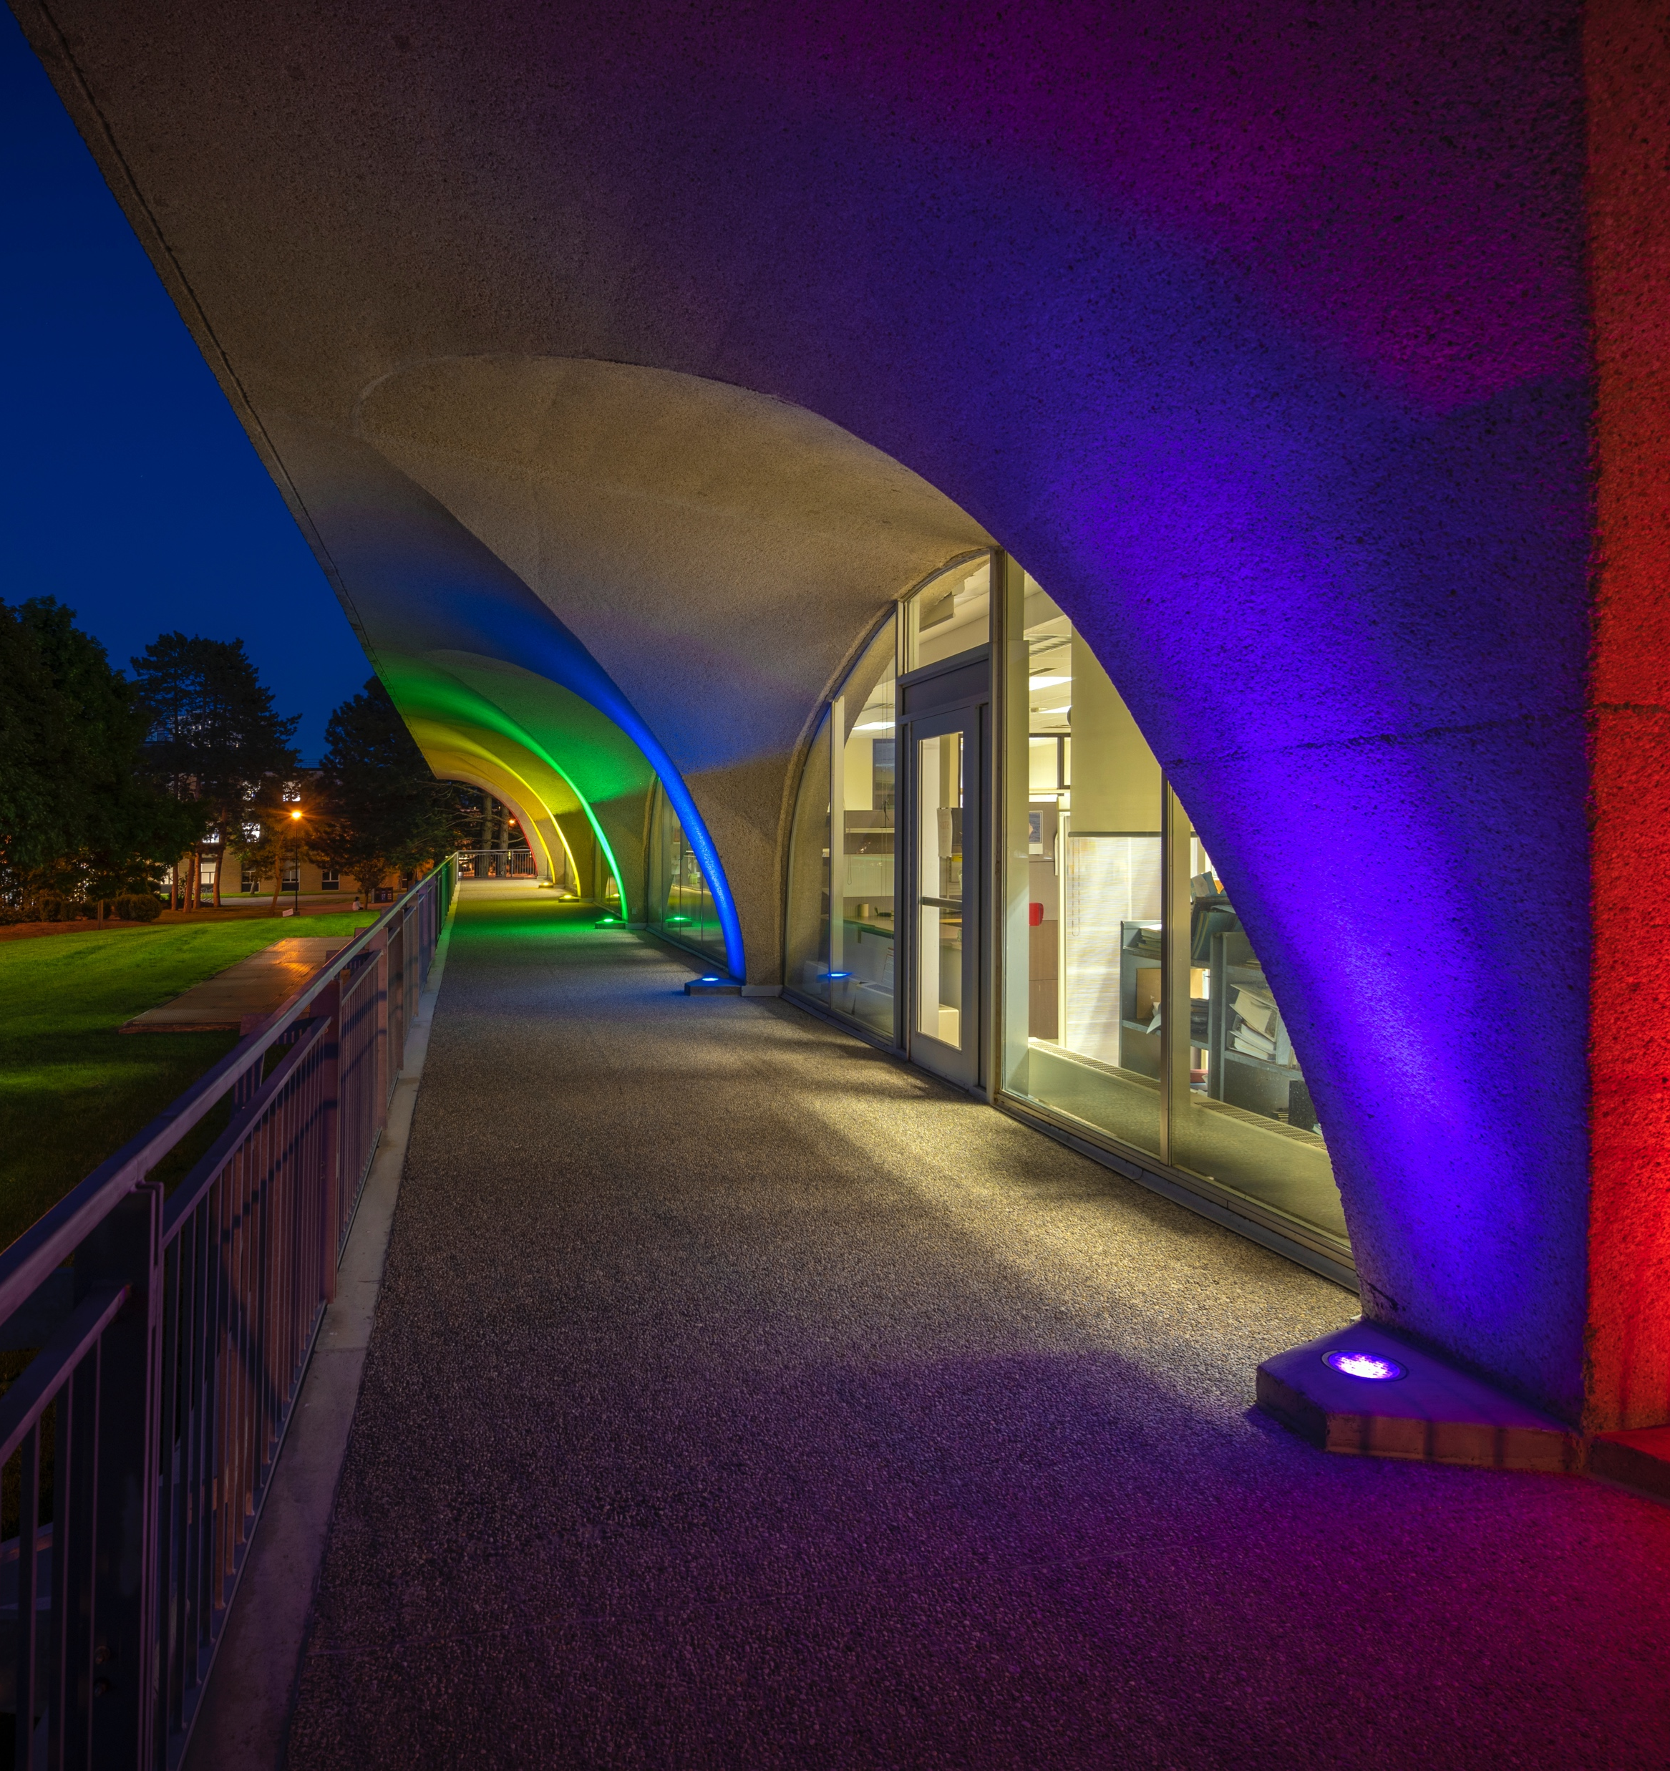
Event title
Additional Info

