Slide 1
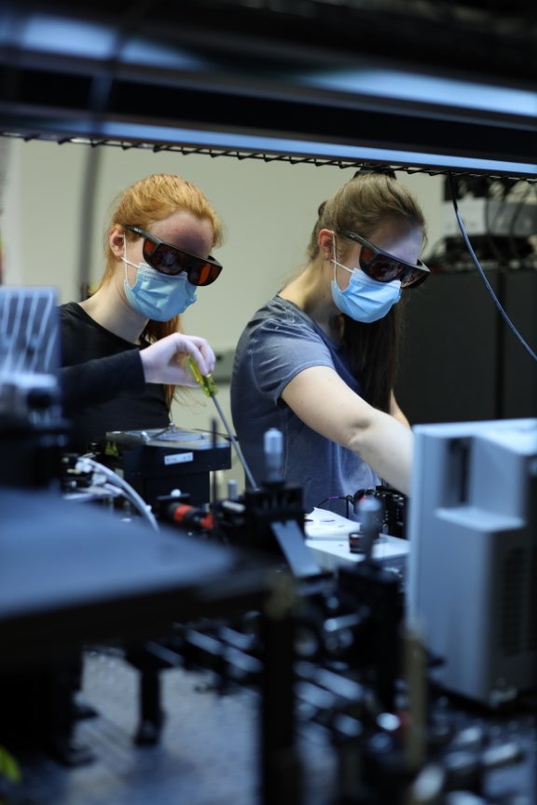
BIOMEDICAL ENGINEERING INFORMATION SESSION
November 9, 2024

Slide 2
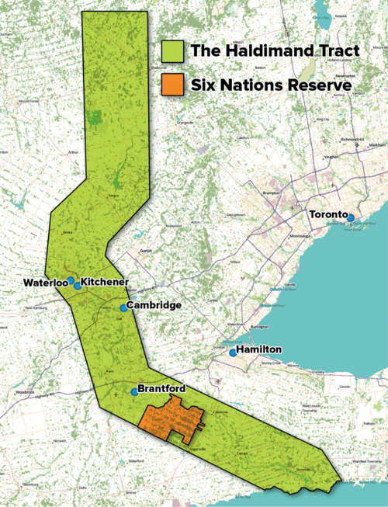
UNIVERSITY OF WATERLOO TERRITORIAL ACKNOWLEDGEMENT
The University of Waterloo acknowledges that much of our work takes place on the traditional territory of the Neutral, Anishinaabeg and Haudenosaunee peoples.
Our main campus is situated on the Haldimand Tract, the land granted to the Six Nations that includes six miles on each side of the Grand River.
Our active work toward reconciliation takes place across our campuses through research, learning, teaching, and community building, and is centralized within the Office of Indigenous Relations.
Image source: Adam Lewis, “Living on Stolen Land” Alternatives Journal December 2015

Slide 3
BIOMEDICAl Engineering Overview

Slide 4
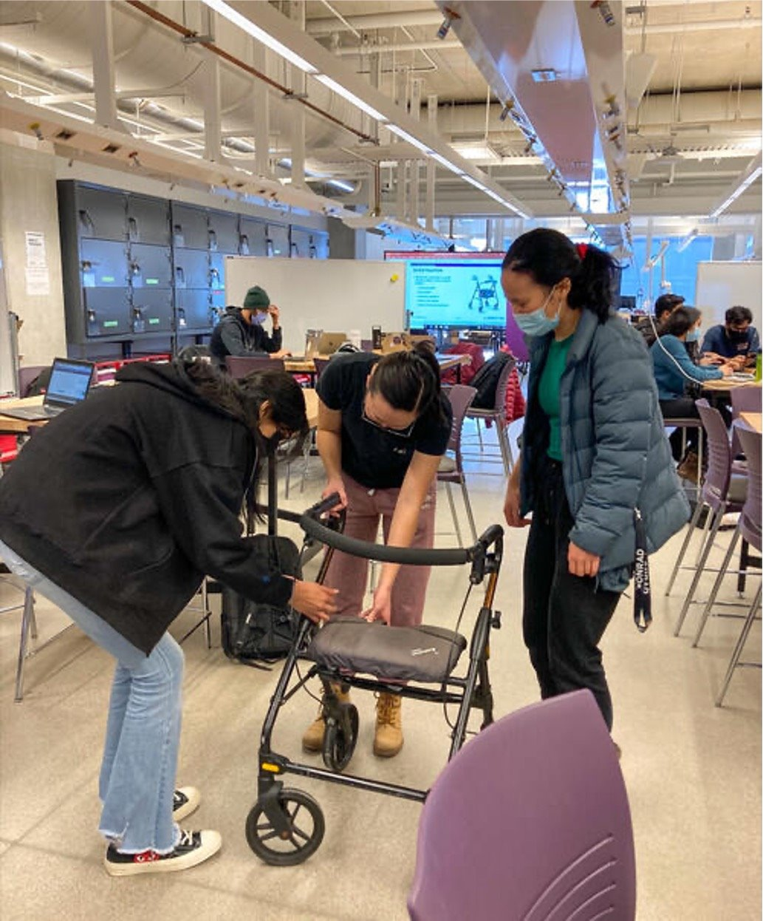
WHAT IS BIOMEDICAL ENGINEERING?
The interface of engineering and life science
Use engineering concepts to develop solutions that improve human health
An interdisciplinary field that combines knowledge from many domains in engineering, health, and science
Notes:
Biomedical engineering is the field where engineering principles meet medical and biological sciences. The goal is to create solutions that improve healthcare and enhance patient outcomes.This could involve anything from designing medical devices to developing new imaging technologies or even creating artificial organs. One major area is the design and development of medical devices like pacemakers, prosthetics, and surgical tools. These innovations help diagnose, treat, and improve patient quality of life. Biomedical engineers also work on creating biomaterials and tissue engineering, developing materials that can interact with the human body to replace or repair damaged tissues and organs. Another key area is medical imaging (like MRI or CT scans) and diagnostic tools. Biomedical engineers help design systems that provide critical insights into patient health, improving diagnosis and treatment planning. Overall, biomedical engineering drives innovation in healthcare by developing cutting-edge technologies such as wearable health devices, robotic surgery tools, and advanced diagnostic systems. This field is highly interdisciplinary, blending expertise from mechanical, electrical, and computer engineering with medicine, biology, and chemistry to address complex healthcare challenges.

Slide 5
COURSE PLAN Overview

Slide 6
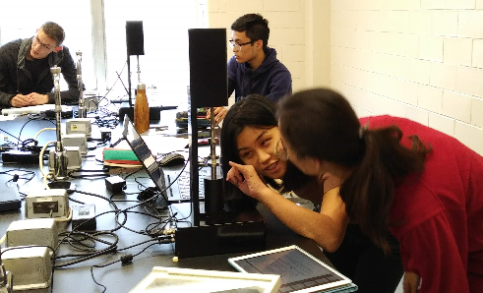
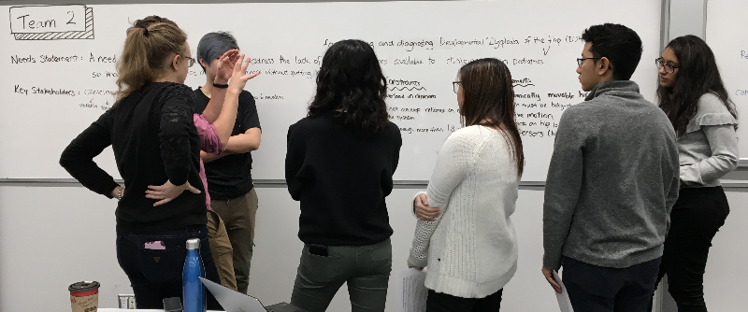
THE SYLLABUS
Biomedical content in over 80% of core courses
Design course in every term (except 2A)
Labs/hands-on experience
Key future engineering career of the 21st century
Notes:
Biomedical engineer has been identified as the fastest growing profession by Forbes in the past 2 years.

Slide 7
BME CURRICULUM OVERVIEW
Fall 1A | Winter 1B | COOP - SPRING | Fall 2A | COOP -WINTER | Spring 2B | COOP - FALL | Winter 3A | COOP- SPRING | Fall 3B | COOP - WINTER | COOP - SPRING | Fall 4A | Winter 4B
Intro to BME Design | Human Factors in Design |  | Engineering Biology + Lab |  | Prototyping, Simulation & Design |  | BME Design |  | BME Design Workshop 1 |  |  | BME Design Workshop 2 | BME Design Workshop 3
Digital Computation | Data Structures & Algorithms |  | Mechanics of Deformable Solids + Lab |  | Circuits, Instrumentation& Measurements + Lab |  | Digital Systems + Lab |  | Control Systems + Lab |  |  | Optimization & Numerical Methods | Technical Elective
Physics: Statics | Chemistry Principles |  | Physics: Dynamics |  | Anatomical & Physiological Systems + Lab |  | Physiological Systems Modelling |  | Biomedical Transport |  |  | Technical Elective | Technical Elective
Engineering Math | Matrices & Linear Systems |  | Materials Science |  | Statistics & Experimental Design |  | BME Ethics |  | Physics of Medical Imaging |  |  | Technical Elective | Technical Elective
Calculus 1 | Calculus 2 |  | Calculus 3 |  | Linear Systems & Signals |  | Elective |  | BME Economics |  |  | Elective | Elective
Written, Oral, & Visual Comm | Elective

Slide 8
SPECIALIZATIONS

Slide 9
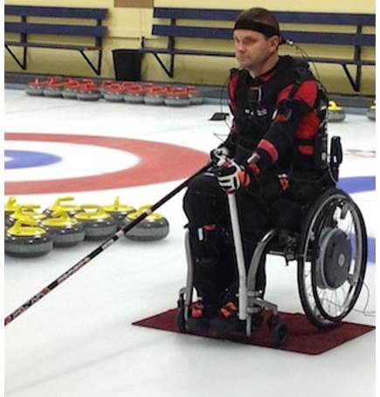
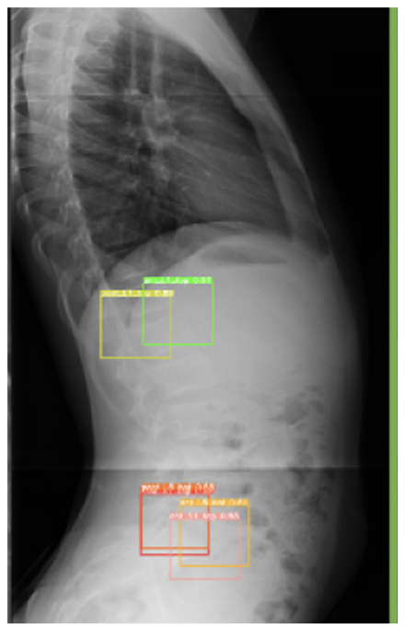
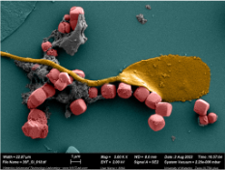
FIELDS OF FOCUS
BME students may choose to take their technical electives from a more restricted list to receive one of the following specializations:
Medical Devices
Neural Engineering
Sports Engineering
Biomaterials and Tissue Engineering
Medical Artificial Intelligence

Slide 10
CUSTOMIZING YOUR DEGREE
Life sciences
Mechatronics
Computing
Biomedical Engineering
Biomaterials & Tissues
Medical Artificial Intelligence
Medical Devices
Sports Engineering
Neural Engineering
Artificial Intelligence (AI)
Management Engineering
Entrepreneurship
Notes:
Alongside the requirements of your degree, you may choose to add a specialization or option to focus in on specific areas of interest. Specializations are program-specific and typically require 4-6 courses to be completed. Biomedical Engineering offers five specializations that you can add to your degree in your upper years: Biomaterials & tissues, medical artificial intelligence, medical devices, neural engineering, and sports engineering.
In the Faculty of Engineering, we also have options, which are available in any of our engineering programs and typically require 5-8 courses to be completed. Some popular options for Biomedical Engineering students to add in their upper years include entrepreneurship, computer engineering, or life sciences, however there are a total of 13 options you may choose from.

Slide 11
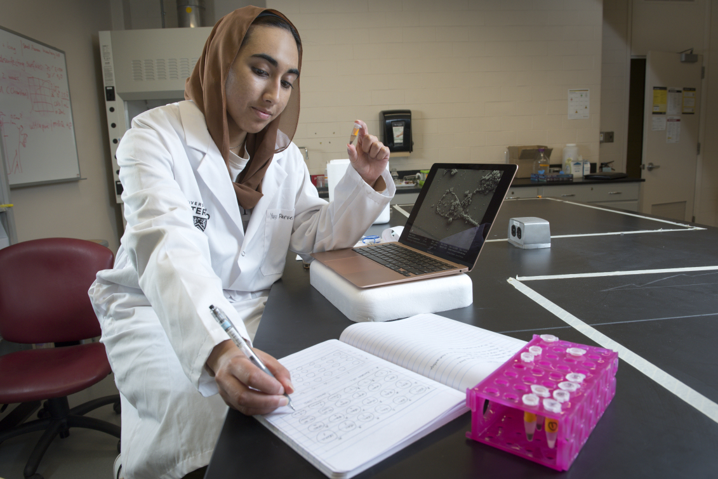
RESEARCH OPPORTUNITIES
Join a student design team
Part-time work in a research lab during academic term (URA)
Volunteer in a research lab during academic term
C0-op opportunities in a variety of research labs
Biomedical research project courses
BME 399
BME 499
Notes:
There are a number of opportunities to get involved in research during your undergraduate degree if you are interested in doing so.
Students can engage in part-time work in research labs during the academic term through the Undergraduate Research Assistant (URA) program. This allows students to gain valuable experience while balancing their coursework, working closely with faculty on ongoing research projects.
For those looking to explore research without a formal commitment, volunteering in a research lab during the academic term is a fantastic option. This provides a chance to contribute to projects, learn new skills, and network within the research community.
Students can also volunteer with student design teams engaged in research projects. We have over 30 student design teams here at Waterloo that compete in international design challenges, however some popular ones include the BIOMOD team, which focuses on biomolecular technology, MedTechResolve, which focuses on the automation of emergency rooms, and the Alternative Protein Project, which focuses on sustainable and secure food research.
The program offers co-op opportunities in a variety of research labs, allowing students to apply their skills in real-world settings. These positions often lead to significant contributions in areas like biomedical devices, healthcare technologies, and more.
Students can enroll in biomedical research project courses (BME 399 & BME 499), where they work on specific research projects under the guidance of faculty. These courses provide a structured environment to delve into research topics and can culminate in tangible outcomes, such as publications or presentations.

Slide 12
WHY CHOOSE BIOMEDICAL ENGINEERING?
Notes:
Before we dive deeper into the program, let’s explore the various types of systems that are integral to Systems Design Engineering. Each type of system has its own unique characteristics and functions, and understanding these differences is essential for designing effective and efficient solutions. We’ll look at four main categories: human factors and interfaces, intelligent and automated systems, physical and mechatronic systems, and social and environmental systems. By examining these types, we can better appreciate the complexities and interdependencies that shape the systems we interact with every day. Let’s begin by diving into the first type: human factors and interfaces.

Slide 13
PROGRAM DIFFERENTIATORS
Interdisciplinary focus
Cutting-edge research and extensive co-op opportunities
Hands-on learning and comprehensive design experience
Commitment to health and wellbeing
Tight-knit student community
Notes:
There are a number of features in our program that make us stand out. Firstly, the program combines engineering principles with biological and medical sciences, allowing students to gain a comprehensive understanding of both fields. The University of Waterloo is also well known for its extensive co-op program, providing students with valuable work experience in various biomedical engineering sectors, enhancing employability upon graduation. Students also have access to state-of-the-art research facilities and opportunities to work alongside leading faculty members in innovative biomedical research projects.
The curriculum emphasizes practical experience through design courses, labs, and project-based learning, equipping students with the skills needed to tackle real-world challenges. Students engage in design projects throughout their studies, culminating in a capstone design course that emphasizes teamwork and real-world application.
The program focuses not only on technical skills but also on the ethical and social implications of biomedical engineering, promoting a holistic approach to health and well-being.
Lastly, the program fosters a supportive and collaborative student environment, encouraging teamwork and connection among peers. This tight-knit community allows students to share ideas, collaborate on projects, and support one another throughout their academic journey, enhancing their overall university experience.

Slide 14
Career Opportunities
96% of BME students were employed in 2023
Graduates work in industry, academia, entrepreneurial ventures, and more!
Sample co-op jobs:
Junior biomedical engineer
Medical device software developer
Robotics and embedded sensor research assistant
Signal processing algorithm developer
Bioengineering research assistant
Medical device designer

Slide 15
AFTER GRADUATION
Find careers in a wide range of areas:
Post-secondary studies
Medical Imaging | Biomedical data | Sporting Equipment
Healthcare Technology | Signal Processing | Pathology Imaging Systems
Machine Learning and AI | Medical Devices | Clinical Trials
Automation | Biomanufacturing | Tissue Engineering
Notes:
A degree in Biomedical Engineering opens doors to various career paths across multiple sectors.
Key Areas of Employment:
Medical Device Industry: Design, development, and manufacturing roles focused on creating and improving medical technologies.
Healthcare Management: Managing and optimizing the use of medical equipment and technology within healthcare facilities.
Research and Development: Engaging in innovative projects related to biomaterials, imaging, and tissue engineering in academic, governmental, or private sectors.
Regulatory Affairs: Ensuring compliance with government regulations for medical devices and products.
Consulting: Providing expert guidance on healthcare technology implementation and operational best practices.
Entrepreneurship: Starting new ventures or working with startups focused on innovative healthcare solutions.
Clinical Engineering: Applying engineering principles to enhance patient care and medical equipment utilization.
Quality Assurance: Ensuring that medical devices and products meet safety and quality standards.
Public Health: Working in sectors aimed at improving community health and addressing public health challenges.
Specialized Fields: Opportunities in areas like biomechanics, health informatics, tissue engineering, and medical imaging, among others.
Graduate Studies:
Graduates have the option to pursue advanced studies, including Master of Engineering (MEng), Master of Applied Science (MASc), or PhD programs, allowing for specialization and deeper research in areas of interest.
With such a diverse array of career opportunities and the option for further education, there is a broad applicability of biomedical engineering skills across various sectors, from research and development to clinical applications and commercialization.

Slide 16
OPEN HOUSE TOURS
Tours depart from the 1st floor of E7 (between Robohub & the elevators)
Notes:
A degree in Biomedical Engineering opens doors to various career paths across multiple sectors.
Key Areas of Employment:
Medical Device Industry: Design, development, and manufacturing roles focused on creating and improving medical technologies.
Healthcare Management: Managing and optimizing the use of medical equipment and technology within healthcare facilities.
Research and Development: Engaging in innovative projects related to biomaterials, imaging, and tissue engineering in academic, governmental, or private sectors.
Regulatory Affairs: Ensuring compliance with government regulations for medical devices and products.
Consulting: Providing expert guidance on healthcare technology implementation and operational best practices.
Entrepreneurship: Starting new ventures or working with startups focused on innovative healthcare solutions.
Clinical Engineering: Applying engineering principles to enhance patient care and medical equipment utilization.
Quality Assurance: Ensuring that medical devices and products meet safety and quality standards.
Public Health: Working in sectors aimed at improving community health and addressing public health challenges.
Specialized Fields: Opportunities in areas like biomechanics, health informatics, tissue engineering, and medical imaging, among others.
Graduate Studies:
Graduates have the option to pursue advanced studies, including Master of Engineering (MEng), Master of Applied Science (MASc), or PhD programs, allowing for specialization and deeper research in areas of interest.
With such a diverse array of career opportunities and the option for further education, there is a broad applicability of biomedical engineering skills across various sectors, from research and development to clinical applications and commercialization.

Slide 17
THANK YOU!

Slide 18
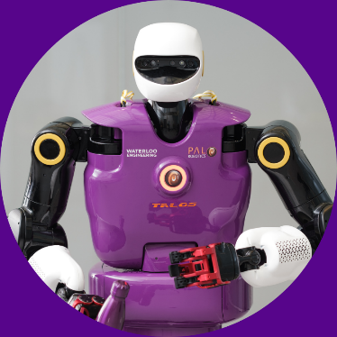
QUESTIONS?
CHATS WITH ENGINEERING STUDENT AMBASSADORS
uwaterloo.ca/future-students/ask/engineering
ADMISSIONS QUESTIONS
enginfo@uwaterloo.ca
TOURS & EVENTS
uwaterloo.ca/future-students/tours-events
Notes:
We’re happy to answer any questions you may have about our Biomedical Engineering program at this time.

