Slide 1
Campus Housing Financial Factors & Proposed Budget
2022/2023 Fiscal year

Slide 2
Purpose
Consult with student stakeholders for awareness and learning on:
Campus Housing within the University
Local state of student housing
Data-driven evidence for Campus Housing
Financial Planning

Slide 3
1. Campus Housing within the University
z

Slide 4
1st Largest Ontario campus housing operation
450
beds for graduate students
5,787
total beds in Campus Housing
75% of Waterloo first year students live in residence
2.1 M square footage of space (20% of campus)
350
staff (~100 full time and ~250 student roles)

Slide 5
Glen Weppler
Director of Housing
Jennifer Ferguson
Assistant Director, Occupancy and Marketing Services
Vacant
Manager, Housing Finance
Student Development and Residence Life
Occupancy and Marketing Services
Accounting & Data Specialist
Mike Iley Assistant Director, Residence Facilities
Residence Facilities
Alex Piticco
Assistant Director, Student Development and Residence Life
Sherry Kihut Manager, Business Technology & Systems
Functional User Analyst
+
Business Process Analyst
Kristen Leal Project Manager, Strategic Initiatives & Assessment
Organization

Slide 6
University of Waterloo Strategic Planning
UWaterloo Mission
advance learning and knowledge through teaching, research, and scholarship, nationally and internationally, in an environment of free expression and inquiry
UWaterloo Vision
Connecting imagination with impact for a better world
UWaterloo Values
We are curious.
UWaterloo Impact Themes
We are courageous.
We are engaged.
We all belong.
Developing talent for a complex future.
Advancing research for a global impact.
Strengthening sustainable and diverse communities.

Slide 7
Campus Housing’s Plan
University of Waterloo Strategic Plan
Advance learning and knowledge
Housing Mission
We want our students to learn where they live.
Housing Values
Winter 2022 Departmental Targets
Developing talent for a complex future
Strengthening sustainable and diverse communities
Housing Vision
Students living in residence will academically outperform their off-campus peers.
Put students first.
Make our team stronger.
Embrace growth.
See the bigger picture.
Operations
New Enterprise System
Paused Activities

Slide 8
2. The local state of student housing
z

Slide 9
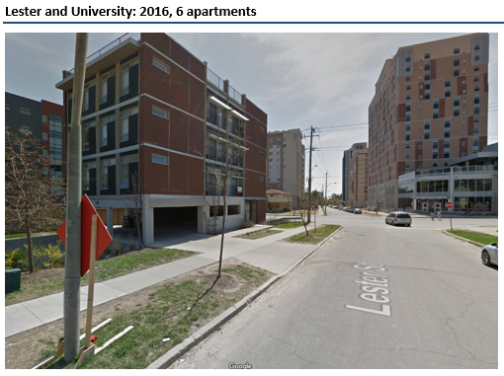
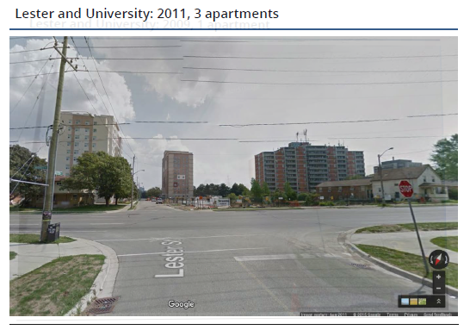
Times are changing...
image
image
image
Notes:
Mike
Stay competitive with services, amenities, and experience of OC housing
Strategic and intentional with capital improvements

Slide 10
Stability & Change
Our Foundation
The Changing Landscape
Own the first-year market
Proximity
Part of the university
Decades of experience
Campus partners
Caring + Dedicated staff
Evidence
Supportive of learning
COVID-19 Pandemic
Competition
Need to market residence experience
Aging buildings
Mental health
Social media
Globalization
Accountability / Expectations
Family involvement

Slide 11
Comparing On- and Off- Campus
Feature | Discount OCH | UW Residence | Premium OCH
~ $ per term | $2,520 | $2,930 | $3,600
12-mo lease required | Most |  | Most
Housekeeping |  | X
Utilities included | Some | X | Some
Close to class |  | X
Internet included |  | X
IT support service |  | X
Public common space |  | X | X
Floor common areas |  | X
Organized events |  | X
Meals available |  | X
Gym, study room, etc. |  | X | X
24-hour security |  | X | X
Tutoring available |  | X
300+ Job opportunities |  | X
Rooftop patio |  |  | Some
Counselling |  | X

Slide 12
Supply/Demand study (2017)
1,060
Students in Waterloo have more choice in where to live than anywhere else in Canada.
Potential surplus
of housing beds
Source: https://www.waterloo.ca/en/government/resources/Documents/Cityadministration/Student-housing-report-2017.pdf

Slide 13
4. Data-driven evidence for Campus Housing
z

Slide 14
Retention rate (2018)
Subgroup | Residence | Off-campus | Difference
Overall | 91.8% | 88.7% | 3.1
AHS | 92.4 | 88.7 | 3.7
Arts | 90.4 | 85.9 | 4.5
Engineering | 91.7 | 90.3 | 1.4
Environment | 90.4 | 90.2 | 0.2
Math | 93.3 | 90.2 | 3.1
Science | 91.2 | 87.9 | 3.3
Male | 91 | 87.4 | 3.6
Female | 92.4 | 90.4 | 2.0
Canadian | 91.8 | 89.2 | 2.6
International | 89.4 | 85.5 | 3.9
Notes:
Table 1 shows the differences in retention rate of those in housing compared to those not in housing. Overall, students who stayed in housing were significantly more likely to be retained as compared to those who did not. Additionally, the following subgroups had a statistically significant higher retention rate when staying in housing. The following subgroups of students had a statistically significant higher retention rate than those of the same subgroup not in housing:
Overall
Arts
Engineering
Mathematics
Science
Gender
Domestic students
International students
Assumptions and Definitions
Population examined: Students included in the analysis were those who first registered for study in a term between academic years 2005/2006 and 2010/2011
Not retained: A student was considered as not retained if they did not progress to second year at any future point while enrolled in their undergraduate career.
Housing: Students were considered as students who stayed in UW housing if theypaid housing fees in their first year of study. All students who stayed in Minota Hagey (any year) were included
The following subgroups were considered within the population: visa status, residence building, academic group, and gender.
The following students were not included in the analysis in either the housing or not in housing group:
don rooms
off campus housing
students who may have paid a housing fee, but also paid a withdrawal fee. The withdrawn students are not included in the residence pool.
FUAC rooms
students who started with advanced standing (i.e. did not register in 1A)
students who transferred from a previous post-secondary institution
Visa status is defined by the fees students pay. If a student pay international tuition, they are considered an international student.
Statistical Tests between students in and not in housing
Part of the large difference outlined in the previous section could be due to the differing demographics in each sample. Further testing was done to eliminate some of the differences.
We examined the demographics of students in housing and those not in housing to determine whether these two populations have different demographic characteristics. If two populations have different demographic characteristics, statistical differences between the two groups may be due to these differences, rather than their housing condition.
The list below illustrates the results of descriptive statistics to determine which subgroups are more likely to stay in housing, and the percentage point difference:
Engineering – overrepresented in housing (+4.1%)
Environment – overrepresented in housing (-0.9%)
Females – overrepresented in housing (+3.3%)
International – overrepresentation in housing (+2.8%)
In order to eliminate the effect of varying retention rates between the listed groups, random sampling was performed twice. In other words, to remove potential impact of subgroups have on the overall retention rate; students were selected at random to see if there was a difference in retention. The results of this are in the Appendix. The findings of this test concluded that variation in statistical difference between subgroups are consistent; students in housing tend to have a higher retention rate.
Two random sampling functions were performed. The first selected 50% of the population randomly, the other selected 30% of the sample.
Retention Rate over time
Table 5 shows how the overall retention rate has changed yearly between 2005/06 and 2010/11 in both the housing, and not in housing groups. There is a difference between housing and non-housing students in every year, and this difference is statistically significant.
Table 5 – Difference in retention rate by year
Retention Rate
Academic Year
Housing
Not in Housing
Difference (% points)
Statistically Different
2005/06
93.6%
86.7%
6.9
Yes
2006/07
94.4%
86.2%
8.2
Yes
2007/08
93.0%
86.7%
6.3
Yes
2008/09
93.6%
88.4%
5.2
Yes
2009/10
92.7%
87.4%
5.3
Yes
2010/11
93.1%
87.1%
6.0
Yes
Using the z-test at 95% confidence

Slide 15
Canadian Research

Slide 16
5. Financial Planning
z

Slide 17
Realities & Principles (in normal times)
98% of revenue from residence fees
Designed to break-even financially. Including:
Debt payments
Capital renewal
Must be financially sustainable over time
Not a profit-centre for the university
University contributes no funds to residence

Slide 18
10-year Occupancy Rate By Term

Slide 19
Ontario University Rate Benchmarks

Slide 20
Residence Fees by Building, Room, Year & Month
Residence | Room Type | 21/22Fee | 22/23 Fee | 1/8th of the Fee
V1/REV | Single | 6,697 | 6,831 | 854
 | Interconnecting | 6,392 | 6,520 | 815
 | Double | 6,008 | 6,128 | 766
 | Triple | 4,806 | 4,902 | 601
 | Quad | 3,905 | 3,983 | 488
MKV | Single - 4 bdrm unit | 7,995 | 8,155 | 1,020
Minota Hagey | Single - 1 term | 3,492 | 3,561 | 891
CMH | Single | 7,346 | 7,493 | 937
 | Double | 7,001 | 7,141 | 893
 | Triple | 5,602 | 5,714 | 715
 | Quad | 4,551 | 4,642 | 581
UWP | Single - 2 bdrm unit | 7,224 | 7,367 | 921
 | Single 3 or 4 bdrm | 6,837 | 6,974 | 872
 | Double | 6,310 | 6,436 | 805
CLV | Single - 1 term, 2bdrm | 3,192 | 3,256 | 814
 | Single - 2 term, 4bdrm | 6,386 | 6,514 | 815
 | Family, monthly | 1,306 | 1,322 | --

Slide 21
Summary 22/23 Campus Housing Budget

