Slide 1
Residence Budget Planning
2018/19 Fiscal year

Slide 2
Think, Pair, Share
What facts do you have about the Waterloo Residences’ budget?
What assumptions are you making about the budget?

Slide 3
Purpose
Learning opportunity
Awareness & comparison opportunity
Legal responsibility to “consult” on “major” decisions
Influence budget planning & allocation

Slide 4
Context

Slide 5
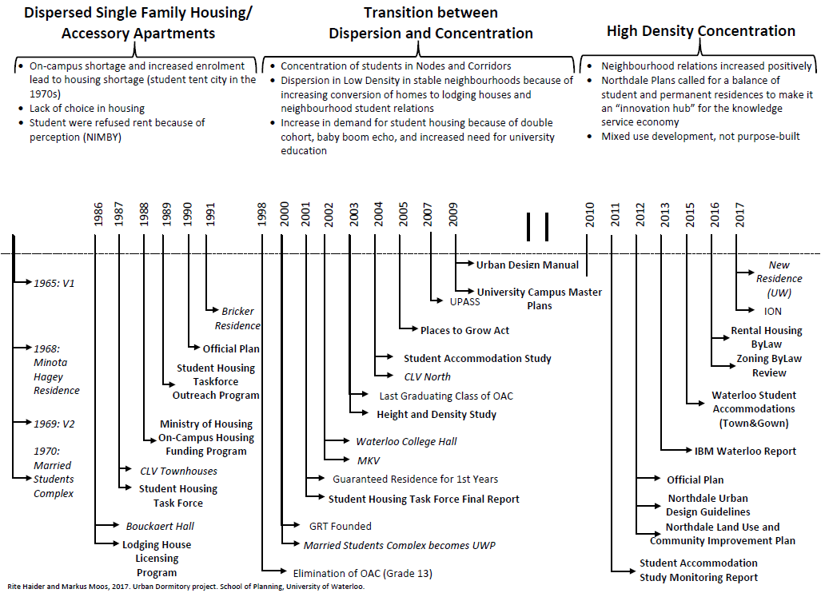
Local history of student housing

Slide 6
Our Mission – The reason we exist
“To foster meaningful growth and learning opportunities by providing a safe, accessible, clean and supportive home where all students succeed personally and academically.”

Slide 7
Our Vision – What we want to be
Our aim is to clearly demonstrate that students living in residence will academically outperform their off-campus peers.

Slide 8
Glen Weppler
Director of Housing
Jennifer Ferguson
Assistant Director, Admissions and Marketing
Christy Elliot
Manager, Housing Finance
Student Development and Residence Life Group
Admissions and Marketing Group
Malorie Glyde
Accounting and Data Specialist
Mike Iley
Assistant Director, Residence Facilities
Residence Facilities Group
Alex Piticco
Assistant Director, Student Development and Residence Life
Sherry Kihut
Manager, Business Systems
Barb Heppler
Functional User Analyst
Danielle Burt
Project Manager, Strategic Initiatives & Assessment
Maya D’Alessio
Project Manager, Strategic Initiatives & Continuous Improvement
Organization

Slide 9
Context
3rd largest Canadian campus housing operation
5,787 beds
80% of 1st year students live in residence
$35 million in annual revenue
2.1 million square feet
~350 staff (~100 full-time & ~250 student roles)
V1 opened in 1965

Slide 10
Our foundation
Own FY market
Proximity
Part of UW
Decades of history
Campus partners
New residence
Evidence
Team culture

Slide 11
The changing landscape
Competition
Need to market residence experience
Aging buildings
Mental health
Speed of sharing information
Online education
Expectations rising
Parental involvement

Slide 12
The local state of student housing

Slide 13
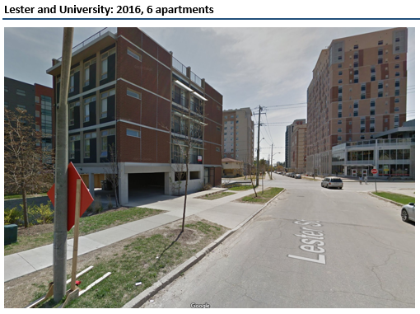
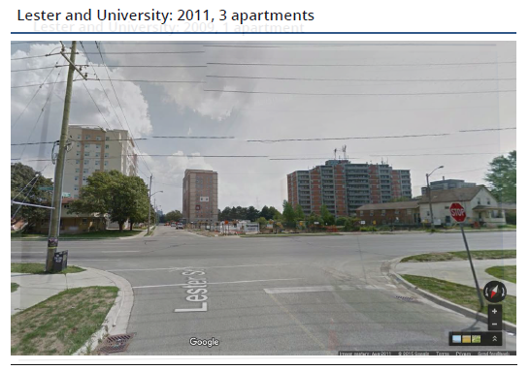
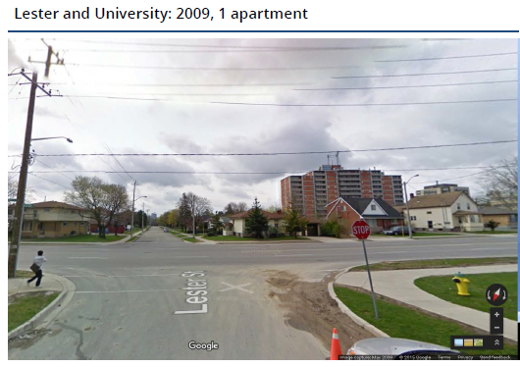
Times are changing...
image
image
image
Notes:
Mike
Stay competitive with services, amenities, and experience of OC housing
Strategic and intentional with capital improvements

Slide 14



Benefits offered off-campus
  Fully-furnished units
  Ensuite bathrooms
  Granite countertops
  Incentives to sign lease
    Free month rent
    Free big screen TV
    Free internet
Source: http://www.rez-one.ca/why-choose-rez-one/
Notes:
No community space
No Dons, 24 hour access to staff, FT staff focused on student’s experience
Wants: Price, proximity, privacy, cleanliness
Needs: Personal interactions

Slide 15

Supply/Demand study finding
1,060
Potential surplus
of housing beds

Slide 16
Choices
Students in Waterloo have
more choice in where to live
than anywhere else in Canada.

Slide 17
Comparing features
Fee per term | Discount OCH | UW Residence | Premium OCH
~ $ per term | $2,200 | $2,600 | $3,200
12-mo lease req’d | Most |  | Most
Housekeeping |  | X
Utilities included | Some | X | Some
Close to class |  | X
Internet included |  | X
IT support service |  | X
Public common space |  | X | X
Floor common areas |  | X
Organized events |  | X
Meals available |  | X
Gym, study room, etc |  | X | X
24-hour security |  | X | X
Tutoring available |  | X
300+ Job opportunities |  | X

Slide 18
Our focus is your learning

Slide 19
Our Building Missions
Learn where you live
Facilitate learning & development
Fill the beds
Provide beds/space
Clarity, coordination & culture
Our students
Student Development & Residence Life
Marketing & Admissions
Residence Facilities
Office of the Director of Housing

Slide 20
Residence is different because…
Dons / Residence Life Program
Velocity Partnership (WERC, Residence, Problem Pitch)
Living-Learning Program
  Academic partnerships
  Coop-LLC
  Life After Graduation
Learning does not happen by chance!

Slide 21
The evidence

Slide 22
Think, Pair, Share
How do you measure the value you get from residence?

Slide 23
General research findings
  Extracurricular activities participation
  Perception of campus social climate
  Satisfaction w PSE experience
  Personal growth and development
  Frequency of peer/faculty interactions
  Persistence to graduation
Source: How College Affects Students, 2005
Notes:
Greater reach than Co-op program – 80 vs 60
Large residential campus – 3rd largest campus housing op in Canada
more likely to participate in extracurricular activities
report more positive perceptions of the campus social climate
tend to be more satisfied with their post-secondary education experience and report more personal growth and development
engage in more frequent interactions with peers and faculty members
more likely to persist to graduation

Slide 24
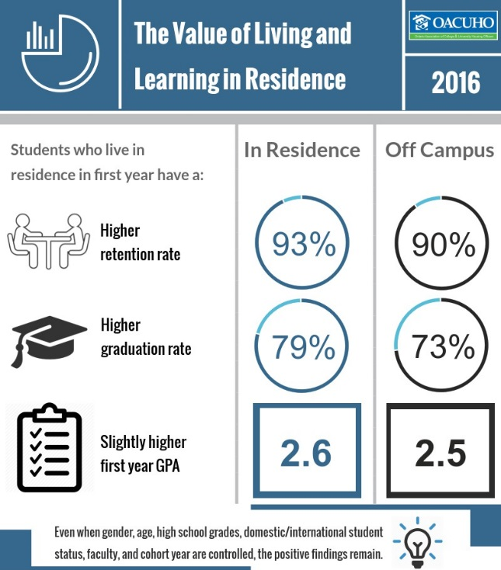
Value of Residence – Research Findings
Source: https://forum.academica.ca/forum/good-news-for-the-champions-of-on-campus-housing

Slide 25
Retention rate at UW
Table 1 – Difference in retention rates of subgroups (of those who first registered for study in a term between academic years 2005/2006 and 2010/2011)
 | Retention Rate
Subgroup | Housing | Not in Housing | Difference (% points) | Statistically Different
Overall | 93.4% | 87.1% | 6.3 | Yes
Applied Health Science | 93.7% | 92.1% | 1.6 | No
Arts | 91.1% | 84.9% | 6.2 | Yes
Engineering | 94.3% | 93.5% | 0.8 | Yes
Environment | 92.1% | 90.5% | 1.6 | No
Mathematics | 94.2% | 76.7% | 17.5 | Yes
Science | 93.3% | 91.3% | 2.0 | Yes
Male | 93.3% | 87.4% | 5.9 | Yes
Female | 93.5% | 86.8% | 6.7 | Yes
Domestic | 93.6% | 90.0% | 3.6 | Yes
International | 90.6% | 60.0% | 30.6 | Yes
Notes:
Table 1 shows the differences in retention rate of those in housing compared to those not in housing. Overall, students who stayed in housing were significantly more likely to be retained as compared to those who did not. Additionally, the following subgroups had a statistically significant higher retention rate when staying in housing. The following subgroups of students had a statistically significant higher retention rate than those of the same subgroup not in housing:
Overall
Arts
Engineering
Mathematics
Science
Gender
Domestic students
International students
Assumptions and Definitions
Population examined: Students included in the analysis were those who first registered for study in a term between academic years 2005/2006 and 2010/2011
Not retained: A student was considered as not retained if they did not progress to second year at any future point while enrolled in their undergraduate career.
Housing: Students were considered as students who stayed in UW housing if theypaid housing fees in their first year of study. All students who stayed in Minota Hagey (any year) were included
The following subgroups were considered within the population: visa status, residence building, academic group, and gender.
The following students were not included in the analysis in either the housing or not in housing group:
don rooms
off campus housing
students who may have paid a housing fee, but also paid a withdrawal fee. The withdrawn students are not included in the residence pool.
FUAC rooms
students who started with advanced standing (i.e. did not register in 1A)
students who transferred from a previous post-secondary institution
Visa status is defined by the fees students pay. If a student pay international tuition, they are considered an international student.
Statistical Tests between students in and not in housing
Part of the large difference outlined in the previous section could be due to the differing demographics in each sample. Further testing was done to eliminate some of the differences.
We examined the demographics of students in housing and those not in housing to determine whether these two populations have different demographic characteristics. If two populations have different demographic characteristics, statistical differences between the two groups may be due to these differences, rather than their housing condition.
The list below illustrates the results of descriptive statistics to determine which subgroups are more likely to stay in housing, and the percentage point difference:
Engineering – overrepresented in housing (+4.1%)
Environment – overrepresented in housing (-0.9%)
Females – overrepresented in housing (+3.3%)
International – overrepresentation in housing (+2.8%)
In order to eliminate the effect of varying retention rates between the listed groups, random sampling was performed twice. In other words, to remove potential impact of subgroups have on the overall retention rate; students were selected at random to see if there was a difference in retention. The results of this are in the Appendix. The findings of this test concluded that variation in statistical difference between subgroups are consistent; students in housing tend to have a higher retention rate.
Two random sampling functions were performed. The first selected 50% of the population randomly, the other selected 30% of the sample.
Retention Rate over time
Table 5 shows how the overall retention rate has changed yearly between 2005/06 and 2010/11 in both the housing, and not in housing groups. There is a difference between housing and non-housing students in every year, and this difference is statistically significant.
Table 5 – Difference in retention rate by year
Retention Rate
Academic Year
Housing
Not in Housing
Difference (% points)
Statistically Different
2005/06
93.6%
86.7%
6.9
Yes
2006/07
94.4%
86.2%
8.2
Yes
2007/08
93.0%
86.7%
6.3
Yes
2008/09
93.6%
88.4%
5.2
Yes
2009/10
92.7%
87.4%
5.3
Yes
2010/11
93.1%
87.1%
6.0
Yes
Using the z-test at 95% confidence

Slide 26
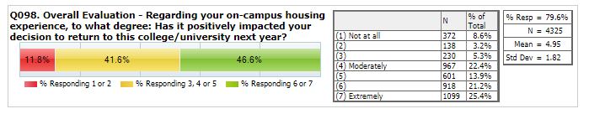
Overall Impact
Does living on-campus positively impact a students decision to return to University?
According to most students… yes!
Notes:
this is for the 16/17 fiscal year for all faculties.

Slide 27
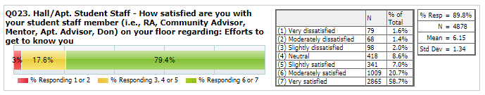
High Impact Practices: Dons
We hire and train amazing Dons that students appreciate:
Notes:
This is for the 16/17 fiscal year for all faculties.

Slide 28
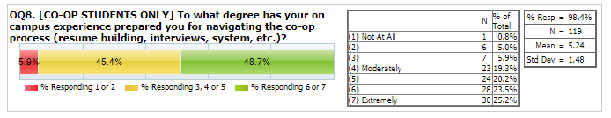
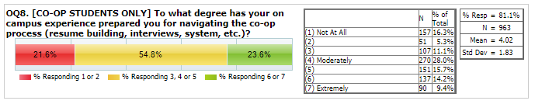
High Impact Practices: LLC
The Co-op Living Learning Community aids students through the co-op process:
Engineers who reported they ARE in co-op LLC:
Engineers who reported they are NOT in LLC:
Notes:
An overwhelming majority of students also reported positive outcomes as a result of living in their living-learning community.
.Living-Learning Outcomes - As a result of your living-learning community, you are better able to: Connect with fellow students within my living-learning community

Slide 29
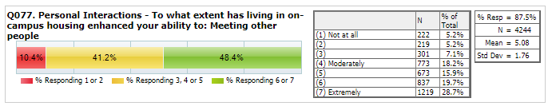
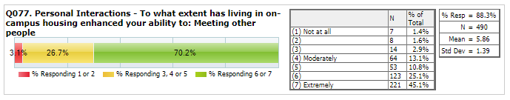
The importance of personal interactions
Not in LLC:
In LLC:
Notes:
This is for the 16/17 fiscal year for all faculties.

Slide 30
What did you identify as items you value?
Anything different?

Slide 31
Financial Highlights

Slide 32
True or False?
The residence makes a profit for the university.
The biggest expense item for residence is salaries/benefits.
The occupancy rate has declined over the last decade.
The residence has never planned a deficit budget.
Living on-campus costs more than living off-campus.

Slide 33
Realities & Principles
98% of revenue from residence fees
Designed to break-even financially. Including:
  Debt payments
  Capital renewal
Must be financially sustainable over time
Not a profit-centre for the university
University contributes no funds to residence

Slide 36
Residence Fees by Building, Room, Year & Month
Residence | Room Type | 17/18 Fee | 18/19 Fee | 1/8th of 17/18 fee | 1/8th of 18/19 fee
V1 / REV | Single | $ 6,324 | $ 6,437 | $ 791 | $ 805
 | Interconnecting | 6,036 | 6,144 | 755 | 768
 | Double | 5,673 | 5,775 | 710 | 722
 | Triple | -- | 4,620 | -- | 578
 | Quad | -- | 3,754 | -- | 469
MKV | Single – 4b suite | 7,549 | 7,684 | 944 | 961
Minota Hagey | Single – 1 term | 3,297 | 3,356 | 825 | 839
CMH | Single | 6,936 | 7,061 | 867 | 883
 | Double | 6,611 | 6,730 | 827 | 841
 | Triple | -- | 5,384 | -- | 673
 | Quad | -- | 4,375 | -- | 547
UWP | Single – 2b suite | 6,822 | 6,945 | 853 | 868
 | Single – 3/4b | 6,457 | 6,573 | 807 | 822
 | Double (Beck) | 5,958 | 6,065 | 745 | 758
CLV | Single – 1t, 2b town | 3,014 | 3,068 | 754 | 767
 | Single – 2t, 4b town | 6,031 | 6,140 | 754 | 768
 | Family, monthly | 1,260 | 1,283 | n/a | n/a

Slide 37
Proposed Budget vs Approved & Actual Budgets

Slide 38
Question?
Glen Weppler, Director of Housing
glen.weppler@uwaterloo.ca
519-888-4567 x32899

