Slide 1
Residence Budget Planning
2019/20 Fiscal year

Slide 2
Think, Pair, Share
What facts do you have about the Waterloo Residences’ budget?
What assumptions are you making about the budget?

Slide 3
Purpose
Learning opportunity
Awareness & comparison opportunity
Legal responsibility to “consult” on “major” decisions
Influence budget planning & allocation

Slide 4
Context

Slide 5
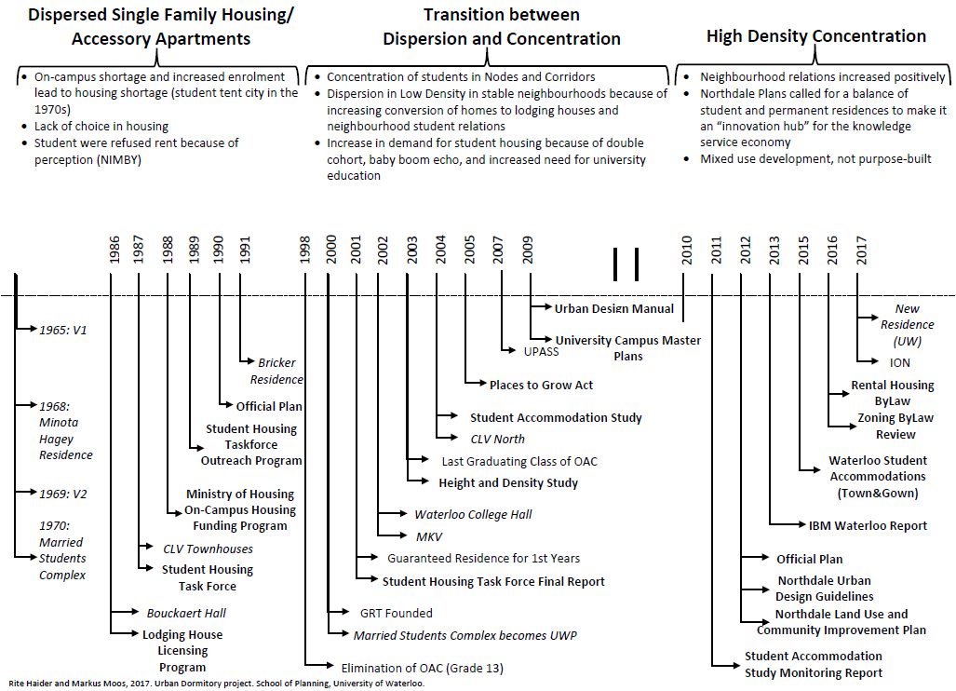
Local history of student housing

Slide 6
Our Mission – The reason we exist
Learn where you live.

Slide 7
Our Vision – What we want to be
Our aim is to clearly demonstrate that students living in residence will academically outperform their off-campus peers.

Slide 8
Glen Weppler
Director of Housing
Jennifer Ferguson
Assistant Director, Occupancy and Marketing Services
Christy Elliot Manager, Housing Finance
Student Development and Residence Life Group
Occupancy and Marketing Services
Malorie Glyde Accounting and Data Specialist
Mike Iley Assistant Director, Residence Facilities
Residence Facilities Group
Alex Piticco
Assistant Director, Student Development and Residence Life
Sherry Kihut Manager, Business Technology & Systems
Barb Heppler Functional User Analyst
Vacant Project Manager, Strategic Initiatives & Assessment
Vacant Project Manager, Strategic Initiatives & Continuous Improvement (part-time)
Michele Ryan Business Process Analyst
Organization

Slide 9
Context
2nd largest Canadian campus housing operation
5,787 beds
80% of 1st year students live in residence
~440 grad beds for 4,582 FTE grads
Generate $52M / $38M operating budget
2.1 million square feet space (~20% of campus)
~350 staff (~100 full-time & ~250 student roles)
V1 opened in 1965
“Married Student Apartments” opened in 1970

Slide 10
Our foundation
Own FY market
Proximity
Part of the university
Decades of experience
Campus partners
Investment in new residence recently
Evidence
Team culture

Slide 11
The changing landscape
Competition
Need to market residence experience
Aging buildings
Mental health
Social media
Globalization
Accountability / Expectations
Family involvement

Slide 12
Think, Pair, Share
When deciding where you will live what factors do you consider?
What are the three most important factors to you?

Slide 13
The local state of student housing

Slide 14
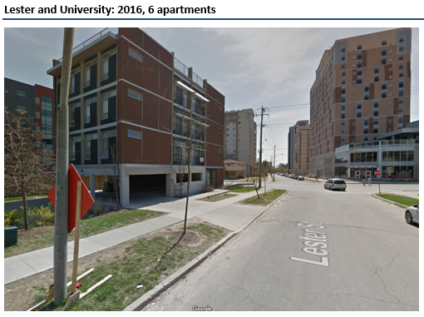
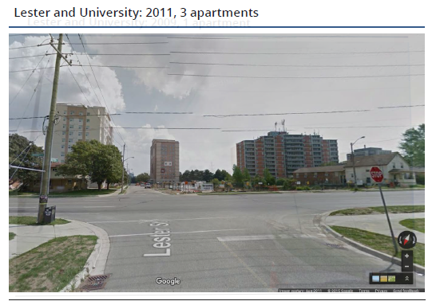
Times are changing...
image
image
image
Notes:
Mike
Stay competitive with services, amenities, and experience of OC housing
Strategic and intentional with capital improvements

Slide 15
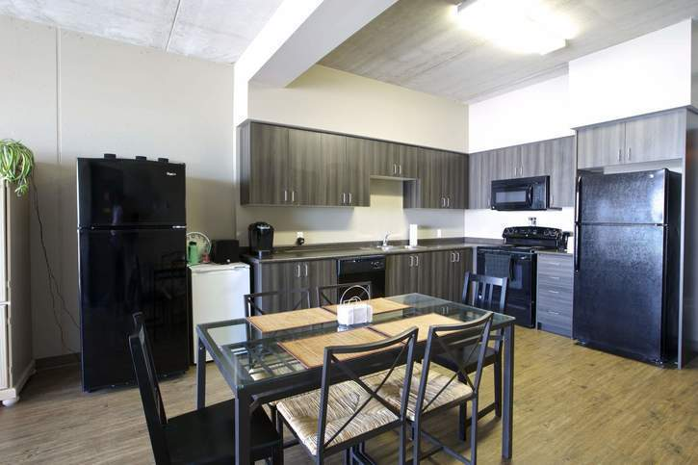
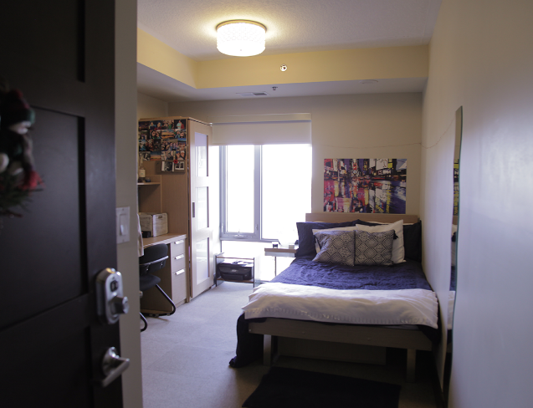
Benefits offered off-campus
Fully-furnished units
Ensuite bathrooms
Granite countertops
Incentives to sign lease
Free month rent
Free big screen TV
Free internet
Source: https://waterloo.themarq.ca/?gclid=CjwKCAiAyfvhBRBsEiwAe2t_i6zsNh4OdNPcpUzMG-YpFRFqZeLVNn27Melf5qUk74NLmjmknpN2qhoCgJwQAvD_BwE
Source: http://www.rez-one.ca/about-rez-one/
Source: http://kingstreettowers.ca/photos/
Notes:
No community space
No Dons, 24 hour access to staff, FT staff focused on student’s experience
Wants: Price, proximity, privacy, cleanliness
Needs: Personal interactions

Slide 16
Supply/Demand study finding (2017)
1,060
Potential surplus
of housing beds

Slide 17
Choices
Students in Waterloo have more choice in where to live than anywhere else in Canada.

Slide 18
Comparing features
Fee per term | Discount OCH | UW Residence | Premium OCH
~ $ per term | $2,300 | $2,900 | $3,500
12-mo lease req’d | Most |  | Most
Housekeeping |  | X
Utilities included | Some | X | Some
Close to class |  | X
Internet included |  | X
IT support service |  | X
Public common space |  | X | X
Floor common areas |  | X
Organized events |  | X
Meals available |  | X
Gym, study room, etc |  | X | X
24-hour security |  | X | X
Tutoring available |  | X
300+ Job opportunities |  | X

Slide 19
Our focus is your learning

Slide 20
Our Building Missions
Learn where you live
Facilitate learning & development
Fill the beds
Provide beds/space
Clarity, coordination & culture
Our students
Student Development & Residence Life
Marketing & Admissions
Residence Facilities
Office of the Director of Housing

Slide 21
Residence is different because…
Staff available 24/7 – Desk Services, Maintenance/Cleaning
Dons / Community Assistants
Living-Learning Program
Academic partnerships
Life After Graduation
Campus partners (Orientation, Velocity, Counseling, etc)
Learning does not happen by chance!

Slide 22
The Waterloo Graduate Housing Difference
Community cluster of graduate students
Dedicated student staff – Community Assistants
Grad & Family focused activities and supports
Contracts aligned to the academic term (no 12 month leases)

Slide 23
Graduate Resident Experience Ideas?
What advise do you have on how Waterloo Residences’ can improve how you “learn where you live”?

Slide 24
The evidence

Slide 25
Think, Pair, Share
How do you measure your level of satisfaction with your living environment?

Slide 26
General research findings
Extracurricular activities participation
Perception of campus social climate
Satisfaction w PSE experience
Personal growth and development
Frequency of peer/faculty interactions
Persistence to graduation
Source: How College Affects Students, 2005
Notes:
Greater reach than Co-op program – 80 vs 60
Large residential campus – 3rd largest campus housing op in Canada
more likely to participate in extracurricular activities
report more positive perceptions of the campus social climate
tend to be more satisfied with their post-secondary education experience and report more personal growth and development
engage in more frequent interactions with peers and faculty members
more likely to persist to graduation

Slide 27
Value of Residence – Research Findings
Source: https://forum.academica.ca/forum/good-news-for-the-champions-of-on-campus-housing

Slide 28
Retention rate (2018)
Subgroup | Residence | Off-campus | Difference
Overall | 91.8% | 88.7% | 3.1
AHS | 92.4 | 88.7 | 3.7
Arts | 90.4 | 85.9 | 4.5
Engineering | 91.7 | 90.3 | 1.4
Environment | 90.4 | 90.2 | 0.2
Math | 93.3 | 90.2 | 3.1
Science | 91.2 | 87.9 | 3.3
Male | 91 | 87.4 | 3.6
Female | 92.4 | 90.4 | 2.0
Canadian | 91.8 | 89.2 | 2.6
International | 89.4 | 85.5 | 3.9
Notes:
Table 1 shows the differences in retention rate of those in housing compared to those not in housing. Overall, students who stayed in housing were significantly more likely to be retained as compared to those who did not. Additionally, the following subgroups had a statistically significant higher retention rate when staying in housing. The following subgroups of students had a statistically significant higher retention rate than those of the same subgroup not in housing:
Overall
Arts
Engineering
Mathematics
Science
Gender
Domestic students
International students
Assumptions and Definitions
Population examined: Students included in the analysis were those who first registered for study in a term between academic years 2005/2006 and 2010/2011
Not retained: A student was considered as not retained if they did not progress to second year at any future point while enrolled in their undergraduate career.
Housing: Students were considered as students who stayed in UW housing if theypaid housing fees in their first year of study. All students who stayed in Minota Hagey (any year) were included
The following subgroups were considered within the population: visa status, residence building, academic group, and gender.
The following students were not included in the analysis in either the housing or not in housing group:
don rooms
off campus housing
students who may have paid a housing fee, but also paid a withdrawal fee. The withdrawn students are not included in the residence pool.
FUAC rooms
students who started with advanced standing (i.e. did not register in 1A)
students who transferred from a previous post-secondary institution
Visa status is defined by the fees students pay. If a student pay international tuition, they are considered an international student.
Statistical Tests between students in and not in housing
Part of the large difference outlined in the previous section could be due to the differing demographics in each sample. Further testing was done to eliminate some of the differences.
We examined the demographics of students in housing and those not in housing to determine whether these two populations have different demographic characteristics. If two populations have different demographic characteristics, statistical differences between the two groups may be due to these differences, rather than their housing condition.
The list below illustrates the results of descriptive statistics to determine which subgroups are more likely to stay in housing, and the percentage point difference:
Engineering – overrepresented in housing (+4.1%)
Environment – overrepresented in housing (-0.9%)
Females – overrepresented in housing (+3.3%)
International – overrepresentation in housing (+2.8%)
In order to eliminate the effect of varying retention rates between the listed groups, random sampling was performed twice. In other words, to remove potential impact of subgroups have on the overall retention rate; students were selected at random to see if there was a difference in retention. The results of this are in the Appendix. The findings of this test concluded that variation in statistical difference between subgroups are consistent; students in housing tend to have a higher retention rate.
Two random sampling functions were performed. The first selected 50% of the population randomly, the other selected 30% of the sample.
Retention Rate over time
Table 5 shows how the overall retention rate has changed yearly between 2005/06 and 2010/11 in both the housing, and not in housing groups. There is a difference between housing and non-housing students in every year, and this difference is statistically significant.
Table 5 – Difference in retention rate by year
Retention Rate
Academic Year
Housing
Not in Housing
Difference (% points)
Statistically Different
2005/06
93.6%
86.7%
6.9
Yes
2006/07
94.4%
86.2%
8.2
Yes
2007/08
93.0%
86.7%
6.3
Yes
2008/09
93.6%
88.4%
5.2
Yes
2009/10
92.7%
87.4%
5.3
Yes
2010/11
93.1%
87.1%
6.0
Yes
Using the z-test at 95% confidence

Slide 29
Overall Impact
Does living on-campus positively impact a students decision to return to University?
According to most students… yes!
Notes:
this is for the 16/17 fiscal year for all faculties.

Slide 30
High Impact Practices: Dons
We hire and train amazing Dons that students appreciate:
Notes:
This is for the 16/17 fiscal year for all faculties.

Slide 31
The importance of personal interactions
Not in LLC:
In LLC:
Notes:
This is for the 16/17 fiscal year for all faculties.

Slide 32
Graduate/Family Performance Indicators
F19 to W19 Renewal rate: 81.5%
Satisfaction rates (17/18)
Safety
94% satisfaction rate with level of safety in their room;
92% in residence community
89% satisfaction with sense of belonging in the community
85% satisfaction rate with services provided
88% satisfaction rate with degree of privacy
91% roommate satisfaction
81% would recommend living on-campus

Slide 33
Think, Pair, Share
Would you adjust how you measure value from living in residence after seeing some evidence?

Slide 34
Financial Highlights

Slide 35
True or False?
The residence makes a profit for the university.
The biggest expense item for residence is salaries/benefits.
The occupancy rate has declined over the last decade.
The residence has never planned a deficit budget.
Living on-campus costs more than living off-campus.

Slide 36
Realities & Principles
98% of revenue from residence fees
Designed to break-even financially. Including:
Debt payments
Capital renewal
Must be financially sustainable over time
Not a profit-centre for the university
University contributes no funds to residence

Slide 40
Residence Fees by Building, Room, Year & Month
Residence | Room Type | 18/19 Fee | 19/20 Fee | 1/8th of 18/19 fee | 1/8th of 19/20 fee
V1 / REV | Single | $ 6,437 | $ 6,553 | $ 805 | $ 820
 | Interconnecting | 6,144 | 6,255 | 768 | 782
 | Double | 5,775 | 5,879 | 722 | 735
 | Triple | 4,620 | 4,703 | 578 | 588
 | Quad | 3,754 | 3,821 | 469 | 478
MKV | Single – 4b suite | 7,684 | 7,823 | 961 | 978
Minota Hagey | Single – 1 term | 3,356 | 3,416 | 839 | 854
CMH | Single | 7,061 | 7,188 | 883 | 899
 | Double | 6,730 | 6,851 | 841 | 857
 | Triple | 5,384 | 5,481 | 673 | 686
 | Quad | 4,375 | 4,453 | 547 | 557
UWP | Single – 2b suite | 6,945 | 7,069 | 868 | 884
 | Single – 3/4b | 6,573 | 6,691 | 822 | 837
 | Double (Beck) | 6,065 | 6,174 | 758 | 772
CLV | Single – 1t, 2b town | 3,068 | 3,123 | 767 | 781
 | Single – 2t, 4b town | 6,140 | 6,250 | 768 | 782
 | Family, monthly | 1,283 | 1,306 | n/a | n/a

Slide 41
Proposed vs Approved Budget & Actual Results

Slide 42
Upcoming Capital Work
Residence | Project | Estimated Cost
Village 1 | North fire system ($ 500,000) South Link upgrades (900,000) Interior stair repairs (700,000) Lounge furniture (250,000) | $ 2,350,000
REV + Village 1 | Court resurfacing (150,000) Roofing/Sanitary renewal (500,000) | 650,000
UWP | WAT fire system (250,000) Roadway/Tunnel (500,000) Furniture (2,675,000) | 3,425,000
Future funding |  | 2,500,000
Other |  | 75,000
Total |  | $ 9,000,000

Slide 43
Discussion
What new information have you gained?
What information surprised you the most?
Was this valuable information for you to know?

Slide 44
True or False?
The residence makes a profit for the university. FALSE
The biggest expense item for residence is salaries/benefits. TRUE
The occupancy rate has declined over the last decade. TRUE
The residence has never planned a deficit budget. FALSE
Living on-campus costs more than living off-campus. FALSE

Slide 45
Question?
Glen Weppler, Director of Housing
glen.weppler@uwaterloo.ca
519-888-4567 x32899

Slide 46
Thanks
Glen Weppler, Director of Housing
glen.weppler@uwaterloo.ca
519-888-4567 x32899

