Slide 1


A Closer Look at
CIW Community Wellbeing Survey
Results for Bruce and Grey Counties
Prepared for:
South East Grey Community Health Centre and
Bruce and Grey Counties
June 2019
Notes:
A Closer Look: A Report of the Canadian Index of Wellbeing
When referring to this report, please use this citation:
Smale, B., Jiang, K., & Gao, M. (2019). A Closer Look at CIW Community Wellbeing Survey Results for Bruce and Grey Counties. A report prepared for South East Grey Community Health Centre. Waterloo, ON: Canadian Index of Wellbeing and University of Waterloo.

Slide 2
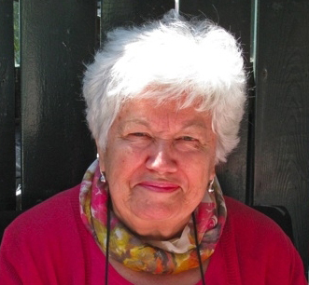
Wellbeing as a basic human right
“People are much more than the goods and services they produce! Their health and quality of life come from the conditions of their daily living – the circumstances in which they are born, grow, live, work, and age.”
The Honourable Monique Bégin
Former CIW Advisory Board Co-Chair
Former Canadian Commissioner
WHO Commission on Social Determinants of Health
Notes:
The Canadian Index of Wellbeing
This quotation by the Honourable Monique Bégin nicely summarises the essence of the CIW. We strive to move away from purely economic measures and to focus on those aspects of people’s lives that matter most to them and enable them to flourish.

Slide 3
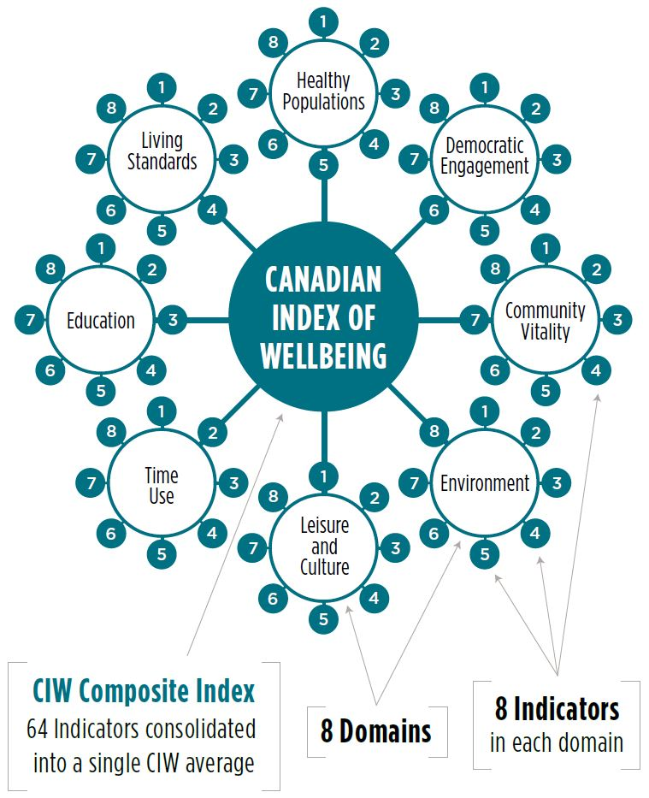
Notes:
Core Values and Domains Identified by Canadians
Since its inception and throughout the development of the CIW, the process has been designed to ensure everyday Canadians hear their own voices and see themselves reflected in the measure.
The CIW came about through the combined efforts of national leaders and organizations, community groups, research experts, indicator users, and importantly, the Canadian public. Through three rounds of public consultations, everyday Canadians across the country candidly expressed what really matters to their wellbeing. The process culminated in the identification of core Canadian values – including equity, diversity, sustainability, economic security – and eight domains of life that contribute to and affect the wellbeing of Canadians: Community Vitality, Democratic Engagement, Education, Environment, Healthy Populations, Leisure and Culture, Living Standards, and Time Use (see Figure 2). This framework shifts the focus solely from the economy to other factors that affect quality of life.
Community Vitality means vital communities that have strong, active, and inclusive relationships among people, private, public, and non-governmental organizations that foster individual and collective wellbeing. Democratic Engagement means being involved in advancing democracy through political institutions, organizations, and activities.
Education is the systematic instruction, schooling, or training given to the young in preparation for the work of life, and by extension, similar instruction or training obtained in adulthood.
Environment is the foundation upon which human societies are built and the source of our sustained wellbeing. On a broader level, environmental protection involves the prevention of waste and damage while revitalizing our ecosystems and working towards the sustainability of all our resources.
Healthy Populations considers the physical, mental, and social wellbeing of the population. It examines life expectancy, lifestyle and behaviours, and the circumstances that influence health such as access to health care.
Leisure and Culture considers how participating in leisure and cultural activities, whether arts, culture, or recreation, contributes to our wellbeing as individuals, to our communities, and to society as a whole. The myriad of activities and opportunities we pursue and enjoy benefit our overall life satisfaction and quality of life.
Living Standards examines Canadians’ average and median income and wealth; distribution of income and wealth including poverty rates, income fluctuations and volatility; and economic security, including the labour market, and housing and food security.
Time Use considers how people experience and spend their time. It examines how the use of our time affects physical and mental wellbeing, individual and family wellbeing, and present and future wellbeing.

Slide 4

2018 CIW Community Wellbeing Survey

Slide 5
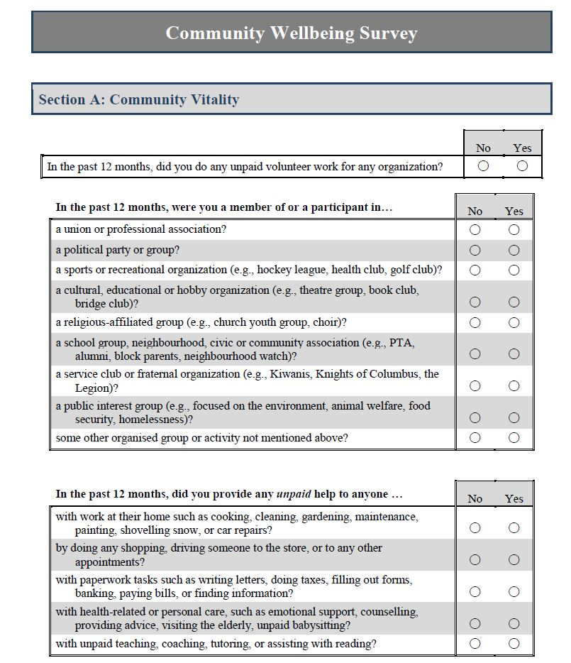
CIW Community Wellbeing Survey
Sample
Random sample of households stratified by County
Questionnaire
Behaviours and perceptions directly related to each of the CIW’s domains
Aspects of and overall wellbeing
Comprehensive demographics
Analysis
Technical report summarising all measures in the questionnaire
Targetted analyses on issues of local concern

Slide 6
Reliability of Sample and Results
Sample
A representative sample of 17,375 households from Bruce and Grey Counties were invited to participate in the survey, with additional efforts to reach smaller rural areas
Estimated response rate of 10.4% – which corresponds to the response rate of most general population surveys
Weighting of data by county, age, and sex ensures balanced representation of voices from across Bruce and Grey Counties
Results
Careful assessment of all respondents to ensure reliable and valid responses to majority of questions on survey
A total of 1,759 usable questionnaires comprised the final sample
The margin of error is ± 2.3% (19 times out of 20) – better than most national polls

Slide 7
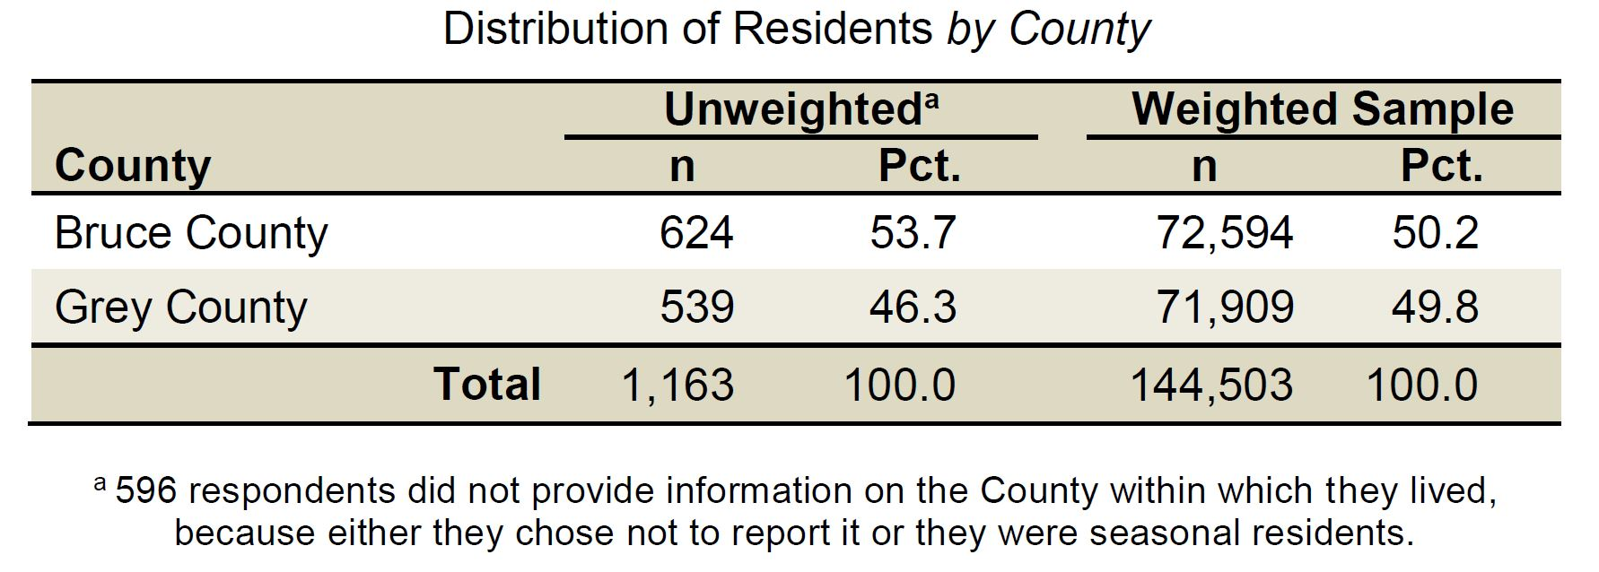
Bruce and Grey Counties Final Sample
Notes:
Weighting the Sample
In order to ensure the results from the survey are representative of the residents of Bruce and Grey Counties, the data provided by the 1,759 respondents were weighted by sex, age grouping, and municipality to match the 2016 Census profile and population projections for those residents 16 years of age and older (N = 144,503). Weighting the data means the overall results presented in this report more accurately reflect the responses of residents without under- or over-representing any groups based on age, sex, or where they live in Bruce and Grey Counties.

Slide 8
Overall Wellbeing in Bruce and Grey Counties

Slide 9
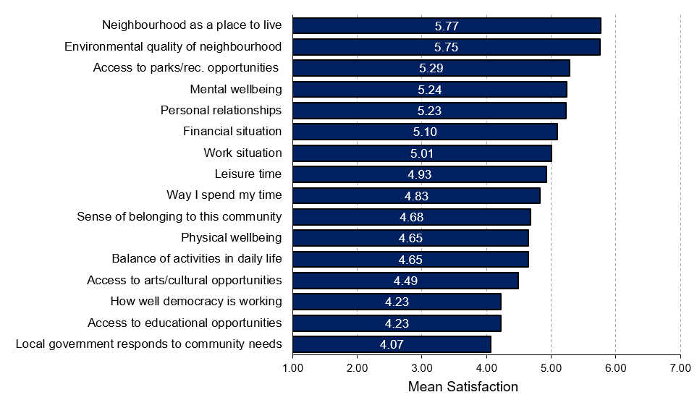
Satisfaction with Aspects of Wellbeing: Bruce and Grey Counties
Notes:
Overall Wellbeing
“How satisfied are residents with different aspects of wellbeing in Bruce and Grey Counties?”
Residents living in Bruce and Grey Counties report higher levels of satisfaction with their neighbourhood as a place to live, with their access to community parks and recreational opportunities, and the environmental quality of their neighbourhood. Given the percentages of residents who express satisfaction with these aspects, not surprisingly many also express satisfaction with their personal relationships and mental wellbeing, which are important contributors to overall wellbeing.
Levels of satisfaction among people residing in Bruce and Grey Counties are comparatively lower for how well the local government is responding to community needs, how well democracy is working in the community, and access to educational opportunities.
Note: The above findings are based on the original 7-point scale where higher scores reflect greater agreement.

Slide 10
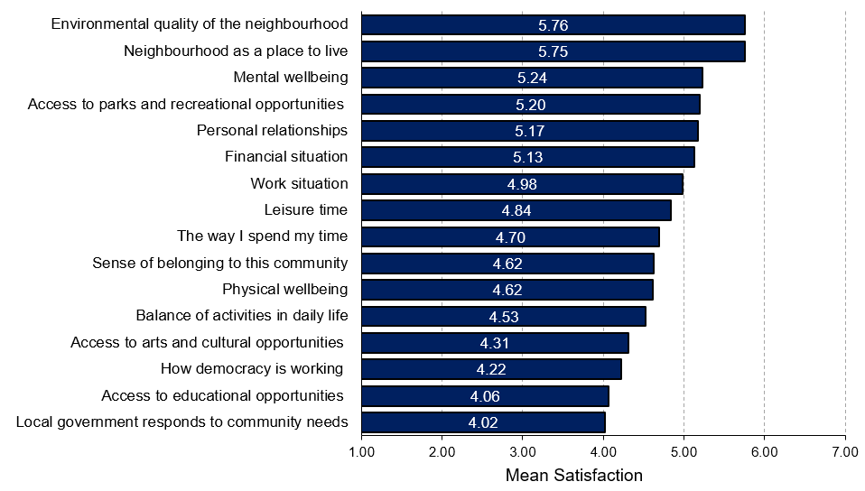
Satisfaction with Aspects of Wellbeing: Bruce County
Notes:
Overall Wellbeing
“How satisfied are residents with different aspects of wellbeing in Bruce County?”
Bruce County residents are most satisfied with the environmental quality of their neighbourhood and least satisfied with how local government responds to community needs.
Note: The above findings are based on the original 7-point scale where higher scores reflect greater agreement.

Slide 11
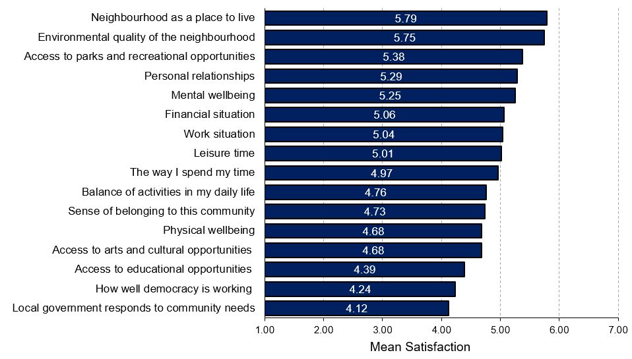
Satisfaction with Aspects of Wellbeing: Grey County
Notes:
Overall Wellbeing
“How satisfied are residents with different aspects of wellbeing in Grey County?”
Grey County residents are most satisfied with their neighbourhood and least satisfied with how local government responds to community needs.
Note: The above findings are based on the original 7-point scale where higher scores reflect greater agreement.

Slide 12
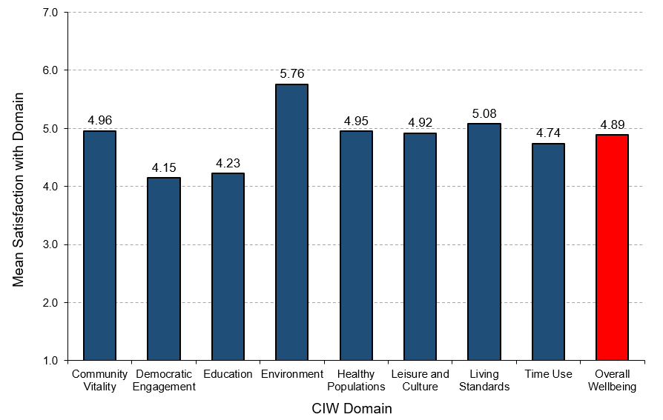
Wellbeing by Domain: Bruce and Grey Counties
Notes:
Overall Wellbeing
“How satisfied are residents in Bruce and Grey Counties with the different domains of wellbeing?”
Residents living in Bruce and Grey Counties report relatively high levels of satisfaction with domains of environment, living standards, and community vitality.
Residents living in Bruce and Grey Counties are most satisfied with the environment domain and report the lowest satisfaction with the democratic engagement and education domains.
Note: The above findings are based on the original 7-point scale where higher scores reflect greater agreement.

Slide 13
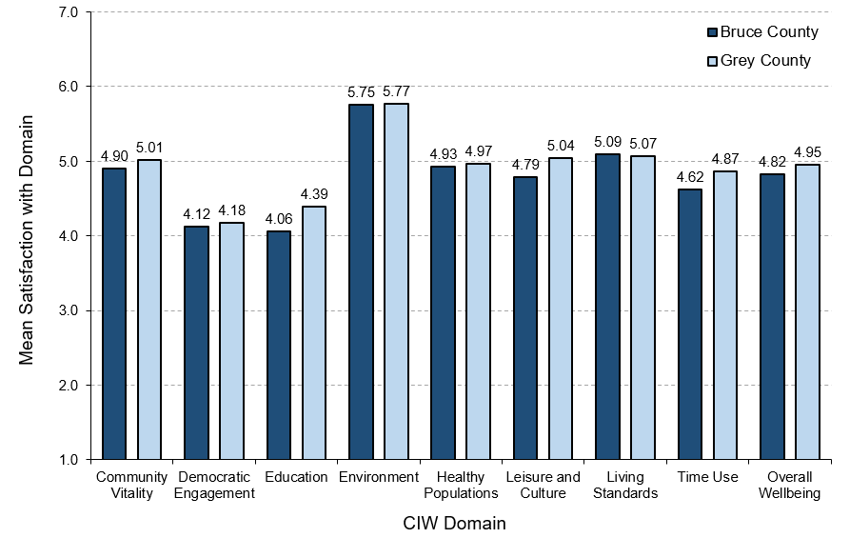
Wellbeing by Domain and County
Notes:
Overall Wellbeing
“How do residents living in Bruce County and Grey Counties compare on different domains of wellbeing?”
Residents living in Grey County report slightly higher overall wellbeing than residents living in Bruce County.
Specifically, Grey County residents are more satisfied with domains of community vitality, democratic engagement, education, leisure and culture, and time use compared to Bruce County residents.
Residents living in Grey County and Bruce County have similarly high levels of satisfaction with the environment domain.
Note: The above findings are based on the original 7-point scale where higher scores reflect greater agreement.

Slide 14
Demographics and Wellbeing
Notes:
Demographics and Wellbeing
Recognizing the unique socio-demographic profile of a region is an important first step in understanding the needs and circumstances of its residents. How many people live here? Are the residents generally younger or older? What do their families look like? How diverse is the population? Answers to these questions allow us to make more informed decisions about the types of programs and services that will best contribute to the wellbeing of residents in Bruce and Grey Counties.

Slide 15

What characterises residents with higher or lower wellbeing?
Characteristics of wellbeing in Bruce and Grey Counties
Below average wellbeing
Above average wellbeing
Women
Younger
On their own
More spend over 30% of income on housing
Living with a disability or chronic illness
Couple with children at home
Tend to be older
Married
More likely to have a university or graduate degree
More likely to be retired
Couple with no children at home (i.e., “empty nester”)
Notes:
Characteristics of wellbeing in Bruce and Grey Counties
Above average wellbeing
46.4% are men
45.3% are 65 years and older
68.6% are married
36.1% have a university or graduate degree
53.5% are retired
44.4% are households of couples with no children at home
Below average wellbeing
62.2% are women
30.6% are under 35 years of age
27.3% are on their own (single, separated, divorced, widowed)
36.3% spend more than 30% of monthly income on housing AND 5.7% spend more than 50% of monthly income on housing
25.8% are living with a disability (mental or physical) or chronic illness that limits activity
40.2% are households of couples living with children at home

Slide 16
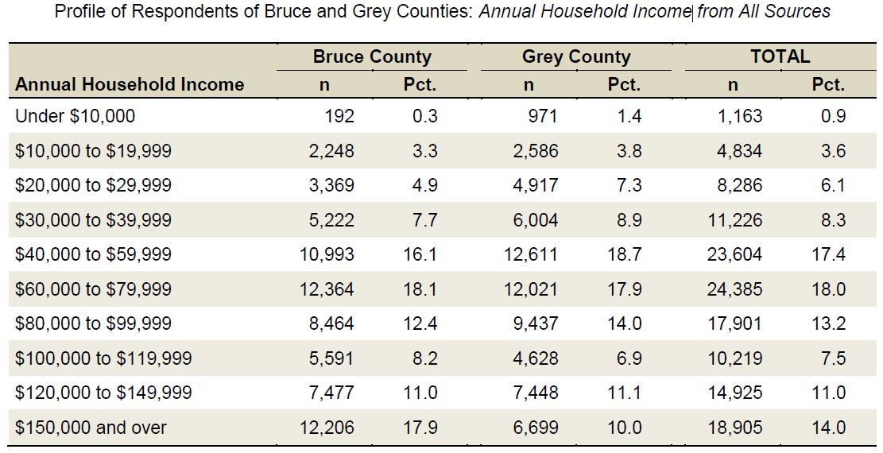
Low Income Residents and Wellbeing
Low income: Total household income before taxes from all sources was under $30,000 per year
Notes:
Selected characteristics of low income residents:
39.3% are 65 years and older
71.7% are women
59.5% are on their own (single, divorced, or widowed)
59.3% are residing in Grey County
Work
13.2% do not work (unemployed, or on leave due to long-term disability)
Housing
39% spend more than 30% of monthly income on housing AND 14.8% spend more than 50% of monthly income on housing
42.2% are living alone or sharing accommodation
17.6% rent their current residence
Health
36.2% are living with a disability (mental or physical) or chronic illness that limits their activity

Slide 17
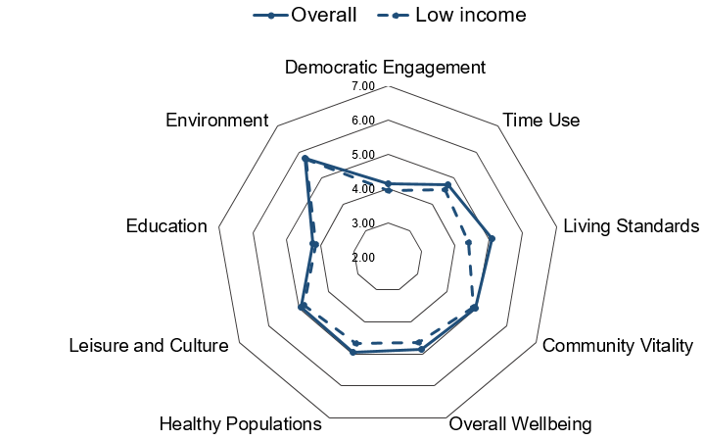
Low Income Residents and Wellbeing
Low income resident satisfaction with domains of wellbeing
Notes:
Low Income
“How do low income residents and the overall general population compare on satisfaction with the domains of wellbeing?”
Low income residents are less satisfied with ALL eight domains compared to the general population of Bruce and Grey Counties.
Low income residents have a significantly lower satisfaction with the Living Standards domain compared to the general population.
Note: The above findings are based on the original 7-point scale where higher scores reflect greater agreement.

Slide 18
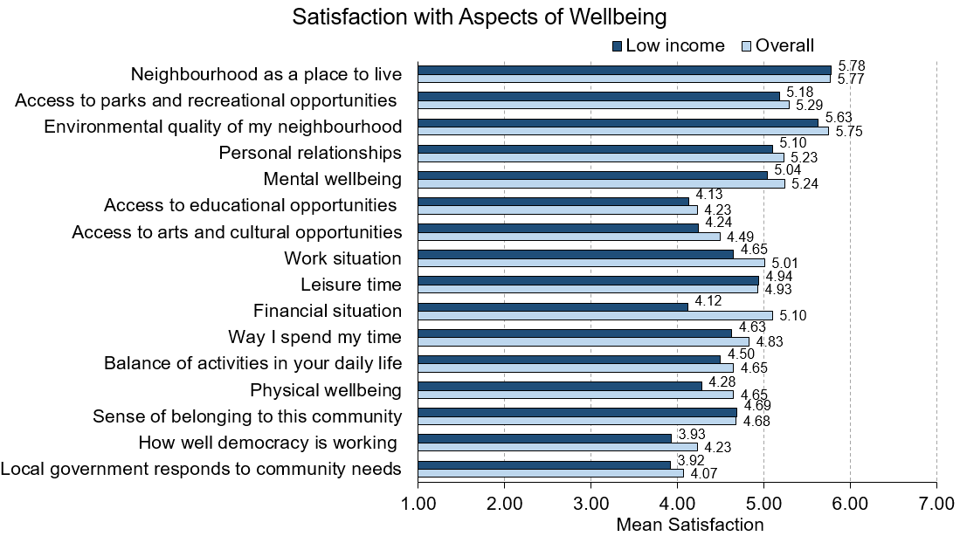
Low Income Residents and Wellbeing
Notes:
Low Income
“How do low income residents and the overall general population compare on satisfaction with aspects of wellbeing?”
Low income residents are less satisfied with nearly all aspects of wellbeing compared to the general population.
Low income residents are least satisfied with how well democracy is working and the way their local government responds to community needs.
Note: The above findings are based on the original 7-point scale where higher scores reflect greater agreement.

Slide 19
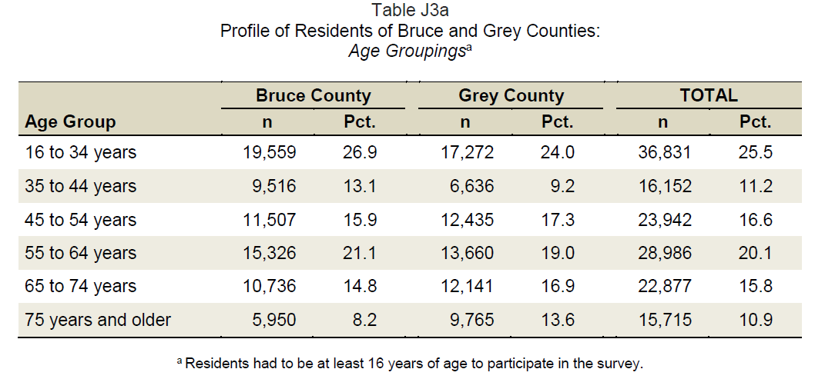
Older Adults and Wellbeing
Older adults: Residents aged 65 to 74 years and those 75 years and older
Notes:
Selected characteristics of older adults:
54.5% are women
87.3% were born in Canada
63.4% are married and 21.2% are widowed
7.8% are living alone
Income and Work
16.4% have a total annual household income before taxes from all sources of under $30,000
88.7% are retired and 9.4% are still working
Housing
86.6% spend less than 30% of their monthly income on housing
Health
27.1% are living with a disability (physical or mental) or chronic illness

Slide 20
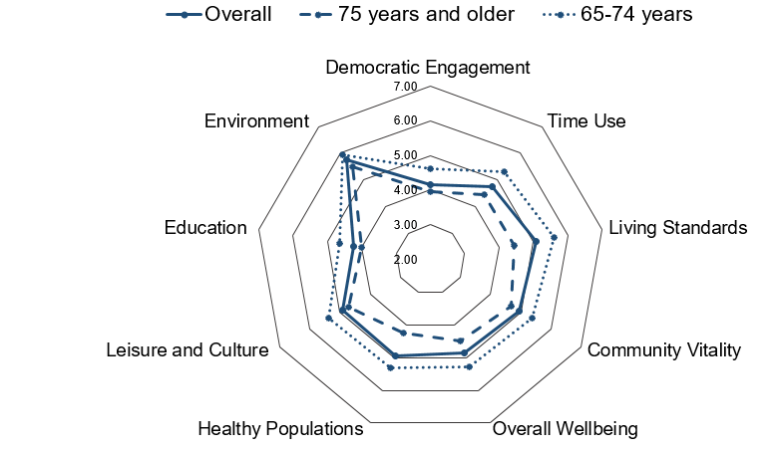
Older adults satisfaction with domains of wellbeing
Older Adults and Wellbeing
Notes:
Older Adults
“How do older adults and the overall general population compare on satisfaction with the domains of wellbeing?”
Older adults in the 65 to 74 years of group are more satisfied in ALL eight domains compared to the general population, and they are least satisfied with the Education and Democratic Engagement domains.
Older adults who are 75 years and older are less satisfied in All eight domains compared to the general population, and they are least satisfied with the Education, Democratic Engagement, and Healthy Populations domains.
Note: The above findings are based on the original 7-point scale where higher scores reflect greater agreement.

Slide 21
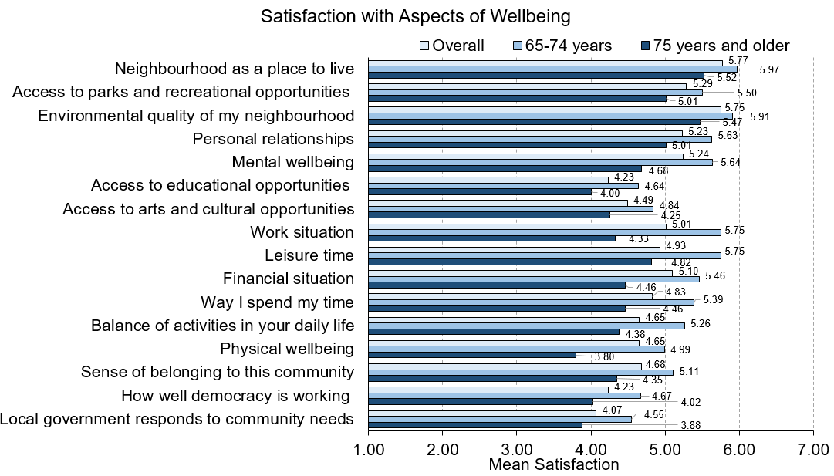
Older Adults and Wellbeing
Notes:
Older Adults
“How do older adults and the overall general population compare on satisfaction with aspects of wellbeing?”
Older adults who are 65 to 74 years of age have higher satisfaction with All aspects of wellbeing compared to the general population as well as older adults who are 75 years and older.
Older adults who are 65 to 74 years of age are more satisfied with their neighbourhood as a place to live and the environmental quality of their neighbourhood but are less satisfied with their physical wellbeing, access to educational opportunities, and the way local government responds to community needs.
Older adults who are 75 years and older are more satisfied with their neighbourhood as a place to live and the environmental quality of their neighbourhood but are less satisfied with access to educational opportunities, the way local government responds to community needs, and how well democracy is working.

Slide 22
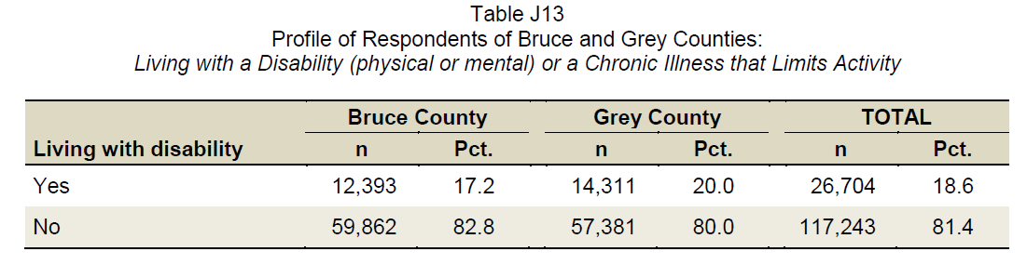
Disabilities and Wellbeing
Living with a disability or chronic illness:
Residents who are living with a physical or mental disability or a chronic illness that limits their activity
Notes:
Selected characteristics of residents living with a disability:
39.1% are 65 years and older
31.2% are on their own (single, divorced, or widowed)
62.2% are women
Income and Work
12.1% do not work (unemployed, or on leave due to long-term disability)
20.6% have a total annual household income before taxes from all sources lower than $30,000
Housing
25.4% are either living alone or sharing accommodation
9.5% rent their current residence
31.2% spend more than 30% of monthly income on housing

Slide 23
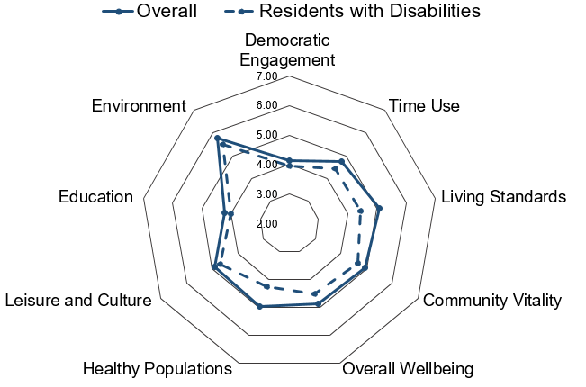
Satisfaction with domains of wellbeing for those residents living with a disability or chronic illness
Disabilities and Wellbeing
Notes:
Residents with Disabilities
“How do residents with disabilities and the overall general population compare on satisfaction with the domains of wellbeing?”
Residents living with a disability are less satisfied in ALL eight domains, compared to the general population.
Residents living with a disability are least satisfied with the Education and Democratic Engagement domains.

Slide 24
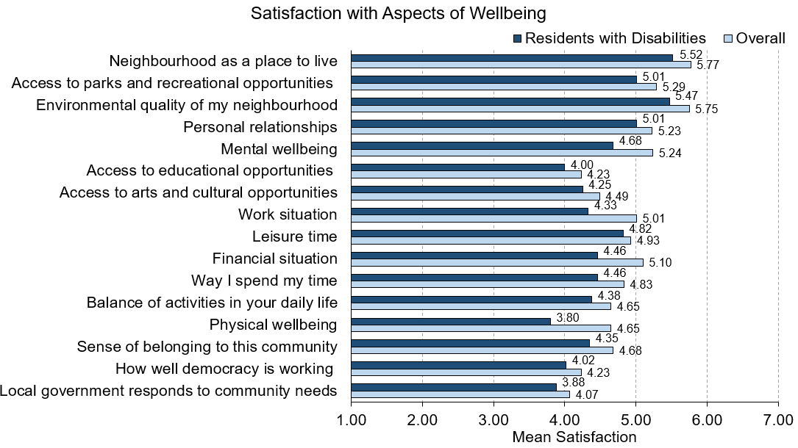
Disabilities and Wellbeing
Notes:
Residents living with a disabilities or chronic illness
“How do residents with disabilities and the overall general population compare on satisfaction with aspects of wellbeing?”
Residents living with a disability are less satisfied with ALL aspects of wellbeing compared to the general population.
Residents living with a disability have lower satisfaction regarding their physical wellbeing, the access to educational opportunities, how well democracy is working, and the way their local government responds to community needs.

Slide 25
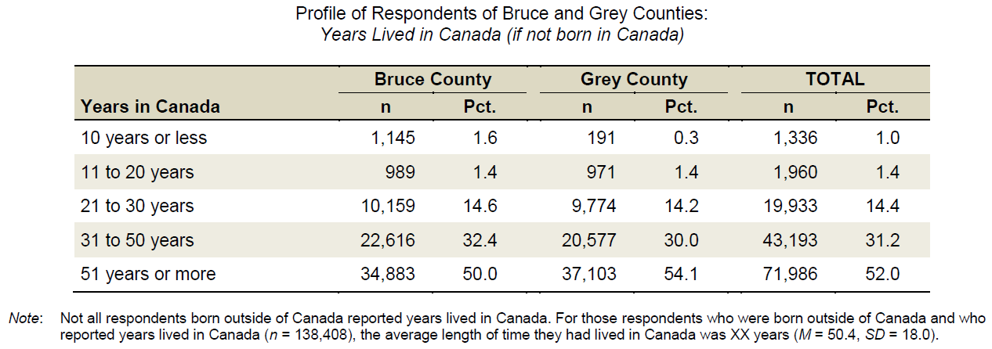
Newcomers and Wellbeing
Newcomers: Residents who have lived in Canada for 10 years or less
Notes:
Selected characteristics of newcomers:
69.9% are married AND 30.1% are widowed
49.8% are couples with children living at home
30.1% are single parent families
70.2% have a graduate degree
70.2% are under 35 years of age
54.4% are women
85.7% are residing in Bruce County
Housing
68% spend less than 30% of monthly income on housing
100% own their current residence
Income and Work
40.1% are employed full-time
57.7% have a total household income before taxes from all sources of more than $150,000 per year

Slide 26
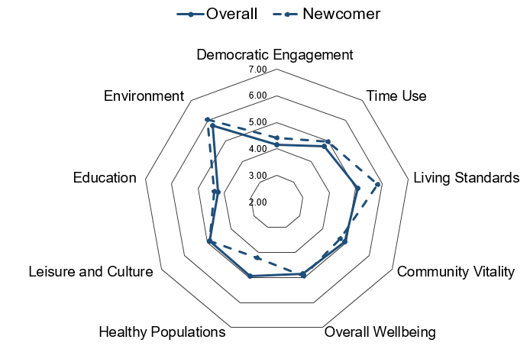
Newcomer satisfaction with domains of wellbeing
Newcomers and Wellbeing
Notes:
Newcomers
“How do newcomers and the overall general population compare on satisfaction with the domains of wellbeing?”
Newcomers have significantly higher satisfaction with the Living Standards domain compared to the general population in Bruce and Grey Counties.
Newcomers are less satisfied with the Healthy Populations and Community Vitality domains compared to the general population in Bruce and Grey Counties.

Slide 27
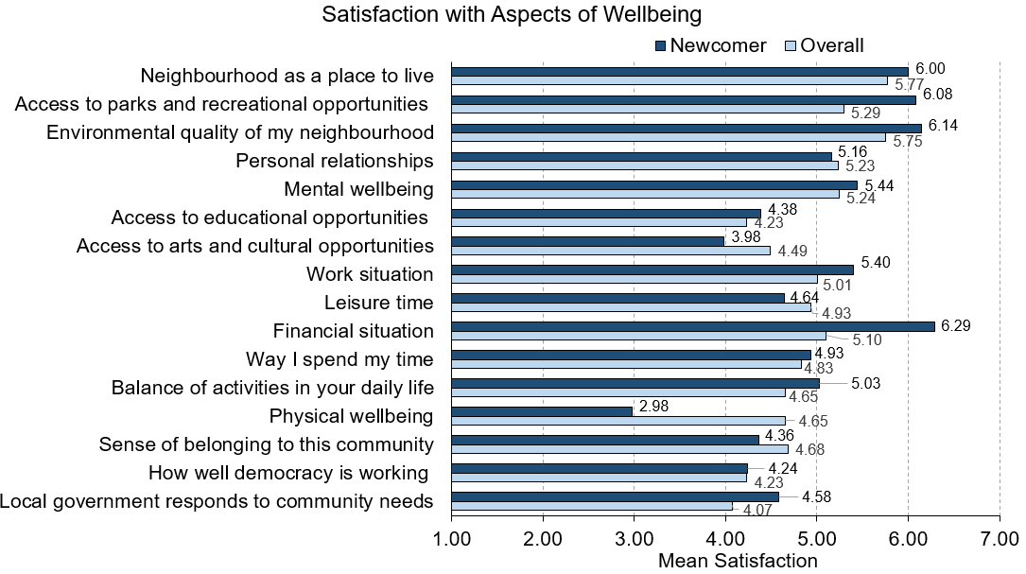
Newcomers and Wellbeing
Notes:
Newcomers
“How do newcomers and the overall general population compare on satisfaction with aspects of wellbeing?”
Newcomers have significantly higher satisfaction with their financial situation and work situation compared to the general population.
Conversely, newcomers are less satisfied with their physical wellbeing, leisure time, and the access to arts and cultural opportunities. In addition, newcomers have a lower sense of belonging to their community compared to the general population in Bruce and Grey Counties.

Slide 28
Wellbeing by CIW Domains

Slide 29

Living Standards
Notes:
Living Standards
Living Standards examines Canadians’ average and median income and wealth, distribution of income and wealth including poverty rates, income fluctuations and volatility. It considers economic security, including labour market security, and housing and food security.
Our living standards should reflect our capacity to transform economic growth into stable current and future income streams for everyone. Economic growth does not automatically translate into better living standards. A higher average income, for example, may be achieved at the cost of increased social inequality or greater economic insecurity. In contrast, achieving greater job quality, reducing poverty, and providing affordable housing and food security to individuals and families will raise wellbeing for everyone.

Slide 30
How do residents with higher or lower wellbeing compare?
LIVING STANDARDS and Wellbeing
Below average wellbeing
Above average wellbeing
Work at multiple jobs
Less likely to work long hours
Lower job security
More people could not pay their bills on time
More people could not pay their mortgage or rent on time
More people ate less due to lack of money for food
More likely to have a regular weekday schedule
More work flexibility
Have better job fit
Have more opportunities for job promotion
Have enough money to buy things they needed and wanted
Notes:
Living Standards
“How do residents with higher or lower wellbeing compare on living standards?”
Above average wellbeing group:
46.5% have a flexible schedule (23.6% for below group)
67.9% work on a regular weekday schedule (60.5% for below group)
Have better job fit (mean = 4.95) compared to people below average in wellbeing (mean = 4.01); higher perceived opportunities for job promotion (mean = 4.76) than people below average in wellbeing (mean = 4.00).
19% report having no money to buy things they wanted at least once in past year (62.4% for below average group); 3.4% report having no money to buy things they needed at least once in past year (32.9% for below average group).
Below average wellbeing group:
23.2% work at multiple jobs (17.8% for above group)
10.1% work long hours (7.9% for above group)
Have lower job security (mean = 4.02) compared to people above average in wellbeing (mean = 5.14)
34.1% could not pay bills on time at least once in past year compared to 7.3% for people with above average wellbeing; 10.2% could not pay mortgage or rent on time at least once in past year compared to 0.4% for those with above average wellbeing; 21.2% ate less at least once in past year because there was not enough food or money for food compared to 1.5% for those with above average wellbeing.

Slide 31
How do women and men compare on living standards?
LIVING STANDARDS and Wellbeing by sex
Women
Men
Work at multiple jobs
More likely to have a regular weekday schedule
Have lower job security
More women could not pay their bills on time
More women ate less due to lack of money for food
More likely to have a flexible work schedule
More likely to work long hours
Have better job fit
Perceive more promotion potential with their job
Have enough money to buy things they needed and wanted
Notes:
Living Standards
“How do women and men compare on living standards?”
Women:
27.8% work at multiple jobs (14.3% for men)
74.4% work on regular schedule (56% for men)
Have lower job security (mean = 4.53) compared to men (mean = 4.75)
20.7% of women report could not pay bills on time at least once in past year (13.7% for men).
10.8% of ate less at least once in past year because there was not enough food or money for food (7.4% for men).
Men:
36.8% have flexible schedule (30% for women)
13.3% work long hours (3.8% for women)
Have better job fit (mean = 4.65) compared to women (mean = 4.41).
Have higher perceived opportunities for job promotion (mean = 4.56) than women do (mean = 4.30).
64.3% have enough money to buy things they wanted (57.3%)
89.8% have enough money to buy things they needed (79%)

Slide 32
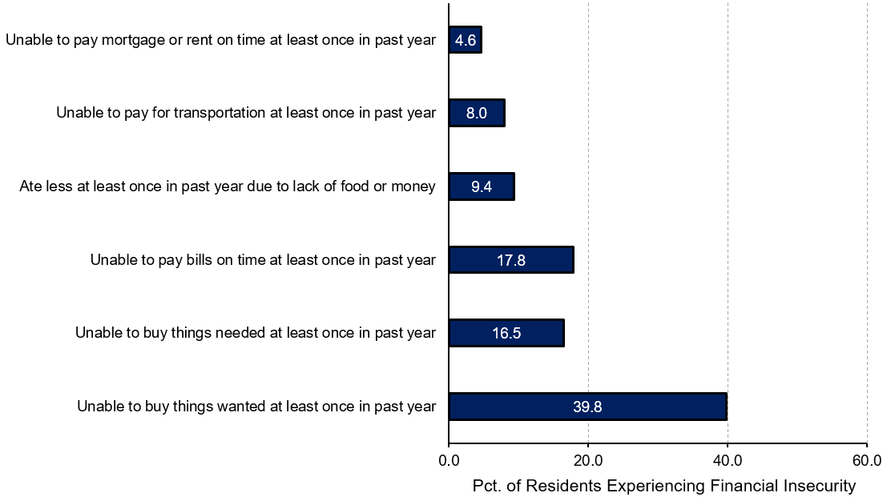
Overall Financial Insecurity
Notes:
Living Standards
“How many residents in Bruce and Grey Counties reported experiences of financial insecurity in the past year?”
Financial hardship means that people may have difficulty meeting their basic subsistence needs including food, shelter, and clothing. Without these essentials, access to other important areas of life such as transportation, leisure, and many social activities can be severely curtailed.
Residents living in Bruce and Grey Counties have the most financial insecurity related to not having enough money to buy things that are wanted, followed by not having enough money to pay their bills on time and to buy things that are needed. People residing in Bruce and Grey Counties experience less financial hardship in paying mortgage or rent on time.

Slide 33
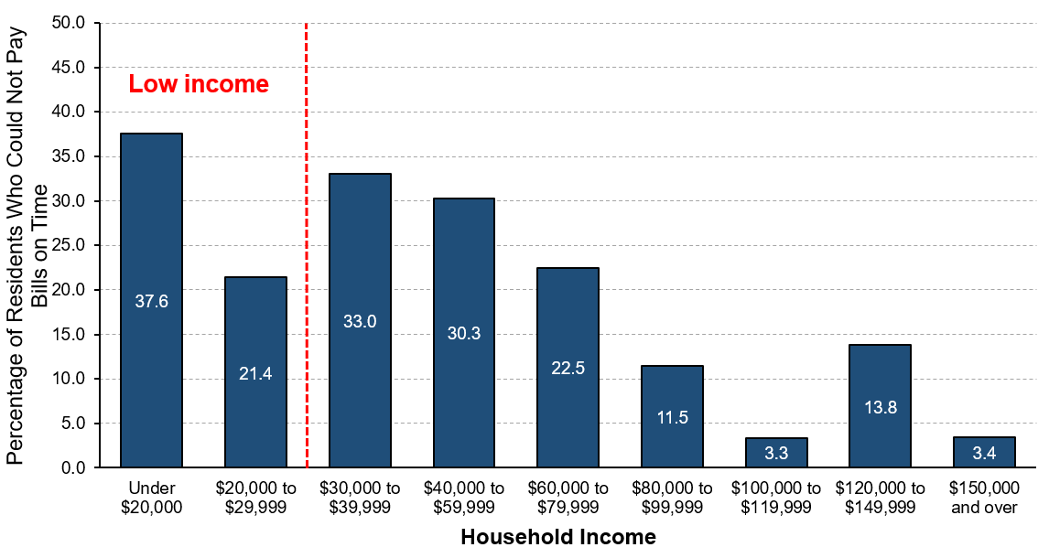
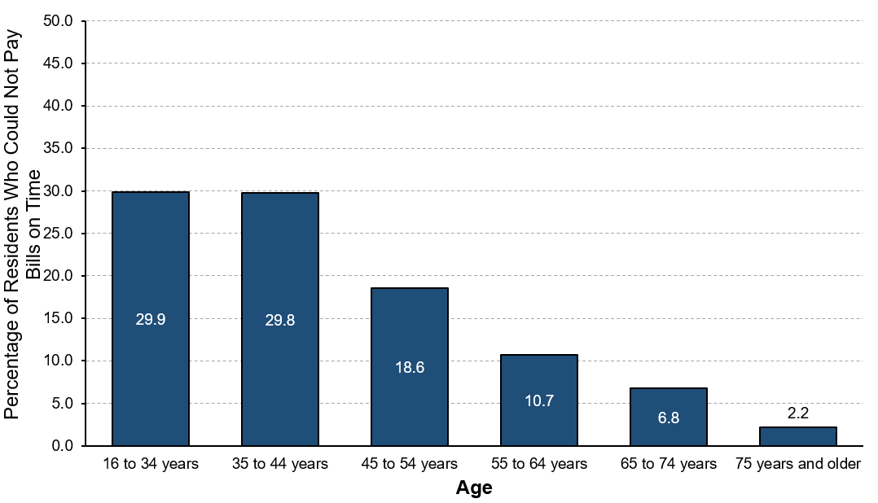
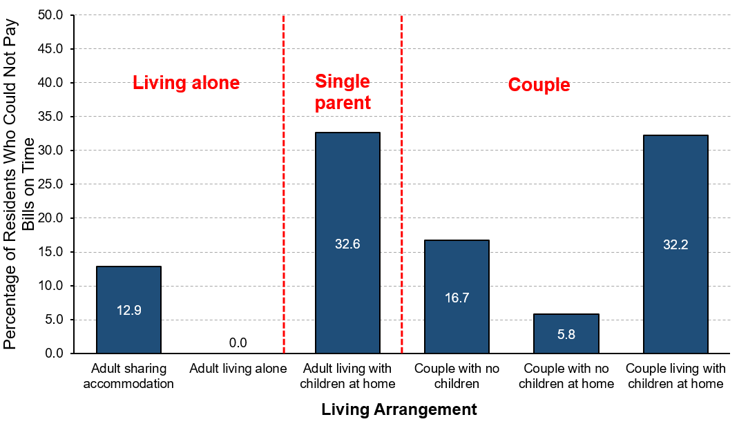
Financial Insecurity: Inability to pay bills on time
INCOME
AGE
LIVING ARRANGEMENT
Inability to pay bills on time is linked to:
Lower incomes;
Younger residents;
Single parent families
Couples living with children
Notes:
Living Standards
“How many residents in Bruce and Grey Counties reported being unable to pay bills in the past year?”
Income is related to ability to pay bills on time. As income increases, inability to pay bills decreases. In particular, people with annual household incomes under $10,000 experience the greatest difficulty in paying their bills on time. Notably, people living on household incomes of $30,000 to $39,999 and of $40,000 to $59,999 per year also report relatively higher percentages experiencing difficulties in paying bills on time.
Age is also related to the inability to pay bills. Older adults are the least likely to experience difficulty paying their bills on time. Young people (under 35 years) and middle age adults (35 to 44 years and 45 to 54 years) report relatively higher financial insecurity.
Households of one adult living with children at home (single parents) report the highest financial insecurity related to paying bills on time, followed by couples living with children at home. Adults living alone report a slightly lower financial security compared to couples. However, residents living alone report no difficulties in paying their bills on time.

Slide 34
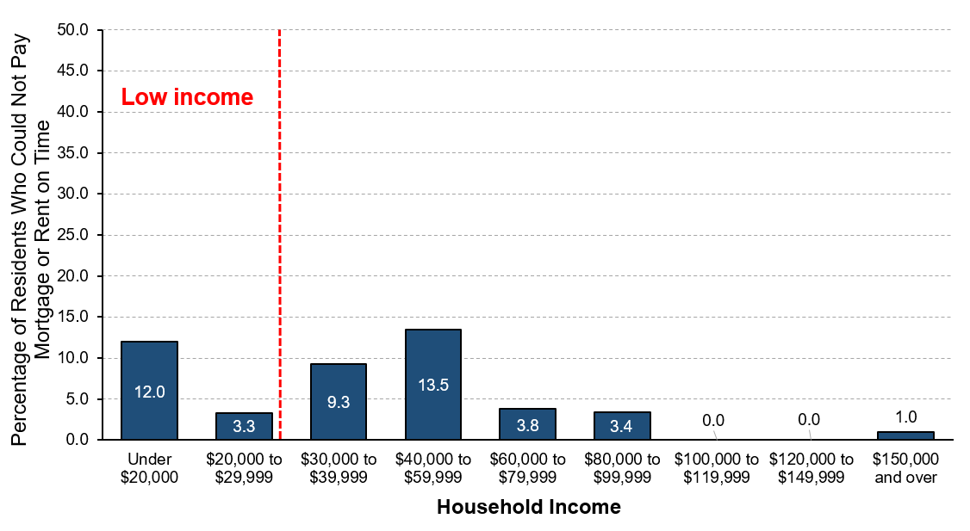
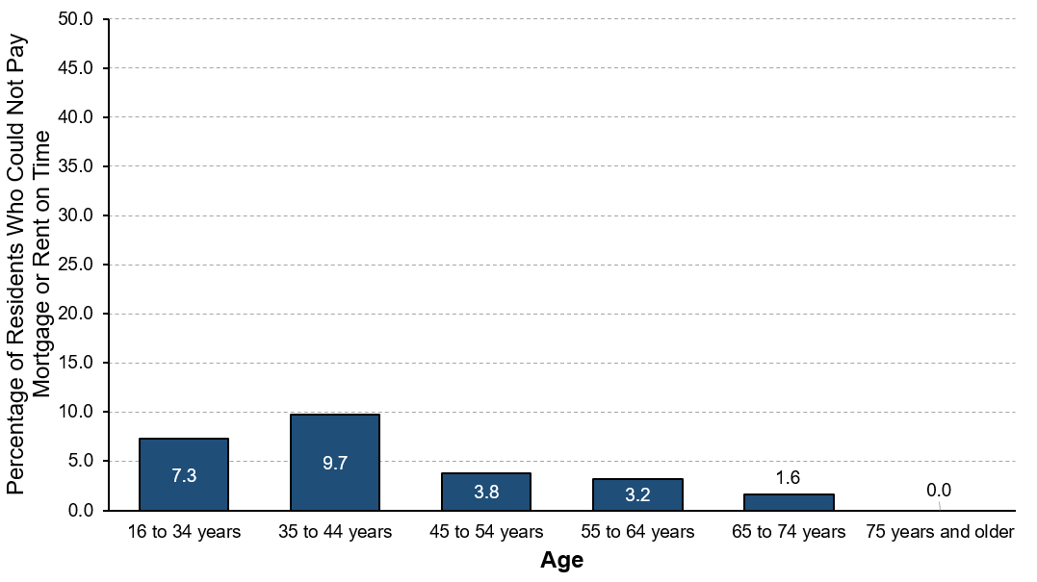
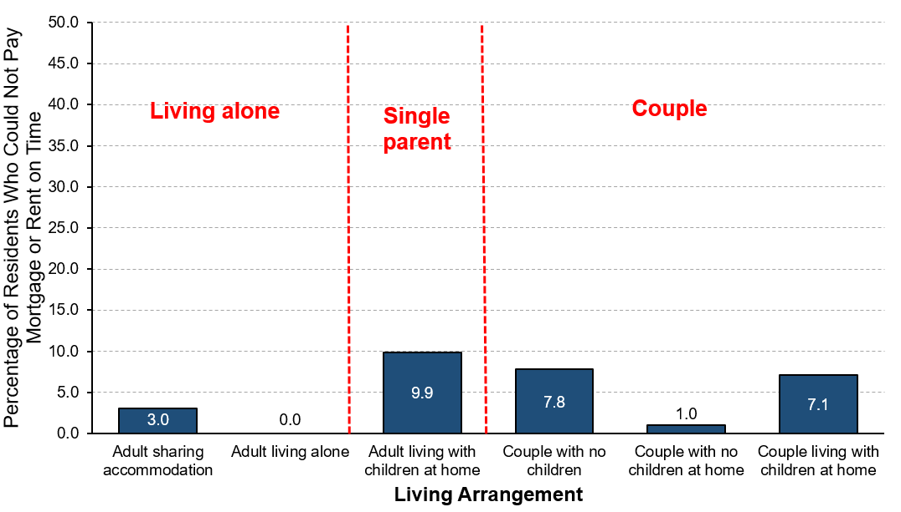
Financial Insecurity: Inability to pay mortgage/rent
INCOME
AGE
LIVING ARRANGEMENT
Inability to pay mortgage or rent on time is linked to:
Lower incomes
Younger residents
Single parent families
Notes:
Living Standards
“How many residents in Bruce and Grey Counties reported being unable to pay rent or mortgage in the past year?”
Income is directly related to ability to pay for housing with the lower income group, especially those living on incomes lower than $20,000 per year, experiencing the greatest difficulty in paying mortgage or rent on time. Notably, people living on household incomes of $30,000 to $39,999 and of $40,000 to $59,999 per year also report relatively higher percentages experiencing difficulties in paying their mortgage or rent.
Age is also related to the inability to pay for housing. Older adults are the least likely to experience difficulty paying mortgage or rent. Young people (under 35 years) and middle age adults (35 to 44 years and 45 to 54 years) have higher percentages of residents who could not pay for housing on time.
Households of one adult living with children (single parents) report the highest level of inability to pay their mortgage or rent on time, followed by households of couples with no children and couples living with children at home. However, residents living alone report experiencing no hardship paying for housing on time.

Slide 35
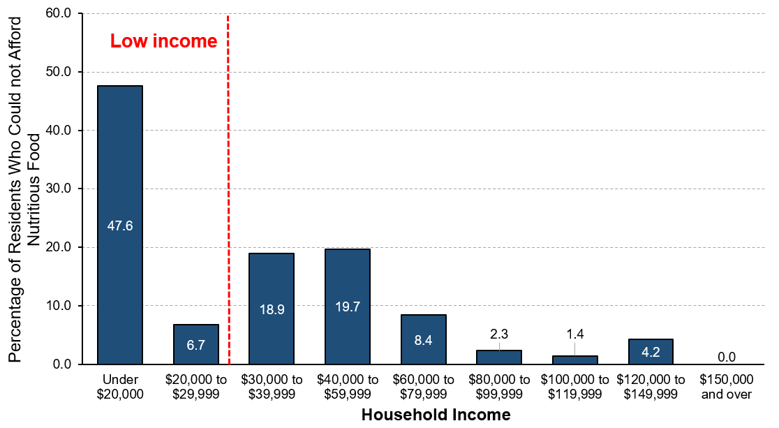
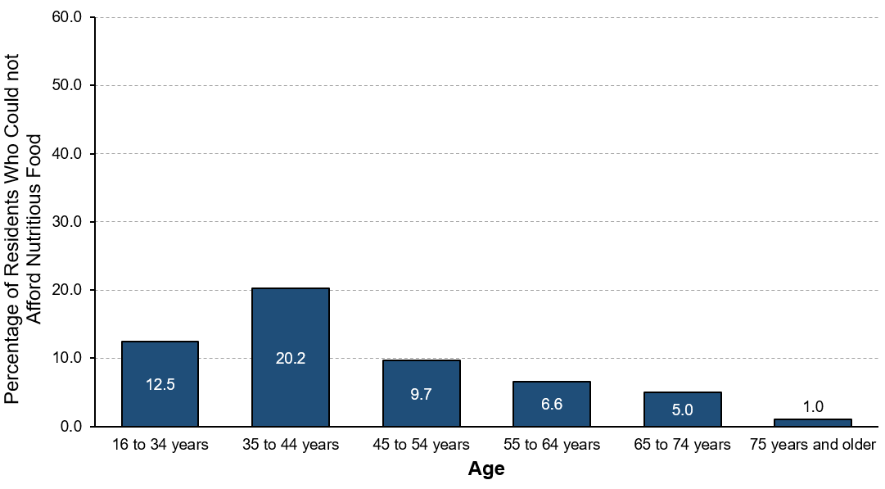
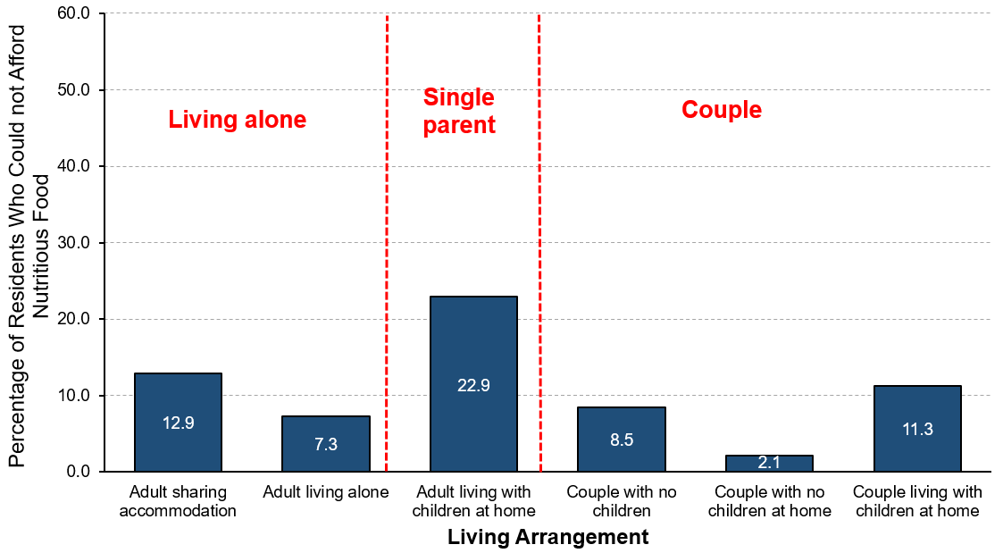
Financial Insecurity: Inability to purchase food
INCOME
AGE
LIVING ARRANGEMENT
Inability to purchase food is linked to:
Lower incomes
Younger residents
Single parent families
Notes:
Living Standards
“How many residents in Bruce and Grey Counties reported being unable to purchase food in the past year?”
Income is related to inability to pay for food with the lower income group, especially those living on incomes lower than $20,000 per year, experiencing the greatest difficulty in meeting their basic needs. Notably, people living on household incomes of $30,000 to $39,999 and of $40,000 to $59,999 per year also report relatively higher percentages experiencing difficulties in purchasing food.
Age is also related to the inability to meet basic financial needs. Older adults are the least likely to experience difficulty in buying food. People in middle age groups (35 to 44 years and 45 to 54 years) are the mostly likely to experience difficulty in purchasing food, followed by younger people (under 35 years).
Households with one adult living with children at home (single parents) are most likely to eat less due to lack of money to buy food (22.9%), followed by adults sharing accommodation with others (12.9%) and households of couples living with children (11.3%). In contrast, households of couples with no children at home report the lowest level of food security. Only 2.1% of couples with no children at home ate less or said they had no enough money for food in the past year.

Slide 36
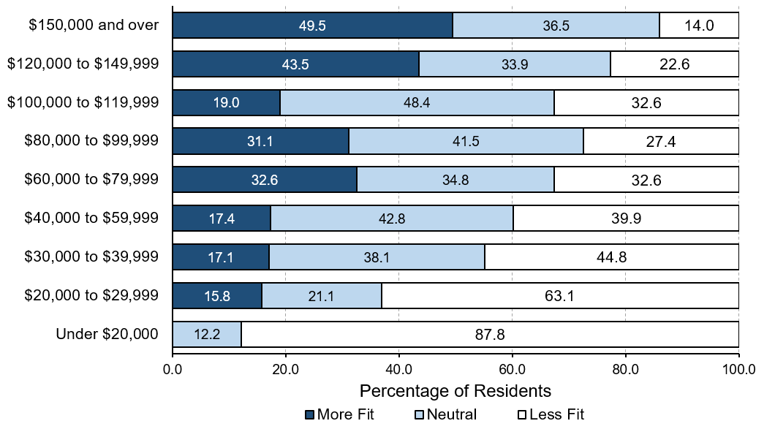
Job Fit by income
Notes:
Living Standards
“Is job fit related to household income?”
Income is associated with perceived job fit. As income increases, so does the percentage of people who agree that opportunities at work and income match their education and training.
Fewer people with an income under $20,000 per year agree that their opportunities at work match their education and training.
People with annual household incomes of $100,000 to $119,999 also are more likely to report a lower degree of job fit.

Slide 37
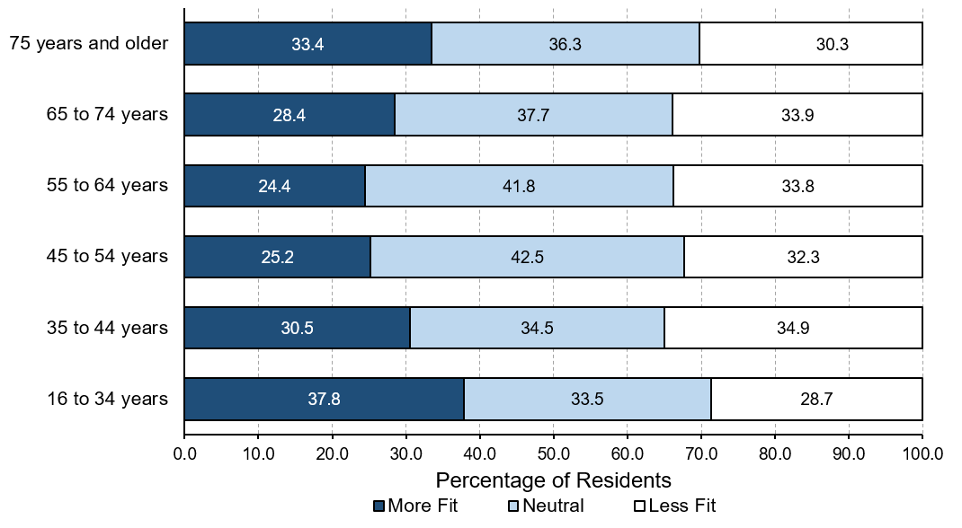
Job Fit by age
Notes:
Living Standards
“Is job fit related to age?”
For all age groups, the percentages of residents who report less job fit are all below 15%.
Comparatively, younger people (under 35 years) and older adults (75 years and older who are still working) are more likely to perceived a better job fit
About one-third of middle age workers (45 to 54 years and 55 to 64 years) feel that their job adequately reflects their efforts and achievements, while a slightly greater percentage of workers 35 to 44 years of age agreed.

Slide 38
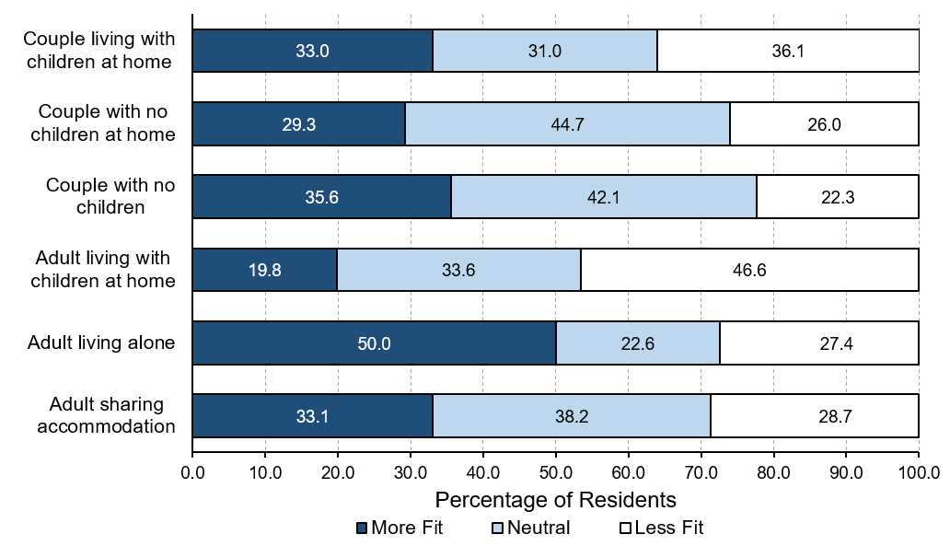
Job Fit by living arrangement
Notes:
Living Standards
“Is job fit related to living arrangement?”
Adults living alone are the most likely to agree that their job adequately reflects their efforts and achievements (50%).
There is a similar percentage of agreement among couples, regardless of whether they have children or live with their children, that their job is a good fit (between 29.3% to 35.6%).
Compared to households of couples, a lower percentage of households with one adult living with children at home (single parents) agree that opportunities at work are adequate and that their income adequately reflects their education and training (19.8%).

Slide 39
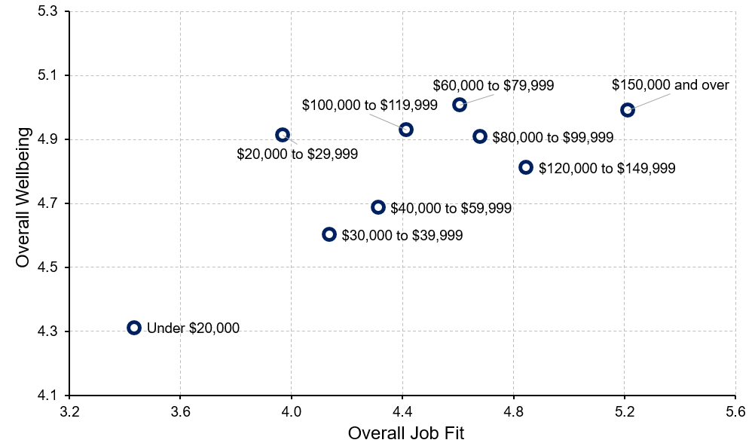
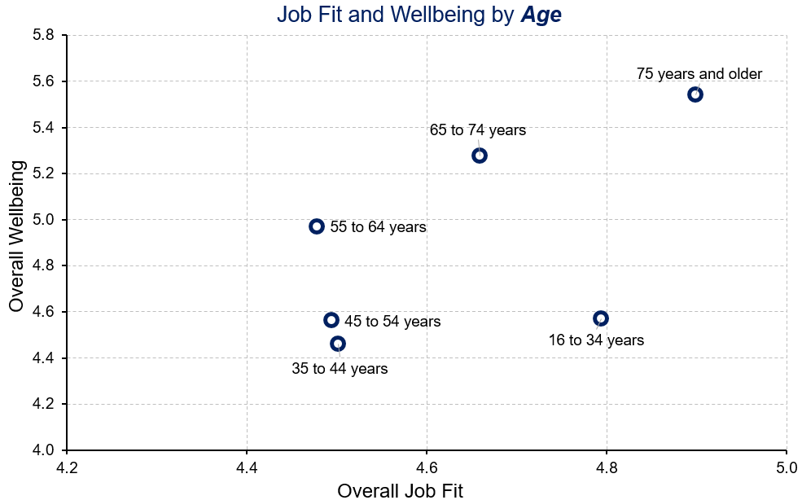
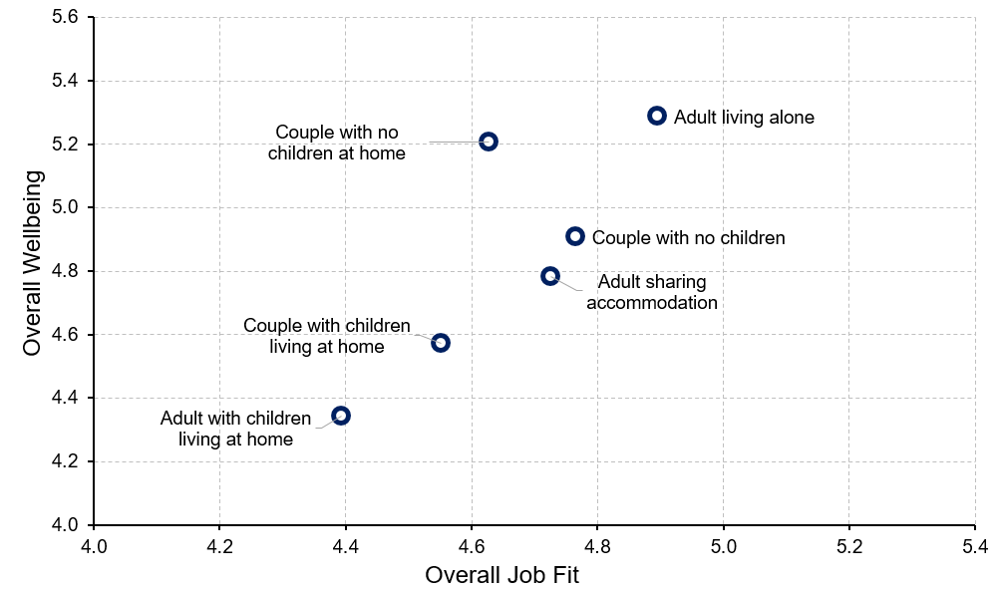
Job Fit and Overall Wellbeing
INCOME
AGE
LIVING ARRANGEMENT
A higher perceived job fit is related to higher overall wellbeing.
And is linked to:
Higher incomes
Older residents
Adults living alone
Notes:
Living Standards
“Is job fit related to overall wellbeing?”
A higher perceived job fit is related to higher overall wellbeing.
And is linked to:
Higher incomes; however, people with annual household incomes of $100,000 to $1199,999 report relatively lower job fit compared to their incomes. And interestingly, people with annual household incomes of $20,000 to $29,999 report somewhat lower job fit and significantly higher wellbeing.
Older adults (75 years and older); however, younger people (under 35 years) report a relatively higher job fit but their overall wellbeing is quite low.
Households of adults living alone

Slide 40
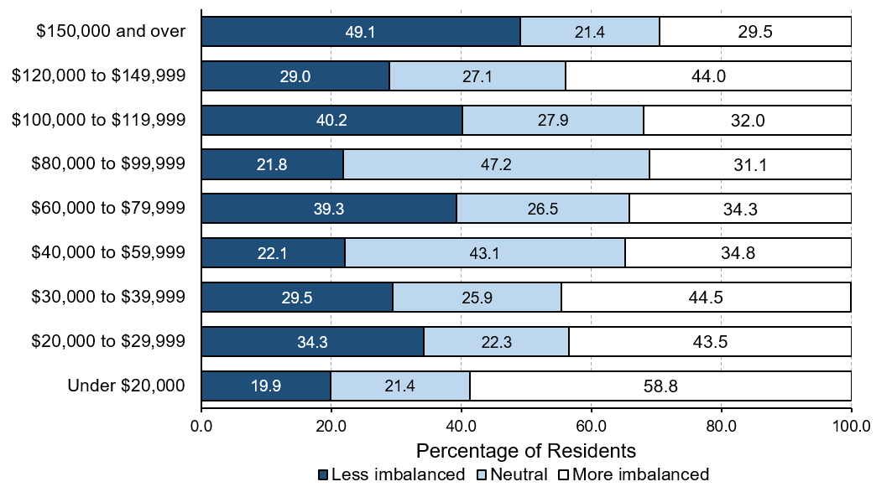
Work-Life Imbalance by income
Notes:
Living Standards
“Is work-life imbalance related to household income in Bruce and Grey Counties?”
Work-life imbalance is the most severe among residents with annual household incomes lower than $20,000. The highest percentage of residents in this lowest income group report greater work-life imbalance (58.8%).
People with annual household incomes in the four categories from $40,000 to $119,000 experiencing less work-life imbalance than residents in other income groups.
Although almost half of the people living on annual household incomes of $150,000 and over report less work-life imbalance (49.1%), there is still a considerable number of people (29.5%) experiencing more work-life imbalance.

Slide 41
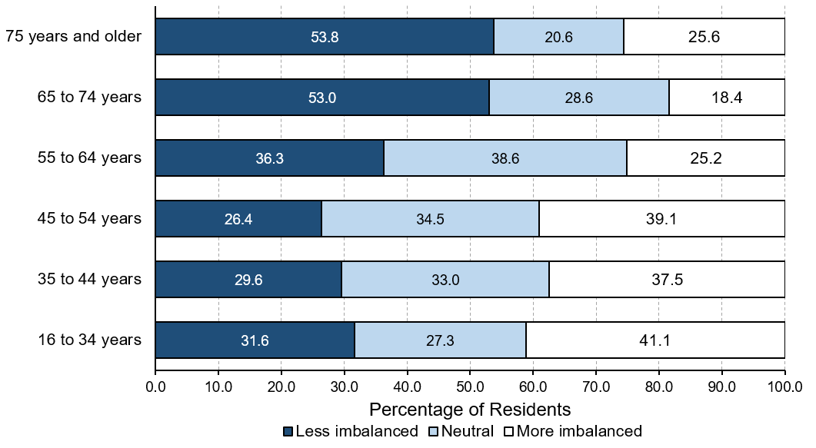
Work-Life Imbalance by age
Notes:
Living Standards
“Is work-life imbalance related to age in Bruce and Grey Counties?”
Work-life imbalance is most common among workers under 55 years of age, which corresponds to peak career years.
Much larger percentages of older residents who are still working – those 65 to 74 years (53.8%) and 75 years of age and older (53.0%) – have more work-life balance, probably because many of them have chosen to continue working.

Slide 42
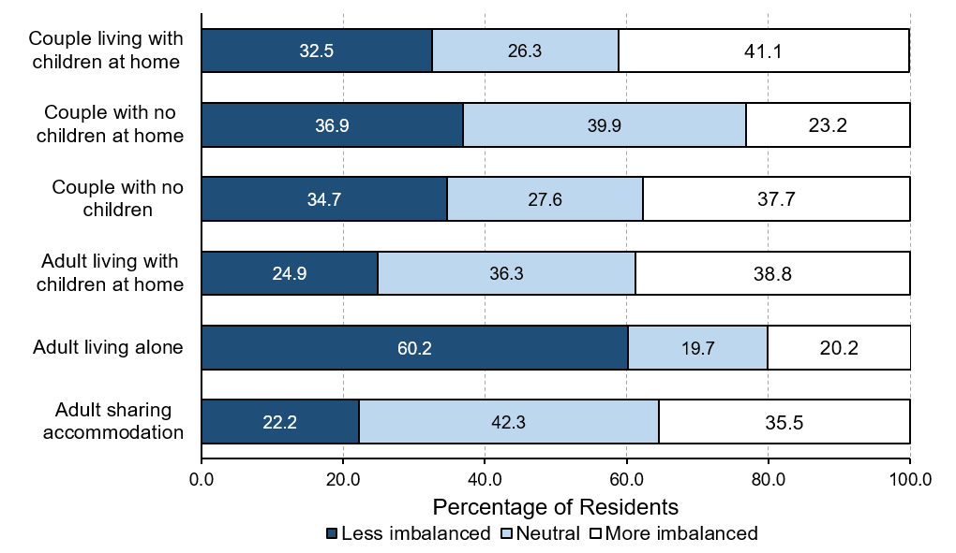
Work-Life Imbalance by living arrangement
Notes:
Living Standards
“Is work-life imbalance related to living arrangement?”
Work-life imbalance is the most severe among adults who share accommodation with others (22.2%).
Perhaps not surprisingly because of multiple demands on their time, households with one adult living with children at home (single parents) are less likely to experience work-life balance (24.9%) compared to people who have a partner.
Adults living alone experience significantly less work-life imbalance compared to other groups.

Slide 43
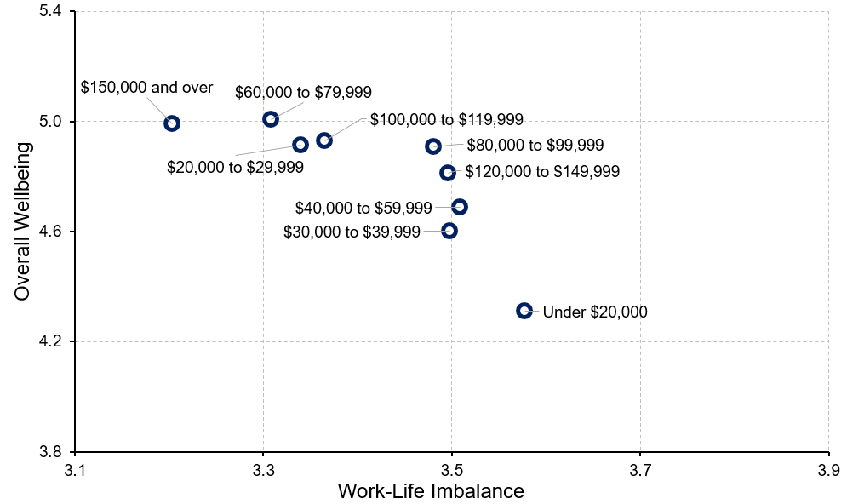
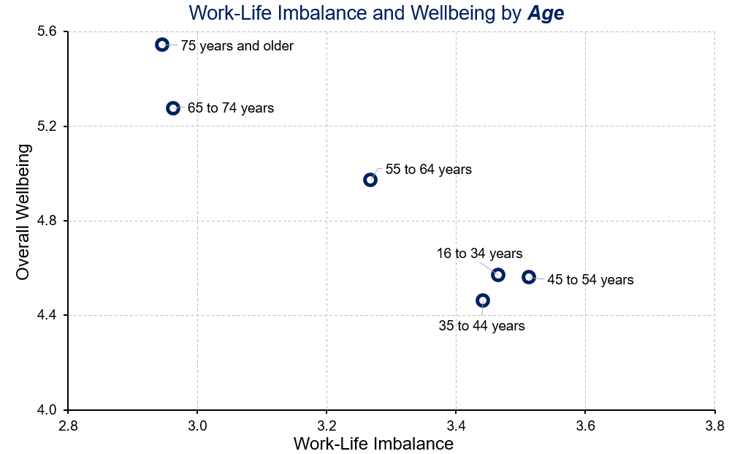
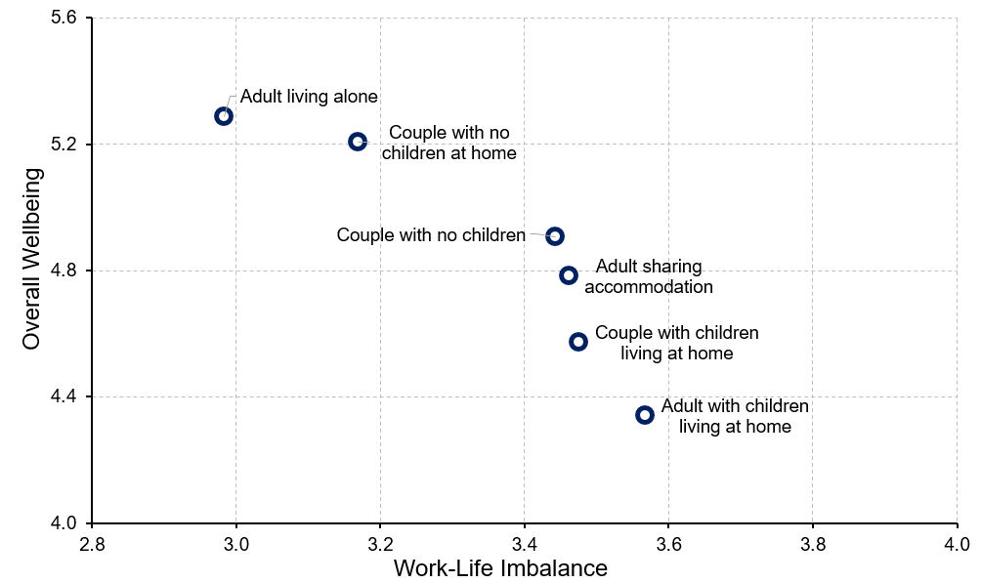
Work-Life Imbalance and Overall Wellbeing
INCOME
AGE
LIVING ARRANGEMENT
A higher perceived work-life imbalance is related to lower overall wellbeing.
And is linked to:
lower incomes
Younger residents
Single parent families
Notes:
Living Standards
“Is work-life imbalance related to overall wellbeing?”
Higher work-life imbalance is related to lower overall wellbeing.
And is linked to:
Lower incomes; however, people with annual household incomes of $120,000 to $149,999 report comparatively higher work-life imbalance and considerably lower wellbeing. In contrast, people with annual household incomes of $20,000 to $29,999 and of $60,000 to $79,999 report comparatively lower work-life imbalance and considerably higher wellbeing.
Younger residents (under 35 years) and mid-age adults (35 to 44 years and 45 to 54 years)
Adults with children living at home (single parents)

Slide 44
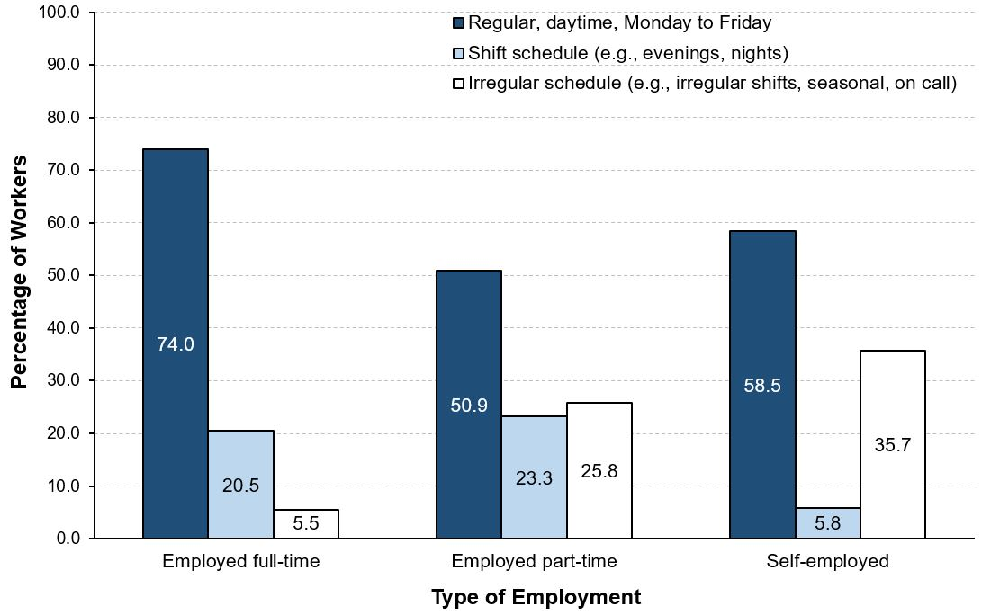
Living Standards
Is the type of employment linked to work schedules?
Notes:
Living Standards
“Is the type of employment linked to work schedules?”
Residents working full-time are more likely to have a regular, daytime job from Monday to Friday (74.0%). Regular schedules are available to about half of those people working part-time (50.9%).
Shift schedules are much more common to full-time workers (20.5%) and part-time workers (23.3%) than to self-employed residents (5.8%).
The nature of self-employment often means less regular schedules and more irregular schedules as workers take on jobs as they becomes available. Over a third of self-employed residents (35.7%) have such irregular schedules.

Slide 45

Healthy Populations
Notes:
Healthy Populations
The Healthy Populations domain considers the physical, mental, and social wellbeing of the population. It examines life expectancy, lifestyle and behaviours, and the circumstances that influence health such as access to health care.
Healthy populations captures both the overall health of the population (“health status”) as well as factors that influence health (“health determinants”). This broad perspective is used because peoples’ lifestyles and behaviours are constrained and shaped by broader social factors such as how food is distributed and priced, how houses are constructed and located, how urban transportation is designed, how easily people can access health care and recreational services, and how we interact with the natural environment.

Slide 46
How do residents with higher or lower wellbeing compare?
HEALTHY POPULATIONS and Wellbeing
Below average wellbeing
Above average wellbeing
Could not afford to pay for doctor prescribed medications
Could not afford to get dental care
Eat healthy meals less often
Get good quality exercise less often
Better self-rated physical health
Better self-rated mental health
Perceive quality of the health care services to be better
Perceive accessibility of the health care services to be better
Notes:
Healthy Populations
“How do residents with higher or lower wellbeing compare on healthy populations?”
Above average wellbeing group:
66.4% rate physical health as very good or excellent compared to 36.1% of people below average in wellbeing.
81.7% rate mental health as very good or excellent compared to 32.4% of people below average in wellbeing.
66.3% rate quality of health care services as very good or excellent compared to 26.9% of people below average in wellbeing.
51.9% rate access of health care services as very good or excellent compared to 22% of people below average in wellbeing.
Below average wellbeing group:
17.1 % could not afford to pay for doctor prescribed medications (2.6% for above average group)
32.6 % could not afford to get dental care (8.9% for above average group)
70.6% eat healthy meals more often (93.3% for above average group).
Less likely to get good quality exercise compared to people below average in wellbeing (58.4% and 82.7%, respectively)

Slide 47
How do women and men compare on healthy populations?
HEALTHY POPULATIONS and Wellbeing by sex
Women
Men
Better self-rated physical health
Could not afford to pay for doctor prescribed medications
Could not afford to get dental care
Perceive quality of the health care services to be better
Perceive access to the health care services to be better
Less likely to eat healthy meals
Over half of both women and men rate their mental health as very good or excellent.
Notes:
Healthy Populations
“How do women and men compare on healthy populations?”
Women:
More women rate physical health as very good or excellent than men do (54.7% and 40.2%, respectively).
11.8% could not afford to pay for doctor prescribed medications (4.3% for men).
22.4% could not afford to get dental care (14.4% for men).
Men:
The percentage of men who rate quality of health care services as very good or excellent (48.5%) is greater than the percentage for women (42.2%).
38.3% of men rate the access to health care services as very good or excellent, whereas only 32.1% of women do.
Men (79.9%) are likely to eat healthy meals regularly compared to women (83.4%).
Over half of both men (55.8%) and women (56.0%) rate their mental health as very good or excellent.

Slide 48
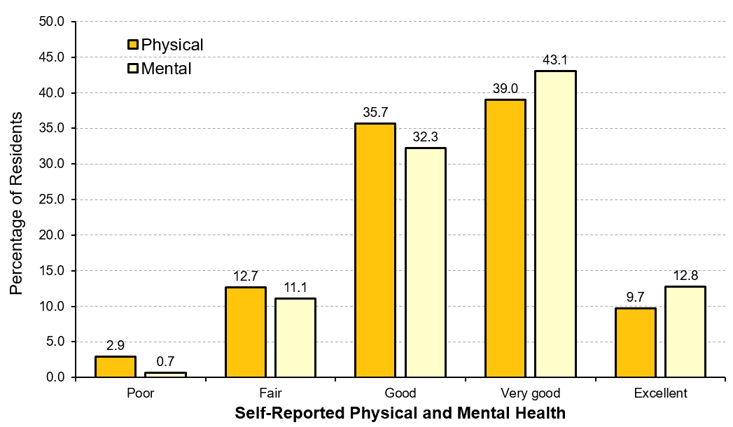
Physical and Mental Health in Bruce and Grey Counties
Notes:
Healthy Populations
“How do residents in Bruce and Grey Counties perceive their physical and mental health?”
Self-assessed health indicates how people themselves feel about their health rather than having a physician or other health care professional provide a separate assessment. Yet, self-assessed health generally corresponds well to objective assessments of health and wellbeing. The physical and mental health of people in the community is important to consider because healthier people enjoy a better quality of life and are more capable of participating in and contributing to family, community, economic, and other activities. Overall, a higher percentage of residents consistently rate mental health as very good or excellent more often than physical health, regardless of the demographic characteristic being considered.
More than half of the residents in Bruce and Grey Counties rate their mental health as very good or excellent (55.9%), while less than 12% rate their mental health as poor or fair (11.8%). In contrast, about half of residents rate their physical health as very good or excellent (48.7%), whereas less than 20% of residents rate their physical health either as poor or as fair (15.6%). In general, more residents rate their mental health as better than their physical health.
Note: The mean is based on a 5-point scale where 1 = poor and 5 = excellent.

Slide 49
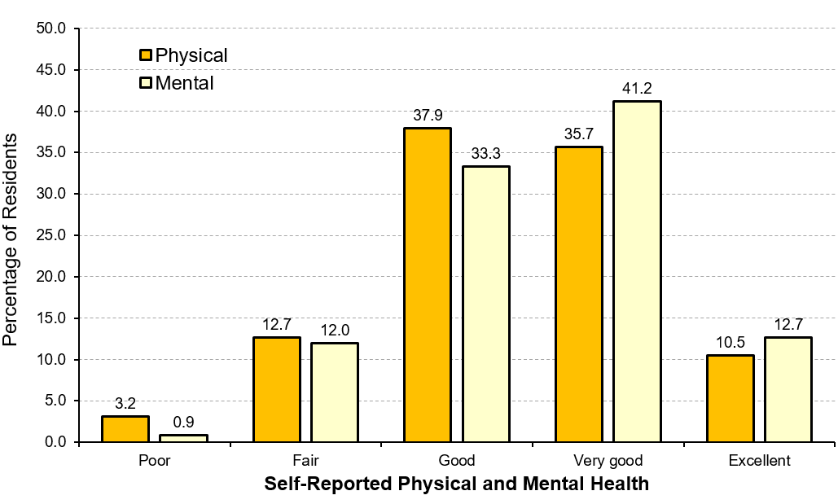
Physical and Mental Health in Bruce County
Notes:
Healthy Populations
“How do residents in Bruce County perceive their physical and mental health?”
More than half of residents in Bruce County rate their mental health as very good or excellent (53.9%), while less than 13% of them rate their mental health as poor or fair (12.9%).
Approximately half of residents in Bruce County rate their physical health as very good or excellent (46.2%), whereas less than 20% of residents rate their physical health either as poor or as fair (15.9%).
In general, more residents rate their mental health as better than their physical health.
Note: The mean is based on a 5-point scale where 1 = poor and 5 = excellent.

Slide 50
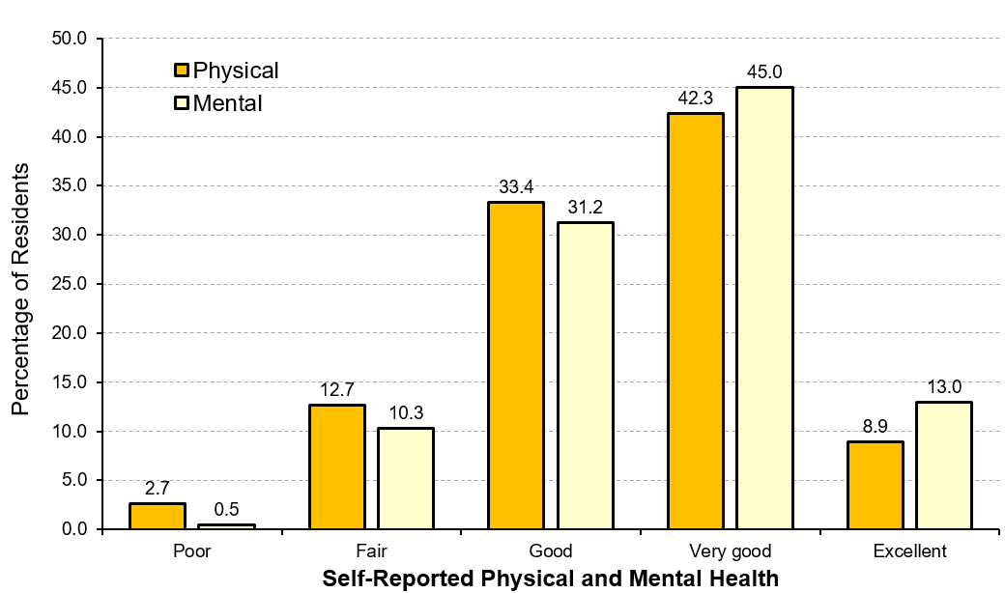
Physical and Mental Health in Grey County
Notes:
Healthy Populations
“How do residents in Grey County perceive their physical and mental health?”
More than half of residents in Grey County rate their mental health as very good or excellent (58.0%), while only about 10% of them rate their mental health as poor or fair (10.8%).
Slightly over half of residents rate their physical health as very good or excellent (51.2%), whereas less than 20% of residents rate their physical health either as poor or as fair (15.4%).
In general, more residents rate their mental health as better than their physical health.
Note: The mean is based on a 5-point scale where 1 = poor and 5 = excellent.

Slide 51
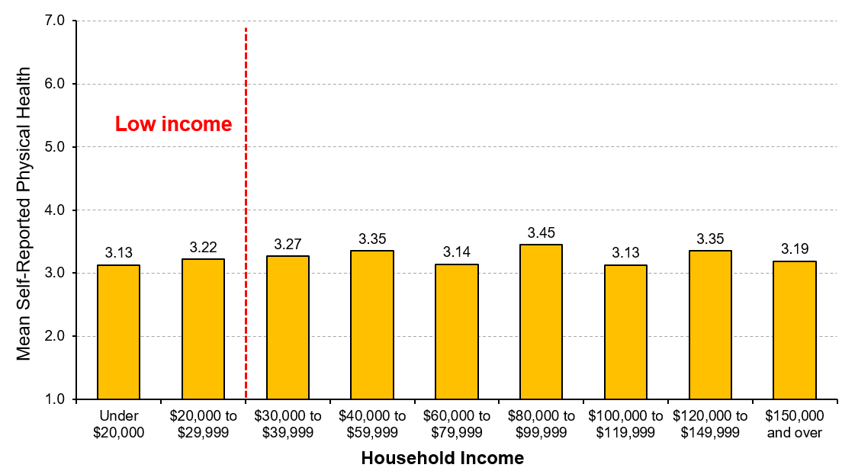
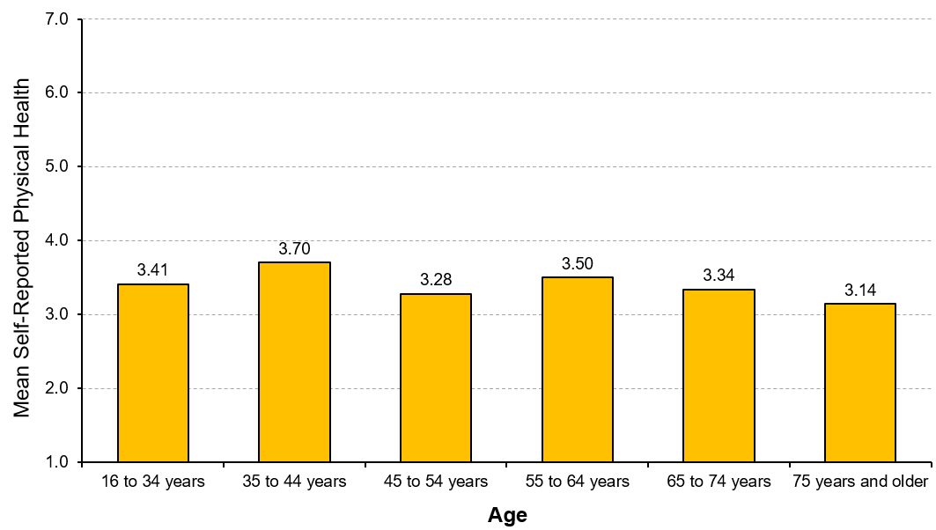
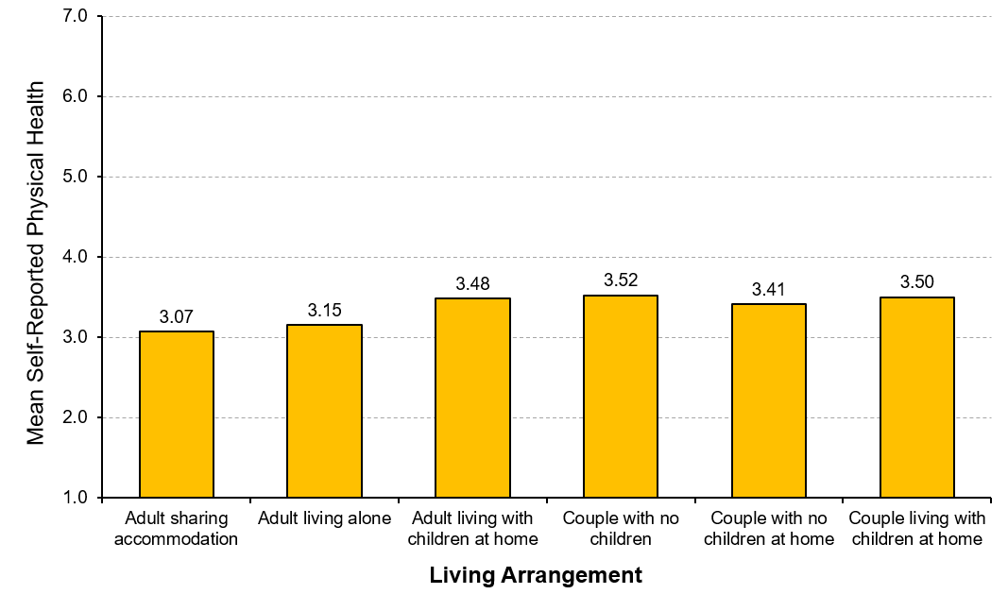
Physical Health in Bruce and Grey Counties
INCOME
AGE
LIVING ARRANGEMENT
Lower rated physical wellbeing is linked to:
Lower incomes
Older residents
Adults living alone or sharing accommodation with others
Notes:
Healthy Populations
“How do residents in Bruce and Grey Counties report their physical health?”
There is little relationship between income level and self-assessed physical health. People with annual household incomes of $80,000 to $99,999 have the highest ratings of self-assessed physical health. In contrast, people living on household incomes lower than $10,000 per year have the lowest ratings of physical health.
Levels of self-assessed physical health are lower amongst older adults (65 to 74 years and 75 years and older). Ratings of physical health are highest among people who are in the age group 35 to 44 years, followed by people who are 55 to 64 years of age.
Levels of self-assessed physical health are higher amongst households of couples (living with or without children, having no children) and households of single parents (adult living with children at home). Physical health is reported lowest by people who share accommodation with others or who live alone.
Note: The mean is based on a 5-point scale where 1 = poor and 5 = excellent.

Slide 52



Physical Health and Overall Wellbeing
INCOME
AGE
LIVING ARRANGEMENT
A lower self-reported physical wellbeing is related to lower overall wellbeing.
And is linked to:
Lower incomes
Mid-age residents
Notes:
Healthy Populations
“Is physical health related to overall wellbeing?”
Overall, lower self-reported physical health is related to lower overall wellbeing.
And is linked to:
Lower incomes (under $20,000); however, people with annual household incomes of $100,000 to $119,999 also report relatively low physical health compared to their incomes. In contrast, people with annual household incomes of $60,000 to $79,999 report comparatively higher physical health and significantly higher wellbeing. Interestingly, people with annual household incomes of $20,000 to $29,999 report higher overall wellbeing despite lower self-reported physical health.
Middle-age adults (45 to 54 years) report both lower physical health and overall wellbeing than any other age group. Older adults (65 years and over) report much higher overall wellbeing despite lower self-rated physical health.
No clear pattern regarding living arrangement is evident; however, households with one adult with children living at home (single parents) report significantly lower overall wellbeing despite their better self-reported physical health.
Note: The mean is based on a 5-point scale where 1 = poor and 5 = excellent.

Slide 53



Mental Health in Bruce and Grey Counties
INCOME
AGE
LIVING ARRANGEMENT
Lower rated mental wellbeing is linked to:
Lower incomes
Younger and middle-aged residents
Adults sharing accommodation with others
Notes:
Healthy Populations
“How do residents in Bruce and Grey Counties report their mental health?”
People with lower incomes, especially those living on annual household incomes under $30,000, report notably lower mental health.
Older people report higher self-assessed mental health. In contrast, younger and middle age adults rate their mental health as slightly lower.
Couples with no children and couples with no children at home report the highest level of mental health (mean=3.71 and 3.69, respectively). In contrast, adults sharing accommodation with others report the lowest level of mental health (mean=3.31). Comparatively, self-assessed mental health is higher among households of couples with no children at home, followed by households of people living with children, and households of adults living alone.
Note: The mean is based on a 5-point scale where 1 = poor and 5 = excellent.

Slide 54



Mental Health and Overall Wellbeing
INCOME
AGE
LIVING ARRANGEMENT
A lower self-reported mental wellbeing is related to lower overall wellbeing.
And is linked to:
Lower incomes
Younger residents
Single parent families
Notes:
Healthy Populations
“Is mental health related to overall wellbeing?”
Lower self-reported mental wellbeing is related to lower overall wellbeing.
And is linked to:
Lower incomes (under $20,000); however, people with annual household incomes of $120,000 to $149,999 also report relatively low mental health and overall wellbeing compared to their incomes. In contrast, people with annual household incomes of $60,000 to $79,999 report comparatively higher physical health and significantly higher wellbeing. Interestingly, people living on household incomes of $20,000 to $29,999 per year report relatively high overall wellbeing despite their notably low mental health.
Younger people (under 35 years) and mid-age adults (35 to 54 years) report lower mental health and overall wellbeing than any other age group.
Households of one adult with children living at home (single parents)
Note: The mean is based on a 5-point scale where 1 = poor and 5 = excellent.

Slide 55

Health Care Services in Bruce and Grey Counties
Notes:
Healthy Populations
“How do residents in Bruce and Grey Counties perceive the quality and accessibility of health care services?”
Canadians place a high value on a universal, publically funded and administered health care system. An important part of that system is providing high quality services so that people can feel confident they will received the best possible care from health care professionals in their community.
Access to health care services in the community is an essential component of quality of life because it allows people to address their health needs locally. These needs can range from regular check-ups, to ongoing care of chronic or episodic illness, to supporting maternal and infant health, and to emergency services and palliative care.
Over 40% of the residents in Bruce and Grey Counties rate the quality of health care services as very good or excellent (44.8%), while 21.7% of residents rate it as either poor or fair. Conversely, about a third of the residents feel that access to health care services is very good or excellent (34.6%), while 31.1% of residents rate it as either poor or fair. In general, most residents feel that the overall quality of health care services is better than their access to them.

Slide 56

Health Care Services in Bruce County
Notes:
Healthy Populations
“How do residents in Bruce County perceive the quality and accessibility of health care services?”
Over 40% of the residents in Bruce County rate the quality of health care services as very good or excellent (43.5%). Conversely, less than 30% of residents feel that access to health care services is very good or excellent (29.6%).
In general, most residents feel the overall quality of health care services is better than their access to them.

Slide 57

Health Care Services in Grey County
Notes:
Healthy Populations
“How do residents in Grey County perceive the quality and accessibility of health care services?”
Approximately half of the residents in Grey County rate the quality of health care services as very good or excellent (46.1%). Similarly, about 40% of residents feel that access to health care services is very good or excellent (39.7%).
In general, most residents feel the overall quality of health care services is better than their access to them.

Slide 58



Quality of Health Care Services in Bruce and Grey Counties
INCOME
AGE
LIVING ARRANGEMENT
Lower perceived quality of health care services is linked to:
Lower incomes
Middle-aged residents
Adults sharing accommodation with others
Notes:
Healthy Populations
“How do residents in Bruce and Grey Counties perceive the quality of health care services?”
There appears to be little differences in perceived quality of health care services based on age, although perceived quality does edge slightly upwards among older residents.
Lower income residents perceive the quality of health care services as generally lower when compared to middle and upper income groups. However, people with annual household incomes of $60,000 to $79,999 and $100,000 to $119,999 also rate quality of health care services as lower than other groups.
Households of adults living alone rate the quality of health care services as the highest (mean=3.36), followed by households of couples with no children at home (mean=3.38). Conversely, households of adults sharing accommodation with others rate the quality of health care services as the lowest (mean=2.84).
Note: The mean is based on a 5-point scale where 1 = poor and 5 = excellent.

Slide 59



Quality of Health Care and Overall Wellbeing
INCOME
AGE
LIVING ARRANGEMENT
A higher perceived quality of health care services is related to higher overall wellbeing.
And is linked to:
Older residents
Couple with no children at home
Adults living alone
Notes:
Healthy Populations
“Is perceived quality of health care services related to overall wellbeing?”
A higher perceived quality of health care services is related to higher overall wellbeing.
And is linked to:
No clear pattern with income; however, along with people living on annual incomes of under $20,000, people with annual household incomes of $100,000 to $119,999 and of $150,000 and over rate the quality of health care services significantly lower. Interestingly, people living on household incomes of $20,000 to $29,999 per year rate the quality of health care services quite low but report their overall wellbeing as significantly high.
Older residents
Households of couples with no children at home and adults living alone
Note: The mean is based on a 5-point scale where 1 = poor and 5 = excellent.

Slide 60



Accessibility of Health Care Services in Bruce and Grey Counties
INCOME
AGE
LIVING ARRANGEMENT
Lower perceived accessibility of health care services is linked to:
Lower incomes
Younger and middle-aged residents
Adults sharing accommodation with others
Notes:
Healthy Populations
“How do residents perceive the accessibility of health care services?”
Perceived access to health care services is the lowest among people with annual household incomes lower than $20,000. Upper income groups ($150,000 and over) also rate the access to health care services notably lower.
Perceived access to health care services generally increases with age, with the exception of the 45 to 54 years of age group. Older adults (75 years and older) report the highest ratings of access to health care services, whereas younger people (under 35 years) report the lowest.
The highest rating of access to health care services is reported by households of adults living alone (mean=3.22). In contrast, households of adults sharing accommodation with others rate the access to health care services as the lowest (mean=2.88).
Note: The mean is based on a 5-point scale where 1 = poor and 5 = excellent.

Slide 61



Accessibility of Health Care and Overall Wellbeing
INCOME
AGE
LIVING ARRANGEMENT
A higher perceived accessibility of health care services is related to higher overall wellbeing.
And is linked to:
Older residents
Adults living alone
Notes:
Healthy Populations
“Is accessibility of health care services related to overall wellbeing?”
A higher perceived accessibility of health care services is related to higher overall wellbeing.
And is linked to:
No clear pattern is apparent for income; however, along with people living on annual incomes of under $20,000, people with annual household incomes of $100,000 to $119,999 and of $150,000 and over rate the access to health care services significantly lower. In contrast, people with annual household incomes of $20,000 to $29,999 rate the access to health care services and overall wellbeing relatively high.
Older residents (75 years and older). Mid-age adults (45 to 54 years of age) rate the accessibility of health care services and overall wellbeing significantly lower than any other age group.
Households in which an adult is living alone.
Note: The mean is based on a 5-point scale where 1 = poor and 5 = excellent.

Slide 62

EDUCATION
Notes:
Education
Education is the systematic instruction, schooling, or training given to the young in preparation for the work of life, and by extension, similar instruction or training obtained in adulthood.
Societies that thrive encourage a thirst for knowledge – at every age and stage of life. Education is a process that begins before school age and is reflected in pre-school arrangements such as child care and early childhood education. Children are born ready to learn – the experiences and relationships in the years leading up to school age influence the capacity for learning. It also continues beyond elementary and high school, to college, university, and professional training through apprenticeships. Education continues as lifelong learning. As the world changes, education helps Canadians adapt to new challenges.

Slide 63
How do residents with higher or lower wellbeing compare?
EDUCATION and Wellbeing
Below average wellbeing
Above average wellbeing
More likely to have taken courses to improve skills or qualification for current job
Courses seen as too expensive
Courses seen as offered at inconvenient times
Higher perceived availability of formal education opportunities
Higher perceived availability of courses for interest
Less likely to have taken courses to get started or prepare for job
Both groups have taken courses for interest in the community or online.
Notes:
Education
“How do residents with higher or lower wellbeing compare on education?”
Above average wellbeing group:
46.6% agree that opportunities are adequate for formal education (24.3% for below average group)
44.2% agree that there are schools nearby to upgrade their educational qualifications (25.9% for below average group)
55.4% agree that there are plenty of opportunities to courses for interest (29.6% for below average group)
51.8% agree that there are places nearby to take courses for interest (28.2% for below average group)
6% have taken formal education courses to get started in their current or a new job (12% for below average group)
9.2% have taken formal education courses to prepare for a job they might do in the future (18.1% for below average group)
Below average wellbeing group:
26.6% take formal education courses to improve their skills in their current job (14.2 % for above average group)
19.6% take formal education courses to lead directly to a qualification related to their current job (8.4% for above average group)
39.6% agree courses are too expensive (9.4% for above average group).
28.3% think courses are offered at inconvenient times (9.9% for above average group).

Slide 64
How do women and men compare on education domain?
EDUCATION and Wellbeing by sex
Women
Men
More likely to take formal education courses to improve skills for current job
More likely to take courses for interest in community or online
Courses seen as too expensive
Courses seen as offered at inconvenient times
Higher perceived availability of formal education opportunities
Higher perceived availability of courses for interest
Less likely to have taken courses to get started or prepare for job
Notes:
Education
“How do women and men compare on education?”
Women:
25.5% take formal education courses to improve their skills in their current job (21.2% for men)
20.4% have taken courses for interest in community or online (11.5% for men)
29.4% agree courses are too expensive (15.7% for men).
19.7% think courses are offered at inconvenient times (13.3% for men).
Men:
40.1% agree that opportunities are adequate for formal education (31.5% for women)
37.3% agree that there are schools nearby to upgrade their educational qualifications (31% for women)
46% agree that there are plenty of opportunities to courses for interest (39.9% for women)
42.4% agree that there are places nearby to take courses for interest (40.6% for women)
12.9% take formal education courses to prepare for a job they might do in the future (15.4% for women)
8.6% take formal education courses to get started in their current or a new job (13.3% for women)

Slide 65

Taking Courses in Bruce and Grey Counties
Notes:
Education
“What are the reasons residents in Bruce and Grey Counties take formal education courses?”
Overall, there are differences with respect to the reasons for taking courses for formal education. Residents living in Bruce and Grey Counties are more likely to take courses to improve skills for their current job (23.7%), followed by taking courses for a qualification related to the current job (17.7%).
The residents are least likely to take formal education courses to get started in a current or new job (11.4%).

Slide 66



Taking Courses for Interest
INCOME
AGE
LIVING ARRANGEMENT
Taking courses for interest is not strongly related to:
Income
Age
Living arrangement
Notes:
Education
“What are the characteristics of people taking courses for interest in Bruce and Grey Counties?”
There appears to be little direct association between income and taking courses for interest. People with annual household incomes of $60,000 to $79,999 are the most likely to take courses for interest (21.8%), followed by those with annual household incomes of $10,000 to $19,999 (20.3%). In contrast, people living on household incomes of $30,000 to $39,999 per year are the least likely to take courses for interest (10.4%).
There is also little association between age and taking courses for interest. People in the 55 to 64 years of age group are the most likely to take courses for interest (19.6%), followed closely by people in the 65 to 74 year of age group (18.2%). However, older adults (75 years and older) are less likely to take courses for interest.
Households of couples with no children are more likely to take courses for interest (21.6%), followed by those adults living alone (20.1%). These groups might identify taking courses for interest as good opportunities to get to know others who share the same interests. Conversely, single adults living with children at home (single parents) are less likely to take courses for interest (13.5%) compared to other groups.

Slide 67

Educational Opportunity in Bruce and Grey Counties
Notes:
Education
“How do residents perceive educational opportunities in Bruce and Grey Counties?”
Having access to educational opportunities, like formal courses, allows people to improve existing or acquire new job skills that can lead directly to qualifications enabling career opportunities. Interest courses are an important component of lifelong learning that can enhance leisure experiences and contribute to ongoing intellectual development and knowledge acquisition.
Residents living in Bruce and Grey Counties report the highest agreement that there are places nearby to take courses out of interest. In addition, they are more likely to agree that there are plenty of opportunities to take courses for interest in their counties. Conversely, residents also report a relatively high agreement that courses are offered at inconvenient times as well as are too expensive.
Note: The mean is based on a 7-point scale where higher scores reflect greater agreement.

Slide 68

Educational Opportunity by income
Notes:
Education
“How do residents with different household incomes perceive the educational opportunities in Bruce and Grey Counties?”
A relationship is evident between income and the perceived barrier of to educational opportunities due to cost. Lower income residents found that cost prevents their participation more than middle or upper income residents.
Having educational opportunities for interest courses at places nearby does not appear to be related to income. The highest level of agreement is among people with household incomes from $20,000 to $29,999 and from $30,000 to $39,999.
People with lower incomes generally agree more that courses are being offered at inconvenient times. In particular, people living on household incomes under $20,000 per year and from $30,000 to $39,999 see the timing of course offerings as most inconvenient.
Note: The mean is based on a 7-point scale where higher scores reflect greater agreement.

Slide 69

Educational Opportunity by age
Notes:
Education
“How do residents at different ages perceive the educational opportunities in Bruce and Grey Counties?”
Perceiving cost as a barrier to educational opportunities declines with age. Older adults report agree less often that cost prevents their participation. In contrast, younger people (under 35 years of age) agree that the cost of programs limits their participation.
Age and agreeing there are places nearby to take courses for interest are linked. People under the age of 55 years are less likely to perceive educational opportunities nearby, but after 55 years, more opportunities to take interest courses are perceived to be available nearby as people get older.
People 35 to 44 years of age agree most that courses are offered at inconvenient times, followed by people 45 to 54 years of age. In contrast, older adults (65 to 74 years and 75 years and older agree less often that courses are offered at inconvenient times.
Note: The mean is based on a 7-point scale where higher scores reflect greater agreement.

Slide 70

Educational Opportunity by living arrangement
Notes:
Education
“How do residents with different living arrangements perceive the educational opportunities in Bruce and Grey Counties?”
Adults living with children at home (single parents) are more likely to agree that courses are too expensive, followed by households of couples living with children at home.
There is a considerable difference among different household types concerning the convenience of courses with single parent families reporting significantly higher level of agreement that courses are offered at inconvenient times.
People who live alone agree more that there are places nearby to take courses for interest, while couples living with children at home and couples having no children are less likely to agree that plenty of interest courses are available in the community.
Note: The mean is based on a 7-point scale where higher scores reflect greater agreement.

Slide 71



Educational Opportunity and Overall Wellbeing
INCOME
AGE
LIVING ARRANGEMENT
Higher level of perceived educational opportunities is related to higher overall wellbeing
And is linked to:
Higher incomes
Older residents
Adults living alone
Notes:
Education
“Is perception of educational opportunities related to overall wellbeing?”
Higher level of perceived educational opportunities is related to higher overall wellbeing.
And is linked to:
Higher incomes; however, people with annual household incomes of $20,000 to $29,999 also report significantly higher perceived educational opportunities and overall wellbeing. Conversely, residents living on household incomes of $120,000 to $149,999 per year perceive educational opportunities notably low compared to their incomes.
Older residents (65 years and older). Younger people (under 35 years) and early mid-age adults (35 to 44 years) report significantly lower perceived educational opportunities and overall wellbeing.
Adults living alone.
Note: The mean is based on a 7-point scale where higher scores reflect greater agreement.

Slide 72

ENVIRONMENT
Notes:
Environment
The environment is the foundation upon which human societies are built and the source of our sustained wellbeing. On a broader level, environmental protection involves the prevention of waste and damage while revitalizing our ecosystems and working towards the sustainability of all of our natural resources.
The environment is the basis for our health, our communities, and our economy. Despite its fundamental importance to human existence and the natural resource wealth it provides to Canada, we often fail to appreciate the various ecosystem services provided by nature that sustain human wellbeing. Indeed, our wellbeing is influenced directly by the quality of our air, soil, and water.

Slide 73
How do residents with higher or lower wellbeing compare?
ENVIRONMENT and Wellbeing
Below average wellbeing
Above average wellbeing
Perceive air quality and water quality as lower
Perceive traffic congestion as worse
Less likely to conserve energy or water
Less likely to purchase local food
Less likely to walk or bike
Perceive quality of nature environment as higher
See more opportunities to enjoy nature in community and in neighbourhood
More likely to reuse and recycle materials, and to reduce and separate waste
More likely to participate in events to protect the natural environment
Notes:
Environment
“How do residents with higher or lower wellbeing compare on the environment?”
Above average wellbeing group:
92.2% agree that the quality of the natural environment in their neighbourhood is very high (78.8% for below group); 92.5% agree that the quality of the natural environment in their community is very high (81.1% for below group).
96.1% agree there are plenty of opportunities to enjoy nature in their community (83.8% for below group); 97.6% agree there are plenty of opportunities to enjoy nature in their neighbourhood (88.1% for below group).
68.1% reuse materials (58.6% for below group), 91.2% recycle materials (83.3% for below group), 80.2% reduce waste (64.2% for below group), 67.7% separate waste (57.4% for below group) very often or all of the time.
22.4% participate in events organized by local groups to protect the natural environment (13.8% for below group).
Below average wellbeing group:
27.1% agree traffic congestion is a problem (18.9% for above group).
80.8% are satisfied with air quality (93% for above group); 72.4% are satisfied with water quality (90% for above group).
73.7% conserve energy (89.3% for above group), 61.8% conserve water (75.3% for above group) very often or all of the time.
17.2% walk or bike more often (30.5% for below group).
41.3% purchase foods locally very often or all of the time (49.5% for above group).

Slide 74
How do women and men compare on environment domain?
ENVIRONMENT and Wellbeing by sex
Women
Men
Perceive air quality and water quality as lower
Feel they have responsibilities to protect the nature environment
More likely to reuse materials, to reduce or separate waste, and to purchase local food
Perceive quality of nature environment in community and in neighbourhood as higher
See more opportunities to enjoy nature in the community
Less likely to conserve energy or water
Both men and women agree that traffic congestion is a problem in the community.
Notes:
Environment
“How do women and men compare on the environment?”
Women:
87.4% feel the air quality in their community is very good (59.2% for men).
80.6% feel the water quality in their community is very good (86.6% for men).
20.5% participate in events organized by local groups to protect the natural environment (12.4% for men).
71.7 % reuse materials (56.1 % for men).
74.9% reduce household waste (66.2% for men).
64.9% separate waste (56.7% for men)
47.9% purchase food produced locally (40.8% for men).
Men:
89.8% agree that the quality of the natural environment in their neighbourhood is very high (82.9% for women); 89.5% agree that the quality of natural environment in the community is very good (85.4% for women).
95.4% agree that opportunities to enjoy nature in community are adequate (92.8% for women).
77.2% conserve energy (82.5% for women), 61.2% conserve water (72% for women) very often or all of the time.
A similar percentage of women and men agree that traffic congestion is a problem in community (24.9% and 24.4%, respectively).

Slide 75

Perceived Environmental Quality by income
Notes:
Environment
“How do Bruce and Grey County residents with different household incomes perceive the quality of the environment in their community?”
Income is related to perceptions of the quality of the natural environment. As incomes increases, so does the perceived quality of the natural environment in their community, which is likely linked to the quality and location of housing they are able to afford. However, people living on household incomes of under $20,000 and of $60,000 to $79,999 per year report relatively high levels of agreement that the quality of the natural environment in their community is very good.
There is also a link between income and perceived opportunities to enjoy nature. Residents with annual household incomes lower than $40,000 report lower levels of agreement regarding opportunities to enjoy nature.
There is no clear pattern in terms of income and perception of traffic congestion in Bruce and Grey Counties. Nevertheless, people with annual household incomes of under $20,000 report the highest level of agreement that traffic congestion is a problem.
Note: The mean is based on a 7-point scale where higher scores reflect greater agreement.

Slide 76

Perceived Environmental Quality by age
Notes:
Environment
“How do Bruce and Grey County residents at different ages perceive the quality of the environment in their community?”
While most residents feel the quality of the natural environment in their community is high, residents 35 to 44 years of age agree more so that it is very high in their community.
There is little difference among the age groups in terms of perceived opportunities to enjoy nature. People 75 years and older report relatively the lowest level of agreement that there are plenty of opportunities to enjoy nature in their community.
Younger people (under 35 years) agree least often that traffic congestion is a problem compared to those in the middle or older age groups. Those 75 years and older agree at the highest level that traffic congestion is a problem.
Note: The mean is based on a 7-point scale where higher scores reflect greater agreement.

Slide 77

Perceived Environmental Quality by living arrangement
Notes:
Environment
“How do residents with different living arrangements perceive the quality of the environment in their community?”
Couples who are living with children at home agree that the quality of natural environment in their community is very good. Comparatively fewer single parents agree.
There are no major differences in agreement that there are plenty of opportunities to enjoy nature in community based on living arrangement. Households of couples living with children at home agree more so, followed by couples with no children at home, and then adults sharing accommodation with others.
Living arrangement appears to make a slight difference in the level of agreement that traffic congestion is a problem in the community. Adults who live alone are somewhat more likely to agree that traffic congestion is a problem in the community.
Note: The mean is based on a 7-point scale where higher scores reflect greater agreement.

Slide 78



Environmental Quality and Overall Wellbeing
INCOME
AGE
LIVING ARRANGEMENT
Higher perceived environmental quality is related to higher overall wellbeing.
And is linked to:
Higher incomes
Older residents
Adults living alone
Notes:
Environment
“Is perceived quality of the environment related to overall wellbeing?”
Higher perceived environmental quality is related to higher overall wellbeing.
And is linked to:
Higher incomes; however, people with annual household incomes of $60,000 to $79,999 perceive the environmental quality to be highest. In contrast, people with annual household incomes of $120,000 to $149,999 perceive the environmental quality and their overall wellbeing to be significantly lower. Moreover, people living on household incomes of $20,000 to $29,999 per year perceive the environmental quality relatively high, but their overall wellbeing is significantly low.
Older residents (65 years and older). Mid-age adults perceive environmental quality to be relatively high, but their overall wellbeing is significantly lower.
Adults living alone.
Note: The mean is based on a 7-point scale where higher scores reflect greater agreement.

Slide 79

Environmental Behaviour by income
Notes:
Environment
“Is participation in sustainable activity related to household income?”
There is a relationship between income and efforts to engage in pro-environment behaviours like recycling and reducing household waste. Generally, as income increases, so do these behaviours.
People with higher incomes are more likely to recycle materials, to reduce household waste, and to conserve energy quite often or all of the time.
People with annual household incomes under $20,000 are the least likely to recycle materials, to reduce household waste, and to conserve energy.

Slide 80

Environmental Behaviour by age
Notes:
Environment
“Is participation in sustainable activity related to age?”
Apart from the youngest age group which has one the lowest rates of recycling materials, as age increases, the percentage of people recycling materials generally decreases.
The 16 to 34 age group also has the lowest percentage (58.2%) of people reducing household waste quite often or all of the time.
There is no major differences in the percentages among age groups that are conserving energy. Comparatively, older adults (75 years and older) are the slightly less likely to conserve energy.

Slide 81

Environmental Behaviour by living arrangement
Notes:
Environment
“Is participation in sustainable activity related to living arrangement?”
Household living arrangement is related to recycling materials. A higher percentage of people in households of couples recycle materials more often than other types of households.
Adults who live alone and couples with no children at home are more likely to reduce household waste quite often or all of the time than other households (79.0% and 78.1%, respectively). Residents sharing accommodation with others are the least likely to reduce household waste (60.4%).
The highest percentage of residents who conserve energy quite often or all of the time are adults living with children at home (single parents, 93.3%), followed by adults living alone (85.7%) and couples with no children at home (84.7%). In contrast, adults sharing accommodation with others have the lowest percentage of people who conserve energy quite often or all of the time (67.6%).

Slide 82

DEMOCRATIC ENGAGEMENT
Notes:
Democratic Engagement
Democratic Engagement means being involved in advancing democracy through political institutions, organizations, and activities.
A society that enjoys a high degree of democratic engagement is one where citizens participate in political activities, express political views, and foster political knowledge; where governments build relationships, trust, shared responsibility, and participation opportunities with citizens; and where citizens, governments, and civil society uphold democratic values at local, provincial, and national levels. A healthy democracy needs citizens who feel their votes count, are informed, participate, debate, and advocate. It needs governments at all levels to be transparent, inclusive, consultative, and trustworthy. In essence, political leadership, citizen participation, and communication demonstrate the level of democratic engagement.

Slide 83
How do residents with higher or lower wellbeing compare?
DEMOCRATIC ENGAGEMENT and Wellbeing
Below average wellbeing
Above average wellbeing
Less interest in federal, provincial, and local politics
More likely to join social media on local issues
Less likely to participate in local events supporting their community
Feel they have less say in what government does
Feel public officials do not care what they think
More likely to agree programs/services have made their community better off
More likely to attend local or regional council meetings
More likely to attend neighbourhood meetings
Feel well-informed and have better understanding of issues facing their county
Notes:
Democratic Engagement
“How do residents with higher or lower wellbeing compare on democratic engagement?”
Above average wellbeing group:
More likely to agree programs/services of the local government have made community better off than the below average group (55.5% and 34.4%, respectively).
15.4% attend a local or regional council meeting (12.9% for below average group).
20.2% attend a neighbourhood meeting (9.1% for below average group).
72.3% feel they have good understanding of important issues in Bruce and Grey Counties (54.4% for below average group).
69.1% feel they are well-informed about politics and government (55.3% for below average group).
Below average wellbeing group:
Less interest in federal politics (45%, 58.6% for above group), provincial politics (45.6%, 62.6% for above group), local politics (39.2%, 57.9% for above group).
29.3% joined a Facebook page on a local issue (20.7% for above group).
59% participate in a local event in support of community (64.3% for above group)
36.6% do not have any say about what government does 24.3%.
50.5% do not think public officials care much what people like them think 26.1%.

Slide 84
How do women and men compare on democratic engagement?
DEMOCRATIC ENGAGEMENT and Wellbeing by sex
Women
Men
More likely to attend a city planning meeting or open house
More likely to join social media on local issues
More likely to participate in local events to support the community
Feel they have a say in what government does
Feel public officials care what they think
Less interest in federal, provincial, and local politics
More likely to agree programs and services have made their community better off
Feel well-informed and have better understanding of issues facing their county
Consider themselves to be well-qualified to participate in politics
Notes:
Democratic Engagement
“How do women and men compare on democratic engagement?”
Women:
20.8% attend a city planning meeting or open house (16% for men).
30.2% join social media on local issues (17.2% for men).
68.3% participate in a local event in support of community 57.7%
27.7% feel they don’t have any say in what government does (36.6% for men).
35.2% feel public officials do not care what they think (40.8% for men).
Men:
More interest in federal politics (60.3%, 46.4% for women), provincial politics (62.9%, 47.5% for women), local politics (49%, 46.7% for women).
More likely to agree programs/services of the local government have made community better off than women do (48.1% and 42.2%, respectively).
74.3% believe they have a pretty good understanding of the important issues facing the county (55.4% for women).
73.7% feel they are well-informed about politics and government (55.8% for women).
54.5% consider themselves to be well-qualified to participate in politics (33% for women).

Slide 85

Overall Interest in Politics
Notes:
Democratic Engagement
“What is the level of interest in politics among residents living in Bruce and Grey Counties?”
Residents of Bruce and Grey Counties report more interest in federal politics and provincial politics than in local politics.
Over half of residents in Bruce and Grey Counties express a lot of interest in federal (52.1%) and provincial (53.8%) politics.
Slightly less than half (47.6%) of residents show a lot of interest in local politics.

Slide 86

Interest in Local Politics by income
Notes:
Democratic Engagement
“Is interest in local politics related to household income?”
Over 60% of people living on household income of $100,000 and over per year are more interested in local politics than other income groups.
Fewer low income residents, especially those with annual household incomes under $20,000, express a lot of interest in local politics.

Slide 87

Interest in Local Politics by age
Notes:
Democratic Engagement
“Is interest in local politics related to age?”
As residents age, their interest in local politics increases.
Residents under 35 years of age are the least interested in local politics. They have the lowest percentage of people with a lot of interest in local politics (35.7%) than any other age group.

Slide 88

Interest in Local Politics by living arrangement
Notes:
Democratic Engagement
“Is interest in local politics related to living arrangement?”
Households of couples with no children at home report the highest percentage of people with more interest in local politics (60.9%), which is notably higher than other households.
Adults living with children at home (single parents) and adults living alone are the least interested in local politics (38.5% and 40.0%, respectively).

Slide 89

Political Capital by income
Notes:
Democratic Engagement
“To what extent is household income related to the degree that residents feel their voices are heard by politicians in Bruce and Grey Counties?”
The extent to which people feel they have a voice with local government and are heard by public officials is referred to as political capital or political efficacy.
More people in lower income households, especially those with annual household incomes under $30,000, feel they do not have a say in what government does.
More people in lower incomes households feel that public officials do not care what they think than do those people with middle or upper incomes.
As income increases, so does the percentage of people who feel they are as well-informed about politics and government as others. However, lower income residents, especially those living on household incomes lower than $20,000 per year, report a higher agreement that they are as well-informed about politics and government as others.
Note: The mean is based on a 7-point scale where higher scores reflect greater levels of agreement.

Slide 90

Political Capital by age
Notes:
Democratic Engagement
“To what extent do residents of different ages feel their voices are heard by politicians in Bruce and Grey Counties?”
There are no major differences amongst age groups in the extent to which they feel they have a say about what government does.
Younger people (under 35 years) and people in the middle age range (35 to 44 years) agree slightly more that public officials do not care much what they think.
Younger people (under 35 years) express the lowest level of agreement that they are as well-informed about politics and government as most people.
Note: The mean is based on a 7-point scale where higher scores reflect greater levels of agreement.

Slide 91

Political Capital by living arrangement
Notes:
Democratic Engagement
“To what extent do residents with different living arrangements feel their voices are heard by politicians in Bruce and Grey Counties?”
Adults who live alone and who share accommodation with others are most likely to agree that they do not have any say about what government does. In addition, households with one adult living with children at home (single parents) also agree more so that they do not have any say about what government does.
Adults living alone are most likely to believe that public officials do not care much what they think. Couples with no children and single parents also agree more that public officials do not care much what they think.
Couples with no children at home have a higher belief that they are as well-informed about politics and government as most people. Conversely, households with adults living alone agree the least that they are as well-informed about politics and government as most people.
Note: The mean is based on a 7-point scale where higher scores reflect greater levels of agreement.

Slide 92



Political Capital and Overall Wellbeing
INCOME
AGE
LIVING ARRANGEMENT
Higher perceived political capital is related to higher overall wellbeing.
And is linked to:
Higher incomes
Couples with no children at home
Notes:
Democratic Engagement
“Is perception of political capital related to overall wellbeing?”
Higher perceived political capital is related to higher overall wellbeing.
And is linked to:
Higher incomes; however people with annual household incomes of $20,000 to $29,999 report significantly higher overall wellbeing despite their lower perceived political capital.
No clear patterns with age; however, younger people (under 35 years) and early mid-age adults (35 to 44 years of age) report the lowest political capital and overall wellbeing.
Households of couples with no children at home. Adults living alone report higher levels of overall wellbeing despite the lowest level of perceived political capital.
Note: The mean is based on a 7-point scale where higher scores reflect greater levels of agreement.

Slide 93

COMMUNITY VITALITY
Notes:
Community Vitality
Vital communities are those that have strong, active, and inclusive relationships among people, private, public, and non-governmental organizations that foster individual and collective wellbeing.
Vital communities are able to cultivate and marshal rich and diverse relationships in order to create, adapt, and thrive in the changing world. They do so by focusing on social relationships and support, including community safety and social engagement, and on social norms and values, including feelings towards others and residents’ sense of belonging to their communities.

Slide 94
How do residents with higher or lower wellbeing compare?
COMMUNITY VITALITY and Wellbeing
Below average wellbeing
Above average wellbeing
Fewer close relatives or friends in community
More socially isolated
Experience discrimination due to religious affiliation and age more often
Feel less safe walking alone after dark
Volunteer more
Strong sense of belonging
Stronger social bonds
Feel help is available if needed
Greater trust in others
More confidence in institutions
Notes:
Community Vitality
“How do residents with higher or lower wellbeing compare on community vitality?”
Above average wellbeing group:
64.6% volunteered (50.6% for below average group).
80.2% have stronger sense of belonging to community (38.6% for below group)
Have stronger social bonds than people below average in wellbeing (mean = 5.48 and 4.43, respectively).
Believe at higher level that help is available if needed (mean = 5.30) compared to people below average in wellbeing (mean = 4.55).
98.6% have a greater trust in people in neighbourhood (78.9% for below group).
79.9% have more confidence in justice system and courts (58.9% for below group); 87.6% have more confidence in the police (57.2% for below group).
Below average wellbeing group:
Fewer close relative (4.66, 6.74 for above group) and friends (3.90, 5.97 for above group)
More socially isolated (mean = 3.82, 2.55 for above group)
4.5% experience discrimination due to religious affiliation more often (0.5% for above group); 6.6% experience discrimination due to age more often (1.9% for above group).
13.6% feel unsafe walking alone after dark in neighbourhood (6.2% for above group).

Slide 95
How do women and men compare on community vitality?
COMMUNITY VITALITY and Wellbeing by sex
Women
Men
Provide more unpaid help for personal support
Volunteer more
Experience gender discrimination more often
More confidence in justice system and courts
Feel less safe walking alone after dark
Provide more unpaid help for home maintenance
Stronger sense of belonging
Greater trust in others
Experience religious and age discrimination more often
More confidence in the police
Notes:
Community Vitality
“How do women and men compare on community vitality?”
Women:
55.1% provide unpaid help for personal support (37.2% for men).
62% volunteered (54.2% for men).
3.1% experience discrimination due to gender (0.7% for men).
Women have more confidence in justice system and courts than men do (71.7% and 64.6%, respectively).
12.2% feel unsafe walking alone after dark in (4.7% for men).
Men:
52.7% of men provide unpaid help with work at their home such as cooking, cleaning, maintenance, car repairs (43.5% for women).
63.1% have stronger sense of belonging to community (59.6% for women).
Men have a greater trust in people in their neighbourhood than women do (89.5% and 85.9%, respectively).
4.1% experience discrimination due to religious affiliation (1.5% for women).
5.8% experience discrimination due to age (1.7% for women).

Slide 96

Social Isolation by income: Bruce and Grey Counties
Notes:
Community Vitality
“Is social isolation related to household income in Bruce and Grey Counties?”
Social isolation is more prevalent among residents with lower incomes in Bruce and Grey Counties.
Residents with annual household incomes under $20,000 are especially at risk of being socially isolated, followed by people with annual household incomes of $40,000 to $59,999.
These patterns based on income are almost identical for both Bruce and Grey Counties.

Slide 97

Social Isolation by age: Bruce and Grey Counties
Notes:
Community Vitality
“Is social isolation related to age in Bruce and Grey Counties?”
Apart from residents 75 years of age and older, people feel less socially isolated as they get older, dropping from 83.6% of 16 to 34 year olds to 70.7% of persons 65 to 74 years of age.
The highest percentage of people who feel socially isolated in the counties is 55 to 64 years olds (14.9%).

Slide 98

Social Isolation by age: Bruce County
Notes:
Community Vitality
“Is social isolation related to age in Bruce County?”
Similar to the region overall, people in Bruce County feel less socially isolated as they get older, dropping from 84.3% of 16 to 34 year olds to 73.8% of persons 65 to 74 years of age.
The highest percentage of people who feel socially isolated in Bruce County is 55 to 64 years olds (17.1%).

Slide 99

Social Isolation by age: Grey County
Notes:
Community Vitality
“Is social isolation related to age in Grey County?”
Feelings of social isolation among residents of Grey County are more mixed when considered based on age.
Higher percentages of younger residents (under 35 years) and older adults (75 years and older) feel less socially isolated in their community.
More than 1 in 10 residents feel more socially isolated in the age groups 16 to 34 years (11.4%), 55 to 64 years (12.4%), and 65 to 74 years (10.3%).

Slide 100

Social Isolation by living arrangement: Bruce and Grey Counties
Notes:
Community Vitality
“Is social isolation related to living arrangement in Bruce and Grey Counties?”
Households of adults living alone and adults sharing accommodation with others are most likely to feel socially isolated. Adults who share accommodation with others report more intense feelings of being socially isolated (19.7%).
Couples living with children at home (84.2%) and couples living with no children at home (80.7%) have the highest percentages of people who feel less socially isolated.
An adult living with children (single parents) are somewhat or more socially isolated than others who have a partner.
These patterns based on living arrangement are highly similar for both Bruce and Grey Counties.

Slide 101



Social Isolation and Overall Wellbeing
INCOME
AGE
LIVING ARRANGEMENT
A higher feelings of social isolation is related to lower overall wellbeing.
And is linked to:
Lower incomes
Mid-age residents
Singe parent families
Notes:
Community Vitality
“Is social isolation related to overall wellbeing in Bruce and Grey Counties?”
As feelings of social isolation increase, overall wellbeing decreases.
And is linked to:
Lower incomes (under $20,000); however, people with annual household incomes of $20,000 to $29,999 and of $60,000 to $79,999 report significantly lower feelings of social isolation and higher overall wellbeing.
Mid-age residents (35 to 44 years of age)
Households of one adult living with children (single parent families).
Note: The mean is based on a 7-point scale where higher scores reflect greater levels of agreement.

Slide 102

Perception of Safety in Community by income
Notes:
Community Vitality
“Are perceptions of safety (walking alone after dark in their neighbourhood) related to income?”
As household incomes increase, the percentage of people who feel safe walking alone after dark in their neighbourhood increases.
Residents with annual household incomes under $20,000 are especially at risk of feeling unsafe walking alone after dark in their neighbourhood, likely due to their ability to pay for housing in better locales.

Slide 103

Perception of Safety in Community by age
Notes:
Community Vitality
“Are perceptions of safety (walking alone after dark in their neighbourhood) related to age?”
Lower percentages of younger residents (under 35 years and 35 to 44 years) report feeling unsafe walking alone after dark in their neighbourhood.
After age 45 years, the percentage of residents who feel unsafe unsafe walking alone after dark in their neighbourhood almost triples and is highest among residents 75 years of age and older.

Slide 104

Safety in Community by living arrangement
Notes:
Community Vitality
“Are perceptions of safety (walking alone after dark in their neighbourhood) related to living arrangement?”
A higher percentage of households of one adult living with children (single parents) feel unsafe walking alone after dark in their neighbourhood (17.8%). The next highest percentage is adults sharing accommodation with others at 13.6%.
Among households of couples, a lower percentage of those living with children at home feel unsafe walking alone after dark (6.1%) than couples who live with no children at home (7.9%) or couples who do not have children (12.0%).

Slide 105

LEISURE and CULTURE
Notes:
Leisure and Culture
By participating in leisure and cultural activities, whether arts, culture, or recreation, we contribute to our wellbeing as individuals, to our communities, and to society as a whole. The myriad of activities and opportunities we pursue and enjoy benefit our overall life satisfaction and quality of life.
As forms of human expression, leisure and cultural activities help to more fully define our lives, the meaning we derive from them, and ultimately, our wellbeing. This remains true throughout our lives regardless of age, gender, or social group. The impact of participation in leisure and cultural activities is even greater for people in marginalized groups, such as those living with disabilities, living in poverty, and as members of a minority population.

Slide 106
How do residents with higher or lower wellbeing compare?
LEISURE and CULTURE and Wellbeing
Below average wellbeing
Above average wellbeing
Participate more in computer-based leisure activities
Use outdoor sports facilities less often
Perceive recreation and culture facilities as less accessible (i.e., costly programs, not convenient, no child care available)
Participate more in arts and cultural activities, and in social leisure activities
Use community recreation centres and performing arts facilities more
Perceive better access to recreation and culture facilities (i.e., easy to get to, facilities are welcoming)
Notes:
Leisure and Culture
“How do residents with higher or lower wellbeing compare on leisure and culture?”
Above average wellbeing group:
68.2% use community recreation centres (57.9% for below group)
44.6% use performing arts facilities (22.6% for below group)
64.5% participate in arts and cultural activities (e.g., attend music concerts) (53% for below group)
93.7% attend social leisure activities (e.g., socialize with friends) (84.8% for below group)
86% agree recreation and cultural facilities being easy to get to (62.1% for below group)
66.9% agree recreation and cultural facilities being very welcoming (40.1% for below group)
Below average wellbeing group:
93.6% participate more in computer-based leisure activities (e.g., search internet) (87.3% for above group)
20.7% use outdoor sports facilities (31.2% for above group).
32.7% agree that recreation and cultural programs are less accessible with respect to cost (7.3% for above group )
23.2% agree that recreation and cultural facilities are accessible with respect to convenience of schedule (61.8% for above group )
12.5% agree that recreation and cultural facilities are accessible with respect to availability of child care (19% for above group )

Slide 107
How do women and men compare on leisure and culture?
LEISURE and CULTURE and Wellbeing by sex
Women
Men
Participate more in home-based leisure activities, and in arts and cultural activities
More likely to socialize online
Use community recreation centres and public libraries more often
Perceive recreation programs as more expensive and childcare as unavailable
Participate more in sports-related social leisure activities
Use sports and outdoor facilities more often
Perceive recreation and culture facilities more welcoming, and programs offered at convenient times
Notes:
Leisure and Culture
“How do women and men compare on leisure and culture?”
Women:
95.1% participate in home-based leisure activities (e.g., reading for fun) (89.6% for men)
65.1% participate in arts and cultural activities (e.g., attend music concerts) (52.8% for men)
64% socialize online (82.7% for men)
68.2% of women use community recreation centres (59.5% for men)
70% of women use public libraries (52.3% for men)
25.6% agree that the cost of recreation and culture programs prevents them from participating (9.9% for men)
15.5% agree that childcare is available at recreation facilities(20.7% for men)
Men:
42% participate in sports-related social leisure activities (e.g., going to sports events) (33.1% for women)
34.1% of men use sports and outdoor facilities (21.8% for women)
47.6% agree that programs are offered at convenient times (40.6% for women)
57.4% agree that recreation and cultural facilities are very welcoming (52.8% for women)

Slide 108

Facility Use in Bruce and Grey Counties
Notes:
Leisure and Culture
“What types of recreation and cultural facilities are used most often in Bruce and Grey Counties?”
In Bruce and Grey Counties, the most frequently used recreation and cultural facilities are local parks, playgrounds, and trails (86.8%). The percentage of residents who use community centres and public libraries is also relatively high (64.7% and 62.7%, respectively).
In contrast, the least frequently used types of facility are curling rinks (13.9%) and outdoor skating rinks (14.4%).

Slide 109

Facility Use by income
Notes:
Leisure and Culture
“Is recreation and cultural facility use related to household income?”
The use of community complex/recreation centres is related to income. As income increases, so does residents’ use of community complex/recreation centres. The use of community complex/recreation centres is less often used by residents with annual household incomes under $20,000 (46.4%). People who have annual household incomes from $30,000 to $39,999 also report a considerably lower percentage of use (48.0%).
People with different levels of incomes are ALL using local parks, playgrounds, and trails to a greater extent in Bruce and Grey Counties, although those with annual household incomes under $20,000 are again comparatively less frequent users.
Generally, there is a much lower level of use of performing arts facilities compared to other types of recreation facilities. In particular, people with annual household incomes under $20,000 did not report using the performing arts facilities at all in the past year..

Slide 110

Facility Use by age
Notes:
Leisure and Culture
“Is recreation and cultural facility use related to age?”
Use of community complex/recreation centres is more prevalent among middle age residents (35 to 44 years and 45 to 54 years), perhaps in part related to the presence of children in the households.
The percentage of residents who use local parks, playgrounds, and trails is highest among people 35 to 44 years of age (97.2%), followed closely by younger people under 35 years of age (94.1%).
Use of performing arts facilities generally increase with age. Younger people (under 35 years) are least likely to use performing arts facilities (24.4%). Conversely, older adults (65 to 74 years and 75 years and older) report higher percentage of use regarding performing arts facilities.

Slide 111

Facility Use by living arrangement
Notes:
Leisure and Culture
“Is recreation and cultural facility use related to living arrangement?”
People in different types of households are all using local parks, playgrounds, and trails in Bruce and Grey Counties. Comparatively, adults living alone do not use local parks, playgrounds, and trails as much as other types of households.
Households of children at home more likely to use community complex/recreation centres more frequently, whether households with couples or single parent families.
Using performing arts facilities is more prevalent among households comprised of couples. The percentage of people who have used performing arts facilities is the highest among couples living with no children at home (40.5%), followed by couples with no children (35.4%), and then couples living with children at home (31.8%). Residents who are living alone report the lowest percentage of performing arts facility use (25.4%).

Slide 112

Accessibility of Facilities in Bruce and Grey Counties
Notes:
Leisure and Culture
“How accessible do residents of Bruce and Grey Counties perceive the recreation and cultural facilities to be?”
Recreation and cultural facilities can enhance quality of life in the community by providing opportunities to improve physical and mental health, relax and unwind, connect with other people, and learn new things. Despite these benefits, there are some reasons why people might choose not to participate in programs or visit recreation and cultural facilities. These reasons may include unaffordable fees or related expenses, the programs could be offered at an inconvenient time of day, and feelings of not being welcome at the facility or event.
Residents living in Bruce and Grey Counties most often agree that local parks and facilities are easy to get to. In contrast, residents less often agree that cost prevents participation or that childcare is available at recreation facilities.
Note: The mean is based on a 7-point scale where higher scores reflect greater agreement.

Slide 113

Accessibility of Facilities by income
Notes:
Leisure and Culture
“How do residents with different household incomes perceive the accessibility of recreation and cultural facilities in Bruce and Grey Counties?”
There is a clear relationship between income and access to recreation and culture facilities with respect to the level of agreement that recreation and cultural facilities in the community are easy to get to. As income increases, so does accessibility.
There is little connection between income and the ability to access recreational opportunities based on the convenience of schedule.
The relationship is also evident between income and less participation in recreation and cultural programs due to cost – low income residents find that cost prevents their participation more than people with higher incomes.
Note: The mean is based on a 7-point scale where higher scores reflect greater agreement.

Slide 114

Accessibility of Facilities by age
Notes:
Leisure and Culture
“How do residents of different ages perceive the accessibility of recreation and cultural facilities in Bruce and Grey Counties?”
There are minor differences amongst different age groups in the extent to which people feel that recreation and cultural facilities are easy to get to. Younger people (under 35 years and 35 to 44 years) report a comparatively higher agreement that facilities being easy to get to.
When compared to other age groups, older adults (65 years and older) agree more strongly that programs are offered at convenient times perhaps because they generally have greater freedom to allocate their time.
There are slight differences amongst different age groups with respect to the cost of programs. Older adults (75 years and older) report the lowest level of agreement that cost prevents their participation. In contrast, younger people (under 35 years and 35 to 44 years) agree more strongly that the cost of programs limits their access.
Note: The mean is based on a 7-point scale where higher scores reflect greater agreement.

Slide 115

Accessibility of Facilities by living arrangement
Notes:
Leisure and Culture
“How do residents in different living arrangements perceive the accessibility of recreation and cultural facilities in Bruce and Grey Counties?”
Couples both with and without children at home agree somewhat more strongly that recreation and cultural facilities are easy to get to than either single parents or people living alone.
Couples with no children at home, as well as adults sharing accommodation with others and adults living alone, agree more that programs at recreation and cultural facility are offered at convenient times than households with one adult living with children at home (single parents).
Adults living with children at home (single parent) agree more strongly that cost prevents their access to programs. In contrast, couples with no children are less likely to agree that cost prevents their participation.
Note: The mean is based on a 7-point scale where higher scores reflect greater agreement.

Slide 116



Accessibility of Facilities and Overall Wellbeing
INCOME
AGE
LIVING ARRANGEMENT
Lower perceived accessibility of recreation and cultural facilities is related to lower overall wellbeing.
And is linked to:
Lower incomes
Younger and mid-age adults
Single parent families
Notes:
Leisure and Culture
“Is perceived accessibility of recreation and cultural facilities related to overall wellbeing?”
Lower perceived accessibility of recreation and cultural facilities is related to lower overall wellbeing.
And is linked to:
Lower incomes (under $20,000); however, people with annual household incomes of $120,000 to $149,999 report relatively lower access to recreation and cultural facilities and lower overall wellbeing. In contrast, people living on household incomes of $20,000 to $29,999 report better access to recreation and cultural facilities and higher overall wellbeing.
Younger people (under 35 years) and mid-age adults (45 to 54 years of age) perceive the accessibility of recreation and cultural facilities to be notably lower and report significantly lower overall wellbeing.
Households of one adult living with children at home (single parent families)
Note: The mean is based on a 7-point scale where higher scores reflect greater agreement.

Slide 117

TIME USE
Notes:
Time Use
Time use measures how people experience and spend their time. It means how the use of our time affects physical and mental wellbeing, individual and family wellbeing, and present and future wellbeing. It examines the length of our workweek, our work arrangements, our levels of time pressure, and the time we spend with friends and in other free-time activities.
The implicit assumption with Time Use is the notion of balance. Most activities are beneficial to wellbeing when done in moderation, but are detrimental when done excessively or not at all. There are only 24 hours in a day, so too much time directed towards one activity can mean not enough or no time at all allocated for other activities that are also critical for our wellbeing. Not only does the amount of time matter, but the pace of and relative control over timing of activities throughout the day can affect overall quality of life.

Slide 118
How do residents with higher or lower wellbeing compare?
TIME USE and Wellbeing
Below average wellbeing
Above average wellbeing
More often feel rushed
Less time to:
Get enough sleep
Prepare healthy meals
Be with partner
Be together with family
Socialize
Work interferes more with personal life
Take more vacation days
More time to:
Keep in shape
Nurture spiritual side
Be with children
Form/sustain relationships
Participate in community
Higher perceived work-life balance
Notes:
Time Use
“How do residents with higher or lower wellbeing compare on time use?”
Above average wellbeing group:
Have more vacation days (mean = 20.7, mean = 11.2 for below group).
Reported having enough time to:
Keep in shape (87.7%) – (32.5% for below group).
Nurture spiritual side (88.4%) – (22.7% for below group).
Be with children (90.9%) – (38.7% for below group).
Form or sustain relationships (94.7%) – (29.9% for below group).
Participate in community (82.9%) – (18.8% for below group).
Feel a lower imbalance between work and life (mean = 2.8) compared to people below average in wellbeing (mean = 3.85).
Below average wellbeing group:
82.2% feel rushed a few times per week - (51.3% for above group).
Reported having enough time to:
Sleep (45.6%) - (90.1% for above group)
Prepare healthy meals (36.8%) - (91.8% for above group)
Be with partner (33.5%) - (90% for above group)
Be together with family (32.1%) - (86.8% for above group)
Socialize (27.2%) - (90.3% for above group)
23.6% provide unpaid care to children (17.6% for above group); 12.5% provide unpaid care to a dependent older adult (8.9% for above group).
Work interferes more with personal life (mean = 4.52) compared to people above average in wellbeing (mean = 2.96)

Slide 119
How do women and men compare on time use?
TIME USE and Wellbeing by sex
Women
Men
Devote more time taking care of children
Devote more time taking care of older adults
More often feel rushed
Less time to:
Be with partner
Be with children
Socialize
More often feel that they have free time on their hands
More likely to agree childcare services in community are adequate
More time to:
Keep in shape
Nurture spiritual side
Form/sustain relationships
Be active in community
Notes:
Time Use
“How do women and men compare on time use?”
Women:
22% devote time taking care of children (19% for men).
12.1% devote time providing help to older adults (9% for men).
72.6% feel rushed a few times per week (61.3% for men).
Reported having enough time to:
Be with partner (57.1%) – (71.5% for men)
Be with family (55.5) – (64.1% for men)
To socialize (59.4%) – (61.7% for men)
Men:
25.1% have free time on their hands more than once a week (23.8% for women).
22% agree that families in their community have access to an adequate supply of childcare services (12.9% for women).
Reported having enough time to:
Keep in shape (64.1%) – (61.1% for women)
Nurture spiritual side (57.5%) – (53.1% for women)
Form or sustain relationships (66.4%) – (62.3% for women)
Be active in community (54.9%) – (50.9% for women)

Slide 120

Providing Unpaid Care by income
Notes:
Time Use
“Is providing unpaid care to children and older adults related to household income?”
As annual household incomes increase, the percentage of people that provide unpaid care to children also increases. A striking exception is people living with lower annual incomes (under $20,000) – almost 1 in 4 (24.9%) provide unpaid care to children.
Between approximately 10% and 13% of residents with annual household incomes from $20,000 to just under $100,000 provide unpaid care to an older adult. The percentage drops to under 8% as incomes rise above $100,000 per year. As with children, a much higher percentage of people earning less than $20,000 per year (21.7%) provide unpaid care to older adults than any other income group.
Without the resources to access care from elsewhere, people in lower income take on the responsibility for children and older adults to a greater extent themselves.

Slide 121

Providing Unpaid Care by age
Notes:
Time Use
“Is providing unpaid care to children and older adults related to age?”
Providing unpaid care to children is more prevalent amongst younger residents in Bruce and Grey Counties, especially those residents from 35 to 44 years of age – more than one-third provide unpaid care to children (35.2%).
The percentage of people providing unpaid care to older adults increases significantly at 45 years of age, likely in support of ageing parents. The highest percentage of people providing care to older adults are from 55 to 64 years of age (19.0%). The percentage declines thereafter, but still remains higher for people in the oldest age groups than for those people under 45 years of age.

Slide 122

Providing Unpaid Care by living arrangement
Notes:
Time Use
“Is providing unpaid care to children and older adults related to living arrangement?”
Not surprisingly, more couples living with children provide unpaid care to children (41.0%) and by households with one adult living with children (single parents at 37.1%).
Households of couples with no children at home, couples with no children, and adults living alone are more likely to provide unpaid care to older adults in Bruce and Grey Counties.

Slide 123

Time Adequacy in Bruce and Grey Counties
Notes:
Time Use
“Do residents in Bruce and Grey Counties feel they have adequate time for certain activities and for others?”
Having adequate time for daily activities that contribute to quality of life is an important component of wellbeing. Overall, residents in Bruce and Grey Counties feel they have enough time for activities related to mental and physical health including sleeping, and preparing and eating healthy meals.
With respect to personal relationships, residents in Bruce and Grey Counties they have adequate time for their partner or spouse, to develop and sustain relationships, and to socialize with others.
Perceptions of having adequate time to be active in the community, to nurture their spiritual or creative side, and to be together with their family are comparatively lower. These results suggest that people may be sacrificing time in these activities in order to have enough time for other responsibilities, commitments, and personal priorities.
Note: The mean is based on a 10-point scale where higher scores reflect greater availability of time.

Slide 124

Time Adequacy by income
Notes:
Time Use
“Is perceived time adequacy related to household income?”
Higher percentages of residents in the highest (42.2%) and the lowest (40.3%) income groups perceive having less time for activities and others.
Approximately 4 in 10 residents with annual incomes from $30,000 to $120,000 all feel they have adequate time for important activities and others.

Slide 125

Time Adequacy by age
Notes:
Time Use
“Is perceived time adequacy related to age?”
Feelings of time adequacy increases with age, and is especially perceived as more available amongst post-retirement residents.
Older residents (79.5% of 65 to 74 year olds and 87.8% of people 75 years and older) have the most time adequacy in Bruce and Grey Counties.
Fewer residents 16 to 34 years of age feel they have sufficient time adequacy than any other age group.

Slide 126

Time Adequacy by living arrangement
Notes:
Time Use
“Is perceived time adequacy related to living arrangement?”
Many fewer couples with children at home (17.4%) and single parents (13.2%) perceive they have sufficient time adequacy for important activities and others. No other group based on living arrangement feels as time constrained.
In contrast, adults who live alone overwhelmingly feel they have adequate time (94.9%).
As a whole, more residents who live with children at home (both couples and single parents) feel they do not have adequate time and those resident without children at home generally have much more.

Slide 127



Time Adequacy and Overall Wellbeing
INCOME
AGE
LIVING ARRANGEMENT
A higher perceived time adequacy is related to higher overall wellbeing.
And is linked to:
Older residents
Adults living alone
Notes:
Time Use
“Is perception of time adequacy related to overall wellbeing?”
A higher perceived time adequacy is related to higher overall wellbeing.
And is linked to:
No clear patterns with income; however, residents with annual incomes under $20,000 are at greater risk of not having enough time to enhance their wellbeing. In addition, people with higher incomes ($120,000 and over) have less time adequacy although their overall wellbeing is relatively high.
Older residents (65 years and older). Young people (under 35 years) and mid-age adults report significantly lower time adequacy and overall wellbeing.
Adults living alone.

Slide 128
Which domains are most critical to the quality of community life?
Notes:
Relative importance of Domains
“Which domains are the most critical to community wellbeing?”
After examining all eight domains and the various factors to which each one is related, a question that inevitably arises is “which domains are most important to the overall wellbeing?”

Slide 129









Which domains are most critical to wellbeing?
Community Vitality
Living Standards
Healthy Populations
Democratic Engagement
Education
Leisure and Culture
Time Use
Environment
Notes:
Relative importance of Domains
“Which domains are the most critical to community wellbeing?”
There are three answers to this question:
Firstly, all eight domains make a significant contribution to wellbeing. In other words, every domain enhances the wellbeing of residents in its own way and works in conjunction with all other domains in further enhancing wellbeing.
Secondly, when the relative contribution of each domain to overall wellbeing is compared, three domains emerge as having the greatest impact: Leisure and Culture, Community Vitality, and Time Use. In other words, as progress is made in areas linked to these domains, the impact on wellbeing is greater than it would be by similar progress made on other domains.
Thirdly, the domains not only contribute to overall wellbeing, but also interact in meaningful ways to collectively have an impact. Consequently, explorations of the various indicators that affect wellbeing should be considered in conjunction with indicators from domains to understand the intersection of domains.

Slide 130
A Closer Look:
Limitations Due to a Disability or Chronic Illness
Housing Affordability
Use of Public Transportation
Notes:
A Closer Look
This section looks into aspects of: (1) the limitations that a disability or chronic illness present for residents, (2) housing affordability, and (3) the use of public transportation, and considers differences based on income, age groups, and living arrangements.

Slide 131

Disability or chronic illness limitations by income
Notes:
Disability or chronic illness limitations to fully participate in community
“Is income related to any limitations due to a disability or chronic illness that prevent residents’ full participation in community?”
As income increases, a lower percentage of residents in Bruce and Grey Counties report that a disability or chronic illness limits their ability to fully participate in community.
Not surprisingly, only 6.6% of residents with household incomes of $150,000 and over report that their disability or chronic illness limits their ability to fully participate in community. In contrast, almost half of residents living with a physical or mental disability or chronic illness indicate that it limits their ability to participate (46.%).

Slide 132

Disability or chronic illness limitations by age
Notes:
Disability or chronic illness limitations to fully participate in community
“Is age related to any limitations due to a disability or chronic illness that prevent residents’ full participation in community?”
As age increases, a higher percentage of residents in Bruce and Grey Counties report that a disability or chronic illness limits their ability to fully participate in community.
Almost 3 in 10 (27.1%) of residents 75 years of age or older report that their disability or chronic illness limits their ability to fully participate in community.

Slide 133

Disability/chronic illness limitations by living arrangement
Notes:
Disability or chronic illness limitations to fully participate in community
“Is living arrangement related to any limitations due to a disability or chronic illness that prevent residents’ full participation in community?”
Almost one-third of adults living alone (31.3%) who are living with a disability or chronic illness report that it limits their ability to fully participate in community.
Residents living in households as a couple, either with (14.4%) or without children at home (17.7%) , report that their disability or chronic illness limits their ability to fully participate in community.

Slide 134

Housing affordability by income
Notes:
Housing affordability: Percentage of income spent on housing
“To what extent does the percentage of monthly household income depend on annual household income?”
As income increases, a lower percentage of residents in Bruce and Grey Counties spend more than 50% of their monthly income on housing.
Not surprisingly, the highest percentage of residents paying 30% to 50% of their monthly incomes (27.0%) are those with annual household incomes of less than $20,000. Of even greater concern, over one-quarter of residents with annual household incomes under $20,000 commit over 50% of their monthly income to housing.

Slide 135

Housing affordability by age
Notes:
Housing affordability: Percentage of income spent on housing
“To what extent is the percentage of monthly household income related to age?”
As age increases, a lower percentage of residents in Bruce and Grey Counties spend more than 50% of their monthly income on housing.
Four in ten residents from 16 to 34 years of age (40.7%) spend 30% or more of their monthly income on housing, more than any other age group.

Slide 136

Housing affordability by living arrangement
Notes:
Housing affordability: Percentage of income spent on housing
“To what extent is the percentage of monthly household income related to living arrangement?”
A higher percentage of single parents spend 30% or more of their monthly incomes on housing (45.8%) than any other residents in a different living arrangement.
More so than any other type of household, a larger percentage of couples with no children still living at home (empty nesters) spend less than 30% of their monthly income on housing (87.7%).

Slide 137

Use of public transportation by income
Notes:
Transportation: Public transit use
“How often do residents with different household incomes use public transit?”
Overall, all income groups use public transit very little with between approximately 70% and 90% of residents indicating they never use it.
Public transit is used most often by lower income groups. Just over 1 in 10 residents with annual household incomes under $20,000 (11.5%) use public transit quite often or all of the time.

Slide 138

Use of public transportation by age
Notes:
Transportation: Public transit use
“How often do residents of different age groups use public transit?”
Generally speaking, the frequency of using public transit is approximately the same for all age groups, with about 5% to 6% using it quite often or all of the time.
The residents that use public transit least often are those aged 16 to 34 years (87.4% say they never use public transit).

Slide 139

Use of public transportation by living arrangement
Notes:
Transportation: Public transit use
“How often do residents from different household types use public transit?”
Couples with children living at home (34.9%) and single parents (45.8%) are the most frequent users of public transit
In contrast, couples with no children at home (empty nesters) use public transit the least.

Slide 140
County Comparisons on Key Concepts
Notes:
County Comparisons on Key Concepts
This section provides county-specific comparisons of selected indicators under each domain.

Slide 141

Community Vitality
Comparing Bruce and Grey Counties:
Aspects of sense of community
Notes:
Community Vitality
“How do Bruce and Grey Counties compare on aspects of sense of community?”
Residents in Bruce County feel slightly more strongly that:
people in their community are available to give help if somebody needs it
they have good friends in their community
they feel at ease with the people in their community
Residents in Grey County feel slightly more strongly that:
their community provides opportunities to do a lot of different things
Note: The mean is based on a 7-point scale where higher scores reflect greater agreement.

Slide 142

Healthy Populations
Comparing Bruce and Grey Counties:
Affordability of medications
and dental care
Healthy behaviour
participation
Notes:
Healthy Populations
“How do Bruce and Grey Counties compare on affordability of medications and dental care, and on healthy behaviours?”
Fewer than 1 in 10 residents of both Counties could not afford prescribed medications at least once in the past year.
Residents in Bruce County were:
slightly less likely to get good quality exercise in the past week
slightly more likely to regularly eat healthy meals in the past week
Residents in Grey County were:
slightly more likely to not be able to afford dental care in the past year (20.6%)
Note: The mean for healthy behaviours is based on a 7-point scale where higher scores reflect greater agreement.

Slide 143

Democratic Engagement
Comparing Bruce and Grey Counties:
Aspects of political efficacy
Notes:
Democratic Engagement
“How do Bruce and Grey Counties compare on aspects of political efficacy?”
Residents in both Bruce and Grey Counties similarly felt that public officials did not care what they think, even though they felt as well informed as others about politics and government.
Residents in Bruce County:
were slightly more likely to feel that they did not have a say about what government does
Note: The mean is based on a 7-point scale where higher scores reflect greater agreement.

Slide 144

Environment
Comparing Bruce and Grey Counties:
Aspects of environmental quality
Notes:
Environment
“How do Bruce and Grey Counties compare on aspects of environmental quality?”
Residents of both Counties agreed that there are plenty of opportunities to enjoy nature in their community.
Residents in Bruce County feel slightly more strongly that:
the air quality in their community is very good
the water quality in their community is very good
Residents in Grey County feel more strongly that:
traffic congestion is a problem in their community
Note: The mean is based on a 7-point scale where higher scores reflect greater agreement.

Slide 145

Education
Comparing Bruce and Grey Counties:
Aspects of educational opportunities
Notes:
Education
“How do Bruce and Grey Counties compare on aspects of educational opportunities?”
Residents in Bruce County feel slightly more strongly that:
courses they would be interested in taking are too experience
Residents in Grey County feel more strongly that:
there are plenty of opportunities to take formal education courses
there are plenty of opportunities to take course for interest
there are places nearby to take courses for interest
Note: The mean is based on a 7-point scale where higher scores reflect greater agreement.

Slide 146

Living Standards
Comparing Bruce and Grey Counties:
Aspects of job fit
Notes:
Living Standards
“How do Bruce and Grey Counties compare on aspects of job fit?”
Residents of both Counties agreed overall that their opportunities at work were adequate.
Residents in Bruce County felt slightly less strongly that:
their current position at work reflects the level of training and education they had received
they had experienced or would experience an undesirable change in their work situation
Residents in Grey County felt slightly less strongly that:
their salary/income is adequate considering all of the effort they had put in and the achievements they made
Note: The mean is based on a 7-point scale where higher scores reflect greater agreement.

Slide 147

Leisure and Culture
Comparing Bruce and Grey Counties:
Outcomes of their leisure experiences
Notes:
Leisure and Culture
“How do Bruce and Grey Counties compare on the outcomes they receive from their leisure experiences?”
Residents of both Counties agreed on the outcomes they receive from their leisure experiences. Among the outcomes they receive are (in order of importance):
their leisure experiences make a positive contribution to their emotional wellbeing
their leisure experiences help them to relieve stress
their leisure experiences helps to restore them physically
their leisure experiences helps them to learn about other people
Note: The mean is based on a 7-point scale where higher scores reflect greater agreement.

Slide 148

Time Use
Comparing Bruce and Grey Counties:
Feelings of time adequacy
Notes:
Time Use
“How do Bruce and Grey Counties compare on feelings of time adequacy?”
Residents in Bruce County feel they have somewhat less time:
to be with their spouses or partners
to be together with their family members
Residents in Grey County feel they have somewhat more time:
to socialize with others
to form and sustain serious relationships
Note: The mean is based on a 10-point scale where higher scores reflect greater feelings of time adequacy.

Slide 149
Interconnectivity of Domains
Notes:
Interconnectivity of Domains
A critical aspect of the CIW framework is the recognition of the interconnectedness of the eight domains. Residents’ wellbeing is a function of the complex interactions between factors cutting across all domains. In other words, a change in a factor within one domain is directly linked to potential changes in factors related to other domains.
In this section, a few examples are provided to illustrate these interconnections. These connections are considered, too, within the context of annual household income and age.

Slide 150

Social isolation and mental health by income
Notes:
Social Isolation and Mental Health by Income
“To what extent is social isolation related to self-rated mental health? Is the relationship linked to income?”
As residents feel more socially isolated within their communities, they report lower levels of mental health.
Residents living in lower income households are at greater risk of both social isolation and reduced mental health.
Note: The mean is based on a 7-point scale where higher scores reflect greater feelings of social isolation.

Slide 151

Social isolation and mental health by age
Notes:
Social Isolation and Mental Health by Age
“To what extent is social isolation related to self-rated mental health for different age groups?”
Generally, younger residents (under 55 years of age) report feeling more socially isolated and have lower ratings of self-reported mental health.
As residents age beyond 55 years, social isolation declines steadily – contrary to what many believe – and their self-rated mental health drops only slightly.
Note: The mean is based on a 7-point scale where higher scores reflect greater feelings of social isolation.

Slide 152

Sense of belonging and mental health by income
Notes:
Sense of Belonging and Mental Health by Income
“To what extent is sense of belonging to the community related to self-rated mental health? Is the relationship linked to income?”
Generally, as residents feel a stronger sense of belonging to their community, they report higher levels of mental health.
Residents living in lower income households are at greater risk of both a lack of belonging to the community and reduced mental health.
Note: The mean is based on a 7-point scale where higher scores reflect a greater sense of belonging.

Slide 153

Sense of belonging and mental health by age
Notes:
Sense of Belonging and Mental Health by Age
“To what extent is sense of belonging to the community related to self-rated mental health for different age groups?”
Generally, younger residents (under 55 years of age) report weaker sense of belonging to their communities and have lower ratings of self-reported mental health.
The youngest age group – residents under 35 years of age – have the lowest sense of belonging to their communities and have among the lowest levels of self-rated mental health.
As residents age beyond 55 years, their sense of belonging to their communities steadily increases and their self-rated mental health drops only slightly.
Note: The mean is based on a 7-point scale where higher scores reflect a greater sense of belonging.

Slide 154

Political efficacy and mental health by income
Notes:
Political Efficacy and Mental Health by Income
“To what extent is political efficacy (i.e., the degree to which residents feel they are being heard by government) related to self-rated mental health? Is the relationship linked to income?”
As residents feel they have more say in the ways their local governments work within their communities, they report higher levels of mental health.
Residents living in lower income households are particularly lacking in political efficacy and this is related to reduced mental health. Does income inhibit their ability to be heard by governments, or do governments not provide sufficient opportunities for lower income residents to express their concerns and be heard?
Note: The mean is based on a 7-point scale where higher scores reflect greater feelings of political efficacy.

Slide 155

Time adequacy and sense of belonging by income
Notes:
Time Adequacy and Sense of Belonging to Community by Income
“To what extent is having enough time for important activities and others related to sense of belonging to the community? Is the relationship linked to income?”
Except for the two highest income groups, as time adequacy increases, residents’ sense of belonging to their communities increases.
For residents in the highest income groups (i.e., annual household incomes $120,000 and higher), even though they report not having enough time for important activities and others, they still have a sense of belonging to community that is among the highest of all residents.
In contrast, residents living in lower income households (under $40,000 per year) also report not having adequate time for important activities and others, but unlike more affluent residents, they have the weakest sense of belonging to community.
Notes:
Sense of belonging mean is based on a 7-point scale where higher scores reflect stronger feelings of belonging to community.
Time adequacy mean is based on a 10-point scale where higher scores reflect greater feelings of time adequacy.

Slide 156

Time adequacy and sense of belonging by age
Notes:
Time Adequacy and Sense of Belonging to Community by Age
“To what extent is having enough time for important activities and others related to sense of belonging to the community for different age groups?”
Time adequacy increases with age – especially post-retirement – and as it increases, residents’ sense of belonging to their communities also increases.
Time for important activities and others is perceived to be less available among younger residents (under 55 years of age) and their sense of belonging to their communities is also weaker.
Notes:
Sense of belonging mean is based on a 7-point scale where higher scores reflect stronger feelings of belonging to community.
Time adequacy mean is based on a 10-point scale where higher scores reflect greater feelings of time adequacy.

Slide 157

SUMMARY

Slide 158
We have tried to
measure what matters…
Now we must
make the measures matter

Slide 159
A pathway forward to wellbeing…
Which are some of the groups that appear to be falling behind in their wellbeing?
Women
Single parents
Lower income
Younger adults
What might be done to raise wellbeing?
Greater access to opportunities in community
Strengthen connections to community
Build trust in institutions, especially government
Ensure all voices are heard in policy development

Slide 160




For positive social change…
“… place wellbeing at the centre
of policy development.”
Canadian Index of Wellbeing
University of Waterloo
@ciwnetwork #wellbeing
www.ciw.ca

