Slide 1
ARTS: SKILLS IDENTIFICATION & ARTICULATION
Stephanie Bailey, Career Advisor
Centre for Career Development November 20, 2024

Slide 2
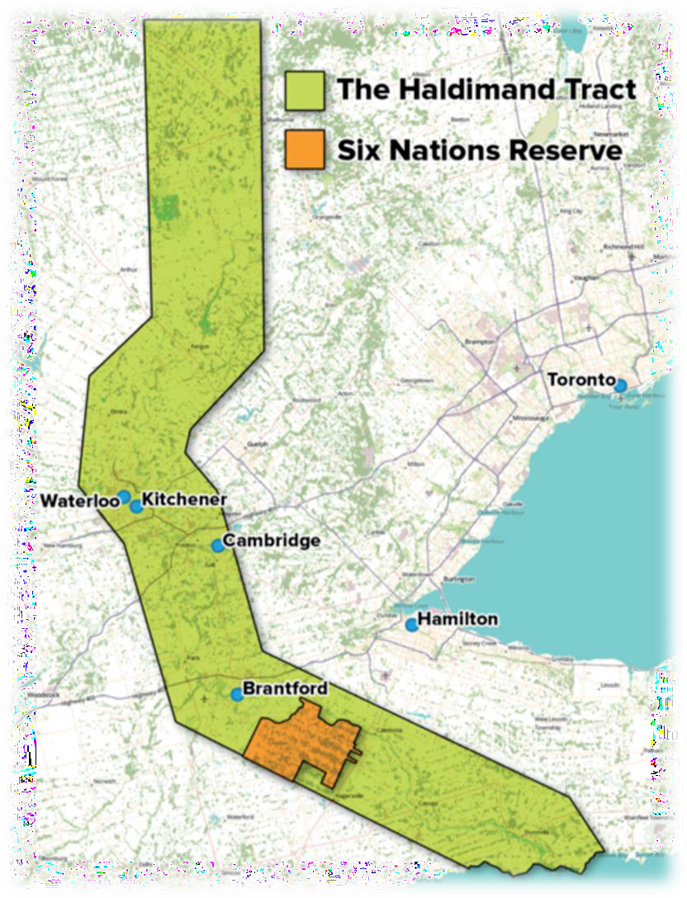
WHOSE LAND ARE WE ON?
The University of Waterloo acknowl s that much of our work takes place on the traditional territory of the Neutral, Anishinaabeg and Haudenosaunee peoples. Our main campus is situated on the Haldimand Tract, the land granted to the Six Nations that includes six miles on each side of the Grand River. Our active work toward reconciliation takes place across our campuses through research, learning, teaching, and community building, and is co-ordinated within the Office of Indigenous Relations.
Office of Indigenous Relations
Beaders n' Eaters!
Location: EC5 4201 (Office of Indigenous Relations) Time: Last Tuesday of every month; 6pm-9pm

Slide 3
A bit about me
MA in English literature
Background in communications and fundraising
Career Advisor at the Centre for Career Development on the undergrad team
Stephanie (she/her)
PAGE 4

Slide 4
What to Expect
Principles of curiosity, care and respect
Take what works for you, leave what doesn’t
Ask questions throughout!
You will need your handout and a writing utensil/computer

Slide 5
LEARNING OUTCOMES
Identify your employment skills
Develop a body of evidence of your employment skills
Analyze job descriptions to identify and articulate skills employers are seeking
Articulate convincing evidence of your employment skills in an interview response format
SKILLS IDENTIFICATION AND ARTICULATION

Slide 6
How confident are you feeling about identifying and articulating your skills?
Not confident
Semi-confident
Very confident
SKILLS IDENTIFICATION AND ARTICULATION

Slide 7
WHAT ARE THE SKILLS EMPLOYERS ARE LOOKING FOR?
SKILLS IDENTIFICATION AND ARTICULATION

Slide 8
WHAT ARE SKILLS?
A skill is a demonstrated ability to do something well
Technical skills vs. transferable skills
Technical: Skills learned for a specific purpose
Transferable: Skills used in multiple domains in your life
SKILLS IDENTIFICATION AND ARTICULATION

Slide 9
SKILLS THAT EMPLOYERS WANT YOU TO HAVE
Problem-solving skills
Ability to work in a team
Written communication skills
Strong work ethic
Flexibility/Adaptability
Verbal communication skills
Technical skills
Analytical/quantitative skills
Initiative
Detail-oriented
Source: The National Association of Colleges
and Employers (NACE) Job Outlook 2024 Survey
PAGE 11

Slide 10
JOB DESCRIPTION ANALYSIS
Employer: RISEDESK Job Title: Digital Marketing Intern Work Location: Hybrid | As the Digital Marketing Intern, you will support all digital marketing channels which will include paid ads, search engine optimization (SEO), social media, partnerships, website UI/UX, and content creation both written and video.
Job responsibilities
Plan and execute paid digital marketing ads on facebook, Instagram, etc.
Create content and implement social media strategies
for Instagram, tiktok, etc.
Improve google SEO through keyword research on- page optimization and backlinks
Support Shopify web design and optimization
elements
Work independently to improve google presence by creating written content for linkedin, blogs, reddit, etc.
Required skills
Currently completing a degree in business, design, communications or related university program
Highly detail-oriented with strong project management
skills
Excellent coach-ability: absorbs knowledge quickly and respects differing opinions
Strong written and verbal communication skills
Ability to take initiative and work with minimal
supervision

Slide 11
JOB DESCRIPTION ANALYSIS
Employer: RISEDESK Job Title: Digital Marketing Intern Work Location: Hybrid | As the Digital Marketing Intern, you will work directly with the co-founder and CEO to support all digital marketing channels which will include paid ads, search engine optimization (SEO), social media, partnerships, website UI/UX, and content creation both written and video.
Collaboration skills
Required skills
Work collaboratively to plan and execute paid digital marketing ads
Strong organizational skills
ign, communications or
Currently completing a degree in business, des
on facebook, Instagram, etc.
related university program
_{Create content and} Digital marketing experience
Highly detail-orie Attention to detail
nted with strong project management skills
channels: instagram, tiktok, etc.
Excellent
coach-ability: absorbs knowledge like a sponge,
opinions
and respects
Coach-able/quick learner
Work independently to improve googl
research on-page optimization, and ba
differing
SEO optimization skills ^{e SEO through keyword}
▪ Fluent in English with strong written and ver
nts
bal communication skills
Support Shopify web design and optimization eleme Strong written/verbal communication skills
Work independently to improve google presence by creating written
content for linkedin, blogs, reddit, and quora
Take initiative/work independently

Slide 12
SKILLS ASSESSMENT CHART
Skill | Evidence
Collaboration skills | Worked as part of a team on a research project exploring cultural impacts of media, delegating tasks and maintaining regular communication to meet deadlines.
Digital marketing skills | Managed social media accounts for the university arts society, increasing engagement by 30% through creative campaigns and analytics-driven content strategies.
Organizational skills | Organized a student art exhibition, coordinating submissions from 25 participants, scheduling the event, and managing promotion and logistics.
Quick learner | Learned to use Adobe Photoshop and Canva independently to design promotional materials for campus events within a week.
Takes initiative | Proposed and launched a mentorship program for first-year arts students, securing faculty approval and recruiting senior mentors.
SKILLS IDENTIFICATION AND ARTICULATION

Slide 13
JOB DESCRIPTION ANALYSIS [3 MINS]
ACTIVITY #1:
Partner up
Read the job description for the TTC job in your handout
Identify all the skills the employer is looking for
3 MINUTES

Slide 14
JOB DESCRIPTION ANALYSIS
Employer: Toronto Transit Commission (TTC) Job Title: Customer Experience Analyst Work Location: Toronto | We are seeking a highly-motivated individual with the passion and enthusiasm to help develop and implement changes that will improve customer experience right across the organization. The student will analyze and evaluate different sources of information to identify trends, variances, gaps and insights.
Required Skills
Solid customer service skills with experience working in a customer-focused environment, including identifying and responding to customer needs
Excellent communication (oral and written) skills
Strong presentation skills
Ability to think critically & interpret multiple data sources to draw meaningful conclusions and make recommendations
Well-developed organizational skills including attention to detail, the ability to prioritize work and the ability
to work collaboratively across multi-disciplinary teams.
Must have vision, commitment and enthusiasm for change

Slide 15
JOB DESCRIPTION ANALYSIS
Employer: Toronto Transit Commission (TTC)
Job Title: Customer Experience Analyst
solid customer service skills ^{ith the passion}
We are seeking a highly-motivated individual w
and enthusiasm to help develop and implement
changes that will
Work Location: Toronto improve customer experience right across the organization. The
excellent written communication skills ^{nt sources of}
student will analyze and evaluate differe
information to identify trends, variances
, gaps and insights.
Required Skills
Solid c strong presentation skills ustomer-focused environment, including identifying and responding to customer needs
Excellent communication (oral and writ _{ability to interpret}
ustomer service skills with experience working in a c
ten) skills
s to draw meaningful conclusions and make recom
Strong presentation skills
multiple data sources
Ability to interpret multiple data source mendations
Well-developed organizational skills including attention to detail, the ability to prioritize work and the ability to work
co
well-developed organizational skills
llaboratively across multi-disciplinary teams.
Must have vision, commitment and enthusiasm for change

Slide 16
ACTIVITY #2:
SKILLS ASSESSMENT [5 MINS]
Refer to your handout
Fill out the skills assessment chart with at least 4 skills you identified
from Activity #1
Include one piece of evidence from skills you’ve developed in this
class
5 MINUTES

Slide 17
SKILLS ASSESSMENT CHART
Skill | Evidence
Solid customer service skills | No specific experience? Highlight familiarity, transferable skills or an eagerness to learn
Excellent written communication skills
Strong presentation skills
Ability to interpret multiple data sources
Well-developed organizational skills
SKILLS IDENTIFICATION AND ARTICULATION

Slide 18
GOING FROM IDENTIFICATION TO ARTICULATION
How do we talk about our skills?
SKILLS IDENTIFICATION AND ARTICULATION

Slide 19
TALKING ABOUT SKILLS
STEP 1: Identify your relevant skills
Review the job description
Create your skills assessment chart
STEP 2: Tell the stories about how you developed those skills
Write the bullet points on your resume
Write a cover letter
Practice your answers to common interview questions
SKILLS IDENTIFICATION AND ARTICULATION

Slide 20
INTERVIEW QUESTIONS
Behaviour based questions ask about past experiences to predict your future behaviour
Tell me about a time when you set a goal for yourself. How did you go about ensuring that you would meet your objective?
Give me an example of a time you faced a conflict while working on
a team. How did you handle the situation?
Describe a situation in which you were under a lot of pressure. What was going on, and how did you get through it?
SKILLS IDENTIFICATION AND ARTICULATION

Slide 21
THE STAR APPROACH
Situation | Background and context
Task | What you needed to do
Action | What you did and how you did it
Result | The outcome of your actions
SKILLS IDENTIFICATION AND ARTICULATION

Slide 22
THE STAR APPROACH OVERVIEW
Situation | Background and context
Task | What you needed to do
Action | What you did and how you did it
Result | The outcome of your actions

Slide 23
THE STAR APPROACH
Q: Describe a time when you managed a project from start to finish
Situation
Provide background and context
Who, what, where, when…
Be brief (you are just providing the context here)
As VP Communications for the Arts Student Union, I noticed our Instagram wasn’t connecting with students, which was affecting attendance at our events.

Slide 24
THE STAR APPROACH
Task
Describe what you needed to do
What goals did you need to reach?
Include challenges and expectations
I decided to run a month-long campaign to boost engagement. My goal was to increase our follower count and improve event attendance by 20%.

Slide 25
THE STAR APPROACH
Action
Explain how you carried out the task
Include tools you used
Focus on relevant talents (skills/characteristics)
Should be the longest part of your response
I broke the campaign down into weekly goals, using a simple task tracker to stay on top of creating, posting, and analyzing content. I designed posts using Canva and ran A/B tests to see what content students liked best.

Slide 26
THE STAR APPROACH
Result
Describe the outcome of your actions
What did you accomplish?
Did you receive any positive feedback or recognition?
What did you learn?
By the end, our followers grew by 30%, and our event attendance went up by 40%. The campaign was a success, and the club decided to keep using my strategy. This experience taught me a lot about staying organized and using data to keep things on track.

Slide 27
THE STAR APPROACH
Q: Describe a time when you managed a project from start to finish
Situation | Engagement was low for the Arts Student Union's Instagram
Task | Ran a month-long marketing campaign on Instagram to increase follower count and improve event attendance by 20%
Action | Created weekly goals Used task tracker to stay on top of creating, posting and analyzing content Designed posts using Canva Tested different types of content
Result | Increased followers by 30% and event attendance by 40% PAGE 29

Slide 28
ACTIVITY #3: STAR APPROACH | PART A: ACTIVE LISTENING
You are the interviewer! You just asked a candidate the following
question: “Give me an example of a time you took initiative”.
As you listen to the interviewee’s response, write down the Situation,
Task, Action and Result on your handout.

Slide 29
ACTIVITY #3: STAR APPROACH | Part A
Q: Give me an example of a time you took initiative.
Sample answer:
When working at McDonald’s in the kitchen I found out from my manager that a bus full of school students were on their way back from a field trip and that they were stopping in for lunch. This was happening right in the middle of our normal lunch hour. I had already made sure that we had all of our inventory ready to go, but I needed to ensure that we would meet our standard service requirements. By utilizing my leadership skills, I delegated extra people from cashier to operate the cook stations. I also requested that employees not take their breaks during this time to accommodate the rush, and assured them that they could take them later. We are a good team and they were happy to change their routine for the day. I also reminded the cashiers to explain to waiting customers that we had higher than normal volume and to thank them for their patience. In the end, by 1:00pm we had served all of the customers within our standard service requirements, with no mistakes in the order. The staff were then able to take their breaks and we continued on with the day as usual.
SKILLS IDENTIFICATION AND ARTICULATION
PAGE 31

Slide 30
THE STAR APPROACH
Q: Give me an example of a time you took initiative.
Situation | Working at McDonald’s in kitchen School field trip during lunch rush
Task | Ensure that standard service requirements were met
Action | Delegated people from cashier to operate cook stations Requested that breaks not be taken during this time Asked cashiers to explain to customers about higher than normal volume and to thank them for their patience
Result | By 1:00pm we served all of the customers, meeting service requirements Delivered strong customer service, with no mistakes

Slide 31
REFLECTION
Please use the chat to share your reflections on the following prompts.
P.S - there are no right or wrong answers!
What is the impact of…
Missing details in the Action section?
Skipping the Results section?
Providing too much information?
SKILLS IDENTIFICATION AND ARTICULATION
PAGE 33

Slide 32
ACTIVITY #3: STAR APPROACH | PART B: WRITTEN RESPONSE [7 MINS]
Write your STAR response to the question:
“Describe a situation where you had to analyze multiple sources of data. What steps
did you take and what conclusion did you form?“
Be prepared to share your response with a partner

Slide 33
Practice Time!
Practice with a partner, taking turns as interviewee and interviewer
Listen carefully (2 mins) and give feedback (2 mins).
Feedback considerations:
What skills were highlighted in the answer?
Is there any part of their STAR response where they could have provided more or less detail?
What do you hear as the central message?
What kind of impression did the interviewee make?
Swap roles and repeat.

Slide 34
STAR RESPONSE DEBRIEF

Slide 35
How confident are you feeling NOW about identifying and articulating your skills?
Not confident
Semi-confident
Very confident
SKILLS IDENTIFICATION AND ARTICULATION

Slide 36
How can you gain more confidence in identifying & articulating your skills?
Keep working on your skills assessment chart
Practice, practice, practice
With a friend, in a mirror or by recording yourself
Continue to develop your skill set
Seek out new academic/life experiences (e.g. take an online course, volunteer, join a club)
Practice, practice, practice
With a friend, in a mirror or by recording yourself
Come in to see a career advisor!
SKILLS IDENTIFICATION AND ARTICULATION

Slide 37
CAREER ADVISING SUPPORTS
SUPPORT | HOW TO ACCESS | TOPICS
1:1 appointments & same-day drop-ins | Book online here | Job Search Tactics
 |  | Résumé Reviews
Workshop or Event | Register on WaterlooWorks | Cover Letter Development
 |  | Interview Prep
 |  | Career Exploration
CareerHub Online | Login using WatIAM to access resources and templates

Slide 38
QUESTIONS?
Stephanie.bailey@uwaterloo.ca
SKILLS IDENTIFICATION AND ARTICULATION

Slide 39
WE WANT TO HEAR FROM YOU!
We are always looking for ways to improve and your feedback is important. Complete the feedback survey delivered to your inbox at the end of this week.
Our mission is to educate and motivate all members of the University of Waterloo community to develop and take action to achieve current and future career goals.

Slide 40
PAGE 45

