Slide 1
Welcome! We’ll get started in a few minutes!
Note: Attendees will be sent the slide deck after the workshop.
In the meantime, feel free to introduce yourself in the chat! (e.g., name, program/faculty, regular/co-op)

Slide 2
Digging into
Name Title, Centre for Career Development
CENTRE FOR CAREER ACTION

Slide 3
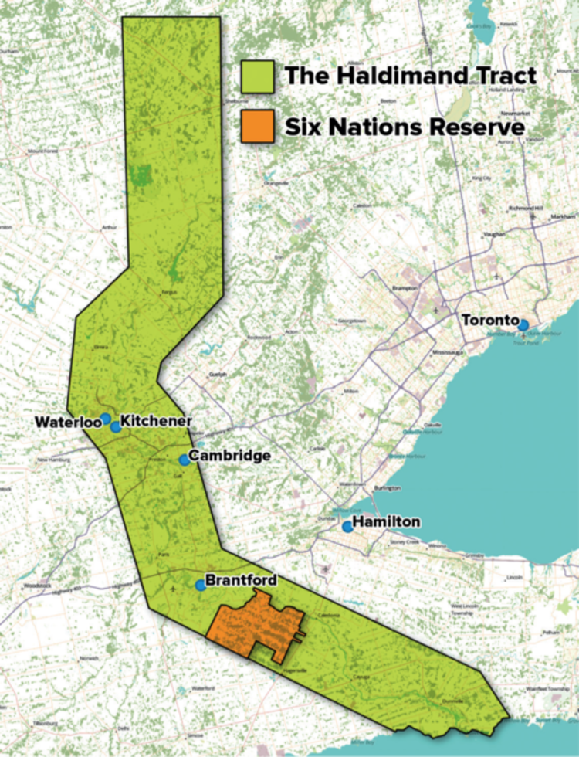
Whose land are we on?
We respectfully acknowledge that we work on the traditional territory of the Attawandaron (Neutral), Anishnaabeg, and Haudenosaunee peoples. The University of Waterloo is situated on the Haldimand Tract, which includes ten kilometers on each side of the Grand River: land promised and never returned to the Six Nations.
Some incredible local community members on IG: Bangishimo Johnston @bangishimo, Amy Smoke @amysmoke, C. Elizabeth Best @lizbot5000
Support: O:se Kenhionhata:tie – Land Back Camp, @ose.kenhionhatatie on IG
Reports: TRC Calls to Action, National Inquiry into MMIWG
Reading: The Inconvenient Indian, 21 Things You May Not Have Known About the Indian Act, This Place: 150 Years Retold
What land are you on? native-land.ca Learning opportunity:
INDG 201 The Indigenous Experience in Canada​

Slide 4
AGENDA
Why LinkedIn?
Components of a LinkedIn profile
Interactive tour of real profiles
Your next steps
Q&A
Growing your network
Notes:
Mention that the slides will be emailed to them by the end of the week/early next. Encourage then to have their LinkedIn out. Perhaps inspiration might strike and you can edit along.

Slide 5
A Safe(r) Space
Going into this presentation, my intention is to create as safe a space as possible.
A safe space means different things for everyone, but we’ll do our best! Let’s keep 3 things in mind:
Choice
Respect
Care
Photo by Dennis Leinarts from Pexels

Slide 6
Housekeeping: co-creating a safe(r) space
Participate in the way that feels most comfortable for you!
Please use the chat or raise your virtual hand to ask questions during presentation time.
Feel free to send me a direct message if you have a question or comment you would like to share anonymously
Ask questions whenever! We’ll also dedicate time at the end for Q&A
If having tech issues, we’ll do our best to troubleshoot
Take what works for you, leave what doesn’t.

Slide 7
CHECKING IN!
Share in the chat, if you’re comfortable!
Your academic program, year
A GIF (or emoji) that captures how you’re feeling right now!
How it feels to network (sometimes)

Slide 8
What are you hoping to get out of this workshop? WHAT DO YOU WANT TO KNOW?
Notes:
If no questions are asked pose this questions:
Q: Do I really need a LinkedIn?
A: Not mandatory but highly recommended! Most employers won’t discount you if you don’t have one (depending on the field), however, having a profile may lead you to opportunities you wouldn’t otherwise have

Slide 9
Why LinkedIn?
Employers will Google you! Be in control of what they see
Stay up to date on new ideas and ways to solve problems
Stay in touch with people you meet in class, at conferences, etc.
Find alumni working in your field
Research future
career ideas
Find more people to connect with in your industry
Notes:
mention how I’m using LinkedIn to connect with medical physicists in the GTA with the intention of learning more about the field and potentially secure a future coop position.
Using LinkedIN to get information about upcoming grad school programs (lots of them advertise and share their work on LinkedIn). I have been contacted by admission recruiters.

Slide 10
Access a growing global Network
810+ million
members
57+ million
companies
21+ million members in Canada
100,000+
recruiters
6 people hired every minute
Source: https://www.omnicoreagency.com/linkedin-statistics/
Notes:
More than half of Canada’s population uses LinkedIn!
A recruiter is a person whose job is to fill job openings in businesses.

Slide 11
COMPONENTS OF A
LinkedIn Profile

Slide 12
MAIN PARTS OF A LINKEDIN PROFILE
Profile Picture & Headline
About
Experience
Education
Skills
And more!
Notes:
Experience is generalized. There are many different features of presenting your experiences: you could separate your volunteer experience from work experience,

Slide 13
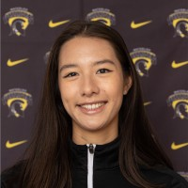
1. ADD A *PROFESSIONAL PHOTO
*your definition of professional!
Karl Nieva
Business Consultant at Promotional Elements
Azzam Bin Aamir
Physics and Astromy student @ Waterloo | Prev. Data scientist @ Pepsi, Purolator
Karina Wilk
Medical Physics Student at the University of Waterloo
Notes:
You get more views if you have a profile picture

Slide 14
2. HEADLINE
Most visible part of your LinkedIn profile
220 character limit – pick what you want people to know!
Expand on skillset and/or specialization
Mention specific technical/hard skills
Use specific keywords, especially ones that recruiters might use in their search engine
Notes:
Use specific keywords that a recruiter or user might search for
For example, Azzam is now looking for full-time positions in data science, naturally that is put in his headline

Slide 15
EXAMPLES OF ACTUAL HEADLINES
Medical Physics Student at the University of Waterloo
Seeking Summer Internship in Accounting | Co-op Biotech/CPA Student at the University of Waterloo
Web Developer at TechCompany | Full Stack Engineer | Front End Specialist | HTML5
Looking for co-op positions in Sport Business | Recreation and Leisure Studies student at the University of Waterloo
Notes:
Always tweak your headline depending on what situation you are in!
Example 1: Karina’s personal headline – as of right now, using LinkedIn to connect with other MedPhys professionals. When I make a connection, it is obvious why I connected with them since they can see my headline prior to accepting my invitation.
Example 2: you might be looking for a summer job? Stick that in your headline because recruiters maybe put those key words in the LinkedIn search engine and you’re profile might come up.
Example 3: Want to showcase your current position or technical/hard skills?

Slide 16
Open Space
50-250 words
Use keywords and action verbs
Share a story
Call readers to action
Formatting
Aspirations, values & accomplishments
all readers to action
Aspirations, values and accomplishments
Notes:
- An open-ended space.
There are so many ways to format a summary.
I didn’t want to show you a few examples of a summary because I don’t want you to think that that should be the way it is done.
Tip: check out other peoples summary’s. get a feel for what other people are doing and see what fits with your style

Slide 17
3. ABOUT
An open-ended space for people to gain understanding of your professional life
Formatting can vary:
Small, concise paragraphs → story approach
Numbered list → highlights outlining achievements, values, skills, and experiences
Hybrid paragraph-bullet combination
Use descriptive words and action verbs
Notes:
- A common question asked is: Is this like a summary of qualifications? Not quite, it is an open-ended space for some to gain understanding of your professional life.
Elevator pitch of your vibes
WALK THRU 1
Now lets is going to walk through where your summary is located and how to edit it. Let notice what style of summary he uses.

Slide 18
SENTENCE STRUCTURE
Action verb versus skill verb.
Instead of starting with “designed”, start with results:
Streamlined, enhanced, improved, increased the efficiency, promoted relationships. Etc.
-OR-
Use narrative structure or a story.
This was my first co-op term and I was excited about being in a hands-on role,
applying my skills in…
I was able to observe senior engineers doing…
…and I learned a lot about ….
It was an amazing experience because…
Notes:
If you have ever attended a resume or cover letter workshop or completed a PD course, you probably have been exposed to this before.
WALK THRU 1
Now lets is going to walk through where your summary is located and how to edit it. Let notice what style of summary he uses.

Slide 19
ANY QUESTIONS?

Slide 20
4. EXPERIENCE
Like a resume experience section
Resume should contain detailed descriptions of an experience that are applicable to the position
LinkedIn doesn’t require as much detail, but you can list more experiences
Include work and volunteer experiences
You receive 12 times more views when you include descriptions of your work experiences.
You receive 6 times more views when sharing volunteer experiences and shows how you are a good fit!
Link companies & skills, request recommendations, and endorse other
You can link your skills to a particular experience
Include Projects
Mention project and the result but leave the gaps out so that they want to connect with you and start a conversation.
Provide enough information to pique interest and start a conversation
Notes:
This section is most similar to a work/volunteer experience section of a resume. To keep things easy for you, I would stick with a similar style of bullet for LinkedIn as you probably use for your resume
Action verbs! Descriptive words!
Why have an experience section on LinkedIn?
People looking at your profile and get a sense of what you have done
Your experience could be tied to your company’s LinkedIn site therefore YOU may come up on an search
Keep in mind that the layout of your experience section may differ! You can have a separate volunteer experience section, or a projects section, etc.

Slide 21
ADD EXAMPLES OF YOUR WORK
Add rich media
Photos, videos, links, presentations, documents, tweets, podcasts
These additions make your professional story appealing and add a social component to your profile
Habitat for Humanity https://www.habitat.org/volunteer/group-opportunities
Notes:
If you can, add examples of your work to give insight or context into your experiences and/or skills.
For example,
marketing and communication -> perhaps if you have experience in this area, you may want to link some of your successful marketing material/campaigns.

Slide 22
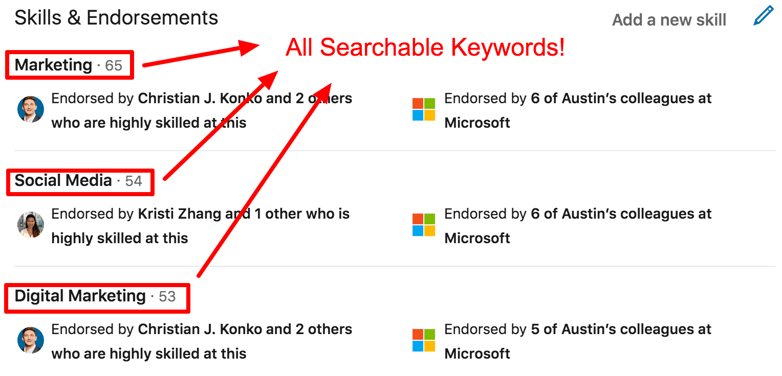
5. ADD SKILLS AND GET ENDORSED
Include a mix of niche and high-level skills
Prioritize your skills
Example of LinkedIn Profile Skills Section https://cultivatedculture.com/linkedin-profile-tips/example-of-linkedin-profile-skills-section/
Notes:
Be somewhat selective when you pick your skills based on what your aspirations are currently. (e.g. if you really want a tech position, it may be good to list your programming experience higher up)
For tech ppl, this is a good place to mention what programming languages you know
Accounting: software you can use
If you have too many your skills will look “messy”
Arrange your skills so that ones you want most visible are at the top
Keep in mind that your skills are searchable key words (go into more depth connect to recruiter)
Other LinkedIn users (people you know and have worked with) can endorse your skills & you can request endorsements
I recently found you can “link” specific skills to the experiences you applied them to.
how to add skills, how to endorse (endorse kaitlin’s skills)

Slide 23
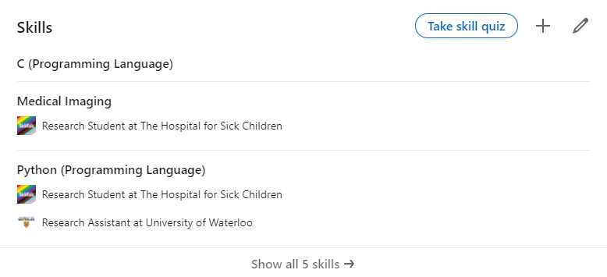
LINKING SKILLS
Notes:
Linking skills! Shows where you have applied your skills
Linked in skills quizzes:
If you want some extra “stuff” on your linked in page it doesn’t hurt to try the quiz! If you don’t do well it just won’t appear on your skills section.
WALK THRU 2: work experiences, request a recommendation, how to add skills, how to endorse skills, how to link skills to a job, skill quizzes

Slide 24
ANY QUESTIONS
about the experience or skills section?
Notes:
Address friends providing endorsements.

Slide 25
KEEP IMPROVING! ADD…
Languages
Groups
Organizations
Licenses & certifications
Honors & awards
Test scores - SAT, LSAT
Patents & publications
Updates and posts (sharing vs. publishing)

Slide 26
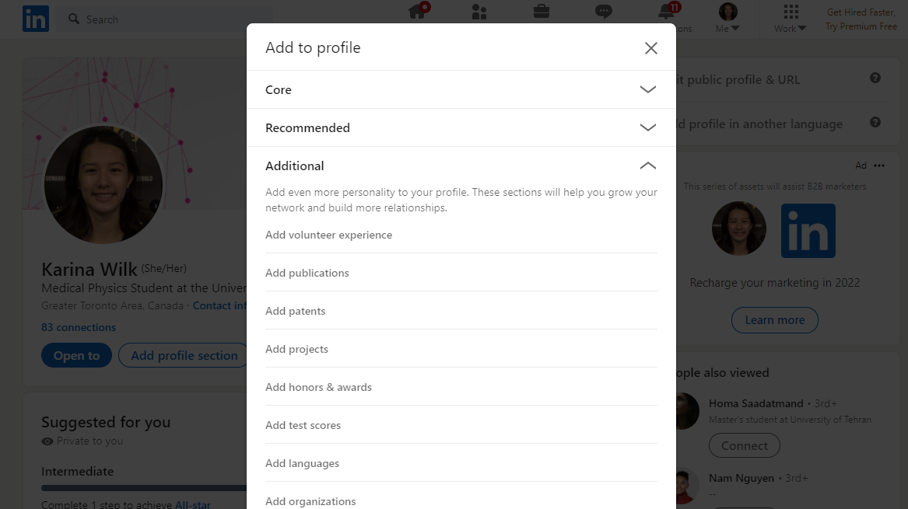
LinkedIn Project Section
Notes:
If you speak multiple languages use the languages section!
If you are working on or have worked on some pretty cool projects, take a look a the projects section!
If you are like me, interested in academia and hoping to publish, take a look at the publications section.
Have you been award some scholarships and awards? Take a look at the honors and awards section!
I recommended having all of the “core” sections and most of the “recommended” sections as long as they are relevant to you

Slide 27
CONNECTING WITH PEOPLE

Slide 28
WHO SHOULD I CONNECT WITH?
Anyone you would like to add to your network!
Alumni
Co-workers
People in the same industry as you
People in the industry you aspire to be in
There is no limit!

Slide 29
HOW TO CONNECT WITH PEOPLE
What is more compelling?
“Hi, I’d like to be added to your professional network on LinkedIn.”
“Hi, I’m looking for a job in marketing and sales. I would enjoy to connect with you to see if I
might be the right person for your team.”
“Hi , I am passionate about helping promote equity and inclusivity, and I know your department at the University of Waterloo is a global leader in this arena. I would be interested to learn from you and get some advice on how I can make an impact in my career.”
“Hi _______, we met at the Women in Engineering conference! I enjoyed the conversation we had and would love to connect!”
Notes:
Explain how connecting works
Use stamps here to see what people think.
Mention where you met! Mention part of the conversation you had! “we met at this event/conference/club”
Note that you have a limited number of personalized messages you can send with the free account

Slide 30
3 SIMPLE STEPS
HOW do you know them
What did you talk about?
WHY you want to connect
Interested in learning more about their experiences
CALL to action
Do you want to meet me?
Where did you meet?
Do you just want to connect?
Build your network

Slide 31
THE ALUMNI SEARCH & GROUPS
a powerful tool to jumpstart your networking
Notes:
WALK THRU 3: alumni search & groups & search analytics

Slide 32
DEALING WITH HARASSMENT

Slide 33
What is considered harassment?
When to block?
Notes:
Deciding/knowing when to block someone can look different for everyone. The point is that someone is doing something that oversteps your personal boundaries and it is no longer feeling like a safe space.
The blocking feature can and should be used if:
Someone is making you uncomfortable with their posts or messages
Someone is using the platform to message you about non networking related inquiries (i.e. asking you questions about your personal life, etc).
Someone is spamming your timeline with content you do not wish to see/engage in. (Will go into this in the next slide)
A person or company is constantly messaging you after you have rejected or ignored their previous messages.
These are just a few examples, however there are many other reasons that you may wish to utilize the block feature.
Let’s focus on what can be considered harassment in the next slide…

Slide 34
HARASSMENT REFERS TO…
Harassment refers to unwanted conduct/behaviour that results in physical, emotional, and/or psychological harm. It can be verbal (spoken or typed), visual, or physical. Harassment can be based on race, age, religion, disability, sex, sexual orientation, gender identity/gender expression, or of a personal nature. Some examples of harassment include, but are not limited to:
Making sexually suggestive comments
Unjustifiably monitoring everything that is being done
Exclusion from group activities or assignments
Unwanted physical touching/contact
Offensive, degrading, or derogatory jokes and comments
Offensive graffiti, cartoons, or pictures
Racial or ethnic slurs
Spreading rumors
Questioning someone’s disability, accommodation needs, or treatment
Unwelcomed comments about a person’s religion and/or religious garments
Notes:
Deciding/knowing when to block someone can look different for everyone. The point is that someone is doing something that oversteps your personal boundaries and it is no longer feeling like a safe space.
The blocking feature can and should be used if:
Someone is making you uncomfortable with their posts or messages
Someone is using the platform to message you about non networking related inquiries (i.e. asking you questions about your personal life, etc).
Someone is spamming your timeline with content you do not wish to see/engage in. (Will go into this in the next slide)
A person or company is constantly messaging you after you have rejected or ignored their previous messages.
These are just a few examples, however there are many other reasons that you may wish to utilize the block feature.
READ SLIDE
READ AFTER SLIDE: This is a slide meant to describe what harassment is in all settings. Therefore, somethings that are listed cannot be done on LinkedIn (i.e., physical contact/touching) but it is still important to be able to recognize what harassment looks like in all settings.
Remember: you don’t have to only block someone when they have done something over LinkedIn. If you are connected to someone on your LinkedIn account that has harassed you or made you feel uncomfortable in a different setting (for example in an online meeting, in an in-person get together) it is your right to remove them from all spaces that they occupy in your life, LinkedIn included.

Slide 35
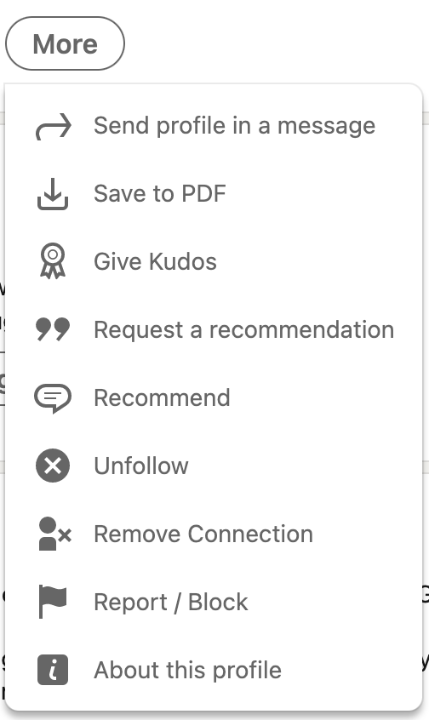
HOW TO BLOCK SOMEONE ON LINKED IN
Go to the profile page of the person you wish to block
Select the “More” button in their title box
Select “Report / Block” from the drop-down menu
In the pop-up window, select “Block (their name will appear here)”,
Confirm by clicking “Block”
Notes:
READ BEFORE SLIDE: It is important to note that blocking someone can feel uncomfortable and often unpleasant, however it is your right to remove anyone from your space if you do not feel safe or comfortable. Someone will not be able to see that you have blocked them (and even though LinkedIn tells people you have viewed their profile, if you are searching them up to block them, then in this instance they won’t be notified you searched them up at all). Blocking someone will limit/restrict their access to your account which we will go into momentarily.
Here are step by step instructions on how to utilize the blocking feature on LinkedIn.
READ SLIDE.
READ AFTER SLIDE:
After blocking a person on LinkedIn they will no longer be able to:
Access your profile
Send you messages
Comment on your posts (even if they are shared by another individual)
See comments you make on other people’s posts
It is important to note that your connection with them will also disappear as well as recommendations or endorsements you have given each other in the past.
An alternative to blocking someone is removing your connection to them as well.
You may want to do this if you feel like it is not harassment, but you still do not want to have this person as a connection.
This may be the solution if:
Someone is posting something that doesn’t align with your views
You believed this person was a connection you wanted and you no longer believe so
Someone is “spam posting” – posting a large amount with little relevance to you or your network and is “clogging” your timeline.
Removing a connection follows a similar process and the button is just above the report/block button.

Slide 36
We'd love to hear from you!
These workshops are for you! We are always looking for ways to improve. Please complete the feedback survey delivered to your inbox after this session.

Slide 37
questions?
Let’s discuss!
Notes:
Deciding/knowing when to block someone can look different for everyone. The point is that someone is doing something that oversteps your personal boundaries and it is no longer feeling like a safe space.
The blocking feature can and should be used if:
Someone is making you uncomfortable with their posts or messages
Someone is using the platform to message you about non networking related inquiries (i.e. asking you questions about your personal life, etc).
Someone is spamming your timeline with content you do not wish to see/engage in. (Will go into this in the next slide)
A person or company is constantly messaging you after you have rejected or ignored their previous messages.
These are just a few examples, however there are many other reasons that you may wish to utilize the block feature.
Let’s focus on what can be considered harassment in the next slide…

Slide 38
YOUR NEXT STEPS
Update preferences, especially if you are looking for employment
Update job experience – include descriptions
Request introductions and start making connections
Investigate the alumni search & join some groups
Do your research
Be critical of the keyword you are using
Notes:
KARINA
Update preferences -> will help recruiters find you
Descriptions will help people get a ore insightful view of your experiences and your skillset
Make connections -> make sure you try your best to personalize the messages
Alumni search -> a great way to do research and find ppl
Research -> could be researching linkedin and discovering new tricks OR could be using Linkedin to research certain companies you are interested
Be critical of your keywords, especially if you’re looking for employment -> all keywords (e.g.. Skills, things in header) are searchable by recruiters

Slide 39
SOME FREQUENTLY ASKED QUESTIONS (FAQs)
What do 1st, 2nd, and 3rd connections mean?
What is LinkedIn Premium? Do I need it?
Can anyone endorse me? Who should endorse me?
What keywords did my searchers use to find me?
Notes:
1st 2nd 3rd connections:
1st: are a direction connections – are part of your network
2nd: are connections of connnections “friends of friends” – people who are outside of your network but share a common connection with
3rd: members that are connected to your second connections
Linked in premium: no not really but depend if you would get use out of the upgraded features
Includes:
Direct messaging to recruiters
Applicant status for job positions
Applicant and salary insights
Unlocks “who’s viewed your profile
Access to linkedin learning courses
$30/month
Endorsements:
Only 1st level connections (directly in your network) can endorse you. It would be good for the person who endorses you to be connected to you in some way (e.g. work, school, volunteer)
Key words:
Interesting question!
Go to your profile > click on search appearances and scroll to “keywords your searchers used” may give you insight on what is “working well” on your profile and what is not. Perhaps you are getting attention on things you aren’t really hoping for.

Slide 40
PAGE 40

