Slide 1
Welcome! We’ll get started in a few minutes!
Note: This session will be not be recorded, but attendees will be sent the slide deck after the fact.
In the meantime, feel free to introduce yourself in the chat! (e.g., name, program/faculty, regular/co-op)

Slide 2
Preparing for interviews
Name
Title, Centre for Career Development

Slide 3
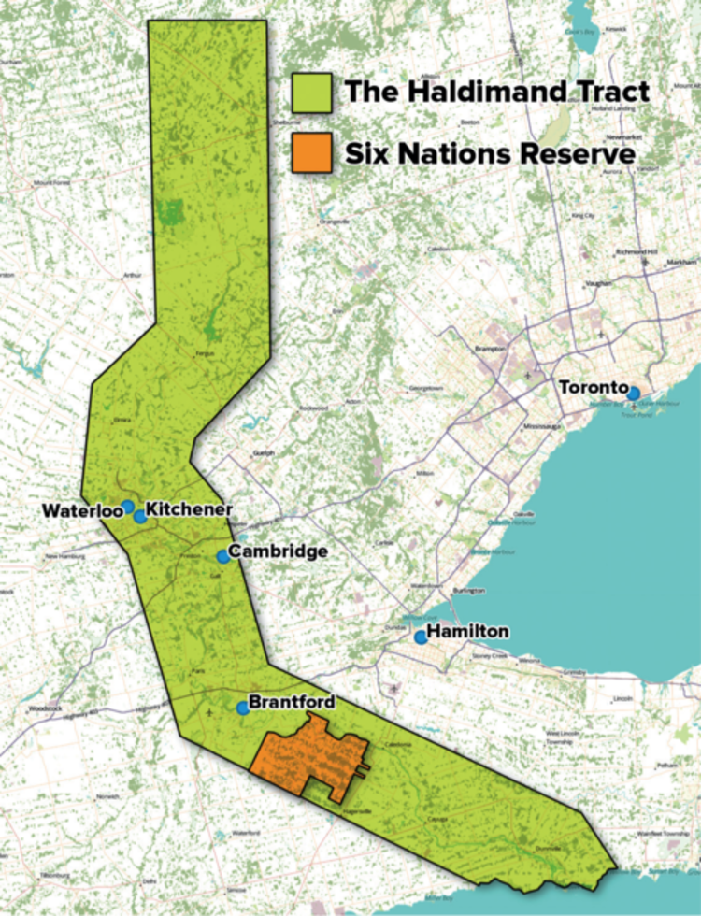
Whose land are we on?
We respectfully acknowledge that we work on the traditional territory of the Attawandaron (Neutral), Anishnaabeg, and Haudenosaunee peoples. The University of Waterloo is situated on the Haldimand Tract, which includes ten kilometers on each side of the Grand River: land promised and never returned to the Six Nations.
Some incredible local community members on IG: Bangishimo Johnston @bangishimo, Amy Smoke @amysmoke, C. Elizabeth Best @lizbot5000
Support: O:se Kenhionhata:tie – Land Back Camp, @ose.kenhionhatatie on IG
Reports: TRC Calls to Action, National Inquiry into MMIWG
Reading: The Inconvenient Indian, 21 Things You May Not Have Known About the Indian Act, This Place: 150 Years Retold
What land are you on? native-land.ca Learning opportunity:
INDG 201 The Indigenous Experience in Canada​

Slide 4
A Safe(r) Space
Going into this workshop, the intention is to create as safe a space as possible.
A safe space means different things for everyone, but we’ll do our best! Let’s keep three things in mind:
Choice
Respect
Care

Slide 5
How might we co-create this safe(r) space?
Participate in a way that feels most comfortable for you!
Please use the chat during presentation time. Ask me questions whenever! At the end of the workshop, you can go mic on or mic off during Q&A
Feel free to send us a direct message if you have a question or comment you would like to share privately
Take what works for you and leave what doesn’t

Slide 6
AGENDA
Virtual vs. in-person interviews
Next steps after your interview
Before the interview: preparation and practice
Wrap up, Q&A
Behavioural vs. technical interviews

Slide 7
What topics do you hope this workshop will cover?

Slide 8
Before the interview
Preparation & Practice

Slide 9
PREPARING FOR THE INTERVIEW
What do you think students could do to get ready for an interview?

Slide 10
Interview Preparation
Review resume
Review job description
Research employer (mission, challenges, motivators, culture and strategic plan)
Practice interview questions
Prepare questions to ask the interviewer
References
Copy of your resume
Know yourself and what you bring to the position
Notes:
There are a couple things you will want to do before you get into the actual interview that will help prepare you and allow you to feel ready.
First review your resume, if you are tailoring all your resumes to fit certain jobs or you have multiple copies of your resume for different industries, make sure you know the details of the one you submitted for this position.
Review the job description. Make sure you know what they are looking for in their candidates. You do not need to have the responsibilities or the description completely memorised but you should be familiar with it.
Research the employer
Practice common interview questions. This will help make sure there is a nice flow with your answers.
Prepare questions to ask the interviewer at the end of your interview
Have references handy
Again, make sure you have a copy of the resume you submitted
Know yourself and what you bring to the position. Be comfortable with speaking about what you offer!!

Slide 11
What is the employer looking for?
Experience
Education
Knowledge
Technical Skills
Transferable Skills
Personal Attributes
Notes:
Read the slide
These are all things employers are looking for in interviews, meaning if they are asking you questions they are trying to figure out these things about you! Try and find answers that incorporate these types of things.

Slide 12
Know the details
How many people will interview you? Who are they?
How long will the interview be?
What components will it include?
Question and answer?
Technical?
Application?
Knowing this information can help relieve anxiety and reduce surprises!
Notes:
*** it is very possible students are not able to reach out directly to their interviewer if the interview is scheduled through WaterlooWorks. If they can contact the employer they can ask more questions about what the interview will be like!

Slide 13
Practice, practice, practice!
How will you practice for your interview?
Behavioural interviews: mock interviews (visit CCD!), sample questions, practicing with folks you trust, GenAI tools? (e.g., Microsoft Copilot)
Technical interviews: connecting with upper-year peers, online prep platforms
Networking?

Slide 14
Virtual vs. in-Person Interviews

Slide 15
VIRTUAL INTERVIEWS

Slide 16
Virtual Interview Considerations
Test your Tech: test run the software with a friend to ensure a smooth experience
Be early: set up your computer, close extra tabs, turn off notifications and open the program
Start with a strong introduction: say hello, smile and look into your camera
“Thank you for taking the time to with me today.”
“I’ve been looking forward to our conversation”
”It’s nice to meet you!”
Be prepared for small talk: remain positive, find a common interest, avoid oversharing or controversial topics

Slide 17
Setting the Stage
Sound: find a quiet space and a room with some sound insulation
Background: have a clean, simple and professional background
Camera Angle: ensure your camera is at eye-level
Lighting: use natural light or a lamp. Ensure you are not backlit!
Dress: dress appropriately* and professionally from head to toe
Photo by Christina @ wointechchat.com on Unsplash
Notes:
Some bears can't learn division

Slide 18
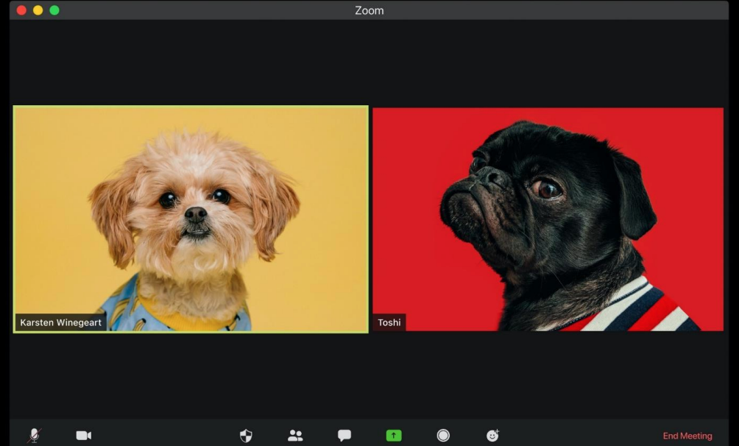
VIRTUAL INTERVIEWS: BODY LANGUAGE
Posture: positive body language
Eye contact: look into the camera
Facial Expressions: smile when appropriate
Voice: be mindful of if you need to slow down
Practice your answers out loud!

Slide 19
IN-PERSON INTERVIEWS

Slide 20
In-Person Interview Considerations
Know the way! Where is the interview located? How long is the commute? Will there be traffic? Parking, etc.?
Remember the previous 3 slides?
Answering the dress question!

Slide 21
Behavioural vs. technical interviews
What’s the difference?

Slide 22
Behavioural interviews

Slide 23
THE DIFFERENT TYPES OF QUESTIONS
Classic
Behavioural
Situational
Skill Testing/Problem Solving

Slide 24
CLASSIC QUESTIONS

Slide 25
Recurring QUESTIONS
Why did you apply?
Why should we hire you?
Organizational knowledge
Short/long-term career goals
Strengths/weaknesses
Tell me about yourself

Slide 26
OUTLINE FOR “TELL ME ABOUT YOURSELF”
When/how did you become interested in this field/role/opportunity?
What knowledge, skills and/or experience do you have?
What are your short/long-term career goals?
Can you tie this into the opportunity you’re pursuing?
Anything else worth sharing? (interests, hobbies, fun facts about yourself?)
Give yourself about 90 seconds (give or take) for this answer
Notes:
The tell me about yourself question and your elevator pitch have a lot more in common than we often notice. This question is the lengthier, more in depth version of your pitch. Typically, this question comes from someone after the elevator pitch, once they have taken you up on your offer of “next steps”
Which is what I have created here:
This is an outline for how to answer the question should it arise. *Share anecdote/experience.*
READ SLIDE (while doing so elaborate on points)
Summarizing yourself in less than two minutes can be a stressful/ intimidating task, but it can also be liberating because you get to choose what to share – you’re the narrator of your own story!
Sometimes it will also require you to think a bit on your feet because employers may hear something and ask you to elaborate, but the more you practice the more prepared you will be. Give yourself grace if you don’t ace it right away, the answer to this question (although it is still you talking about yourself) can be different depending on who you are speaking to (I.e., your answer in an interview for a customer service position will differ for an interview for an analyst role, or depending on whether you’re speaking to an employer or an employee at your organization of interest (or a professor/TA, depending on what opportunities you are pursuing) [Or depending on whether you’re in a networking conversation, an interview, or communicating virtually over email, LinkedIn, etc).

Slide 27
BEHAVIOURAL QUESTIONS

Slide 28
BEHAVIOUR-BASED QUESTIONS
Past behaviour is a good indicator of future behaviour.
Typical behavioural questions begin with:
Tell me about a time when…
Describe a situation in which…
Recall an instance when…
Give me an example of…

Slide 29
STAR APPROACH
Situation | Background and context
Task | What you needed to do
Action | What you did and how you did it
Result | The outcome of your actions

Slide 30
Q: TELL ME ABOUT A TIME YOU COMMUNICATED SCIENTIFIC KNOWLEDGE TO A NON-SCIENTIFIC AUDIENCE
Situation | “Let’s Talk Science” Volunteer
Task | Create workshop on global warming for 8th graders
Action | Researched the 8th grade science curriculum Consulted with professors and TAs on strategies to simplify information Delivered the workshop to 20 students and kept them engaged by inserting analogies, videos and activities into the workshop
Result | Students expressed their newfound interest in global warming, and I was invited to deliver another workshop

Slide 31
SITUATIONAL QUESTIONS

Slide 32
SITUATIONAL/HYPOTHETICAL QUESTIONS
Actual (hypothetical) situation from job
Can be very general but also can be very specific
Typical questions begin with:
What would you do if…
Describe how you would…
What approach would you take…
Say you were faced with…

Slide 33
SITUATIONAL/HYPOTHETICAL QUESTIONS about work
What would you do if you were almost finished working on a project that had a tight deadline but upon review you realized you’d made a mistake at the beginning that would require you to start over?
How would you resolve conflict with a co-worker?

Slide 34
SKILL TESTING AND PROBLEM-SOLVING QUESTIONS

Slide 35
SKILL TESTING/PROBLEM SOLVING QUESTIONS
Skill testing
Technical questions
Hands-on
Problem Solving
Written or spoken
Demonstrate structured thinking
Show your process (the right answer may not matter)

Slide 36
Technical interviews

Slide 37
Considerations for Technical Interviews
Field/subfield/domain
Organization size
Asynchronous vs. synchronous assessments
Prep platforms: Glassdoor, HackerRank, LeetCode, NeetCode, Techie Delight, and many others!

Slide 38
WHAT DO I DO ABOUT…?
Feeling nervous or anxious
Silence
Stumped
Salary & negotiation
Photo by JESHOOTS.COM on Unsplash

Slide 39
WRAPPING UP AN INTERVIEW
How do you best answer the following:
Is there anything else that you’d like to add?
Is there anything else you’d like to tell us about yourself?
Do you have any questions for us?

Slide 40
QUESTIONS TO ASK AT THE END OF AN INTERVIEW
What do you expect a co-op student to have accomplished in the first month?
What aspects of the role do you believe to be the most rewarding or the most challenging?
What are the key priorities for someone in this role?
Can you give me an example of the types of projects the previous co-op student was involved in?
What type of training would there be for the successful candidate?
In what ways can I prepare for this job, if I am the successful candidate?
What is the compensation for this position?*

Slide 41
PRO TIPS
Based on your analysis of the role, the organization, and your own experiences, go into the interview with 5 things you want them to know about you
Treat the interview like a conversation, not like an exam
Demonstrate your enthusiasm for the role/organization
Make sure you have a list of questions to ask
Make practice work for you!
Send a thank you/follow up email *when appropriate
Notes:
We know that the job posting is kind of our little window into what the employer is looking for. So now that we know what we can offer, we can try to highlight the areas that we think will overlap with what the employer might find interesting.

Slide 42
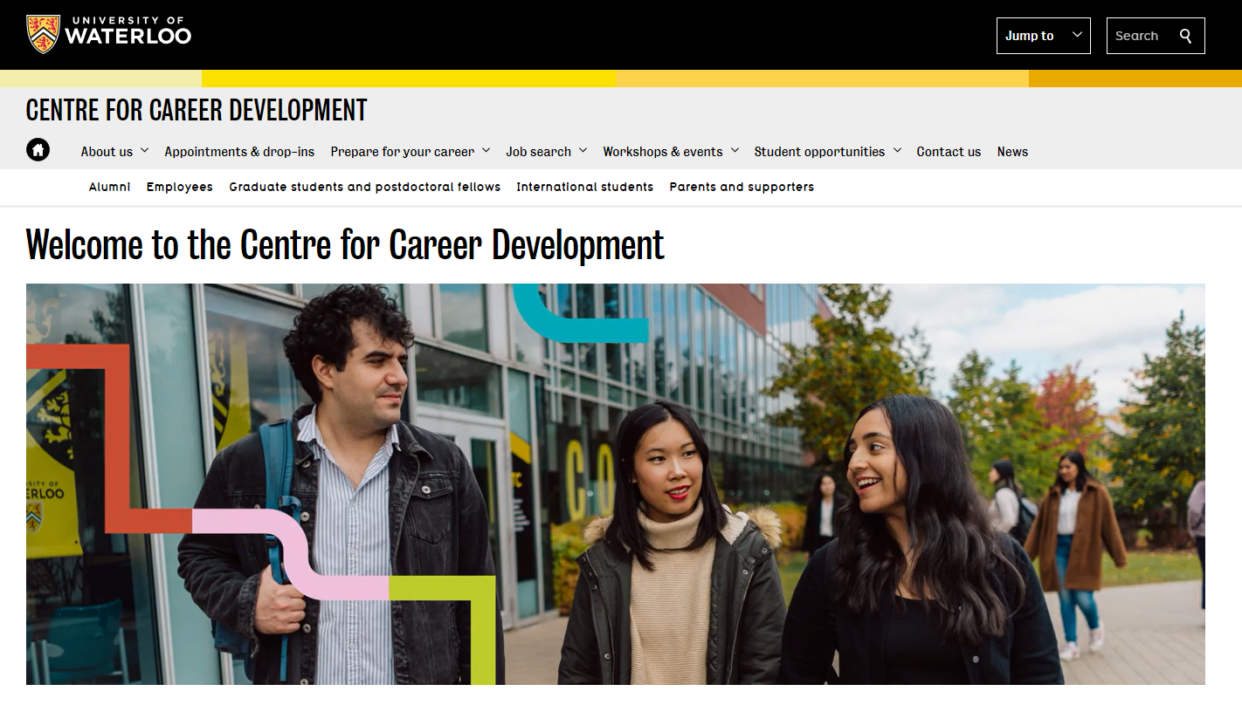
Career Development website
Visit our website for:
Booking appointments/ drop-ins
Job search resources
Pre-recorded workshops
And more!
https://uwaterloo.ca/career-development/

Slide 43
Thank you! Any Questions?
Don’t hesitate to reach out!
Notes:
Teams chat

