Slide 1

NAITIONAL TECHNICAL UNIVERSITY OF UKRAINE ”KYIV POLITECHNICAL INSTITUTE”
WELDING FACULTY
Presented by: Valerii D. Kuznetsov, D.Sc. (Tech), Professor,
Surface Engineering department, Head
E-mail: kvd@wd.ntu-kpi.kiev.ua
http://weld.kpi.ua

Slide 2
Table of Content
Introduction Slide #3
Organizational structure of Welding faculty Slides #4
Magnetic control of quality of welded joints
Slides #5-6
Welded joints quality monitoring Slides #7-9
Monitoring of tensions in the pipelines Slides #10-11
Surface engineering |Slides #12-20
Q&A

Slide 3
Faculty Background
Welding faculty was founded by Boris Paton the president of the National Academy of Science of Ukraine in 1976.
The faculty is the leading post-secondary higher education entity in Ukraine
The educational process is delivered in a close collaboration with the Paton Electric Welding Institute of the National Academy of Sciences of Ukraine.
The best undergraduate students have an opportunity to obtain a European specialist’s certificate.

Slide 4
.
Organizational structure of Welding faculty
International Institute of Welding
E.O. Paton Electric Welding Institute of
NAS of Ukraine
Dean
Otto-von-Guericke University (Germany)
Student’s self-governance
Council of scientists
Commission on procedures
Deputy Dean International Relations
Deputy Dean Procedure Work
Deputy Dean of the Joint Department
Deputy Dean Scientific Work
Deputy Dean Training and Education
Ukrainian Regional IWE Accreditation
Methodists of Dean’s Office
WF
MEI
FPE
.
Welding Production Department
.
Joint Ukrainian-German Department
Ukrainian Regional IWE Training Centre
Department of Graduate Studies
.
Welding Industrial Systems Department
.
Surface Engineering Department

Slide 5
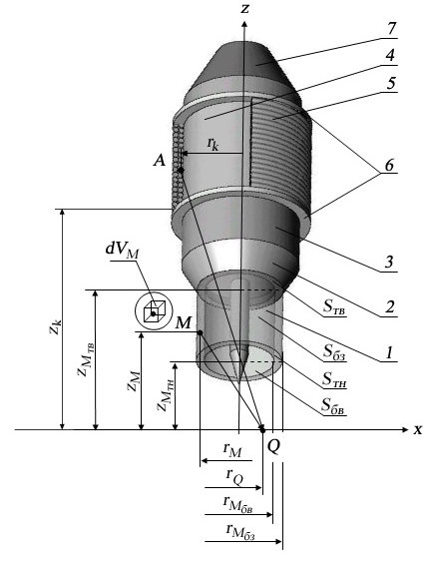
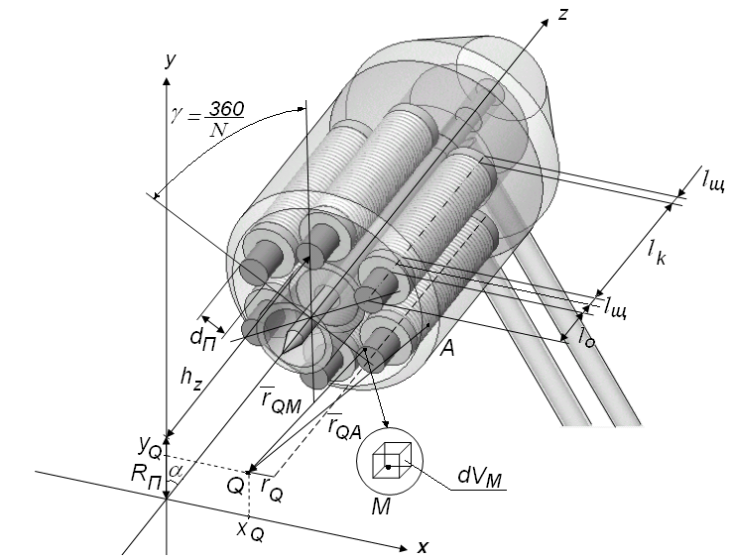
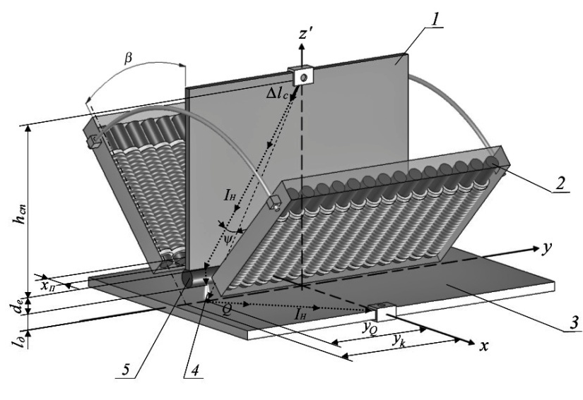
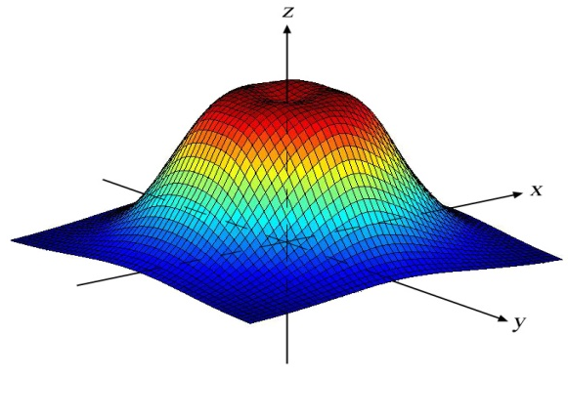
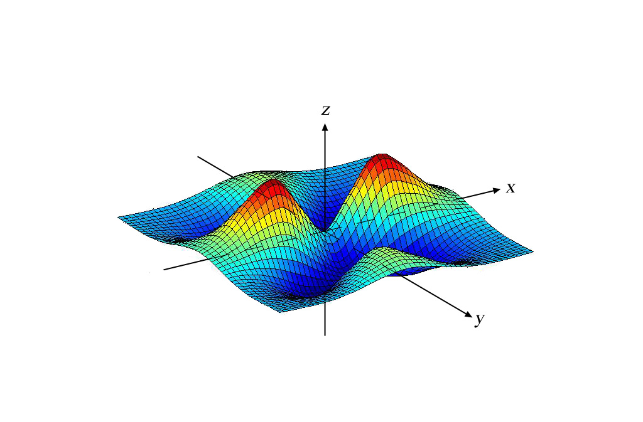
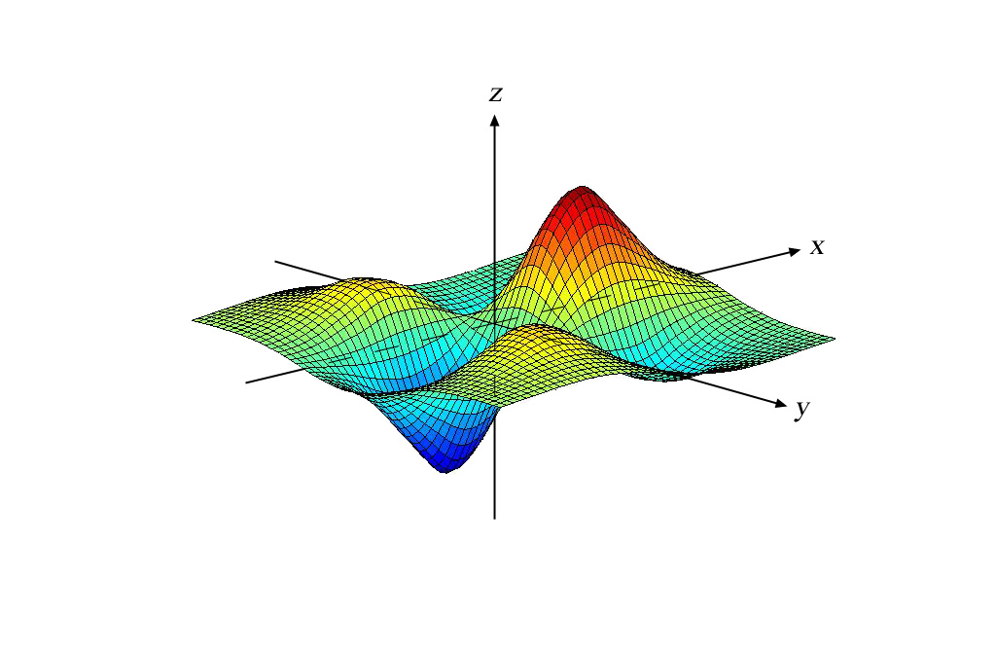
Magnetic control of quality of welded joints
Single-pole system
Multi-pole system
Wide-bead deposition by welding

Slide 6
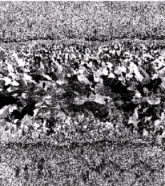
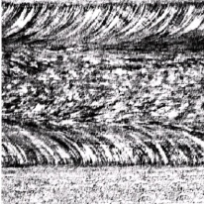
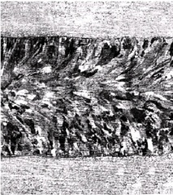
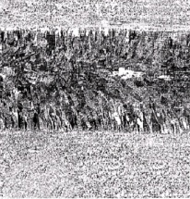
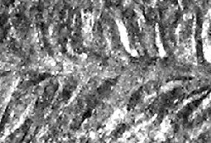
Welding with electro-magnetic effect results in:
Porosity decreasing
17 times
12 times
7 times
Increasing of the resistance to hot cracking
4 times
1.6 times
2.2 times
Increasing of the resistance to intergranular corrosion
2 times
1.7 times
Technologies of welding with electro-magnetic effect are used by the following industrial plants:
۩ Kyiv aircraft building plant; ۩ Frunze Sumy machine engineering productive unit;
۩ Yuzhniy machine engineering plant; ۩ Perm motor engineering complex;
۩ Saratov machine engineering plant; ۩Malyshev Kharkiv plant
۩ Baltia plant;

Slide 7
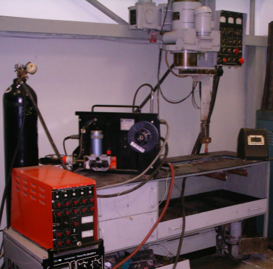
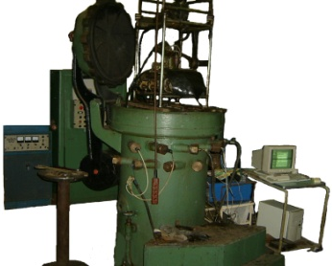
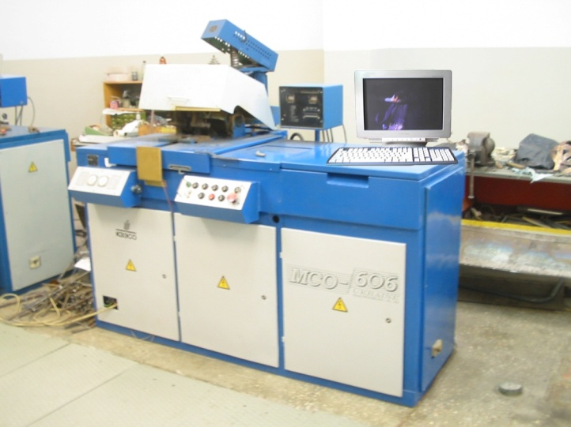
Welded joints quality monitoring
Control unit
Welding parameters
Heat dispenser
Energy transformer
Heating source
Construction
Joint parameters
Disturbance
Disturbance
Disturbance
Electric parameters of the heating source

Slide 8

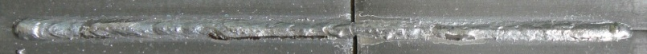
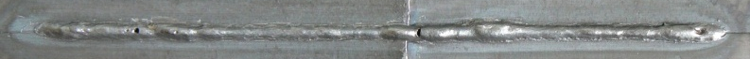
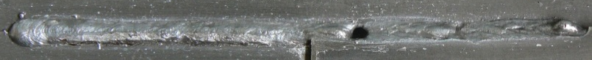
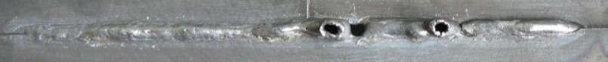
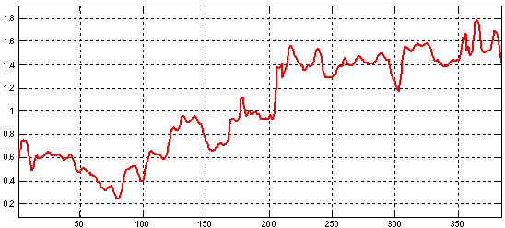
MAG welding quality monitoring with artificial neural network
ADC
Disturbance removal unit
Parameters calculation
Fragmentation
Normalization
Analysis
Input data
Data processing results

Slide 9



Resistance welding quality monitoring with artificial neural network
.
ADC
Filtering
Fragmentation
Integrating
Analysis
Basic parameters
Input data
Data processing results
L = 20 – 25 mm, without cracks
Reduced speed
L = 12 – 15 mm,
with cracks
Increased voltage
L = 25 – 30 mm, without cracks

Slide 10
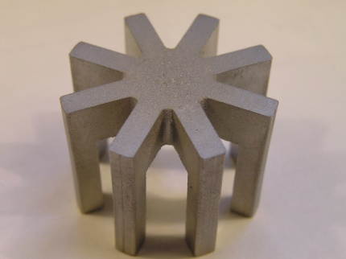
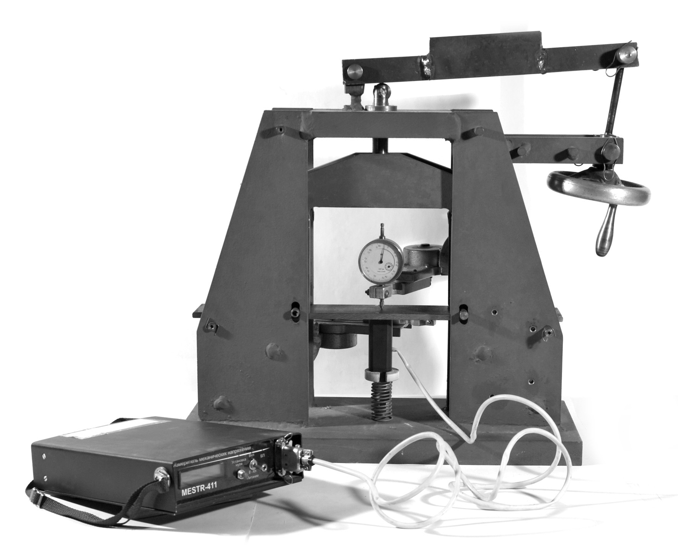
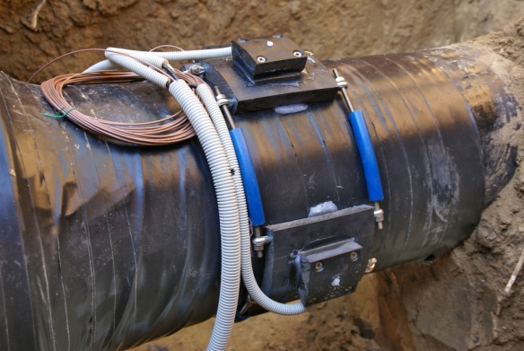
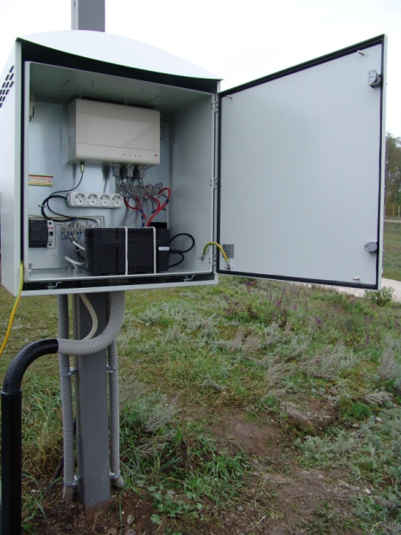
Monitoring of tensions in the pipelines
Magnetic circuit of the electro-magnetic converter
Mechanical tensions measuring system
System of electro-magnetic converters
Monitoring system scheme
Measuring unit

Slide 11
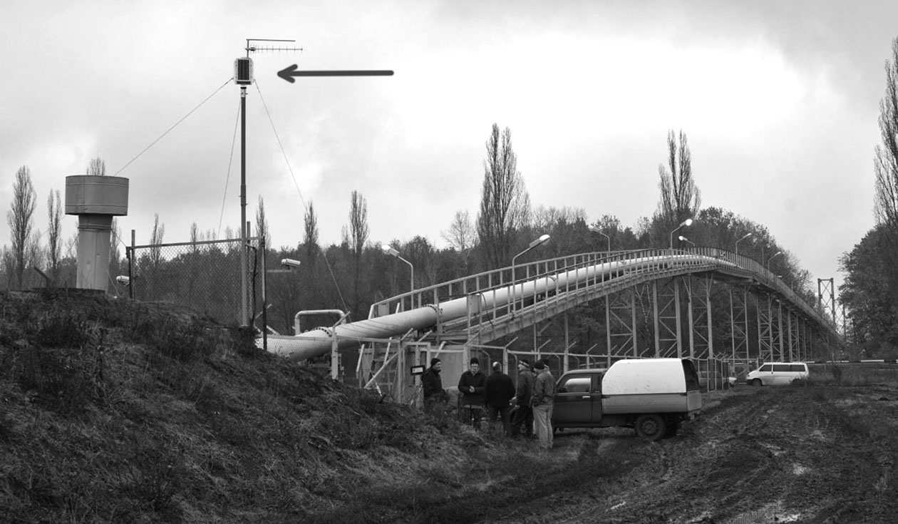
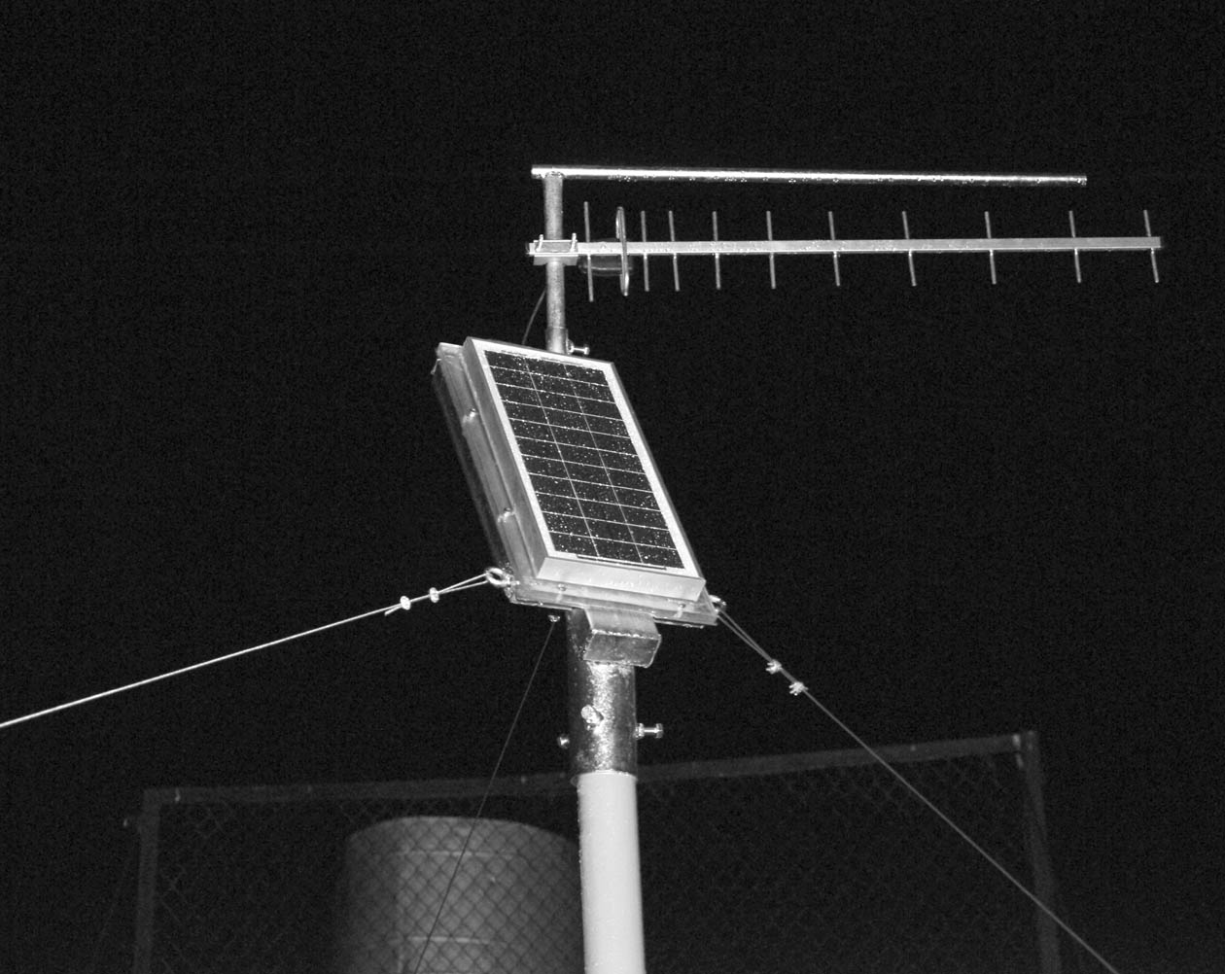
Installation of the monitoring system

Slide 12
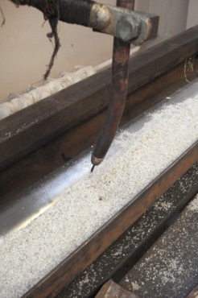
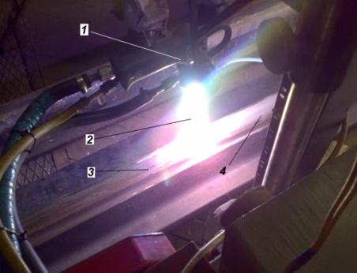
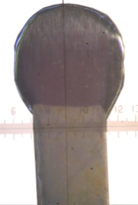
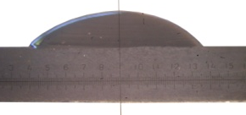
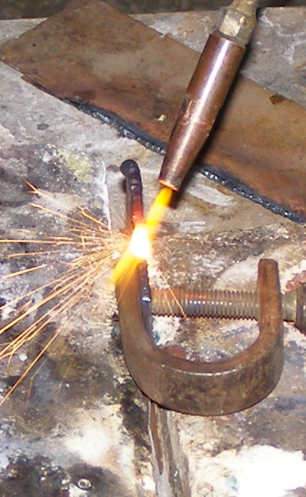
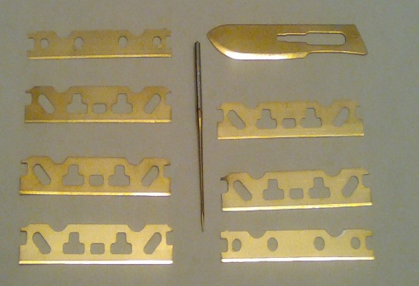
Surface engineering
WEAR-RESISTANT COATINGS
setting of rail- way switches
blade-type and thin base materials
TIG coatings
SAW deposition
Plasma coating
Ion-plasma method
Hydrogen-oxygen flame
stamp matrix
bearing seats
cutting instrument (razors, needles, etc)

Slide 13
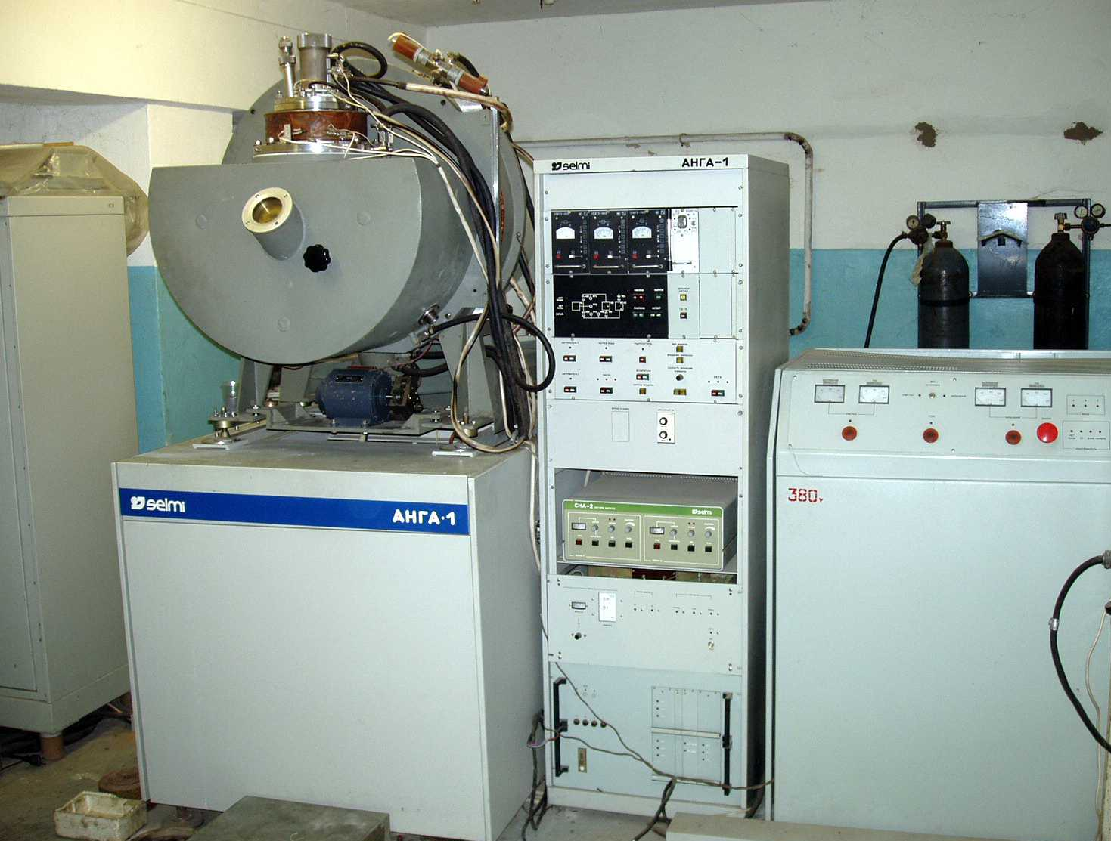
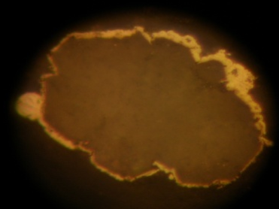
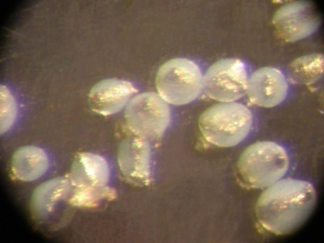
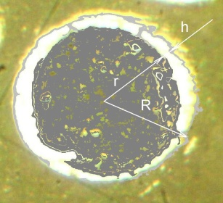
New composite materials with ultra disperse
and nano-sized components
Particle of Al2O3 powder plated by titanium and aluminum (x800)
Particles of powder after mechanical mixing with aerosyl (x200)
Particle of NiAl powder after plating: r – initial radius, R – radius after h – coating thickness
System for ion-plasma coating of powder materials

Slide 14
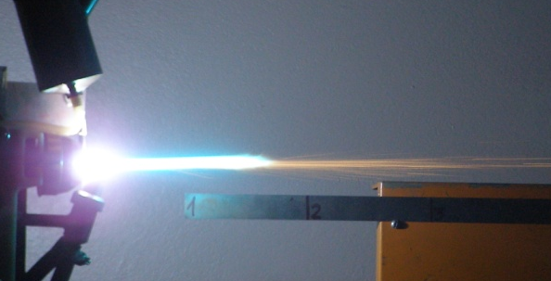
LOW EFFICIENCY LAMINIAR PLAZMATRON WHITH ANODE AJUSTED SEPARATEVLY
PLAZMATRON PARAMETERS
working gas .................................................rgon operating current, A ....................................80-120
voltage., V.............................................. to 60
power of plasmatron, kW ......................... to 8,0
flow of gas, l/min.
plasma-forming ........................................ 2,0-3,0 shielding .....................................................1,0-4,0 productivity, kg/h…. ................................. 0,5-4
coated ratio of material .............. . 0, 6-0,8
overall dimensions, mm .................... 140x115x6
THE MAIN PARTS
1- extension anode, 2-hopper, 3- basic nozzle, 4- compressive nozzle, 5- tungsten electrode, 6,9,11 – current pick-up, 7- supply of the plasma-forming gas, 8- mechanism for electrode centering, 9 - supply of cooling water, 10 housing of plasmatron, 12- mechanism for anode displacement

Slide 15
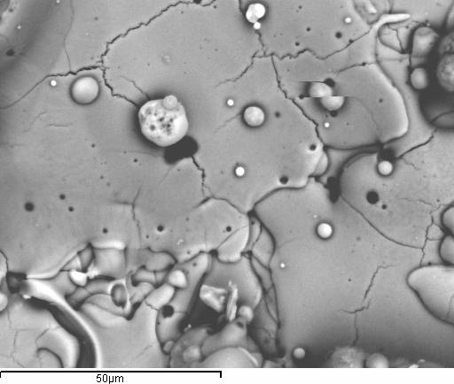
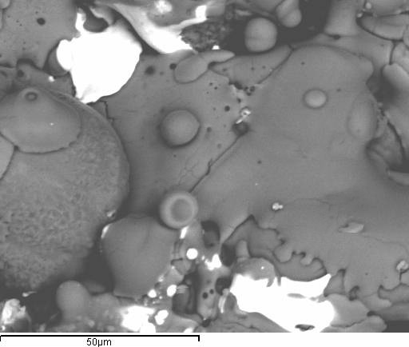
SURFACE AND MICROSTRUCTURE OF PLAZMA SPRAYED COATINGS
Surface of plasma coating on the basis of Al2O3
(microscopic cracks are visible )
Microstructure of coating on the basis of Al2O3
(interlayer is necessary )
Microstructure of coating on the basis of Al2O3 plated by Ti and Cu (interlayer is not necessary, minimum porosity)
Surface of plasma coating on the basis of Al2O3 plated by Ti and Cu
(there is no microscopic cracks)
(х 1000)
1 –coating, 2-substrate; 3 –interlayer NiAl. (x250)

Slide 16
PROPERTIES OF PLAZMA SPRAYED COATINGS WHITH UDC
Tensile strength of steel samples with the composite coatings of system AlNi- aL and [PG]-10[Ni]- aL
Kinetics of plasma coatings wear on the basis of plated powders
1 – Al₂O₃, 2 – Al2O3/Ті/Al

Slide 17
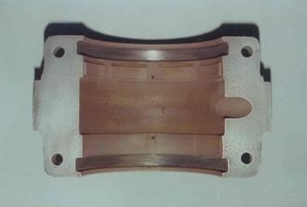
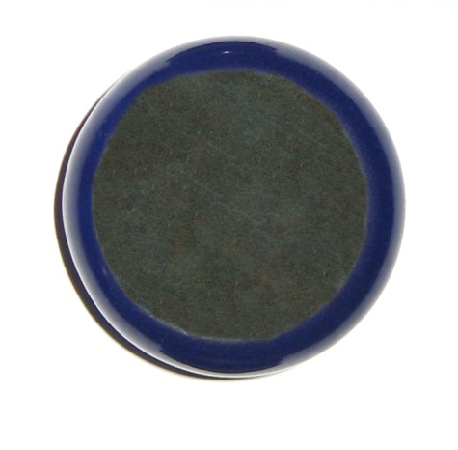
Application of composite powders with ultra disperse constituents
Plasma spraying of the powder Al₂O₃, plated by Ti and Cu to the axial supports of the pump impeller for pumping of aggressive liquid
Plasma spraying of antifriction layer to the bearing surface
the powder [PG]19[M] +[aerosil]
Restoration of the damaged sections of the enamel coatings with plasma spraying of the Al₂O₃ powder plated by Ti and Al
Restoration of the worn blade for the cut of glass mass by plasma spraying of the Al₂O₃ powder plated by Ti and Al
Enamel
Плазменное
покрытие
у

Slide 18
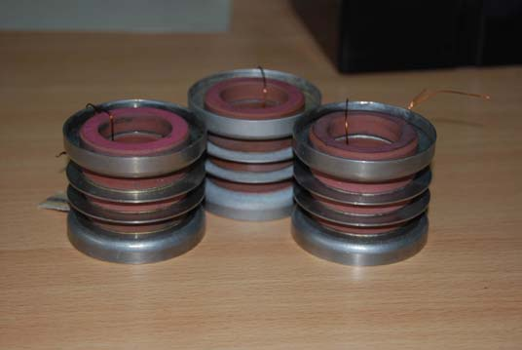
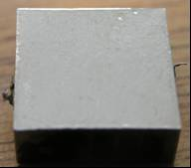
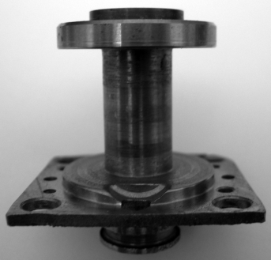
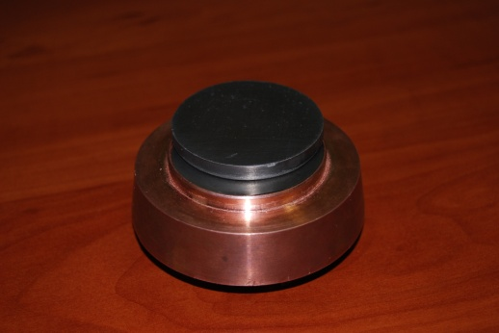
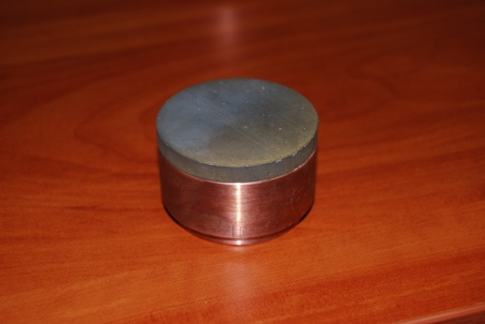
Diffusion technologies in surface engineering
а) б)
The exterior view of the surface of heat resistant alloys [CHS]88[U]-[VI] (a) Inconel 718 (b) alloyed by zirconium with the use of high current electron beam
Cermet pressure seal of electron-beam gun, made by diffusion welding with the fusible padding
Aviation magnetic valve, obtained by the simultaneous diffusion welding of 5 parts from the different materials
Composite cathodes for the ion-plasma spraying of hafnium, executed by the diffusion welding

