Slide 1
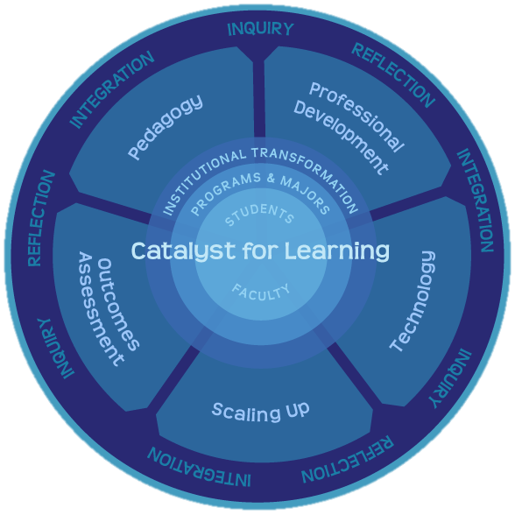
Designing the University for 2030: ePortfolio as a Catalyst for Change
Randy Bass
Georgetown University
University of Waterloo
March 27, 2014
Notes:
Thesis: although the current movement toward massive online learning holds promise, the current context is being dominated by an “instructionist” paradigm that emphasizes presentation of material and machine-guided learning. This is effective for a particular kind of learning, especially in certain disciplines at the lower end of knowledge. But it doesn’t address a wider definition of learning that is more constructionist—focused on social learning, making, experimentation, and connecting. Some of these limitations, at least in the short run, might be embedded in the concept of “massiveness” (and the dreams of scale) itself.

Slide 2
2030

Slide 3
“What the hell is the World Wide Web?”
1994

Slide 4
2030
Designing for context not content

Slide 5
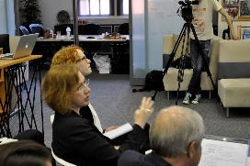
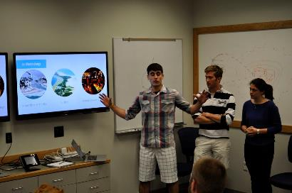
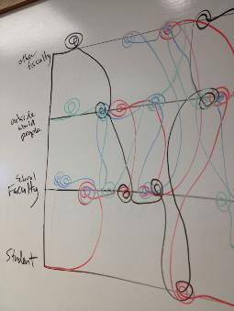
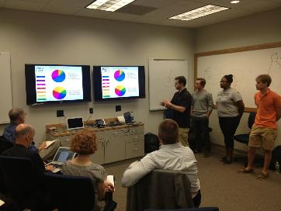
“The Future of the University as a Design Problem” (Spring 2014) taught with Ann Pendleton Jullian

Slide 6
What will the world be like in 2030? What will the conditions of knowledge, technology, learning and work be in 15-20 years? What kind of graduate do we want to produce?
What might a design approach look like?

Slide 7
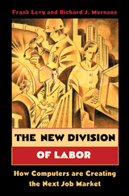
Changing Capacities and
Outcomes for the 21st C
“the human labor market will center on three kinds of work:
solving unstructured problems, working with new information, and carrying out non-routine manual tasks.”

Slide 8
What kind of education is needed at this moment of history? What kind of education is only possible in these emerging conditions?
What might a design approach look like?

Slide 9
“Universities are primarily equipped only to look in the rear-view mirror.”
John Seely Brown

Slide 10
Our understanding of learning has expanded at a rate that has far outpaced our conceptions of teaching.

Slide 11
Learning Paradigm:
Learning –focused
Outcome-driven
Student-centered
Expanding understanding of learning &
changing skillset required for the 21st C
Growing mismatch between these changing aspirations for learning and our structures

Slide 12
High Impact Practices (National Survey of Student Engagement--NSSE)
First-year seminars and experiences
Learning communities
(Common intellectual experiences)
Writing-intensive courses
Collaborative assignments
Undergraduate research
Global learning/ study abroad
Internships
Community-based learning
Capstone courses and projects
George Kuh, High Impact Practices: What are they, who has access to them, and why they matter. (AAC&U, 2008)
Notes:
This is the list of High Impact Practices, according to the data that has come out of NSSE. You’ll note that these are all either in the co-curriculum or anomalous curricular experiences.

Slide 13
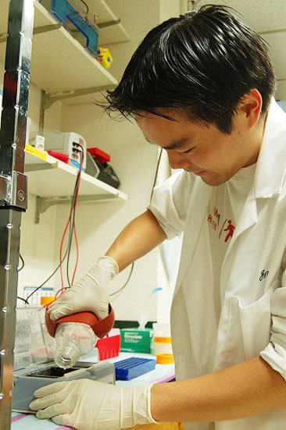
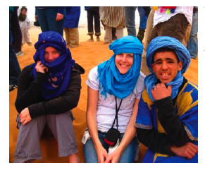
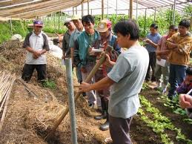
Study abroad
Internships
Undergraduate research
Experiential
co-curriculum
Experiential
co-curriculum
Collaborative Assignments
Formal undergraduate curriculum
First-year Seminars
Student Affairs
Advising
Community-based learning
Writing-intensive
Capstone courses
Experiential
co-curriculum
Where are the high-impact practices located?

Slide 14
What makes High Impact Practices high impact?
Experiential
co-curriculum
Invest time and effort (time on task)
Experiential
co-curriculum
Accountable talk and thinking
Formal undergraduate curriculum
Get (and give) frequent and meaningful feedback
Make daily decisions – judgment in uncertainty
Experiential
co-curriculum
Meet challenges to perspectives and belief, take risks, operate outside comfort zone
NEW ECOLOGY FOR LEARNING
Opportunity to integrate, synthesize, make meaning

Slide 15
Changing Capacities and
Outcomes for the 21st C
“the human labor market will center on three kinds of work:
solving unstructured problems, working with new information, and carrying out non-routine manual tasks.”

Slide 16
What makes High Impact Practices high impact?
Experiential
co-curriculum
Invest time and effort (time on task)
Experiential
co-curriculum
Accountable talk and thinking
Formal undergraduate curriculum
Get (and give) frequent and meaningful feedback
Make daily decisions – judgment in uncertainty
Experiential
co-curriculum
Meet challenges to perspectives and belief, take risks, operate outside comfort zone
NEW ECOLOGY FOR LEARNING
Opportunity to integrate, synthesize, make meaning

Slide 17
Disrupting Ourselves

Slide 18
What difference could Learning Portfolios make to the
future of higher education?

Slide 19
“The future is already here. It is just not evenly distributed.”
William Gibson

Slide 20
ePortfiolio help institutions address priorities and meet challenges they didn’t know they had thirty years ago.
“ePortfolio is rare among innovations in that they are not really replacing anything.”
(Trent Batson)
Notes:
Begin Section III here. This is our key assertion. Move from here to the idea of bridging paradigms and then discuss disruption, implications, and response in ways that follows the right hand column of the chart.

Slide 21
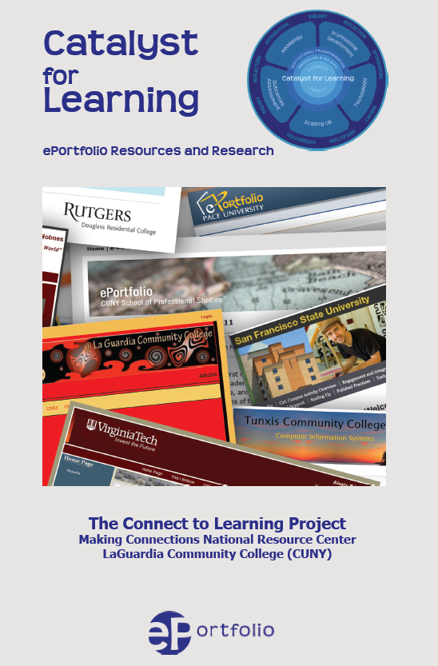
ePortfolio: What Have We Learned?
Findings from the
Connect to Learning Project
C2L.mcnrc.org

Slide 22
Connect to Learning
FIPSE Funded national project, led by LaGuardia’s Making Connections National Resource Center
Partnership w/ AAEEBL, Trent & Judy Batson
Bret Eynon, Director
Judit Torok, Co-director
Laura Gambino, Research Director
Mikhail Valentin, Web Design
Randy Bass & Helen Chen
Senior Research Scholars

Slide 23
Notes:
24 campuses engaged in sustained networked inquiry
GO TO WEBSITE, IF FEASIBLE – IF NOT, USE NEXT SLIDE

Slide 25
What Difference does ePortfolio Make? C2L evidence supports 3 preliminary claims
Sophisticated ePortfolio initiatives:
Advance Student Learning & Success
Make Student Learning Visible
Catalyze Institutional Change

Slide 26
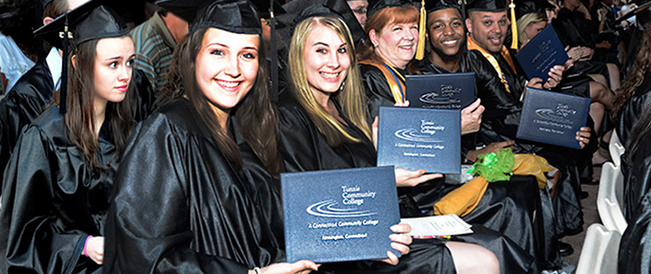
Claim # 1: ePortfolio initiatives Advance Student Learning & Success
At a growing number of campuses with sustained portfolio initiatives ePortfolio practices correlate with higher levels of student success, as measured by pass rates, GPA, retention, graduation, etc.

Slide 27
Claim # 1: ePortfolio initiatives advance student learning & success.
Helping students reflect on & connect their learning across academic, co-curricular and community-based learning experiences, sophisticated ePortfolio practices correlate with higher levels of student success, as measured by pass rates, GPA and retention.

Slide 28
ePortfolio was introduced into a required first semester “Mission” course in 2008-9, and student performance improved
 | Pre ePortfolio (2007-8) | Post ePortfolio 2009-12
GPA in Mission Course | B (3.213) | B+ (3.508)
GPA in all first semester courses | B- (2.933) | B (3.095)

Slide 29
ePortfolio integrated into Metro Health Academies, an SFSU learning community project for high-risk students
 | Metro Academy, First Year/First Time Students | All SFSU First Year/ First Time Students
1 Yr Retention Rate | 90.0% | 79.3%
3 Yr Retention Rate | 79.0% | 60.0%
4 Yr Grad’n Rate | 24.6% | 14.9%

Slide 30
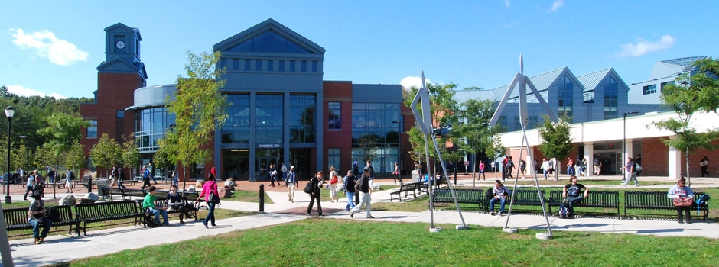
Tunxis Community College

Slide 31
How does ePortfolio Shape the Student Learning Experience?
C2L Core Survey
Conducted on multiple C2L campuses across three semesters: Fall 2011, Spring 2012, Fall 2012 (Spring 2013 pending) n=6,729
Goal: to build a common data set that can help us better understand the contours of the ePortfolio-enhanced student learning experience

Slide 32
Building my ePortfolio | Agree/ Strongly Agree
Helped me make connections between ideas | 75.6%
Helped me think more deeply about course content | 64.4%
Allowed me to be more aware of my growth & development as a learner | 69.3%
My (ePortfolio-enhanced) course engaged me in… | Quite a Bit/ Very Much
Synthesizing & organizing ideas, information or experiences in new ways | 83.1%
Applying theories or concepts to practical problems or in new situations | 77.2%
My course contributed to my knowledge, skills and personal development in understanding myself | 78.6%

Slide 33
What makes High Impact Practices high impact?
Experiential
co-curriculum
Invest time and effort (time on task)
Experiential
co-curriculum
Accountable talk and thinking
Formal undergraduate curriculum
Get (and give) frequent and meaningful feedback
Make daily decisions – judgment in uncertainty
Experiential
co-curriculum
Meet challenges to perspectives and belief, take risks, operate outside comfort zone
NEW ECOLOGY FOR LEARNING
Opportunity to integrate, synthesize, make meaning

Slide 34
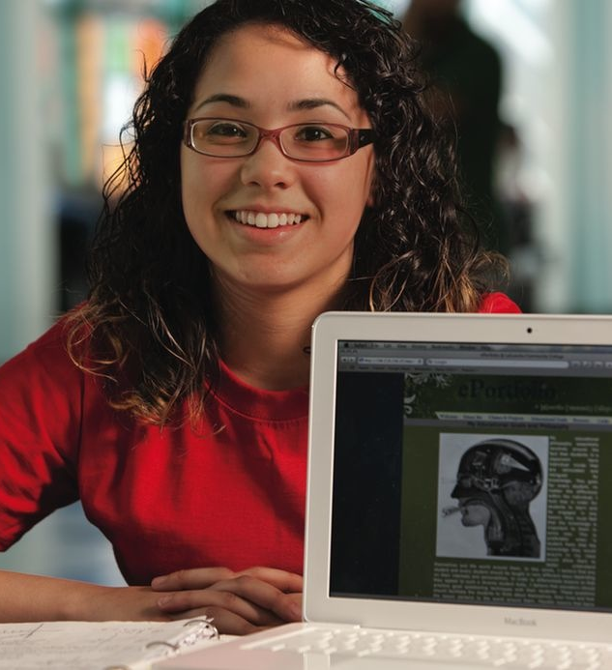
Claim #2: ePortfolio Initiatives Make Student Learning Visible
ePortfolio initiatives support reflection, social pedagogy, and deep learning.
Helping students reflect on and connect their learning across academic and co-curricular learning experiences, sophisticated ePortfolio practices transform the student learning experience. Advancing higher order thinking and integrative learning, the connective ePortfolio helps students construct purposeful identities as learners.

Slide 35
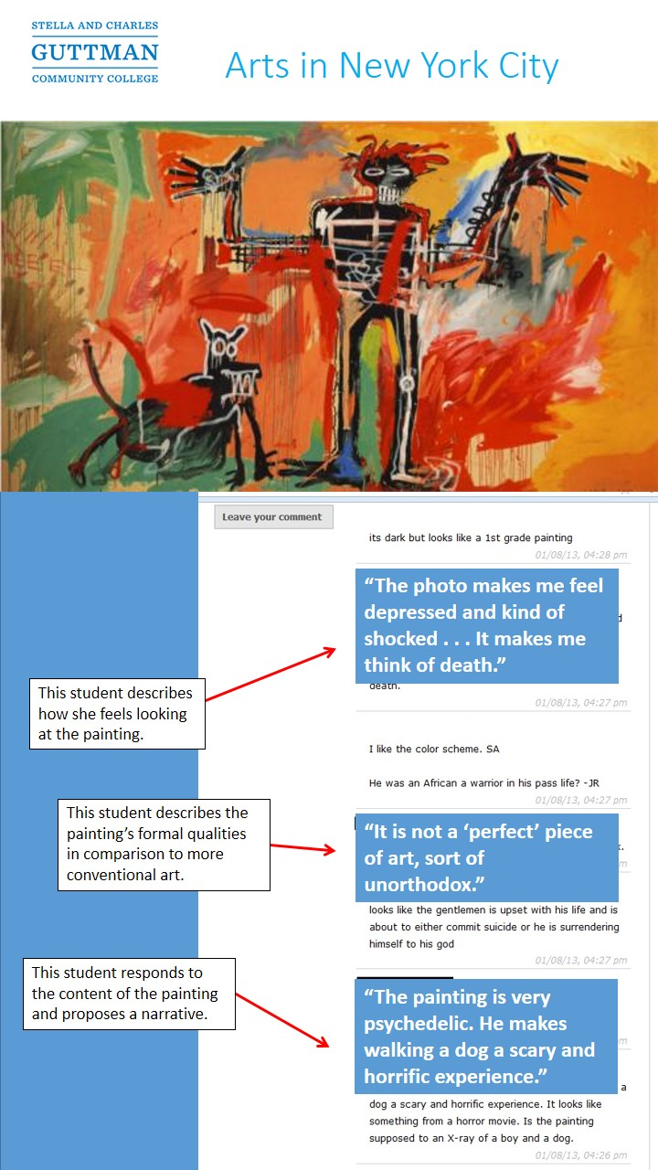
Making Learning Visible to Others
ePortfolio as a Social Pedagogy
Feedback, Peer Critiques
External Audiences – Family, Professionals, Experts in the field
Collaborating on Shared Projects
Constructing Sustained Knowledge Communities

Slide 36
Building my ePortfolio helped me to make connections between ideas…

Slide 37
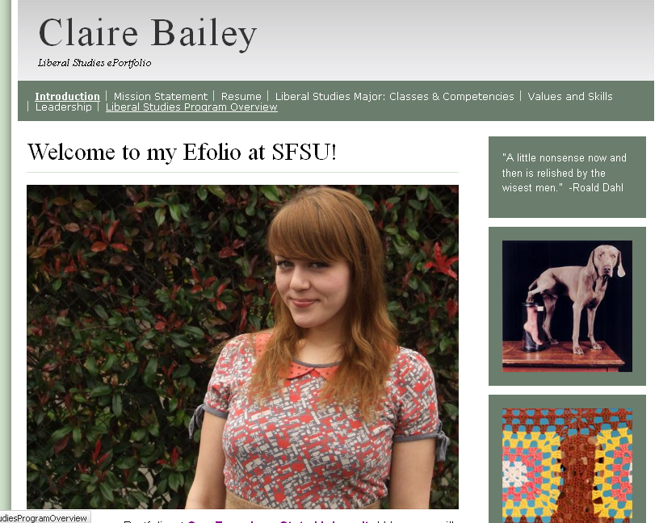
Sophisticated ePortfolio practice makes the integrative qualities of student learning visible to faculty and the institution. Grounding outcomes assessment in these artifacts helps faculty see classrooms, students, and their own work in new contexts, empowering them to “close the loop” in unique and powerful ways.
Authentic Artifacts of
Integrative Learning
Re-Design Program
Curricula & Pedagogy
Purposeful
Faculty Engagement
Learning-Focused
Institutional Outcomes
Assessment

Slide 38
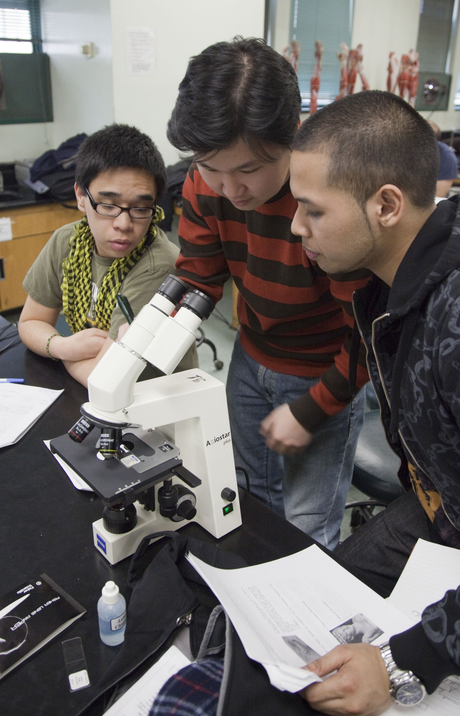
Claim #3: ePortfolio initiatives Catalyze learning-centered Institutional Change
Focusing attention on student learning and prompting purposeful connection across departments and divisions, ePortfolio initiatives can catalyze campus cultural and structural change, helping the institution move towards becoming an adaptive learning organization.

Slide 39
Being Disrupted

Slide 40
A Brief History of the Past Three Years in Higher Education

Slide 41
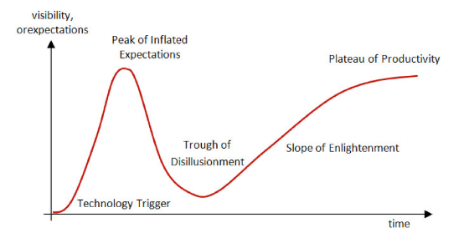
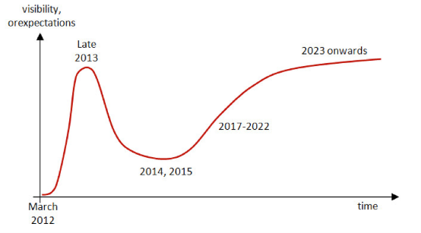
http://pando.com/2013/09/13/moocs-and-the-gartner-hype-cycle-a-very-slow-tsunami/

Slide 42
External Forces of Potential Disruption

Slide 43
We are working out a great tension between integration and dis-integration.

Slide 44
“I have 150,000 data points about your students that you don’t have.”
CEO, Knewton

Slide 45
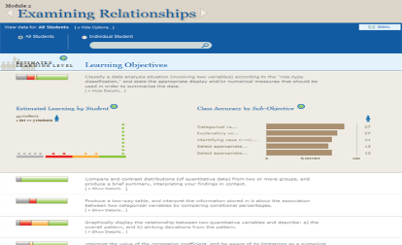
Learning Analytics:
Personalization of learning
…through data
…at scale
“Learning analytics is the new black.”
Oded Meyer, Georgetown

Slide 46
The split logic of the learning paradigm
Disintegrative (granular):
Design of discrete experiences
Outcomes driven
Competency-based
Focus on what’s measureable
Learning decoupled from formal boundaries
Integrative (holistic, coherent):
Design of whole learning experiences
Curricular and co-curricular
Competencies conceived as part of a whole vision of learning
Connections
Formation

Slide 47
ePortfolios for the new ecology

Slide 48
The Recentered Curriculum

Slide 49
Engaging Difference
Ethical Judgment
Self-Reflection
Practitioner education, leadership
Massive
Online
Blended
Formal undergraduate curriculum
High impact integrative
curriculum
Experiential
co-curriculum
Foundational Knowledge
Some generic and interchangeable
Some institutionally-distinctive expertise
Institutional Brand and Identity
Local and Identity
Jesuit and Catholic
Mentor-based
tradition
Residential, Diverse
LOCUS OF INTEGRATIVE LEARNING

Slide 50
Learning Portfolios
Kathleen Yancey
Delivered Curriculum
Experienced Curriculum
Lived Curriculum

Slide 51
Learning Portfolios and the future recentered Curriculum
Self-authorship
Students learn on an arc that moves them inward and outward
Contributing to a knowledge community
Developmental Outcomes
High impact integrative
curriculum
Capacities and dispositions
creativity, resilience, empathy, responsibility, curiosity
Unstructured problems
Inquiry
Social pedagogies
Foundational Knowledge
Some generic and interchangeable
Some institutionally-distinctive expertise
Local and Identity-specific
Urban setting
Community-based
Mentor-based
Residential, Diverse
What will universities be for?
Notes:
Collapse into one or just narrate the analytics piece in the text.

Slide 52
“Through my ePortfolio I learned how to express myself as a hard working student. Being a shy girl was always an issue for me. This ePortfolio helped me to see a new me… the potential I have as a student and what I want to accomplish in my life.” Rezwana Islam
Building my ePortfolio | Agree/ Strongly Agree
Allowed me to be more aware of my growth & development as a learner | 69.3%
Helped me make connections between ideas | 75.6%

Slide 53
Portfolios: You have to Look IN, Before you can Look OUT
What’s My Story?
What’s My Story for Others?
What’s My Story in New Media?
Master’s Program in Communication, Culture and Technology (Georgetown)
Professor Jeanine Turner

Slide 54
Northeastern University
“[based on our read of the portfolios… the redesign transformed the program from a collection of courses into an intentionally designed learning experience… from a ‘degree with a portfolio requirement’ into a portfolio program whose students graduate with a collection of signature work that evidences their capabilities.”
“Are we who we think we are? ePortfolios as a Tool for Curriculum Redesign.” Gail Matthews-DeNatale

Slide 55
Learning Analytics “attainment” “activity”
Authentic student work
Artifacts of inquiry and practice (e.g w/VALUE rubrics)
Learning Analytics
“dispositional”
Formal undergraduate curriculum
High impact integrative
curriculum
Experiential
co-curriculum
Foundational Knowledge
Some generic and interchangeable
Some institutionally-distinctive expertise
ePortfolios as capture of the whole education and institutional value
Integrative of all analytics?
Local and Identity-specific
Urban setting
Community-based
Mentor-based
Residential, Diverse
Notes:
Collapse into one or just narrate the analytics piece in the text.

Slide 56
Jack DeGioia, President, Georgetown
Three interlocking and inseparable elements of the University:
Formation of men and women
Knowledge-creation through scholarship and research
Public Good and the Common Good
Notes:
The concept of formation in the Jesuit tradition is at the heart of an education dedicated to shaping students to be fully human and to cultivate a sense of personal responsibility for improving the world. Formation is not just about those ancillary aspects of education that layer onto academic or cognitive development. Formation is fundamentally about the goal of integration, of striving to cultivate a balanced person, with intellectual, affective, creative and reflective capacities.
Formation is also fundamentally a learner-centered concept; it is not only about transmission of knowledge but also what the student or learner makes of all the shaping influences that are provided as part of the environment. This is how, for example, formation is used in the context of professional or practitioner education, as the fullest sense of professional identity. In both the Jesuit tradition and practitioner education, formation is ultimately about how one embodies knowledge, traditions, and values—and expresses them through practice.
See The Formation of Scholars: Rethinking Doctoral Education in the 21st Century (Jossey-Bass, 2008) and related Carnegie studies of the professions.

Slide 57
Formation
Transformation
Integration

Slide 58
2030

Slide 59
Questions, Comments, Feedback Randy Bass Georgetown University bassr@georgetown.edu
PLEASE DO NOT REPRODUCE WITHOUNT PERMISSION

