Slide 1
Concept Mapping Tools
Dr. Mark Morton
Centre for Teaching Excellence
University of Waterloo
mmorton@uwaterloo.ca
www.markmorton.ca

Slide 2
Learning Outcomes for this Workshop
After this workshop you will be able to….
describe the basic functionality that is common to most concept mapping tools (such as CmapTools, Novamind, Vue, and others)
explain why concept maps can enhance learning
develop effective learning activities and teaching strategies involving concept maps
list best practices for using concept maps in your courses
explain how a concept map can be used as a presentation tool

Slide 3
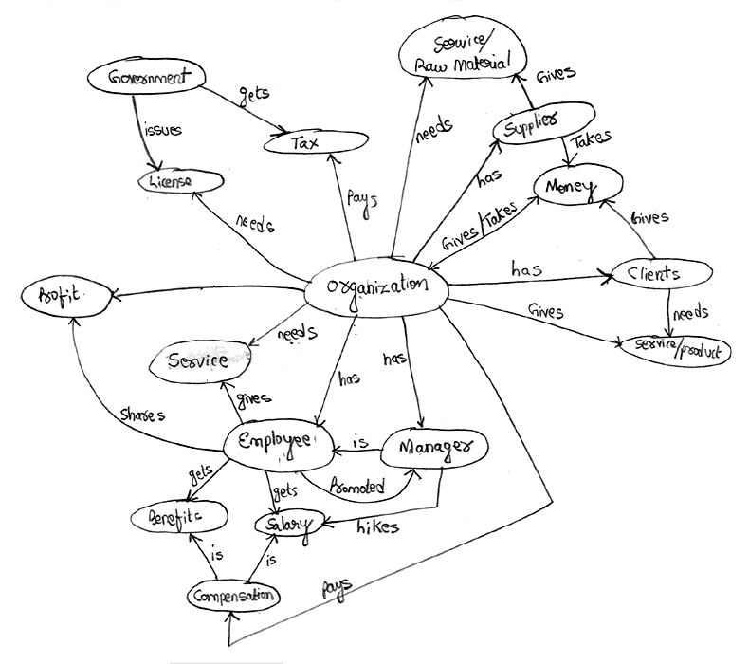
What is a concept map?
A visual representation of the relationships among things, ideas, or procedures.

Slide 4
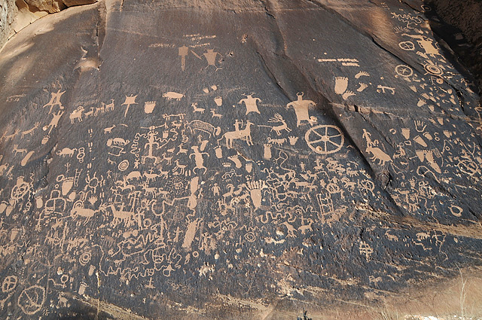
Visual thinking
Concept maps are a form of visual thinking, which seems to be “hard-wired” into humans. We’ve been doing it for thousands of years.
Ancient rock carvings, created around100 AD in what is now Utah

Slide 5
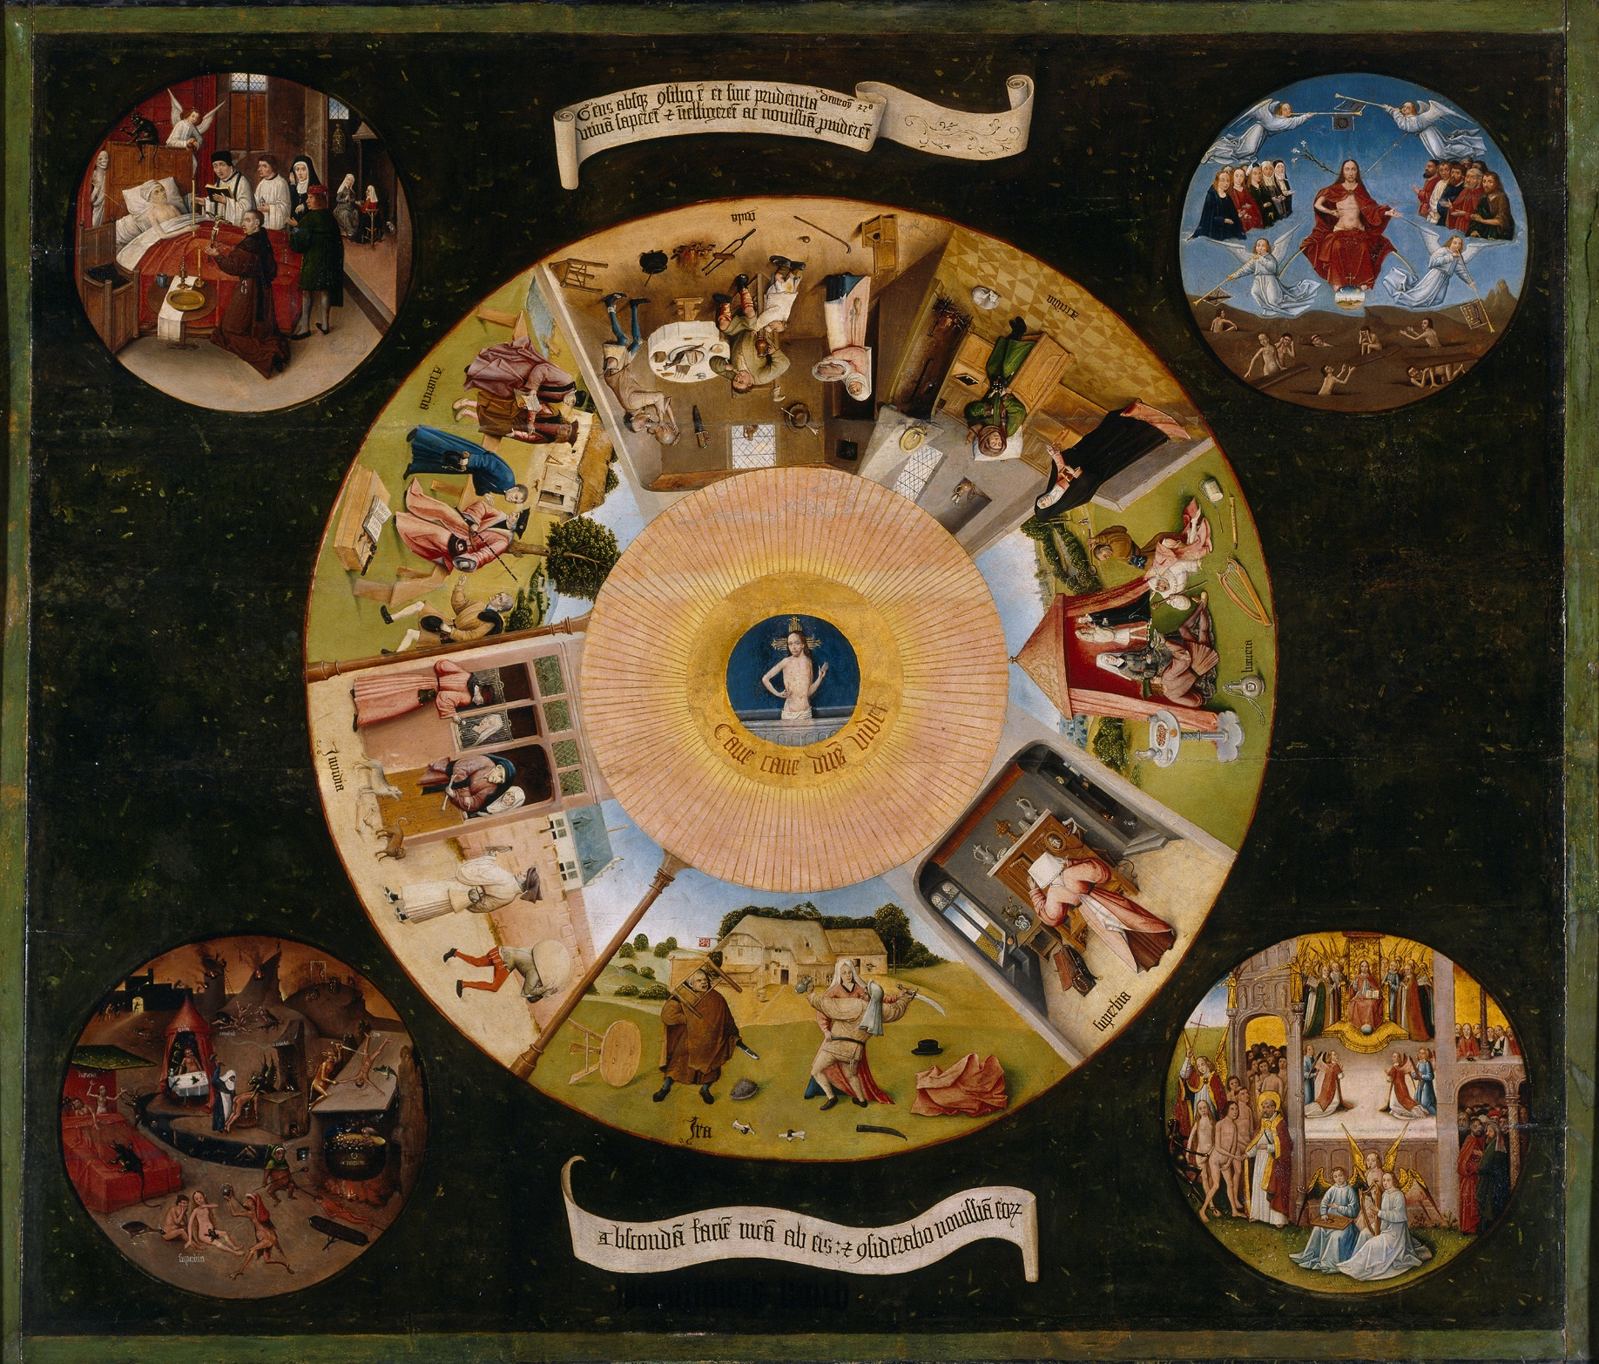
Visual thinking
And we’ve continued to use concept maps in more recent centuries.
Painting of the Seven Deadly Sins by Hieronymous Bosch, around 1525

Slide 6
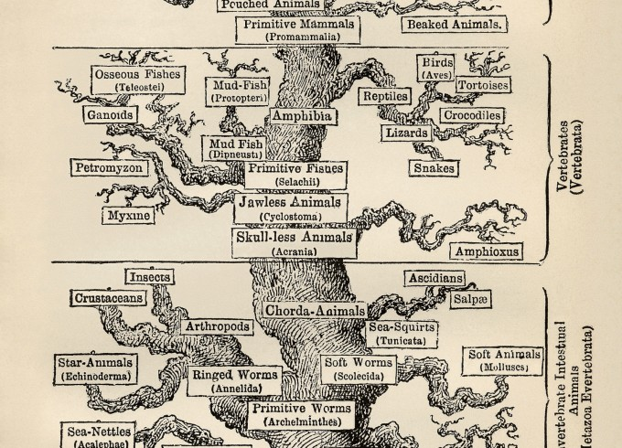
Visual thinking
Humans have also used concept maps in the sciences for centuries
Tree of Life.
Ernst Haeckel, 1807

Slide 7
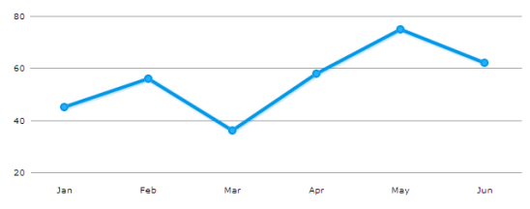
Visual Thinking: Why is it Effective?
Our brain’s visual cortex is able to process an image much more quickly than our cerebral cortex can process data.
Most people are better able to remember a visual representation – such as an image or a graph – than a chart full of numbers.
These two items present the same information, but which one is easier (and faster) to interpret? Which one are you more likely to remember tomorrow?

Slide 8
Evidence of Effectiveness
“The meta-analysis found that, in comparison with activities such as reading text passages, attending lectures, and participating in class discussions, concept mapping activities are more effective for attaining knowledge retention and transfer.” — Nesbitt, 2006.
“The vast majority of articles in this meta-review indicate that concept maps foster the development of meaningful learning, critical thinking and problem solving in the learner…. meaningful learning occurs when the student links new knowledge with previous knowledge, thereby creating more integrated cognitive knowledge structures.” – Daley, 2010

Slide 9
Evidence of Effectiveness
“Concept Mapping appears to be particularly beneficial when it is used in an on-going way to consolidate or crystallize educational experiences in the classroom, for example, a lecture, demonstration, or laboratory experience. In this mode, learners experience an educational event and then use Concept Mapping in a reflective way to enhance the learning from the event.” — Canas, 2003
“Use of the concept mapping software proved to be a powerful tool for improving students’ ability to generate, visualize and organize ideas…. Users of the concept mapping software became faster and more efficient in generating and organizing ideas.” — Al-Jarf, 2009

Slide 10
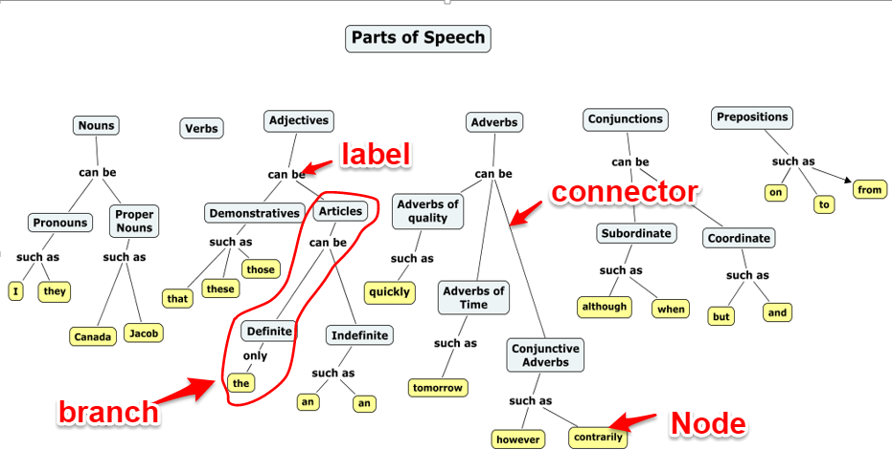
Terminology
A shape that contains a word or phrase is called a “node”
A line that connects two shapes is called a “connector”
The word or phrase that is appears on a connector is called a “label”
A sequence of shapes connected by a series of connectors is called a “branch”
A line that connects two nodes from separate branches is called a “cross link”

Slide 11
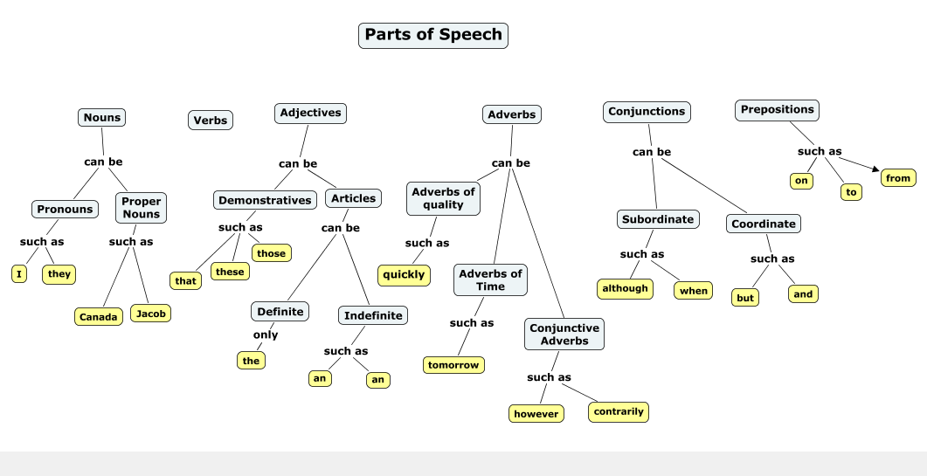
Types of concept maps
Concept maps can have a strict hierarchy – that is, clear “levels” along the branches.

Slide 12
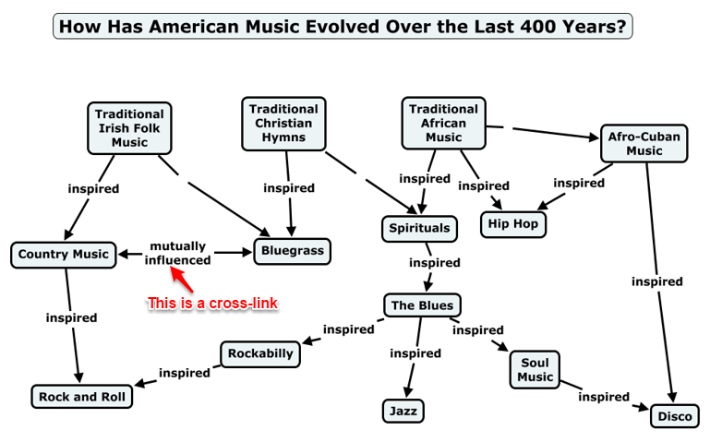
Types of concept maps
Or concept maps can be semi-hierarchical – often, these have cross-links between nodes belonging to separate branches.

Slide 13
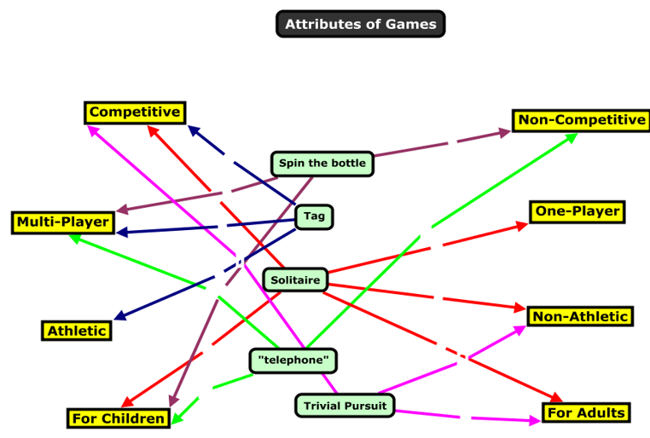
Types of concept maps
Or, concept maps can have no hierarchy – they might simply represent a network.

Slide 14
Advantages of computer-based concept mapping tools over paper & pencil:
Infinite size and complexity
With large concept maps, a user can pan around its various parts
With detailed concept maps, a user can zoom in on specific parts
Dynamic branches
A branch can be closed (to hide its sub branches) and then opened (to reveal the sub branches). Here is a quick example.
Hyperlinked nodes
Nodes can have hyperlinks attached to them, which a user can click to access further resources that are relevant to that node
We’ll see examples of all of these later in the presentation

Slide 15
Advantages of concept mapping tools over paper & pencil:
Rollover text
Nodes can have descriptive or explanatory texts that is not visible until a user puts the cursor over the node
Presentation mode
The creator of the map can create a “path” that leads a user through the concept map in a logical and linear manner
We’ll see examples of all of these later in the presentation

Slide 16
Learning Activity #1
In small groups, share some ideas about how you could use concept mapping tools in your courses. What learning activities could be based on concept maps? How could they enhance your teaching?
After coming up with a few ideas, be prepared to have one person in your small group share those ideas with the large group.
Have students create a concept map to assess their prior knowledge of a topic.
Once a week, have students build concept maps that visually represent the ideas that were covered in that's week's classes.
Have students build a concept map of the course content over the duration of the term, one that maps their growing understanding of the course content.
When lecturing, give students a partially finished concept map:
Give them a map of empty nodes and lines, and have them add the correct terms to the nodes during a lecture (or as homework).
Give them a list of terms with no map, and have them create the map during a lecture (or as homework).
Have students collaborate on making a concept map.

Slide 17
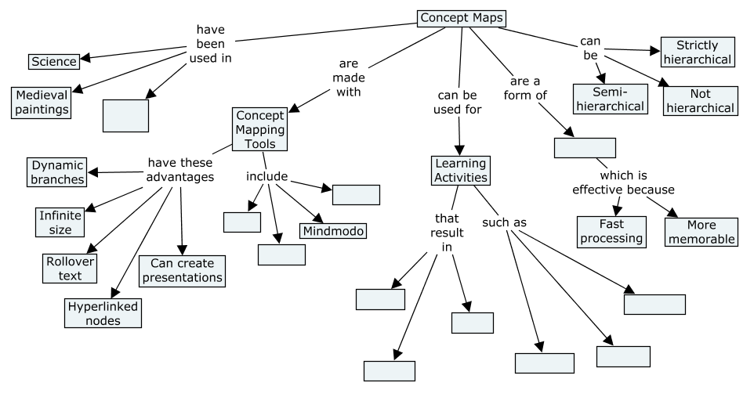
Learning Activity #2
Complete the partially completed concept map that you have been given using these words or phrases (each word or phrase becomes a node):
Ancient rock carvings
Better knowledge retention
CmapTools
NovaMind
Better problem solving
Mapping ideas from a lecture
Collaborating on a map
Better organization skills
Completing partial maps
VUE
Visual thinking

Slide 18
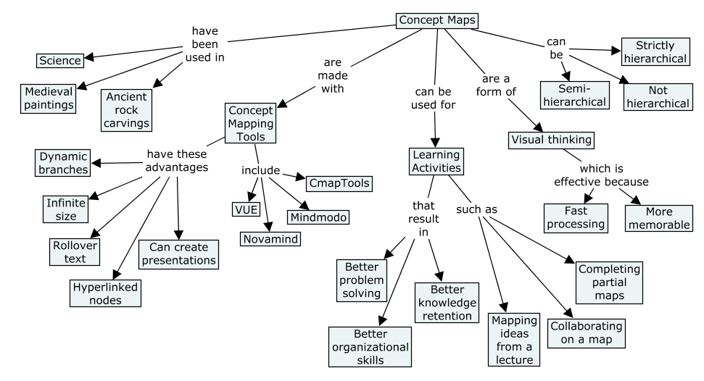
The completed map might look something like this:

Slide 19
Demonstration
A quick demonstration of two concept mapping programs:
MindMeister (I will do a live demo, but if you are viewing this presentation after the workshop, you can watch a demonstration here)
Popplet (I will do a live demo, but if you are viewing this presentation after the workshop, you can watch a demonstration here)

Slide 20
Learning Activity
Create a concept map that shows the relationships among the major topics or ideas in one of your courses. You can do this in one of two ways:
1. Use a sheet of paper and a pencil or pen.
OR
2. Use an online tool:
If you have laptop, go to www.mindmeister.com . Create a free account. Within a couple of minutes, you will be sent an email that confirms your account. Click the link in that email, then sign into Mindmeister with the username and password you created.
If you have an iPad, go to the App Store, search for Popplet Lite, and install it.

Slide 21
Best Practices for using concept maps
Explain to students why you are having them create concept maps.
Use concept maps consistently through the term.
Have students collaborate on creating concept maps
Where appropriate, show students how the same body of knowledge can be represented equally well in different concept maps.

Slide 22
Turning concept maps into presentations
Mindomo (Watch all of this 7-minute video)
CmapTools (Watch the first 5m30s of this 8 min video)
Visual Understanding Environment (VUE) (Watch the first 5m40s of this 9-min video)
Novamind (Similar to Mindomo, so don’t watch any of this 8-minute video during the workshop)

Slide 23
Resources
Novamind
Home
Video tutorial
VUE
Home
Video tutorials
CmapTools
Home
Video tutorial
Mindomo
Home
Video tutorial
A CTE Teaching Tip on concept maps
A CTE screencast on concept maps
Learning activities involving concept maps developed by Harvard University
An overview of research on concept maps, developed by Harvard University

