Slide 1
Learning Outcomes
Concept Mapping Tools
Mark Morton and Samar Mohamed, CTE
After this workshop you will be able to….
explain why concept maps can enhance learning
Identify the various elements of concept maps
describe the basic functionality that is common to most concept mapping tools
list best practices for using concept maps in your courses
develop effective teaching and learning activities involving concept maps
explain how a concept map can be used as a presentation tool (time permitting)

Slide 2
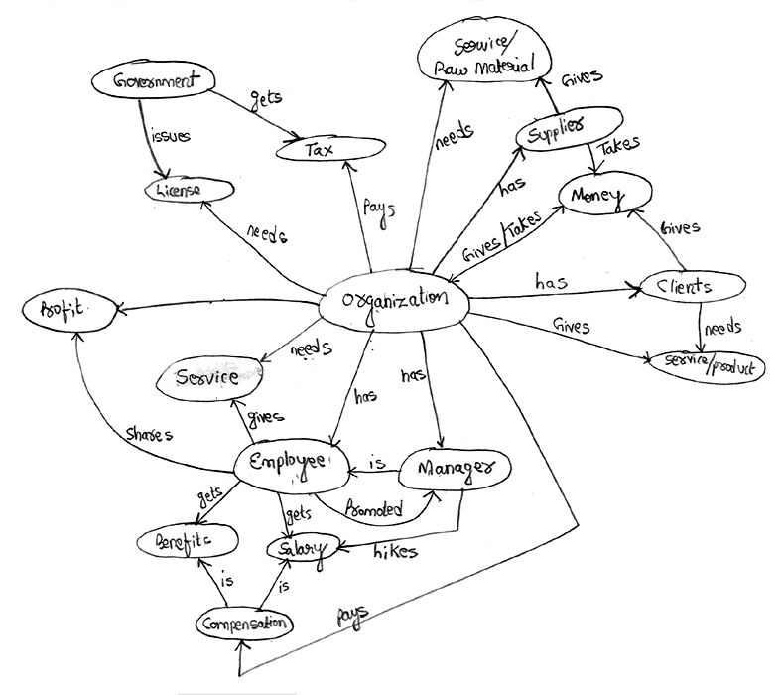
What is a concept map?
A visual representation of the relationships among things, ideas, or procedures.

Slide 3
An Experiment
Each participant in the workshop will be given one of two documents to study for three or four minutes.
We’ll then compare the effectiveness of each document

Slide 4
Concept maps, as developed by Joseph Novak, are a representation of organized knowledge. Organized knowledge, which is necessary for both effective teaching and effective learning, is made up of concepts that are cognitively connected by linking words. Concepts are essentially perceived regularities or patterns that are discerned in events or things. On a concept map, concepts can be labeled either by words or by symbols. Two or more concepts connected by a linking word form a proposition, which is a unit of meaning. Propositions, in turn, can also be connected to each other by a crosslink that shows interrelationships between different segments of a concept map. Concepts in a concept map tend to be hierarchically structured, which facilitates creativity which in turn helps to identify further interrelationships. Concept maps are developed to answer focus questions. The nature of the focus question being asked depends on both the social and personal context of the person asking the question.
Notes:
Text-based document.

Slide 5
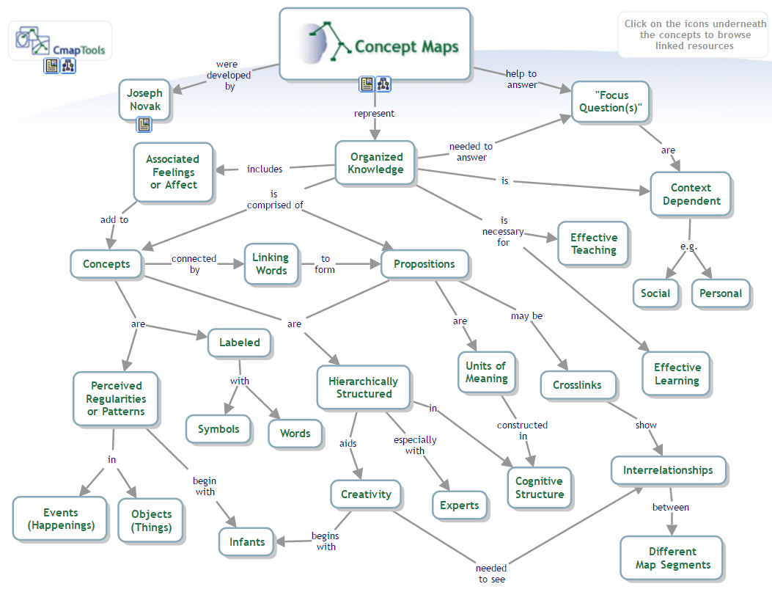
Notes:
Concept map rendering of the same information

Slide 6
Evidence of Effectiveness
“The meta-analysis found that, in comparison with activities such as reading text passages, attending lectures, and participating in class discussions, concept mapping activities are more effective for attaining knowledge retention and transfer.” — Nesbitt, 2006.
“The vast majority of articles in this meta-review indicate that concept maps foster the development of meaningful learning, critical thinking and problem solving in the learner…. meaningful learning occurs when the student links new knowledge with previous knowledge, thereby creating more integrated cognitive knowledge structures.” – Daley, 2010

Slide 7
Evidence of Effectiveness
“Concept Mapping appears to be particularly beneficial when it is used in an on-going way to consolidate or crystallize educational experiences in the classroom, for example, a lecture, demonstration, or laboratory experience. In this mode, learners experience an educational event and then use Concept Mapping in a reflective way to enhance the learning from the event.” — Canas, 2003
“Use of the concept mapping software proved to be a powerful tool for improving students’ ability to generate, visualize and organize ideas…. Users of the concept mapping software became faster and more efficient in generating and organizing ideas.” — Al-Jarf, 2009

Slide 8
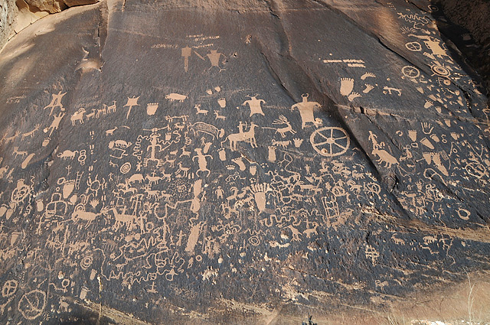
Why Are They Effective?
Concept maps are a form of visual thinking, which humans have long been leveraging.
We were doing it thousands of years ago.
Ancient rock carvings from around 100 AD in Utah

Slide 9
And four centuries ago.
The Armada Portrait, 1588

Slide 10
Spanish Armada, attacking
Spanish Armada, defeated
And four centuries ago.
The Armada Portrait, 1588
She is turning her back on the conflict: peace is ahead
Pillars of Hercules (strength)
Stylized pomegranate, representing prosperity
Her ruff represents holiness (like a halo)
Imperial crown, representing equality with the Holy Roman Emperor
Pearls represent chastity
Mermaid, representing command of the seas
Globe, with her hand on America
Fan of ostrich feathers, representing devotion (Raleigh)

Slide 11
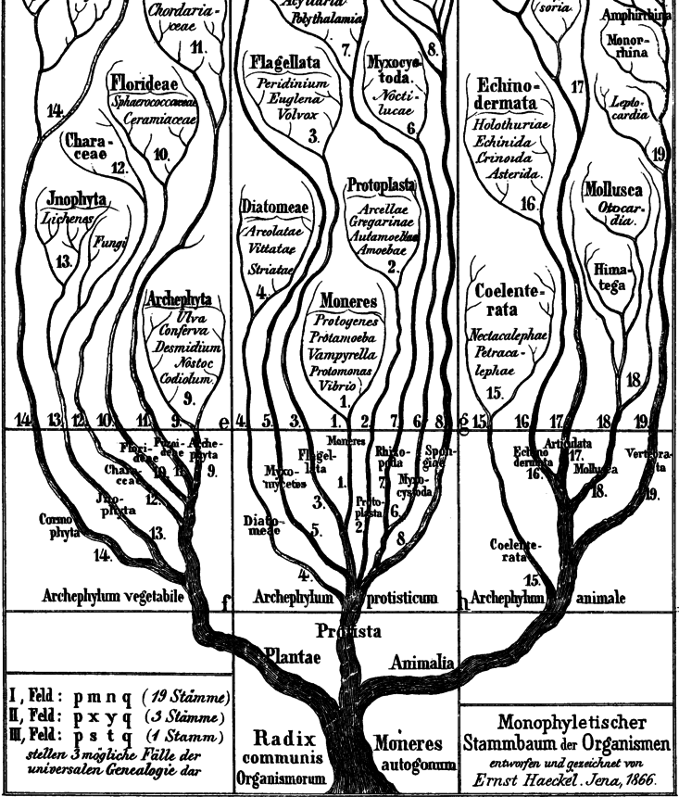
Visual thinking
And 200 years ago.
Tree of Life. Ernst Haeckel, 1807

Slide 12
Visual thinking
And now
Course prerequisites for Computer Science students at Waterloo

Slide 13
Visual Thinking
It seems to be hardwired into us: studies of infants as young as eight-months-old show that they are able to discern patterns and visual relationships.
Acquiring language is a process of identifying relationships and recognizing patterns
Notes:
Source: -- Gasser, M., & Colunga, E. (2003). Pattern learning in infants and neural networks. Connectionist Models of Development. Developmental Processes in Real and Artificial Neural Networks, 233-256.

Slide 14
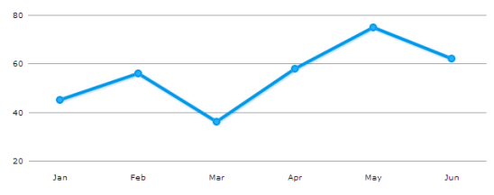
Visual Thinking
Our visual cortex can process an image much faster than our cerebral cortex can process data.
It’s easier to remember a visual representation – such as an image or a graph – than a chart full of numbers.
Notes:
These two items present the same information, but which one is easier (and faster) to interpret? Which one are you more likely to remember tomorrow?

Slide 15
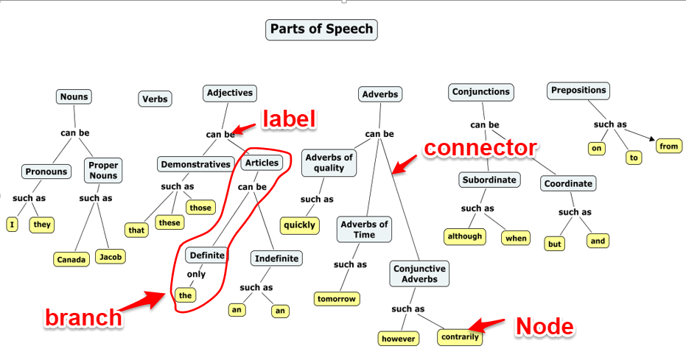
Some Basic Terminology
A shape that contains a word or phrase is called a “node”
A line that connects two shapes is called a “connector”
The word or phrase that is appears on a connector is called a “label”
A sequence of shapes connected by a series of connectors is called a “branch”
A line that connects two nodes from separate branches is called a “cross link”

Slide 16
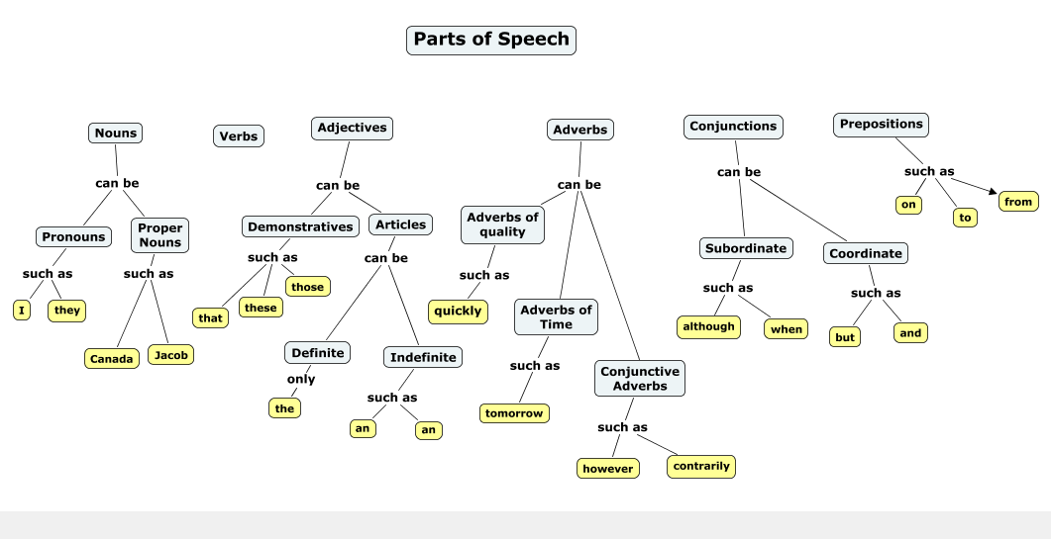
Types of concept maps
Strict hierarchy

Slide 17
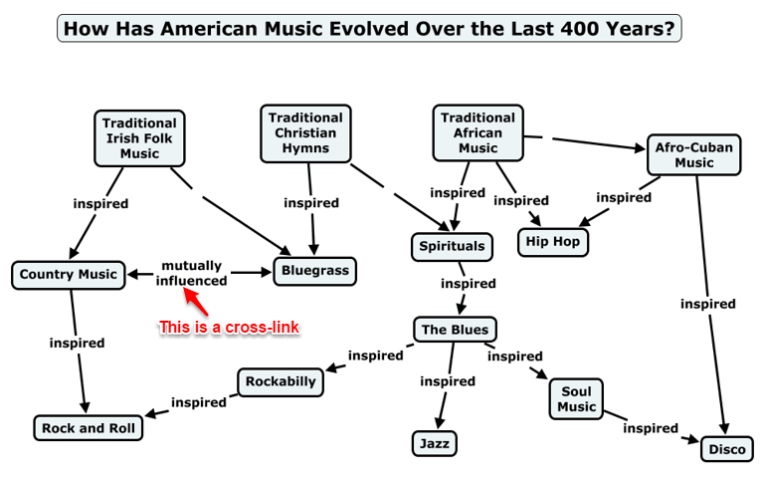
Types of concept maps
Semi-hierarchical
Notes:
Note the cross-links between separate branches.

Slide 18
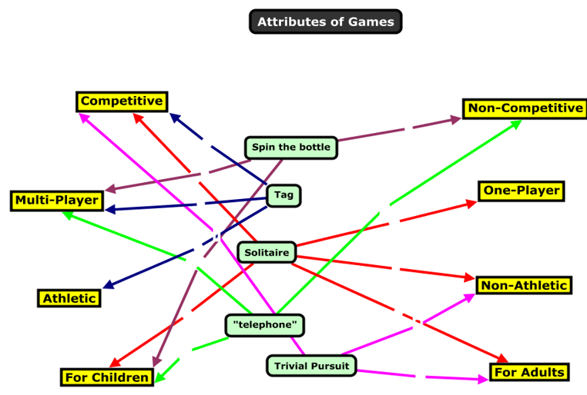
Types of concept maps
No hierarchy
Notes:
Essentially, this represents a network.
Joseph Novak, a leading proponent of concept maps, says that a concept map must have hierarchy. I think that some knowledge systems simply don’t have a hierarchical structure.

Slide 19
Demonstration
A two-minute YouTube video showing how to create a concept map with CmapTools:
Notes:
Key aspects of CmapTools
You can create your concept map by double clicking in several places on your screen (to create blank nodes) and then joining the nodes with connectors.
OR
You can create your concept map by double clicking in one spot on your screen (to create one blank node) and then dragging the connector from the top of node to another part of the screen (where another node will appear).
You can move nodes by clicking and dragging.
You can add the following to nodes: links to web pages; links to files (such as PDFs); links to other concept maps.
You can add information to a node that will “pop up” when the cursor is placed over that node.
You can change the following via the Style Palette:
Font size, font colour, regular, bold, italic
Node shape, node size, node colour
Line colour, line width, line style (continuous, dashed, dotted, etc.)
Arrowhead direction, no arrows, double arrows
To access the Style Palette, you click on “Window” in the top menu, and then select “Show Style Palette.”
You can save your concept map to your PC or you can save it to the CmapTools server. The advantage of the latter is that you can access the concept map from anywhere, and you can share it with others. The disadvantage of saving it to the CmapTools server is that is can sometimes be challenging to find your folder among the thousands of others on the server (they are listed alphabetically, but still it does take a 30 seconds of so; this can be dealt with by adding your CmapTools folder to your “Favorites” list in CmapTools.

Slide 20
Advantages of computer-based concept mapping tools over paper & pencil:
Infinite size and complexity
With large concept maps, a user can pan around its various parts
With detailed concept maps, a user can zoom in on specific parts
Dynamic branches
A branch can be closed (to hide its sub branches) and then opened (to reveal the sub branches). Here is a quick example.
Hyperlinked nodes
Nodes can have hyperlinks attached to them, which a user can click to access further resources that are relevant to that node

Slide 21
Advantages of concept mapping tools over paper & pencil:
Rollover text
Nodes can have descriptive or explanatory texts that is not visible until a user puts the cursor over the node
Presentation mode
The creator of the map can create a “path” that leads a user through the concept map in a preferred, linear manner

Slide 22
Learning Activity
In small groups, share some ideas about how you could use concept mapping tools in your courses. What learning activities could be based on concept maps? What makes these learning activities effective?
Have students create a concept map to assess their prior knowledge of a topic.
Once a week, have students build concept maps that visually represent the ideas that were covered in that's week's classes.
Have students build a concept map of the course content over the duration of the term, one that maps their growing understanding of the course content.
Have students collaborate on making a concept map.
When lecturing, give students a partially finished concept map:
Give them a map of empty nodes and lines, and have them add the correct terms to the nodes during a lecture (or as homework).
Give them a list of terms with no map, and have them create the map during a lecture (or as homework).
Notes:
7 mins for LA and up to another 15 for presentation and discussion

Slide 23
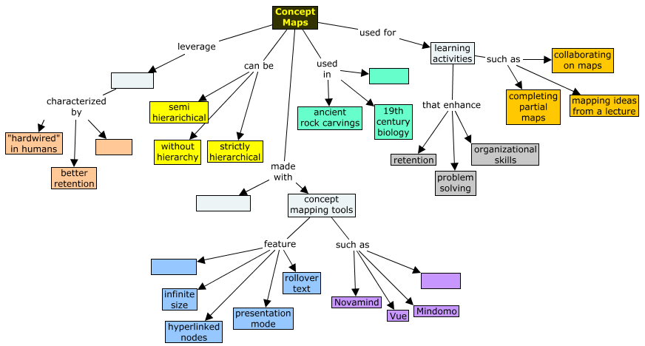
Example
Complete the partially completed concept map that you have been given using these words or phrases (each word or phrase becomes a node):
CmapTools
16th-century portraits
fast processing
dynamic branches
mapping ideas from a lecture
visual thinking
pencil & paper

Slide 24
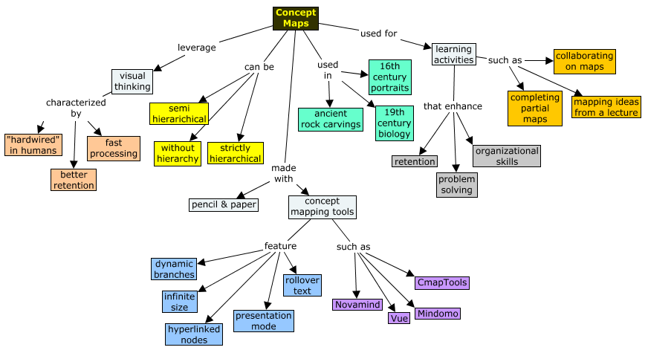
The completed map might look something like this:

Slide 25
Best Practices for using concept maps
Explain to students why you are having them create concept maps.
Have students use concept maps actively: i.e. don’t just give them a concept map, but rather have them build it.
Use concept maps consistently through the term.
Have students collaborate on creating concept maps

Slide 26
Learning Activity
Use pen and paper to create a concept map that shows the relationships among the major topics or ideas in one of your courses.

Slide 27
Turning concept maps into presentations
Mindomo
CmapTools
Visual Understanding Environment (VUE)
Novamind
Notes:
Mindomo (Watch all of this 7-minute video)
CmapTools (Watch the first 5m30s of this 8 min video)
Visual Understanding Environment (VUE) (Watch the first 5m40s of this 9-min video)
Novamind (Similar to Mindomo, so don’t watch any of this 8-minute video during the workshop)

Slide 28
Resources
Novamind
Home
Video tutorial
VUE
Home
Video tutorials
CmapTools
Home
Video tutorial
Mindomo
Home
Video tutorial
A CTE Teaching Tip on concept maps
A CTE screencast on concept maps
Learning activities involving concept maps developed by Harvard University
An overview of research on concept maps, developed by Harvard University

