Slide 1
Concept Mapping Tools
Dr. Mark Morton
Centre for Teaching Excellence
University of Waterloo
mmorton@uwaterloo.ca
www.markmorton.ca

Slide 2
Learning Outcomes for this Workshop
After this workshop you will be able….
distinguish four different concept mapping tools
create a sophisticated concept map using CmapTools
explain how instructors can use concept maps as an effective presentation tool
develop concept map learning activitiesfor students that will enhance their learning.

Slide 3
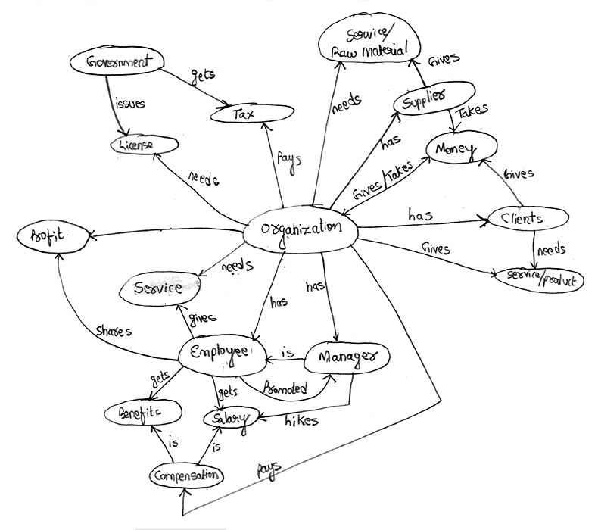
Basic Functionality of CmapTools
With CmapTools you can make a concept map (a visual representation of relationships among things or ideas) just as you can with pen and paper.
Additional features will be identified later.

Slide 4
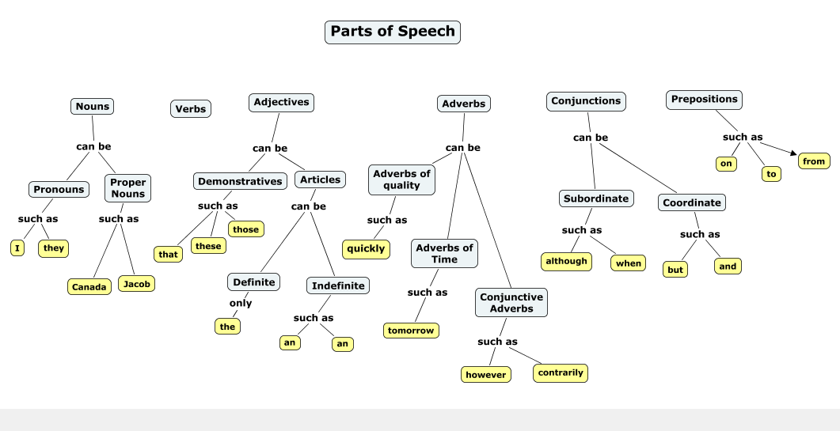
The kinds of concept maps you can make with CmapTools: Vertical hierarchy

Slide 5
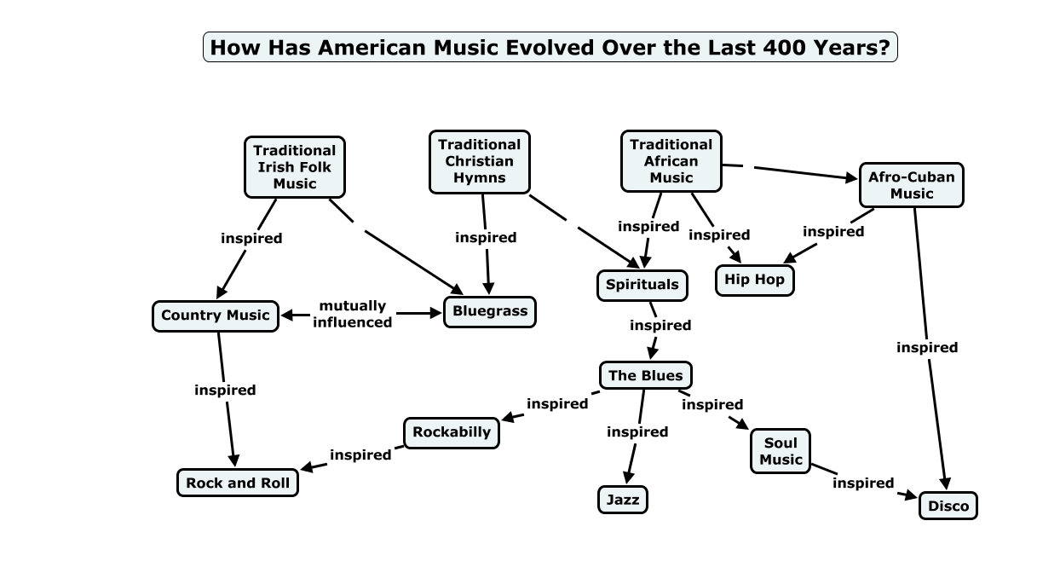
The kinds of concept maps you can make with CmapTools: Less vertical hierarchy

Slide 6
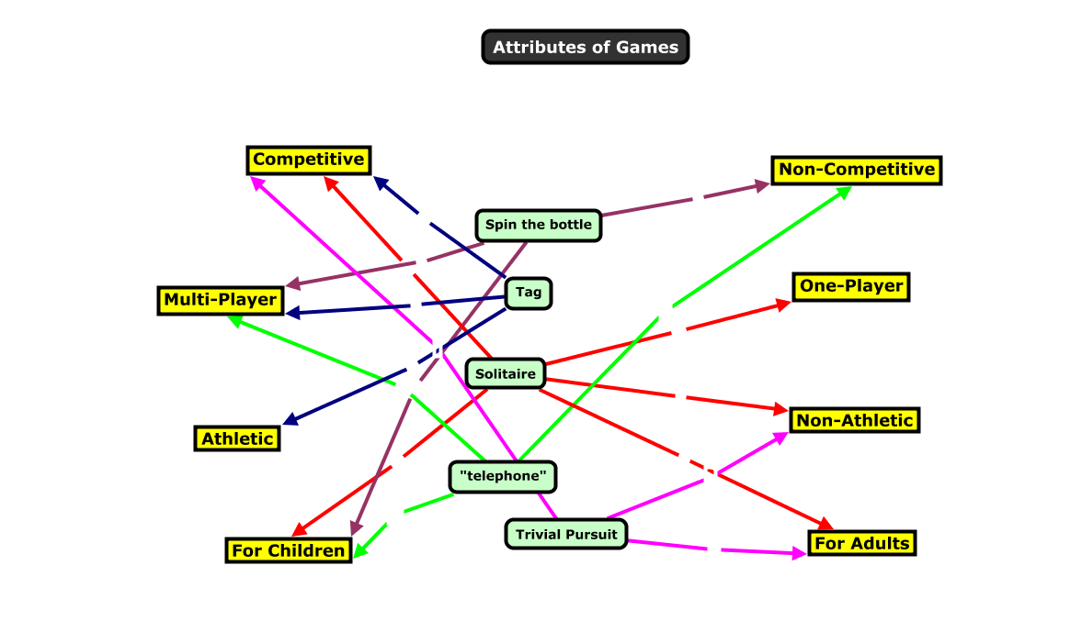
The kinds of concept maps you can make with CmapTools: No hierarchy

Slide 7
Some key features of CmapTools
Go to the CmapTools program to demonstrate the following:
Nesting
Hyperlinked nodes
Rollover text
Presentation mode
How to make a concept map

Slide 8
Small group brainstorming
Based on your understanding of the functionality of CmapTools, how could you incorporate that tool into your teaching practice to enhance your student’s learning experience?
Have your students create a concept map to assess their prior knowledge
Every week, have students build concept maps that visually represent the ideas and information that were covered in that's week's classes or readings.
Have students build a concept map of the course content over the entirety of the term, one that charts their growing understanding of the course content.
When lecturing, give your students a partially finished concept map: either the map of nodes and lines without labels, or a list of labels with no map. Have them complete it during a lecture or as an assignment.
Have students collaborate on making a concept map.

Slide 9
Small group brainstorming
What best practices can you propose to support effective use of concept mapping tools in your courses?
Use concept maps consistently through the term.
Explain to students why you are having them create concept maps.
Collaboration
Where appropriate, show students how the same body of knowledge can be rendered equally well with very different concept maps.

Slide 10
Evidence of Efficacy
“The meta-analysis found that, in comparison with activities such as reading text passages, attending lectures, and participating in class discussions, concept mapping activities are more effective for attaining knowledge retention and transfer. Concept mapping was found to benefit learners across a broad range of educational levels, subject areas, and settings.” — Nesbitt, 2006.
“The vast majority of articles in this review indicate that concept maps foster the development of meaningful learning, critical thinking and problem solving in the learner. As indicated in these studies, meaningful learning occurs when the student links new knowledge with previous knowledge, thereby creating more integrated cognitive knowledge structures.” – Daley, 2010
“Concept Mapping appears to be particularly beneficial when it is used in an on-going way to consolidate or crystallize educational experiences in the classroom, for example, a lecture, demonstration, or laboratory experience. In this mode, learners experience an educational event and then use Concept Mapping in a reflective way to enhance the learning from the event.” — Canas, 2003

Slide 11
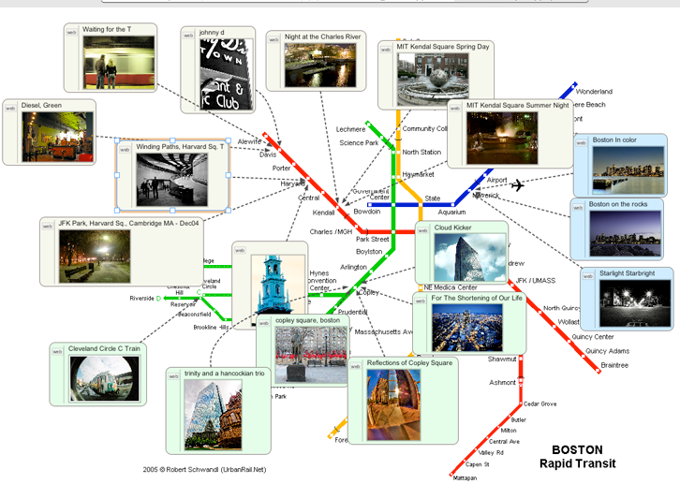
Alternatives to CmapTools: VUE

Slide 12
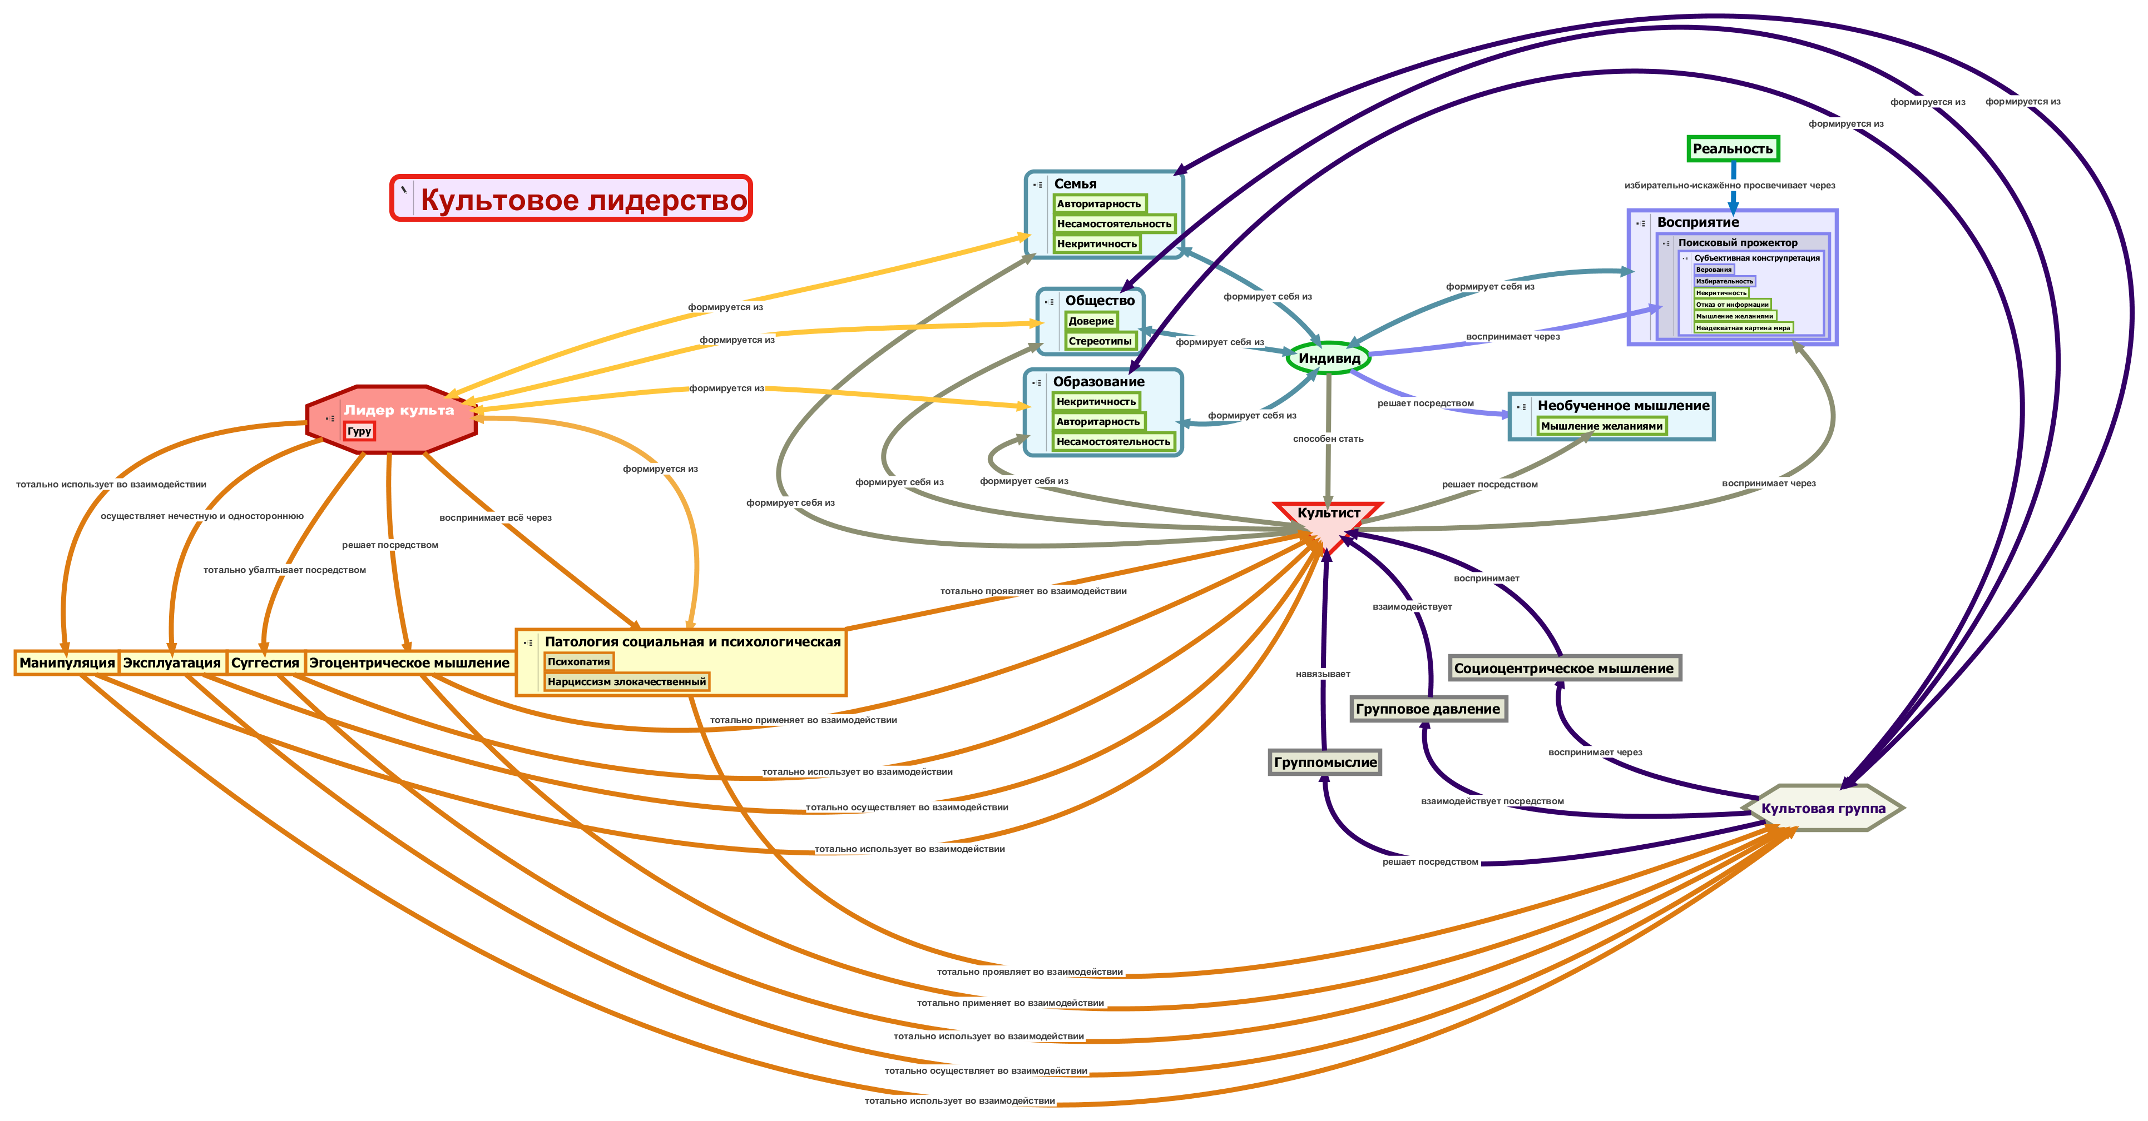
Alternatives to CmapTools: VUE

Slide 13
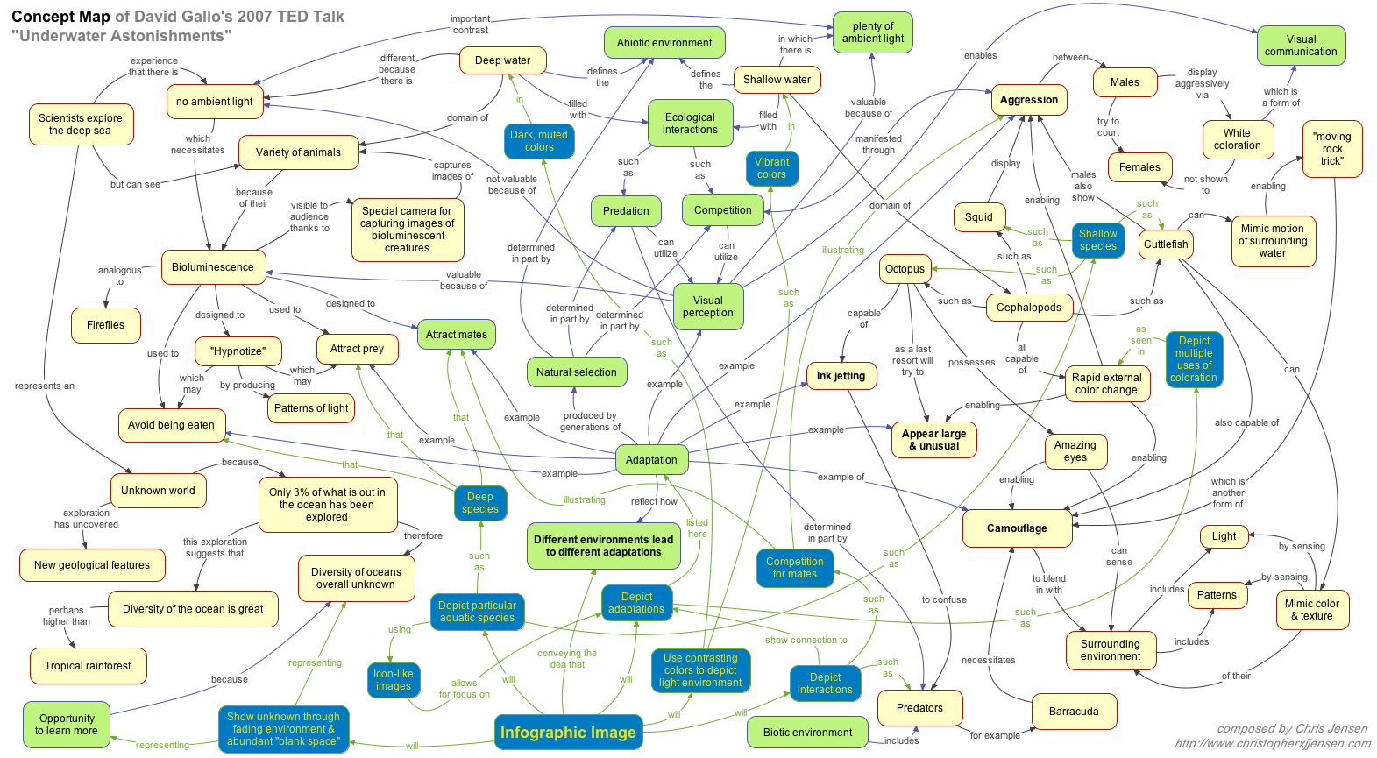
Alternatives to CmapTools: VUE

Slide 14
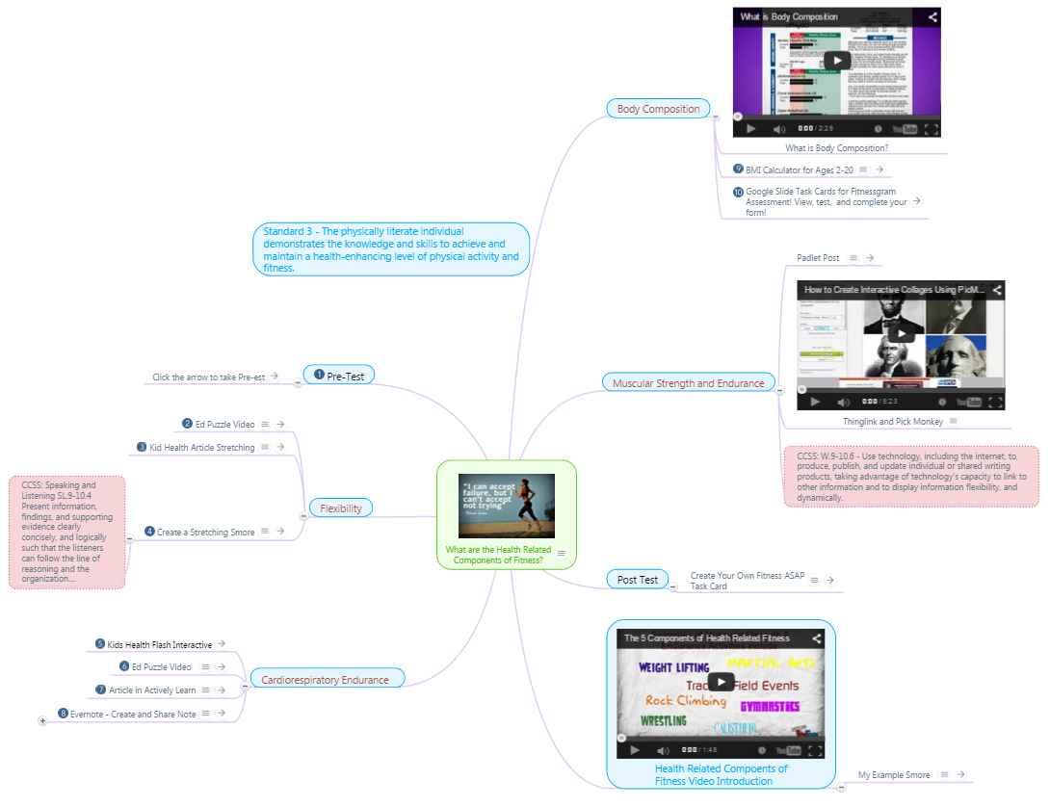
Alternatives to CmapTools: Mindmeister
Click the image to go the live version

Slide 15
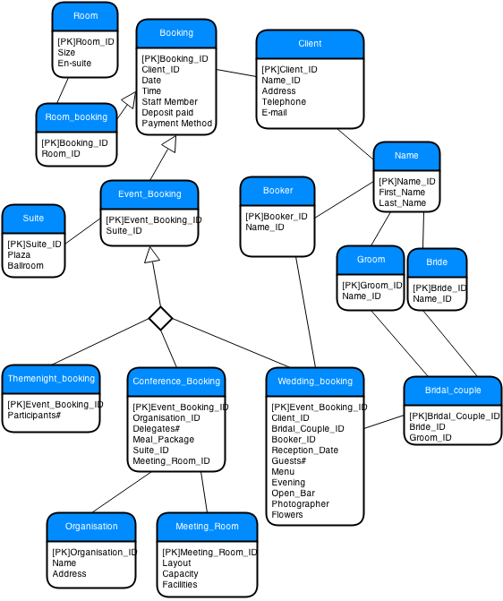
Alternatives to CmapTools: Draw.Io
xxx
xxx

Slide 16
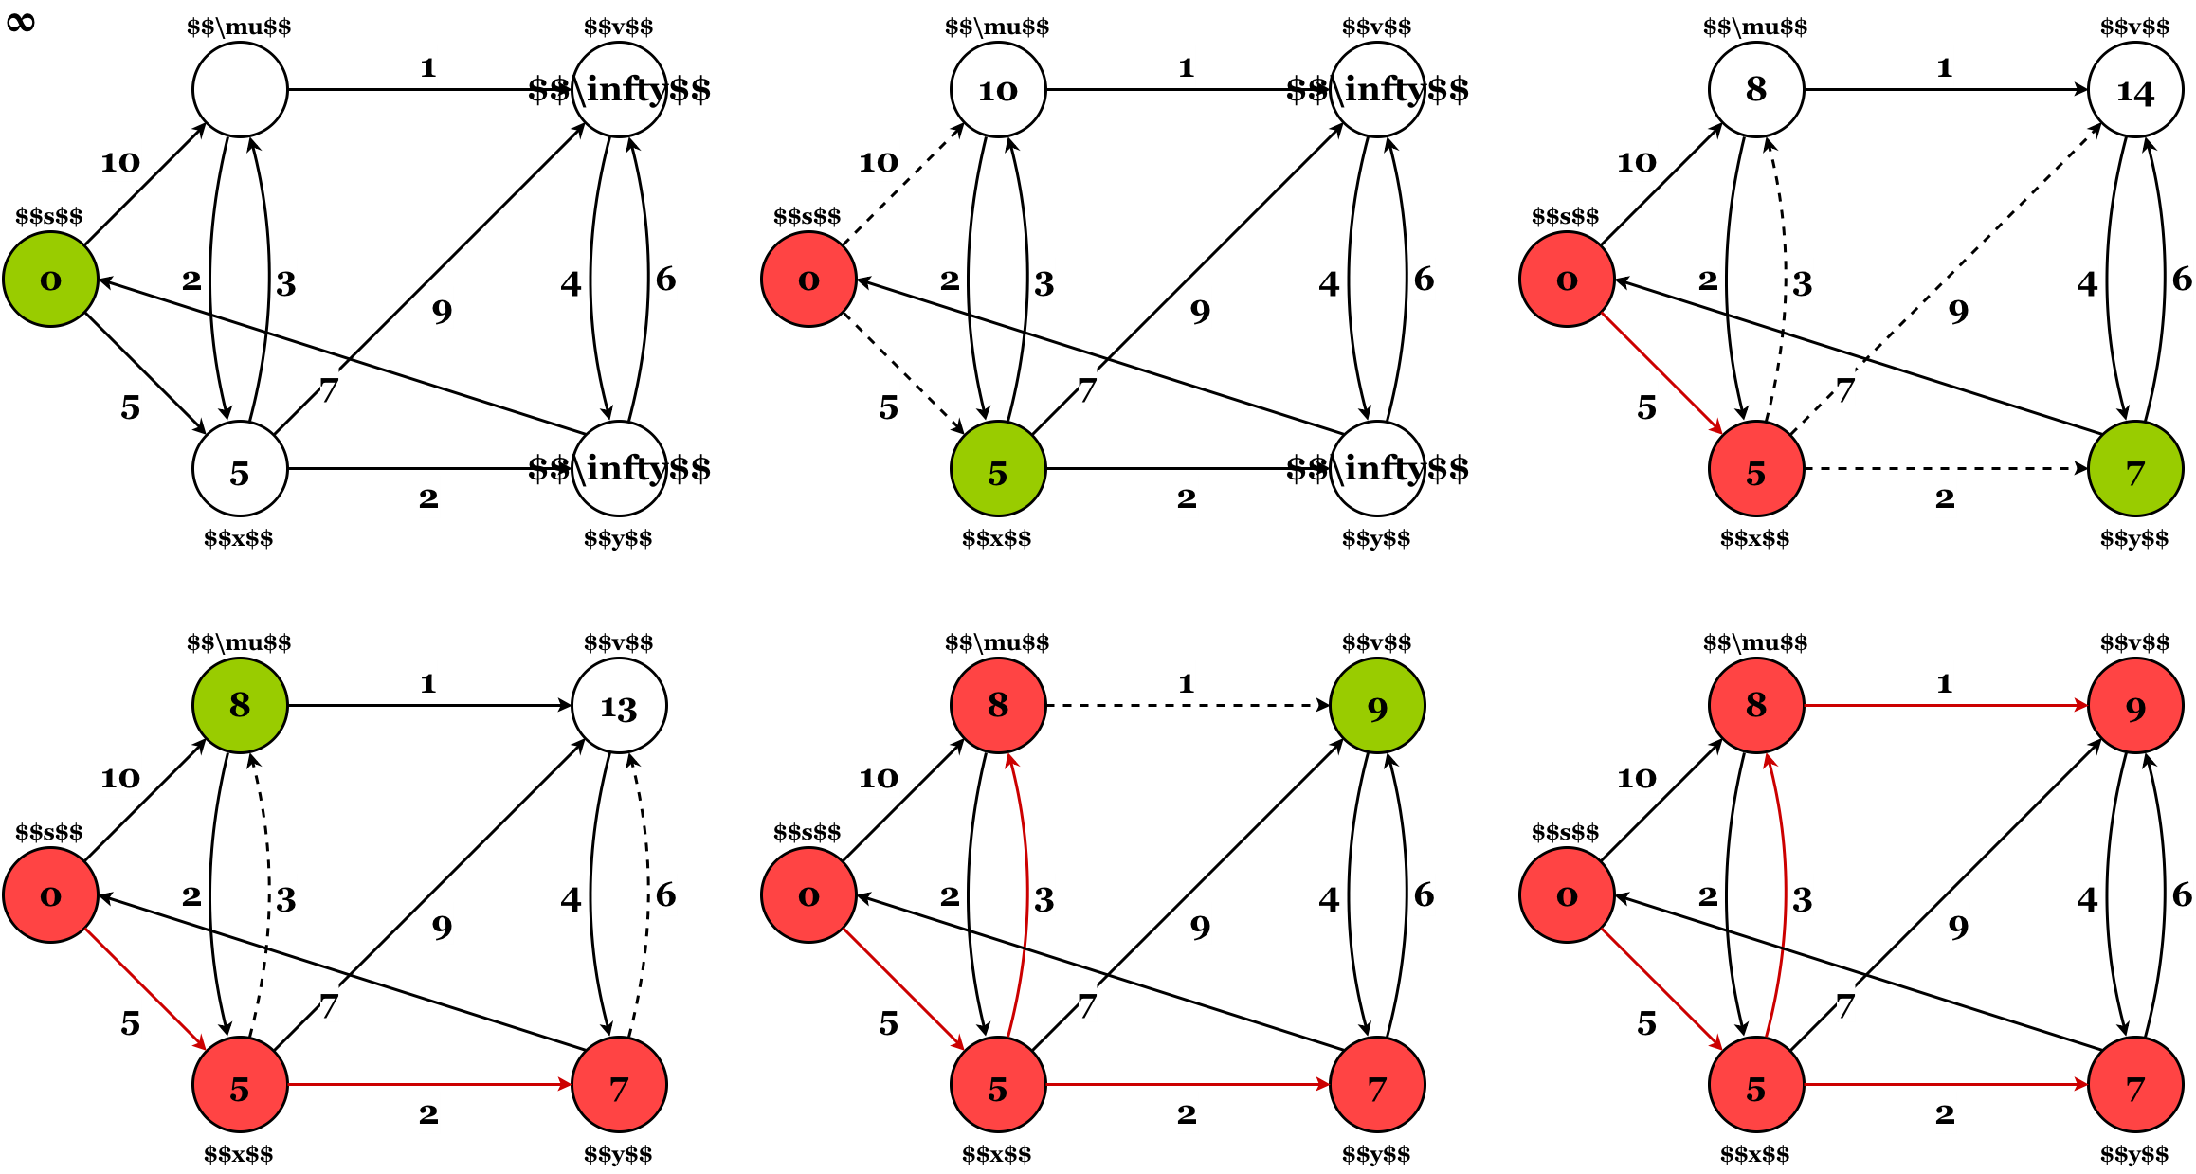
Alternatives to CmapTools: draw.io
www.draw.io

Slide 17
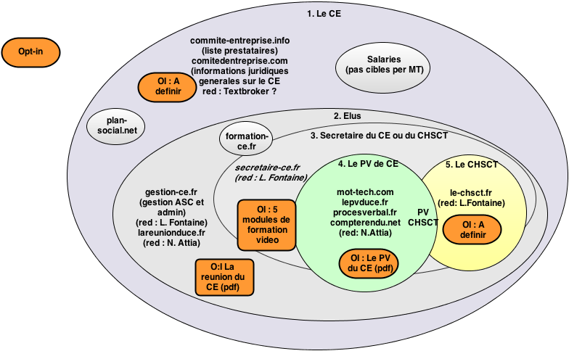
Alternatives to CmapTools: Draw.Io
xxx
xxx

Slide 18
Concept Mapping Tools Compared
What are the relative advantages and disadvantages of these four tools?
 | CmapTools | VUE | MindMeister | draw.io
Cost | Free | Free | $6 USD/month | Free
Nodes can be hyperlinked | Yes | Yes | Yes | Yes
Nodes can be images | No | Yes | Yes | Yes
Nodes can be embedded videos | No | No | Yes | No
Real-time collaboration | Yes | No | Yes | Yes
Nesting of nodes | Yes | No | N/A (branching) | No
Dynamic Branching | No | No | Yes | No
Platform | PC | PC | Web | Web
Presentation mode | Good | Great(pathways) | Great | No
Library of shapes and connectors | Basic | Basic | Basic | Vast
Save maps to a third-party server | Yes | No | No | No
Layout control | Basic | Basic | Basic | Full
Auto arrange map | Yes | Yes | Yes | Yes
Integrates with RSS feeds | No | Yes | No | No

