Slide 1
ePortfolios: Process and Product
Mark Morton
Kyle Scholz

Slide 2
Learning Outcomes of this Workshop
After the session, participants will be able to:
explain how ePortfolios can enhance student learning
describe how ePortfolios can contribute to a student's career success
discover how ePortfolios might be integrated into their courses and/or program
Notes:
Mark

Slide 3
Structure of This Workshop
What are ePortfolios?
Why do ePortfolios work?
Evidence of Effectiveness
ePortfolios at the University of Waterloo
Assessing ePortfolios
Best Practices
Choosing an ePortfolio Platform
Resources
Notes:
Mark

Slide 4
What are ePortfolios? (A Description)
A Product
A collection of digital artifacts that belong to or represent someone, such as essays, posters, photographs, videos, artwork, and other course-related assignments; volunteer experiences, employment history, and extracurricular activities.
All of the above are “products.”
A Process
But ePortfolios are also a “process.”
For the learners, ePortfolios are a process of generating new or deeper learning by reflecting on one’s existing learning and/or experiences.
For instructors, ePortfolios are a pedagogical and assessment process.
Notes:
Mark
Portfolio Initiatives Support Reflection, Social Pedagogy and Deep Learning
Helping students reflect on learning across academic and co-curricular experiences, ePortfolio practices transform the learning experience. Advancing higher order thinking and integrative learning, the connective ePortfolio helps students construct purposeful identities as learners.
C2L research suggests that the power of ePortfolio emerges from its capacity to serve as a connector. An integrative ePortfolio experience can help students link and make meaning from various learning experiences; and an integrative campus ePortfolio initiative can spur connection and collaboration across departments and divisions, catalyzing the growth of institutional learning cultures.

Slide 5
What are ePortfolios? (Some Distinctions.)
How does an ePortfolio differ from a blog?
Blogs are “in the moment” (like a newspaper) whereas ePortfolios are more retrospective (like an annual report).
Blogs grow and grow; that is, old blog postings are not removed. In contrast, an ePortfolio is trimmed and pruned of old artifacts and reflections as new ones arise.

Slide 6
What are ePortfolios? (Some Distinctions.)
How does an ePortfolio differ from a Learning Management System such as Blackboard?
Ownership
An LMS is “owned” by the university; an ePortfolio is (or at least can be) owned by the student
Control
The design, appearance, and layout of a LMS is controlled by the instructor; with an ePortfolio, those aspects are more easily controlled by the student.

Slide 7
What are ePortfolios? (Some examples.)
Solange Bonilla (explore her entire ePortfolio, but note especially her “Competencies” page)
Kimberly McSorley (note her “Teaching Philosophy” page)
Joel Swenddal (note his “Influences” which include reflections)
Brenna Gall (note her “Academic Highlights and Reflections” page)
Esther Troyer (note her “Reflections” page)
Christina Lorimer (note her “Professional Bibliography” page)
Daphne Powell (note her “Welcome” page)
Notes:
Mark

Slide 8
What are ePortfolios? (A Description)
A Product
A collection of digital artifacts that belong to or represent someone, such as essays, posters, photographs, videos, artwork, and other course-related assignments; volunteer experiences, employment history, and extracurricular activities.
All of the above are “products.”
A Process
But ePortfolios are also a “process.”
For the learners, ePortfolios are a process of generating new or deeper learning by reflecting on one’s existing learning and/or experiences.
For instructors, ePortfolios are a pedagogical and assessment process.
Notes:
Mark
Portfolio Initiatives Support Reflection, Social Pedagogy and Deep Learning
Helping students reflect on learning across academic and co-curricular experiences, ePortfolio practices transform the learning experience. Advancing higher order thinking and integrative learning, the connective ePortfolio helps students construct purposeful identities as learners.
C2L research suggests that the power of ePortfolio emerges from its capacity to serve as a connector. An integrative ePortfolio experience can help students link and make meaning from various learning experiences; and an integrative campus ePortfolio initiative can spur connection and collaboration across departments and divisions, catalyzing the growth of institutional learning cultures.

Slide 9
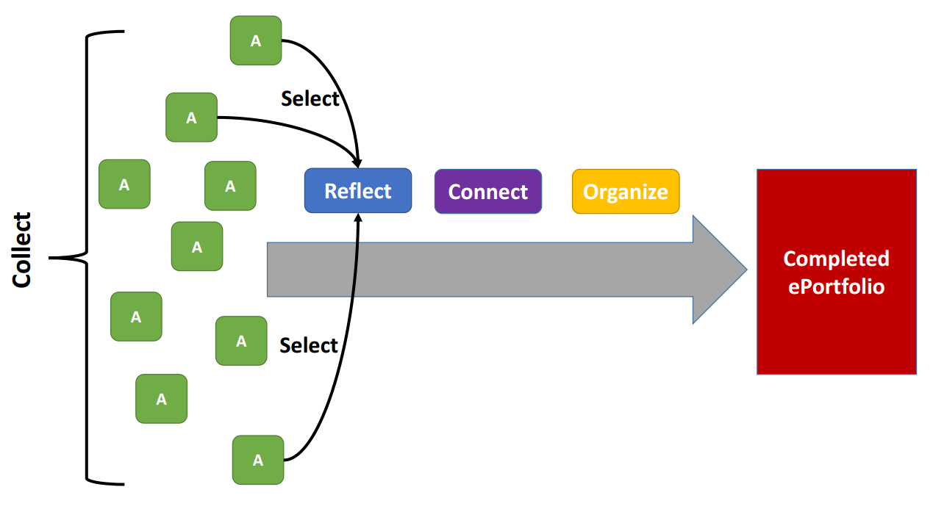
The Process and the Product
Image developed by Dr. Robin Mueller, Taylor Institute for Teaching and Learning
Notes:
Mark

Slide 10
Just the Process
See how San Francisco State University articulates this process to their students
Notes:
Mark

Slide 11
Student and Instructor Perspectives
Notes:
Mark

Slide 12
Why do ePortfolios work?
They leverage a learning theory called Social Constructivism, which says that learning happens most effectively…
when students construct a system of knowledge for themselves, rather than simply having information presented to them.
when it happens in a social context – that is, when a student constructs knowledge through dialogue and interactions with others.
Notes:
Kyle

Slide 13
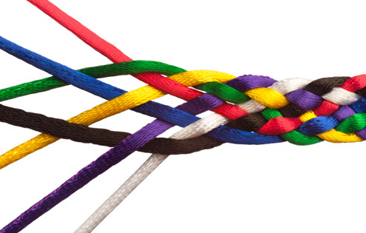
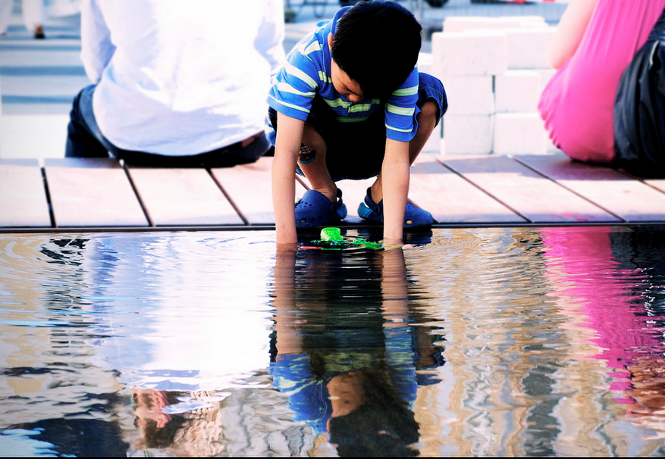
Why do ePortfolios work?
They encourage (or force) students to reflect on their learning and to make connections between different learning experiences, and between learning experiences and life experiences.
Connections strengthen learning
Reflection deepens learning
Notes:
Kyle

Slide 14
Why do ePortfolios work?
They make “invisible learning” visible. Invisible learning is:
The intermediate steps that occur whenever someone attempts to learn something or do something.
Aspects of learning that go beyond the cognitive to include the affective, the personal, and issues of identity.
Notes:
Kyle

Slide 15
Why do ePortfolios work?
They provide students with a sense of ownership and choice
“When students perceive that they have choices in how to learn subject matter they are more engaged and motivated to move beyond simple information acquisition to trying to gain an understanding of the subject.” http://www.cjlt.ca/index.php/cjlt/article/view/97/91
Notes:
Kyle

Slide 16
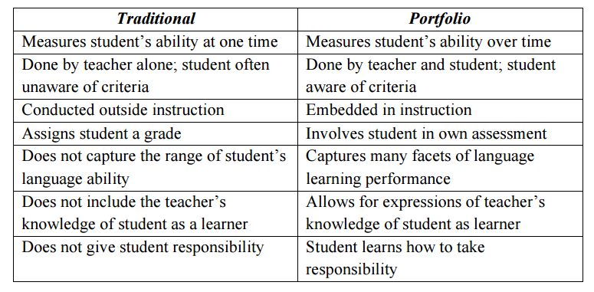
Why do ePortfolios work?
They allow instructors to assess students more fully and deeply
Notes:
Kyle

Slide 17
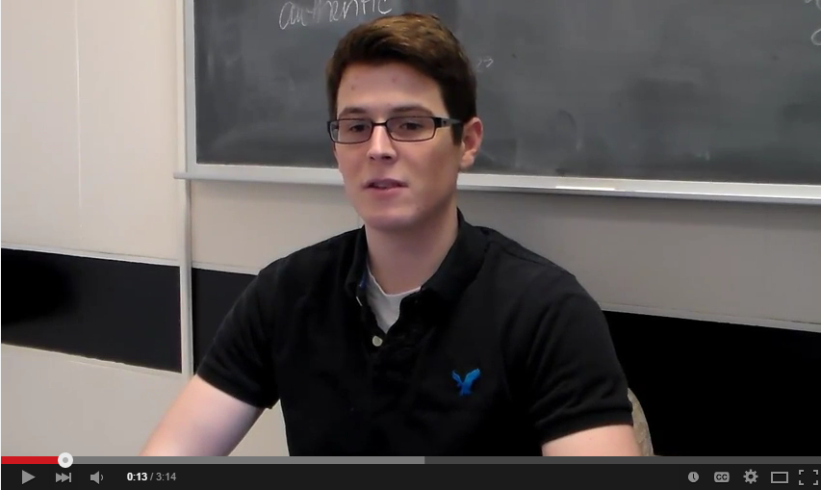
Why do ePortfolios work?
Let’s hear from a University of Waterloo student
Click the image to open the video (0.00 to 3.14)
Notes:
Kyle

Slide 18
Evidence of Effectiveness
“Undergraduates using electronic portfolios had higher grade-point averages, credit hours earned, and retention rates than a comparable set of students who did not use the system.” -- Bowling Green State University
“In ePortfolio courses, the pass rate is 77%; in comparison courses, sections of the same courses where ePortfolio is not being used, the pass rate is 72%. For a high pass -- a C or above -- the pass rate in ePortfolio sections is 74%; in non-ePortfolio sections of the same courses, the pass rate is 67%. -- LaGuardia (C2L ePortfolio Research Project)
Notes:
Mark

Slide 19
Evidence of Effectiveness
Additionally, the LaGuardia study revealed 76% of students using ePortfolios in one semester returned the next semester; for non-ePortfolio students, the return rate was 71%.
“Between the ‘before’ essays (submitted for a grade during the semester) and ‘after’ essays (submitted for the final ePortfolio), we observed a statistically significant improvement: on a 6-point scale used by holistic raters, 46%of the students sampled improved the ratings of their essays by 1 or more points.” – Reflection, Revision, and Assessment in First-year Composition ePortfolios, 2007
Notes:
Mark

Slide 20
ePortfolios at UW
ePortfolios have been used at the University of Waterloo since 2000
Courses using ePortfolios at UW in Winter 2015: 19
Number of students using ePortfolios at UW:
Winter 2014 - ~ 2100
Spring 2014 - ~ 1200
Fall 2014 - ~2600
Notes:
Kyle (and feel free to riff on your other awareness of ePortfolios at UW)

Slide 21
A UW Instructor Describes an ePortfolio Assignment
Dr. Marcel Pinheiro
First-Year Biology
Class size: 270
Click the image to watch the video
1:31 to 3:30 and 6:48 to 8:14
Notes:
Kyle (and feel free to riff on your other awareness of ePortfolios at UW)

Slide 22
A Demonstration
Kyle will access UW’s learning management system to demonstrate how he uses ePortfolios in one of his courses

Slide 23
Assessing ePortfolios
ePortfolios require a significant investment of time and energy from students. Therefore, it is important that they be assessed carefully, and that the assessment contributes in a substantial way to a student’s final grade in a course.
The best way to assess an ePortfolio is by means of a rubric such as this one: http://bit.ly/eportfolio-rubric
Share the rubric with your students before they start working on their ePortfolios.
Notes:
Kyle

Slide 24
Assessing ePortfolios
When assessing ePortfolios, special attention might be given to the reflection component, where students can be required to comment on how their chosen artifacts pertain to the achievement of targeted outcomes or competencies.
Examples of institutional competencies:
University of Waterloo’s Undergraduate Degree Level Expectations
Association of American Colleges and Universities: VALUE Rubrics
Notes:
Kyle

Slide 25
Best Practices
Spend time explaining the benefits of ePortfolios to your students.
Explain to your students what you expect them to do in their ePortfolios.
Provide your students with numerous examples of successful ePortfolios that have been developed by other students.
Encourage your students to look at and comment on one another’s ePortfolios.
Notes:
Mark
Scaffolding:
Help them start small: have them choose just one artifact (such as an essay they wrote) and have them reflect on the challenges they had to address as they wrote the essay.
Or, have them select two assignments from different courses, and have them reflect on how each of those assignments helps them to better understand the other assignment.
Alternatively, if your program or institution has identified key competencies, have students choose one competency and then have them reflect in writing on how a particular assignment helped them to develop that competency.
Introduce the Learning Portfolio Activity Early and Communicate Expectations
Give ‘em Grades
Provide Feedback Early and Often
Respect Disciplinary Context
Provide Opportunities for Meaning Making
Recognize that ePortfolios may be ‘new’ to students

Slide 26
Best Practices
Create an ePortfolio for yourself, and share it with your students.
Make the ePortfolio an integral and ongoing part of how you assess your students.
Scaffold your students as they begin to develop their ePortfolio.
Your ePortfolio platform should allow students the ability to customize the design and layout of their ePortfolios, so that they can feel that the ePortfolio is “theirs.”
Your ePortfolio system should allow students to create different “views” or versions of their ePortfolio for different audiences.
Notes:
Mark
Scaffolding:
Help them start small: have them choose just one artifact (such as an essay they wrote) and have them reflect on the challenges they had to address as they wrote the essay.
Or, have them select two assignments from different courses, and have them reflect on how each of those assignments helps them to better understand the other assignment.
Alternatively, if your program or institution has identified key competencies, have students choose one competency and then have them reflect in writing on how a particular assignment helped them to develop that competency.
Introduce the Learning Portfolio Activity Early and Communicate Expectations
Give ‘em Grades
Provide Feedback Early and Often
Respect Disciplinary Context
Provide Opportunities for Meaning Making
Recognize that ePortfolios may be ‘new’ to students

Slide 27
Some Instructors Have ePortfolios, Too
Hanna Erpestad, Lake Superior College
Eric Forsyth, Bemidji State University
Mark Morton, University of Waterloo
Notes:
Mark

Slide 28
Choosing an ePortfolio Platform
www.digication.com
www.taskstream.com
www.pebblelearning.com
www.myefolio.com
www.foliotek.com
www.epsilen.com
www.mahara.org
www.foliospaces.org
Notes:
Mark

Slide 29
Choosing an ePortfolio Platform
A 2009 study entitled “Evaluation of ePortfolio Software” assessed the functionality of most of the platforms named above. The authors concluded that “Mahara and PebblePad represent the most balanced products.” (Mahara is free if it is installed locally by your institution; or you can use the hosted version at www.foliospaces.com)
MyeFolio is also a good platform www.myefolio.com
Notes:
Mark

Slide 30
Resources
Bass, R. (2012). Disrupting Ourselves: The Problem of Learning in Higher Education. Educause Review, 47(2).
Catalyst for Learning: ePortfolio Research and Resources
CTE’s ePortfolio Resources
International Journal of ePortfolio
Reynolds, C., & Patton, J. (2014). Leveraging the Eportfolio for Integrative Learning: A Faculty Guide to Classroom Practices for Transforming Student Learning.
Student ePortfolio Overview at San Francisco State University
Notes:
Kyle

Slide 31
Small Group Discussion
Why would or wouldn’t ePortfolios be a good idea in your course or program?

