Slide 1
Introduction to the Flipped Classroom
Kyle Scholz
Christine Zaza
Notes:
CZ:
Do handouts on tools
UDL, slide design, AODA type of info
Slide re-design of model

Slide 2
Our plan for this morning:
Engage you in a flipped class experience
Identify what makes a class a “flipped” class
Discuss the advantages and challenges of teaching a flipped class
Identify which concepts might be taught more effectively in a flipped class in one of your courses

Slide 3
Your “out-of-class” learning activity
Let’s get you onto LEARN (www.learn.uwaterloo.ca)
Go into LEARN – find Advanced Session sandbox – you should all be students in this course
Go to the Introduction to the Flipped Classroom folder
Watch the video (see the guiding questions), read the article and submit the quiz as outlined in the instructions

Slide 4
Flipped Class Model
In Class
Stage 1:
Introduce the Task
Stage 4:
Conduct in-class activity related to the task
Outside of class
Stage 2:
Students complete task outside of class
Stage 3:
Assess students’ learning
Notes:
Let’s now unpack what you just engaged in

Slide 5
Example
In Class
Stage 1:
In week 2, introduce students to their task: i.e., view the week 3 mini lecture, and read chapter 3
Stage 4:
In week 3, conduct in-class activity related to week 3 material
Outside of class
Stage 2:
Students view the week 3 mini lecture and read chapter 3
Stage 3:
Students complete the week 3 online quiz

Slide 6
Stage 1:
Introduce the Task
In Class:
In the first class, introduce the flipped model
Communicate clear goals and expectations
Explain why you want students to do this
Tell students how long it will take them
How the task will be used in class
Introduce the out of class task
Consider:
time commitment and degree of challenge
Notes:
Set the stage for learning by introducing the out of class task
Goal: maximize student participation/readiness
NB: link not found: Gary Smith (2008) First-Day Questions for a Learner-Centred Classroom. http://www.ntlf.com/issues/v17n5/v17n5.pdf

Slide 7
Stage 2:
Out of Class Task
Choose media carefully (videos, readings, podcasts, etc.)
Create your own materials or pull in outside resources
Create guiding questions or prompts for students
Include a way for students to submit questions about difficult concepts to facilitate Just-in-Time Teaching (JITT)
Notes:
Efficacy of screencasts: http://www.konferenslund.se/pp/SC_Pinder.pdf; http://www.sussex.ac.uk/elearning/documents/me2u-final-report.pdf; http://www.ifets.info/journals/14_2/20.pdf

Slide 8
Stage 2:
Out of Class Task
You can teach all or just some specific core concepts online
Using Blackboard for teaching activities is particularly useful when:
there’s a wide variation in what your students know at the beginning of the course (pre-requisite material)
there are complex or challenging concepts
several good online resources already exist
you want to make time for exciting in class activities

Slide 9
Stage 3:
Assess the Out of Class Task
Check for evidence of preparation for the in class activity
Self assessment quizzes online can include questions that provide information about students’ conceptual understanding and provide opportunities for providing formative feedback
Low stakes assessment at the beginning of class can motivate preparation
Consideration:
Because students are more likely to remember and value what is assessed, assessing helps with learning
Notes:
Efficacy of screencasts: http://www.konferenslund.se/pp/SC_Pinder.pdf; http://www.sussex.ac.uk/elearning/documents/me2u-final-report.pdf; http://www.ifets.info/journals/14_2/20.pdf
ane
Resources:
3. Assessing Learning - Julie Schell’s questions – Julie Schell (see http://blog.peerinstruction.net/2013/02/19/how-to-evaluate-students-effort-on-out-of-class-work-in-a-flipped-class/) suggests asking questions that go beyond just testing for coverage of the material or simple recall. Get the students to answer questions (3), with at least a couple that relate to the content and that would be difficult to answer without thinking about the material in an analytical way. For each question have students must include a rationale or supply the reasoning for their responses. A final question that asks for their "sticking points" with the material can help uncover learning bottlenecks that can then be addressed in class (JITT). Grade the students on their effort, rather than the degree of correctness of the answers. See a simple rubric developed by Eric Mazur's group at Harvard for "effort grading" in the link above.

Slide 10
Stage 4:
In-Class Activity Related to the Task
Answer students’ questions from the out of class task
The activity builds on the out-of-class task
The objectives of activity are linked to course objectives and assessments
Peer-to-peer and student-instructor dialogue is encouraged
Create opportunities for collaboration and peer learning in a low risk environment
Design well planned activities (discussion, problem solving, exploration)
Application activities scale to class size
Notes:
Kyle
Resources:
In Class Task - Biggs 4 points on educative conceptual change (objectives of the activity are clear and linked to course assessments; students feel the need to do the activity to be successful (motivation); students can focus on task without worrying about making mistakes or being penalized for not getting it right – task is about the learning not the assessing; dialogue and collaboration)
What activities? Idea about two halves of the class preparing differently and then pairs teaching the concept to each other, then combining the pairs
What to do if they don’t prepare?
Use the first 10 minutes of class wisely as people are most awake then
Don’t need to give up lecturing completely but do mini lectures with short activities in between, clickers a la Mazur
Outline the time for each activity, ( 1 min , 2 min) getting the timing right is probably the hardest thing with conducting active learning (like workshops!) quick targeted interactions can be very effective.
ASSESSMENT overall – after class or on summative test?
Application activities (if we do this again modify the last box in slide 8.
Group work – IF – AT cards
If time allows share a few examples of classes e.g., Emiko. Extensive use of IF-AT cards post Camtasia. E.g., more science based Finish at 10:45

Slide 11
Advantages
Can increase the amount and quality of instructor-student and student-student interaction in the classroom
Allows students to access course materials at their own pace, when and where they want
Assesses student work before they come to class
Encourages better preparation for student and instructor
Allows more class time to be spent on active learning activities
Can foster peer learning

Slide 12
Challenges
In-class activities can be compromised if students do not come to class prepared
Students’ initial reaction may be challenging
It can be time-consuming for instructors to prepare online teaching materials before the course
Instructors need to be proficient with at least one of the technological tools for creating online material
Instructors may need the support of the university before making this change

Slide 13
Examples from UWaterloo

Slide 14
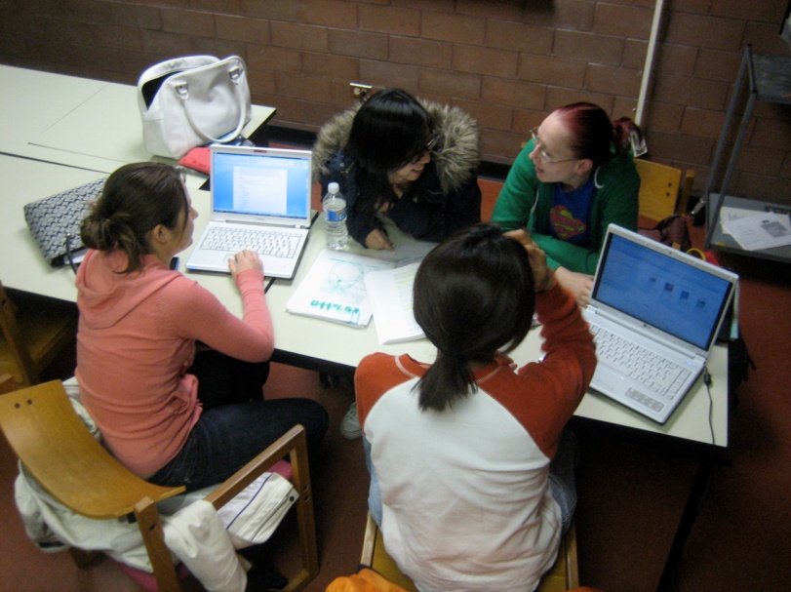
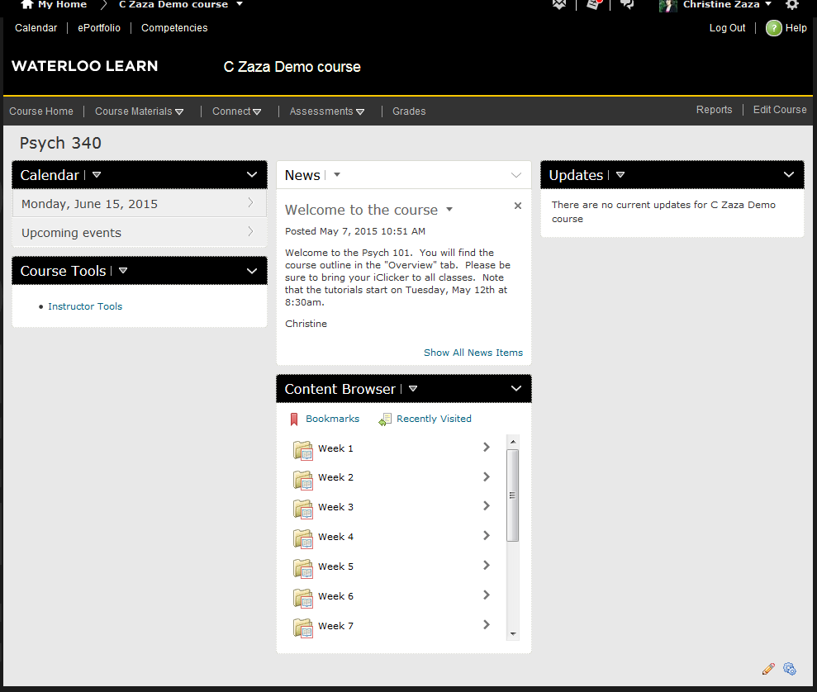
Psych 340 Training & Development (60 to 100 students)
One Week
Online, Before Class
Audio narrated slides
Weekly quiz before class
In Class
Hands-on, team based, authentic learning activities
Notes:
All content delivery – online
Class time reserved for activities
A truly flipped model

Slide 15
PHARM 224 Pharmacokinetic Fundamentals
Online Before Class
In Class
Weekly lectures
Weekly quizzes for self-assessment
Weekly written problem sets for self-assessment
Bi-weekly, instructor-led tutorials, where students solve problems
Bi-weekly mini sessions (“Mighty Minutes”) on challlenging concepts

Slide 16
Break
http://bit.ly/flip-loop
http://bit.ly/flip-loop
Notes:
Break 10:45 – 11:00
During the break have a look at the questions that they have asked.

Slide 17
Screencasting Tools
Go back into LEARN
Go to the Introduction to the Flipped Classroom folder again - Examples of videos
Check out different types of videos – which could work in your course?
Notes:
Kyle
11:00 -11:25
First “What questions have not come up in our discussion so far that came in on the online quiz?” demo the JITT
Examples of technology

Slide 18
Recommendations for Creating Online Teaching Material
Notes:
There is much to consider when deciding how to create content online

Slide 19
Keep it short (< 10 minutes)
Notes:
This is true whether it is online or in the classroom

Slide 20
Ensure that audio is good quality
Notes:
Research shows that students care more about the quality of audio than they do about your visuals. If the audio is not good students won’t listen to it.

Slide 21
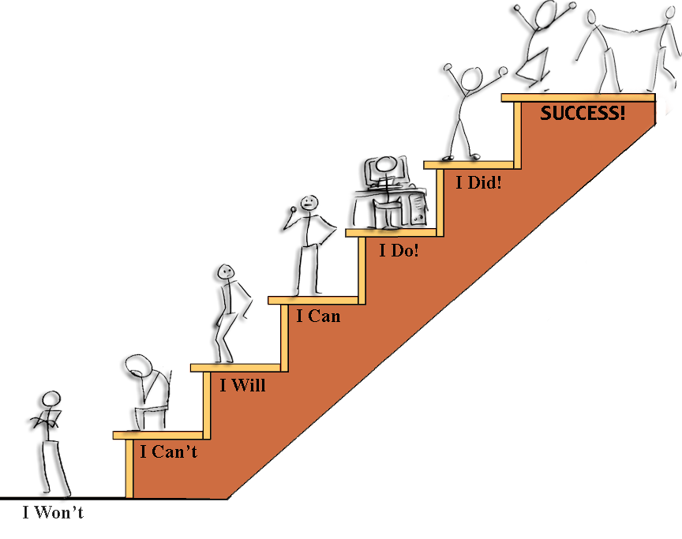
Make it Accessible
Notes:
Accessibility for Ontarians with Disabilities

Slide 22
Font Size
This is 8 point font
This is 9 point font
This is 12 point font
This is 14 point font
This is 16 point font
This is 20 point font

Slide 23
Use of Colour
This colour contrast is hard to read
This colour contrast is easier to read
Reading long passages with this colour contrast is fatiguing to the eye.
Don’t rely only on colour when you want to emphasize important words because some people are colour blind.
Use lots of white space on slides.
Avoid red and green and yellow (because yellow is hard to read)

Slide 24
Placement of Text
Keep text outside of the image
Avoid embedding text in an image, especially if some of that text will be cut off by the image.

Slide 25
Model good practice for using and referencing copyrighted material

Slide 26
Group activity
Look at the cards with various in-class and out-of-class activities that could be used to structure a flipped classroom
Choose 4 as a group
Apply them to a classroom environment you are familiar with to create flipped classroom designs
Prepare to share your thoughts with everyone else

Slide 27
Flipping your own teaching
Are there any specific activities that would work best for your teaching?
On the handout provided, indicate which ones you would like to try in your own teaching.

Slide 28
Final Words
Start small
Flip only 1 or 2 classes
Make learning meaningful

Slide 29
Additional Resources: CTE Teaching Tip Sheets
Online Activities and Assessment for the Flipped Classroom
In Class Activities and Assessment for the Flipped Classroom
Nine Alternatives to Lecturing
Developing Online Activities for Blended Courses
Notes:
You can find out more about these and other activities on these Teaching Tip Sheets
End here - – people can leave if they want to at this point

