Slide 1
Dr. Mark Morton Centre for Teaching Excellence University of Waterloo mmorton@uwaterloo.ca www.markmorton.ca

Slide 2
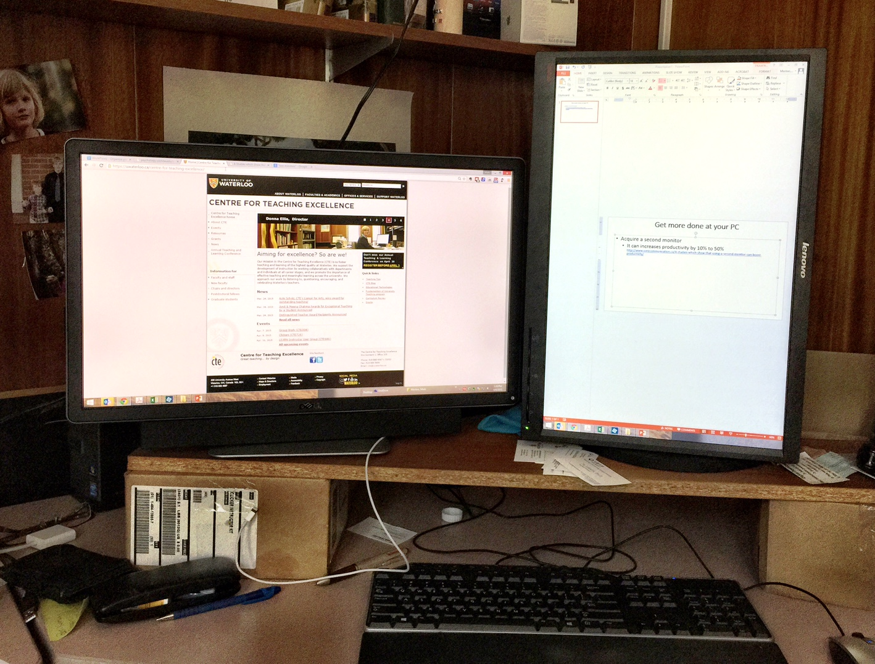
Get more done at your PC
Acquire a second monitor
It can increases productivity by 10% to 50%
http://www.corecommunication.ca/4-studies-which-show-that-using-a-second-monitor-can-boost-productivity/

Slide 3
Get more done at your PC
Don’t multitask
It increases errors and decreases efficiency
http://msutoday.msu.edu/news/2013/brief-interruptions-spawn-errors/

Slide 4
Get more done at your PC
Take breaks
Taking regular breaks increases productivity and creativity
http://www.nytimes.com/2012/06/17/jobs/take-breaks-regularly-to-stay-on-schedule-workstation.html

Slide 5
Grade essays faster
Use “autotext with hyperlinks”(watch the first 3m25s of this screencast)
This a method of creating inserting long comments into a Word document by typing an abbreviation that automatically “expands” into a long comment. For example, I might type “xnts” into a student’s essay, which will then expand into this:
“Your paragraph does not have a clear topic sentence. Without a topic sentence, your paragraph will wander, and your reader will not understand your main idea. You can read more about topic sentences here.”
Notice, too, that the expanded comment includes a hyperlink to an additional online resource.

Slide 6
Survey a group of people
Use an online form tool
Use the survey tool in Blackboard to create a survey for your students
Polldaddy
Toofast

Slide 7
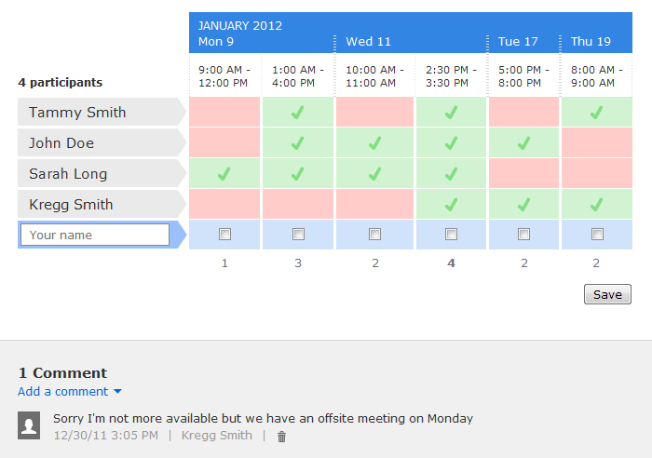
Find a meeting time that works for everyone
Use Doodle

Slide 8
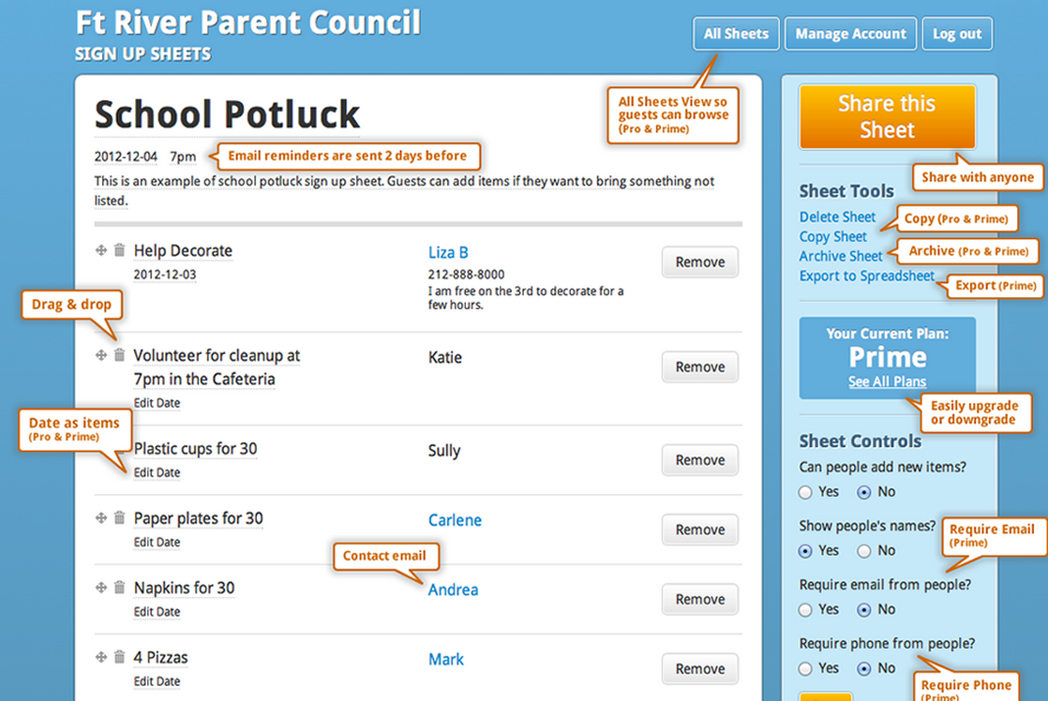
Get people to sign up for something
Use an online sign-up sheet
Bringit (free)
Jooners (not free, and for more complex sign ups)

Slide 9
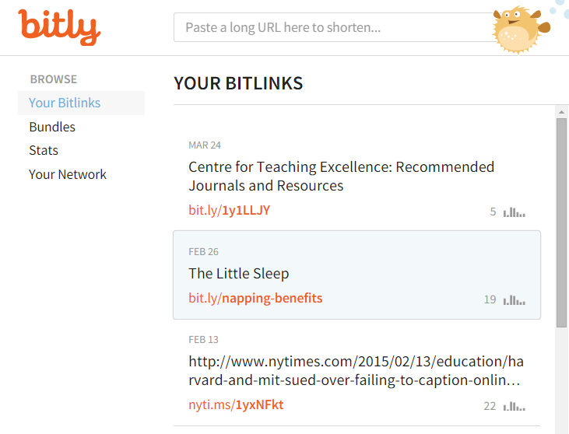
Shorten a long URL
Use an URL shortening tool
Bit.ly. Example: http://bit.ly/napping-benefits
Google URL shortener.

Slide 10
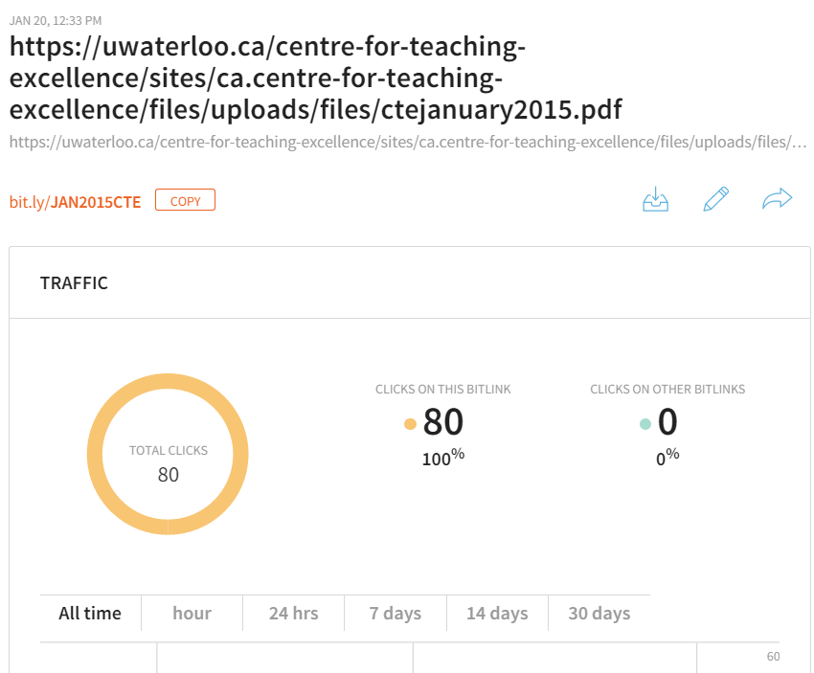
Track how many people click your links
Use an URL shortening tool
Google Analytics
Bit.ly.
Google URL shortener.

Slide 11
Find copyright-free images
Use Flickr to find images tagged under a Creative Commons license
Use Google’s Advanced Image Search to find items tagged under a noncommercial reuse license.

Slide 12
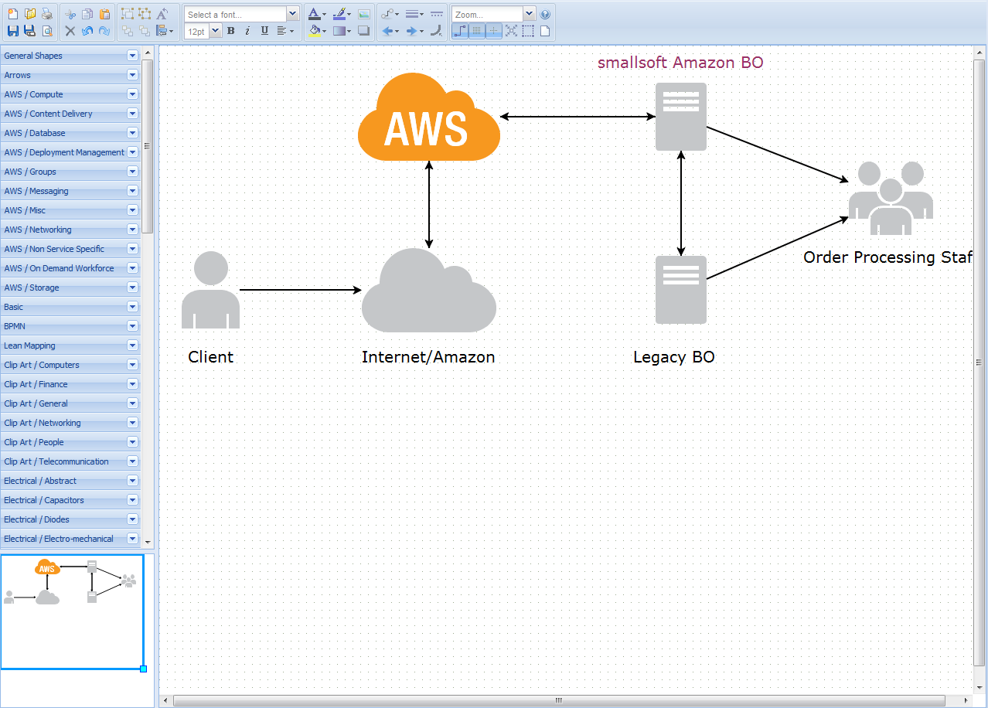
Help people understand something by creating a diagram
Use Draw.io. Example.
Use Gliffy

Slide 13
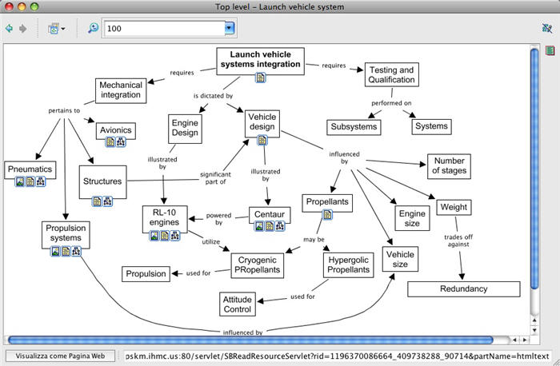
Help people understand something by creating a diagram
Use CmapTools. Example.
Use MindMeister. Example.

Slide 14
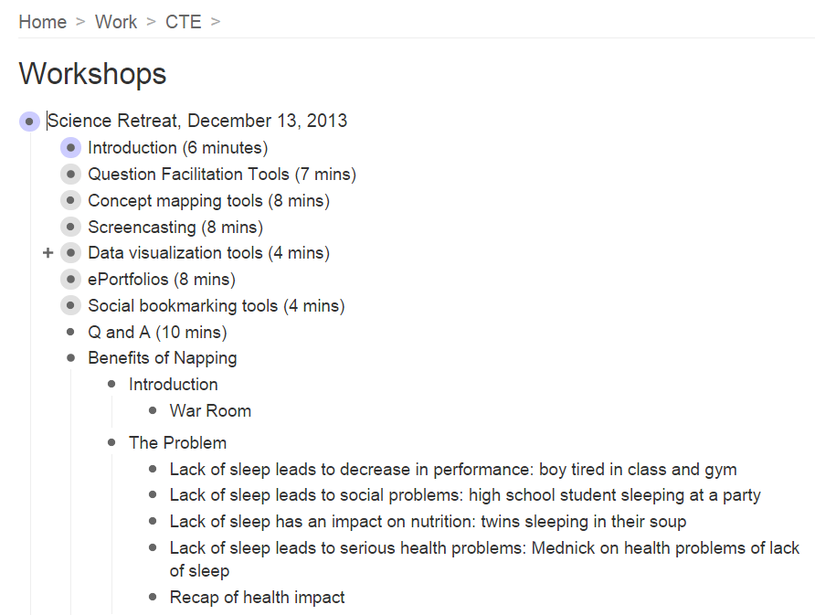
Create an outline whose levels open and close
Use Workflowy. Example.

Slide 15
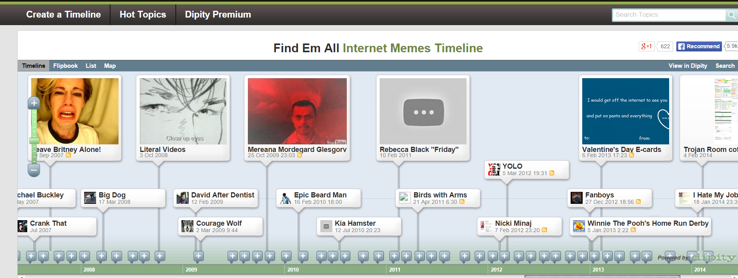
Create a timeline of events
Use TikiToki. Example: History of the tower of London.
Use Dipity. Example: History of Lebanon

Slide 16
Make a screencast
Use screencasts to communicate oft-repeated information to clients, or to provide them with “just-in-time” information.
Use the narration tool in PowerPoint. Example.
Use Screencast-o-Matic. Example.
Use Camtasia. Example.
Use Explain Everything on a mobile device. Example.

Slide 17
Search the web effectively
Use Google’s Advanced Search tool.
Example: an image search for “fruite” or “fruits” found on pages that have been added in the last year and whose domain ends in “on.ca” but excluding pages that contain “banana”
Example: a search of PDFs that include the phrase “large classes” on Australian websites
Example: find pages that link to UW’s home page.

Slide 18
Access Files from Anywhere
Use Dropbox
How to
Video tutorial
Example (aggregate results for KSU Training program of the Instructional Challenges Survey)

Slide 19
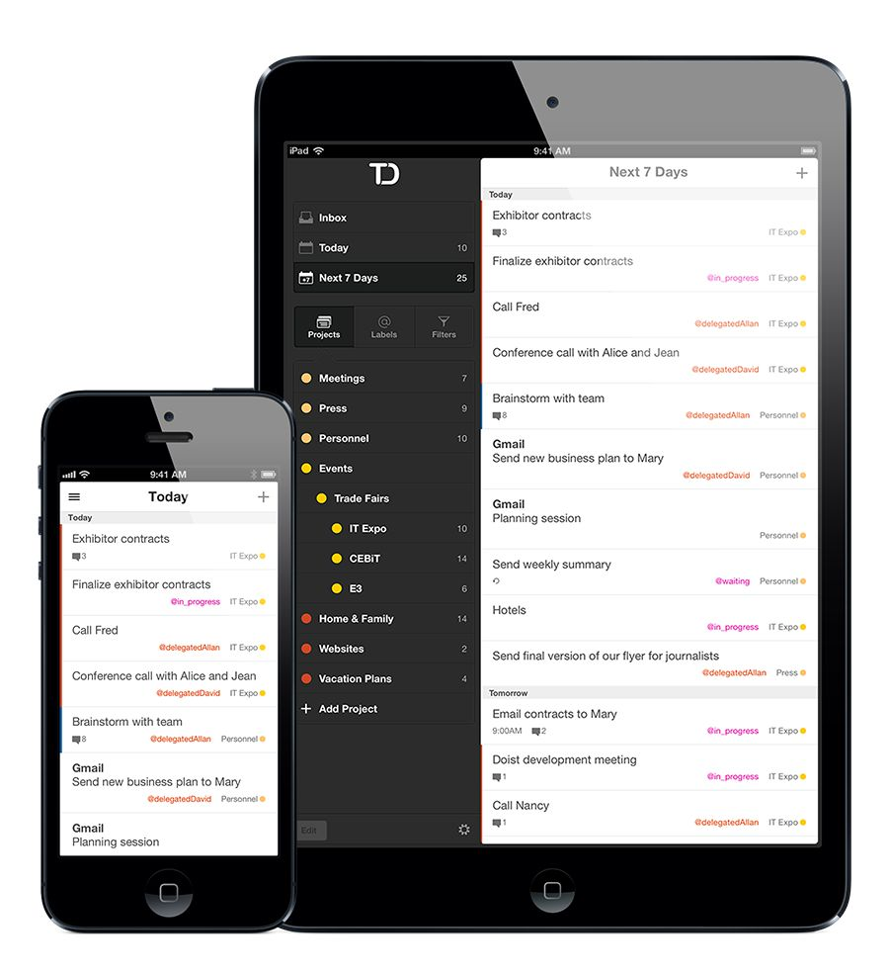
Assign and Keep Track of Tasks
Use Todoist
Home page
Video overview
Video tutorials

Slide 20
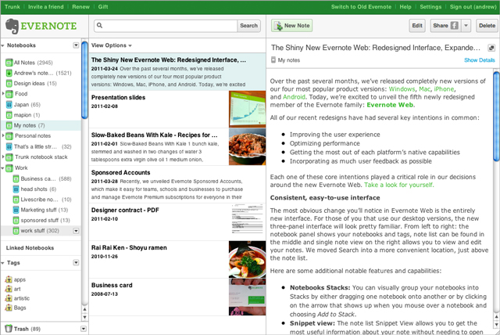
Collect, organize, and share web resources
Use Evernote
An article from Lifehacker
Example of a "notebook" in Evernote
Video tutorial

Slide 21
Collaborate on a document in real time
Use Google Docs as a wiki
Example: bit.ly/KSU-wiki
Video tutorial

Slide 22
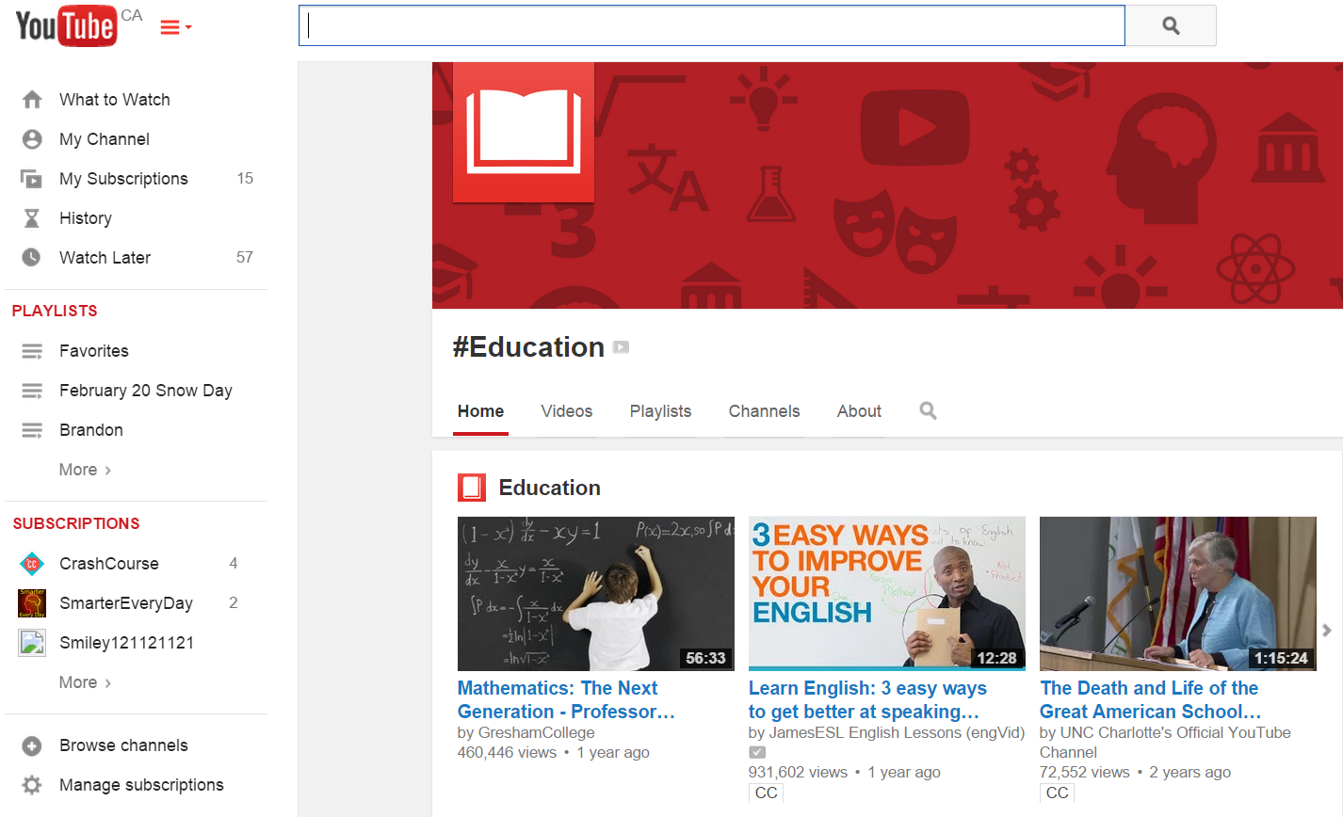
Learn how to do something
Find an online video or screencast that explains what you want to learn
YouTube: How to change a tire.
Khan Academy: Find the volume of a sphere
Vimeo: How to use a semi-colon

Slide 23
Keep track of passwords
Use LastPass

Slide 24
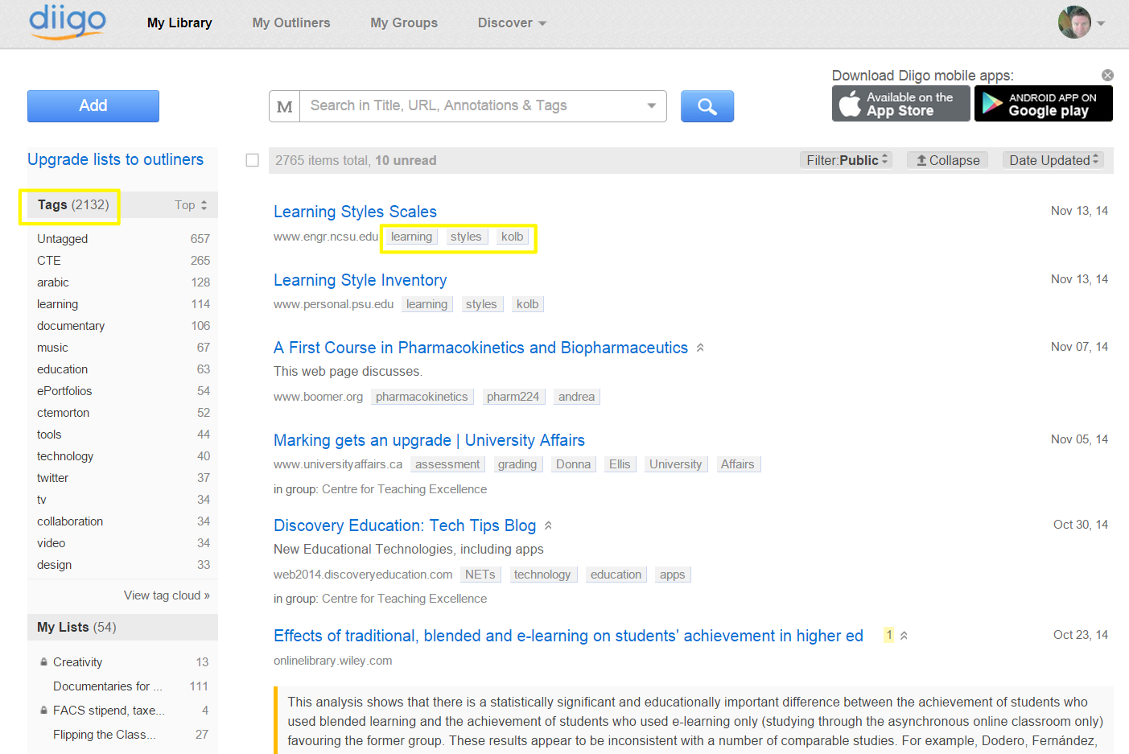
Save, tag, categorize, and share online resources
Use Diigo (a social bookmarking tool)
Tag and search your own collection of online resources
Search the online collections of other users
Create categories (called “outliners”)
Create a “group” to collaborate with others.

Slide 25
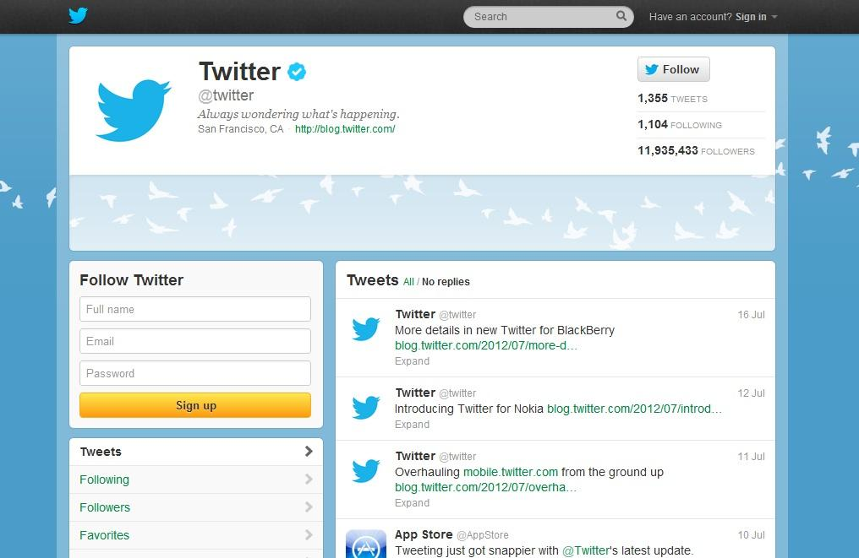
Share web resources quickly and efficiently with your students or colleagues
Use Twitter

Slide 26
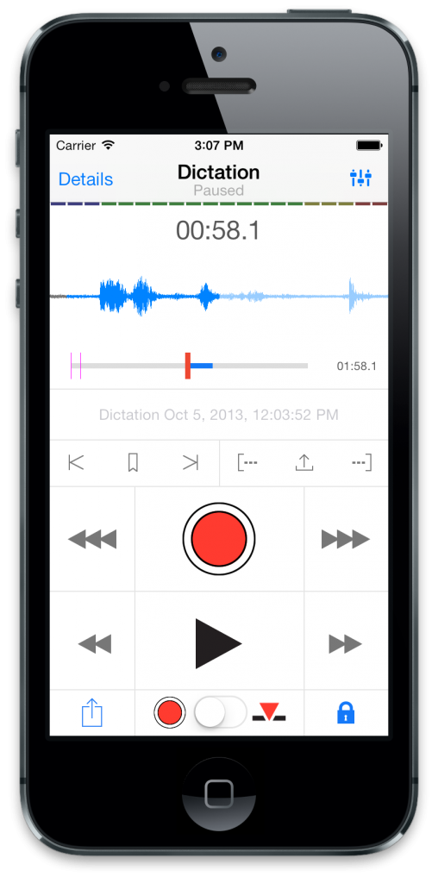
Record an interview, or record spoken ideas, in an efficient manner
Use Dictate
Dictate records audio, but only does so when you are speaking: in other words, if you are brainstorming in your office, you can turn on Dictate, and it will record what you speak -- but it won't record the silences between your thoughts. Thus, a 20-minute session of brainstorming might actually end up being just four minutes of actual audio.

Slide 27
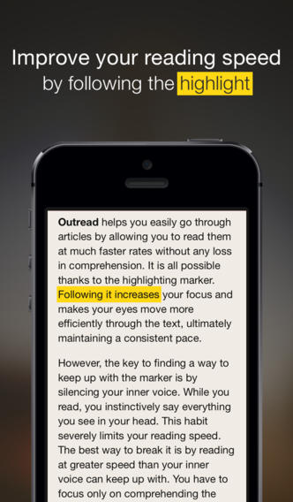
Read more quickly
Use Outread
Outread is a Rapid Serial Visual Presentation (RSVP) tool; that is, it presents text to you one word or short phrase at a time in the same place on your screen. This allows you to read much more rapidly than you otherwise can.

Slide 28
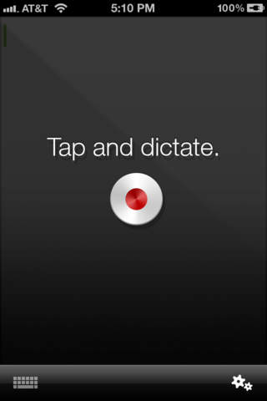
Write a document more quickly and with less effort
Use Dragon Dictation
Dragon Dictation is a speech-to-text app.

Slide 29
Evolvo
Use Evolvo
Evolvo is a text-to-speech app.

Slide 30
Learn more about productivity
The Science of Productivity (YouTube video)
Getting Things Done blog
Art of Stress-Free Productivity (TED Talk)

Slide 31
Dr. Mark Morton Centre for Teaching Excellence University of Waterloo mmorton@uwaterloo.ca www.markmorton.ca

