Slide 1
Question Facilitation Tools
Dr. Mark Morton
Centre for Teaching Excellence
University of Waterloo
mmorton@uwaterloo.ca
www.markmorton.ca

Slide 2
Learning Outcomes for this Workshop
After this workshop you will be able….
to explain the basic functionality of four question facilitation tools
to identify which tool is most relevant to your teaching practice
to describe how you might use a given tool to enhance your students’ learning experience
to locate additional resources for those tools that you want to learn more about.

Slide 3
What this workshop won’t do
Get into the technical specifics of how to use these tools (for example, how to set up a clicker receiver, how to create a module in Top Hat, and so on)
CTE has other resources to learn those details

Slide 4
What you’ll be doing in this workshop
Listening (to learn about the functionality of the tools)
Thinking (about how those tools can be used effectively)
Sharing (your ideas)

Slide 5
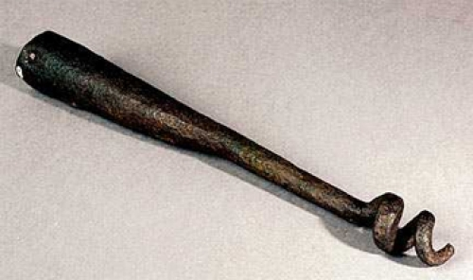
A Warm-Up Exercise
Based on its appearance, how could you use this tool?

Slide 6
Question Cookie
What does it do?
It’s an online space where students can post questions
Other students can see the questions and vote them up or down
Everyone can see how many students like a question and how many students don’t like it
Questions can be sorted from newest to oldest, or by the number of votes.
The instructor and/or students can respond, in Question Cookie, to questions that are posted

Slide 7
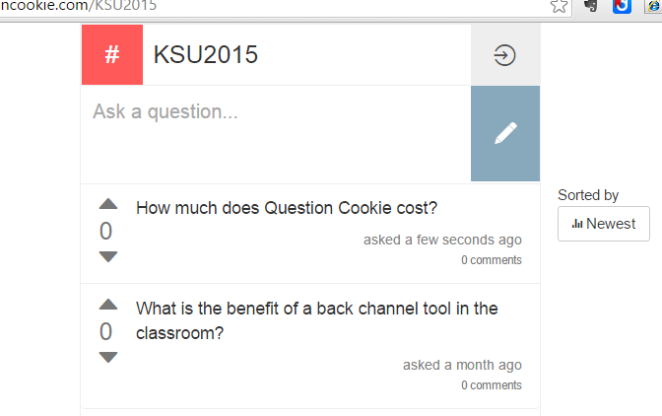
Question Cookie
What does it do?
It’s an online space where students can post questions

Slide 8
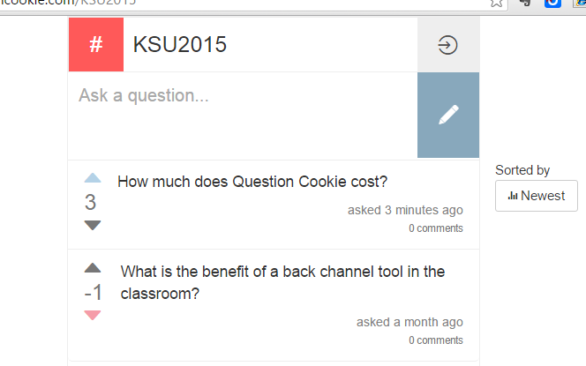
Question Cookie
What does it do?
Other students can see the questions that are posted and vote them up or down.
Everyone is able to see how many students like a question and how many students don’t like it

Slide 9
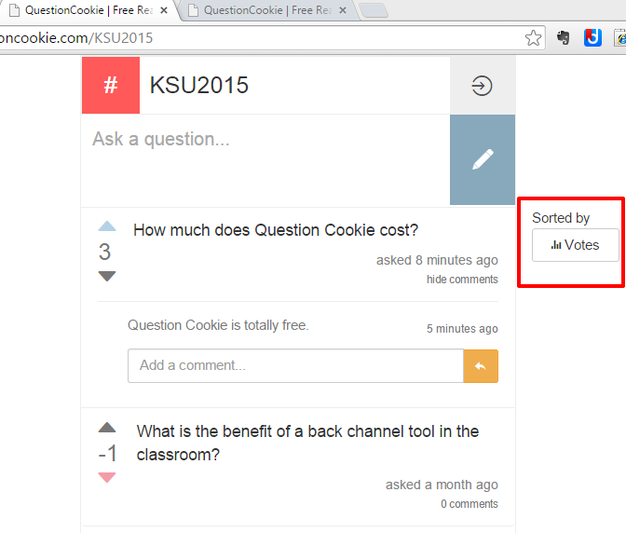
Question Cookie
What does it do?
Questions can be sorted from newest to oldest, or by the number of votes they have received.

Slide 10
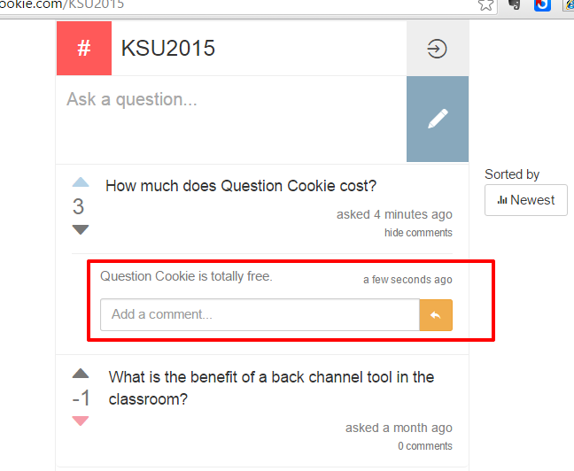
Question Cookie
What does it do?
The instructor and/or students can respond, in Question Cookie, to questions that are posted

Slide 11
Brainstorming: How could Question Cookie enhance your students’ learning experience?
Question Cookie
Encourages “shy” students to ask questions in class
You can see which questions are of most interest to the greatest number of students
You can “check” the questions before responding to them
You can copy questions that you don’t answer in class into a discussion group in your Learning Management System, and respond to them there.

Slide 12
Over the next five days, in this training program, we will be using Question Cookie
Question Cookie
KSU instructors are welcome to ask questions verbally in class, but also try asking some of your questions in Question Cookie.
Near the end of each workshop, or at the end of each day, I will review the questions in Question Cookie, and respond to some of them.
The URL you need is this: www.questioncookie.com/KSU2015 (KSU in capital letters)

Slide 13
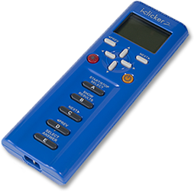
Clickers
What does it do?
The instructor projects a question on the classroom screen
Students use their clickers to respond to the question
The clicker system collects the responses and displays them as a bar chart

Slide 14
Clickers
What does it do?
The instructor projects a question on the classroom screen

Slide 15
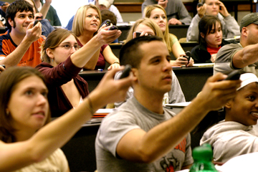
Clickers
What does it do?
Students use their clickers to respond to the question

Slide 16
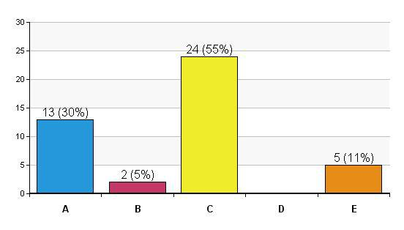
Clickers
What does it do?
The clicker base unit collects the responses and displays them as a bar chart

Slide 17
Brainstorming: How can Clickers enhance your students’ learning experience?
Clickers
Clickers can make your class time more engaging: sustains student interest
Use clickers to assess whether students are “getting it”
Use them to ensure that students come to class fully prepared.
Leverages Peer Instruction
The best way to learn something is to teach someone else
Overcomes “expertise bias”

Slide 18
Example of Peer Instruction using clickers
Clickers
Grab an iClicker and get ready to use it!

Slide 19
Example of Peer Instruction using clickers
You have 1 cup of coffee and 1 cup of milk. You take 1 tablespoon of milk, drop it into the coffee, and mix it completely. Then you take 1 tablespoon of that coffee/milk mixture, drop it back into the milk, and mix it completely. Is there now more milk in the coffee, or more coffee in the milk?
There is more milk in the coffee
There is more coffee in the milk
The amount of milk in the coffee is equal to the amount of coffee in the milk
I don’t know how to figure it out
Step 1: Come up with an answer by yourself then select it using your clicker

Slide 20
Step2: the instructor reveals the bar chart
Clickers

Slide 21
Step 3: discuss the same question in a small group. Try to convince the others in your group that your answer is correct.
Clickers
You have 1 cup of coffee and 1 cup of milk. You take 1 tablespoon of milk, put it into the coffee, and mix it completely. Then you take 1 tablespoon of that coffee/milk mixture, put it back into the milk, and mix it completely. Is there now more milk in the coffee, or more coffee in the milk?
There is more milk in the coffee
There is more coffee in the milk
The amount of milk in the coffee is equal to the amount of coffee in the milk
I don’t know how to figure it out

Slide 22
Step 4: The instructor reveals the new bar chart
Clickers

Slide 23
Step 5: the instructor reveals the answer, and explains why.
Clickers
The amount of milk in the coffee is equal to the amount of coffee in the milk
You can establish this algebraically:
Or you can establish it via a much more elegant method that will promote deep thinking….

Slide 24
Brainstorming: What made the peer instruction effective?
Clickers
The act of choosing an answer, after thinking about the question individually, established an emotional connection to the answer: we want to know if we are correct.
The arguments and perspectives of others (even if they are incorrect) help us to see new ways of thinking about the problem.
It’s fun.

Slide 25
Top Hat
What does it do?
Top Hat is an online platform with clicker-like functionality.
The instructor creates the questions in the online platform; many kinds of questions are supported.
The instructor displays the questions on the classroom screen; or, students can view the questions on their laptops or smart phones.
Students use their laptops or smart phones to respond to the questions.
Top Hat collects the students’ responses and displays them as a bar chart (or in other graphical forms)

Slide 26
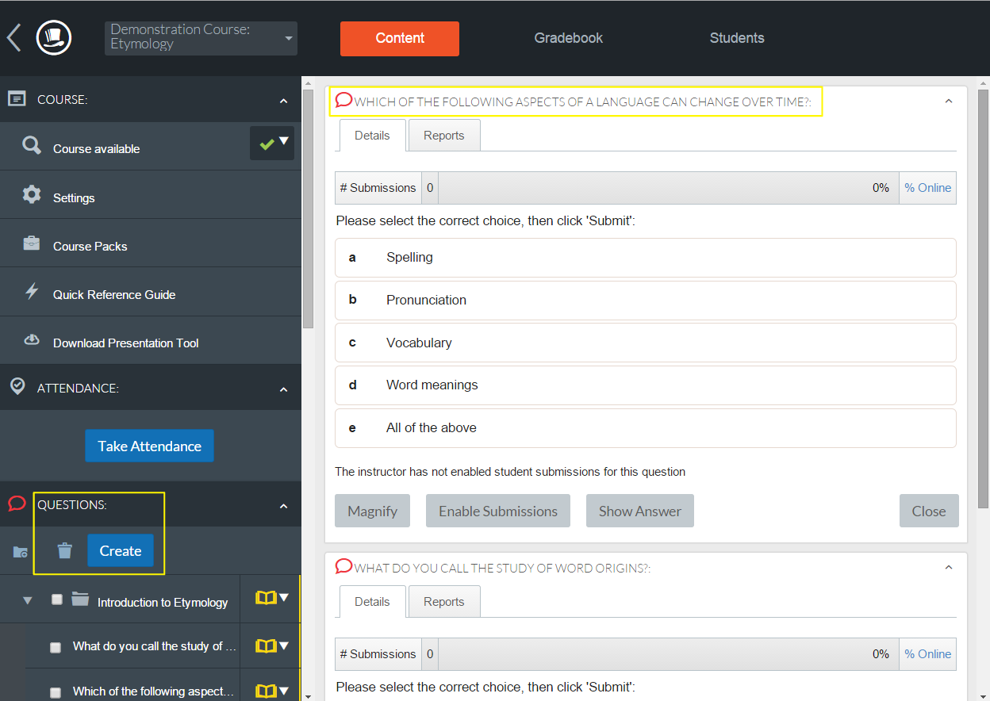
Top Hat
The instructor creates the questions in the online platform; many kinds of questions are supported.

Slide 27
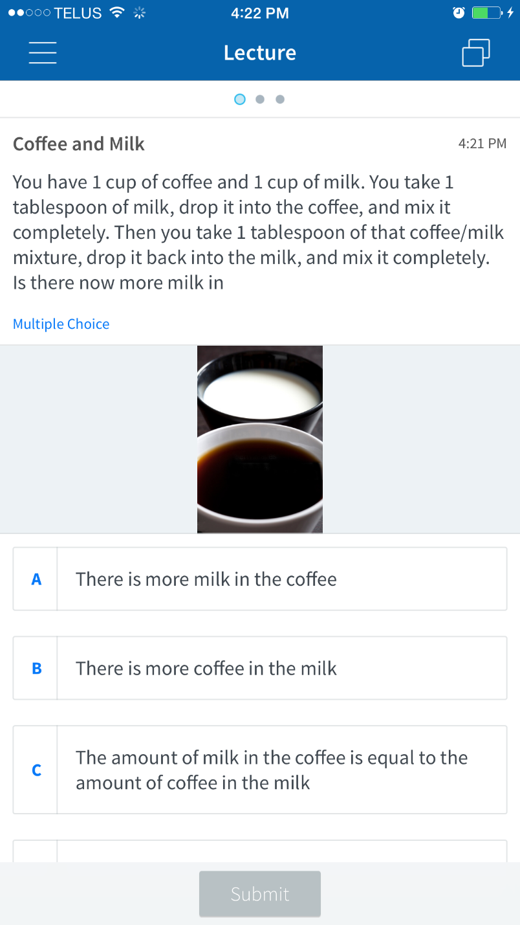
Top Hat
The instructor displays the questions on the classroom screen; or, students can view the questions on their laptops, or smart phones.
Students use their laptops or smart phones to respond to the questions.
This is how a question looks in Top Hat on an iPhone

Slide 28
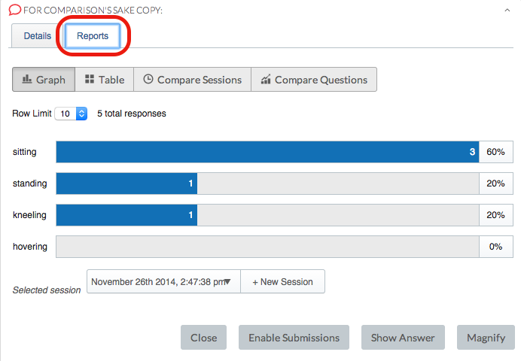
Top Hat
Top Hat collects the students’ responses and displays them as a bar chart (or in other graphical forms)

Slide 29
Top Hat
Additional functionality
Instructors can create discussion forums in Top Hat where students can ask questions, vote on each others questions, and respond to each other’s questions.
In addition to using Top Hat to ask questions during class, an instructor can also set questions in Top Hat as “homework” which students complete outside of class.
Create tournaments in which students compete with one another

Slide 30
Brainstorming: What are the relative merits of Top Hat versus Clickers?
Clickers
Clickers have one purpose: to collect responses (they don’t have other “distractions” built into them)
Clickers are cheap (not all students can afford a mobile device, which is needed to use Top Hat)
Top Hat
Students never forget their smartphones but they might forget to bring their clickers
Top Hat allows you to ask a wider variety of questions
Top Hat seems more modern than clickers
With Top Hat, each student can interact with simulations and animations
Top Hat facilitates students asking (and voting on) their own questions
Top Hat lets an instructor set questions as homework, and has a tournament mode.

Slide 31
Piazza
What does it do?
Piazza is an online space that blends the functionality of an online discussion forum with the functionality of a wiki.
Students or the instructor post questions in Piazza. The questions appear in chronological sequence (like posts in a discussion forum).
Students collaboratively solve the question in a single online space (like a wiki).
The instructor can “endorse” the students’ solution when appropriate.
The instructor can respond to the question.
Follow-up questions or discussion can be posted.

Slide 32
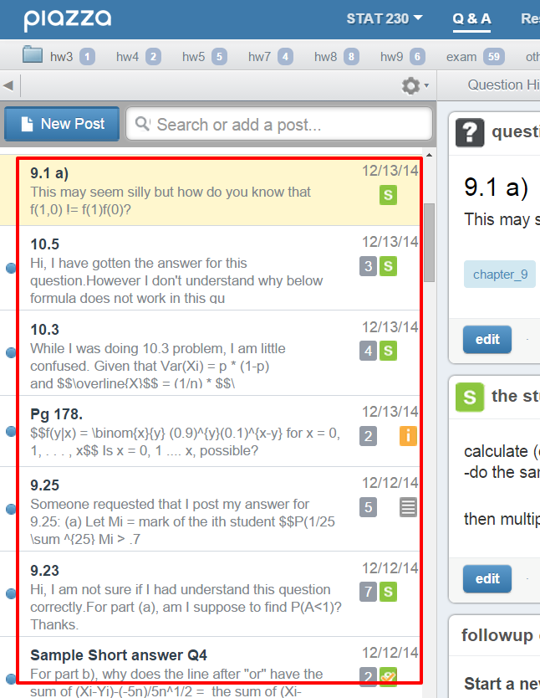
Piazza
What does it do?
Students or the instructor post questions to Piazza. The questions appear in a chronological sequence (like posts in a discussion forum).

Slide 33
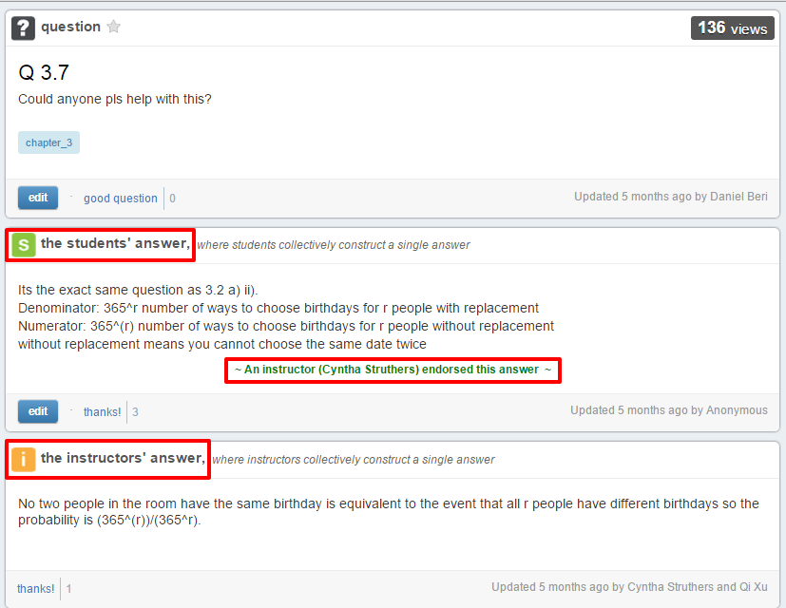
Piazza
What does it do?
Students collaboratively solve the question in a single online space (like a wiki).
The instructor can “endorse” the students’ solution when appropriate. The instructor can respond to the question.

Slide 34
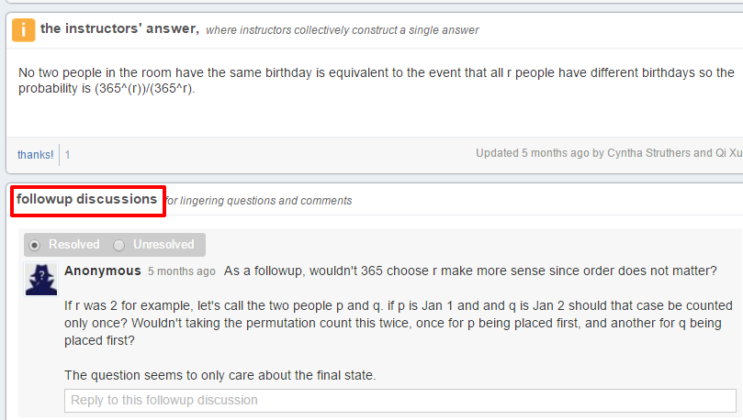
Piazza
What does it do?
Follow-up questions and discussion can be posted.

Slide 35
Brainstorming: How could Piazza enhance your students’ learning experience?
Piazza
It empowers students: they collaborate on developing their own answers to their own questions.
It leverages peer instruction:
The best way to learn something is to teach someone else
Overcomes “expertise bias”
Students get just-in-time responses to their questions, usually within a few minutes.

Slide 36
A Quick Quiz about Question Cookie, Clickers, Top Hat, and Piazza
Which tool(s) can you use to facilitate peer instruction?
Clickers, Top Hat, Piazza
Which tool lets students ask questions during a lecture, and vote on those questions?
Question Cookie
Which tool helps students ask questions and answer each other’s questions?
Piazza
Which tool is an app that students use on a smart phone or laptop?
Top Hat

Slide 37
Questions and Discussion

