Slide 1
Making a difference while learning: Using the campus as a living lab in courses
Heather McDiarmid
Shirley Yang
Robyn McIntyre
Christine Barbeau

Slide 2
Land Acknowledgement
“We are on the Traditional Territory of the Anishinaabeg (Mississauga Nations), the Haudenosaunee (Six Nations of the Grand River) and the Huron Wendat as well as those who exist only in blood memory to remember the ancestors who are before recorded time.”
Peter Schuler, Mississaugas of the Credit First Nation
Notes:
Peter Schuler an Elder of the Mississaugas of the Credit First Nation of the Anishnaabek Peoples.

Slide 3
Outline
What is a living lab?
History of living lab at UW
The living lab moving forward
Case studies
The living lab into the future
How can the living lab work with your course?
Notes:
I will be inviting you to participate directly as we go along
Please interrupt if you have questions

Slide 4
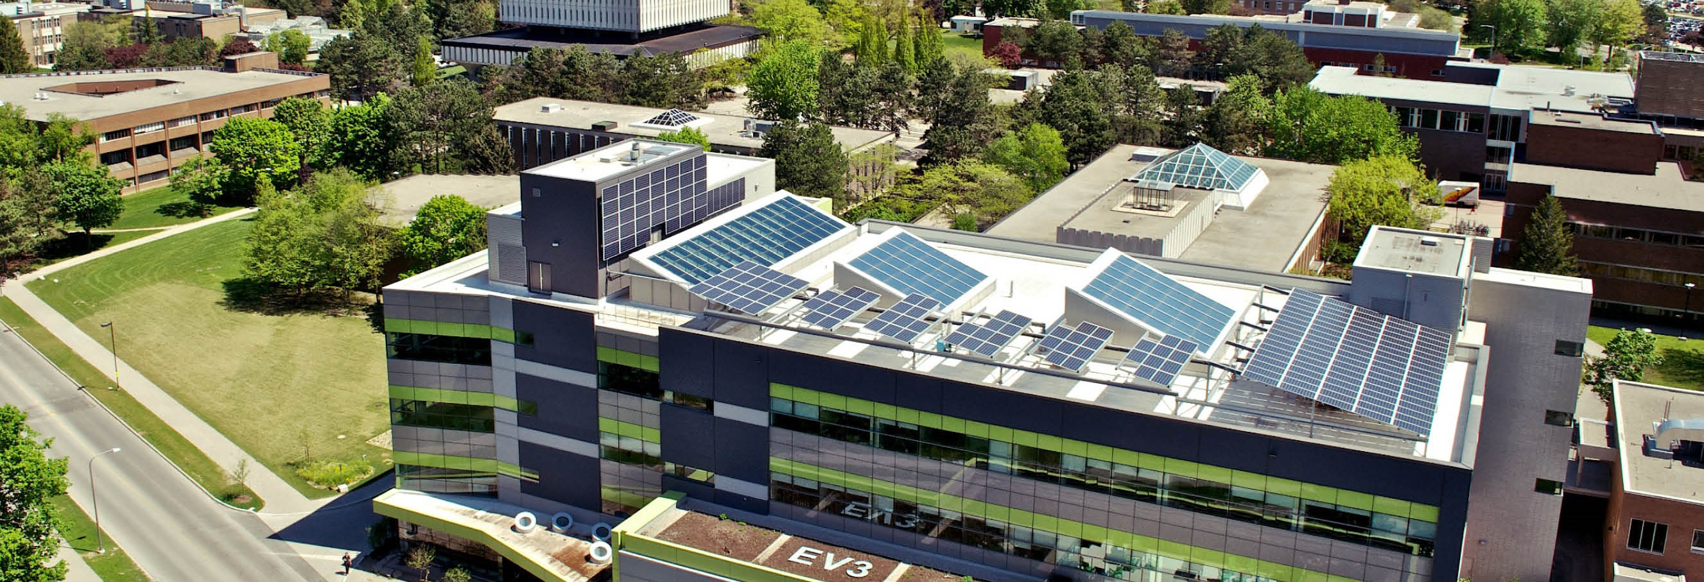
Introduction
Your name,
what courses you are considering adding a living lab to?
Notes:
My name Heather McDiarmid, I am the Sustainability Living Lab Coordinator here on campus. This is a new position created to amplify the number and impact of projects carried out here on campus that support greater operational sustainability. I am excited to be in this position because as a former Sessional Lecturer in Biochemistry and Climate Change Mitigation and also as a homeschooling parent, I love to help people to get excited about their learning. That is what we are trying to do here.

Slide 5
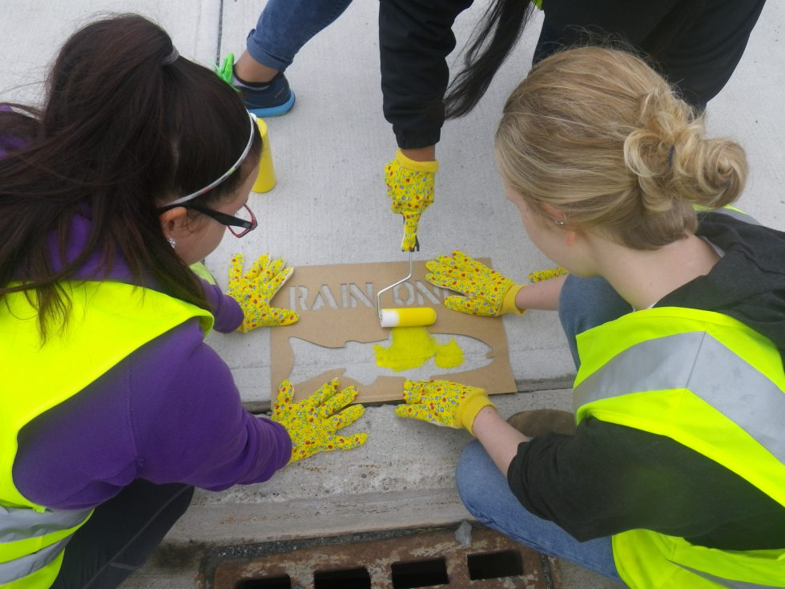
Story as introduction
Notes:
Many years ago, my kids and I participated in the Yellow Fish Road program
We distributed leaflets in our community and painted a yellow fish on storm drains to remind people that to protect our ecosystems, only rainwater belongs in storm drains
My son practiced reading, something he was not keen on doing, and learned a ton about pollution and its effects on wildlife – he felt empowered by a project that was having a meaningful impact
I think we all feel that way: we want to make a difference and when we can tie what we are learning in with important work, we are more motivated to invest ourselves in that learning
This is a living lab project, this is what I am looking to achieve on our campus

Slide 6
What is a living lab?
"Involving users in innovation activities in real environments" Hossain, Leminen, Westerlund, 2019
The use of real-life environments for researching, testing and applying innovative solutions to our society's challenges
Notes:
THe living lab idea has been defined in many ways but here are a few that resonate with me
It is a form of experiential learning, can be problem-based or project-based, it can have other approaches
An opportunity for students to apply their skills, knowledge and understanding to real world sustainability challenges on campus

Slide 7
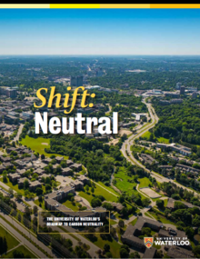
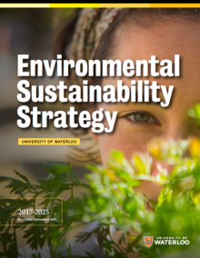
Sustainability context for living lab projects
Environmental Sustainability Strategy
27 objectives supporting the goals
Shift Neutral
46 initiatives supporting the climate targets
Notes:
At the University of Waterloo, the living lab concept is applied in a sustainability context
The good news is that the University has already identified priority areas for action,
for example, the Environmental Sustainability Strategy
Be a leader in environmental sustainability education and research
Operate the campus sustainably (energy, waste, grounds, transportation, CC, water, food, procurement)
Embed sustainability practices into campus culture – engagement/communications
Shift Neutral – anyone know our long term goal?
Become carbon neutral by 2050
Reduce emissions by 17.5% below 2015 levels by 2025
UN Sustainable Development Goals – can anyone tell me what that is all about?
Although not explicitly part of the identified campus goals, these provide a useful framework for thinking about sustainability challenges and the interconnectedness of these
17 goals
Keep in mind that The University of Waterloo campus is akin to a small city, with its own roads, fleet, governance, buildings, district heating system, green spaces

Slide 8
Are there any obvious campus sustainability connections to your courses?
Notes:
energy, waste, grounds, transportation, CC, water, food, procurement

Slide 9
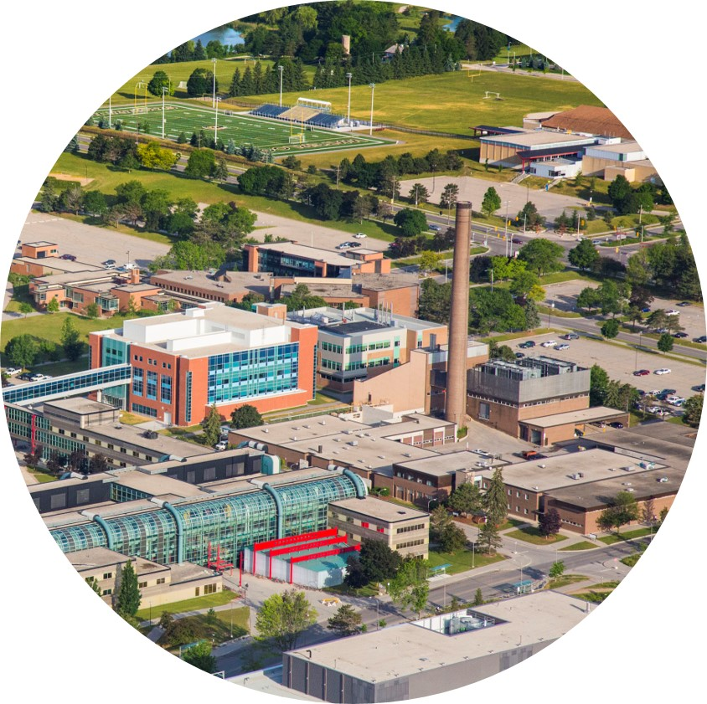
Living Labs at UWaterloo: a History
Phase 1: Leading the way 1990s-2005
ERS 250: Greening the Campus course
The first Canadian example of “Campus as a Living Lab”
Lessons learned
Students can produce valuable and quality work
Most projects did not have impacts
Many projects could not be fully developed in a 3-month course
Staff often felt overwhelmed by student requests
Notes:
Nearly 300 campus-focused projects
Course ended in 2005
Some examples of work that students did:
Waste audits of different buildings with recommendations
Surveys of travel behaviours with recommendations
Study of the need for more secure bike parking facilities with recommendations
Most projects did not have impacts
Not linked to campus priorties
Often not practical
Did not consider institutional limitations
Multi-year projects and promising ideas that could not be fully developed in a 3-month course never reached their potential
Staff often felt overwhelmed with request for information, interviews, or other data on campus sustainability issues

Slide 10
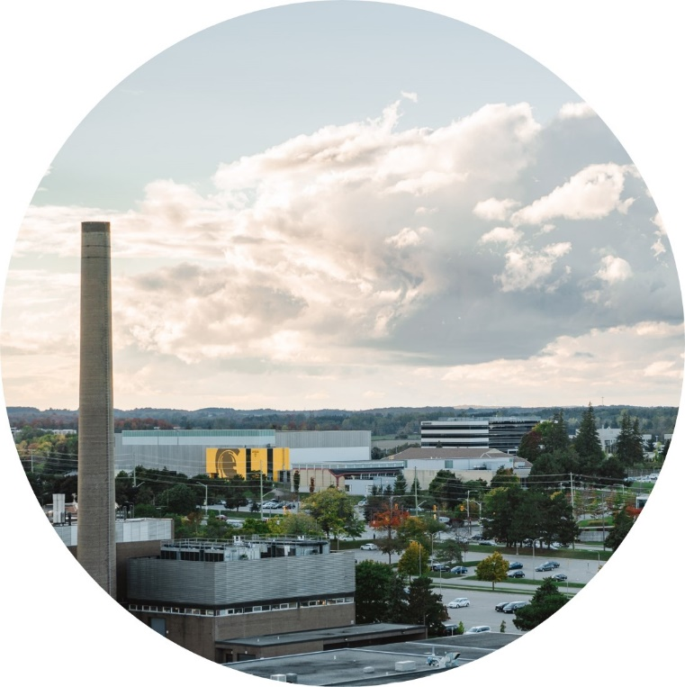
Phase 2: ongoing
The Sustainability Office has supported student-initiated projects
Many of these have had meaningful impacts on campus operations
Lessons learned
Projects often require Sustainability Office support
Projects that are not tied to a course or degree tend to peter out
Limited opportunities without a formalized program
Living Labs at UWaterloo: a History
Notes:
SO office support to
Access data
Access campus stakeholders
Provide insights into institutional processes

Slide 11
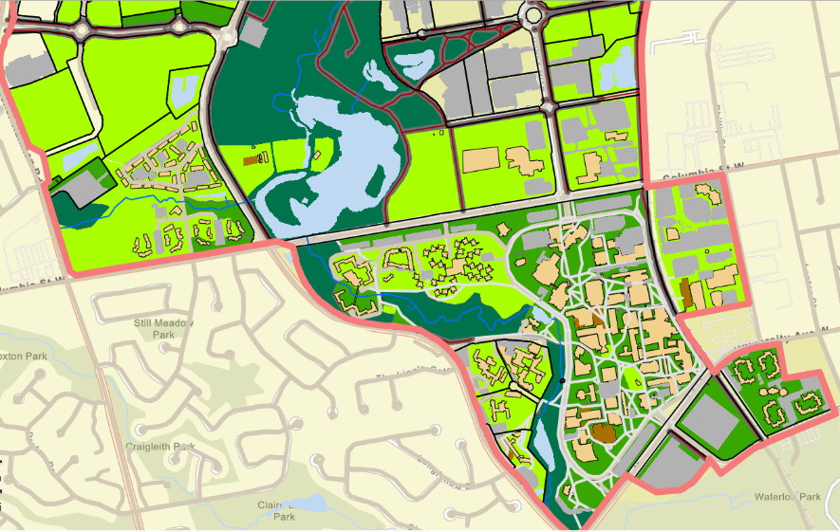
Living Labs at UWaterloo: Moving Forward
Phase 3: Formalizing the process
Sustainability Living Lab Coordinator position created Fall 2021
Development of a formalized Sustainable Living Lab program
Website launched https://uwaterloo.ca/sustainability-living-lab/
Notes:
SO is the client
We can help to access data
We can facilitate engagement with staff, ensuring efficient transfer of needed information
We can help students to understand the institutional context for projects (eg decision-making processes, division of power, financial limitations, etc)
We help to match campus priorities and needs with course goals
We can work on follow up to support project implementation or to ensure continuity on a project over several years

Slide 12
Key features of UW living lab
Sustainability challenges address campus needs
Identified by campus operational groups
Tied to exiting strategic plans
Projects are directly related to course goals
Skills, learning outcomes, knowledge
Facilitated by the Sustainability Office
Acts as the client for projects
Facilitates engagement with campus stakeholders
Facilitates access to campus resources
Notes:
eg Sustainability strategy, Shift Neutral climate action plan
SO is the client
We can help to access data
We can facilitate engagement with staff, ensuring efficient transfer of needed information
We can help students to understand the institutional context for projects (eg decision-making processes, division of power, financial limitations, etc)
We help to match campus priorities and needs with course goals
We can work on follow up to support project implementation or to ensure continuity on a project over several years
My job is to
work with campus groups to ID campus needs
Work with instructors to ID course needs and seek projects that match those needs or can be adapted to meet those needs
Learn from students about what they want to work on, what are they excited about
Bring these together to design projects that
Meet everyone's needs
Have a high probability of making a real impact

Slide 13
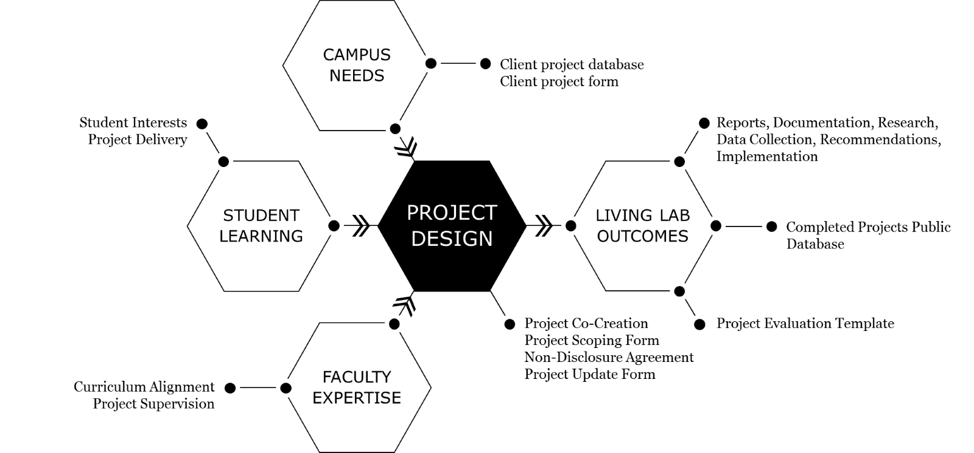
Notes:
James Nugent designed this image
Campus needs: are a living list of projects, gaps, or areas of improvement identified by employees across any areas of the Environmental Sustainability Strategy.
Student learning: course-based opportunities for students to complete applied learning projects using the campus needs as topics.
Faculty expertise: course instructors that coach students through projects, or faculty researchers conducting research on topics relevant to the campus needs.
Project design: matching campus needs with student learning and faculty expertise, including clarifying expectations and setting project scopes. The emphasis here is on collaborative co-development of projects that will be mutually beneficial.
Living lab outcomes: reports, presentations, data sets, and any other results from the completed projects, all displayed publically.

Slide 14
Process
Sustainability Office solicits project ideas from campus operations
Sustainability Office seeks course instructors interested in using living lab projects
Database of project proposals are showcased on our website
Students and instructors can modify project proposals to match course goals
The Sustainability Office supports projects by facilitating access to data and people
The Sustainability Office can support project continuity beyond the course
Notes:
Project continuity beyond the course
Where appropriate, supports implementation of recommendations
Develops follow-up projects that move an idea forward. Some projects may take several steps from
pre-feasibility research of the problem
economic feasibility
analysis of the engineering design implications
analysis of the policy and social dimensions
Development of a communications strategy

Slide 15
What do you see as the main benefits of a living lab program?
for your courses,
for your students,
for our campus,
for our society?
Notes:
Improved student engagement and associated learning
Exposure to systems-level and multi-disciplinary thinking as students must consider complex problems with multi-dimensional impacts
Exposure to real world 'messy' data
Opportunities for stakeholder engagement
Projects with impact that can grab employers' attention
Favaloro, Tela, Tamara Ball, and Ronnie D. Lipschutz. "Mind the gap! Developing the campus as a living lab for student experiential learning in sustainability." Sustainability on university campuses: Learning, skills building and best practices. Springer, Cham, 2019. 91-113.

Slide 16
Case studies
Shirley Yang
MSc thesis on Integrating Community‐Based Social Marketing Theory to Improve Waste Sorting Behaviour at the University of Waterloo.
Robyn McIntyre
Sustainable Regional Transportation Study for PLAN 405
Christine Barbeau
Developing a living lab project for ERS 340/1 to implement naturalization practices on campus

Slide 17
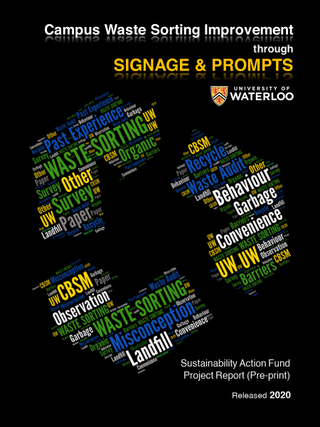
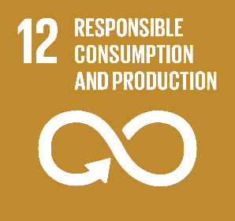
Campus Waste Sorting Improvement via Re-designing Waste Signs
Redesign Waste Signs: Why?
35.33% (2019)
3,192 Tonnes of waste sent to landfill
60% (2025)
90% (2035)
Zero Waste Campus

Slide 18
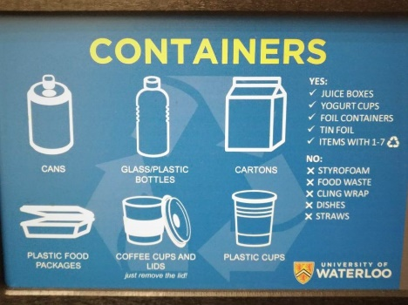
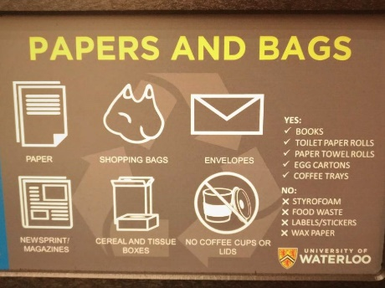
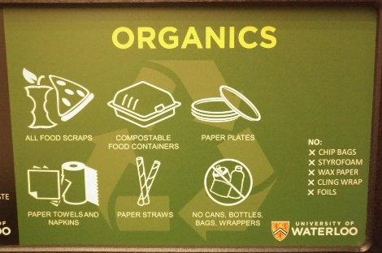
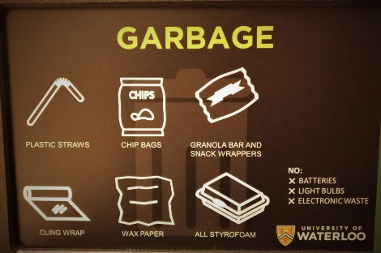
Redesign Waste Signs: How?
Pre
Post

Slide 19
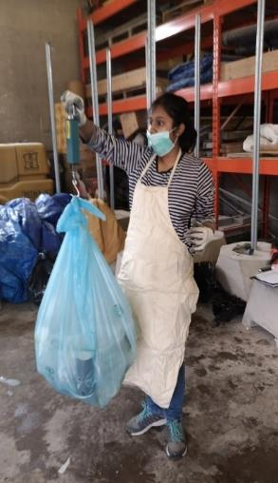
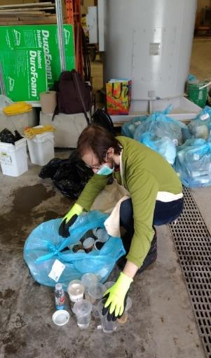
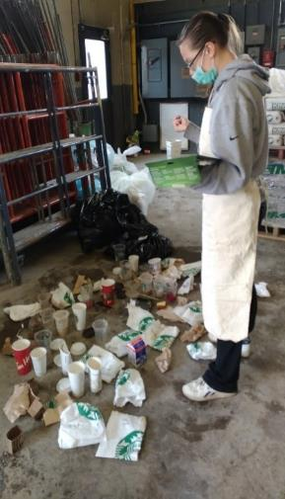
Redesign Waste Signs: How?
Survey
Waste Audit
Observation

Slide 20
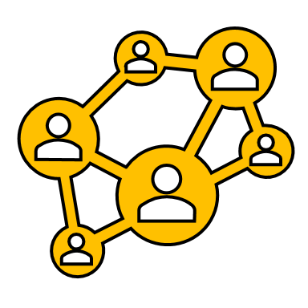
The Role of Sustainability Office
Funds
Stakeholder Connections
Consultation
Project Support

Slide 21
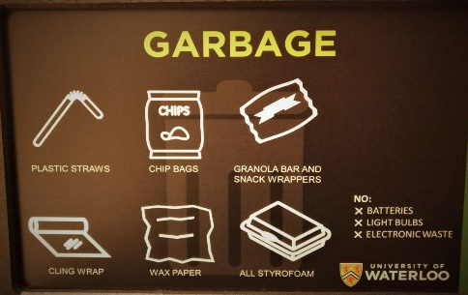
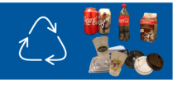
Direct Changes on Campus
Image credit: UW Sustainability Office

Slide 22
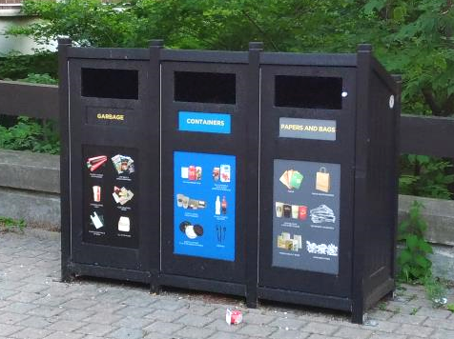
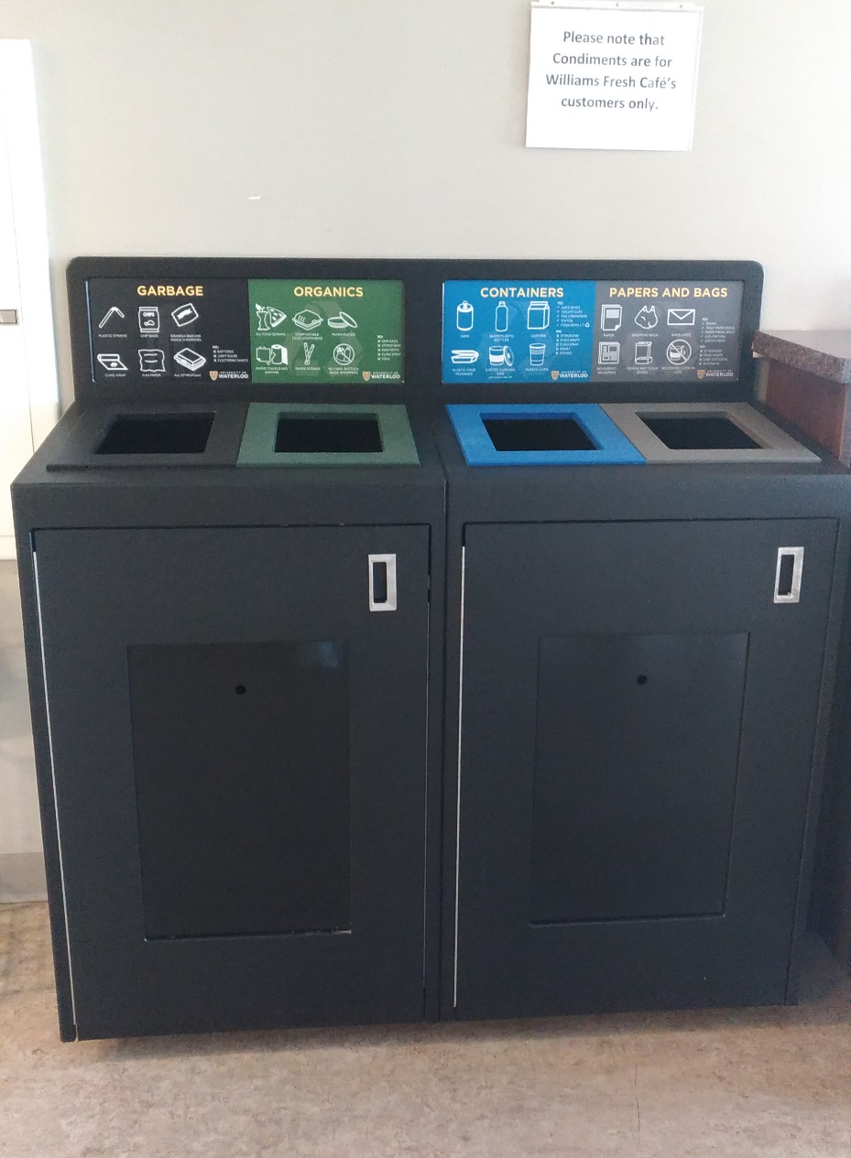
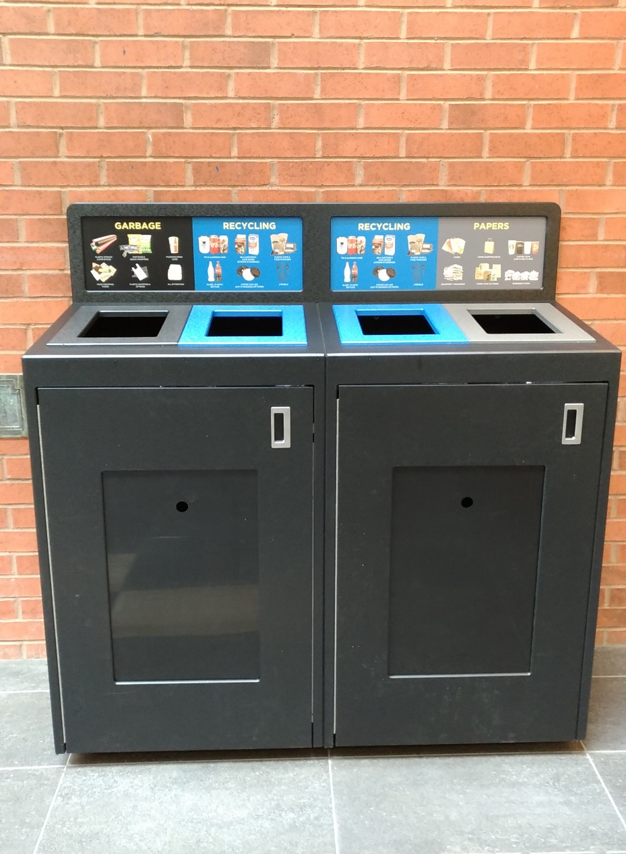
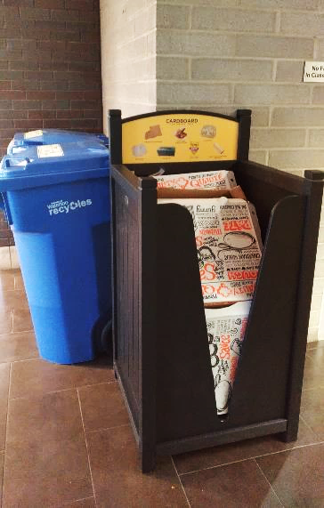

Slide 23
Indirect changes or influence
Connecting intelligence and interests
Establishing communication channels

Slide 24
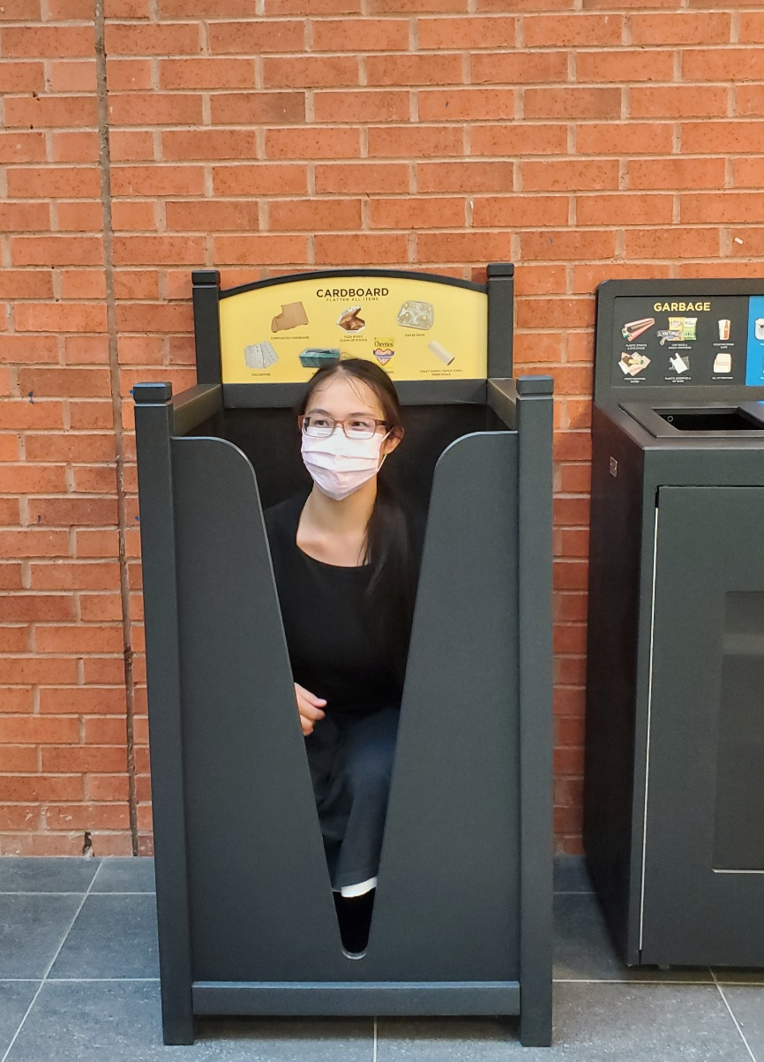
Thank you!! &
Ya-Han Yang
(Shirley Yang)
Program Assistant
The Region of Waterloo
Waste Management & Division
yh6yang@uwaterloo.ca

Slide 25
Robyn McIntyre – PLAN 405 group project

Slide 26
Christine Barbeau – Continuing Lecturer in SERS

Slide 27
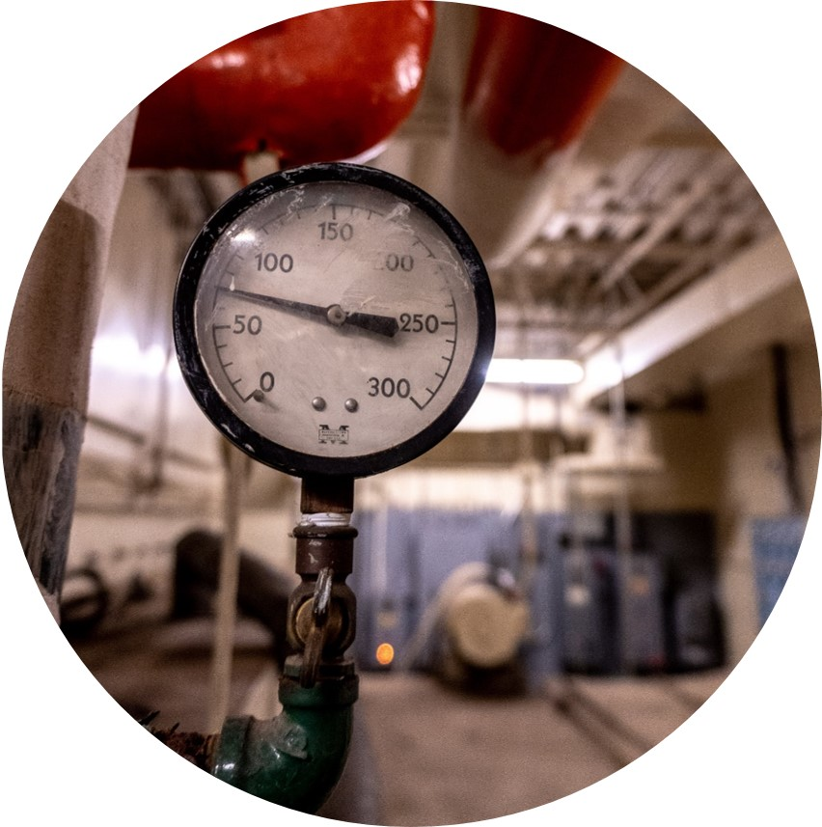
Types of living lab projects
Research a problem and make recommendations
feasibility of ground source heat pumps for select campus buildings
Apply a practice to the University
public service announcement for food services
Use real data from campus operations
Ecology Lab, energy data on campus, waste, water data
Notes:
Research and recommend
These are often the very first steps in developing plans
Explore the potential for ideas, the ones with promise go on to the next steps
Some may involve surveys to understand a problem
Apply
Implementing a new idea
Many of these are communication campaigns
Data
Real data is messy, students need experience dealing with real data
There is the potential to gain important insights from existing data
Limited impact for the University
We are looking for ways of making data easier to access so the SO doesn't have to be as actively involved in supporting these projects but we are interested in learning about the insights that can be gained from going deeper in analyzing the data

Slide 28
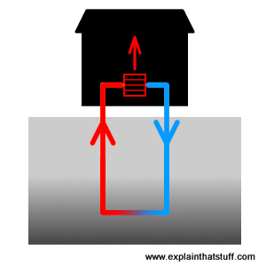
Example: Ground source heat pump feasibility study
Background
Scope of Work could include
Resources available
Proposed deliverables
Stakeholders
Key contacts
Notes:
Background:
need to shift off fossil gas if we are to meet be carbon neutral by 2050
Buildings not on the district heating system are a good place to start
Scope of Work could include
Researching geological suitability
Researching building requirements
Cost analysis, including upfront and operational costs
GHGe and energy impact analysis
Best practices, incentives, other considerations
Resources
Data is available through the Sustainability Office for natural gas consumption in buildings not served by the district heating system. The age and condition of existing equipment can be obtained from Plant Operations through the Sustainability Office. Load profiles and peak demand values are not available at this time.
Facilitate engagements with campus operations.
Proposed Deliverables
The details of the deliverables are flexible but must meet the requirements set out by the course instructor. Some proposed deliverables include:
A work plan early in the term outlining key milestones and responsibilities.
Updates on progress at least once during the term.
A final report outlining the outcomes of the feasibility study, including cost estimates from local sources.
Key Contacts

Slide 29
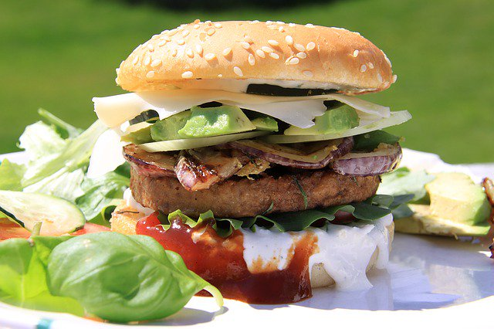
Current project proposals
Fueling station decision analysis
Ground source heat pump feasibility study
Naturalized landscaping business case
Zero emission landscaping equipment business case
Communications strategy for shorter showers
Communications strategy for sustainable food choices on campus
Communications strategy for waste sorting tools
More coming…

Slide 30
Living Labs at UWaterloo: Plans for the Future
Learn from current projects
Ongoing projects
Multi-stage projects
Transdisciplinary projects
Larger implementation projects
Projects tied to academic research
Seeking projects from the community
Projects that test innovative and new ideas
Notes:
Ongoing projects
Naturalization of campus grounds
Multi-stage projects
Projects that cannot be comleted in one term, may be split into stages
Multi-disciplinary projects
Bringing students from different programs of study or even different courses together to work on a project collaboratively
Larger implementation
UBC built an 18-storey mass timber residence building, the tallest in the world at the time as a campus as a living lab project
Projects tied to academic research
Open the door for researchers to apply their theory to campus grounds
Seeking projects from the communitiy
Same model but our partners are community groups, the municipality etc
Projects that test innovative and new ideas
The campus is a true laboratory to test new ideas, prototypes and transformational thinking

Slide 31
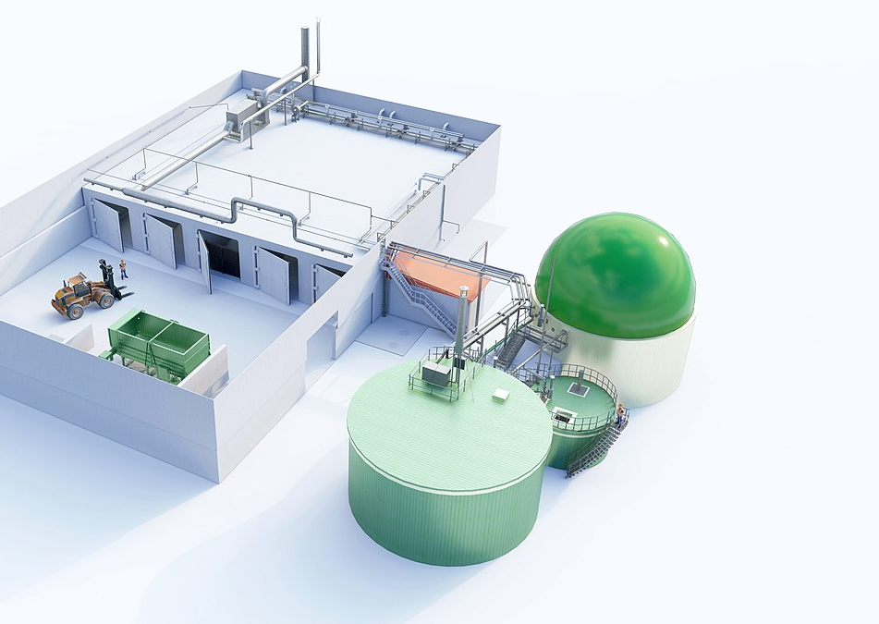
Big project example: campus biodigester
Background research
Economic feasibility study
Engineering feasibility study
Environmental impact study
Stakeholder engagement planning
Communication campaign
https://commons.wikimedia.org/wiki/File:Dry_-_solid-state_anaerobic_digestion_AD_biogas_plant.jpg
Notes:
A biodigester is a facility that takes organic waste, such as food waste and breaks it down aerobically or anaerobically to produce compost that can be recycled into the soil
This could be carried out as 6 separate studies over many years as a multi-stage project
This could be carried out as one multi-disciplinary study that encourages collaboration and systems thinking
NOTE: this is just a thought exercise, plant operations has not communicated interest in exploring a campus biodigester at this time

Slide 32
How might Living Labs apply to your course?

Slide 33
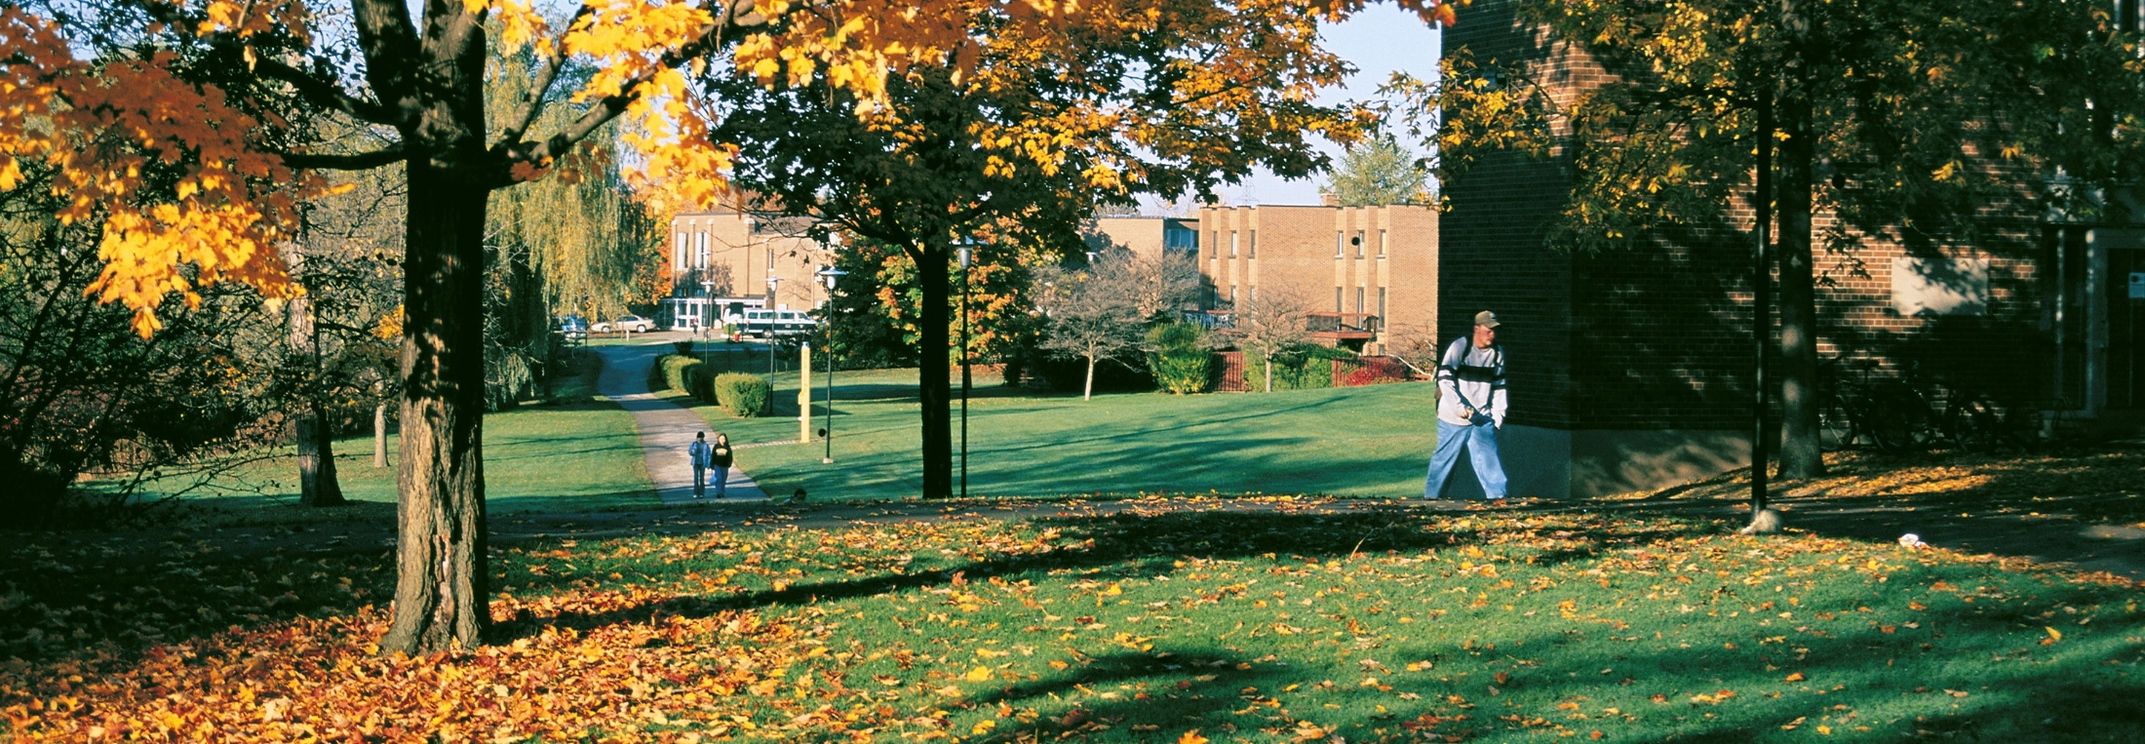
Want to explore further?
Reach out to me anytime:
Heather McDiarmid
Sustainability Living Lab Coordinator
Hmcdiarm@uwaterloo.ca

Slide 34
sources
Hossain, Mokter, Seppo Leminen, and Mika Westerlund. "A systematic review of living lab literature." Journal of cleaner production 213 (2019): 976-988. https://doi.org/10.1016/j.jclepro.2018.12.257
NELSON, HOLLY GRACE, et al. "ENGAGED LEARNING IN THE LANDSCAPE: CAMPUS AS LIVING LAB." OUTSTANDING PAPER (2019): 359.
Favaloro, Tela, Tamara Ball, and Ronnie D. Lipschutz. "Mind the gap! Developing the campus as a living lab for student experiential learning in sustainability." Sustainability on university campuses: Learning, skills building and best practices. Springer, Cham, 2019. 91-113.
Verhoef L.A. et al. (2020) Towards a Learning System for University Campuses as Living Labs for Sustainability. In: Leal Filho W. et al. (eds) Universities as Living Labs for Sustainable Development. World Sustainability Series. Springer, Cham. https://doi.org/10.1007/978-3-030-15604-6_9
https://uwaterloo.ca/sustainability-living-lab/
https://sustain.ubc.ca/research/research-collections/brock-commons-tallwood-house
https://uwaterloo.ca/sustainability/sites/ca.sustainability/files/uploads/files/environmental_sustainability_strategy_accessible.pdf
https://uwaterloo.ca/sustainability/sites/ca.sustainability/files/uploads/files/shift_neutral_final_aoda.pdf

