Slide 1
Map the System
Community Partner Engagement
Notes:
Hi everyone! If you are watching this presentation, it likely means you are interested in participating in Map the System as a community partner. Community partners add valuable real-world experience to Map the System, allowing students to work on projects with potential for real community impact. We piloted bringing community partners into MTS for the first time last year, with great success. We are excited at the prospect of new partners joining us this year and exploring how we can all have stronger collective impact on challenges that we care about.

Slide 2
What to Expect
December
January to March
April and Beyond
Propose a systems-level challenge
Support students in exploring the challenge
Identify pathways for further action
Notes:
Here is an overview of what you can expect from engaging with Map the System. Over the new few months, your role as a community partner will be to propose a systems-level challenge relevant to your work or industry, support students in developing their understanding of the problem space and provide feedback on systems-level maps.

Slide 3
Identifying a Challenge
Resources to explore:
UWaterloo Map the System Student Workbook
Student Submission Evaluation Criteria
Impact Gaps Canvas
Student Guide to Mapping a System
Notes:
The first step to participating in Map the System is identifying a systems-level problem. There are some great resources available for helping you understand what systems-level problems look like that I will link below.

Slide 4
Characteristics of Systems-Level Challenges
The problem is chronic
No agreed upon best course of action
Multiple interconnecting components
Resistance to change
Notes:
Generally, systems level problems share some of the following characteristics:
The problem is chronic (persists over time and is not easily resolved with one-time interventions)
Stakeholders find it difficult to agree on the best course of action (multiple perspectives are required to fully develop effective solutions)
Interconnectedness (there are multiple interconnected components or stakeholders where changes to one part of the system can have significant impacts on other parts of the system)
Short-term efforts seem to undermine long-term solutions (the system is resistant to change due to complexity and non-linear interactions – interventions may have unintended consequences)

Slide 5
Example: Rising Incarceration of Indigenous Women in Prisons
According to recent research, awareness of residential schools and their ongoing impacts on Indigenous people is at an unprecedented high in Canada – but so is the proportion of women in Canada’s prisons who are Indigenous (over 50% and rising). This tragic paradox begs the question: How and why are these numbers climbing at the same time? Indigenous leaders and justice system reform advocates alike have raised the alarm about the mass incarceration of Indigenous people – especially women - for many decades (including the Truth and Reconciliation Commission – Call to Action 30). Advocates have clearly, consistently identified intergenerational trauma, enduring colonial practices and systemic racism as the basis of the prison pipeline. This pipeline describes the experience of many Indigenous women navigating child welfare, education and health care systems and suffering well-worn patterns of systemic abuse and abandonment that often leave them stuck in cycles that lead to prison.
Notes:
That is a long list of characteristics – so here is a practical example posed by a partner who has previously participated in Map the System.

Slide 6
Characteristics of Systems-Level Challenges
The problem is chronic
No agreed upon best course of action
Multiple interconnecting components
Resistance to change
Notes:
Let's look at how MCCO's challenge aligns with the systems characteristics we identified.
Chronicity: The ongoing rise in incarceration rates of Indigenous women, despite awareness and advocacy illustrate the chronic nature of this problem

Slide 7
Characteristics of Systems-Level Challenges
The problem is chronic
No agreed upon best course of action
Multiple interconnecting components
Resistance to change
Notes:
Multiple perspectives in the conversation, all with different ideas about how to best approach the challenge. Examples....

Slide 8
Characteristics of Systems-Level Challenges
The problem is chronic
No agreed upon best course of action
Multiple interconnecting components
Resistance to change
Notes:
Interconnectedness: systems such as child welfare, education, healthcare all impacts the prison pipeline

Slide 9
Characteristics of Systems-Level Challenges
The problem is chronic
No agreed upon best course of action
Multiple interconnecting components
Resistance to change
Notes:
Resistance to Change: interventions aimed at reducing incarceration rates may have unintended consequences if they do not address underlying issues like intergenerational trauma and systemic racism.

Slide 10
Illustrating the Impact
What narrative or story can you tell to illustrate the real-world impact of this problem?
How does it intersect with the work of your organization?
Notes:
As you think about the systems-level problems that matter to you, it can be helpful to identify a narrative or story that illustrates the impact that this problem has on people and places. This helps people new to a problem space see the tangible impact that these challenges have on the people involved.

Slide 11
Knowledge Sharing
How will results be shared or knowledge exchanged?
Example: “Map the System project outputs will contribute directly to the work of Project Ploughshares on climate, peace and security including a specific project focused on the implications of climate change on the role of the Canadian armed forces in the Artic. Outputs might be included in a survey and conference with relevant exerts and as part of briefing materials to the Department of National Defence. Internally, outputs will also be used to inform plans for our work going forward.”
Notes:
The last important piece to consider when mapping out your problem space is how these results will be used. If you are matched with a student team and they submit a systems map and written analysis on your problem space, how will you use and distribute this information?
For example, here is how a previous partner, Project Ploughshares, framed their sharing:

Slide 12
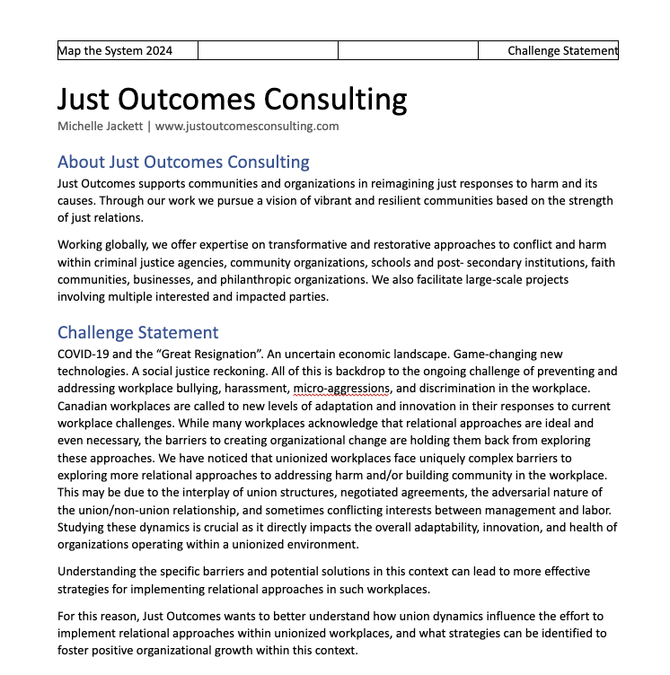
One-Page Challenge Statement
About your organization
The challenge
Impact on the organization
Possible connections
Notes:
Here is the template we recommend following as you generate your one-page challenge statement. (include screenshot of completed challenge).

Slide 13
Access to Support
Notes:
Once you have drafted out your challenge statement one-pager, staff from GreenHouse and the Grebel Centre for Peace Advancement will work with you to provide feedback and support on your submission. We can assist in identifying challenges, scoping the problem, and identifying pathways for implementation and knowledge sharing.

Slide 14
Explore Previous Challenge Submissions
Organization | Topic
Grief Matters | Grief literacy and experiences among university students
Just Outcomes Consulting | Impacts of unionized workplaces on relational practices
MCCO | Incarceration rates of Indigenous women in Canadian prisons
MCCO | Truth and reconciliation in anabaptist churches
MedMelanin | Systemic misdiagnosis of women of colour in Canadian healthcare
Project Ploughshares | The role of Canadian armed forces in addressing climate change
UW Sustainability Office | Waste diversion rates at the University of Waterloo
Notes:
I would encourage you to explore the examples of past problems shared below to see a number of diverse approaches to framing systems problems for student understanding.

Slide 15
Matching
Notes:
Once your one pager is submitted, our team will work to find and match you with students who share an interest in the topic. You will know by [DATE] whether your problem has been selected by a student team. If you do not get matched this round, there are plenty of other opportunities to engage with students via GreenHouse and the Centre for Peace Advancement. We will keep an eye out for opportunities that might be a good fit.
Partners will be invited to attend the Map the System kick-off on [DATE] for an opportunity to network and share your problem directly with students interested in participating. Here’s a great example of how a previous project partner, Just Outcomes, ‘pitched’ their problem space to students.

Slide 16
What to Expect
December
January to March
April and Beyond
Propose a systems-level challenge
Support students in exploring the challenge
Identify pathways for further action
Guide students towards existing resources and knowledge
Connect to relevant stakeholders in your network
Provide feedback and direction to support understanding
Notes:
Once matched with a student team, your role is to help provide context, knowledge, and connections that will help students in their exploration of the system. You may choose to meet with students several times over the course of February and March as they work through their research process.
As the community partner, you can guide students towards existing resources and knowledge, connect them to relevant stakeholders in your network, and provide feedback to support their understanding.

Slide 17
Student Submissions
Fiona Li
Partnered with MCCO
UW Campus Finals Winner
2nd Place National Map the System Winner
Notes:
In April, students will aim to submit a systems map and written analysis. This map showcases the work that Fiona Li did on the problem of Indigenous incarceration rates. Fiona’s work was selected as a campus winner, and she represented UW at the national MTS finals in Calgary in February.

Slide 18
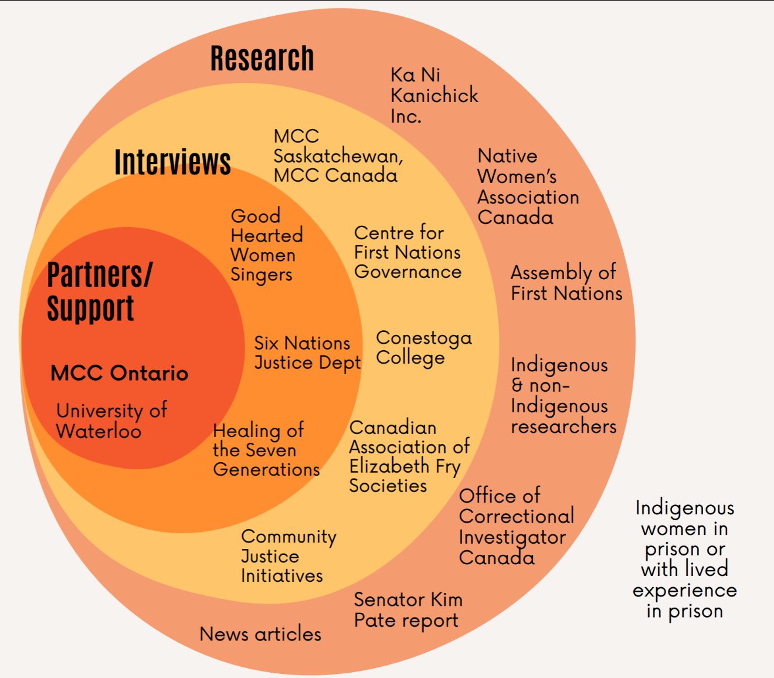
Student Submissions
Notes:
Here are some components submitted in Fiona's final presentation. This diagram here illustrates all the research Fiona did - both primary and secondary - to understand the system.

Slide 19
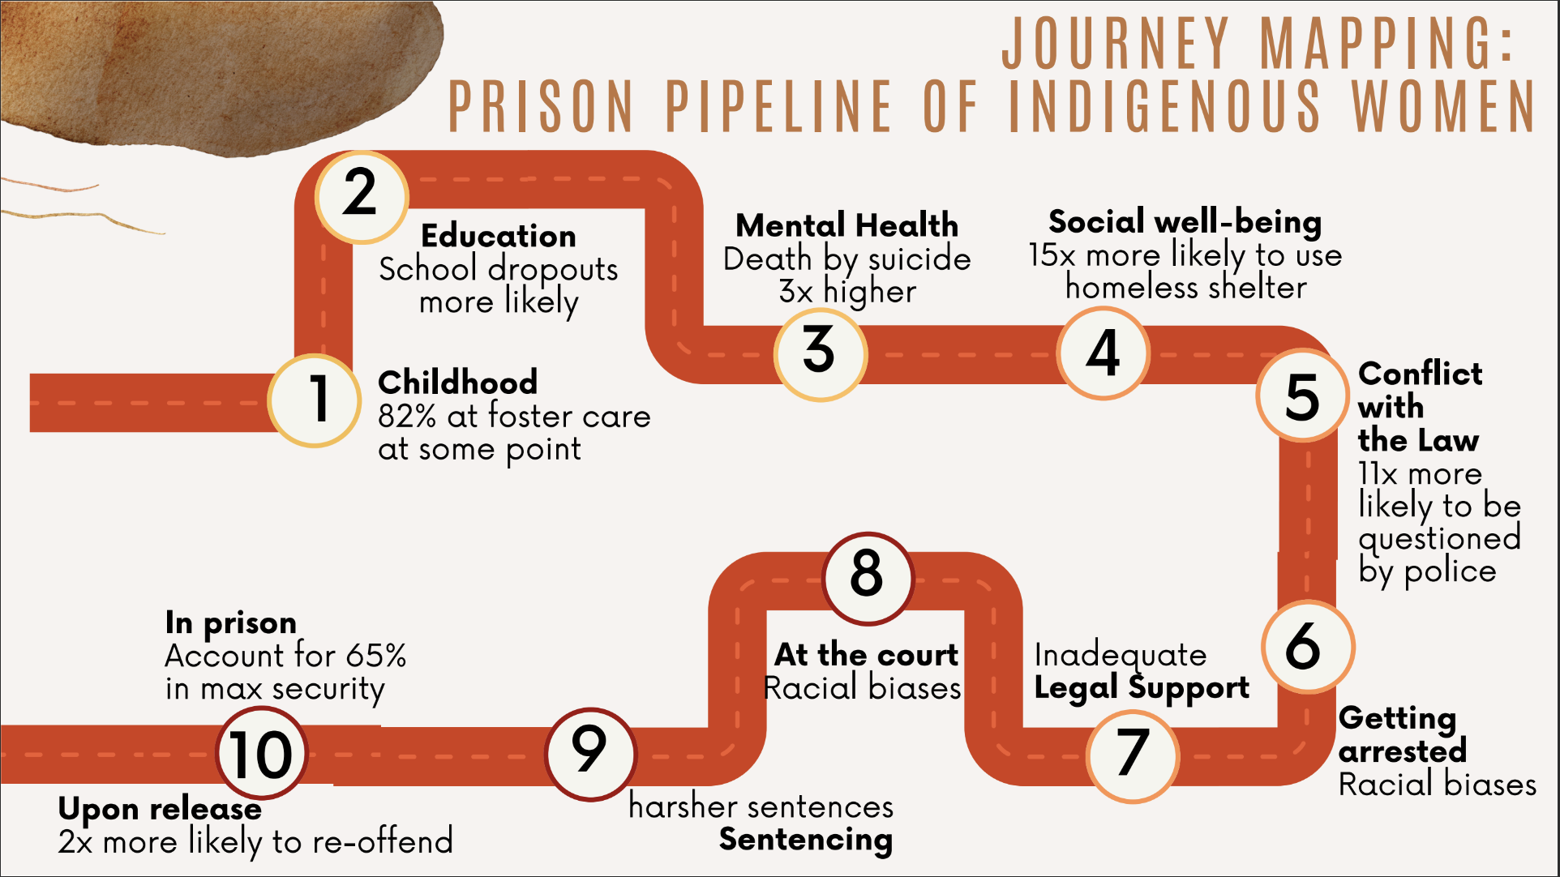
Student Submissions
Notes:
This graphic shows a journey map that outlines how someone might end up incarcerated from an individual perspective

Slide 20
Student Submissions
Notes:
While this graphic shows the larger system at hand.

Slide 21
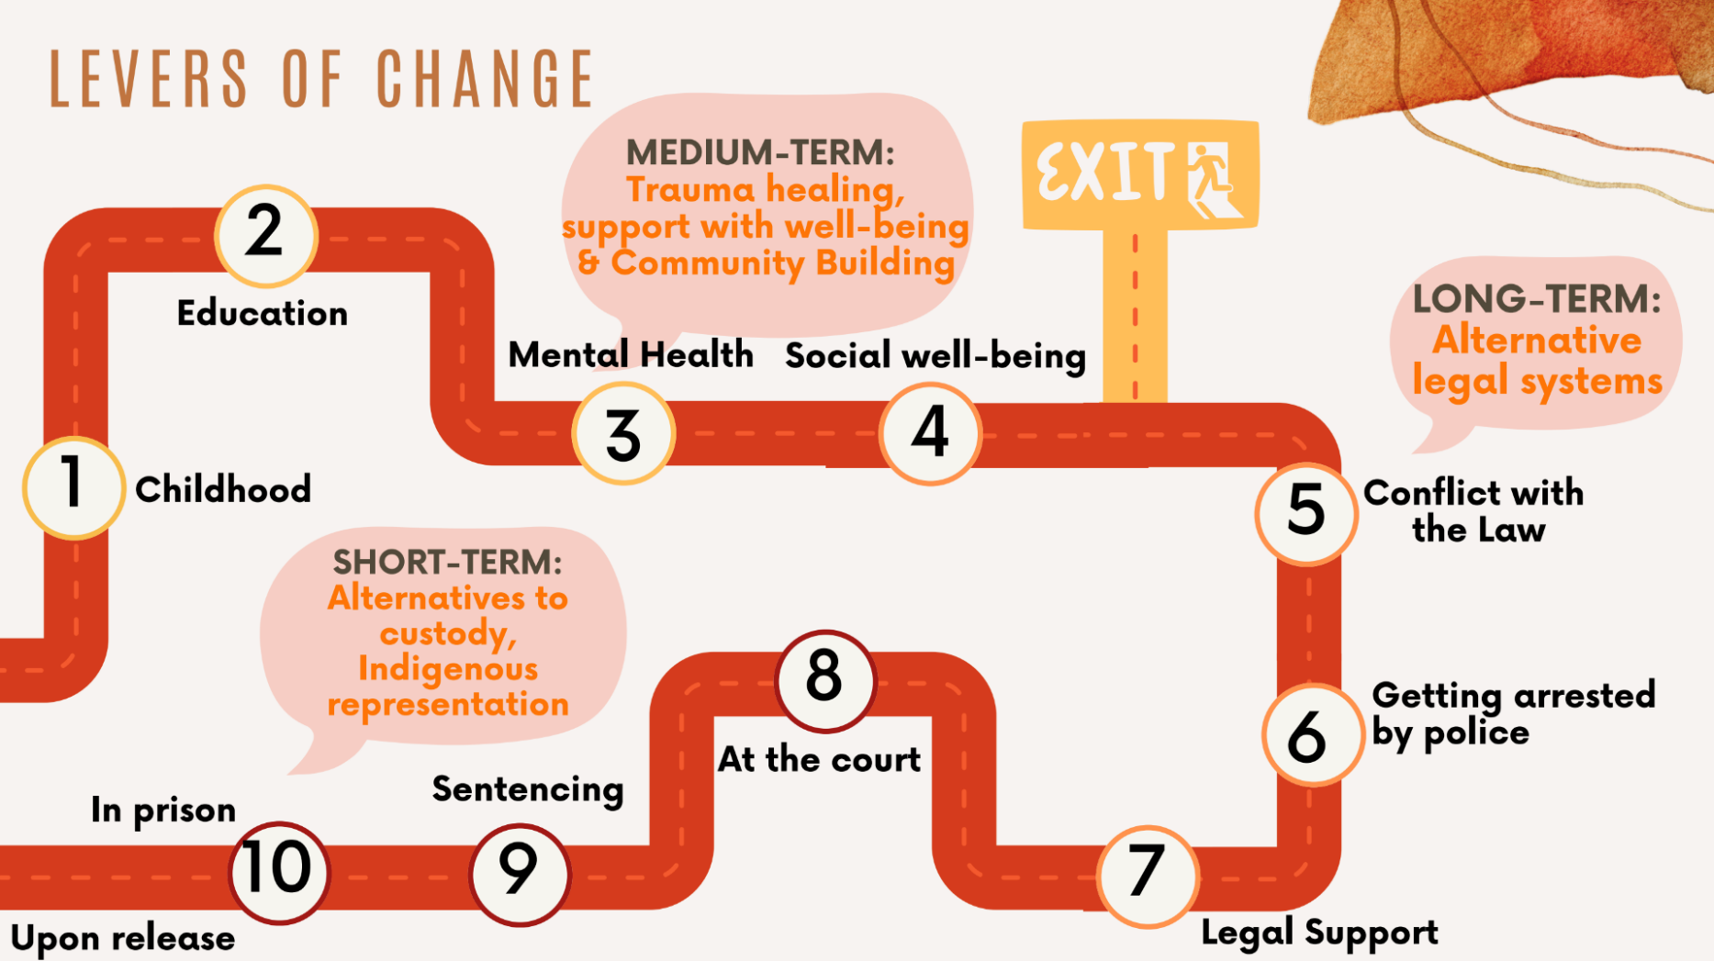
Student Submissions
Notes:
Obviously, systems level problems are complex. One of the outcomes that students work towards are identifying levers of change – or the points in the system where action could be taken. I love that Fiona took the approach of outlining short term, medium term, and long term actions.

Slide 22
Possible Outcomes
Notes:
Several of the partners who have previously engaged with MTS experienced a variety of benefits beyond access to the results that students submitted. In Fiona’s case, her connection through MTS lead to an internship with MCCO where she could continue to explore the problem space and begin to intervene on levers she identified in her map with the support of community partners. Several organizations were connected to co-op students or a potential hiring pool of people who now had a deep understanding of problems relevant to their organization.

Slide 23
Ready to Get Involved?
Let us know that you’re interested in participating:
Expression of Interest Form
Submit your challenge statement one-pager by December 16, 2024

