Slide 1
TO UNLEASH EVS... G FROM THE NICHE
2015

Slide 2
EV CHALLENGES
RECHARGE TIME
HOW TO BUILD A BATTERY THAT RECHARGES IN 3 MINUTES
RANGE
HOW TO GET UP TO 500 km
COST
HOW TO COMPETE WITH MAINSTREAM CARS

Slide 3
RECHARGE TIME
SOLUTION: NOT NEEDED
3 MINUTE CHARGING IS NOT FEASIBLE FOR POWER GRID,
WOULD CAUSE GRID CONGESTION AND CAPACITY ISSUES:
“If you were to charge a car in 12 minutes for a range of 500 km, for example, you're probably using up electricity required to power 1000 houses. That totally goes against the need to stabilize electricity use on the grid.”
- Yoshikazu Tanaka, MIRAJ Engineering
HOWEVER, METAL-AIR BATTERIES DO NOT NEED TO BE CHARGED!

Slide 4
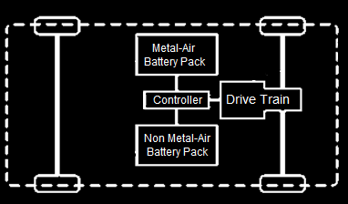
RECHARGE TIME
IMPLEMENT Li-ION ARCHITECTURE WITH A Zn-AIR RANGE EXTENDER
Li-ION PROVIDES APPROXIMATELY 135 km ON A SINGLE CHARGE
UTILITY FACTOR OF 0.829
AFTER THAT DISTANCE, Zn-AIR RANGE EXTENDER KICKS IN
BOTH BATTERY CHARGED DURING OFF-PEAK HOURS
REF. TESLA MOTORS, INC.
PATENT 20130187591

Slide 5
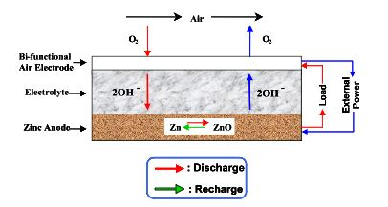
RECHARGE TIME
Zn-AIR BATTERY : CHEAP, 3-5 TIMES THE ENERGY DENSITY OF Li-ION, STABLE, CAN BE RECHARGED UP TO 3000x
WOULD OUTLIVE CAR AS RANGE EXTENDER

Slide 6
RANGE
WHY 500 km?
BEST IN MARKET: > 430 km WITH Li-ION
SOLUTION: HIGH ENERGY DENSITY METAL AIR RANGE EXTENDER

Slide 7
COST
CURRENT ENERGY STORAGE SYSTEM (ESS) COSTS:
TODAY - $270 per kWh FOR Li-ION.
SHORT TERM: TESLA GIGAFACTORY GOAL IS $200 per kWh
TODAY - $160 per kWh FOR Zn-AIR
SHORT TERM: EOS ENERGY STORAGE GOAL IS $100 per kWh
SOLUTION: METAL-AIR HYBRID

Slide 8
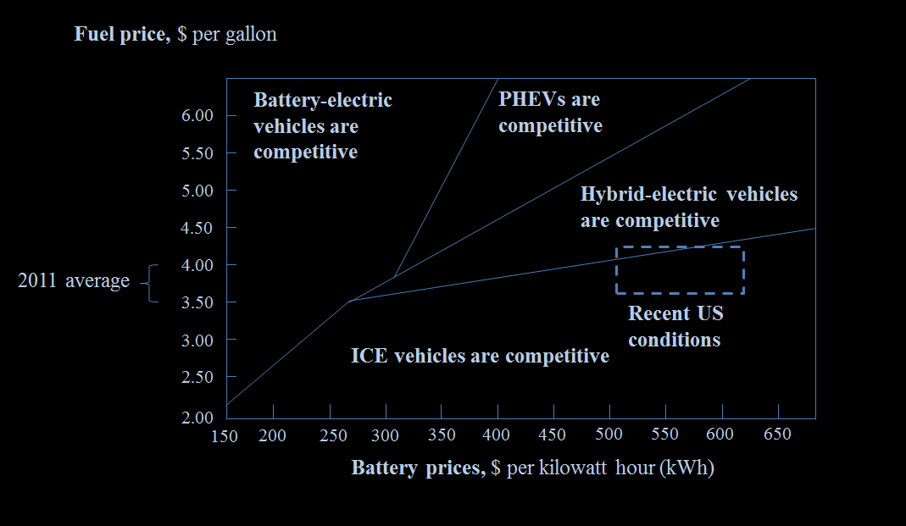
COST
Zn-AIR ENERGY STORAGE SYSTEM (ESS) AS RANGE EXTENDER
CURRENT: $160 per kWh

Slide 9
COST
LONG TERM COST REDUCTION
CAR-SHARING
ALREADY PREFERRED BY CONSUMERS IN CHINA (¥159 per DAY, ~$31.24 per DAY)
ZIP CAR-STYLE RENTAL TO FURTHER DECREASE COST TO CONSUMERS
AUTONOMOUS FLEETS FOR PERSONAL ON-DEMAND MOBILITY
LOCAL DEALER PARTICIPATION
ACT IN ECOSYSTEM AS SERVICE CENTRES
E.G. REPLACING Zn-AIR BATTERIES

Slide 10
COST
LONG TERM COST REDUCTION
UNIVERSITY COMPETITIONS RELATED TO EV CHALLENGES
GETS STUDENTS INTERESTED IN MANUFACTURING SECTORS
ACQUIRE FRESH AND NEW IDEAS
PROGRAMS TO BRING TOGETHER MANUFACTURERS, RESEARCHERS & STAKEHOLDERS TO IMPROVE:
COMPOUNDS USED IN THE BATTERIES
EFFICIENCY TO INCREASE THE AMOUNT OF BATTERIES PRODUCED
SOFTWARE SOLUTIONS USED

Slide 11
SO WHAT’S OUR BIG IDEA?

Slide 12
UWAFT BENCHMARK EV

Slide 13
SPECIFICATIONS
VEHICLE:
PRIMARY ESS: Li-ION BATTERY WITH RANGE OF ~150 km
SECONDARY ESS: Zn-AIR RANGE EXTENDER OF ~600 km
ECO-SYSTEM:
IMPLEMENTATION OF A CAR SHARING COMPANY
LOCAL DEALER PARTICIPATION
Notes:
ESS: Energy Storage System (Same as Page 7),

Slide 14
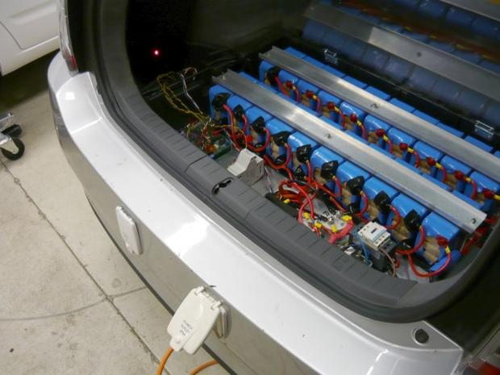
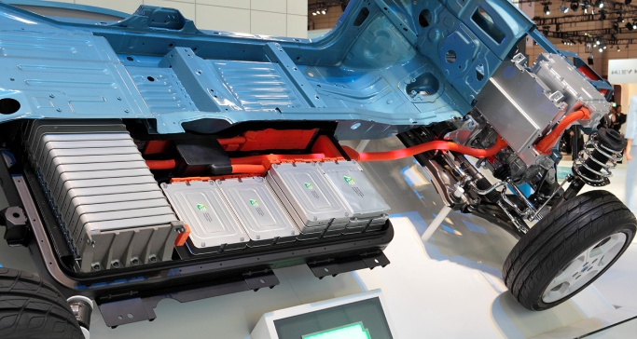
ALTERNATIVE SOLUTIONS
Al-AIR BATTERY: 8000 Wh kg⁻¹
80% EFFICIENCY
Li-AIR : 1700 Wh kg⁻¹
70% EFFICIENCY
BATTERY SWAP STATIONS: INEFFECTIVE DUE TO DIFFERENT CONFIGURATIONS & STYLES
NOT RECHARGABLE
SOME NEED COOLING
LACK OF STANDARDIZATION
WARRANTY ISSUES
NOT AS PRACTICAL AS Zn-AIR

Slide 15
SUSTAINABLE
LONG LASTING
AFFORDABLE

Slide 16
MAKING EVS THE STANDARD, RIGHT HERE IN CANADA
2015

Slide 17
TEAM MEMBERS
MECHANICAL ENGINEERING:
COLE POWERS
HARLEY TONG
MATHEW JOSEPH
RICKEY WANG
CHEMICAL &
NANOTECHNOLOGY ENGINEERING:
LILYN GAO
NATHAN LEE
PARIS LI

Slide 18
ADVISORS
DR. MICHAEL W. FOWLER
ASSOCIATE PROFESSOR
CHEMICAL ENGINEERING
UNIVERSITY OF WATERLOO
CAIXIA WANG
CANDIDATE FOR MASc
CHEMICAL ENGINEERING
UNIVERSITY OF WATERLOO

Slide 19
REFERENCES
Lithium-air Battery: Promise And Challenges, G. Girishkumar Et Al.
Highly Durable And Active Non-precious Air Cathode Catalyst For Zinc Air Battery, J. Chen Et Al.
Novel Anode For High Power Zinc-air Batteries, X.G. Zhang
Design And Analysis Of Aluminum/Air Battery System For Electric Vehicles, S. Yang Et Al.
Preliminary Analysis Of Evionyx Ni-zn Battery And Zn-air Fuel Cell, Report Prepared By Emc
Http://www.Nissanusa.Com/Electric-cars/Leaf/Charging-range/
Http://www.Houseplannings.Com/Car-plan-view/5/Car-top-view/

