Slide 1
SHARCNET
More than just HPC

Slide 2
Organization

Slide 3
ARC not HPC
Notes:
We are the long tail of research computing - majority of jobs fit within one node - we just have lots and lots of them!

Slide 4
Traditional Computational User
1,000+ nodes
35,000+ cores
300+ GPUs
20+ PB storage
150+ TB ram
100gb networking
Notes:
Target jobs < 1024 cores each, most of our workload fits within a single node
#271 as of Nov 2018

Slide 5
GPU Nodes
7 Nodes
8x V100 GPUs
192g ram
4TB NVMe
160 Nodes
2x P100 GPUs
128g ram
1.6TB NVMe SSD
Notes:
We are the long tail of research computing - majority of jobs fit within one node - we just have lots and lots of them!

Slide 6
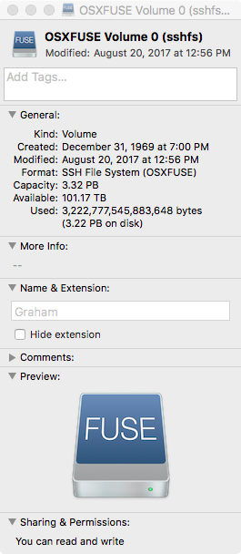
Storage / Backup
Notes:
1TB space with Office 365, ensure data stays in canada, spectrum protect for backups, mount storage right on your laptop

Slide 7
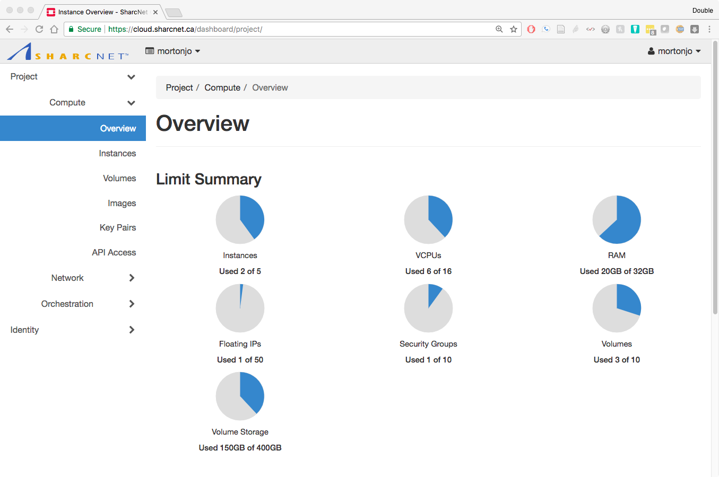
Cloud Services
IaaS
Notes:
Mostly IaaS right now, more layers coming - spin up/down VMs, have root access - very similar to AWS

Slide 8
DB Services

Slide 9
Tools

Slide 10
Science Gateways

Slide 11
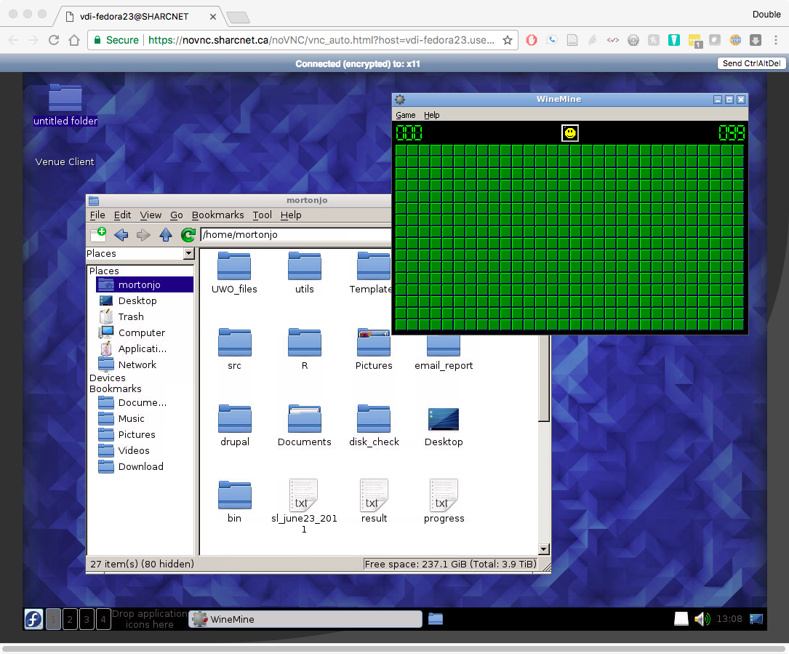
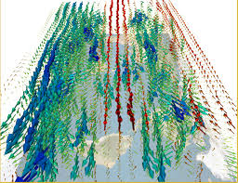
Visualization / Desktop
Notes:
I’d replace the graphic on the left – it’s too low quality to look good on a big screen. I would have but I’m not sure what an appropriate replacement would be.

Slide 12
Case Study - Hacked List
Gather Data
Searching + Incognito
Move to SHARCNET
Globus
Create CentOS Machine
OpenStack
Clean Data
Perl
Insert into DB
DB Services
Notes:
Eat our own dog food - my example - alternative would be to do spark or elastic search

Slide 13
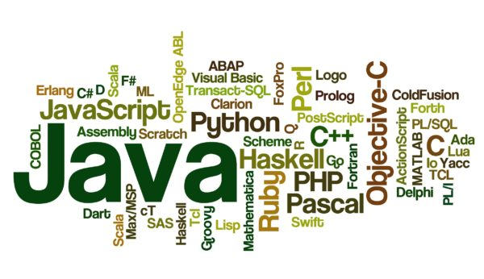
Programming Help
Notes:
Projects have ranged from assisting in the optimal parallelization of weather models for a group at Environment Canada (Howard Barker), to developing an open-source library for studying mutations in the human genome (Peter Rogan, Western University), to developing extended-precision mathematical models for nuclear physics (Gordon Drake, University of Windsor)
½ and FTE for 4 months, 10 rounds , 40+ awards

Slide 14
Training
Notes:
Closing in on 100,000 views

Slide 15
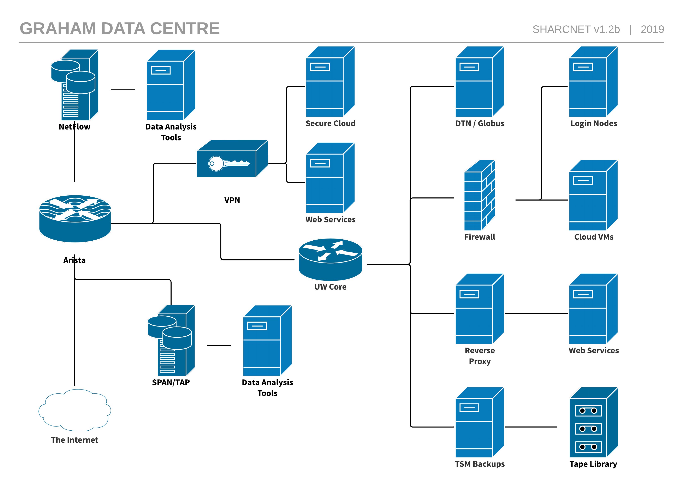
Cyber Security

Slide 16
Data Centre Tour

Slide 17
Questions

