Slide 1
Scaling Up
An Algorithm for Growth

Slide 2
The Problem
Notes:
Why is this? We grow companies too slowly

Slide 3
The Growth Imperative

Slide 4
Why Growth
Revenue X Revenue Multiple = Valuation
Growth Rate increases revenue multiple

Slide 5
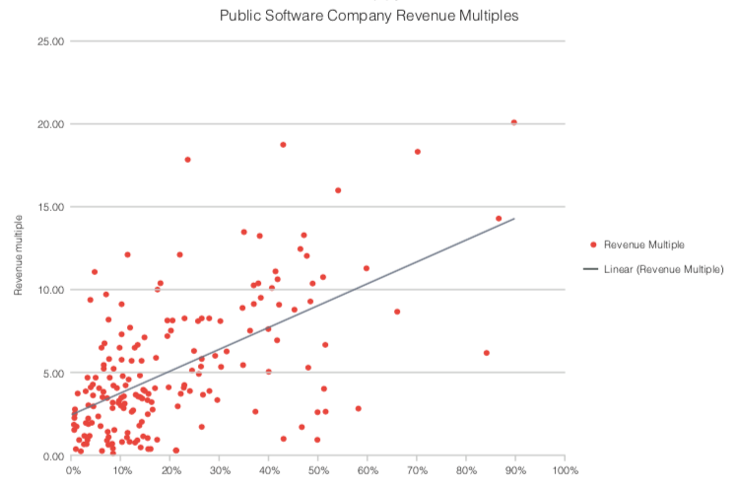
Public Software Company Revenue Multiples

Slide 6
Real SaaS Growth Rates

Slide 7
Realistic Objectives
Under $1 million 10% - 20% a month
$1 - $5 million 100% - 200% a year
Over $5 million 60% to 100% a year
IPO Stage 60% a year

Slide 8
The Market

Slide 9
Large Number of Buyers
Notes:
Dropbox Box
Founded 2007 2005
Raised $1.2 B $1.1B
Revenue $1.1B $.5B
Valuation $8.9B $2.7B

Slide 10
Horizontal Solution

Slide 11
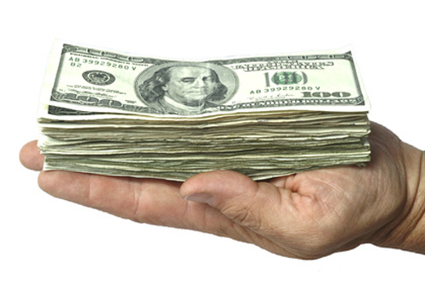
Existing Budget
Notes:
Google Advertising
Amazon Shopping
Uber Taxi etc
AirBnB Hotel

Slide 12
Product Market Fit

Slide 13
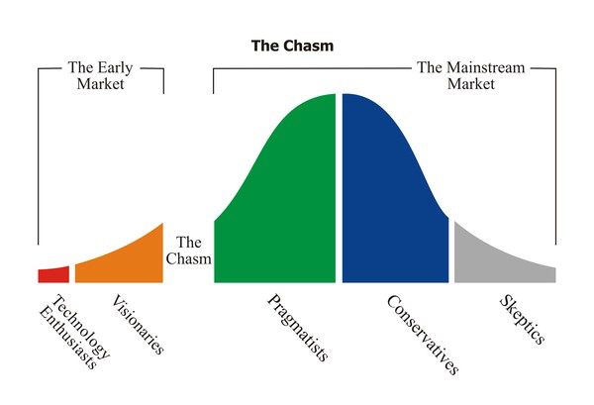
Strong Buying Triggers
Notes:
Operational
Regulatory
Strategic
Financial

Slide 14
Weak Buying Barriers
Notes:
Transaction costs
Learning costs
Psychological costs
Risks to switching
Endowment effect
Status quo bias
The sloth factor

Slide 15
High Degree of Competitive Differentiation
Notes:
Different Dimensions of
Quality
Cost
Speed

Slide 16
The 40% Rule
Notes:
40% of your buyers will be “Very Disappointed” if your solution were not available
Segment your market to identify good fit where that segment scores 40%

Slide 17
Unit economics

Slide 18
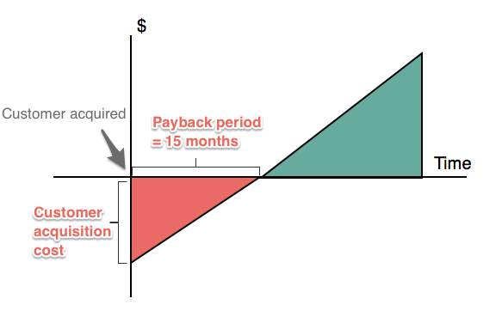
Months to Payback

Slide 19
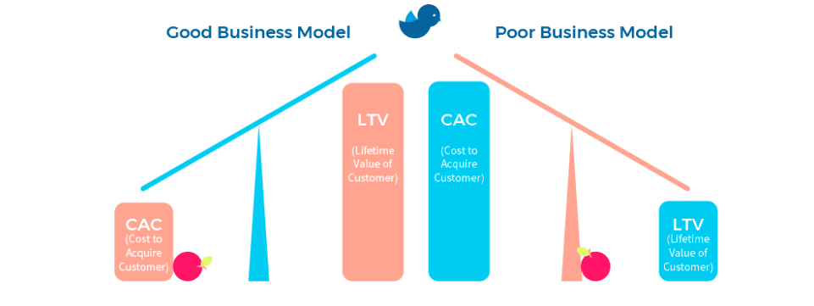
Marketing Efficiency

Slide 20
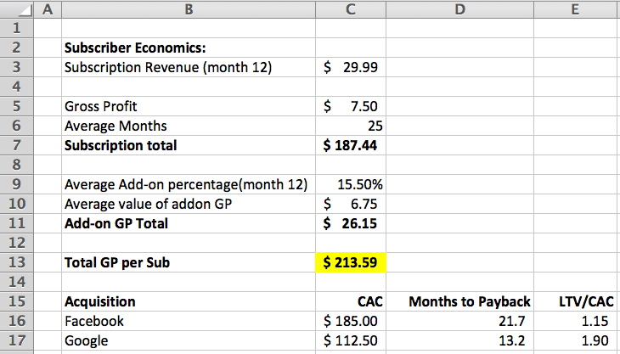
You need strong unit economics

Slide 21
Premature Scaling
Notes:
Kills startups
Can’t take a big slow growing company and get it to scale as the preconditions are not likely to be in place.

Slide 22
Capital

Slide 23
Capital as a % of Revenue

Slide 24
Facebook
Raised $340 m by 2007 to get to $153m of revenue

Slide 25
How much should you raise in your 1st round?
Notes:
And the first quartile ones are the ones that go public
Q1 10
Q2 5
Q3 0
Q4 1

Slide 26
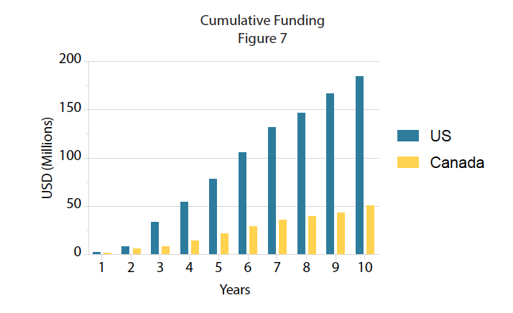
Implications over time

Slide 27
Financial Velocity – Public SaaS
Financial Velocity = Capital raised / Years in Existence

Slide 28
Spending

Slide 29
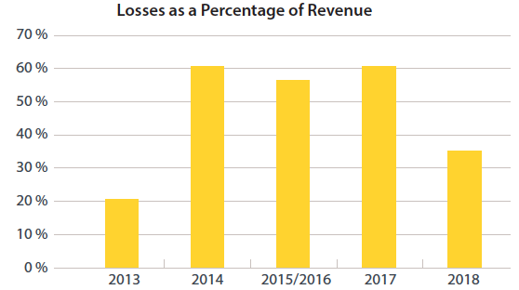
What do you do with all that money?
Notes:
You’re going to lose most of it.
This graph shows losses as a percent of revenue for software IPOs from 2013 to 2018
That’s how you grow at 100%

Slide 30
Operational Spending

Slide 31
M&S to R&D

Slide 32
An Algorithm for Growth

Slide 33
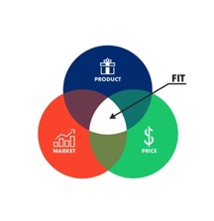
The Foundation
Large
Market
Product Market Fit
Unit Economics

Slide 34
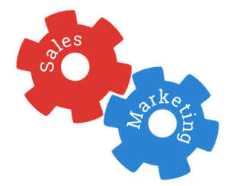
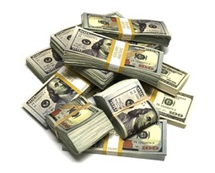
The Algorithm
100%
Growth
Capital 2.5 X
Revenue
M&S 2.6 X
R&D

Slide 35
More Resources
narwhalproject.org

