Slide 1


Communicating your research in a one-minute video
Elise Vist (they/them)
Multimodal and Public Scholarship Program Developer
All slides in Communicating your research in a one-minute video by Elise Vist are licensed under Attribution-NonCommercial 4.0 International.

Slide 2
Multimodal communication
Notes:
Although I’ve spent the last few minutes talking about the structure, I would encourage you to think about this structure at the same time as you think about the design of the video. Because you are engaging in multimodal communication, you need to think about how the images, sounds, and movement you’ll use in your video will help shape this story simultaneously.

Slide 3







Multimodal communication is greater than the sum of its parts
Notes:
A video isn’t just image plus sound plus movement, it’s all those things together adding up to something more than the individual parts.
Telling a story visually and orally
We’ve been focusing on the words that you might use to tell your story, but this is a video. Words and pictures should work together to tell the story of your research. How do you do this?
Draft the two pieces together. As you tell the story, consider what kinds of visuals you might use to help translate your research for your audience.
Speech
Body language
Images/imagery
Color
Text
Movement
Cuts/scenes
---- think about what happens in video (mentimeter?)

Slide 4
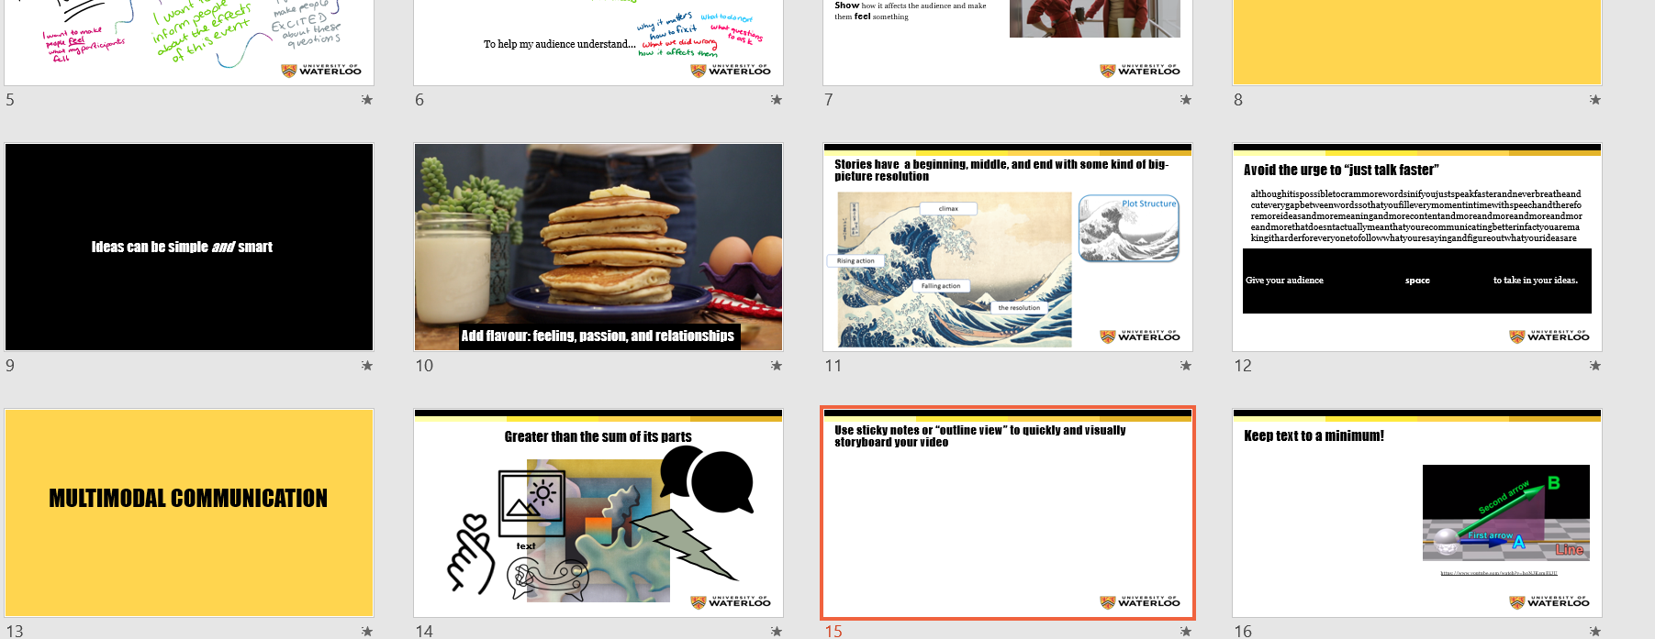
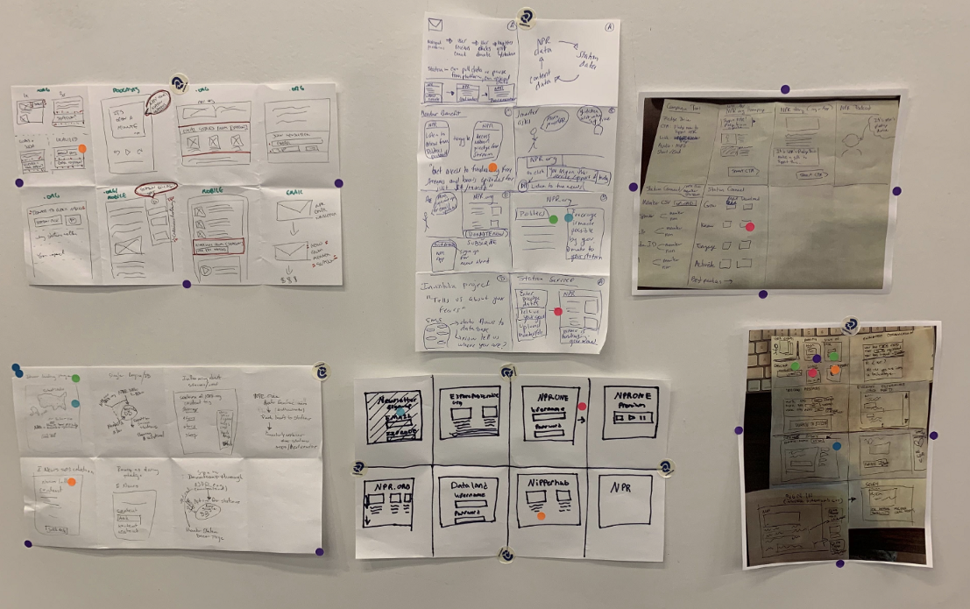
Use sticky notes or “slide sorter” to quickly and visually storyboard your video
Image from “From Sticky Note to Storyboard” by Michael Chaplin
Notes:
To help you keep all these elements together when planning, we recommend storyboarding. It can be difficult to draft a video as a video, which is why people use storyboards as a drafting tool. Use sticky notes, pieces of paper, or even the slide sorter view in a slide app to sketch out the scenes, primarily focusing on visuals and simple concepts. There’s much less cost to deleting, adding, or moving scenes around when you use a storyboard, and lets you experiment with different structures, stories, ideas, and metaphors so that you can really find the right one.
This is where you can think about things like whether you want to do a voiceover, or a talking head, or have an animated graph or a series of static images, ambient music, a moving shot, and so on….
Create a storyboard that maps the words and images out in a sequence.
Brainstorm your options. Consider:
Is this a voiceover video?
Will you be present in some or all of it?
Will the images be representative? Symbols to show networks or connections?
Will animation work? Can you you film on site somewhere?
Critically: What can you show better than tell? What does your audience need to see?
Don’t be afraid to try different things! Watch examples!

Slide 5
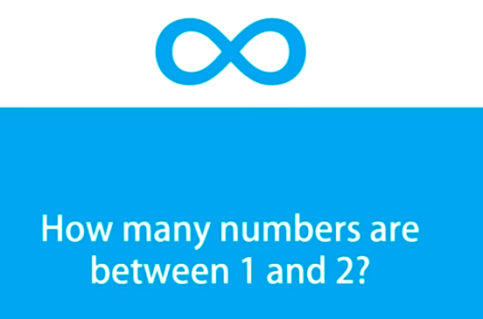
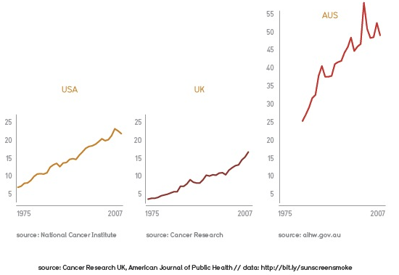
Use text for snappy call-outs or quick captions
Melanoma is a huge problem in Australia
From “Calculus at a Fifth Grade Level” by Lukey B. on YouTube
From “I like this chart” by Cole Nussbaumer
Notes:
Some quick tips about communicating multimodally:
Just as the solution is never “speak more quickly to fit more words in” the solution is also rarely “just put the words on screen instead”. Keep text to a minimum to avoid splitting your audience’s attention. Use text for quick, snappy callouts or short captions.
Use less text than you think you need. Just as the solution is never to speak more quickly, the solution is also very rarely going to be “put the text on screen instead”
You’ll never match every viewer’s reading speed simultaneously, so keep your text to quick, short phrases that people can perceive quickly, like labels and short, snappy captions.
If your instinct is to add text because you don’t have time to say it out loud, this is a sign that you need to revise your script and outline, not that you need to add text!

Slide 6
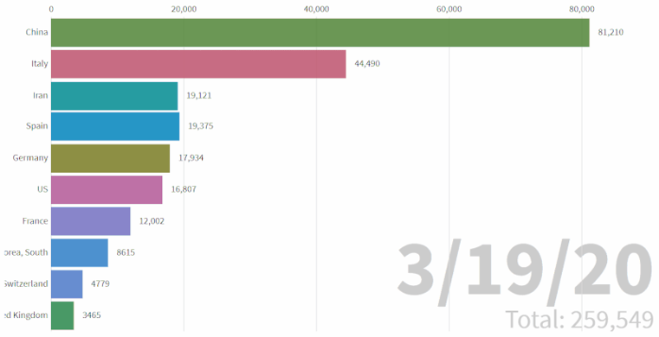
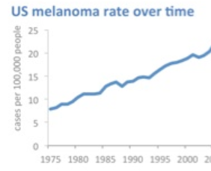
This is not a journal article: use simplified versions of your graphs and data
App.flourish.studio: Bar Chart Race
Notes:
Although your data and tables are surely very interesting to you and people in your field, remember the time constraint: people don’t have time to pore over a chart to understand what it means. Simplify your charts and use colour – and even animation! – to help your key message stand out

Slide 7
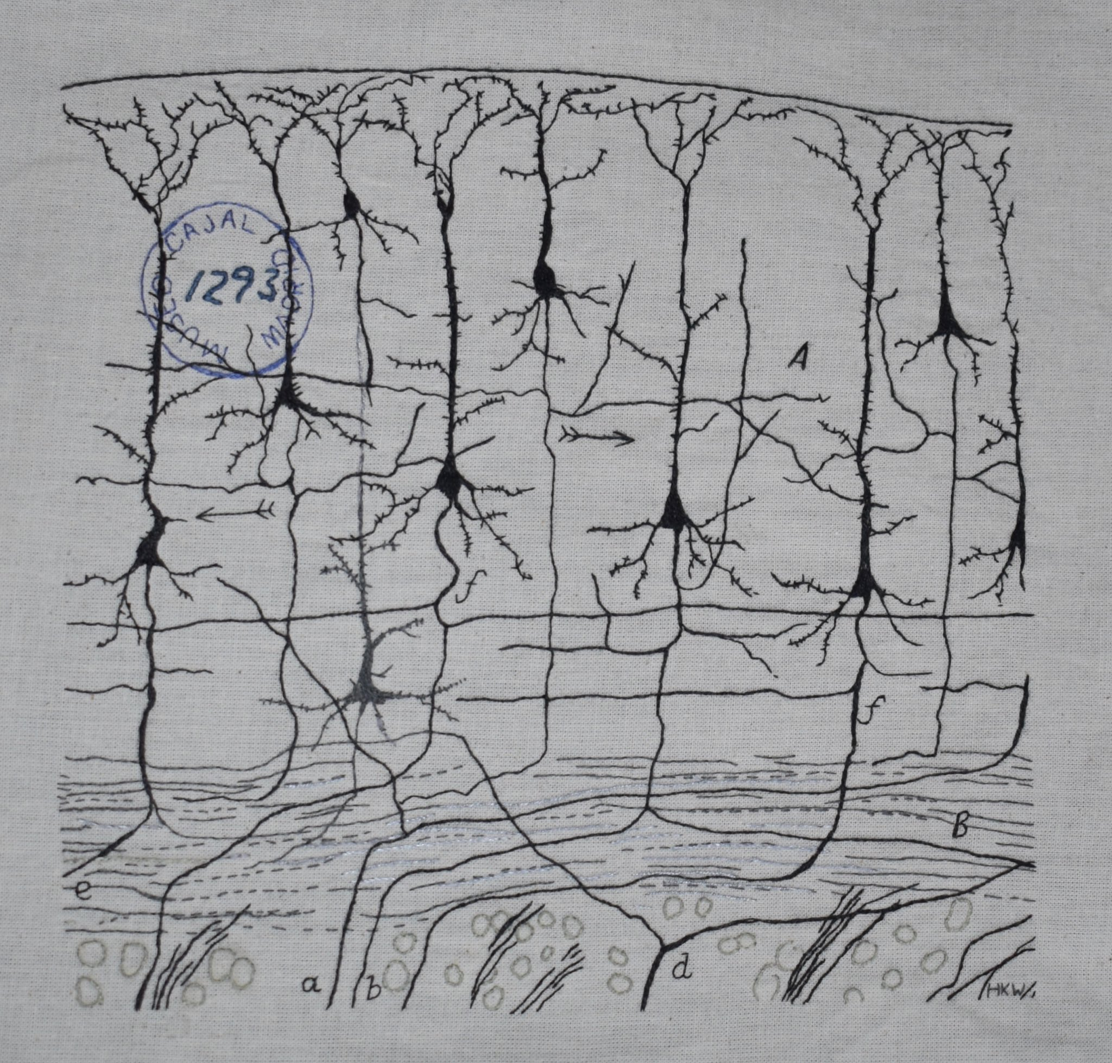
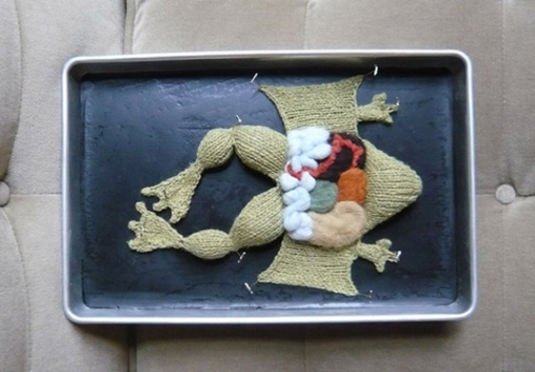
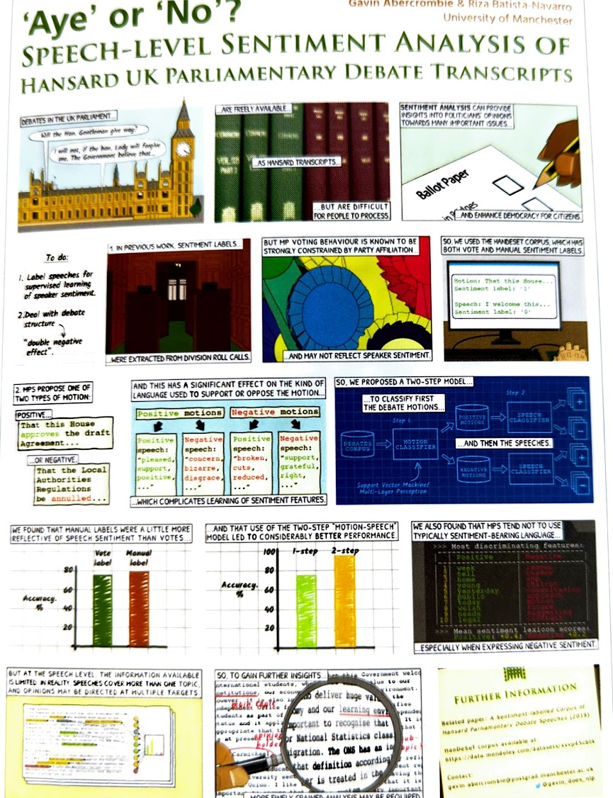
Bring in your existing skills and interests: be creative!
@NeedlesNeurons
Emily Stoneking
From BetterPosters
Notes:
Create stop motion from your sculptures
Embroider your data onto a sweater
Paint your most surprising figure
Write a song to teach the concept
Have a child narrate your video
Add speech bubbles and transitions like a superhero comic

Slide 8
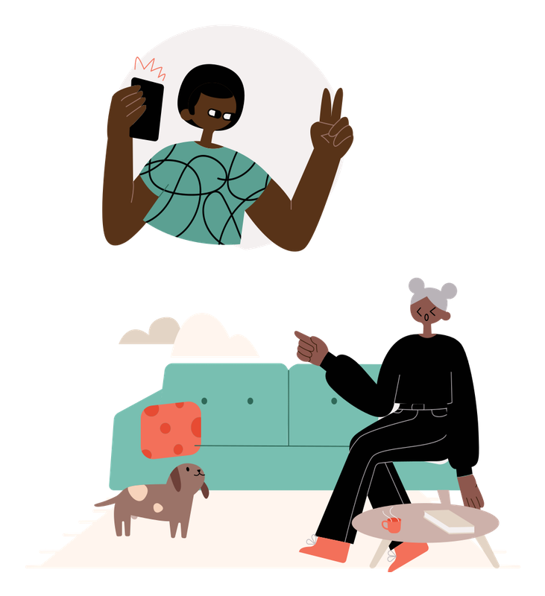

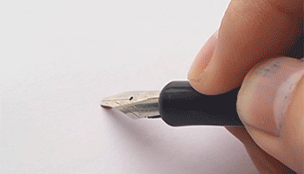
Use, create, and edit images, illustrations and animations to help tell your story
Image from Zeiss Microscopy
bit.ly/StockPhotosEtc
Illustration created on blush.design by Irene Falgueras
Notes:
For those of you who can’t make their own images, there are TONS of places to get unique, non-cheesy art that you are allowed to use!!
-images are good for showing how things work.
-symbolism and metaphor are very powerful. An image represents an idea. When you’re explaining a new concept, you should start with something people already know.
Just be careful that you’re clear. Ask someone if your image makes sense. Sometimes a symbolic image might not carry the message you want it to – clarity must come before cleverness. You risk being cryptic.
Other images: illustrations
Canva
Blush
BioRender
PowerPoint!
Prezi
thenounproject

Slide 9


Use representative and diverse stock photos/videos
bit.ly/StockPhotosEtc
Notes:
Avoid google images – good practice is to provide attribution, and many stock photo databases require it, as Broadly’s Gender spectrum does. Depending on the rules of the competition, you should either rprovide that attribution in the video (as a caption alongside the image, or at the end in ‘credits’) OR provide the attribution in the description.
https://www.pexels.com/video/a-female-scientist-writing-data-of-samples-under-study-4121618/
https://drive.google.com/file/d/1N7Z5a5tZ-jSle3tD8N5a_A99IRmRr_iI/view
For example, if you’re talking about the importance of diversity in a field, for example, then having images of only cis men, or only white people confuses your story!

Slide 10

Perform with your voice to help tell the story
Video by Yasmine Figueiredo from Pexels
Notes:
Perform with your voice: pace, tone, volume ---- let your passion shine through.
Think about how your voice implies things about your message
Some depressing statistic, said happily
The same depressing statistic, said thoughtfully

Slide 11


Use other sounds, like ambient noise and music, when it helps tell your story
Paris Metro Traffic sound by Greg Baumont from FreeSound.com
bit.ly/StockPhotosEtc
Notes:
As with anything else, use sound – or the lack of it – to help get your message across. For example, this ambient traffic noise seems at odds with the artistic shot of geese in flight over a sunset. However, my message might be about urban sprawl and its effect on ecosystems, in which case the juxtaposition is useful! Return to your key message, audience and purpose to help you decide what sounds are beneficial.
Ambient
Music
Sound effects
Check in with your goal and your message when making choices!

Slide 12
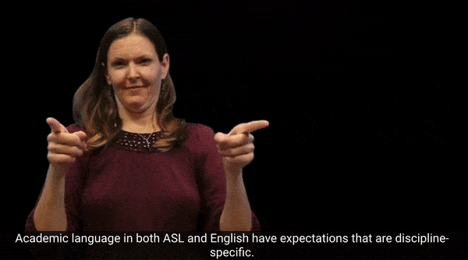
Use captions to include other languages in your video
In PowerPoint, when you animate a text box, you have the option to animate text by word, like this!
ASL in Academic Settings by Dr Raychelle Harris at ASLized
Notes:
Add translation for your other language by adding text elsewhere on the screen. For gradflix, avoid putting it in the bottom third, as that’s where captions for the entire video will go!
Most video editors will include some kind of text overlay – but there are other options, like handwriting the translation as part of your illustration, animating the text in Powerpoint or Canva.
In powerpoint, when you animate a text box, you have the option to animate text by word, like this!

Slide 13
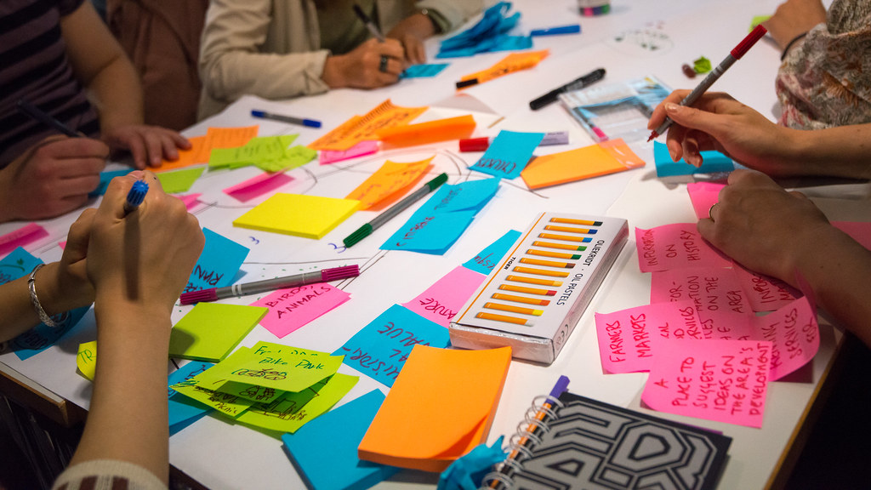
Use this as an opportunity to take a risk and try something new, weird, different…or something you’ve always been curious about!
Notes:
Judges look at technical quality, but a) that’s less important than effectively, persuasively telling the story of your research and getting your audience to care. And b) technical quality is more about making sure your content is clear, legible, listenable and less about making it look shiny and fancy.
I personally would prefer an interesting attempt at stop motion that doesn’t quite succeed than a series of stock videos recorded by a professional team.

Slide 14
Communication is 50% of the judging criteria
Audience
Story
Multimodal
Notes:
+ 30% for creativity and visual impact – so 80% of your score comes from the choices you make regarding what to show and how to tell your story, so make these a priority when planning. Worry less about making something look shiny and cool, and instead focus on making decisions that support your messages.
Audience and purpose: communicate complex ideas clearly and with appropriate terminology to a non-specialist audience
Story: Use a logical sequence to show the importance of your research/scholarship and make the audience care
Multimodal: Use the tools of the video, such as image, sound, and movement, to support your message

Slide 15

Writing Centre Services

Slide 16
Copyright Information
All slides in Communicating your research in a one-minute video by University of Waterloo Writing and Communication Centre are licensed under Attribution-NonCommercial-ShareAlike 4.0 International. To view a copy of this license, visit http://creativecommons.org/licenses/by-nc-sa/4.0/

