Slide 1


Introducing the GRADflix Competition
Sarah Howard (she/her) Manager, Postdoctoral Affairs and Programming Development
All slides in Introducing the GRADflix competition by University of Waterloo Graduate Studies and Postdoctoral Affairs are licensed under Attribution-NonCommercial 4.0 International.

Slide 2
What is GRADflix?
Started by GSPA in 2018, since adopted by other Universities
GRADflix is a research communication opportunity for graduate students, where you will create a one-minute video that describes your research.
Videos can take many forms, but must include:
Movement (slide transitions, zoom, a subject moving on video, etc.)
Sound (voice over, sound, and/or music)

Slide 3
Eligibility
To be eligible to participate in GRADflix, you must meet the following criteria:
University of Waterloo graduate students must be registered in a master's (Thesis or MRP) or PhD program at the time of the GRADflix competition.
Master's and PhD students who have degree completed, but have not yet convocated, are eligible to participate.
You must be willing to allow your video to be made public and provide a photo and short biography if you are selected as a finalist. Your photo and biography will also be made public.
By submitting your video, you are agreeing that your submission is an original work created by you, and that you have all necessary rights in and to the submission.

Slide 4
Eligible research stages
Submitting
Proposal
Outlining methodology
Gathering Data
Evaluating findings
Writing Thesis
Degree Complete

Slide 5
Required experience
No technical expertise
No video editing experience
No public speaking practice

Slide 6
Judging criteria
50% Communication:
30% Creativity:
20% Technical quality:
Your ability to communicate your research effectively and efficiently to a general audience through language and visuals.
Your ability to present your research in a unique and thoughtful way.
Your ability to produce a video with quality visual and audio components.
Notes:
Communication (50%)
Your ability to communicate your research effectively and efficiently to a general audience through language and visuals. A strong video will demonstrate:
Ability to explain complex ideas to a non-specialist audience
Well-designed script with clear language and terminology
Good pacing and sequencing of information (i.e. easy to follow)
Audio and visuals that add information, clarify ideas, or complement the message
Clear explanation of contribution(s) to research/scholarship
Note: The GRADflix competition will be judged in English.
Creativity (30%)
Your ability to present your research in a unique and thoughtful way. A strong video will demonstrate:
Creative use of (limited) time
Novel and interesting presentation of information
Engaging format that captures audience interest
Technical quality (20%)
Your ability to produce a video with quality visual and audio components. A strong video will demonstrate:
High quality sound and images
Integration of appealing audio/visual elements
Note: By submitting your video, you are agreeing that all sounds, images, information, etc. are cited or credited in the video, as required. See submission details for further information.

Slide 7
Important dates
October 27, 2022
GRADflix training session (you are here!)
November 16, 2022
GRADflix drop-in feedback session #1
November 22, 2022
Deadline to register to participate in GRADflix
December 6, 2022
GRADflix drop-in feedback session #2
January 10, 2023
Video submission deadline (by 4:00 pm)
January 31, 2023
GRADflix virtual showcase event

Slide 8
Submission details
Send the video (saved as an MP4 file) to gradventure@uwaterloo.ca using Sendit.
In addition to your video, you must fill out and submit the GRADflix participant information form with the following information:
your preferred name (as you would like it written on the webpage if you are selected as a finalist)
your pronouns
the name(s) of your supervisor(s)
a short biography of approximately 60-100 words
a good quality portrait or headshot photo
contact information to be listed with your video
your availability the day of the showcase – finalists must be able to attend or have a delegate

Slide 9

Virtual showcase
Finalists selected by a panel of judges
Streamed live on YouTube
Live People’s Choice vote
Announcement of winners!

Slide 10
Prizes
2nd place winner
$500
3rd place winner
$250
4th place winner
$250
1st place winner
$750
Notes:
These prizes are based on the judging criteria previously mentioned (communication, creativity, technical quality)

Slide 11

Additional prizes
1st place winner
$750
2nd place winner
$500
3rd place winner
$250
4th place winner
$250
$250
$250
People’s Choice Winner
Most compelling social impact story
NEW!
Notes:
BONUS prizes
These are not based on formal judging/judging criteria
People’s Choice – audience is given details on judging criteria, but also make their own judgements
Social Impact – Judged by how your research has potential to make a difference in the well-being of people and/or the planet. Specifically, how urgent is the problem and how big is it?
Sponsored by GreenHouse: GreenHouse is a social impact incubator that offers programs, opportunities, and a community for students to develop problem solving skills, form innovative ideas, and make new forms of sustainable impact around social or environmental change.

Slide 12
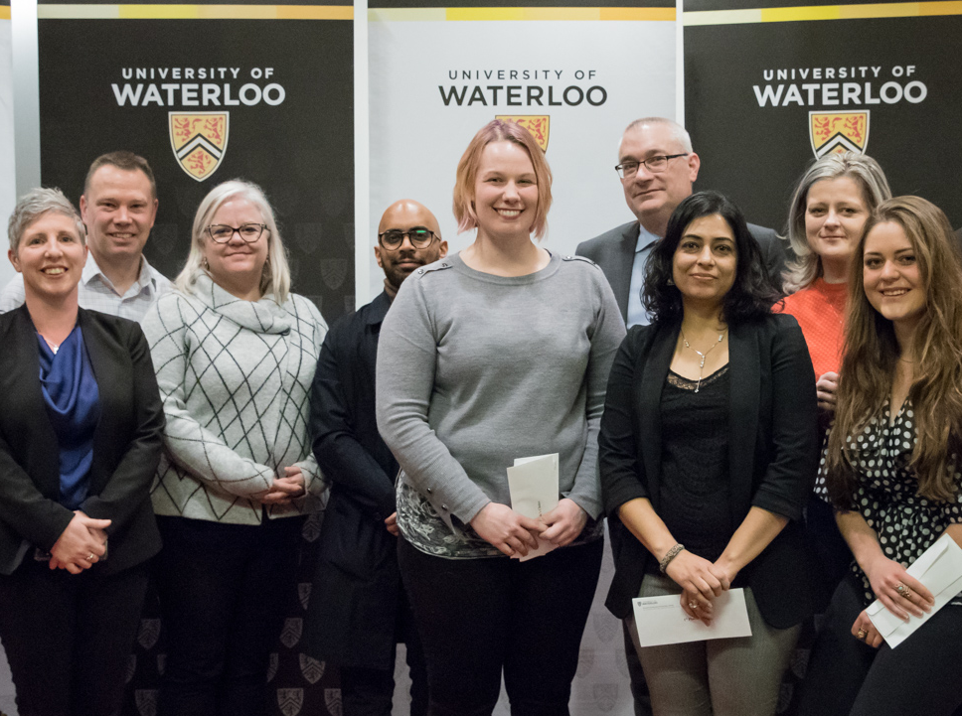
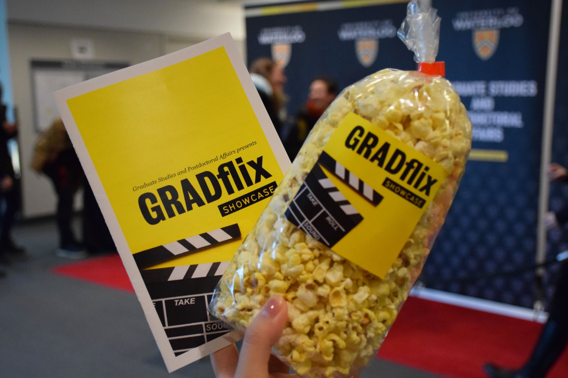
Finalist viewing party!

Slide 13
Why Participate?

Slide 14
Why Participate?
Develop and broaden your research communication skills
Learn and practice video production and editing skills
Create a video useable in other academic and professional contexts
Expand your network and gain greater exposure for your research
Win prizes!

Slide 15
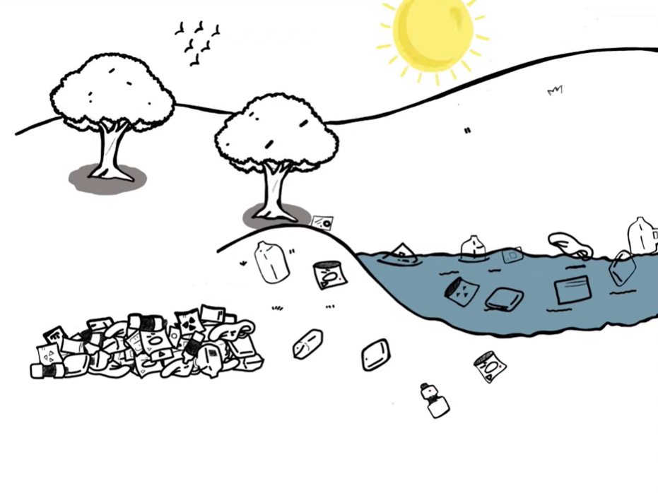
Why Participate? Don’t just take our word for it!
Up next, hear from our 2022 GRADflix 1st place winner, Eugenia Dadzie!
Check out the GRADflix website for more interviews from past winners!
Screen capture from Eugenia Dadzie’s winning video, Microbes and enzymes: sustainable plastic degradation

Slide 16
Copyright Information
All slides in Introducing the GRADflix Competition by University of Waterloo Graduate Studies and Postdoctoral Affairs are licensed under Attribution-NonCommercial 4.0 International. To view a copy of this license, visit http://creativecommons.org/licenses/by-nc/4.0/

