Slide 1


Understanding Copyright
Considerations
Lauren Byl
Copyright and Licensing Librarian
All slides in Understanding Copyright Considerations by Lauren Byl is licensed under Attribution-NonCommercial 4.0 International.

Slide 2

Copyright
To produce a work, or a substantial part of it
To reproduce a work, or a substantial part of it
To publish a work, or a substantial part of it, if unpublished
Notes:
First the basics – what is copyright? Copyright is the right to produce a work, or a substantial part of it, to reproduce a work, or a substantial part of it, or to publish a work or a substantial part of it, if unpublished. The Copyright Act is what outlines protections and exceptions for use of works in Canada.

Slide 3
When you don’t need permission
You are using a fact or an idea.
You are using works that are in the public domain.
You are using creative commons licensed works.
You can use copyright act exception.
You are using your own content.

Slide 4
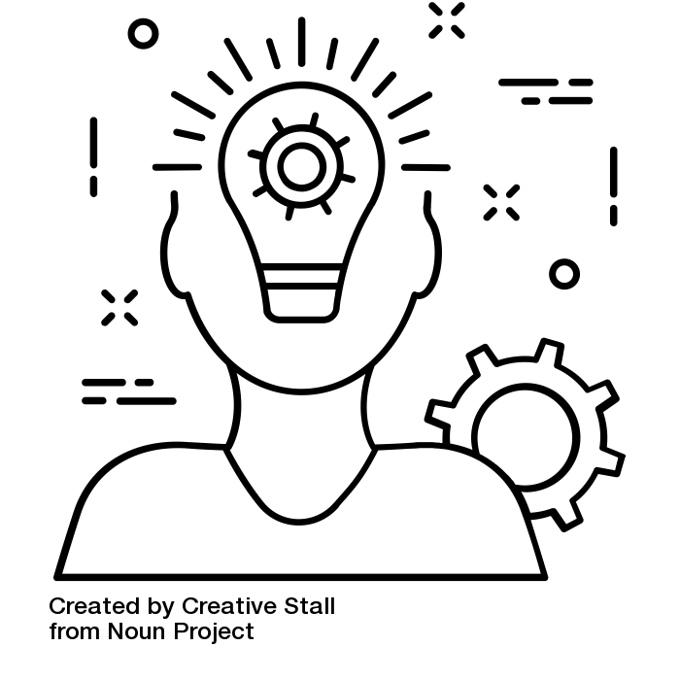
Facts and Ideas
Facts
Ideas
2 + 2 = 4
World War II happened between 1939 and 1945.
Yellow and red make orange.
In a news report: The driver of the car was wearing a blue shirt.
Idea by Creative Stall from the Noun Project.
Notes:
Facts and ideas are not protected by copyright law. The creative expression of them is. A news article is a creative expression of facts, carefully curated together – the entire article is protected under copyright, but the individual facts in the article are not. Another example is numerical data – it may be a fact that there are 50 students in the room, and that half of you are taking this course as an elective. I could express that as a pie chart. The pie chart (as an expression of the data, would be copyright protected), you could express the same data as a bar chart without my permission.
Ideas are not protected either – someone who has an idea must express it in some fashion for it to be protected by copyright law. You can describe the ideas/theories in someone else’s work without infringing the copyright in their work. There are two additional concepts that are important to understand here – merger doctrine (where the idea and its expression can’t be separated, ex recipes) and scenes a faire (something customary to a genre, ex dragons and knights).

Slide 5
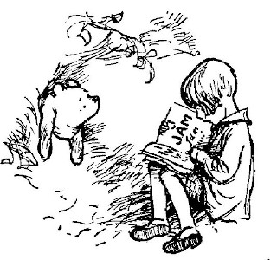
Public Domain
In Canada, copyright lasts for the life of the author and 50 years after their death.
Public domain works are those where this term has passed.
For example, A.A. Milne, original creator of Winnie the Pooh, died in 1956 – 65 years have passed since Milne’s death, so the work is in the public domain
Notes:
You are free to use works that are in the public domain. Project Gutenberg Canada has done fantastic work in gathering digitized versions of public domain works that meet the current Canadian definition of the public domain (life + 50). You can also make use of the American Project Gutenberg, as the United States has a longer copyright term than Canada – this means that anything in Project Gutenberg US is also in the Canadian public domain. You only use the term of copyright for the country you are in when you are making use of the work – if you are in Canada when you are using a work, you use the Canadian copyright term.

Slide 6
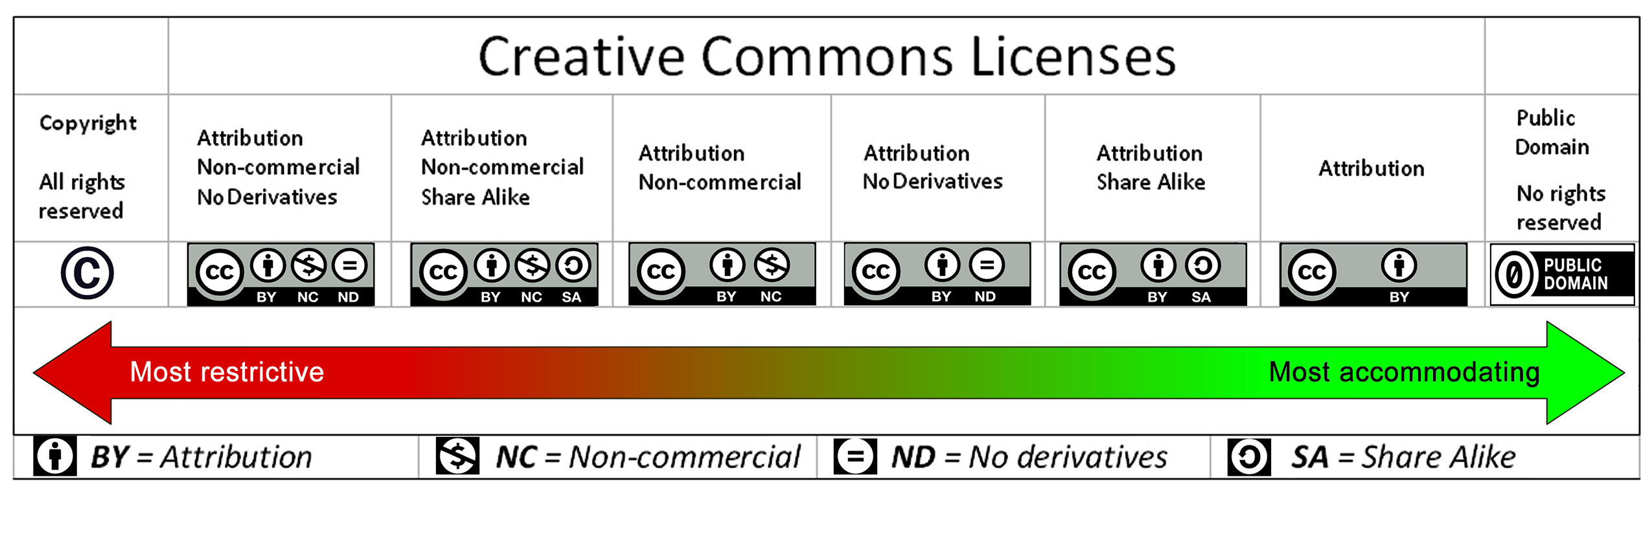
Creative Commons Licensed Works
Image credit: CC-BY – Barbara M. Waxer
Notes:
Creative Commons is a licensing system. The main idea behind it is to open up use of works, by allowing creators to assign license to their work that make it easy for users to understand what they can and can’t do. The continuum on this slide represents the varying degrees of CC licenses that are available from most restrictive (CC-BY-NC-ND) to least restrictive (CC-0). This principle also applies to other open licensed works (such as software licensed under GNU General Public License or MIT License), in each case being careful to follow the requirements of the license.

Slide 7
Non-Commercial User Generated Content (s. 29.21)
Under this exception you can use works published or ‘made available to the public’ in a new work of your creation, as long as:
  You are using the third party work for non-commercial purposes
  You mention the source
  You use a legal version of the work
  Your use of the work does not have an substantial adverse effect on the exploitation of the third party work
This exception is often called the YouTube exception.
This exception has not yet been tested by the courts.

Slide 8
Am I doing this right?
Remember:
  It can be complicated. If you’re confused or second guessing yourself, you aren’t alone.
  Be reasonable and respectful.
    Copyright decisions are made on a continuum of risk – there is often isn’t a definite yes or no to your question. Think about what is reasonable in your case.
    Avoid trying to find a tricky way to get around copyright issues – if you’re trying to find a loophole it’s probably best to stop and ask for a second opinion.
    Think about modelling best practices. What would you want as an author?
  You can always ask copyright@uwaterloo.ca for help. Caveat: We can’t provide legal advice.

Slide 9
Copyright Information
All slides in Understanding Copyright Considerations by Lauren Byl are licensed under Attribution-NonCommercial 4.0 International. To view a copy of this license, visit http://creativecommons.org/licenses/by-nc/4.0/

