Slide 1
An Introduction to Differential Privacy for Analysis of Sensitive Data
Gautam Kamath
University of Waterloo
Cybersecurity, Privacy, & AI in Health Data: Advancements & Challenges
May 5, 2023

Slide 2
Privacy
Modern large-scale machine learning & statistics employ enormous amounts of sensitive data…
…making it very easy to violate individual privacy!

Slide 3
Vulnerability of GWA Studies
Genome-wide association study (GWAS): examine DNA of thousands of individuals to find associations between single-nucleotide polymorphisms (SNPs) and a disease
$χ^{2}$-statistics & associated $p$-values
Highly sensitive medical data
Bad news: can reidentify individuals who participated! [Homer et al., 2008]
Membership inference
National Institutes of Health (NIH): No more public access to aggregate genetic data!

Slide 4
Vulnerability of US Census Data
Using publicly-released statistics, the US Census Bureau reconstructed microdata
Rows consisting of (voting block, age, sex, race, ethnicity)
Exact match on almost 50% of the US population!
For ~half of the population, uniquely identifies them, and can match with external data

Slide 5
So What?

Slide 6
Solutions to privacy risks?
Redacting small counts?
“Swapping”?
$k$-anonymity?
All heuristic or best-effort privacy methods have been shown to be vulnerable to privacy attacks

Slide 7
Differential Privacy (DP)
Dataset
Statistic
Output
$$X$$
$$M(X)$$
[Dwork, McSherry, Nissim, Smith], 2006

Slide 8
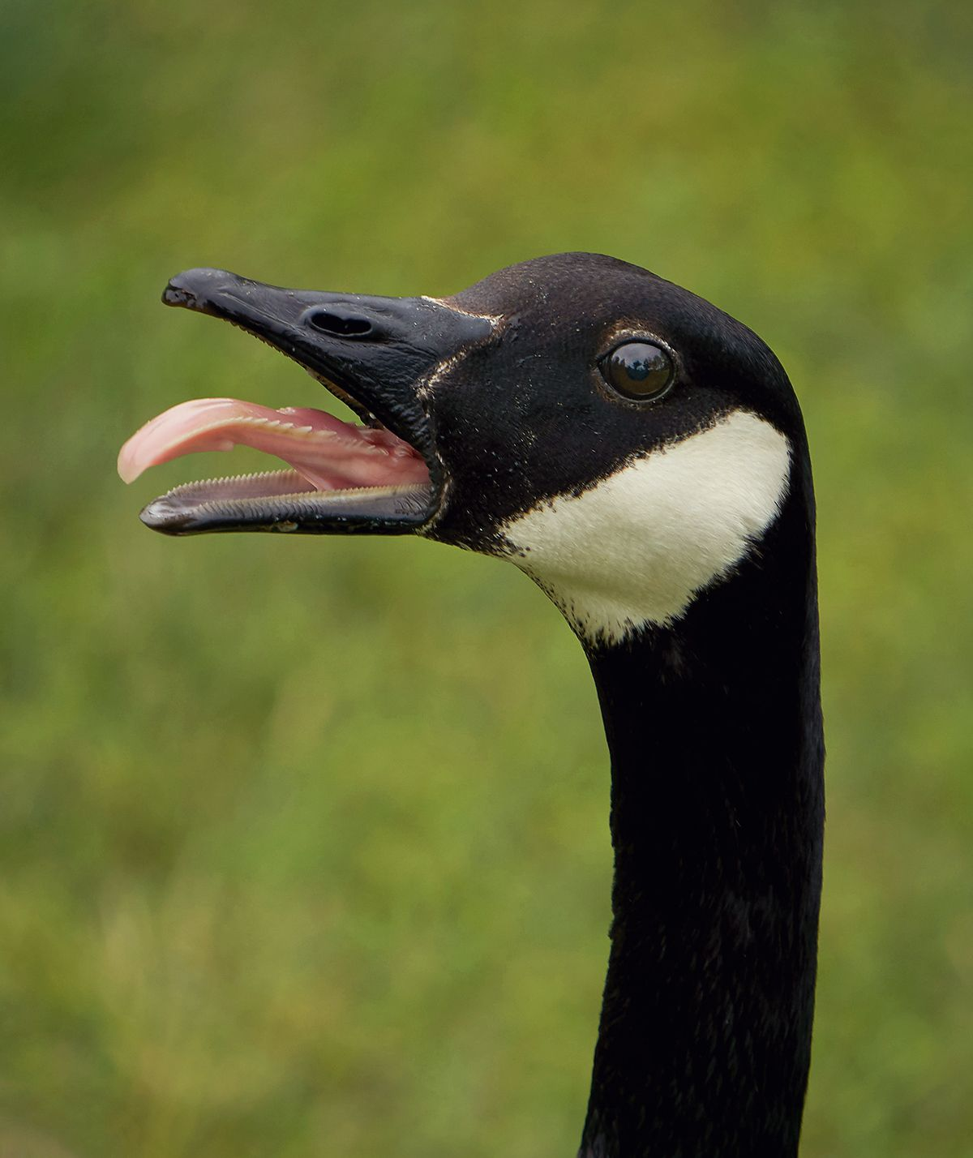
Differential Privacy (DP)
Dataset
Statistic
Output
Malicious Party
or
$M:D^{n}→R$ is $ε$-DP if for all inputs $X, X^{′}$ which differ on one entry:
$∀S⊆R$ $Pr\left[M\left(X\right)∈S\right]≤e^{ε}Pr\left[M\left(X^{′}\right)∈S\right]$
$$X$$
$$M(X)$$
?
$$X′$$
[Dwork, McSherry, Nissim, Smith], 2006

Slide 9
Differential Privacy (DP)
Dataset
Statistic
Output
Malicious Party
or
“An algorithm is $ε$-differentially private ($ε$-DP) if it is hard to tell if one datapoint was added/removed by looking at the output.”
A quantitative definition: smaller $ε$ $→$ better protection
Allows tradeoffs between privacy and utility
$$X$$
$$M(X)$$
?
$$X′$$
[Dwork, McSherry, Nissim, Smith], 2006

Slide 10
Differential Privacy (Informal)
“An algorithm is $ε$-differentially private ($ε$-DP) if it is hard to tell if one datapoint was added/removed by looking at the output.”
Why is this a reasonable notion of privacy?
Looking at the output, can’t tell if a user was in the dataset or not
If you can’t even know if a user is present, you can’t know their data

Slide 11
What does DP protect against?
Database reconstruction (e.g., the Census example)
Finding a user’s private data
Membership inference (e.g., the GWAS example)
Determining whether or not a user was in the dataset
And much more!

Slide 12
Who uses differential privacy?

Slide 13
How to make a statistic differentially private?
Intuition: add enough noise to mask any individual’s contributions…
...but little enough noise to still be useful!
Asking a population of 100 people, how many smoke?
E.g., 20 say yes
Instead of reporting 20 publicly, instead report 20 + random noise
Example samples: 19.59, 20.97, 19.64, 21.73
Isn’t this obvious…?
DP is rigorous, quantifiable, and composable

Slide 14
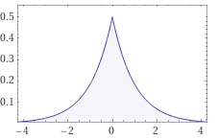
DP is Rigorous and Quantifiable
Theorem: Reporting the number of smokers + Laplace$(1/ε)$ noise guarantees $ε$-differential privacy ($ε$-DP)
We can rigorously prove this approach guarantees privacy
Recall: 20 smokers
Example: Can guarantee $1$-DP by adding $Laplace(1)$ noise
Sampled outputs: $20.68, 19.24, 20.28, 19.83, …$
Stronger privacy: $0.1$-DP by adding $Laplace(10)$ noise
Sampled outputs: $22.45, 11.45, 2.4, 15.03, 29.47$
Quantifiable: more noise gives better privacy but less accuracy

Slide 15
DP is Composable
Not very useful to output just one statistic…
Complex analyses depend on and report numerous statistics
Example: consider some population of 100 people
20 are smokers: noised with $Laplace\left(1\right)$ noise: 19.51
37 have a chronic illness: noised with $Laplace\left(1\right)$ noise: 36.89
12 make over $250,000/year: noised with $Laplace\left(1\right)$ noise: 12.53
Releasing all three noised statistics $\left(19.51, 36.89, 12.53\right)$ is $3$-DP
Can quantify composition of releasing multiple statistics
Useful, e.g., for a census

Slide 16
Application: Google COVID-19 Community Mobility Reports

Slide 17
Application: 2020 US Census

Slide 18
Conclusion and Recommendations
Differential privacy is a rigorous and versatile tool for privacy-preserving data analysis
Canadian organizations need to re-evaluate privacy and disclosure risks of their statistical releases
Red teaming?
Move beyond heuristic and best-effort approaches for privacy, and turn to rigorous methods
Ensure compliance with privacy legislation
Give Canadians trust in how their data is used
Particularly for health applications!

