Slide 1
SYNTHETIC HEALTH DATA
Cybersecurity, Privacy, and Artificial Intelligence in Health Data: Advancements and Challenges Conference
May 5, 2023, Ottawa, Canada
Helen Chen, PhD
Professor of Practice School of Public Health Sciences, Faculty of Health
President
Canadian Personalized Healthcare Innovation Network
Photo credit: @bruce.digital

Slide 2
DATA IS THE NEW FUEL

Slide 3
REAL HEALTH DATA IS NOT EASY TO ACCESS
Notes:
Lack of high-quality, FAIR (Findable, Accessible, Interoperable, Reusable) health data → hindering health technology improvements or innovations.

Slide 4
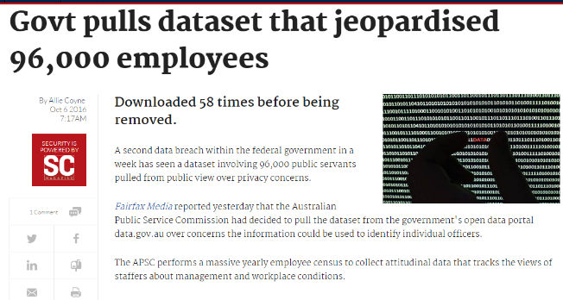
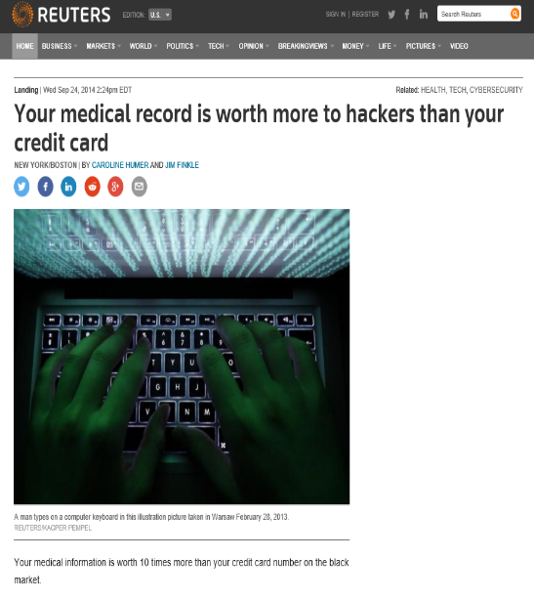
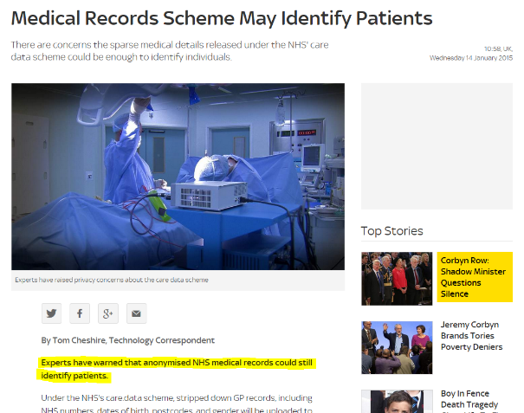
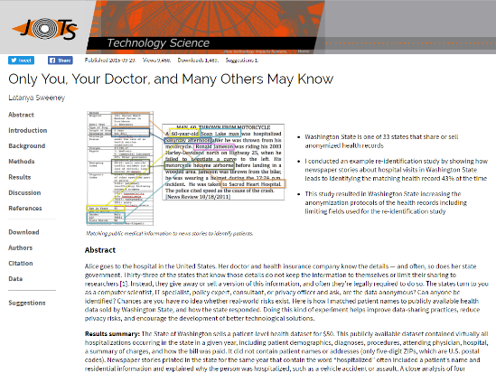
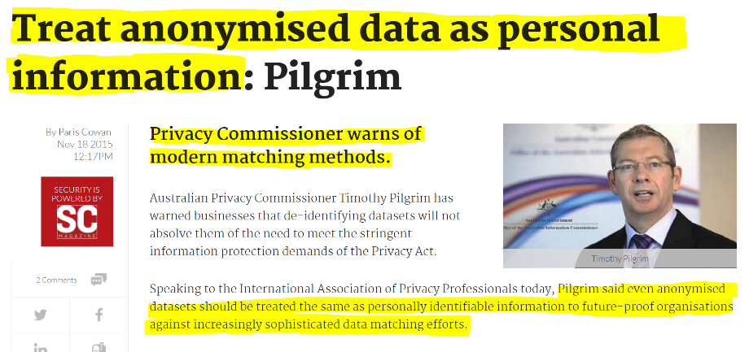

Slide 5
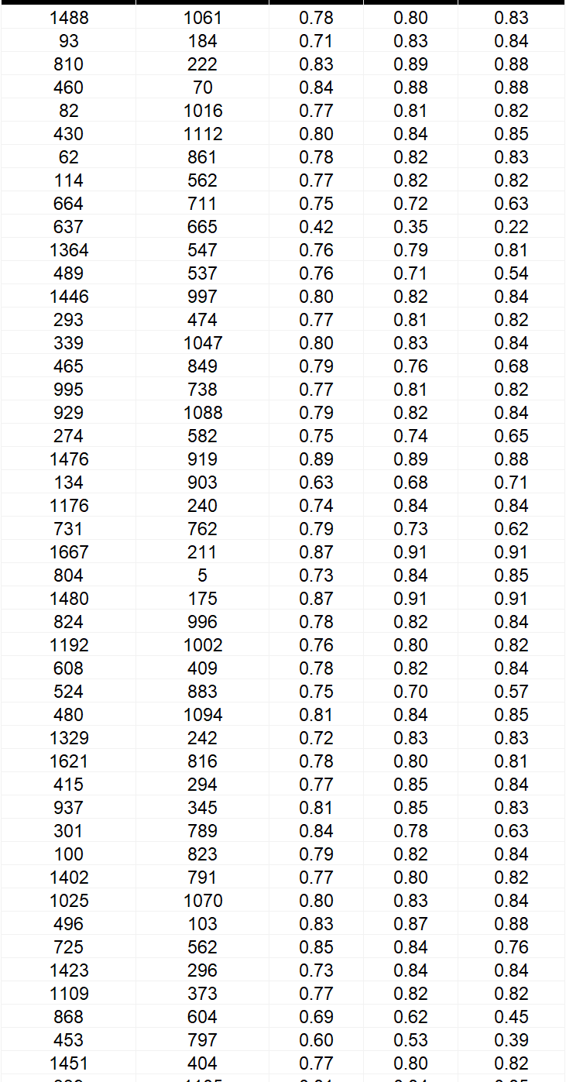
WHY WE NEED ACCESS TO REAL DATA
=
?

Slide 6
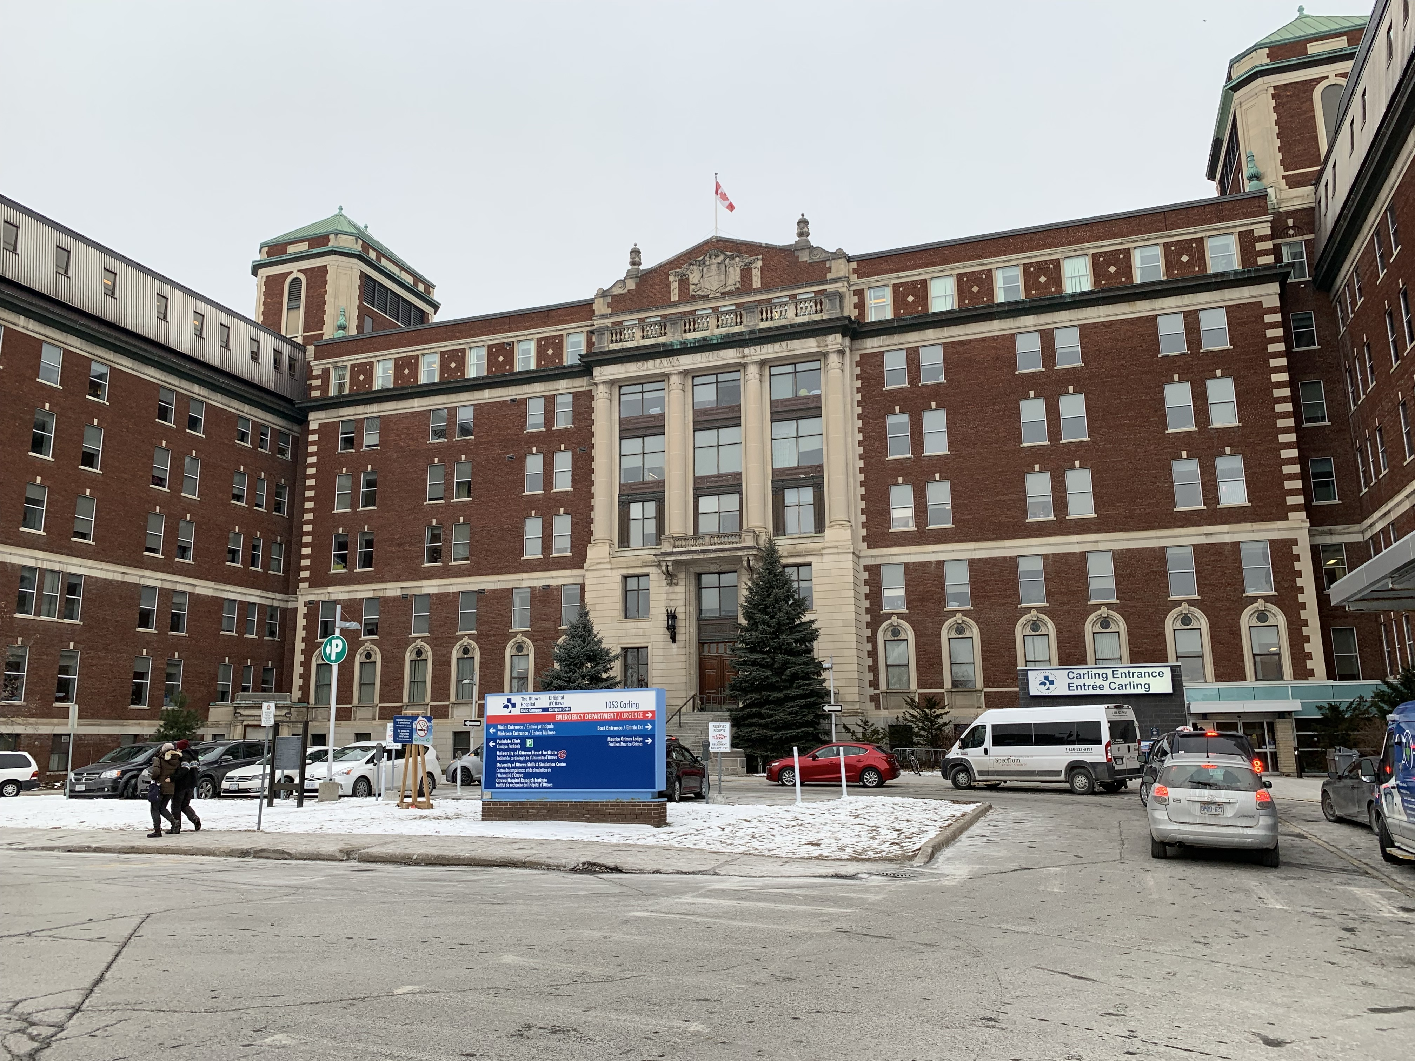
=

Slide 7
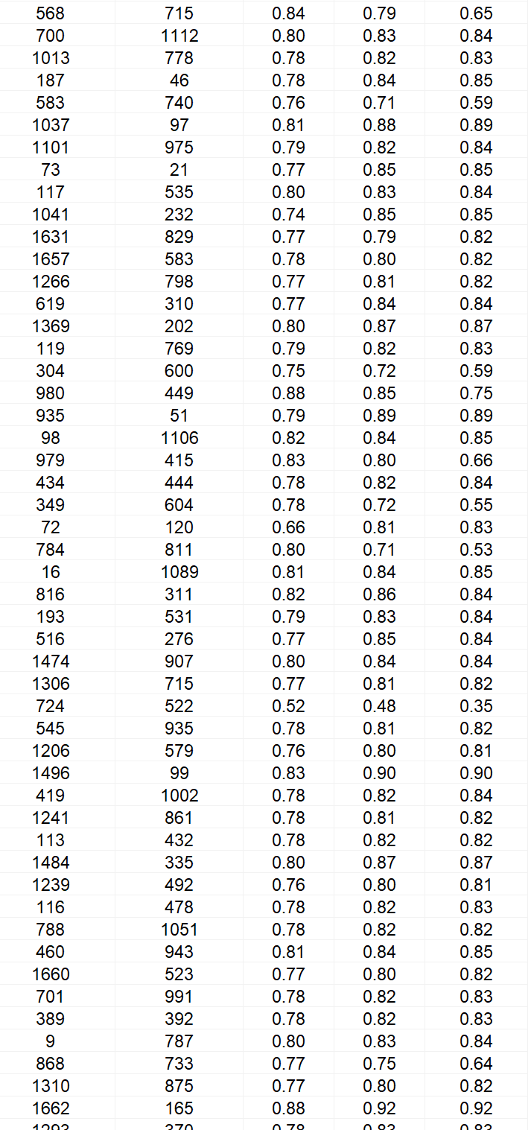
SYNTHETIC
Photo copyright © Yuval Ofek

Slide 8
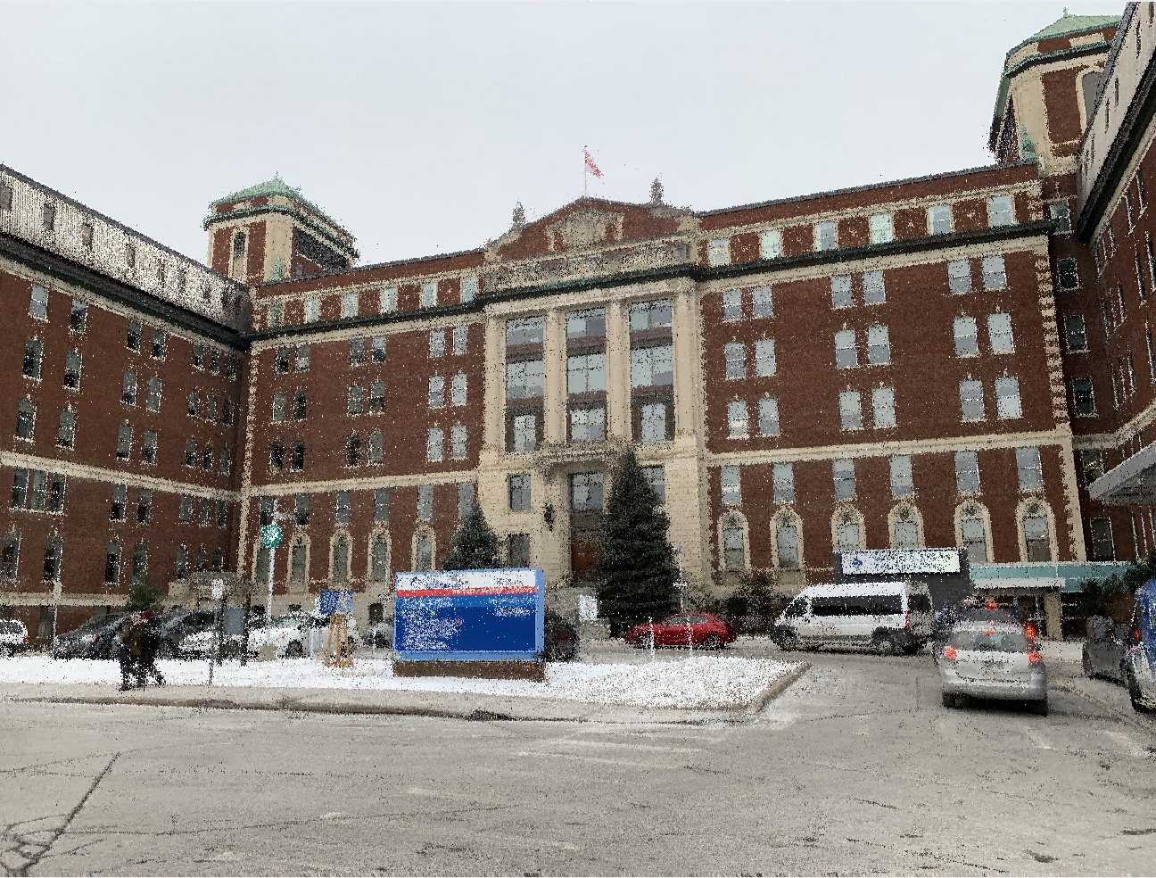

Slide 9
ORIGINAL
SYNTHETIC
Courtesy of Daniel Blumenthal

Slide 10
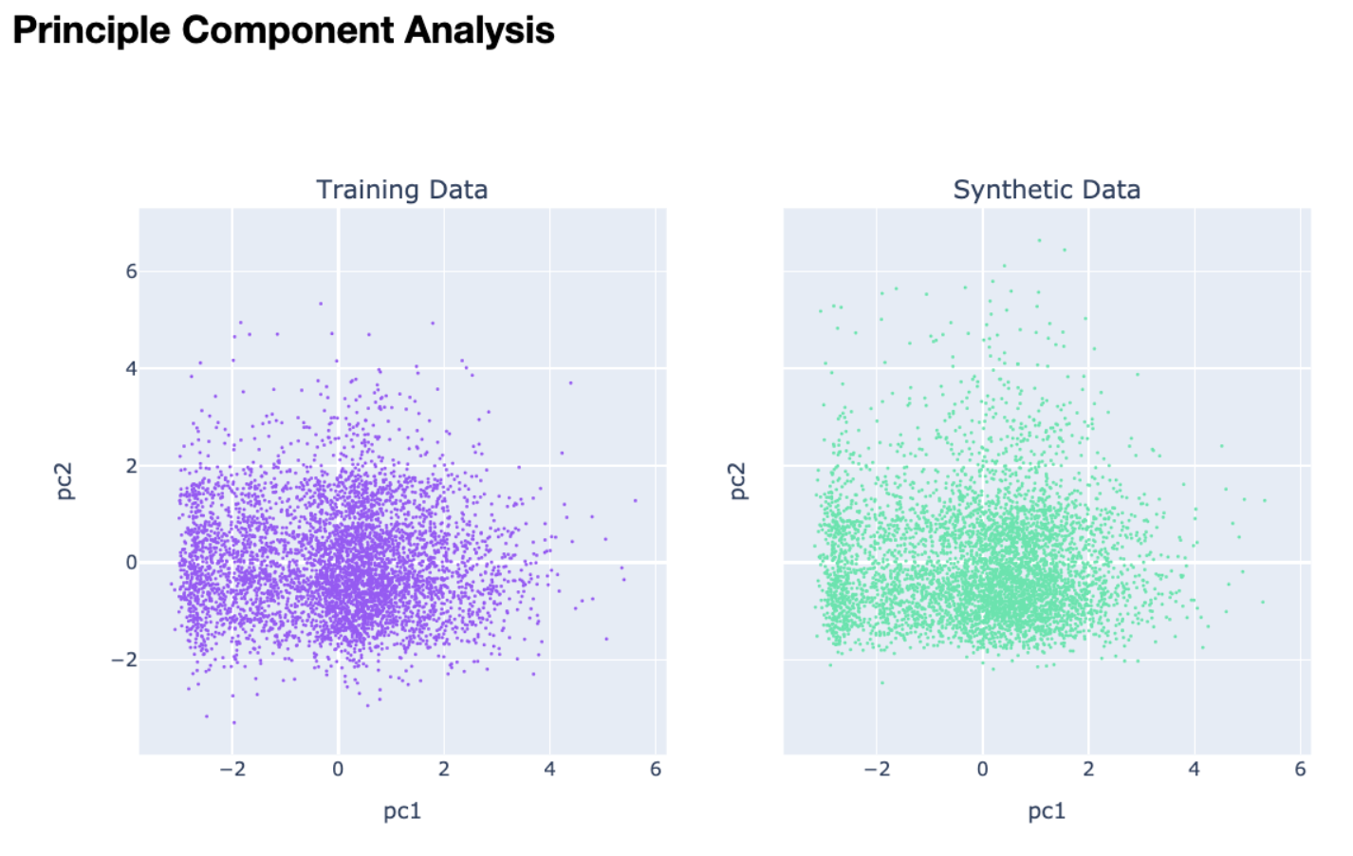
WHAT IS SYNTHETIC DATA
Synthetic data is artificially generated data from real-world data and reflect characteristics of real-world data.
Similar patterns
Similar associations
Similar events
Alex Watson, https://gretel.ai/blog/what-is-synthetic-data, 2022
Notes:
https://blogs.nvidia.com/blog/2021/06/08/what-is-synthetic-data/

Slide 11
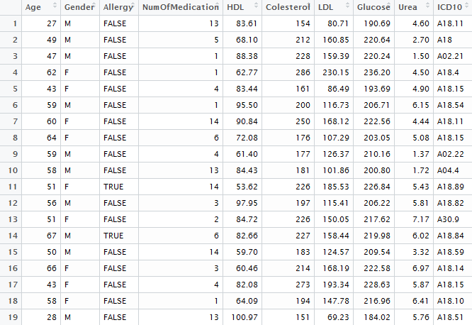
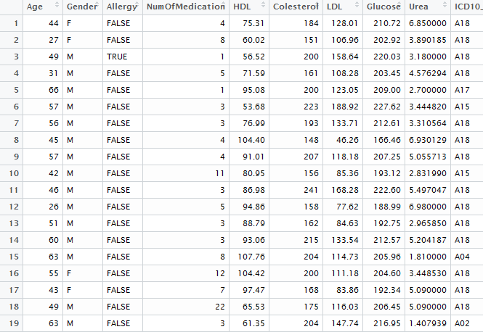
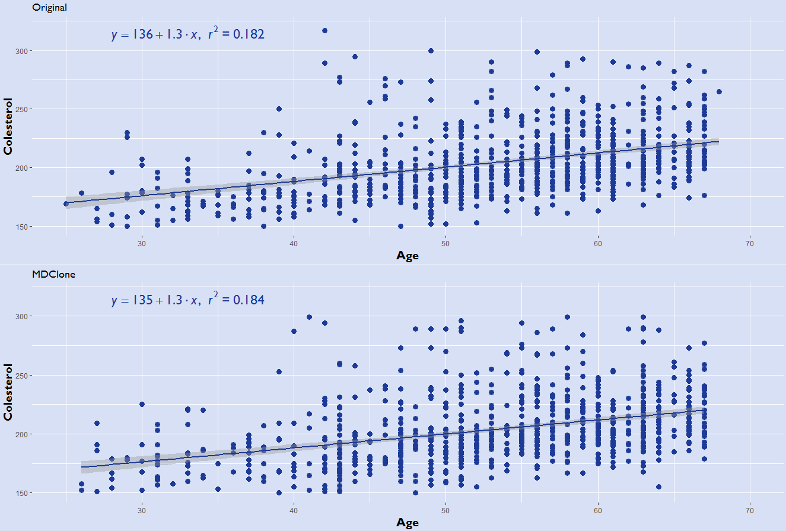
Original Data
Synthetic Data

Slide 12
SYNTHETIC DATA GENERATION TECHNIQUES
James, S., Harbron, C., Branson, J. et al. Synthetic data use: exploring use cases to optimise data utility. Discov Artif Intell 1, 15 (2021). https://doi.org/10.1007/s44163-021-00016-y

Slide 13
HOW USEFUL IS SYNTHETIC DATA?
“We synthesized the Ontario case database of 90 514 individuals testing positive for SARSCoV-2 and created a synthetic version of that. The synthesis method used sequential decision trees. A machine learning (gradient boosted trees) mortality prediction model was constructed using the synthetic data and its accuracy and the relationships it detected were compared to the real data. The results of the real and synthetic data models were similar and the conclusions were the same.
A privacy risk assessment on the synthetic data showed that the attribute and membership disclosure risks were low.
We conclude that the synthetic version of the COVID-19 testing dataset can be shared more broadly as it has high utility and privacy characteristics.”
Khaled El Emam, Lucy Mosquera, Elizabeth Jonker, Harpreet Sood, Evaluating the utility of synthetic COVID-19 case data, JAMIA Open, Volume 4, Issue 1, January 2021, ooab012

Slide 14
SYNTHETIC DATA UTILITY
Reference: James, S., Harbron, C., Branson, J. et al. Synthetic data use: exploring use cases to optimise data utility. Discov Artif Intell 1, 15 (2021). https://doi.org/10.1007/s44163-021-00016-y

Slide 15
Multi-layer Privacy Solution
Internal Quality Improvement
Authority to see all data
Internal Research
De-id or synthetic data only pre-IRB
Fast-tracked IRB process
Third-Party
Access limited to specific project/domains
Synthetic only

Slide 16
ACCELERATE HEALTH CARE AND INNOVATIONS
Source: https://medium.com/behavioural-insights/what-is-synthetic-data-and-how-can-it-accelerate-public-policy-research-466076d44fc5

Slide 17
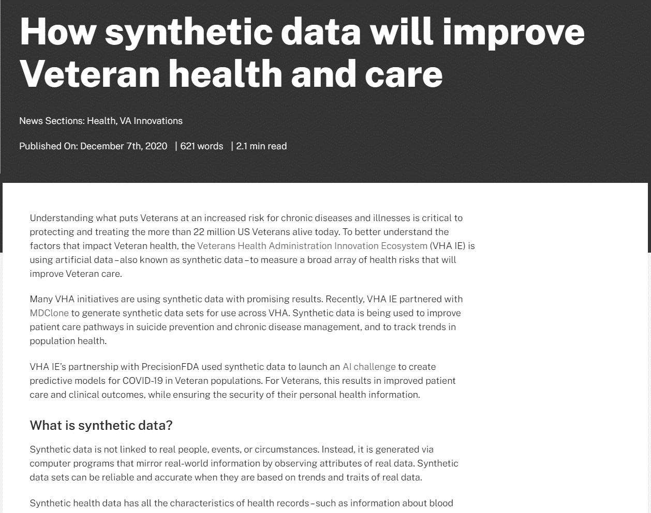
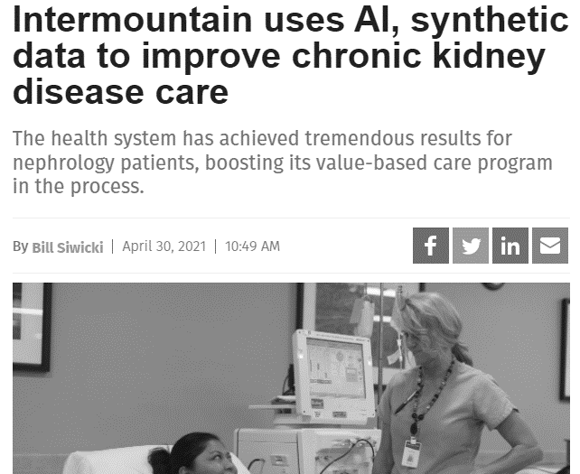
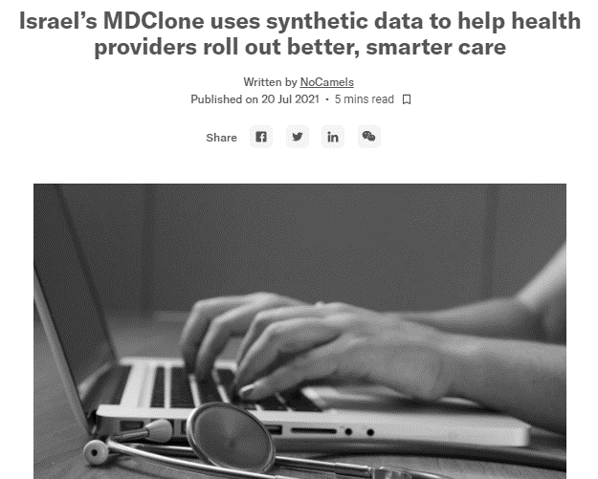
WHO ARE USING SYNTHETIC HEALTH DATA?
Curtesy of MDCLONE SYNTHETIC DATA

Slide 18
ARC – THE CENTER FOR DIGITAL INNOVATION SHEBA MEDICAL CENTER
Determining CPVID patients
Developing algorithms to identify patients that have COPD and are about to deteriorate
Better triaging ER patients
Examining drug usage for reverse anesthesia and topical hemostasis in the operating rooms
Examining CT scans’ findings and clinical outcomes
Developing algorithms for the optimal frequency of therapeutic drug monitoring for mood-stabilizing drugs
https://www.mdclone.com/case-study-sheba-medical-center
Notes:
Determining patterns among hospitalized COVID-19 patients
Developing algorithms that they’re implementing to identify patients that have COPD and are about to deteriorate
Better triaging patients coming into the ER by seeing whether a patient who is coming in has COPD based on initial symptoms and vital signs
Examining drug usage for reverse anesthesia and topical hemostasis in the operating rooms
Examining CT scans’ findings and clinical outcomes among anticoagulated patients presenting to the ER with minor head trauma in an attempt to minimize hospitalizations for observation in these patients
Developing algorithms for the optimal frequency of therapeutic drug monitoring for mood-stabilizing drugs

Slide 19
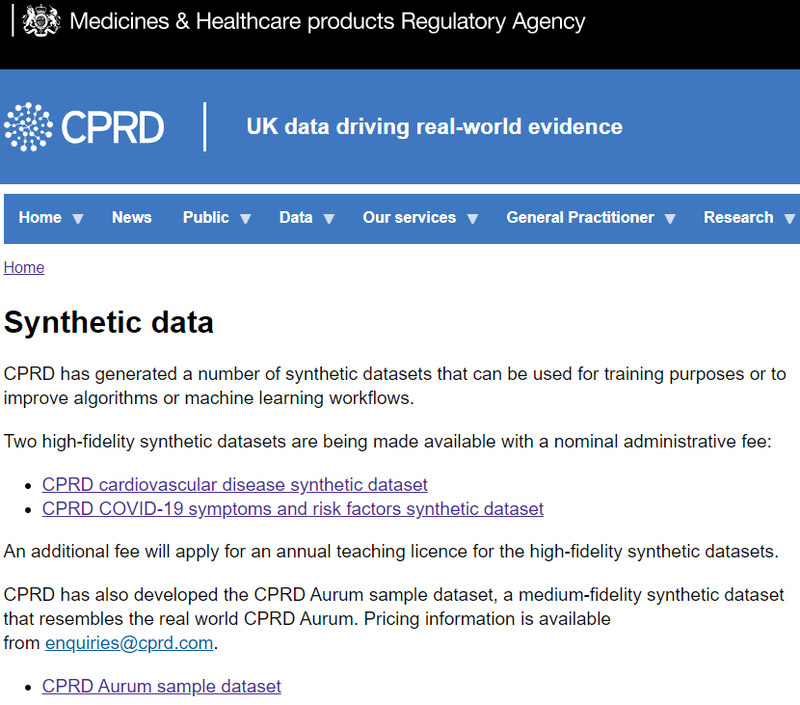
SYNTHETIC HEALTH DATA – UNITED KINGDOM
Clinical Practice Research Datalink (CPRD)
Health Data Research UK (HDRUK)
Notes:
CPRD synthetic data: https://cprd.com/synthetic-data
HDRUK: https://www.hdruk.ac.uk/helping-with-health-data/synthetic-data/

Slide 20
FUTURE OF FEDERATED HEALTH DATA NETWORK
Data at source is made available for clinicians for quality improvement and operation optimization
Synthetic data is annotated with cohort description, generative algorithm and quality measurement
Synthetic data is discoverable and can be used for federated learning
Countability and valuation is transparent

Slide 21
WHAT DOES IT TAKE TO BUILD SUCH FUTURE?
Trust
Assurance of privacy and IP protection
Algorithms to generate high quality synthetic health data
FAIR data governance
Data infrastructure
Notes:
SYNTHETIC DATA ON DATA ACCESS AND PRIVACY PROTECTION
Opportunities
Enhancing privacy in technologies
Improved fairness
Increase access to realistic health data
Challenges
Output control could be complex
Difficulty to map outliers
Quality of the model depends on the data source

Slide 22
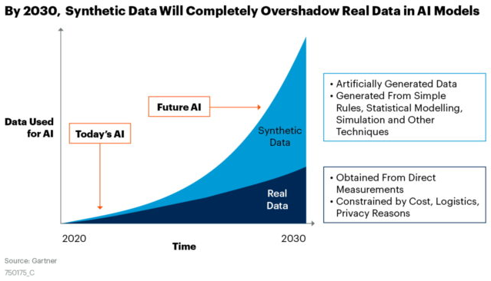
WE MUST ACT NOW
Notes:
https://blogs.nvidia.com/blog/2021/06/08/what-is-synthetic-data/

Slide 23
WHO ARE USING SYNTHETIC HEALTH DATA?
Amazon is using synthetic data to train Alexa's language system.
Google's Waymo uses synthetic data to train its automatic cars.
Health insurance company Anthem works with Google Cloud to generate synthetic data.
American Express & J.P. Morgan are using synthetic financial data to improve fraud detection.
Roche is using synthetic medical data for clinical research.
German insurance company Provinzial tests synthetic data for predictive analytics.
Notes:
Roche using the Harvard Dataverse dataset. This public data sample provides 4 datasets of clinical trial data, containing 33 variables and 55660 observations on 123 patients.

Slide 24
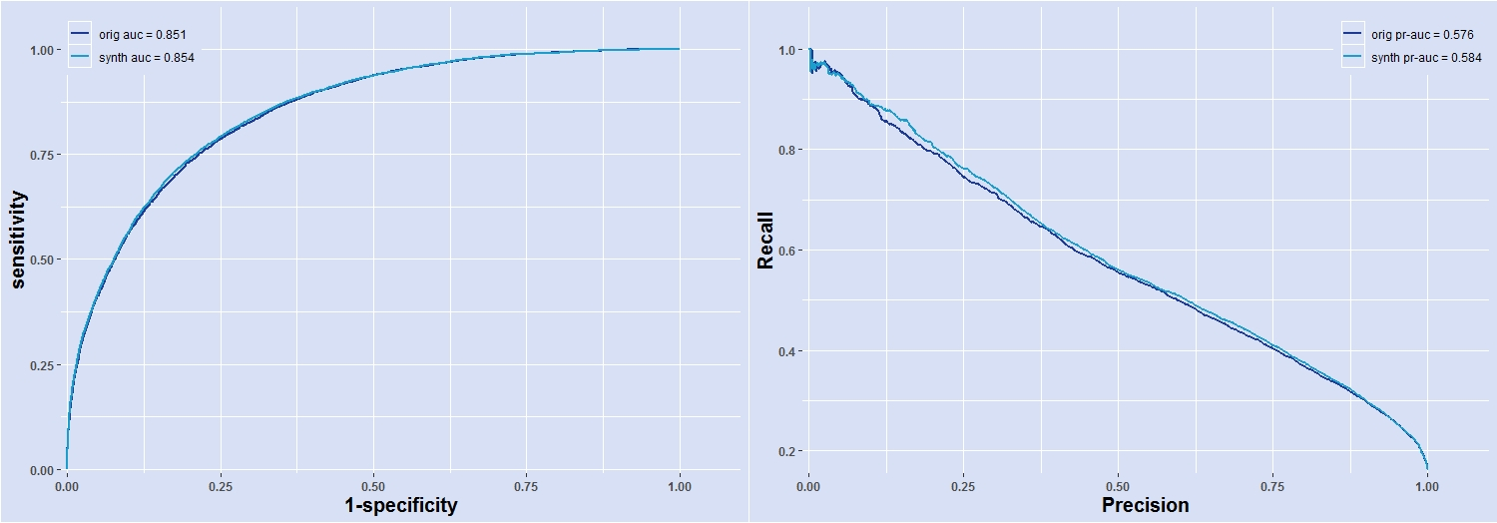
Multivariate Distributions
Prediction of COVID-19 Severity

Slide 25
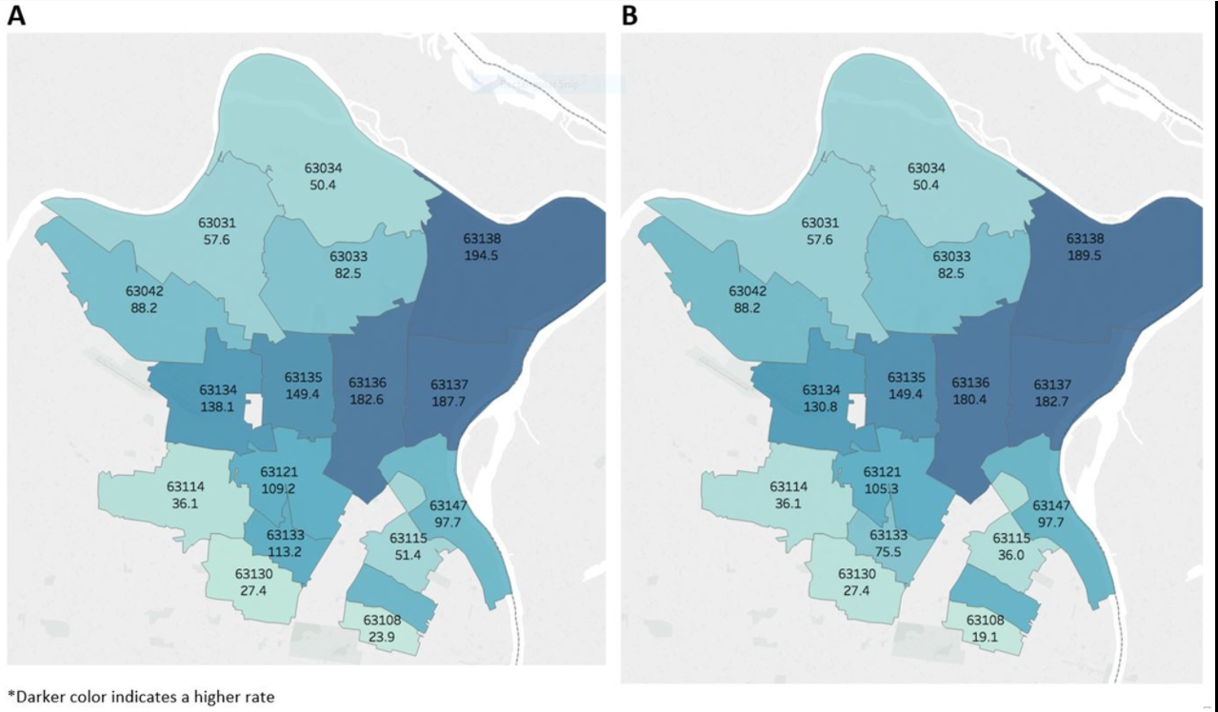
Population Analysis
Chlamydia rates by zip code
Original
Synthetic

