Slide 1
Modernizing Canadian health data systems to improve capacity for evidence-informed decision making when the only constant is change
John P Hirdes, PhD FCAHS
University Professor, School of Public Health Sciences
University of Waterloo

Slide 2
Major changes affecting health and health care
Long-term predictable trends
Aging → complex needs, more uncertainty in outcomes
Female labour force participation → child care, competing time demands
Geographic mobility → reduced availability of informal caregivers
Urbanization → aging of rural and remote communities
“Unexpected”events or trends result in rapid change
COVID-19
Mis-information and anti-science

Slide 3
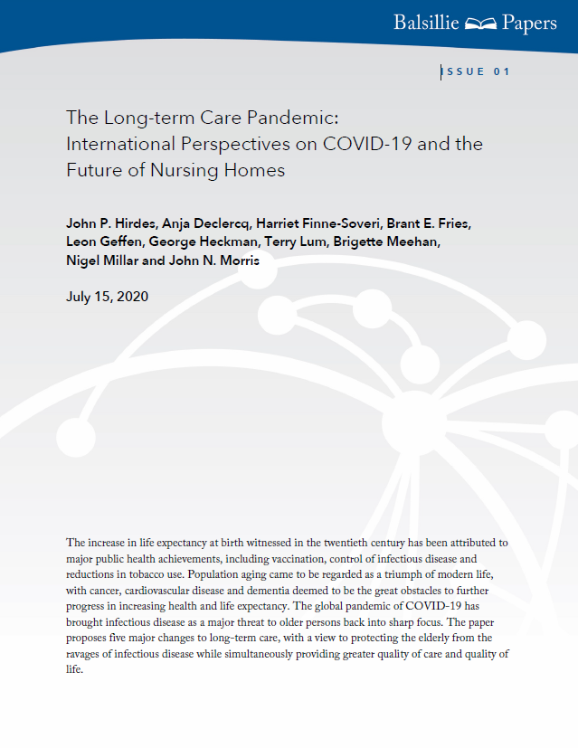
What did we know at the start of the pandemic?
Virtually no evidence of impact in LTC
Available reports in Mar-May 2020 mainly on hospitals in China
Case reports in some US LTC homes
Main identified risk factors
Age
Multimorbidity
Emphasis placed on hospitals rather than LTC or home care

Slide 4
Sample Characteristics
Characteristic | Canada |  |  |  |  |  | United States Simulation Model Cohort |  | New Zealand Simulation Model Cohort
 | Mortality Cohort |  |  |  | Simulation Model Cohort
 | Home Care (n=841,440) | Assisted Living (n=98,406) | Nursing Homes (n=422,903) | Post-acute Hospitals (n=291,117) | Home Care (n=232,857) | Nursing Home (n=173,359) | Home Care (n= 391,910) | Nursing Homes (n= 2,046,851) | Home Care (n=75,195) | Nursing Homes (n=59,317)
Age Groups (%) 18-49 50-59 60-69 70-79 80-89 90-119 | 4.9 6.6 12.3 24.5 39.3 12.5 | 2.5 3.4 6.0 13.6 46.0 28.5 | 1.0 2.4 6.6 18.8 45.4 25.8 | 3.6 5.8 12.5 26.5 37.8 13.8 | 4.1 5.2 11.2 22.0 37.4 20.2 | 1.0 2.5 7.3 17.6 38.1 33.6 | 7.3 10.4 19.0 26.1 27.3 9.9 | 2.8 6.5 14.4 22.1 32.7 21.4 | 0.9 2.1 8.3 25.9 43.8 18.9 | 0.4 1.3 5.3 18.2 42.7 32.2
Sex (%) Male Female | 40.3 59.7 | 33.6 66.4 | 36.8 63.2 | 43.0 57.0 | 38.1 61.9 | 34.3 65.7 | 33.7 66.3 | 42.4 57.6 | 40.5 59.5 | 36.9 63.1
Major Comorbidity Count (%) None 1-2 3+ | 30.2 64.5 5.3 | 23.0 70.2 6.9 | 11.1 77.4 11.6 | 17.8 68.2 14.0 | 26.6 68.1 5.3 | 9.3 78.6 12.1 | 29.9 64.6 5.5 | 19.8 69.2 11.0 | 26.9 70.0 3.1 | 15.6 80.6 3.8
Years | 2002- 2018 | 2002- 2018 | 2005- 2017 | 1998- 2017 | 2019 | 2019 | 2017 | 2016 | 2017- 2019 | 2017-2019

Slide 5
90-day Mortality Rates by Age, Pneumonia and Major Comorbidity Count, Home Care and Nursing Homes, Canada, 2002-2018

Slide 6
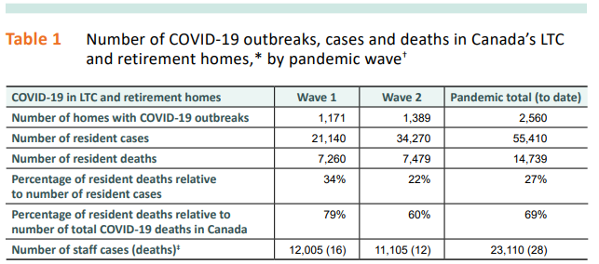
About 10,000 deaths in nursing homes

Slide 7
Factors affecting our capacity to manage change

Slide 8
Examples of health system data gaps for vulnerable populations
Older adults
Robust systems in place for long-term care homes and home care
Limited to no data for retirement homes, assisted living
Limited clinical data for acute care, primary care
Mental health
Few provinces with common clinical standard (beyond DAD) for in-patient mental health
No national standards for community mental health
Children
No national standards for child/youth mental health
No national standards for pediatric home care

Slide 9
Information Resources in LTC
Strengths
Weaknesses
interRAI assessment systems
Multiple sectors
Most provinces & territories
But using older systems!
Under-used for clinical practice
Risk-adjusted outcome-based quality indicators
IT infrastructure
National reporting systems
Public reporting mechanisms
Quality of life/resident experience
BC & NB have common standard
Public health reporting
E.g., outbreak information
Structural measures
E.g., staffing
Process measures
E.g., vaccination data
Cross-sector mechanisms for timely sharing of clinical information

Slide 10
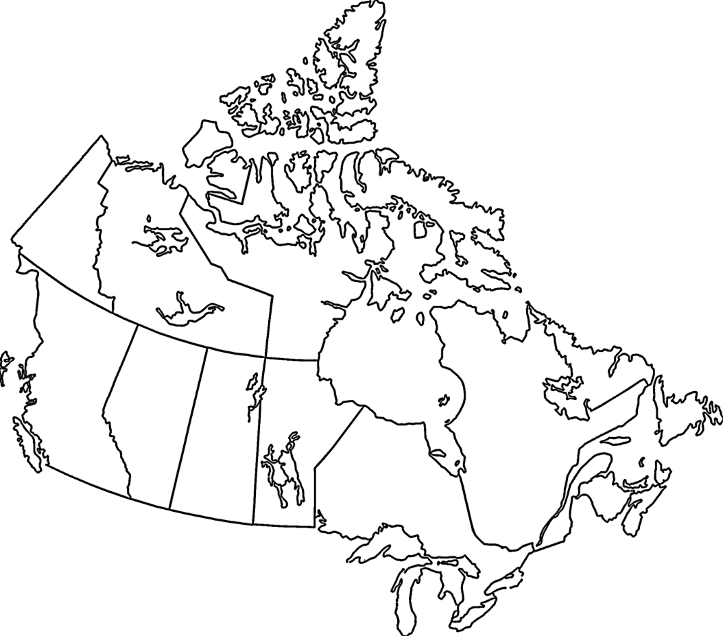
Use of interRAI Instruments in Canada
 | RAI 2.0/ interRAI Long Term Care Facilities
 | RAI-Home Care
 | RAI-Mental Health
 | interRAI Community Mental Health
 | interRAI Emergency Screener for Psychiatry
 | interRAI Brief Mental Health Screener
 | interRAI Child/Youth Mental Health
 | interRAI Intellectual Disability
 | interRAI Palliative Care
 | interRAI Acute Care/Emergency Department
 | interRAI Contact Assessment
 | interRAI Community Health Assessment
 | interRAI Subjective Quality of Life
20+ million assessments
6+ million unique individuals
600K+ new assessments/year
About 7 billion data points
Longitudinal & linkable
Solid symbols refer to implentations that have been mandated by government
Hollow symbols refer to research, pilot studies, or implementation planning underway

Slide 11
Inconsistent data standards: Is a rose by any other name still a rose?
Scientific considerations with inconsistent measures
Some cross-walks feasible for measures with partially shared definitions
More granular → cruder measures
Historical differences will be important for some (but not all) comparisons
Prevalence and incidence estimates problematic
Estimates of associations probably OK, unless fundamental change in practice
Pre-pandemic, mid-pandemic, and post-pandemic comparisons will require caution
Social and political considerations with inconsistent measures
First line of defense for poor quality reports: “Not measured same way”
Second line of defense” “My population is different”
Risk adjustment essential

Slide 12
The denominator problem
Sampled data
Non-response bias poses serious threat to representativeness & generalizability
Periodic sampling may not yield data when needed
Routinely collected data
Administrative and clinical point of care data systems for several sectors
Representativeness not a concern if everyone in setting is included
However, defining the denominator not always clear
E.g., Who counts as home care client, long-term care resident?

Slide 13
Inertia in mobilization of evidence: two challenges
When world is changing quickly, mobilizing data is essential
Paper records in file cabinets have no utility
Non-standardized data may not be interpretable or accepted
Narrative notes often lack essential information
“Had a good day”, “Slept well, ate well”
Batch submission of data can leave good evidence unavailable at the time it is needed
Health system data should move toward “near real time” functionality
Analytic capacity may be a problem
Bandwidth of persons with appropriate expertise
Lack of timely access to data
Risk aversion among some researchers

Slide 14
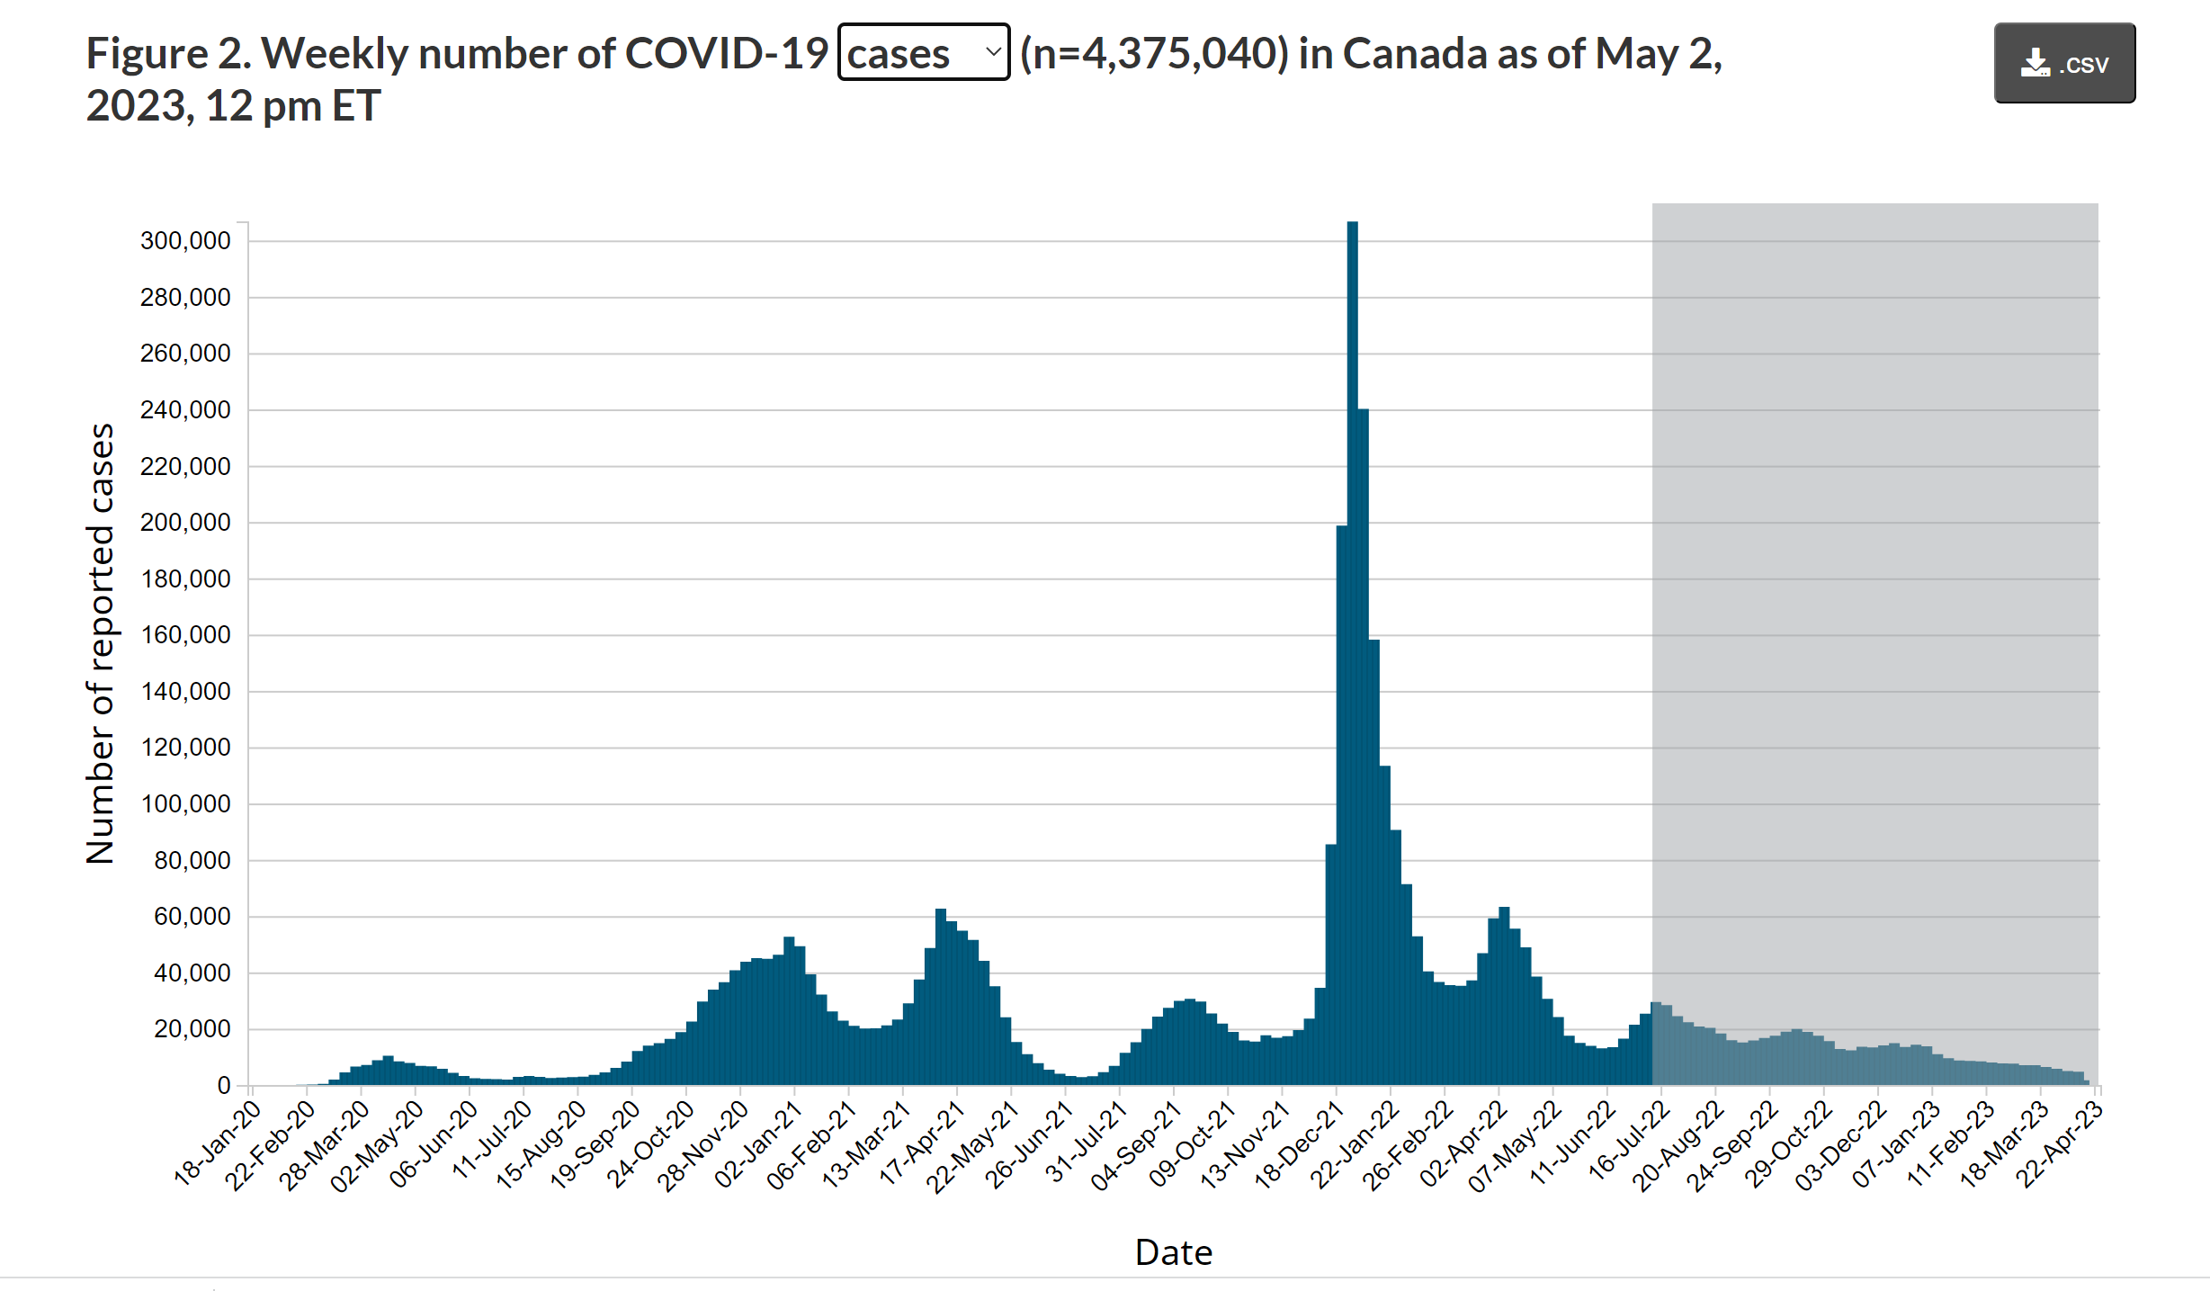
Pandemic curve over time

Slide 15
Two contemporary privacy concerns could limit use of data
Subpopulations and re-identification risk
At-risk populations often at greatest risk of adverse health outcomes
Poverty, stigma, marginalization, barriers in system navigation
Small n often means excluded from analyses or collapsed into ambiguous, residual category
Linked data
Can resolve many methodological challenges without increasing data collection burden
System level views rather than sector-specific views, dynamic vs static populations
Larger number of variables increases possibility of reidentification

Slide 16
Cognitive Performance Scale by Care Setting, Canada
(n=1,836,156)

Slide 17
Opportunities and risks for AI and health
Complex analytic challenges
Black box vs interpretable AI
Need for replication across settings and populations
Deeper understanding of “truth” vs idiosyncratic prediction
Identifying effective treatment depends on understanding of underlying mechanisms
Clinical, managerial, and policy decisions
Decision makers as curators of evidence (including AI based evidence)
Potential for reduction of errors that harm health and well-being
Risk of error with automated decision-making
“The computer says so”

Slide 18
Data-driven vs evidence informed decisions
Data do not “speak for themselves”
Health system priorities are ultimately value-based
Choices are often ambiguous and usually involve opportunity costs
Value frameworks should be explicitly defined through social and political process
Health data systems should help us understand whether our choices are supporting progress toward goals valued by Canadians

Slide 19
Case example: Triage rules during later waves of pandemic
Health system leaders contemplated use of Clinical Frailty Scale to limit access to ICU and other acute hospital services
Proposed cut-point would have
Seriously constrained access for adults with physical disabilities who may still have good prospects for recovery
Prevented access for over 90% of home care clients
Eliminated access for virtually all nursing home residents

Slide 20
Some practical recommendations
Enhance public trust and confidence through education and transparency
Professional standards and accreditation process for researchers and analysts?
Synthetic data
Some applications but not a panacea
Move to newer standards for “near real time”
E.g., IRRS system to replace CCRS and HCRS
Fill in system gaps with interoperable measures
Use of full range of analytic tools including (but not limited to) AI
Increase capacity of decision-makers at all levels to evaluate, interpret, communicate, and act on evidence from diverse sources

Slide 21
Thank you!

