Slide 1
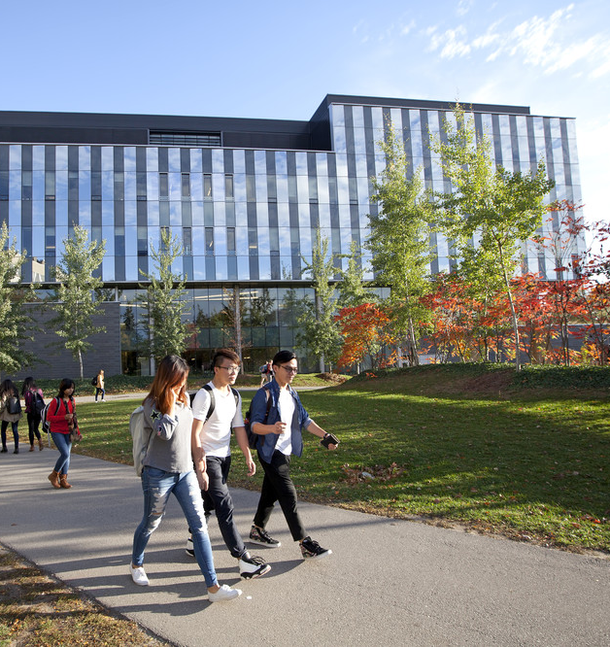
DATA SCIENCE FALL 2021 ORIENTATION
We ask that you mute your microphones while others are talking to prevent interruption.
Please note that this session will be recorded.

Slide 2
WELCOME AND INTRODUCTION
Silvana Shamuon
Data Science Program Administrator

Slide 3
1 FACULTY, 3 UNITS
Department of Combinatorics & Optimization
Department of Statistics and Actuarial Sciences
What does your choice of DS at Math UW mean?
Data Science programs at Math Waterloo provide a rigorous foundation in multidisciplinary studies.
MDSAI offers real world co-op experience.
Cheriton School of Computer Science
2 PROGRAMS
Master of Data Science and Artificial Intelligence (MDSAI)
Master of Mathematics in Data Science (Mmath in DS)
S

Slide 4
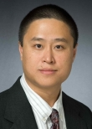
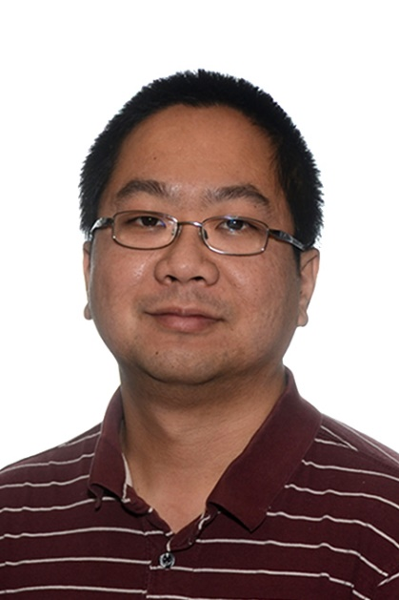
A FEW NAMES OF INTEREST
DATA SCIENCE
Mu Zhu
Program Director,
STATS Professor
Ricardo Fukasawa
Graduate Officer
C&O Professor
Silvana Shamuon
Graduate Program Administrator
S

Slide 5
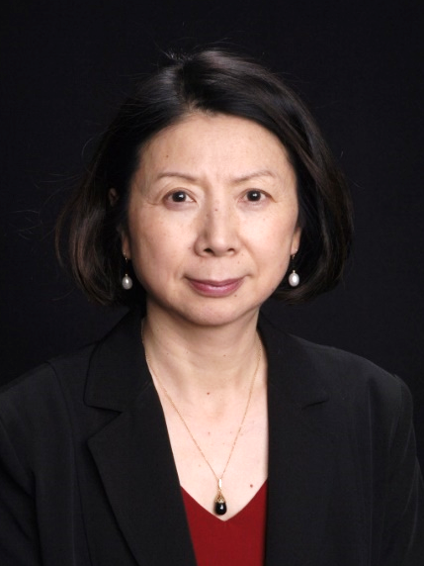
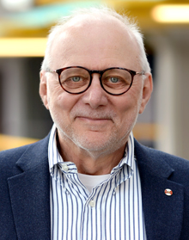
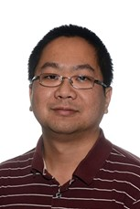
A FEW NAMES OF INTEREST
DATA SCIENCE COMMITTEE
Mu Zhu
S&AS, Chair
Yuying Li
CS Professor
Tamer Özsu
CS Professor
Ali Ghodsi
S&AS Professor
Ricardo Fukasawa
C&O, Associate Chair
Bill Cook
C&O Professor
S

Slide 6
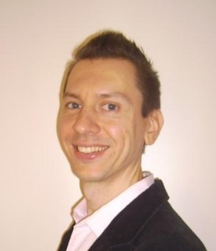
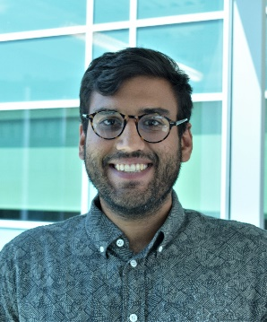
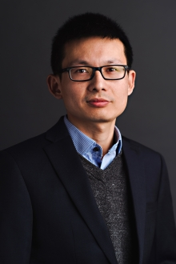
DATA SCIENCE FACULTY MEMBERS
S

Slide 7
WELCOME TO THE UNIQUE FACULTY OF MATHEMATICS
260+
full-time professors
As North America’s only dedicated Faculty of Mathematics, we make world-leading contributions and create and attract industry leaders.
Math degrees lead to 7/10 of the top jobs for the last three years according to CareerCast.com
Successful spin-off companies have started on campus and continue to participate in the education of Waterloo students, including the companies listed on the right.
Intelligent Mechatronic Systems Inc.
800+ graduate students
40,750+
Alumni in
105 countries around the world
Virtek Vision International Inc.
S

Slide 8
STUDY DURING COVID-19
Courses in F21 will be both in-person and online
Learning modality, campus access, and lab rules are all dynamically changing
UW Co-op, a large, experienced, and well running system, is adapting quickly to continue its commitment to students
Maintaining communication, fast response, and patience is key
S

Slide 9
Greetings from the Director
Mu Zhu, Director
Data Science Graduate Program

Slide 10
THANK YOU!
Professor Yuying Li
Founding Program Director (< 2021)
Professor Stephen Vavasis
Interim Program Director (2021.01 – 2021.08)
M

Slide 11
MY PERSONAL ADVICE TO STUDENTS
mathematics/theory vs software/practice
ability to create new software, not just use existing software
skill/vision/perspective vs specific knowledge
focus on broadening your experiences and tasting different ways of thinking
not a checklist of specific know-hows—many become outdated fast anyway
not “end of the world” if a specific course is not available; take another one
faculty freedom in teaching vs a fixed, rigid, standardized syllabus
if the latter, there’d be no value in going to “top schools”
M

Slide 12
MY PERSONAL ADVICE TO STUDENTS
in short …
Grow up!
You are not in high school or an undergrad anymore!
M

Slide 13
Whom to Approach?
specific ›››››››››› program administrator (i.e., Silvana)
e.g., forms, approvals, signatures, rules/procedures (co-op, graduation, …), …
email: ds.grad.admin@uwaterloo.ca
philosophical ›››››››››› program director (i.e., Mu)
e.g., advice (academic, career, …), concerns, complaints, …
email: ds-director@uwaterloo.ca
telegram: @statprofz (**NEW**; experimental)
M

Slide 14
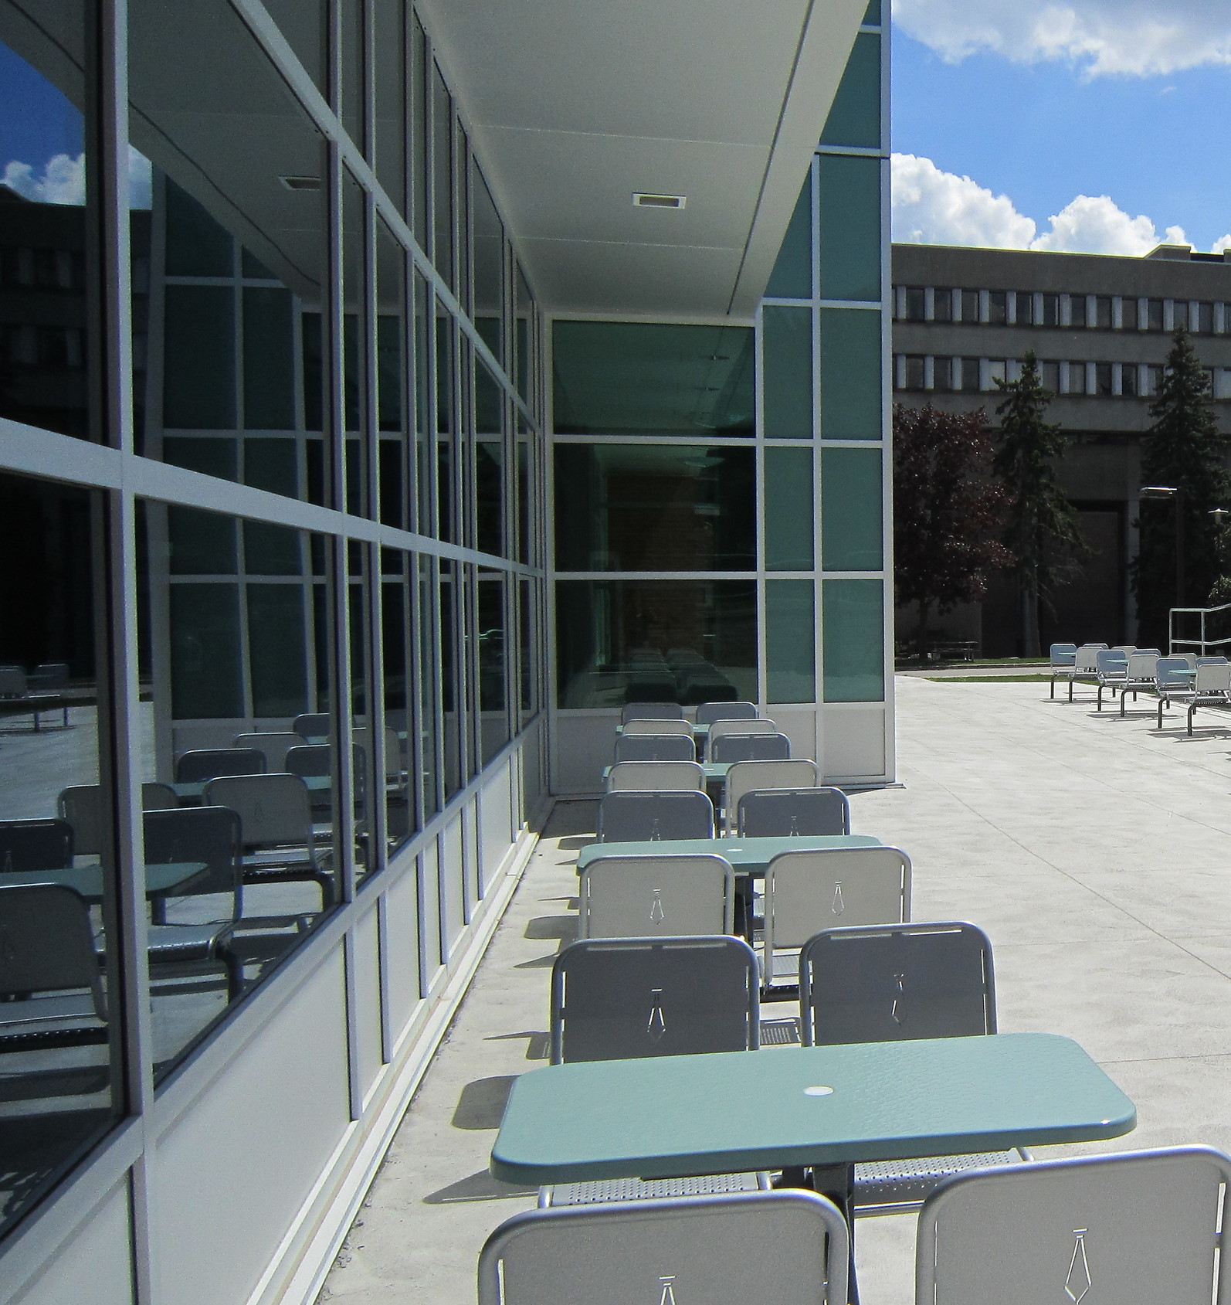
ADMINISTRATION & PROGRAM OVERVIEW
Silvana Shamuon
Graduate Program Administrator

Slide 15
ADMINISTRATIVE TOPICS
Your EMAIL account (ending in @uwaterloo.ca) is set up automatically at the time of enrollment but you may need to register. Check your UW email regularly.
Update your MAILING ADDRESS on QUEST as soon as possible. As the university will use this as your primary mailing address.
For MMath in DS students, funding is handled by your home unit (your supervisor’s department/school). Please connect with them if you haven’t already and copy me.

Slide 16
COVID-19 AND FALL 2021
For Fall 2021, graduate data science courses will be available online and some in-person instruction may be available as shared by your instructor (read more details).
Students will require a fast and reliable internet connection to access virtual computing resources (more information to follow), complete coursework, and attend any live lectures.
Information RE: Covid and campus given via Grad Ready (keep a look out for ongoing communication)

Slide 17
COVID-19 AND FALL 2021
If you plan to come to campus in-person from outside of Canada, please check the Government of Canada policies.
Vaccination Policy
https://checkin.uwaterloo.ca/
As of September 7, everyone in the University of Waterloo community, including visitors must provide proof of vaccination before coming to campus.
Health Canada or World Health Organization-approved vaccines will be accepted.
Residents need to have received their first dose before their scheduled residence move-in date and provide proof of vaccination to the University of Waterloo before they move-in.
Everyone must be fully vaccinated no later than October 17, 2021.
Anyone who can’t get a vaccine due to medical reasons or other grounds protected under the Ontario Human Rights Code will be able to submit a request for accommodation.
Anyone granted accommodation and anyone not yet fully vaccinated must test negative on a rapid antigen test no more than 72 hours before coming to our campuses and buildings.
First and second dose vaccines are available at Health Services.
FAQ: https://uwaterloo.ca/coronavirus/frequently-asked-questions

Slide 18
COVID-19 AND FALL 2021
4. Waterloo Student Quarantine Package
Registration for fall 2021 is now open.
If you have a study permit (or study permit approval) with a valid TRV or eTA, you can register for the package as soon as you book your flight, or at least 14 days before you travel. All registrations must be received before Monday, November 1, 2021 at 11:59 EDT - review the deadlines. We would not recommend entering Canada any sooner than one month prior to beginning your studies or co-op work term.
To be eligible for the Quarantine Package you must meet all of the following criteria:
Be a current or incoming student of the University of Waterloo enrolled in a full-time or part-time academic program, or co-op work term, during fall 2021.
Must travel to Canada from an international destination to study at the University of Waterloo.
Must travel between August 1 to November 15, 2021.
Please note: This package is optional and available for one-time use only.
If you are not sure if you are eligible for this package, please contact ise@uwaterloo.ca.
5. Find additional information here:
https://uwaterloo.ca/coronavirus/academic-information/graduate-student-information

Slide 19
TYPE ALL FORMS!
Remember, UWaterloo DOES NOT accept handwritten forms. All forms will be electronically fillable using Adobe Reader or MS Word.

Slide 20
MANDATORY GRADUATE STUDENT TRAINING
Grad students must complete the following training modules in the first 8 weeks.
Delivery | Course ID | Duration
Online – Safety Office | Employee Safety Orientation (SO1001) | ~60 min
Online – Safety Office | WHMIS 2015 (SO2017) | ~45-60 min
Online – Safety Office | Workplace Violence Awareness (SO1081) | ~60 min
Online – LEARN (for TAs only) | Accessibility Training module | ~30 min
Online – LEARN | Graduate Academic Integrity Module | ~1-2 hours

Slide 21
DATA SCIENCE GRAD STUDENT SUPPORT AND RESOURCES
Please visit the updated listing of Modified Services.
Support Area | What They Do | Location/Contact
Graduate Studies and Postdoctoral Affairs (GSPA) | Provides support to students, postdocs, staff and faculty who are engaged in graduate work and research at the University of Waterloo. | The Centre, Needles Hall, 2nd floor, room 2201 askthecentre@uwaterloo.ca 519-888-4567 ext.42268
The Centre | General UWaterloo questions, official documents | The Centre, Needles Hall, 2nd floor, room 2201 askthecentre@uwaterloo.ca 519-888-4567 ext.42268
Counselling Services | Professional counselling services are provided, at no charge, in a private and confidential setting to UWaterloo students. Get self-help, mental health, urgent care contact information and more. | Needles Hall, 2nd floor 519-888-4567 ext. 32655
Health Services | Provides convenient, confidential and comprehensive medical care to registered students at Waterloo. They work in coordination with other health-related services on campus and in the Kitchener-Waterloo community. | Health Services Building 519-888-4096
Student Success Office (SSO) | Provides and facilitates strategic student support for academic and personal success. *Support for international students include immigration consulting, SIN, application help, etc. | South Campus Hall, second floor 519-888-4567 ext. 84410
Co-operative Education & Centre for Career Action (CCA) | General co-op questions, interview and career services available to students | William M. Tatham Centre (TC) ceca@uwaterloo.ca 519-888-4026

Slide 22
MASTER OF DATA SCIENCE AND ARTIFICIAL INTELLIENCE (MDSAI)
Courses at a glance
(not an exhaustive list)
Data-Intensive Distributed Computing and Analytics
Exploratory Data Analysis
Statistical Learning: Classification
Convex Optimization and Analysis
Data Visualization
Database Systems Implementation
Machine Learning: Statistical and Computational Foundations
Probabilistic Inference and Machine Learning
Advanced Topics in Artificial Intelligence
Optimization for Data Science
Computational Inference
Principles of Data Management and Use
Distributed Systems
Full-time program structure
12 to 16-month professional coursework-based program
Degree requirements: 9 courses and 1 co-op term*
*students may extend their work term for up to 8 months with the same employer
Part-time program structure
36-month duration with 1 course per term

Slide 23
MDSAI CO-OP (SPRING 2021)
This cohort’s co-op term is Spring 2022 (May – August 2021).
*Mandatory preparatory workshops for co-op Masters students will be held on the following dates: You must attend ALL 3 dates to complete these workshops before your co-op term.
*International students will require a co-op work permit. Bettina Wahl from Co-operative Education will go into more detail later on.
Workshop | Date | Time
Co-op Documents (Résumés, cover letters) workshop | Tuesday, September 28 | 10 am – 11:30am
Interviews workshop | Thursday, October 7 | 10am – 11:30am
Co-op Education process & strategy workshop | Friday, October 15 | 10am – 11:30am

Slide 24
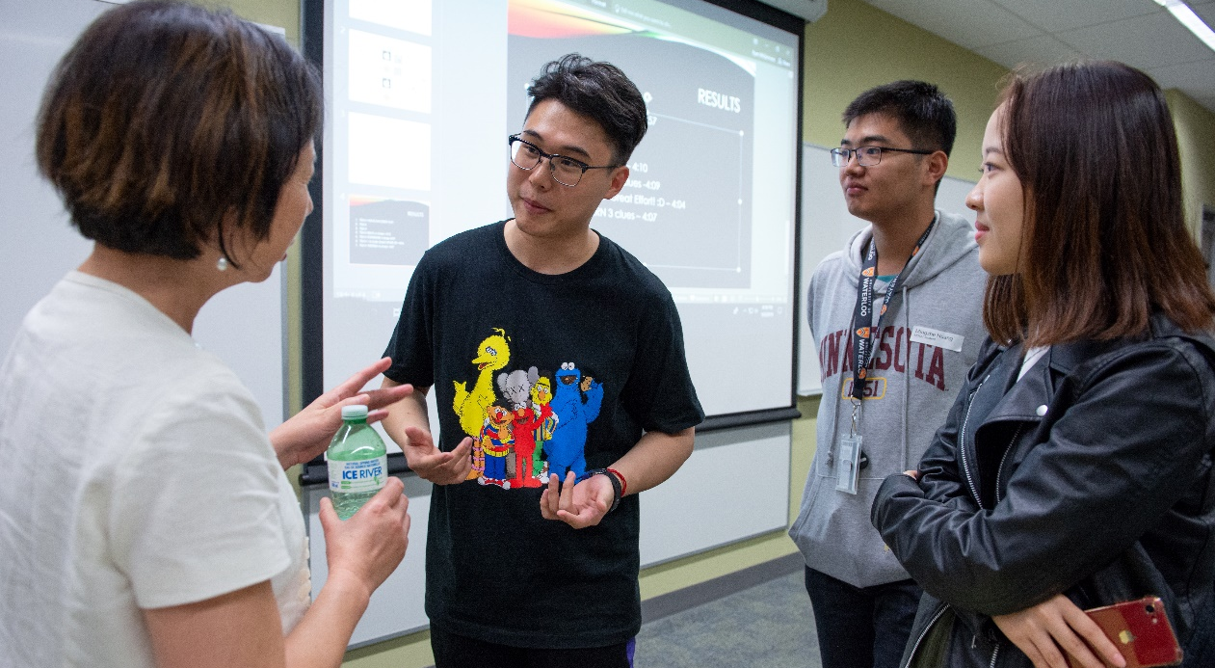
MASTER OF MATHEMATICS IN DATA SCIENCE (MMATH IN DS)
Faculty Members’ Fields of Study
Artificial Intelligence
Causal Inference
Computer Systems and Databases
Data Exploration and Analysis
Data Visualization
Ethics in Artificial Intelligence
Machine Learning
Numerical Linear Algebra
Optimization
Scientific Computing
Statistical Learning
Program Structure
16 to 24-month research-based program with guidance from a faculty member in the field of Data Science
Degree Requirements: 4 courses (see courses at a glance on previous slide) and a thesis

Slide 25
ETHICS WORKSHOPS
3 live virtual workshops instructed by Professor Maura Grossman (offered at two different times each) will be offered this Fall term to complete your required Ethics milestone.
It is strongly recommended that you complete these workshops this Fall 2021 term. More information, including syllabus and links will be provided by email in the next few weeks.
Workshop | Date | Time
Ethics Workshop 1 | Tuesday, October 26th | 9am – 12pm ET OR 2pm – 5pm ET
Ethics Workshop 2 | Tuesday, November 2nd | 9am – 12pm ET OR 2pm – 5pm ET
Ethics Workshop 3 | Tuesday, November 9th | 9am – 12pm ET OR 2pm – 5pm ET

Slide 26
QUESTIONS?
Mu Zhu, Professor and Program Director
ds-director@uwaterloo.ca
Available by appointment, virtually only.
Silvana Shamuon, Graduate Program Administrator
ds.grad.admin@uwaterloo.ca
Available by appointment, virtually only.

Slide 27
COURSE OFFERINGS
CS – Yuying Li
C&O – Ricardo Fukasawa
STAT – Mu Zhu

Slide 28
COURSE OFFERINGS – C&O – Ricardo Fukasawa
Pending instructor availability – check the schedule of classes each term
DEPT | FALL TERM 2021 | WINTER TERM 2022
COMBIN. & OPTIM. | CO 602 CO 650 CO 673* | CO 663 CO 769
Note that CO 769, CS 798, CS courses at the 800 level, and STAT courses at the 900 level should be on a topic in Data Science or Artificial Intelligence; they are subject to the approval of the Director.
*CS 794 / CO 673 Optimization for Data Science is only offered in the Fall term and being a core course, please consider when you will enroll
Some elective courses are pending instructor availability and will not be found in this list
R
Notes:
Here you’ll find a table of when courses are typically found but just know this varies from term to term pending instructor availability. I recommend you check the schedule of courses when you’re thinking about what courses to take. The information found on the table is as of August.
Note that CO 769, CS 798 CS 800 and STAT 900 courses are all topics courses and will need approval from the director. This means that those topics need to have some Data Science components and you may be asked to share the syllabus to make sure that it meets the DS component.
CS 794/CO 673 are the same course so when you enroll we recommend you enroll in the CS version as we set up reserves through CS. This is the only course that is only offered in the Fall term out of all your core courses. Most students have a co-op then return next Fall so there is a possibility to do it next Fall but if you choose to extend your co-op term there will be a conflict.
Lastly, there is an ethics milestone for your degree. There are two ways to achieve this milestone. One is to take the CS 798 course and the other is a 3 day workshop. We strongly recommend the workshop because while this course is great, but it is not always available with this topic.

Slide 29
COURSE OFFERINGS – STAT – Mu Zhu
Pending instructor availability – check the schedule of classes each term
DEPT | FALL TERM 2021 | WINTER TERM 2022
STATISTICS | STAT 841 STAT 842 STAT 844 STAT 940* ----------------------- STAT 845 | STAT 841 STAT 842 STAT 844 STAT 940* ----------------------- STAT 840 STAT 847
Note that CO 769, CS 798, CS courses at the 800 level, and STAT courses at the 900 level should be on a topic in Data Science or Artificial Intelligence; they are subject to the approval of the Director.
*STAT 940 is a “new” course on deep learning. I will approve it as an elective (although procedure still has to be followed).
Some elective courses are pending instructor availability and will not be found in this list
M
Notes:
STAT 847 is a mandatory course, and only offered in the winter.
STAT 940 is a new course on deep learning. I am pre-approving here if you want to take it as an elective. This is not controversial.

Slide 30
COURSE OFFERINGS – CS – Yuying Li
Pending instructor availability – check the schedule of classes each term
DEPT | FALL TERM 2021 |  | WINTER TERM 2022
COMPUTER SCIENCE | CS 600 CS 631 CS 638 CS 651 CS 654 CS 680 CS 685 CS 686 | CS 794* CS 795 CS 798** CS 858 | CS 631 CS 648 CS 651 CS 654 CS 680 CS 686 | CS 886
Note that CO 769, CS 798, CS courses at the 800 level, and STAT courses at the 900 level should be on a topic in Data Science or Artificial Intelligence; they are subject to the approval of the Director.
*CS 794 / CO 673 Optimization for Data Science is only offered in the Fall term and being a core course, please consider when you will enroll
**CS 798 Advanced Research Topics on Artificial Intelligence: Law, Ethics, and Policy can be completed as your ethics workshop milestone requirement if available (not available Fall 2021) OR 3-day (over 3 weeks) Ethics in Data Science and Artificial Intelligence workshop (offered this Fall 2021)
Some elective courses are pending instructor availability and will not be found in this list
Y

Slide 31
COURSE ENROLMENT
Classes officially begin next Wednesday, Sep 8 but you may use the QUEST system on-line until Tuesday, Sep 28th to add classes to your schedule. Please make sure to check GSPA’s Important Dates for deadlines. Below are some course-related deadlines to make note of for Fall 2021:
Sep 28: 100% tuition and fee refund deadline
Sep 29: Dropping a course adds a WD (withdrew) on transcript
Oct 26: 50% tuition and fee refund deadline
Nov 24: Dropping a course adds a WF (withdrew/failure) – grade 32% on transcript
MDSAI students are normally expected to take 3 courses each study term (First Fall study term, Winter study term, Final Fall study term) for a total of 9 courses. Please consult with the Director for any exceptions to this. We strongly recommend taking a maximum of 3 courses at least in the first term.
MMath in DS students must complete 4 courses.
Students lacking adequate background in computer science or statistics may be required to complete a foundation course (CS 600 or STAT 845).
EMLS (remedial language courses) do NOT count towards a student's grad course count for a term and EMLS 601R (speaking) & 602R (writing) can be taken in the same term.
S

Slide 32
COURSE SUBSTITUTION
Request to waive a core course requirement can be made by submitting a form (completed electronically) ,
Silvana Shamuon, ds.grad.admin@uwaterloo.ca
Needs evidence (course outline, topics, textbook) indicating a previous course taken is sufficiently close to one of the core courses
The request needs the approval of program Director,
Mu Zhu
ds-director@uwaterloo.ca
The DS 701/702 project course will require a student to find a willing professor in the DS field and a proposal on the project should be sent to Director for approval.
S

Slide 33
ACADEMIC INTEGRITY
Academic integrity is a principle highly valued at UW
Policy 71 prescribes UW disciplinary process
Collaboration rules for courses during covid-19 may be different
Rules on collaboration also differ from course to course
Prof A: “No collaboration”
Prof B: “Students can discuss but the final submission should be their own work”
If the rules for a course are not clear, ask the instructor
https://uwaterloo.ca/academic-integrity/integrity-matters-mobile-application
M

Slide 34
QUESTIONS?
Mu Zhu, STAT Professor and Program Director
Yuying Li, CS Professor
Ricardo Fukasawa, C&O Professor
M

Slide 35
COMPUTING AND SOFTWARE AT WATERLOO
Mu Zhu

Slide 36
COMPUTING AND SOFTWARE
The mandatory Math Faculty Orientation on September 7th will include important information regarding:
VPN
Software (R, Python, Matlab, Microsoft 365, …)
Servers (Linux, Windows, GPU, …)
File Storage
Network Drive
UW IT departments + help desk
etc
M

Slide 37
LAB SPACE
The Data Science program has designated lab space in the M3 building!
both existing/ready-to-use (2nd floor) and new/under-construction (next door)
Unfortunately, not ready to open immediately this term due to Covid-19.
Will email and give information about using the space when appropriate.
M

Slide 38
CURRENT STUDENT PERSPECTIVE & MATH GRAD STUDENT ASSOCIATION
Ting Pan

Slide 39
MATH GRADUATE STUDENT ASSOCIATION (MATH GSA)
Objectives (in the Faculty of Mathematics)
Providing a forum for the voices of all graduate students
Promoting an interdisciplinary culture
Representing the interests of graduate students
Promoting, directing and coordinating activities that will benefit the members.
Examples of what we have done
Monthly/weekly virtual and holiday events
Mental health training workshop and Mentorship program
T

Slide 40
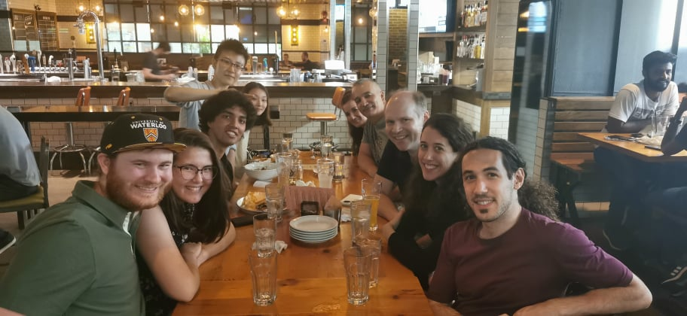
MDSAI PROGRAM DIRECTOR & CLASS AMBASSADOR
Duties
Monthly board meeting with Math GSA
Arranging events for students of the MDSAI program
One-year program = one-year service time
What it brings to me
Building up connections inside or outside the MDSAI program
Helping others by volunteering as panelists
Running for the position!
An email will be sent out for the election (September, 2021) from Math GSA
T

Slide 41
VECTOR INSTITUTE
Johannah Thumb

Slide 42
What Does Vector Institute Do?
World-Class Research
Hiring top AI scientists
Publishing & presenting in top conferences and journals
Computing resources (800+ GPUs)
Growing community of over 600 Vector researchers including Faculty, Affiliates, Students and collaborators
Work with Industry
Upskill their technical and business professionals through industry-focused AI training
Collaborate with Vector researchers and other industry sponsors on hands-on AI projects with applications to real business problems
Consult with top Vector researchers for guidance on specific AI-related challenges
Academic Partnerships
Working with Ontario universities to deliver more AI master’s programs and graduates to grow the workforce
Support AI master’s students in career exploration, networking, and securing meaningful employment in industry
Work with the Health Sector
Create opportunities for AI research and widespread applications stemming from Ontario’s large single-payer health system
Supporting the establishment of private and secure analysis-ready health data infrastructure for research; health system improvement projects

Slide 43
Vector Recognized AI-Related Programs
The MDSAI and M.Math in Data Science programs are recognized by the Vector Institute as delivering a curriculum that equips its graduates with the skills and competencies sought by industry
Your programs’ curricula was reviewed by a committee of Vector faculty and industry representatives working in AI.
Recognized programs may be in core-technical (typically STEM) or complementary areas (e.g. business or health) and may have an applied or research focus.

Slide 44
Vector & YOU: Benefits to AI Master’s Students
Opportunities to learn about career pathways and projects in AI including exploring specific industries and topics such as our upcoming event on Research & Careers in AI: Health (November 10)
Build a strong network to support you throughout your career through networking opportunities with other students, researchers, industry professionals, recruiters, and more!
Career exploration and recruitment-focused events such as our annual Vector AI Master’s Summit & Career Fair on September 23rd and information sessions with individual employers throughout the year

Slide 45
Vector & YOU: Benefits to AI Master’s Students
Career support activities to support you in preparing for your internship/job search or career transition
Exposure to leading AI research and best practices through events and our video archive including Fields Talks, past Research & Careers in Events, research talks from top faculty and practitioners in AI
Access to Vector’s paid Applied Internship Program and work at Vector on real-world data and AI-related projects across workstreams including Health, Engineering, Industry Innovation, and Academic Partnerships
Join the Vector alumni network post-graduation and continue to receive the support of Vector’s community through events and networking opportunities throughout your career

Slide 46
Vector’s Digital Talent Hub: Why Create a Profile?
View a Curated Job Board for AI Roles
Let Employers Find You Through Our Candidate Database
Use Your Linkedin Profile to Sign Up in Under 5 Minutes
One Source for Internships, Co-ops, Full Time Roles and Fellowships
Set Job Alerts and be Notified When Specific Types of Jobs are Posted
Differentiate Your Application through Restricted Jobs
Link to Recruitment Events
Notes:
Why Create a Profile?
Curated job board for AI roles
Applying to public and restricted AI job opportunities, including Internships, Co-ops and Full Time Roles.
Allowing employers access to your profile for passive recruitment opportunities.
Setting up automated job alerts to automate your job search.
With restricted jobs – your application is differentiated for recruiters
Sign up with Linkedin in under 5 minutes
Links to in-person recruitment events.

Slide 47
Stay in Touch with Vector Directly!
Email us at aimasters@vectorinstitute.ai
Hear about events, upcoming internships at Vector, career opportunities, and more! https://bit.ly/aisummit2021
Recordings of past events on our Youtube channel

Slide 48
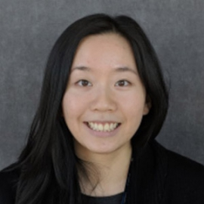
QUESTIONS?
Johannah Thumb,
Vector Institude
J
Notes:
Event note – refer to email

Slide 49
CO-OP AND INTERNATIONAL EMPLOYMENT
Bettina Wahl

Slide 50
LOOKING FOR WORK IN CANADA: CO-OP WORK PERMIT FOR WORKING IN CANADA
You MUST have a valid co-op work permit to undertake a work term in Canada
On-campus or off-campus; paid or volunteer
If working from within Canada for an international employer
If counted towards co-op, work can be done only on a co-op work permit
You DO NOT need a valid co-op work permit if working remotely from outside Canada for a Canadian employer,
Review COVID-19 travel allowances carefully
Your study permit is NOT a valid work permit for co-op work terms
Whether your work is counted towards co-op credit, or not (part-time, unpaid, etc.)

Slide 51
LOOKING FOR WORK IN CANADA: CO-OP WORK PERMIT FOR WORKING IN CANADA
You must submit a copy of your work permit to Co-op Ed (CE) for recording on your file
Send to: ceeivsies@uwaterloo.ca
Apply NOW – if you’re within Canada and you haven’t already!!!
Email CE for any questions/procedure of application: ceeivsies@uwaterloo.ca
For any additional immigration-related support, contact the SSO’s Immigration Consultants

Slide 52
STUDENT SUCCESS OFFICE
Karry Kwan

Slide 53
STUDENT SUCCESS OFFICE (SSO): INTERNATIONAL SUPPORTS
The following supports for international students are available through the SSO:
International Student Experience
International Student Guide
(including travel and
quarantine resources)
International Student Connection e-Newsletter
International Student Online Discussions
International Peer Community (IPC)
UWinterloo
Immigration Consulting
Online same-day appointments with a registered Immigration Consultant
Immigration Information Sessions
Campus-wide
support
Campus-wide international student initiatives
Work with Faculty-based Academic Advisors
International student F.A.Q.s on the Coronavirus Information website
Notes:
Within the Student Success Office, we have small but dedicated teams working on bringing answers and clarity to international students, supporting their access to programs, and creating a sense of community to help combat possible feelings of loneliness or isolation. Due to COVID-19, many of our supports and programs have moved online. The plan is to resume having them in-person as soon as it is deemed safe to do so.
The International Student Guide [https://uwaterloo.ca/isg] aims to:
help you understand the steps needed to prepare for travel or to begin your studies (e.g. immigration documents required, Canadian culture or how to get ready for school), and
provide information on programs and services available to you at the University of Waterloo, including checklists and many other resources such as information on how to open a bank account or get a cell phone plan, not to mention our newest resource – “How to make a quarantine plan”
One great way to stay informed of events and important news is to sign up for our monthly International Student Connection e-newsletter. Through the e-newsletter, you can find out about our informative events such as the International Student Online Discussions!
These online discussions [link: https://uwaterloo.ca/student-success/international-student-resources/online-discussions] (previously known as International Student Breakfast Seminars when they were held in person) are community-centered discussions where international students and scholars can meet new people, share experiences, and learn about topics that are relevant to where they are at in the term.
Past topics include:
Adapting to the Canadian classroom
Self-care and physical activity
Embracing a Canadian winter
Finding a job in Canada
Filing your taxes in Canada
The International Peer Community [https://uwaterloo.ca/sso/ipc] is a peer support program aimed at helping international students settle in and feel at home, regardless of whether they are physically in the City of Waterloo or in their home country. IPC [as it’s commonly referred to for short] events help students build support networks and develop a sense of community belonging. Over the Fall term, we will be hosting some exciting virtual events such as our Coffee Chats, Games Nights, Foodie Friday and many more. Sign up today to participate in the fall term if you haven’t done so already: https://uwaterloo.ca1.qualtrics.com/jfe/form/SV_6mnDftdIntGSffo
UWinterloo is a program held during the month of December to connect international students with others who are staying on campus over the holidays. *When this program was held virtually last year, a pen pal program was introduced that paired international students up with domestic students, staff, faculty and alumni. Given its success, the Student Success Office may run the program – called “Pen-demic Pals” – again this December if the situation with the pandemic necessitates that we continue being virtual. More information about UWinterloo 2021 will be available later in the term.

Slide 54
STUDENT SUCCESS OFFICE: INTERNATIONAL STUDENT SUPPORT
Immigration Consultants
Ask questions about study permit conditions and policies for working as an international student in Canada
Get help with your immigration-related applications (i.e. study permit extension, co-op work permit and/or post-graduation work permit)
Receive immigration support for graduate student dependants and information on how to invite your family to visit
Submit a web form inquiry to our team of consultants: uwaterloo.ca/student-success/ask-immigration-consultant
Remote same-day appointments are available Monday – Friday, 10:00 a.m. to 4:00 p.m. You can sign-up via Waterloo’s Portal app; registration starts at 8:00 a.m. each weekday
Register your immigration status through Portal’s Immigration Document Reminder System. (click on the goose icon and enable the “Are you an International Student?” switch)

Slide 55
STUDENT SUCCESS OFFICE: INTERNATIONAL STUDENT SUPPORT
Immigration Information Sessions
Immigration Consultants also host weekly Immigration Information Sessions on a number of topics. You can sign up via Waterloo’s Portal app.
These sessions are held online through Microsoft Teams. After registering, you will receive a direct Microsoft Teams link to join approximately 20 minutes before the session begins.
Spaces are limited, so sign up soon!
Sessions on offer for Fall 2021 term
Co-op Work Permit
COVID-19 Immigration Updates
Post-Graduation Work Permit (Grad)
How to Apply for a New Temporary Resident Visa (TRV)
Pathways to Permanent Residency

Slide 56
QUESTIONS?
Karry Kwan,
International Student Programs Specialist
Bettina Wahl,
International Employment Specialist
S

Slide 57
NEXT STEPS

Slide 58
How to connect with your cohort
Telegram App
Download the Telegram App.
Join the conversation here:
https://t.me/joinchat/yZMH5YMhGWwyZTI1

Slide 59
NEXT STEPS
Courses officially start next Tuesday, September 8th! You should be enrolled in 3 courses by now (+ remedials if applicable) - deadline to enroll is Sep 28
Attend Math Grad Orientation on Tuesday September 7th. Registration was due using your @uwaterloo.ca email on Tuesday, August 24^{th.}
Start thinking about your course sequencing past this term.
Ensure you mark ALL co-op workshops (for MDSAI full-time students) and ethics workshops (all DS students) in your calendar:
Workshop | Date | Time
Ethics Workshop 1 | Tuesday, October 26th | 9am – 12pm ET OR 2pm – 5pm ET
Ethics Workshop 2 | Tuesday, November 2nd | 9am – 12pm ET OR 2pm – 5pm ET
Ethics Workshop 3 | Tuesday, November 9th | 9am – 12pm ET OR 2pm – 5pm ET
Co-op Documents (Résumés, cover letters) workshop | Tuesday, September 28 | 10 am – 11:30am
Interviews workshop | Thursday, October 7 | 10am – 11:30am
Co-op Education process & strategy workshop | Friday, October 15 | 10am – 11:30am
S

Slide 60
NEXT STEPS
Complete online mandatory training modules
Check your UW email and update Quest personal information
International students:
Get in touch with The Centre for help with immigration documents, SIN, health insurance, etc.
Apply for a co-op work permit if you haven’t already.
Delivery | Course ID | Duration
Online – Safety Office | Employee Safety Orientation (SO1001) | ~60 min
Online – Safety Office | WHMIS 2015 (SO2017) | ~45-60 min
Online – Safety Office | Workplace Violence Awareness (SO1081) | ~60 min
Online – LEARN (for TAs only) | Accessibility Training module | ~30 min
Online – LEARN | Graduate Academic Integrity Module | ~1-2 hours
S

Slide 62
Virtual Intros!
Let’s meet each other!

Slide 63
VIRTUAL INTRODUCTIONS
Roundtable Introductions:
Your name
Where you are from
What you were doing before graduate studies
Why you decided to apply for MDSAI/MMath
A fun fact about yourself / 2 truths & 1 lie
Notes:
Normally, we would go around the table to introduce ourselves however, to do this virtually, we’ll be using a tool called Mentimeter. In Mentimenter you will get the chance to introduce yourself by stating your name, where you’re from, what you were doing before, why you decided to apply, and a fun fact about yourself. You’ll have 5 minutes and as the submissions come up, I will ask some of you to share or elaborate.

