Slide 1
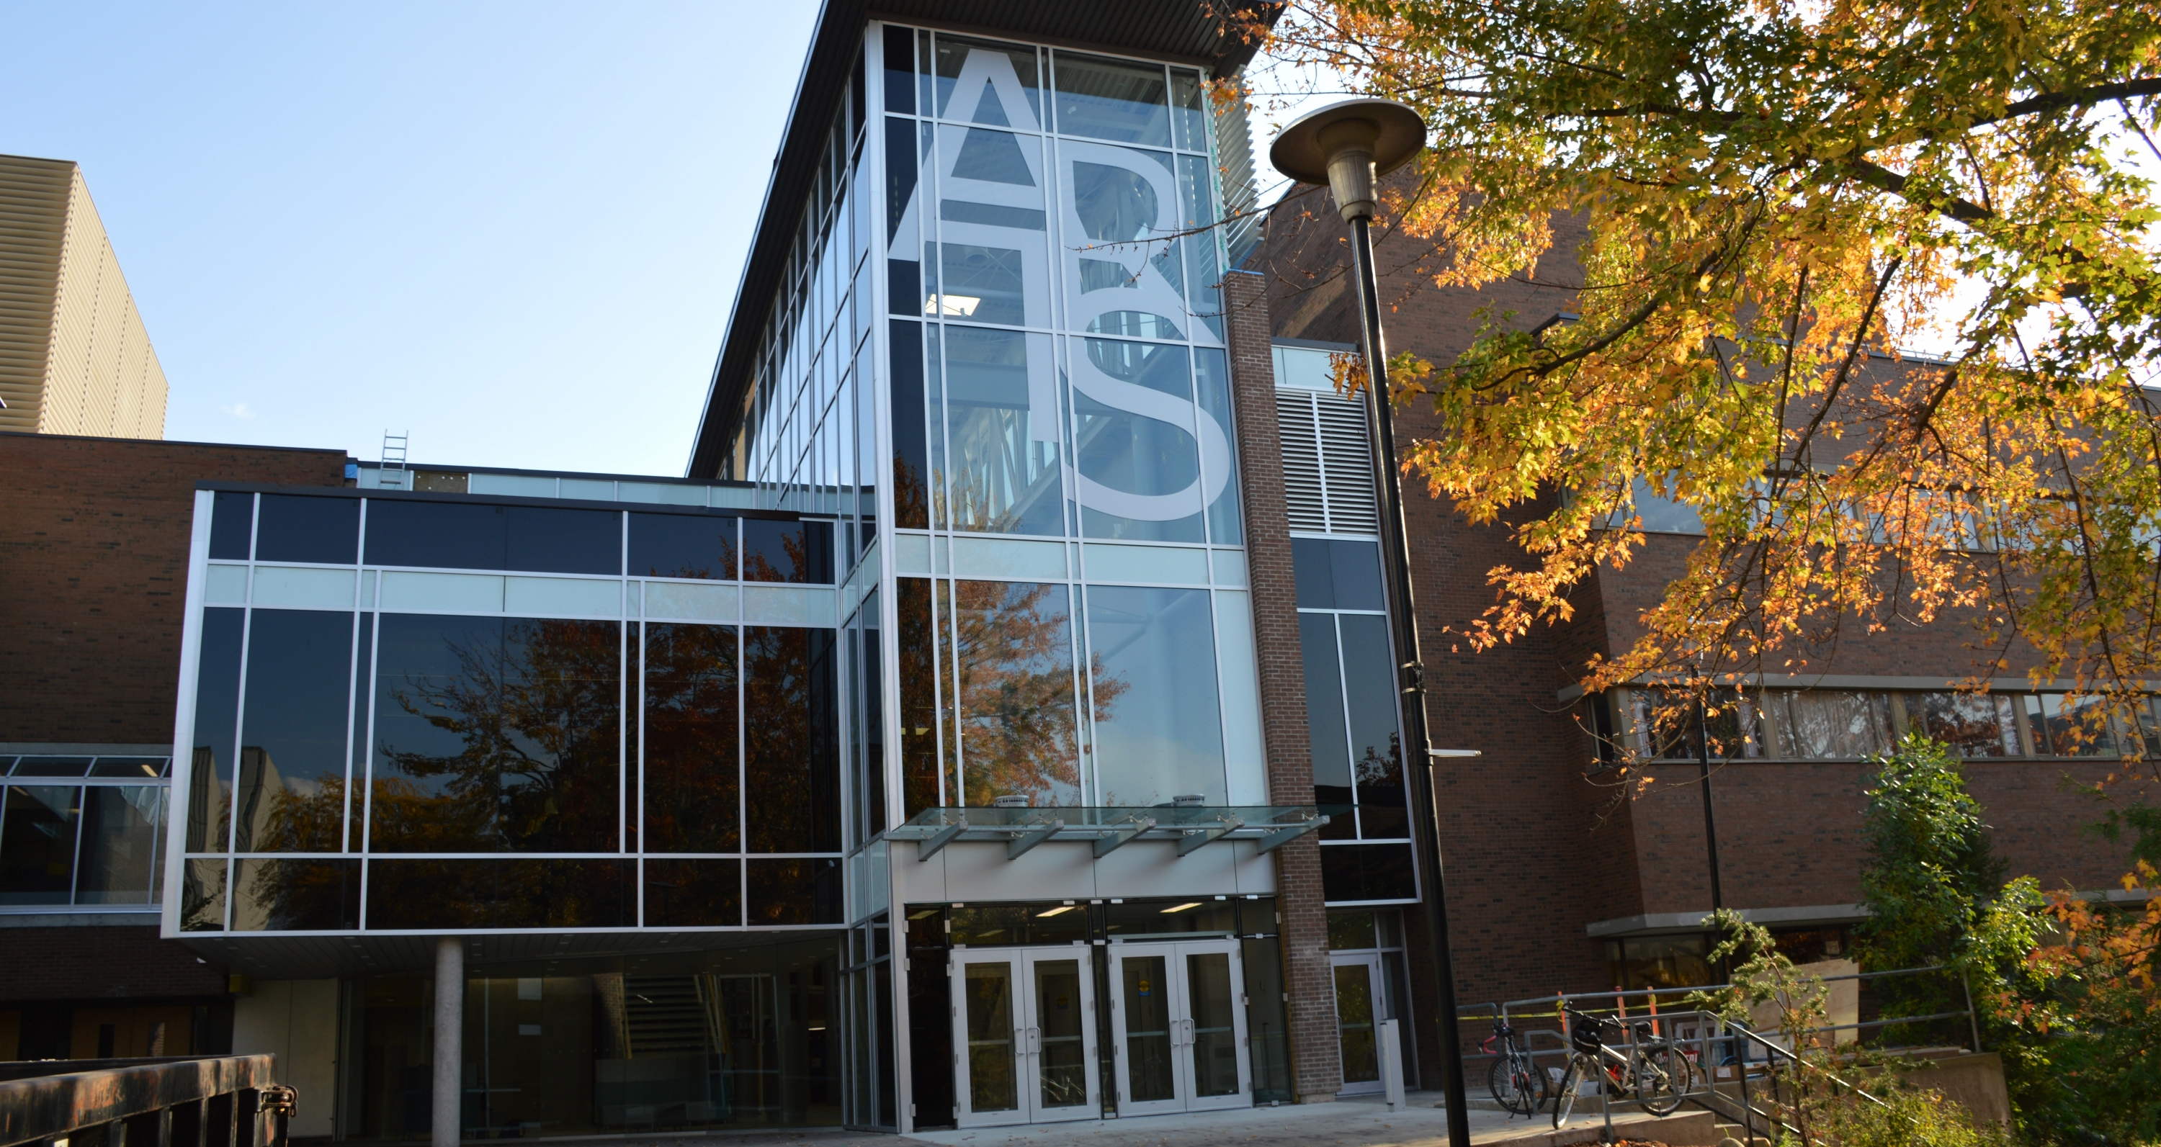

Economics 2+2 Meet and Greet
2025

Slide 2
Resources & IMPORTANT DATES
Pierre
Chausse
Marilena Strambu
Julie Pocock
TRANSFER CREDIT QUESTIONS
Marilena.strambu@uwaterloo.ca
Jpocock@uwaterloo.ca
2+2 PROGRAM QUESTIONS
pierre.chausse@uwaterloo.ca
Please CC’ Pierre
Zoe
Cleeves
Priya
Vyas
OTHER ADVISING QUESTIONS
econugadv@uwaterloo.ca
3
19
19
SEPTEMBER
START OF CLASSES
SEPTEMBER
WINTER COURSE SELECTION
NOVEMBER
WINTER DROP/ADD

Slide 3
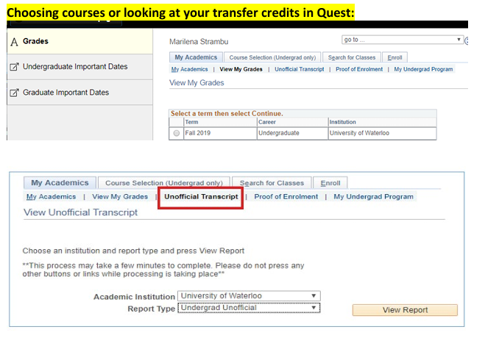
Transfer Credits
A MAXIMUM OF 20 COURSES CAN BE TRANSFERRED.
WE CHOOSE THE BEST COURSES TO TRANSFER BASED ON WHAT IS NEEDED FOR YOUR PROGRAM.
FOR EXAMPLE, WE TRY TO TRANSFER AS MANY OF THE BREADTH REQUIREMENTS AS POSSIBLE.
FEEL FREE TO CONTACT US IF YOU WANT TO CHANGE THEM BY CONTACTING MARILENA AND PIERRE.

Slide 4
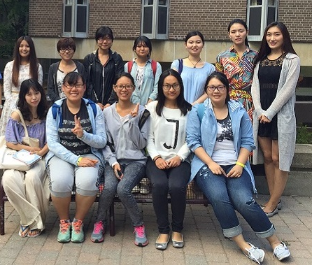
HONOURS ECONOMICS + Intensive specialization
11
5
CORE COURSES
ELECTIVE COURSES
16
70%
ECON COURSES TOTAL
FIRST FALL: ECON 290, ECON 322 AND EMLS
FIRST WINTER: ECON 391, ECON 323
SPRING TERM: ECON 306, ECON 393*
SECOND FALL & WINTER: ECON 406/7/8/9 AND TWO 400-LEVEL ELECTIVES
ADD ELECTIVES AND ARTS BREADTH REQ. TO ABOVE
COURSES ADDITIONAL TO THIS WILL DEPEND ON YOUR INDIVIDUAL TRANSFER CREDITS

Slide 5
HONOURS ECONOMICS
16
5
CORE COURSES
ELECTIVE COURSES
21
75%
ECON COURSES TOTAL
FIRST FALL: ECON 290, ECON 322 AND EMLS
FIRST WINTER: ECON 391, ECON 323,
SPRING TERM: ECON 306, ECON 393
SECOND FALL:
SECOND WINTER:
SECOND FALL OR WINTER: ECON 406/7/8/9 AND TWO 400-LEVEL ELECTIVES
ECON 392
ECON 491
ECON 496
ECON 421
ECON 472

Slide 6
HONOURS MATHEMATICAL ECONOMICS
13
60%
MATH AVG
MATH COURSES
16
70%
ECON COURSES TOTAL
ECON AVG
FIRST FALL: ECON 290 AND EMLS
FIRST WINTER: ECON 391, ECON 392
SPRING TERM: ECON 306, ECON 393*
SECOND FALL: ECON 491, 406/7/8/9, 4XX
SECOND WINTER: ECON 496, 472, 4XX
A minimum of 7 courses from the MATH Faculty
ADD ELECTIVES AND ARTS BREADTH REQ. TO ABOVE
EXAMPLE: EXACT PLAN WILL DEPEND ON YOUR TRANSFER CREDITS

Slide 7
SPECIALIZATIONS IN ECONOMICS
ECONOMETRICS
FINANCE
PUBLIC POLICY
TWO OF THE FOLLOWING:
ECON 422
ECON 423
ECON 424
ECON 425
ECON 421/STAT 321/STAT 331
NEED TO HAVE ECON 323
ECON 372* AND THREE OF THE FOLLOWING:
ECON 332
ECON 406
ECON 423
ECON 424
*ECON 371 IS A PREREQ FOR ECON 372
ECON 361, ECON 441 AND TWO OF THE FOLLOWING:
ECON 351
ECON 363
ECON 366
ECON 436
ECON 443
ECON 445
ECON 451
ECON 452
ECON 456
ECON 457
ECON 471
IF YOU WANT TO DECLARE A SPECIALIZATION, INFORM YOUR ADVISOR AS SOON AS POSSIBLE

Slide 8




Get involved & get support
UW ECONOMICS
ECON-NECTION
STUDENT SUCCESS
ACADEMIC
SOCIETY
MENTORSHIP
OFFICE
ADVISORS

Slide 9
Helpful LINKS
Helpful links for current students: https://uwaterloo.ca/pathway/current-students
Academic Calendar: Academic Calendar
Academics for undergraduate students: Academics for U/G students
Academic Advisors: https://uwaterloo.ca/the-centre/academics/academics-undergraduate-students/academic-advisors
Accessibility- Student support services: https://uwaterloo.ca/accessibility/support-services/accessibility-students
Bachelor of Arts Degree Requirements (Arts): Bachelor of Arts Degree Requirements
Forms: https://uwaterloo.ca/the-centre/forms-and-official-documents/forms-undergraduate-students
Immigration and residency support:https://uwaterloo.ca/the-centre/immigration-and-residency and
https://uwaterloo.ca/international-experience/immigration-consulting/ask-immigration-consultant
Important dates: Important dates
LEARN: https://learn.uwaterloo.ca/d2l/home
Undergraduate Schedule of Classes: https://classes.uwaterloo.ca/under.html
Offices and Services: https://uwaterloo.ca/offices-services
Programs & Plans: Programs & Plans Student Financial Services: https://uwaterloo.ca/finance/student-financial-services
The Student Service Centre - THE CENTRE: https://uwaterloo.ca/the-centre

Slide 10

Canada’s Innovation University

