Slide 1
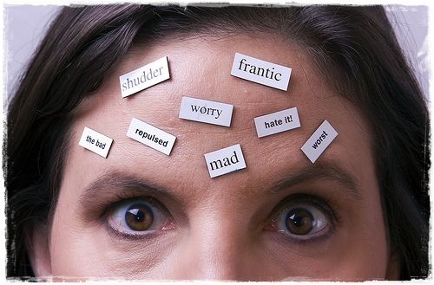
Wellness Hack – Negative Thinking
Designed by: The Engineering Wellness Team

Slide 2
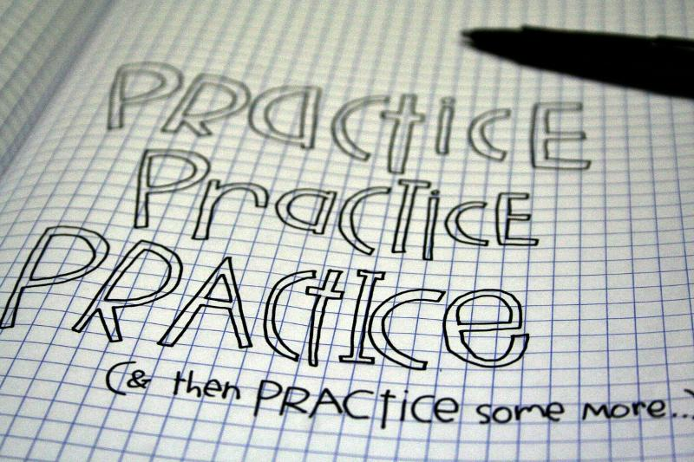
Negative thinking can negatively impact your academic performance!
We are the Products of our Thoughts
Taking the Positive Route
Practice makes Perfect(ish)
Our internal monologue governs so much about how we think, feel, and act. What we think has a powerful effect on our lives and how we feel. While it’s common to trust our inner-selves, the truth is that our thoughts have a tendency to deceive us!
It’s not easy to think positively in the face of overwhelming negativity or adversity. Fortunately, there are many ways you can modify your thought path either through self-compassion/improvement or professional support.
Behaviours that are automated and routinized become our habits. Habit change is realized through consistent effort and practice. Think about how long it took for you to form a negative perspective. Switching to more positive thinking will also take time!
Notes:
We are the Products of our Thoughts
Researchers estimate we have anywhere between 30,000-80,000 thoughts each day with 80% of them repeated.
When we’re caught in a negative spiral (or confronted with a negative or unpleasant situation), the intensity and frequency of negative thoughts increase.
Negative thoughts can impact both mental and physical health. Negative thinking can fuel anxiety which could also lead to increases in our body’s stress response (sympathetic nervous system).
Taking the Positive Route
Negative thinking can be mitigated or reduced using self-care methods or through the help of another.
By being more compassionate and forgiving of yourself, you can reduce the frequency and intensity of negative thoughts.
Positive thinking leads to life-long benefits such as; reduced rates of depression, lower levels of distress and stress overall, improved cardiovascular health, and even an improved immune system!
Practice Makes Perfect(ish)
Habits are routine behaviours and actions that have become automated.
Habits are useful when they benefit us (like not having to consciously think about and look at where the break pedal is in a car), but can have disastrous impacts when they work against us (cigarette cravings or triggers).
We can ‘rewire’ the neural links in our brains which form automated habits through consistent (and conscious) effort and practice. The first step is being mindful of the habits and behaviours that you want to change – like your negative thinking or pessimistic outlook!
Don’t get discouraged if change isn’t realized instantly. Like all habits, positive ones also take time to form. Take it in baby steps!

Slide 3
Common Thinking Errors (Distortions)
All-or-Nothing Thinking (aka. Black and White thinking) – Thinking of things in absolute terms like, “always”, “every”, or “never”. Few aspects of human behaviour (and life) are so absolute.
Overgeneralizations – Taking isolated cases and using them to make wide generalizations. For example, you see a single negative event as a never-ending pattern of defeat.
Negative Mental Filter – Focusing exclusively on certain, usually negative or upsetting, aspects of something while ignoring everything else. For example, you selectively hear the one tiny negative feedback surrounded by all of the positive remarks.
‘Shoulding’ – Shoulding is focusing on what you can’t control. Obsessing on what you think ‘should’ or ought to be rather than the actual situation you are faced with. Learn to work with “What is”.
Disqualifying the Positive – Continually shooting down positive experiences for arbitrary, ad hoc reasons. Maintaining a negative belief that is contradicted by your everyday experiences.
Labelling and Mislabeling (similar to overgeneralizations) – Rather than describing a particular or specific behavior, you assign a label to someone or yourself that is represented in absolute and unalterable negative terms.
Notes:
These are simply the most common thinking errors that we often engage in. See if any in particular are familiar to you. Being aware of your thoughts is the first step towards positive habit change!

Slide 4
Common Thinking Errors (Distortions) continued…
Magnification & Minimization – Exaggerating negatives and understating positives. Often the positive characteristics of other people are exaggerated and negatives understated (think social media). A subtype of magnification – catastrophizing – is focusing on the worst possible outcome, however unlikely, or thinking that a situation is unbearable or impossible when it is really just uncomfortable.
Emotional Reasoning – Making decisions and arguments based on how you feel rather than objective reality. Those who allow themselves to get caught up in emotional reasoning can become completely blinded to the difference between feelings and facts.
Personalization & Blaming – Personalization occurs when you hold yourself personally responsible for an event that isn’t entirely under your control. On the flip side of personalization is blaming – some people blame others or their circumstances for their problems and tend to overlook ways that they themselves are contributing to the problems.
Jumping to Conclusions – Assuming something negative where there is actually no evidence to support it. Two specific subtypes are also identified:
Mind Reading – assuming the intentions of others.
Fortune Telling – anticipating that things will turn out poorly. You feel convinced that your prediction is an already established fact.
Notes:
These are simply the most common thinking errors that we often engage in. See if any in particular are familiar to you. Being aware of your thoughts is the first step towards positive habit change!

Slide 5
Migrating to Positive Thinking
1. Maintain Awareness
2. Challenge your Thoughts
3. Use Available Supports
The key to any positive habit change is self-awareness. You won’t feel the need to change if you don’t see anything worth changing! Be mindful of your thinking and see if you catch yourself falling into the thinking errors trap.
The strategy of challenging your thoughts shifts you away from thinking emotionally and moves you into thinking more logically. This allows you to see a different perspective, think clearer, and shift your impulsive emotional responses. This will take time and practice before the results are more automatic.
As much as we may try to convince ourselves, sometimes it’s best to hear it from someone you trust, respect, and know. We’re our own worst critics after-all! What would a friend say to your negative thoughts? If you need some tips, see the resources slide!
Notes:
Maintain Awareness
Recognize when you are thinking overly negatively or anxiously. Try to identify some ways in which your negative thoughts might not be the most accurate.
Writing your thoughts down (perhaps in a journal) helps you process them as they occur. As you become more practiced in identifying your negative thoughts, you won’t need to write them down as often as you’ll be able to process them more quickly and migrate to a more balanced mindset.
Challenge your Thoughts
Developing more balanced thinking takes time. Your overly negative thinking patterns were formed over time and it will take time and practice (consistent practice) to change this. Don’t get discouraged!
The goal is not to develop unrealistically inaccurate super-positive thoughts either. The ideal is to achieve a balance. When considering a thought, ask yourself if it is possible that a negative belief and a positive belief about the situation can both be true. For example, is it possible to be rejected by a romantic partner and still have people in your life who love and value you?
Use Available Supports
Support networks are important for overall wellbeing and for working through positive habit change (like changing your negative thought patterns). Reaching out for help when you need it is OKAY!
Consider consulting a friend, loved one, family member, or professional support regarding your negative thoughts, especially if they are frequently impacting you in negative ways. Sometimes the perspectives of others can help reveal more about our situation than we previously understood.
It is easier to mitigate negative thinking when you aren’t in a state of panic or distress. When your anxiety or stress is very high, look towards relaxation strategies first!
Habit change is best realized through accountable action. Do you have someone in your friend group, family, or support network that can help talk through the difficult moment you are experiencing? Anyone who you can share your negative thoughts with to hear their opinion?

Slide 6
Challenging your Negative Thoughts
There are different methods that you can use to challenge your negative thoughts. Below are just a few:
Challenging Thinking Questions:
Am I being objective? Am I looking at the whole picture? Is this a helpful way of thinking?
If what I predict happens, what would that mean to me? What would realistically happen next? How would I cope?
What is the worst that can happen? What is the best that could happen? What is most likely to happen?
Perspective Taking Questions:
How would someone who isn’t anxious view this same situation?
How would someone who cares about me view this situation? What would they say to me?
What would I say to a loved one who was having the same negative thoughts?
Positive Coping Statements:
I’ve felt like this before, and it goes away with time. This too will pass.
I know what is happening and how my body is reacting. I just need to breathe through this.
I can survive this. I’ve done it before!
Notes:
Our brains have an interesting way of viewing the world, as they have a tendency to err on the side of negativity and caution more often than positivity and optimism. After-all, back in primeval days our brains had to be overly critical otherwise a wrong move would have resulted in a timely demise. However, in the 21st century we’re not as exposed to physically threatening phenomena as we once were, but our brains (the pre-frontal cortex) haven’t quite caught up. We’re hardwired to see the negative more than the positive as the negative could have (back in the day) literally eaten us! Thankfully, your assignments, midterms, and exams aren’t out to get you!
Within this slide are but a few examples of ways that you can challenge your negative thoughts in the moment and regain clarity. Try challenging the negative thought directly by breaking down the elements or try viewing your situation from a different perspective by asking meaningful questions. Positive coping statements can help reduce stress and negative thoughts while practicing self-compassion and care. Don’t be your own worst critic – be your own best friend! Being as kind to ourselves as we are to others is a great step in moving towards a more positive lifestyle!

Slide 7
Resources and Supports for Mitigating Negative Thoughts
Campus Wellness – Counselling Services
MATES Peer Support
Contac the FoE Wellness Team (ENGWellness@uwaterloo.ca)
ENGSoc Mental Health Supports webpage
Includes ‘How to’ mental health guide for UW campus
Includes information regarding Waterloo Regional Supports
Additional Resources from Campus Wellness:
In-person Workshops and Seminars
Online Workshops
Challenging Thinking handout (PDF)
Regional (Waterloo Region) Support Services – external database from Campus Wellness
Notes:
If you are not sure what you need, or where to start, please reach-out to your Academic Advisor or the FoE Wellness Team (ENGwellness@uwaterloo.ca). They can help guide you to what you need.

