Slide 1
Creating Your Wellness Team
Designed by: The Engineering Wellness Team
Notes:
Introduction:
There is on old expression that “no one is an island”. The expression refers to the fact that none of us live in isolation. Our lives and wellbeing are a dynamic flow of people and events that impact them.
Wellness is not something we achieve alone. Many people contribute to that wellness, from our hair dresser, coffee barista, to friends, family, services, and professional roles such as doctors, lawyers, accountants, counsellors and more.
Part of wellbeing is having a team of people we can call on in times of need. It is important to know who we can go to for what types of issues. It is helpful to identify these people BEFORE we need them. Let’s talk about who is on your team.

Slide 2
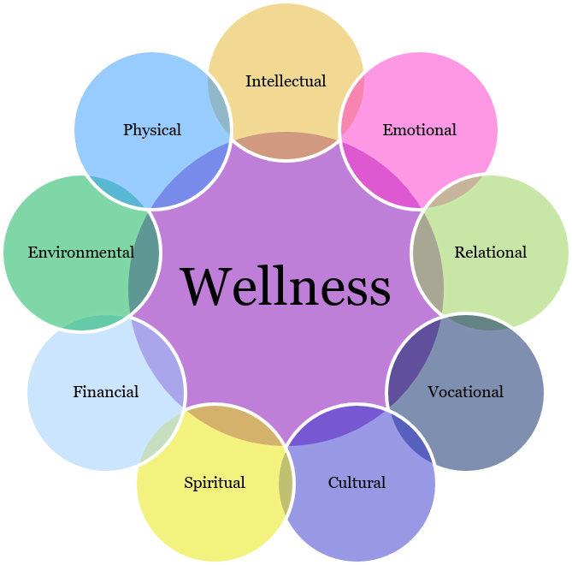
What is a Circle of Care (or Wellness Team)?
A circle of care is a group of people who hold a combination of professional (doctors & accountants) and non-professional (friends & family) roles who we can go to for support, help, insights, treatment, and/or referrals. We all NEED a team!
Identify Needs in all 9 dimensions of wellbeing
Professional Team Members
Non-professional Team Members
Wellness has many aspects. Take some time to identify your needs in each of the dimensions. Create a quick reference guide with the names and contact information of people who could help you with the needs you identified.
Identify professionals (on and off campus) who could provide recommendations, advice, or (if needed) treatment, in these areas, such as doctors, occupational therapists, counsellors/therapists, accountants, personal trainers, nutritionists, chaplains, and so on.
Identity individuals (on and off campus) that you can access for support, help and/or referrals. These could be services or staff, classmates, family and friends, TAs or faculty, or peer supports such as Mates and Move Your Mind.
Notes:
Our Wellness Team is also our Circle of Care. This is a group of people who can help us. We are also part of other people’s circle of care. Be sure to let your friends, family, and classmates know what you can help them with.
Start thinking about the 9 dimensions of wellness (intellectual, emotional, relational, vocational, cultural, spiritual, financial, environmental, and physical.) What are some of your needs in each of these areas. Who or what could help you meet those needs? Then create a quick reference guide with names and contact information
Be sure to include professionals/services you might pay for, as well as friends, family and classmates you could call when you just need to chat, or need help moving, or are looking to hang-out and do something fun.

Slide 3
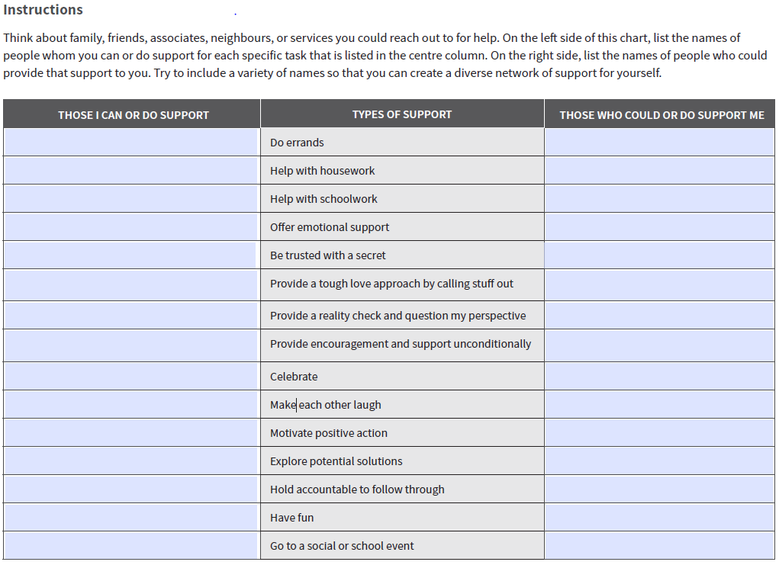
Who’s on Your Team?
Source: From Surviving to Thriving: Developing academic resilience. Free resource for post-secondary students.
Notes:
This is an exercise that can be found in From Surviving to Thriving: Developing academic resilience. It is a free resource for post-secondary students offered through the Great-West Life Centre for Mental Health. There are other wonderful exercises in the booklet. You can download the book for free.
This is an example of some of the things you might have on your quick reference guide. You will want to create a similar page for professional support such as counsellors, doctors, dentists, optometrist, etc.

Slide 4
How do I ask for help?
Asking for help can be uncomfortable. Below are 11 tips that might make asking easier:
Remember that we are all human and need help from time to time
Asking for help early offers a greater likelihood of success
Asking for help proactively is a sign of strength and wisdom
Review the names on your Wellness Team. Who could you talk to about your situation?
Is there a service (on or off-campus) that addresses the very issue you have? If so, those folks are accustomed to helping people in your situation and are likely to be more open, supportive, and less judgmental.
When you ask for help, be respectful, ask directly for what you need (don’t make the person guess).
Listen and take-in what the other person says. Try not to dismiss the suggestions out-right. If you see a challenge with the suggestion ask “how could I overcome ____ barrier so I could use your suggestion?”
Demonstrate that you have tried to help yourself. Be willing to tell the person what you tried and the outcome.
Give help to others. If you give more help than you ask for, it becomes easier to ask.
Take a deep breath, and go for it. If the person cannot help you, you are in the same situation. If they can help you, you have improved your situation. You have nothing to lose and everything to gain.
Celebrate the fact that you were brave and asked!
Notes:
Asking for help can feel uncomfortable and embarrassing. Many of us have received negative messages about asking for help. We can be afraid of what others will think. Asking for help can make us feel vulnerable and even exposed. Sometimes, we just think we can handle it ourselves. However, continuing to struggle until its too late has it’s own consequences. If you wait too long to ask for help, you will often receive the response “you should have asked sooner”.
Is there anything you would add to the list? What else works?

Slide 5
Practice Safe Stress! (Free resource from the Great-West Life Centre for Mental Health)
From Surviving to Thriving (Workplace Strategies for Mental Health) (PDF)
Notes:
This is the booklet From Surviving to Thriving: Developing academic resilience. It is a free resource for post-secondary students offered through the Great-West Life Centre for Mental Health. There are other wonderful exercises in the booklet. You can download the book for free from the link provided. It has a number of other exercises and tips you might find helpful.

Slide 6
Resources to Expand your Wellness Team
ENG Student Wellness Coordinators (email: ENGWellness@uwaterloo.ca)
Campus Wellness
Health Services
Student Health Pharmacy
AccessAbility Services
Student Success Office
Waterloo Athletics
UW Chaplains Association
Move Your Mind
Eating Well (Campus cookbook)
Waterloo Student Food Bank
Mates (Peer Support)
Glow Centre for Sexuality and Gender Diversity
ENG Soc Mental Illness How-to For Waterloo
ENG Soc Mental Health Resource Bank
Sexual Violence Prevention and Response Office
Centre for Mental Health Research and Treatment
Campus Housing Student Wellness
The Big List of Self-Care and Distraction Activities
Mental Health and Wellness Canada
Off campus recourses (links to several)
Here 24/7 Crisis Help Line (Kitchener-Waterloo)
Good2Talk Crisis Help Line (Ontario)
Crisis Services Canada (Phone, text, chat)
Crisis Text Line
Canadian Mental Health Association (Waterloo Wellington)
Canadian Mental Health Association Self-Help and Peer Support
McGill University (Self-guided help)
Waterloo Undergraduate Student Association (WUSA) – 400 clubs
Supports and Resources for Co-op
Student Awards & Financial Aid
Budgeting Basics
Understanding Mental Health (Lumenus)
Wellness Module 1: Mental Health Matters (Here to Help)
Resilience Research Centre (Dalhousie University)
The Road to Resilience (American Psychological Association)
Self-compassion (Information and guided medications)
Notes:
If you are not sure what you need, or where to start, please reach-out to your Academic Advisor or an Engineering Student Wellness Coordinator (ENGwellness@uwaterloo.ca). They can help guide you to what you need.

