Slide 1
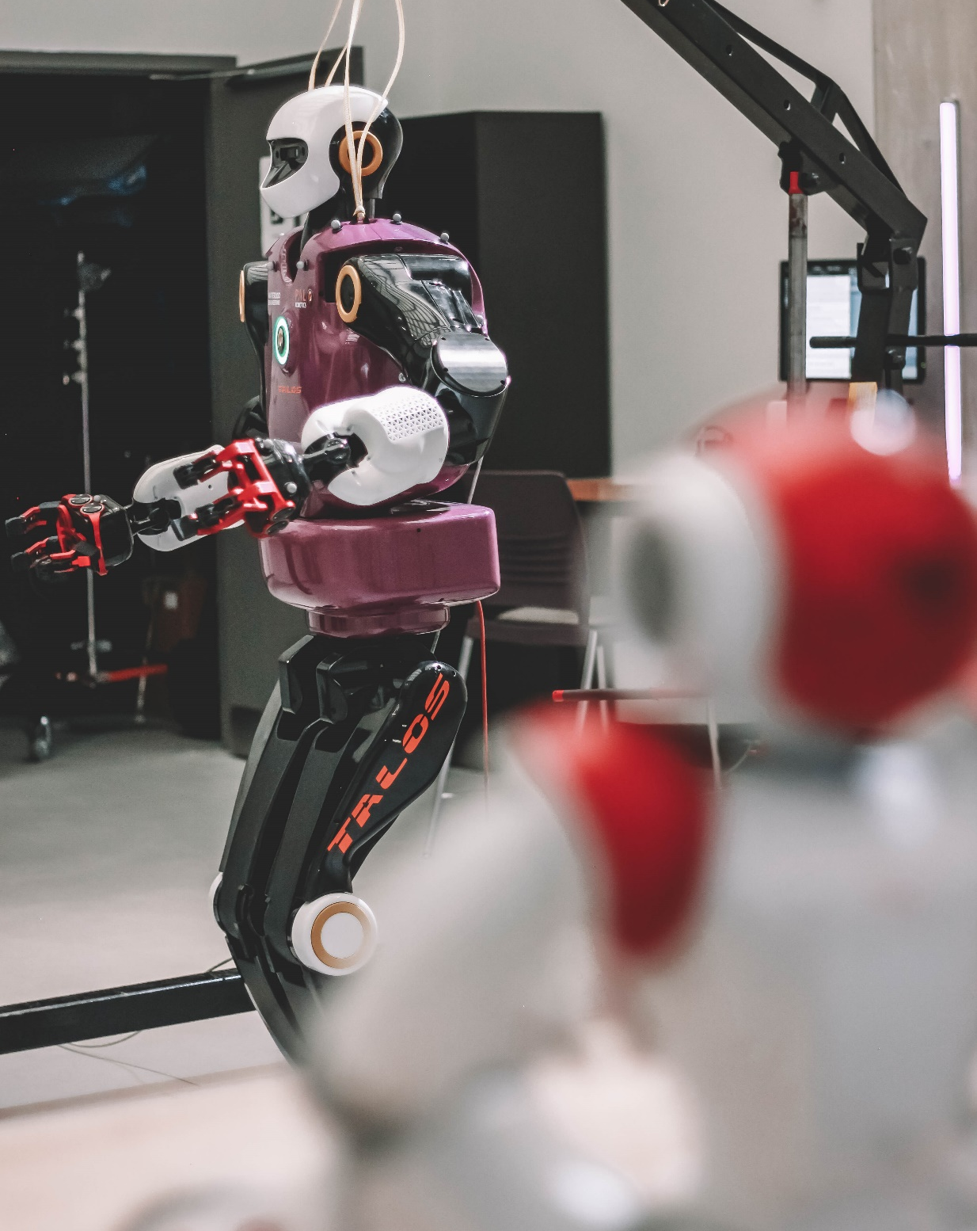
Student Success
Webinar: Fall 2022
Wednesday September 21, 2022
10:30-12:00 p.m. EDT
Please use the Q&A function to submit your questions

Slide 2
Presenters
Name | Role & Department
Siva Sivoththaman | Associate Dean, Graduate Studies Faculty of Engineering
Rita Cherkewski | Manager, Graduate Operations Engineering Graduate Studies Office
Jennifer Collins | Strategic Graduate Enrolment Manager Engineering Graduate Studies Office
Amanda McKenzie | Director, Quality Assurance (Academic Programs) and Academic Integrity

Slide 3
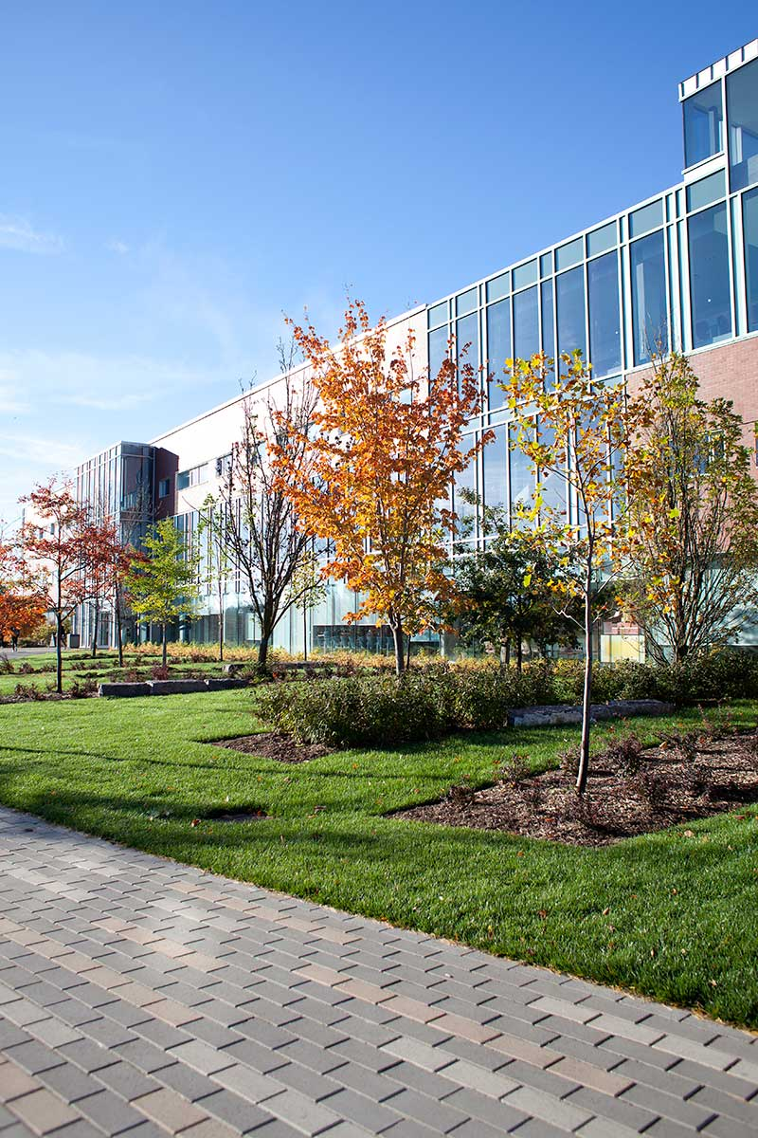
Agenda
Associate Dean’s Welcome (5 min)
Program Information (10 min)
  Course Planning & Advising
  Teaching Assistantships
  Advice from a Student
Student Success (45 min)
  Health and Wellness
  Campus Life
  Career and Academic Resources
  International Student Support
  Academic Integrity
Questions from you! (30 min)

Slide 4
Welcome!
Prof. Siva Sivoththaman
Associate Dean, Graduate Studies and Postdoctoral Affairs
Faculty of Engineering

Slide 5
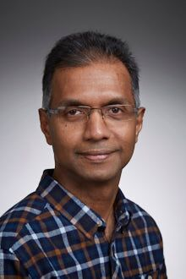
Welcome from the Faculty of Engineering!
The Engineering Graduate Studies Office helps to support you and your Graduate Coordinators (staff) and Associate Chairs (faculty) who work with graduate students in each department
Engineering has the largest graduate student population at the University of Waterloo – about 40% of the total
Total anticipated enrolment for Fall 2022: ~2400 students across 8 academic units within the Faculty of Engineering
Over 700 new students this term
Your official program requirements are found here: https://uwaterloo.ca/graduate-studies-academic-calendar/engineering
Professor Siva Sivoththaman
Associate Dean, Graduate Studies
E-mail: engadgrd@uwaterloo.ca
Office: Engineering 7 7416

Slide 6
Welcome from the Faculty of Engineering!
Each of your programs are found within a Department which are a part of the Faculty of Engineering.
Engineering is a part of Graduate Studies with 5 other Faculties across campus.
Engineering Graduate Studies Office
You and your department
Graduate Studies and Post-doctoral Affairs (GSPA)
Faculty of Engineering
6 Departments
Architecture
Conrad Entrepreneurship
The other 5 Faculties:
Science, Arts, Health, Math, Environment
The other Departments

Slide 7
Program Tips

Slide 8
MEng/MMSc Student Academic Advisors
Your Associate Chair is your Academic Advisor
  ECE is the exception to this with a separate faculty member designated specially to advise MEng students
You can contact your MEng Advisor/Associate Chair or Graduate Coordinator for any issues that come up during your program
Dept. | MEng/MMSc Advisor (typically the Associate Chair. Graduate Studies) | E-mail
CIVE | Professor Adil Al-Mayah | cee.gradchair@uwaterloo.ca
CHE | Professor Nasser Mohieddin Abukhdeir | chegrad@uwaterloo.ca
ECE | Professor Christopher Nielsen | cnielsen@uwaterloo.ca
MME | Professor Cecile Devaud | cdevaud@uwaterloo.ca
MSCI | Professor Hossein Abouee Mehrizi | haboueemehrizi@uwaterloo.ca
SYDE | Professor Eihab Abdel-Rahman | sydegrad@uwaterloo.ca

Slide 9
MASc/PhD Student Academic Advisors
Your Supervisor is your Academic Advisor
Supervisors will act as your advisor for most questions during your program
You can also rely on other students and postdocs in your lab for insights
Departmental staff & your Associate Chair can also be called upon if you have other questions

Slide 10
Course Selection Advice
Expect to take fewer courses each term than in your undergraduate degree.
  Most students find that they will be the most successful taking only 2-3 courses each term
Ask the course instructors or your supervisor if you are unsure about whether you have the right academic background for their course.
You can register for courses in all three academic terms;
  each term is 4 months long and they begin in September, January, May
Course Drop Deadline – 3 weeks into term
  Fall 2022 – September 27th
  Questions? – Ask your advisor!

Slide 11
You can apply to become a Teaching Assistant
Students will be invited to register for ExpecTAtions by their department coordinator
  The next ExpectTAtions workshop will be in October
  Completion of ExpecTAtions Workshop is required for anyone wishing to serve as a teaching assistant in the Faculty of Engineering.
Students must have a Canadian bank account and a SIN number to be a Teaching Assistant, even if working remotely
Not all departments have positions for MEng/MMSc students, ask your coordinators
Your pay as a Teaching Assistant is taxable income, and is in addition to any GRS or other funding research students receive
Contact your departmental staff with any Teaching Assistant questions

Slide 12
Who do you ask for help?
Questions about… | Ask…
What courses to take or Career advice | Associate Chair/MEng Advisor | Research Supervisor
How to: drop a course, change your program, or change your enrolment status, or apply for a new program | Department Coordinators & the GSPA forms website: https://uwaterloo.ca/forms/graduate-studies/
An issue or question about your courses | First the course instructor, your Academic Advisor, and then the Associate Chair (if needed)
Applying for a job and/or network | Centre for Career Action
Becoming a Teaching Assistant | Department TA coordinators
Your UHIP healthcare plan | https://uwaterloo.ca/finance/student-financial-services/university-health-insurance-plan-uhip or https://uhip.ca/

Slide 13
Who do you ask for help?
Questions about… | Ask…
Feeling sad, homesick, or finding your courses too challenging | Academic Advisor, your Department Coordinator, Counselling Services, Health Services, or a doctor.
Your specific program requirements | The Graduate Studies Academic Calendar (the official rules) https://uwaterloo.ca/graduate-studies-academic-calendar/engineering
If you need an accommodation for a course because you get hurt or have an illness | Accessibility Services

Slide 14

Advice from a student: Ben Ecclestone
Graduated from Biomedical Engineering (BEng) from the University of Guelph in 2020.
Started MASc in Systems Design Engineering, then upgraded to a PhD.
Currently a PhD Candidate in Systems Design Engineering with Dr. Parsin Haji Reza
Studying Photoacoustic Remote Sensing (PARS) Microscopy

Slide 15

Ben’s advice
Don’t be afraid to ask questions (During lecture, office hours, emails, etc.).
Get involved in the community! Engineering is a team sport.
If you need help or support just ask. There are resources for everything (counselling, writing, resumes, housing, etc.).
Take time for relaxing, socializing, and sleeping. Overloading on schoolwork can be counterproductive.

Slide 16
Student Success
Health and Wellness

Slide 17
AccessAbility Services
AccessAbility Services facilitates all graduate student academic accommodations for persons with disabilities including temporary, permanent, chronic, & suspected disabilities (e.g., broken arm, mental health condition, medical illness, trauma).
They work with students to develop an academic accommodation plan for each course, milestone, and graduate activity (e.g., comprehensive exam, thesis defense, dissertation research).
They also offer workshops and supports from learning strategists and assistive technologists.
Apply early. If in doubt, apply! They can help.
Register here: https://uwaterloo.ca/accessability-services/
Phone Ext. 35082, email: access@uwaterloo.ca

Slide 18
Office of Equity, Diversity, Inclusion and Anti-racism (EDI-R)
AVP, EDI-R
Senior Director, EDI-R
Equity Office
Anti-racism Office
Education and Outreach Office

Slide 19
What do we do?
Systemic Change
Education and Outreach
Individual Support
Review existing processes, strategic plans, policies (etc.) at the University and support the embedding of equity and anti-racism
Lead systemic initiatives to help embed equity and anti-racism into practices across campus (e.g. Inclusive Washrooms, Menstrual Equity, Anti-Racism Policy, Transitional Year Program, admissions)
Individual support for students, faculty and staff with equity or racism related barriers or challenges (e.g. experiences of racism, transitioning in the workplace etc.)
Provide guidance and advice on equity or anti-racism issues/requests.
Proactively build the capacity of campus members around how to understand and apply equity and anti-racism.
Build relationships with stakeholders.
Build awareness across campus around equity and anti-racism.
Provide responsive trainings to departments/units.

Slide 20
When to connect with EDI-R
If you need individual support:
  E.g. Experiencing an equity or anti-racism related barrier and need help determining next steps, your options, or require support.
If you have ideas/suggestions on where equity related gaps are on campus.
  E.g. Ideas for systemic gaps, or opportunities for change.
To take trainings like:
  Equity 101
  Pathways for Addressing (with care) Disclosures of Racism
  Disrupting and Decentering Whiteness
  2SLGBTQ+ Fundamentals
  Equitable Recruitment and Selection
For more information, to set up a meeting or to connect, fill out our Intake Form, or register for trainings on our website.

Slide 21
(Engineering) Counselling Services
https://uwaterloo.ca/campus-wellness/counselling-services
  Open to all registered students, at no cost.
  In-person, by phone or video appointments
A Mental Illness How-to for Waterloo - 17 pages of how to navigate the mental health system at UW, written by students for students. (Written before COVID-19)
  Everything from how to get an appointment with a psychiatrist to how to register with AccessAbility, to how to find a therapist on co-op.
  Did you know?
  Many graduate students feel sad or stressed during their program at some point. It is very common, and we recommend that you ask for help if you need it.
  There is no shame in taking care of yourself and reaching out for support. The sooner you mention an issue, the faster it can be addressed with help from our support services.

Slide 22
(Engineering) Counselling Services
  Offers a safe, confidential space in which to talk about the stressors in graduate school and life, emotions (including problems with anxiety and depression), and relationships.
  Understand how to navigate issues in your academic and personal life.
  Share your experience, obtain feedback, and explore new ways of coping with issues unique to graduate students in a safe and confidential context.
  Appointments are offered in-person, by phone or video

Slide 23
Student Success
Campus Life

Slide 24
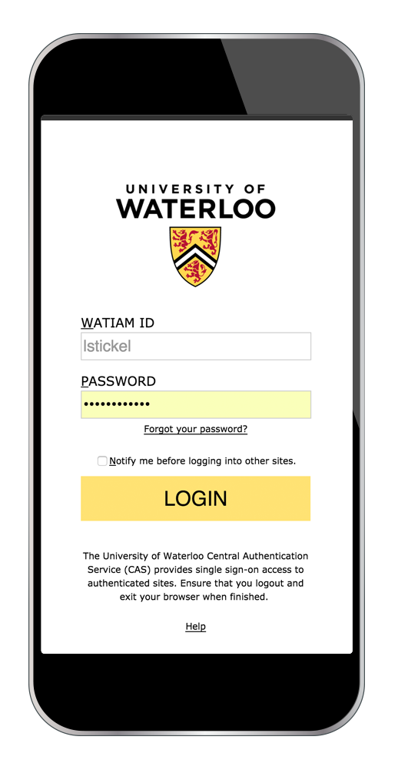
UWaterloo Portal
Your unique class schedule
Learn announcements
Event listings and registration
Grade calculator
Appointment booking
Immigration document reminders
Tutor Connect
Campus map and open classrooms
Access Portal: Portal Web: portal.uwaterloo.ca
App available on Google Play or App Store

Slide 25
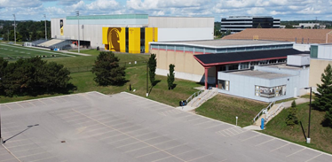
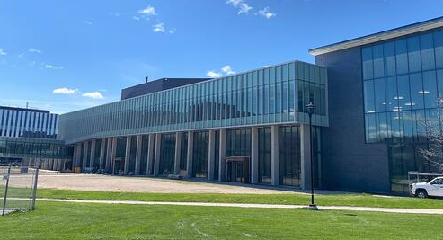
WATERLOO WARRIORS - ATHLETICS AND RECREATION
Check out our facilities (Physical Activities Complex (PAC) and Columbia Icefields (CIF))
Rec Membership included with your Student Fees.
Drop-In/Open Rec times available
Wide range of Rec Programs available:
    Aquatics
    Clubs
    Esports
    Dance Classes
    First Aid
    Fitness Membership
    Golf Simulator
    Intramurals
    Martial Arts
    Move Your Mind
    Personal Training
    Rock Climbing Memberships
    and more!
Free admission to Varsity games with your WatCard.
  Black and Gold Day at Football (September 10)
Check out job and volunteer opportunities
  www.gowarriorsgo.ca/jobs

Slide 26



WATERLOO WARRIORS - ATHLETICS AND RECREATION
Sign up for our Warriors Insider Newsletter
  www.gowarriorsgo.ca/warriorsinsider
Download the Warrior Rec App
Stay connected on social media
Visit www.gowarriorsgo.ca/fall2022 for a full list of programs this term.

Slide 27
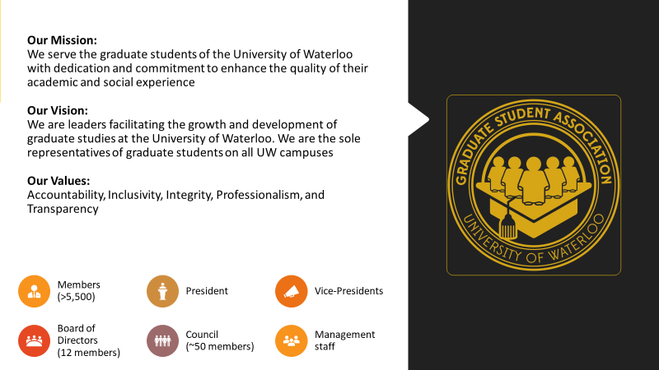
Graduate Student Association

Slide 28

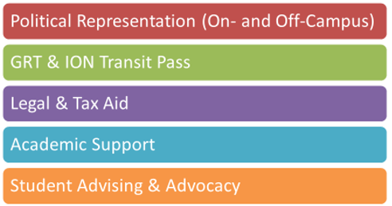

Graduate Student Association
  Find out more about the GSA’s services and how to get involved at: https://gsauw.ca

Slide 29

Glow Centre
Glow is the oldest continually-running university-based 2SLGBTQ+ group in Canada. Glow promotes a healthy attitude towards all sexual orientations and gender identities on the UWaterloo campus by providing a wide variety of services including peer support, social events, advocacy work, and other resources.
Some of our Services & Resources:
Peer Support, Community Outreach, Social Events, the Glow Lending Library, Incident Reporting, Trans Resources, and Gender-Neutral Washrooms list
Works under three policies/principles:
Confidentiality
Safe Space
Inclusion
For more information, visit:
https://wusa.ca/services/glow-centre-sexual-and-gender-diversity

Slide 30
Student Success
Academic & Career Resources

Slide 31

Graduate Professional Skills
What is GRADventure?
Central hub of professional development resources designed specifically for graduate students
Support for achieving your personal, academic, and professional goals
“One-stop shop” for workshops, trainings, and programs offered across campus
Access to asynchronous resources from past workshops and events
Over 150 workshops and events per year
Website: uwaterloo.ca/gradventure/

Slide 32

Graduate Professional Skills
Professional Skills Foundations
Professional skills credential program for graduate students
Assess your skills, structure your professional development, and build skills in four key areas:
  career preparation,
  communication,
  leadership and
  personal effectiveness
Achievable within one year
Website: uwaterloo.ca/gspa/foundations/

Slide 33

Student Success Office: Academic support
Peer success coaching
Meet one-on-one with an experienced graduate student who can help you achieve all-around success by helping you identify your strengths, and by sharing strategies and resources that can help support your learning
Book a virtual 1-1 or in-person appointment at: uwaterloo.ca/sso/success-coaching-appointment

Slide 34

Centre for Career Action: Graduate Students
Centre for Career Action
Live Chat Available at:
uwaterloo.ca/career-action
Phone: 519-888-4047
@CCAGrad
Three Career Advisors for Grad Students who assist with:
Job Search Tactics
Résumé/CV
Cover Letter
Interview Prep
Career Planning
We offer:
Individual Appointments
Drop-ins
Workshops
Online Resources
Conferences
Career Panels
Online Resources: careerhub.uwaterloo.ca

Slide 35
Centre for Career Action: Graduate Students
Visit Waterlooworks.uwaterloo.ca to:
  Book virtual and in-person appointments
  Register for events/workshops
  Register for Employer Information Sessions
  Browse job postings
Can’t make it to a live workshop?
  Visit the CCA’s asynchronous workshops when it suits your schedule

Slide 36

The Writing and Communication Centre offers individual appointments, workshops, and learning resources on communication topics
WHAT WE DO:
Work with you to synthesize, integrate, and share best practices in communication
Help you experience your work as others do
Help you develop skills and strategies that last a lifetime
Support and promote a lively, cross-disciplinary writing culture on campus and online
Press “play” to watch our introductory video!
Notes:
So, just as an overview, if you’ve never heard of a Writing Centre before, or if you’re not really sure what it is we do, the biggest misconception is that we’re an editing service. And that is not what we do at all. We’re a teaching centre. We work with you to help you become a better writer, or a better communicator, and make sure that you’re getting your ideas across as clearly and as efficiently as possible so your audience can understand what it is you’re trying to say. So, in that way, we act as your audience and give you feedback on how we’re interpreting or how we’re understanding your message and give you feedback on how to improve that. It’s really a back-and-forth-type experience and our goal is to support you while you’re here at Waterloo, while you’re doing your degree, but with the idea that once you’re done and no longer a student at the university, you will have developed skills that you can use throughout the rest of your career and that you won’t need us anymore once you’re done.

Slide 37
Writing and Communication Centre: A hub of practice and support
Speak Like a Scholar
Learn to give effective online academic presentations with confidence.
Writing Cafés
Write together online or in person.
#WaterlooWrites
Virtual writing communities on Teams.
Grad Student Services
Rock Your Thesis
Learn how to plan and write your thesis.
Dissertation Boot Camp
Kick start your thesis or dissertation.
One-on-one
Appointments
Online writing & communication
Resources
Grad-specific
Online Workshops
To access appointment, resource, or workshop information, click the buttons above.
www.uwaterloo.ca/wcc

Slide 38
Student Success
International Student Support

Slide 39
Student Success Office: International Student Support
Immigration Consultants
Ask questions about study permit conditions and policies for working as an international student in Canada
Get help with your immigration applications (applying for a study permit extension, co-op work permit, temporary resident visa, and post-graduation work permit)
Receive immigration support for graduate students with dependants and information on how to invite your family to visit
Submit a webform inquiry to our team of consultants: uwaterloo.ca/student-success/ask-immigration-consultant
Same-day appointments delivered remotely and in-person: Monday – Friday 10:00 AM EDT to 4:00 PM EDT. You can sign-up via Waterloo’s Portal app and registration starts at 8:00 AM EDT each weekday.
Immigration Consultants also host weekly Immigration Information Sessions on several topics. You can sign-up via Waterloo’s Portal app.
Register your immigration status through Portal’s Immigration Document Reminder System. (click on the goose icon and the enable the “Are you an International Student” switch)

Slide 40
Student Success Office: International Student Support
International Peer Community
Meet undergraduate and graduate international students, build your support network and learn about Canadian culture
Bi-weekly in-person programming
Register at: uwaterloo.ca/sso/ipc
Breakfast Seminars
Chance for undergraduate and graduate international students to connect to campus and receive support during the online fall term
Learn more at: https://uwaterloo.ca/student-success/international-student-resources/breakfast-seminars

Slide 41
Student Success
Academic Integrity

Slide 42

ACADEMIC integrity
Amanda McKenzie & Erin Nearing

Slide 43
Academic Integrity
At the University of Waterloo, academic integrity is a commitment to six values: honesty, trust, fairness, respect, responsibility, and courage (International Center for Academic Integrity, n.d.)
Integrity is foundational – it is part of our identity, and it guides our actions.
Notes:
Let’s unpack that word “integrity” …

Slide 44
Why does Integrity matter?
“In looking for people to hire, look for three qualities: integrity, intelligence, and energy. And if they don’t have the first one, the other two will kill you.”
Source: Success Will Come and Go, But Integrity Is Forever (forbes.com)
“It takes 20 years to build a reputation and five minutes to ruin it. If you think about that, you'll do things differently.”
- Warren Buffet
Source: https://www.inc.com/marcel-schwantes/warren-buffett-says-you-can-ruin-your-life-in-5-minutes-by-making-1-critical-mistake.html
Notes:
Type in the chat why you think integrity matters

Slide 45
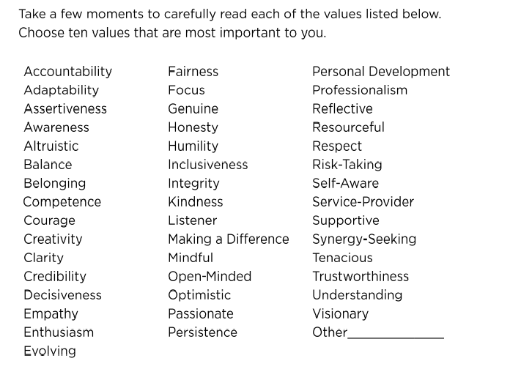
What are your core values?
3
Notes:
What are your top values? Type them in the chat.

Slide 46
Living in Alignment
Do your values match your thoughts, behaviours, and actions?
Do you live your values consistently in all dimensions of your life?
Notes:
Now that you’ve identified your top values – ask yourself if you are following them everyday? How close are you living in alignment to your values? Are the values used consistently in every aspect of your life?

Slide 47

Source: Brene Brown https://www.youtube.com/watch?v=iB-WxyNclFs 17:50-18:00

Slide 48
Get to Know the Rules
Policy 71
Sets out expectations
Lists various offences
Explains the disciplinary process
Describes potential penalties
What do I do if I suspect academic misconduct?
You are required by policy to report any suspected cases of academic misconduct or cheating to the course instructor AND the Associate Dean, Graduate Studies.
Notes:
As an ISA, you should forward any suspected cases of cheating to the IS Coordinator, and should not confront students yourself. The University of Waterloo and Faculty of Mathematics policies regarding academic integrity specify what constitutes cheating and the appeals process available to students.

Slide 49
Policy 71
It is important to report academic misconduct because:
It helps UWaterloo monitor our educational programs to ensure they prevent academic misconduct. The majority of misconduct happens unintentionally, and it’s our goal to ensure it doesn’t happen in the first place
The penalties are appropriate to the action. A penalty for a first offence committed in ignorance is less severe than a repeat offender. Often, the penalty is remedial.
If a student is cheating in one course, they are likely struggling and/or repeating this behaviour in other courses. Reporting means we’re able to help these students earlier and identify any repeat behaviour.
If misconduct is not addressed, it is not fair to those who completed the work honestly and with good academic integrity practices

Slide 50
UNAUTHORIZED COLLABORATION
What does this look like?
Students working together to complete an assignment, in part or in whole, when the instructor said to work alone
Tutors, editors, or friends completing or re-doing assignment responses for students
For example:
The instructor gives the students an assignment and asks them to complete it independently. The students meet online to complete the assignment together
A student is frustrated while completing an assignment. A friend or a tutor gives the student some answers

Slide 51
UNAUTHORIZED COLLABORATION
Students might engage in unauthorized collaboration because they are unclear about the level of group work permissible for the assignment, or because they are struggling with the content/assignment.
To avoid/address unauthorized collaboration violations:
Collaboration expectations should be specified and clear for each assessment
Be aware of the instructor’s expectations for collaboration for each assessment so you can answer student questions or identify issues while marking
Encourage students to come to you if they need assistance
Report suspected misconduct so it can be investigated

Slide 52
PLAGIARISM
What does this look like?
Using someone else’s work, code, data, research, etc., in part or in whole, without proper acknowledgement
Re-submitting work without permission or acknowledgement
For example:
A student forgets their assignment is due tomorrow. They copy their friend’s code
A student re-uses an assignment from another course without permission from their instructor, and without citing themselves

Slide 53
Plagiarism Violations
A student might unintentionally plagiarize because they are not aware they need to cite, or they might forget to include citations. A student might intentionally plagiarize because they have left something until the last minute, or they are struggling to complete the assignment.
How to address/avoid Plagiarism violations:
Make sure any teaching materials are properly cited
Report suspected plagiarism (e.g., two students assignments look very similar)
Notes:
30 sec
A student might unintentionally plagiarize because they are not aware they need to cite, or they might forget to include one or multiple citations. A student might intentionally plagiarize because they have left something until the last minute, or they are struggling to understand the course content/complete the assignment.
Plagiarism can be avoided by ensuring any of your teaching materials are properly cited, so student’s understand the importance. If there is confusion among students, or you notice issues, communicate that to the instructor so that expectations can be clarified for this assignment/future assignments. Be explicit in instructions about citation expectation (e.g., students must use APA in-text citations and a Reference List for this assignment). Like with UC, be aware of the instructor’s expectations, so you can identify issues while marking, and accurately answer student’s questions. Refer students to citing resources when giving out assignments, or if they struggled with formatting, etc., in their assignments (e.g., the Library or Purdue Owl).

Slide 54
Cheating
‘Trying to gain/give an improper advantage in an academic evaluation.”
Example:
The use or intent to use an unauthorized aid
Accessing exams/solutions without permission
Notes:
Cheating is defines as “trying to gain/give an improper advantage in an academic evaluation”.
Cheating can take many forms of dishonest behaviour- common examples include the intention or use of an unauthorized aid, or accessing exams or solutions without permission.

Slide 55
Cheating Violations
A student might cheat if they are stressed out, are feeling unprepared to take a test, or are struggling with the course content.
How to address/avoid cheating violations:
Encourage students to talk to you or the instructor if they are feeling overwhelmed in advance of the deadline or exam date
Ensure students are given plenty of time to complete assignments, and refer them to time management resources (e.g., the assignment planner)
Report suspected cheating
Notes:
30 sec
A student might cheat if they are stressed out, are feeling unprepared to take a test, or are struggling with the course content.
To avoid cheating violations, encourage students to talk to you or the instructor if feeling overwhelmed. It’s always a good idea to reach out for help well advance of the deadline or exam date. Ensure students are given plenty of time to complete assignments, and refer them to time management resources.

Slide 56
Intellectual Property Copyright Violations
“The possession or use of another person’s intellectual property without that person's permission or knowledge.”
“Students may not distribute or reproduce the materials, whether for commercial purposes or not, without the express written consent of the faculty or instructor.”
Example:
Students posting course materials online without permission
Students using UW course materials in a third-party setting without permission
Notes:
30 sec
Policy 71 defines theft of intellectual property as “The possession or use of another person’s intellectual property without that person's permission or knowledge.” According to UW IP guidelines, students may not distribute or reproduce the materials, whether for commercial purposes or not, without the express written consent of the faculty or instructor.
Examples of IP copyright violations include posting course materials online without permission, or using UW course material in an third-party setting without permission.

Slide 57
Intellectual Property Copyright Violations
A student might commit an Intellectual Property Copyright violation for money, to help other students, or for access to course notes in note-sharing platforms. They also may simply be not be aware of the University’s policy on posting materials online or using them in a third party-setting.
How to address/avoid IP violations:
Be explicit with students about whether course materials can or cannot be shared beyond the classroom
If you become aware of things being posted on online websites that shouldn’t be, alert the copyright owner (e.g., the instructor of the course)
Notes:
30 sec
A student might commit an Intellectual Property Copyright violation for money, to help other students, or for access to course notes in note-sharing platforms. They also may simply be not be aware of the University’s policy on posting materials online or using them in a third party-setting.
To avoid IP copyright violations, be explicit with students about whether things can or cannot be shared beyond the classroom. Be aware that things are likely being posted online – if you come across something or hear something, report it immediately.

Slide 58
Remember to…
Be aware of the academic integrity expectations for each assessment so you can answer student questions/identify issues while marking
Reported suspected academic misconduct. It is important that students get the help and guidance that they need.
Encourage students to come to you or the instructor if they are feeling overwhelmed/need help with the content
If you’re in the position to, be proactive about discussing academic integrity with students. Be explicit about what is acceptable or not acceptable (e.g., can they collaborate?). Research shows this is the most effective way to reduce academic misconduct.

Slide 59
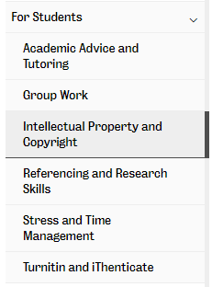
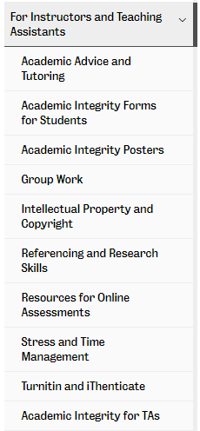
Office of Academic Integrity Website

Slide 60
Questions?
academic.integrity@uwaterloo.ca
www.academic.integrity@uwaterloo.ca
Instagram/uwacademicintegrity
Twitter/WaterlooAI

Slide 61
Question Period
Enter your questions in the Q&A!

Slide 62
Thank you for watching!

