Slide 1
Introduction to Equity
Developed by: Monique Chambers (she/her)
Senior Equity Training Specialist, Education and Outreach, EDI-R Office
Amaya Kodituwakku (they/them)
Binuki De Silva (they/them) Training and Outreach Specialists (co-op), EDI-R Office

Slide 2
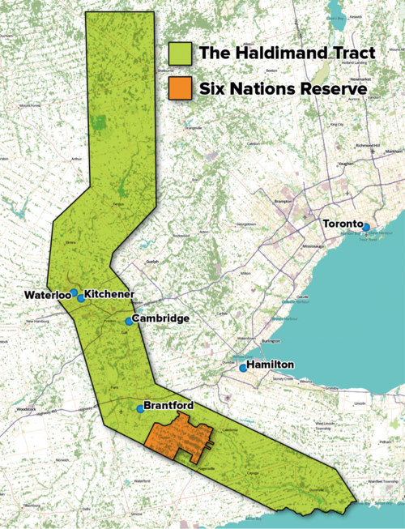
Territorial Acknowledgement
The Office of EDI-R acknowledges that we live and work on the traditional territory of ‎ the Neutral, Anishinaabeg and Haudenosaunee peoples. The University of Waterloo is situated on the Haldimand Tract, the land promised to the Six Nations that includes six miles on each side of the Grand River.
www.native-land.ca/

Slide 3
Workshop Agreement
Safety: We are not here to debate if racism, sexism, and discrimination experienced by equity-deserving groups exist. We are here to create a safe learning environment.
Be respectful
Engage mindfully
Speak from your personal experience
Maintain confidentiality
Take care of yourself

Slide 4
Comfort Zone
Next Steps
Learning Edge
Comfort Zone
Harmony Movement. Educator’s Equity Workbook Toronto: 2013

Slide 5
Learning Objectives / Agenda
Diversity, Equity, Inclusion
Positionality and Privilege
Racism and White Supremacy
How to be Anti-Racist
Microaggressions
Allyship versus Solidarity
Case Studies to Apply Knowledge

Slide 6
POWER AND PRIVILEGE

Slide 7
Sometimes You're a Caterpillar

Slide 8
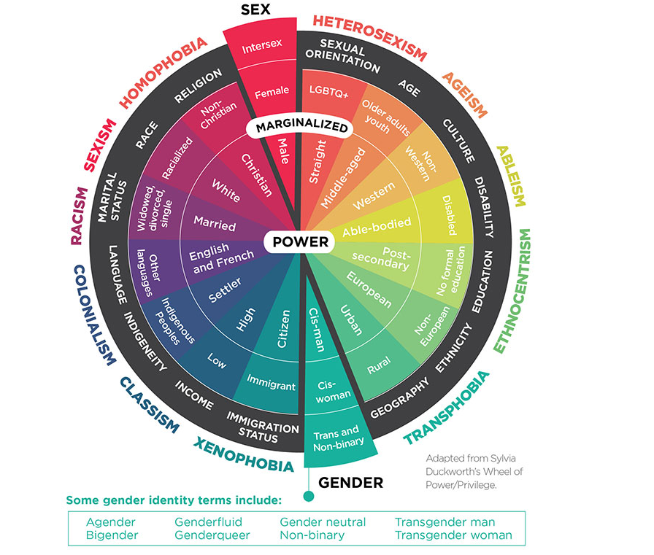
Power and Privilege
Power: the ability to influence and make decisions that impact others
Privilege: a group of cultural, social, legal, and institutional rights extended to a group based on being members of a social group. Individuals with privilege are positioned as the “normative” group, which renders those without access to these privileges marginalized, invisible, and/or classed as ‘abnormal’.
Source: Greta Bauer, Ph.D., is a Professor of Epidemiology and Biostatistics at Western University

Slide 9
Privilege Exercise
Personal Inventory
Read each statement and put a checkmark beside every statement that applies to you

Slide 10
Privilege Exercise: Pair and Share
Find a partner and discuss your experience with this exercise
Consider the following:
How did it feel doing this exercise?
Did anything surprise you?
What are some of the systems of oppression we see operating in these statements?

Slide 11
Implicit bias

Slide 12
Impact of Implicit Bias

Slide 13
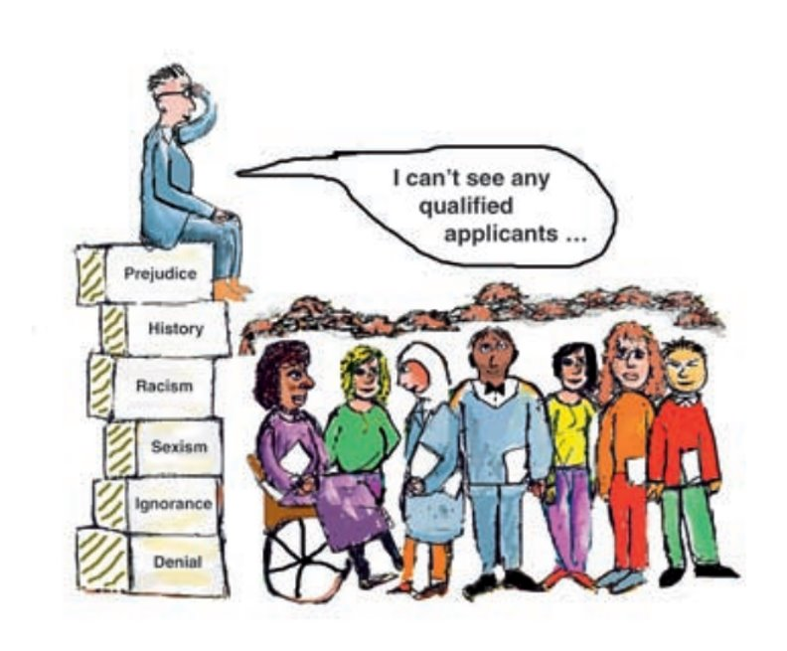
Implicit Bias
Social stereotypes about certain groups of people that individuals form outside their own conscious awareness
Everyone holds implicit biases about various social and identity groups and these biases stem from one’s tendency to organize social worlds by categorizing
While these are implicit and often go undetected, it is incredibly important to acknowledge the damage they can cause.

Slide 14
MICROAGGRESSIONS

Slide 15
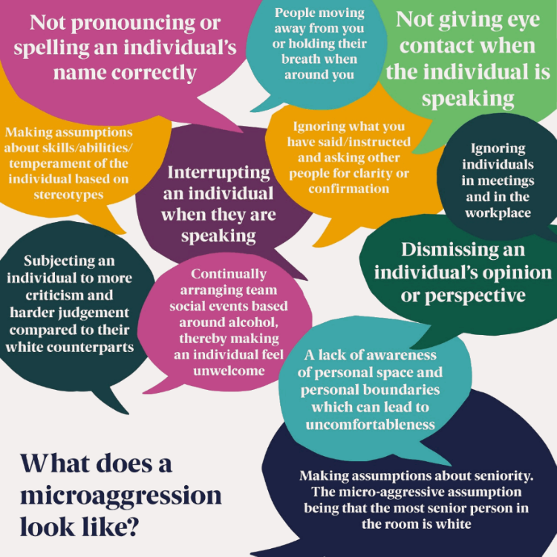
Microaggressions
Microaggressions are born from ingrained prejudices and beliefs; they are a typically covert form of racism and/or discrimination
Microaggressions can cause serious psychological damage to the targeted individual, creating intense conscious and unconscious stress
It is important to remember to focus on impact over intent as subtle prejudice and implicit bias are real and consequential

Slide 16
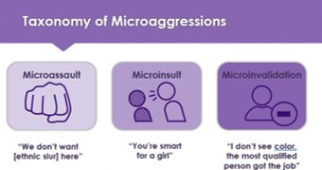
Forms of Microaggressions
Microassaults: "Explicit racial derogations characterized primarily by verbal or nonverbal attacks meant to hurt the intended victim through name-calling, avoidant behavior, or purposeful discriminatory actions."
Microinsults: “Behaviours, actions, or verbal remarks conveying rudeness, insensitivity, or demeaning a person’s group, social identity, or heritage.”
Microinvalidations: “Communications that exclude, negate, or nullify the psychological thoughts, feelings, or experiential reality of a marginalized person.”
SOURCE:https://auburn.edu/equitytaskforce/pdf/Racial_MicroaggressionsshortVersion.pdf

Slide 17
Microaggressions
Notes:
Second video is centered on microaggressions (generally speaking)

Slide 18
(alt video option)

Slide 19
ANTI-RACISM and WHITE SUPREMACY

Slide 20
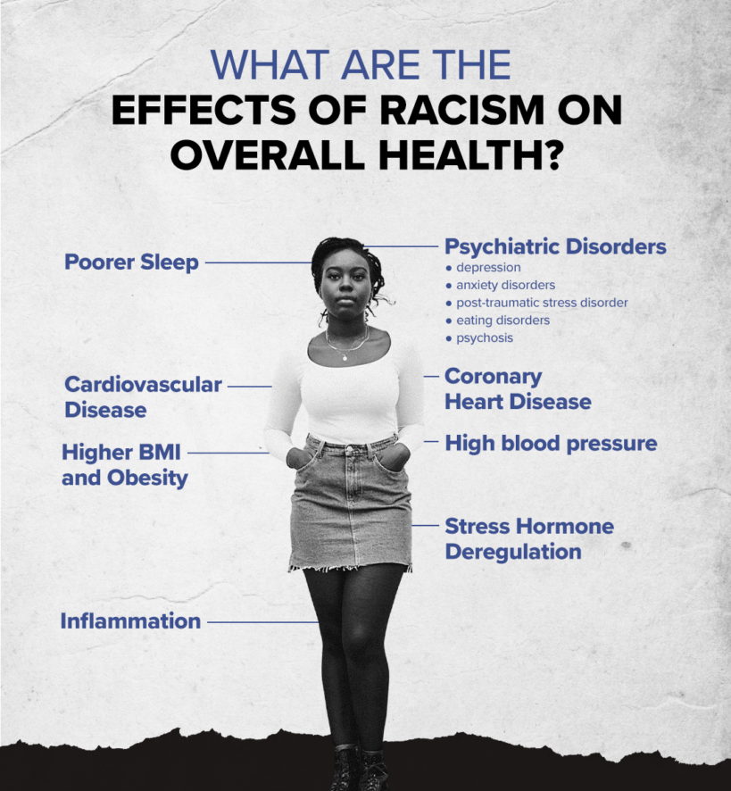
An Introduction to Racism
A social construct used to justify the domination, enslavement, and exploitation of racialized groups by Europeans
We all participate in racist systems
Racism is just as bad in Canada as it is in the US
"Visitor: My Life in Canada" by Anthony Stewart

Slide 21
Anti-Racism
"The only thing that should come after: 'I’m not racist but….' is 'but racism is so ingrained in my society and culture that on some level I definitely am and need to do my part to destroy the system of oppression that people like me have created and benefit from on the daily.'"
- Sheri Faye Rosendahl​
Anti-Racism:
The active work of dismantling institutional, systemic, and structural policies, practices, and behaviours that reproduce and maintain systems of white supremacy.

Slide 22
White Supremacy
The idea (ideology) that white people and the ideas, thoughts, beliefs, and actions of white people are superior to racialized people and their ideas, thoughts, beliefs and actions.
Ever present in our institutional and cultural assumptions that assign value, morality, goodness and humanity to the white group while casting racialized people as worthless (worth less), immoral, bad, and inhuman and ‘undeserving.’
Critical race theory: the term ‘white supremacy’ also refers to a political or socioeconomic system where white people enjoy structural advantage and rights that other racial and ethnic groups do not - both at a collective and an individual level.

Slide 23
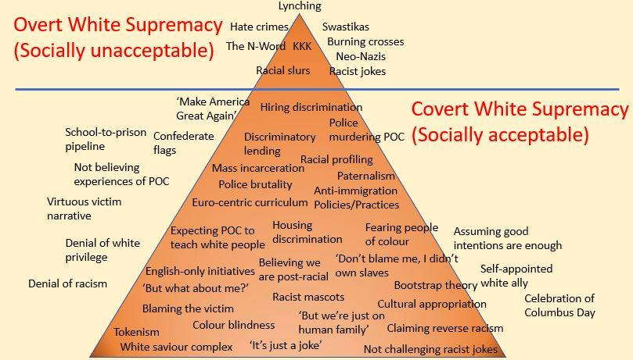
White Supremacy
Source Safehouse Progressive Alliance for Nonviolence (2005) Adapted: Ellen Tuzzulo (2016) Mary Cordero (@jewelspewels) (2019); The Conscious Kid () 2020

Slide 24
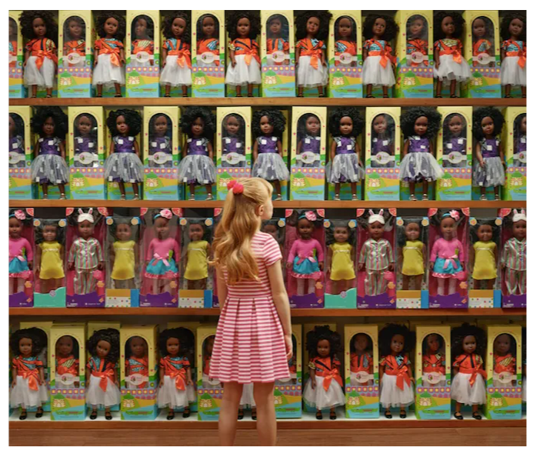
“Let’s Talk About Race” Photo Series

Slide 25
allyship

Slide 26
Allyship vs Solidarity

Slide 27
CASE SCENARIOS

Slide 28
Case Scenario
Sam walks into a classroom and another student says to their friend “what is that guy wearing? I swear he just needs to make up his mind. One day he’s wearing guy clothes and the next pink tank tops with lipstick and earrings. I hope I don’t have to work with him in a group I feel so uncomfortable."
The professor overheard the conversation and said, "Samantha please sit down. She can wear what she wants and doesn’t need your approval, in Canada this is acceptable, but I'm sure in her culture this is not."

Slide 29
Case Scenario Questions
What are the stereotypes at play here?
What impact could this have on Sam?
What impact could the professors' actions have on other students in the class?
Is this prejudice or discrimination?

Slide 30
Education and outreach unit equity, diversity, inclusion and anti-racism Office ediro.trainings@UWATERLOO.CA

