Slide 1
Introduction to Equity
Developed by: Education and Outreach,
Office of Equity, Diversity, Inclusion, and Anti-Racism
Image designed by Freepik

Slide 2
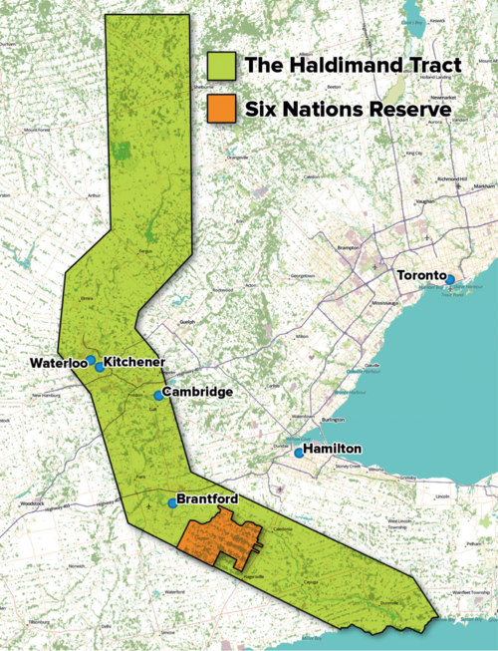
Territorial Acknowledgement
The Office of EDI-R acknowledges that we live and work on the traditional territory of ‎ the Neutral, Anishinaabeg and Haudenosaunee peoples. The University of Waterloo is situated on the Haldimand Tract, the land promised to the Six Nations that includes six miles on each side of the Grand River.
Map source: Adam Lewis, “Living on Stolen Land,” Alternatives Journal December 2015
www.native-land.ca/

Slide 3
Workshop Agreement
Safety: We are not here to debate if racism, sexism, and discrimination experienced by equity-deserving groups exist. We are here to create a safe learning environment.
Be respectful
Engage mindfully
Speak from your personal experience
Maintain confidentiality
Take care of yourself

Slide 4
Comfort Zone
Next Steps
Learning Edge
Comfort Zone
"Comfort Zone". Educator’s Equity Workbook Toronto, 2013, https://www.harmony.ca/wp-content/uploads/2013/06/Equity-Workbook-sample-web.pdf

Slide 5
Learning Objectives / Agenda
Diversity, Equity, Inclusion
Positionality and Privilege
Racism and White Supremacy
How to be Anti-Racist
Microaggressions
Allyship versus Solidarity
Case Studies to Apply Knowledge

Slide 6
POWER AND PRIVILEGE

Slide 7
Sometimes You're a Caterpillar
Video source: https://www.youtube.com/watch?v=hRiWgx4sHGg

Slide 8
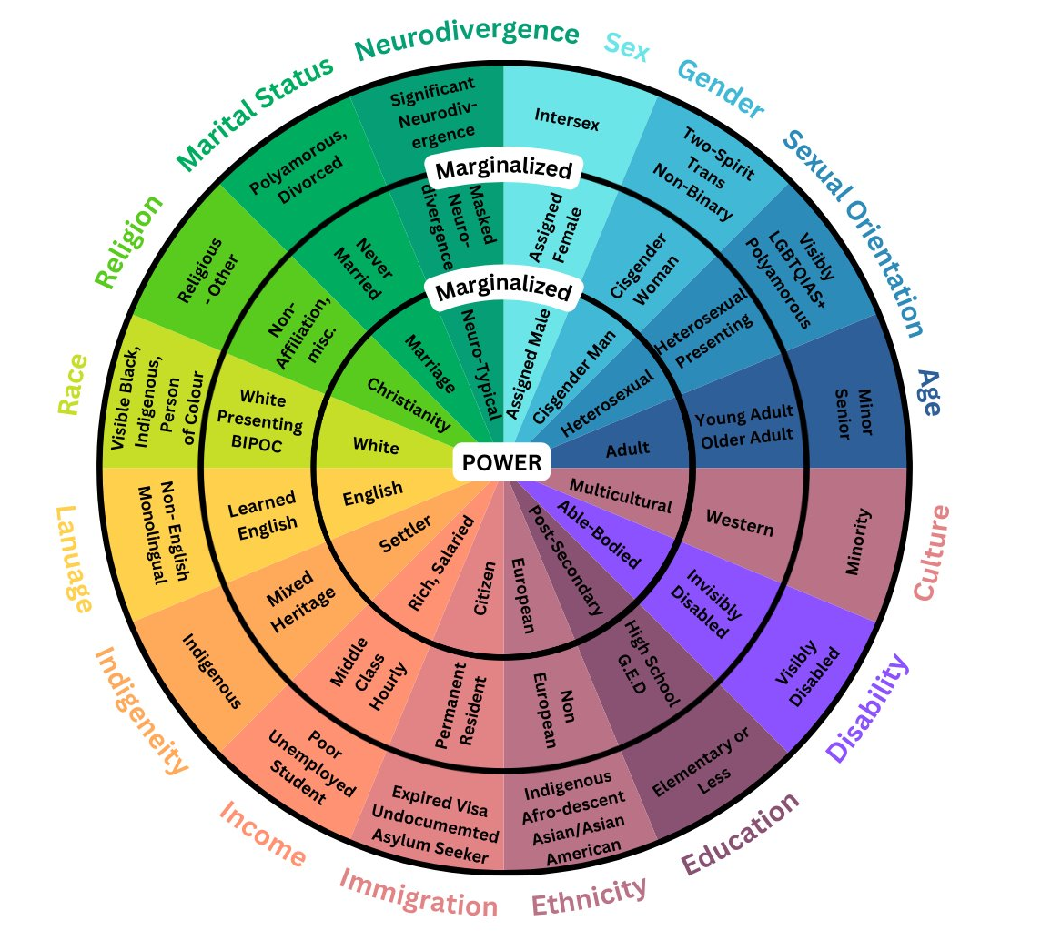
Power and Privilege
Power: the ability to influence and make decisions that impact others
Privilege: a group of cultural, social, legal, and institutional rights extended to a group based on being members of a social group. Individuals with privilege are positioned as the “normative” group, which renders those without access to these privileges marginalized, invisible, and/or classed as ‘abnormal’.
Image adapted from Sylvia Duckworth's Wheel of Power/Privilege

Slide 9
Privilege Exercise
Personal Inventory
Read each statement and put a checkmark beside every statement that applies to you
Photo by Glenn Carstens-Peters on Unsplash
Introduction to Equity

Slide 10
Privilege Exercise: Pair and Share
Find a partner and discuss your experience with this exercise
Consider the following:
How did it feel doing this exercise?
Did anything surprise you?
What are some of the systems of oppression we see operating in these statements?
Photo by Glenn Carstens-Peters on Unsplash
Introduction to Equity

Slide 11
Implicit bias

Slide 12
Impact of Implicit Bias
Video source: https://ethicsunwrapped.utexas.edu/video/implicit-bias

Slide 13
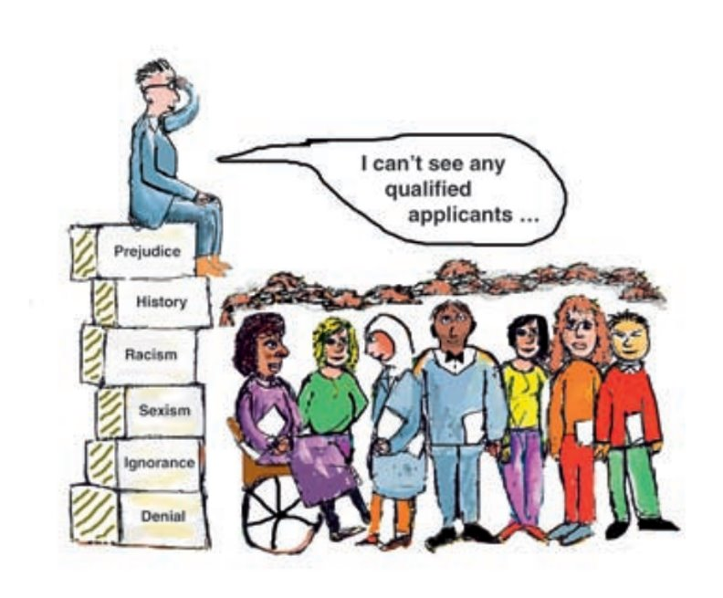
Implicit Bias
Social stereotypes about certain groups of people that individuals form outside their own conscious awareness
Everyone holds implicit biases about various social and identity groups and these biases stem from one’s tendency to organize social worlds by categorizing
While these are implicit and often go undetected, it is incredibly important to acknowledge the damage they can cause.
Image adapted from Swedish version: https://lagensomverktyg.se/wp-content/uploads/sites/4/2016/08/Pauls-PowerPoint-19-maj-2016.pdf

Slide 14
MICROAGGRESSIONS

Slide 15
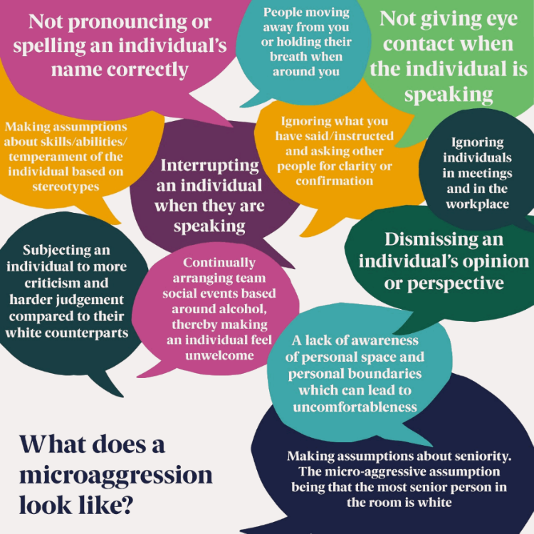
Microaggressions
Microaggressions are born from ingrained prejudices and beliefs; they are a typically covert form of racism and/or discrimination
microaggressions can cause serious psychological damage to the targeted individual, creating intense conscious and unconscious stress
It is important to remember to focus on impact over intent as subtle prejudice and implicit bias are real and consequential
Image source: https://www.rpharms.com/recognition/inclusion-diversity/microaggressions

Slide 16
Forms of Microaggressions
Microassaults: "Explicit racial derogations characterized primarily by verbal or nonverbal attacks meant to hurt the intended victim through name-calling, avoidant behavior, or purposeful discriminatory actions."
Microinsults: “Behaviours, actions, or verbal remarks conveying rudeness, insensitivity, or demeaning a person’s group, social identity, or heritage.”
Microinvalidations: “Communications that exclude, negate, or nullify the psychological thoughts, feelings, or experiential reality of a marginalized person.”
Information source: https://auburn.edu/equitytaskforce/pdf/Racial_MicroaggressionsshortVersion.pdf

Slide 17
Forms of Microaggressions
Microassault
Microinsult
Microinvalidation
Image created by Icongeek26 - Flaticon
Image created by Parzival’ 1997 - Flaticon
Image created by Freepik - Flaticon
"We don't want [ethnic slur] here."
"You're smart for a girl."
"I don't see colour, the most qualified person got the job."
Chart derived from: https://www.culturalcomplications.com/

Slide 18
Microaggressions
Video Source: https://www.youtube.com/watch?v=mE81rarE9-o&ab_channel=JulietHall
Video Source: https://youtu.be/nQ9l7y4UuxY

Slide 19
(alt video option)
Video Source: https://youtu.be/ZahtlxW2CIQ

Slide 20
ANTI-RACISM and WHITE SUPREMACY

Slide 21
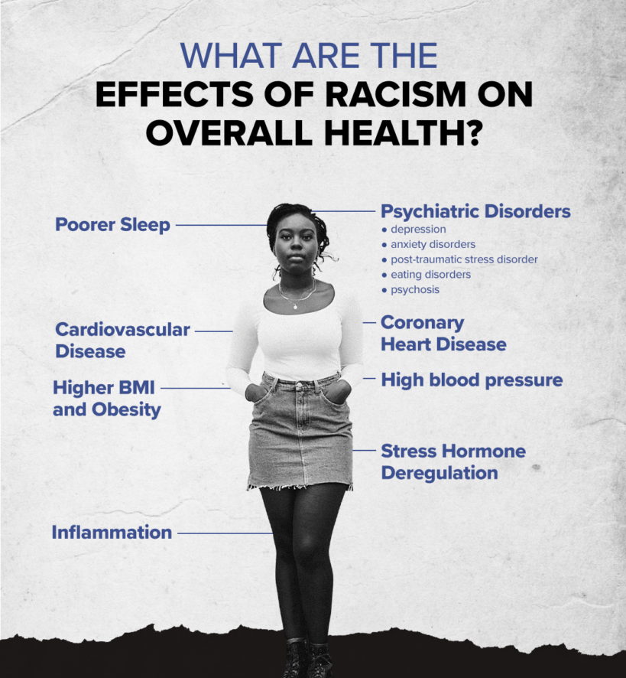
An Introduction to Racism
Image by Jeremiah McNair on https://www.medicalnewstoday.com/articles/effects-of-racism
A social construct used to justify the domination, enslavement, and exploitation of racialized groups by Europeans
We all participate in racist systems
Racism is just as bad in Canada as it is in the US
"Visitor: My Life in Canada" by Anthony Stewart
Information source: https://kojoinstitute.com/3870-2-canada-s-anti-black-racism-myths/

Slide 22
Anti-Racism
"The only thing that should come after: 'I’m not racist but….' is 'but racism is so ingrained in my society and culture that on some level I definitely am and need to do my part to destroy the system of oppression that people like me have created and benefit from on the daily.'"
- Sheri Faye Rosendahl​
Anti-Racism:
The active work of dismantling institutional, systemic, and structural policies, practices, and behaviours that reproduce and maintain systems of white supremacy.
Introduction to Equity

Slide 23
White Supremacy
The idea (ideology) that white people and the ideas, thoughts, beliefs, and actions of white people are superior to racialized people and their ideas, thoughts, beliefs and actions.
Ever present in our institutional and cultural assumptions that assign value, morality, goodness and humanity to the white group while casting racialized people as worthless (worth less), immoral, bad, and inhuman and ‘undeserving.’
Critical race theory: the term ‘white supremacy’ also refers to a political or socioeconomic system where white people enjoy structural advantage and rights that other racial and ethnic groups do not - both at a collective and an individual level.
Introduction to Equity

Slide 24
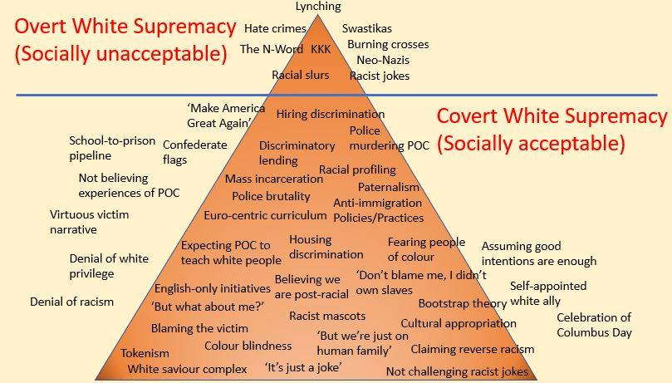
White Supremacy
Source: Safehouse Progressive Alliance for Nonviolence (2005) Adapted: Ellen Tuzzulo (2016) Mary Cordero (@jewelspewels) (2019); The Conscious Kid (2020)

Slide 25
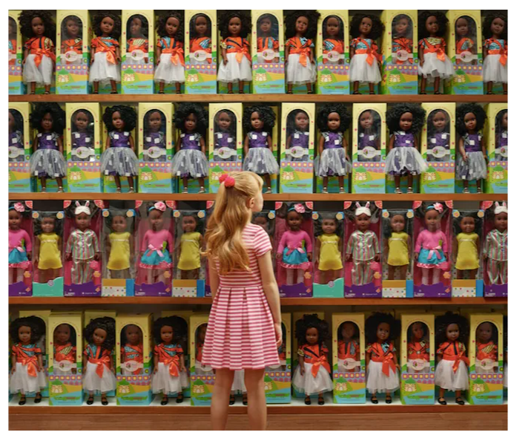
“Let’s Talk About Race” Photo Series

Slide 26
allyship

Slide 27
Allyship vs Solidarity
Image source: https://www.allpeoplesuu.com/helping-fixing-serving-allyship-solidarity/

Slide 28
CASE SCENARIOS

Slide 29
Case Study
Your colleague, Sam, recently added They/Them/Theirs pronouns to their email signature. Sam confided in you that they didn't want to make a public announcement of this shift in case people got angry at them. They hoped that people in the department would notice the change on their own.
A few days later while you and Sam are eating in the lunchroom, a different colleague named Mya comes in to warm up her food. As the microwave is going, Mya turned to Sam and says, "I noticed you want to be referred to by they moving forward."
Sam looks up, quite happy to hear this, until the colleague continues to say, "I'm sorry, but I just can't do that. You know it's grammatically incorrect, right? I work in communications – you should see the mistakes I see sometimes" and laughs. Sam doesn't say anything, and the microwave stops. Mya takes her lunch, says bye to you both, and leaves the room.
What are the issues?​
What was the harm caused?​
How can you move forward to support Sam in the immediate and in the long term?​
Notes:
What are the issues?
Transphobic rhetoric
Public humiliation aspect
What was the harm caused?
Sam is invalidated in their identity/made to feel like less than a person
Support
Check in with Sam and ask what they need
Ensure to validate their gender identity
Offer to speak to Mya or higher ups for Sam (always take their lead)
Talk to management about holding mandatory workshops

Slide 30
Education and outreach unit equity, diversity, inclusion and anti-racism Office equity@uwaterloo.ca

