Slide 1
Anti-Racism Response: Blackface on (and off) Campus PART 1 ​
Anti-Racism Unit
Office of Equity, Diversity, Inclusion, and Anti-Racism
February 2024

Slide 2
What is racism?
Racism includes ideas or practices that establish, maintain or perpetuate the racial superiority or dominance of one group over another.
Racism is different from just racial prejudice, hatred, or discrimination. It involves one group having the power to carry out systematic discrimination through the institutional policies and practices of the society and by shaping the cultural beliefs and values that support those racist policies and practices.
Sources:
Government of Ontario Glossary
“What Is Racism?” − Dismantling Racism Works (dRworks) web workbook.
Notes:
For the purpose of this presentation, racism includes ideas or practices that establish, maintain, or perpetuate the racial superiority or dominance of one group over another.
Racism is different from racial prejudice, hatred, or discrimination, as it involves one group having the power to carry out systematic discrimination through the institutional policies and practices of the society and by shaping the cultural beliefs and values that support those racist policies and practices.
Many anti-racism thought leaders note that racism is political and the constant reinforcement of power and oppression over those seen as racially inferior.
It is important that we acknowledge in this context how power in academia and leadership, and ultimately society, has a foundation of whiteness and white supremacy, leading to systemic barriers and racism for many Black, Indigenous, and racialized individuals and students both on and off campus. Though we will go into the history of systemic racism later on in this presentation, please reflect on and keep this definition in mind when engaging with the remainder of the content.

Slide 3
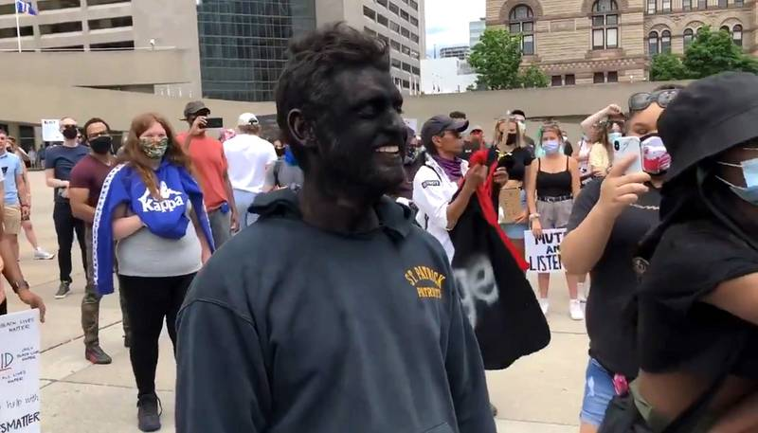
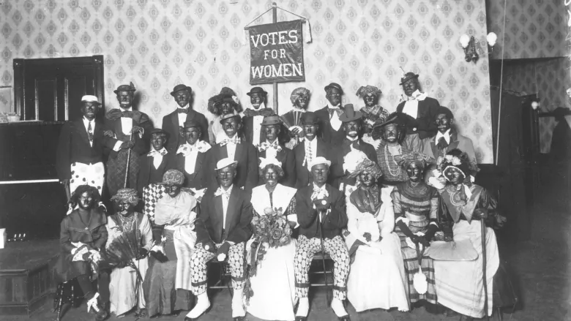
What is Blackface?
This man went to an anti-racism protest in Toronto wearing blackface in 2020. (Twitter.com)
Blackface is "the imitation of Black skin tone, speech, traditional dress, etc., by a person who is not Black." This is done to mock or ridicule Black people and is historically rooted in minstrel shows.
Blackface still occurs today and is an act of violence and white supremacy.
A cast photo of a minstrel show called "Votes for Women," shot circa 1915. (Provincial Archives of Manitoba).
Sources/Learn more
Articles:
A Brief Guide to 21st-Century Blackface
Blackface has a long history in Canada — here’s a look
Videos:
The history of blackface in North America
Blackface Is and Always Will Be Racist
Notes:
As stated by the dictionary, Blackface is "the imitation of Black skin tone, speech, traditional dress, etc., by a person who is not Black." This is done to mock or ridicule Black people.
Blackface is historically rooted in minstrel shows. Minstrel shows took place in the United States and Canada throughout the 19th and early 20th centuries. In these shows, white performers darkened their skin and mocked Black people through racist caricatures. In Canada, hundreds of these shows took place and were put on by charitable organizations, religious groups, schools and members of the military and law enforcement. They were quite common in Canadian society and many influential and famous individuals participated. In fact, the individual that wrote the hymn that became the Canadian national anthem preformed in these shows. Ultimately, they are ingrained in Canadian history. These shows were intended to be comedic to white audiences, but were extremely racist and demeaning.
However, Blackface is still used currently to mock and ridicule, and this is not something that has only been done in history. After all, minstrel shows were still occurring up until 1965. More recently, in 2009, five University of Toronto students were captured wearing Blackface on Halloween, dressed up as the Jamaican bobsled team from the movie Cool Runnings. In 2014, students wore blackface at Brock university, dressing up in the same costume. In 2020 during a peaceful protest against anti-Black racism in Toronto, a man appeared in Blackface, laughing at the protestors rightfully disturbed by his presence. Blackface happens repetitively in Canada in various different settings.
Something consistent with these historical and current-day instances of blackface is that they are attempting to do something funny for a white audience. However, what is funny about mocking Black people? As stated by Philip SS Howard in their paper A laugh for the national project: Contemporary Canadian blackface humour and its constitution through Canadian anti-blackness, "The common-senseness of these associations of the Black body with humour demonstrate the deep foundations ... that render the associations powerful enough to motivate action, while keeping them beyond conscious critique." This quote-on-quote "humor" is racist. We must acknowledge that blackface is an act of violence and white supremacy.
Sources:
Blackface
Blackface has a long history in Canada — here’s a look
This is why blackface is offensive
SEE IT: Man goes to Toronto anti-racism protest in blackface

Slide 4
Video: A look at Canada's long history of blackface
Video: https://www.youtube.com/watch?v=5n6UkouDYr4&t=95s&ab_channel=GlobalNews

Slide 5
Blackface and White Supremacy
White Supremacy: political, economic, and cultural system in which white folx overwhelmingly control power and material resources; conscious and unconscious ideas of white superiority and entitlement are widespread; and relations of white dominance and non-white subordination are re-enacted across a broad array of institutions and social settings
White people had the power to define what constituted entertainment at the expense of Black humanity
White people gained profit off of mocking Black people using blackface in minstrel shows, in which people paid to see
We must recognize that these power dynamics never went away, and are very much ongoing
When we continue to participate in blackface, this is actively upholding white supremacy
Notes:
When the words “white supremacy” come up, many think of individual people and/or groups; of white supremacists and hate groups. However, white supremacy is much more than this – it is a political, economic, and cultural system in which white folx overwhelmingly control power and material resources; conscious and unconscious ideas of white superiority and entitlement are widespread; and relations of white dominance and non-white subordination are re-enacted across a broad array of institutions and social settings.
In terms of blackface, this is not to say that white supremacy does not show up when white supremacists wear blackface. This is something we must recognize while also considering the broader structure and the power dynamics at play.
So far in this presentation, we have gone over the origins of blackface. We learned how white people created blackface to deliberately mock and demean Black people as a means of entertainment. Blackface had no other purpose or intention.
The practice of blackface and minstrel shows began around the same time enslavement was beginning to be abolished. Furthermore, the power that white people had to enslave black people shifted to different realms, but never fully disappeared. For example, white people had the power to define what constituted entertainment at the expense of Black humanity. White people gained profit off of mocking Black people through the use of blackface in minstrel shows, in which people paid to go and see.
We must recognize that these power dynamics never went away, and are very much ongoing. White supremacy is embedded within systems and structures that are created by and prioritize the superiority of white people while actively disadvantaging Racialized people. When we continue to participate in blackface, this is actively upholding white supremacy.

Slide 6
Video: The Long, Painful Legacy Of Blackface In America (HBO)
Note: While this video is American-based, its entire discussion is also relevant and accurate in the Canadian context.
Video: https://www.youtube.com/watch?v=9soZnDf0P7E&ab_channel=VICENews

Slide 7
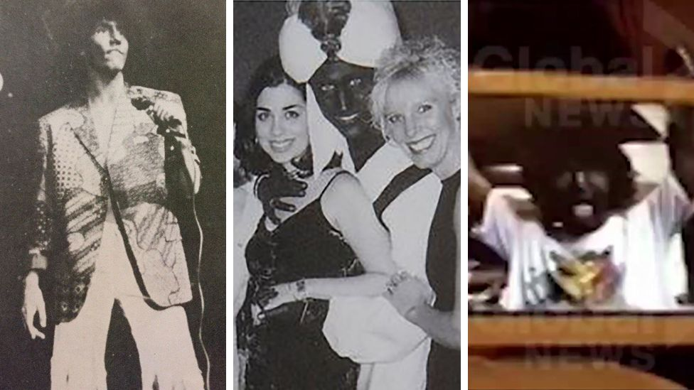
Blackface & Leadership Example
Images of Prime Minister Justin Trudeau’s participation in Blackface and Brownface in the 1990s, as well as most recently in 2001
Image: https://www.bbc.com/news/world-us-canada-49763805
Notes:
We see this ingrained white supremacy and power at the front of Prime Minister Justin Trudeau’s participation in Blackface, depicted in images released in September of 2019 which show Trudeau engaging in incidents of Blackface and Brownface over the course of an 11-year period. Three incidents surfaced – two of which show Trudeau engaging in acts of Blackface, and one which shows Trudeau dressed in Brownface and a turban.
Quickly, Trudeau called an emergency news conference where he apologized and stated that he “should have known better” and that it was something that he didn’t think was racist at the time. Further, he went on to say that it was not something that represented the person he has become or the leader he was trying to be. However, when asked later about how many incidents of Blackface Trudeau may have engaged in, he responded that he did not want to be definitive due to the recent pictures that came out and his absence of remembering them.
Let’s unpack this.
Firstly, through the public nature and governmental position of Justin Trudeau himself, this incident reinforces the presence of white supremacy in not only Canadian leadership but leadership as a whole.
As discussed in the previous slide, Blackface arose out of power dynamics ingrained in the oppression and blatantly dehumanizing portrayals of the Black community by white individuals. Blackface reinstated the concept of white ownership through enforcing the dominance that is the foundation of white supremacy that has roots in colonization and slavery, as well as the overarching creation of oppressive and racist institutions and systems that were made by white people for white people.
In his participation in and the resurfacing of these acts of Blackface and Brownface, Trudeau showcases how leadership continues to be rooted in individuals and systems of white supremacy, as well as how systems of government – those in charge of creating policy, laws, and ultimately social hierarchy – continue to be passive to white supremacy and fail to be anti-racist, even on under the façade of equitable programs, liberal leadership, and language and communication focused on the diversity within Canada.
Additionally, this incident reinforces the presence and continued normalization of Blackface, Brownface, and cultural appropriation. These acts of racism are not incidents that have only occurred within our history, they are not incidents that are limited to white supremacist organizations, they are not incidents that we can joke about. Blackface, Brownface, and acts of cultural appropriation continue to exist and occur within our society, as we can see within this example. It is important that in organizations and roles of leadership we are recognizing and acknowledging the continued presence of these acts of racism, specifically due to the maintenance of perceptions that see Blackface as “nonexistent”, limited to being a “historical” act of racism , or a joke or costume that doesn’t require conversation or critical dialogue.
For instance, as mentioned earlier, in Trudeau’s follow-up apology, he references his participation in Blackface as something that he did not think was racist at the time. In addition to this, he was unable to say how many times he engaged in acts of Blackface and Brownface, stating that he did not want to give a “definitive number”. These statements further show the problematic and casual nature that surrond perceptions of Blackface, as Trudeau’s vagueness and inability to bring attention to the problematic nature of his participation reinforces the common perception rooted in whiteness that sees acts of blackface as something that is “taken too seriously”, leaving it to be brushed off by society as well as invalidating and dehumanizing feelings rooted in trauma and harm that may be experienced by Black communities within Canada as a result of this situation. Moreover, in doing this, it refuses to acknowledge how this violence and harm is being further through asking Black, Indigenous, and racialized communities to trust an individual who has openly engaged in an act of racism against their identity.
Lastly, it is important to bring attention to the causality of additional acts of cultural appropriation external to Blackface that exist within this example, as well as the impact of those acts on Indigenous and racialized Communities. Cultural appropriation of Indigenous peoples and Brownface often arise in a similar context as well as use similar reasoning and justification to that of the historical origins of Blackface. Often portrayed in costumes, acts of cultural appropriation similar to that of Trudeau’s showcase how at the center of these acts are whiteness, white perceptions, and white ideologies that are foundationally based in white supremacy and power over narratives, identities, as well as what is considered to be racist or an act of racism.
Sources:
First photo in colour of Trudeau donning blackface emerges on eve of election night | National Post
Canada's Justin Trudeau cannot say how often he wore blackface - BBC News
Trudeau photos force conversations about racism, history of blackface, experts say | CBC News
What we know about Justin Trudeau's blackface photos — and what happens next | CBC News

Slide 8
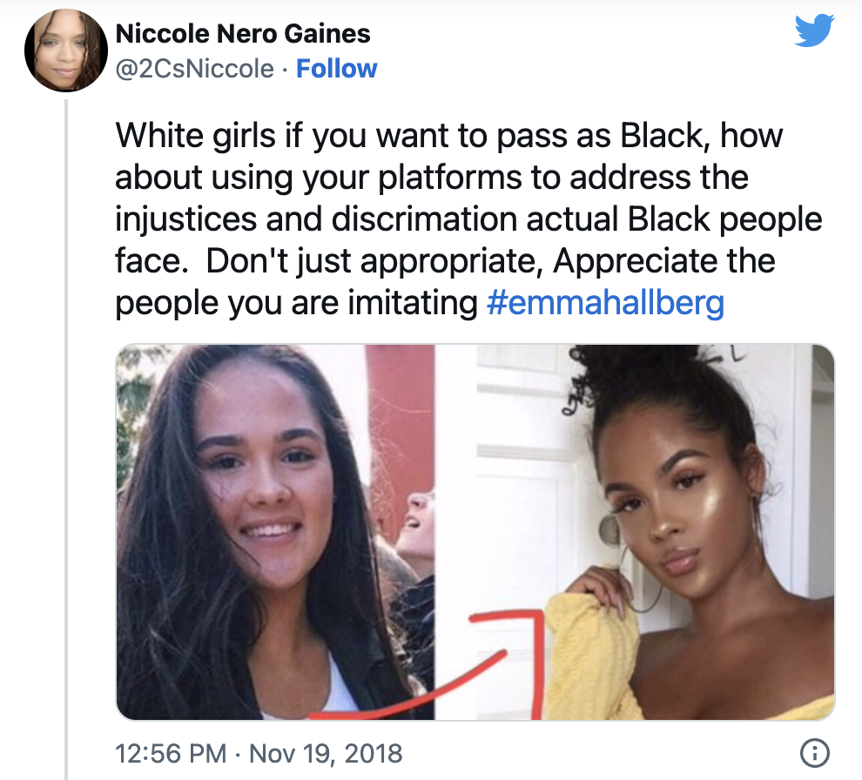
Blackface & the Media
“Digital blackface is when non-Black people use the images and voices of Black individuals to explain emotions or phenomena … It’s when people use images to claim Black identity, but they don’t identify as Black.” - Jardin Dogan (@blkfolxtherapy)
Video: https://www.youtube.com/watch?v=b1tfKEVBcdY&ab_channel=TheRoot
When Blackfishing occurs, Black beauty and aesthetics are only celebrated and appreciated when displayed on white bodies​
Notes:
Canada has a tendency of hiding and ignoring it's racism. Despite Canada's long history and realities with blackface, when one googles "Blackface in Canada," all that appears is Justin Trudeau. Why is that?
In reality, we see Blackface occur more often than we might think. As said by Jardin Dogan a counsellor and educator specializing in Black mental health and creator of the popular Instagram account @blkfolxtherapy, “digital blackface is when non-Black people use the images and voices of Black individuals to explain emotions or phenomena … It’s when people use images to claim Black identity, but they don’t identify as Black.” As a social media user, I see this happening all the time – through non-Black people making their Bitmoji's black, using Black-skinned emojis, and in gifs, memes, and TikTok sounds. Especially through using gifs of Black people to display extreme emotions, we see how non-Black people reinforce racial stereotypes about Blackness that might not always be true. Whether it is done to be funny, or to negate negative stereotypes about Black people, this is always harmful. These practices dismiss the severity of everyday racism Black people encounter while simultaneously culturally appropriating their language and expressions.
Aside from digital blackface, we also see people engaging with actual blackface on social media. For example, in 2020, a A Kamloops RCMP officer posted photos to social media of him using a charcoal face mask with the captions "Is my skin care racist? Micro-aggressions matter," and "Blackface session. It's supposed to help my looks. I don't think it's working." Recently, after the trailer for the new The Little Mermaid came out, we saw viral videos of Black children reacting to this trailer, expressing joy of seeing themselves represented in a Disney princess movie. However, this was met with people mocking these children and their joy, creating videos in Blackface where they re-enacted the reactions in a disgusting and harmful way. These are just two instances of non-Black people deliberately darkening their face, to then take photos to post online for the purpose of mocking and ridiculing Black people.
Another phenomena that frequently takes place on social media is blackfishing. This is when white people try to appear Black on social media, sometimes also engaging in cultural appropriation. Usually, this is done through the use of makeup and/or hairstyles. However, more recently, people have been engaging in blackfishing using a photo or video filter that darkens their skin. In these cases, Black beauty and aesthetics are only celebrated when displayed on white bodies, reinforcing whiteness as the norm and upholding whiteness as the ideal beauty standard. Oftentimes, social media influencers and public figures engage with blackfishing and ultimately profit off of Blackness without experiencing the systemic harm and racism that Black people face on a daily basis.
Whether it be blackface, digital blackface, blackfishing, or a combination of any of these, blackface within social media is harmful. Here, we can see racism being perpetuated on social media platforms, which exist within the broader institution of the media, in which racism is embedded.
Sources:
Kamloops Mountie criticized for social media post comparing cosmetic face mask to blackface
What Is Digital Blackface? Experts Explain Why The Social Media Practice Is Problematic
Blackface has resurged in the internet age. And you might be part of the problem.
‘Blackfishing’: A problematic trend where people pretend to be black

